Slide 1
OVERVIEW of the
GSN Program
Katrin Hafner
GSN Program Manager
TA Team Meeting
IGPP, La Jolla, CA
November 9 & 10, 2015

Slide 2
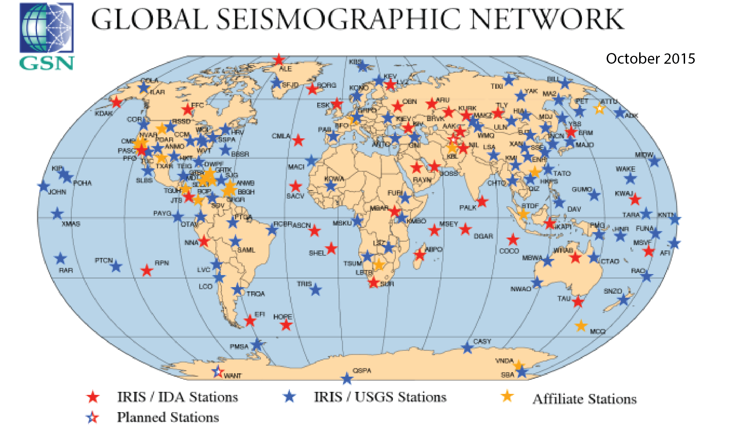
“a global network of uniformly spaced stations (~2000 km spacing”), capable of recording the full range of seismic signals, with data collection in real time”

Slide 3
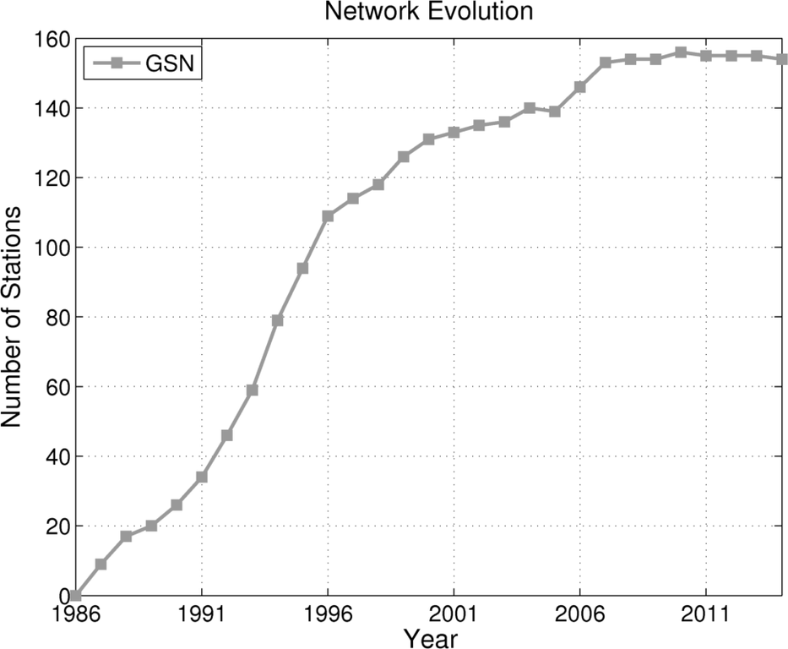
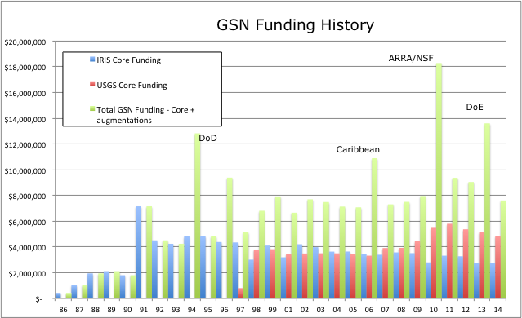
GSN - History
Key foundational element of IRIS
NSF funded the construction of the GSN
(DoD funds also)
Beginning in 1998 USGS line item for GSN
established to take over operations
Periodic recapitalization funds

Slide 4
GSN - Organizational Structure
The GSN is operated as a partnership between IRIS and USGS
IRIS’ GSN activities are funded via NSF
  Five year Cooperative Agreements
  GSN is part of the FY14-FY18 award: Seismological Facilities for the Advancement of Geoscience and EarthScope (SAGE)
IRIS provides GSN Program Manager
IRIS/IDA component of the network is primarily operated via a subaward to Project IDA
  Field operations
  Data Collection Center

Slide 5
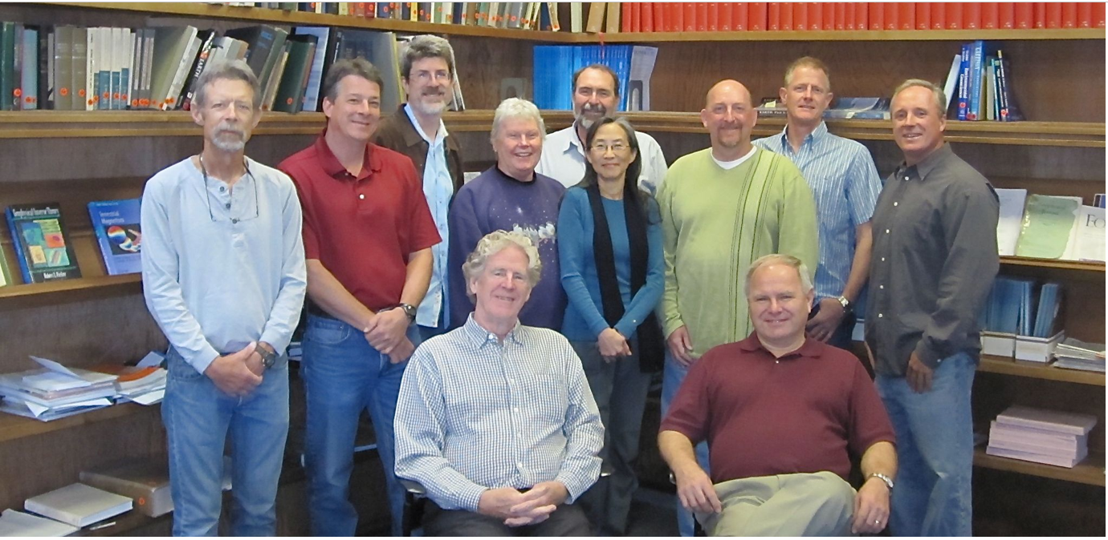
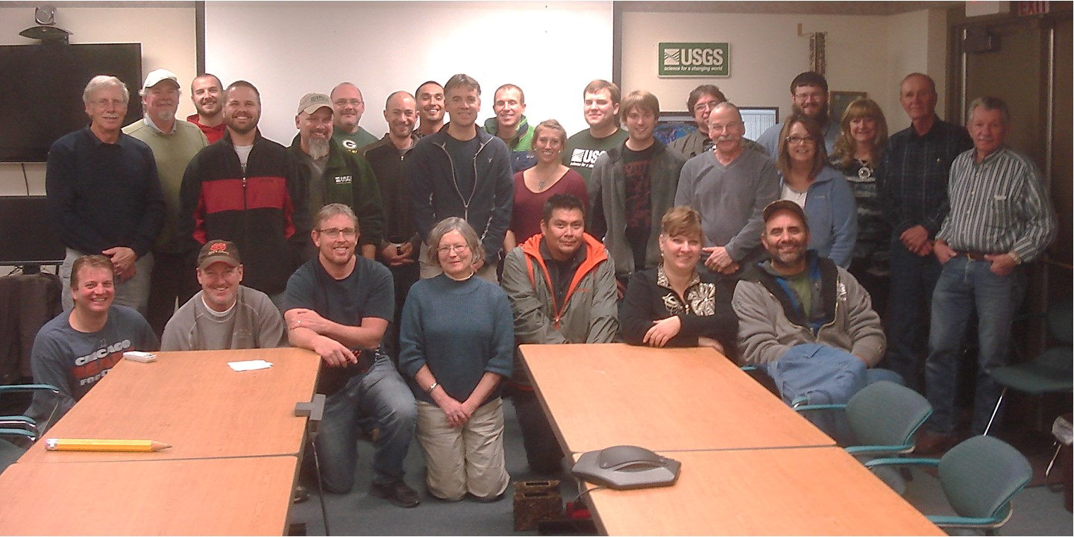
GSN OPERATIONS
IRIS/IDA
Operates 39 stations
DCC at UCSD
ships data to the IRIS DMC
USGS/ASL
Operates 100 stations
DCC at USGS/NEIC
ships data to the IRIS DMC

Slide 6
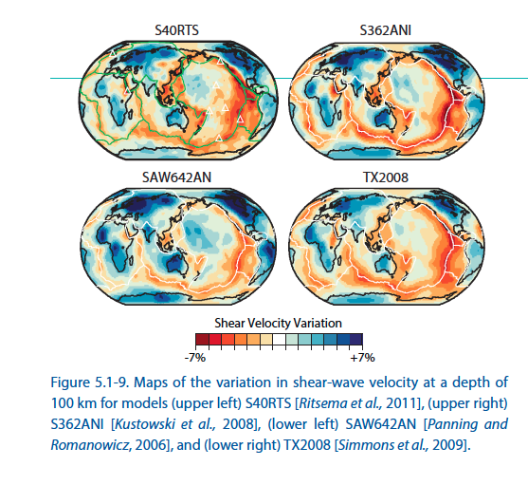
GOALS of the GSN
High dynamic range
Broadband (hrs to ~10 Hz)
Quiet instruments / sites / installations
Real-time telemetry
Global distribution at ~ 2000 km spacing
Well-characterized instrument response
French & Romanowicz, Nature, 2015
Multi-Purpose Network
Basic Earth science research
Monitoring applications such as earthquakes, tsunamis, and nuclear testing
Notes:
GSN is fundamentally important for scientific discovery in earth sciences; earth structure and dynamics of the earth’s interior
Physics of great earthquakes (e.g. the M>9 Sumatra and Japan earthquakes and tsunamis. Has provided decade long high quality recordings.
Cornerstone facility for seismology
Isocontours of mantle plumes identified using waveform modeling of GSN data. A few weeks ago in Nature → GSN still enabling cutting edge science!

Slide 7
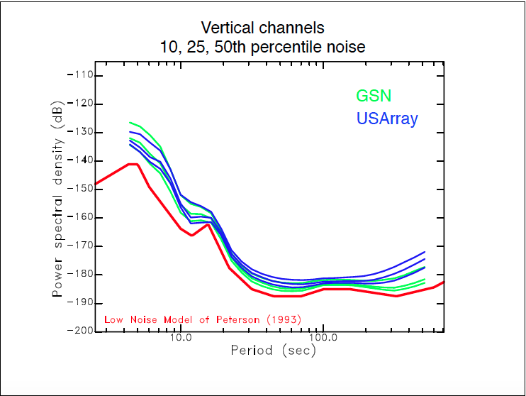
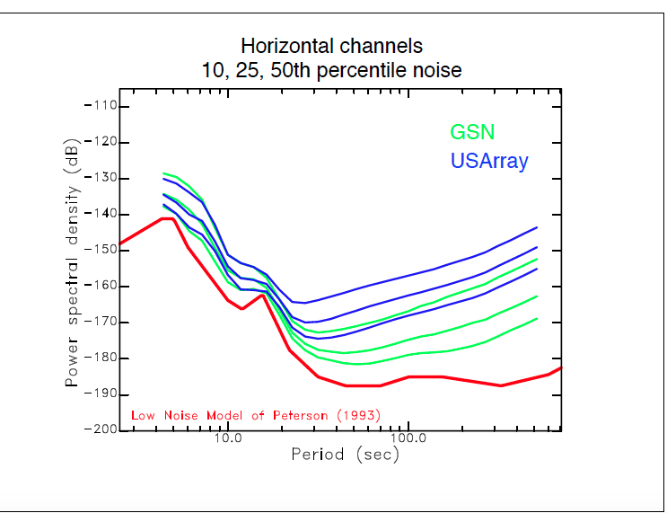
GSN Data Quality

Slide 8
IMPACTS on GLOBAL MONITORING
National Earthquake Information Center usage
  Rapid determination of size and location of major earthquakes
  Provides comprehensive catalog of EQ source info
Tsunami warning
  ~100 GSN stations are used for real-time analyses by the NTWC; coverage in oceans and international areas is key – sparse coverage by other networks
Verification seismology (CTBTO)
  ~50 auxiliary seismic stations are contributed by GSN

Slide 9
GSN PARTNERSHIPS
GSN is itself a partnership – NSF, USGS & IRIS
  Other US government contributions have bolstered support
  and reinvestment in the GSN for its multi-use capabilities (monitoring)
    Dept of Defense
    Dept of Energy
    Dept of State
Host country partnerships
  MOUs between foreign governments, private entities & universities
  Long-standing relationships between network operators and local personnel
National agencies
  NOAA, NEIC, PTWC, NTWC – data flow & delivery
International agencies
  FDSN partners for improved coverage (GEOSCOPE, GEOFON, etc.)
  CTBTO interactions, training, etc.

Slide 10
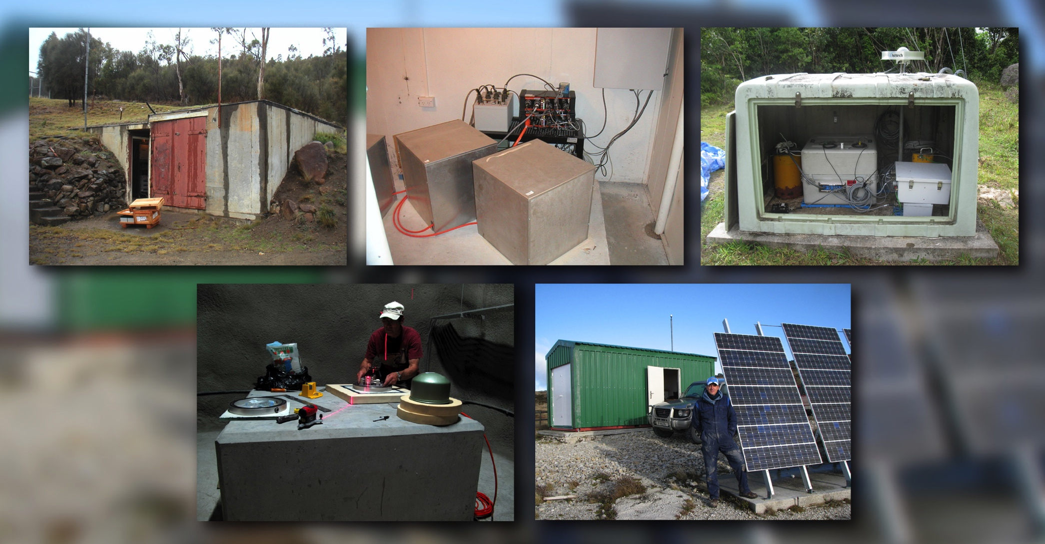
Typical GSN Station Installations

Slide 11
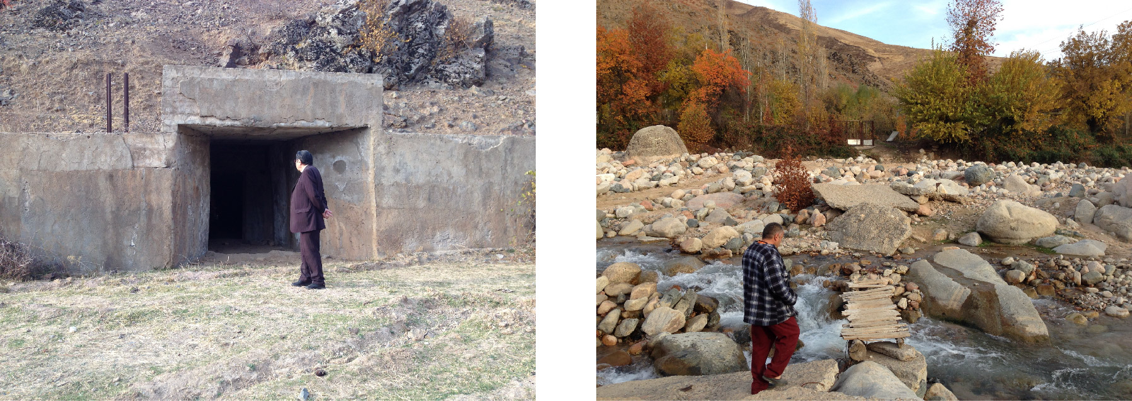
Simiganch, Tajikistan (SIMI):
LLNL provided funding to IRIS for equipment and installation costs
MOU with Tajiks in place
Site mods (bridge, power, doors) to be done by Tajiks
IDA assembled equipment; shipment now in Dushanbe
Installation projected for May2016

Slide 12
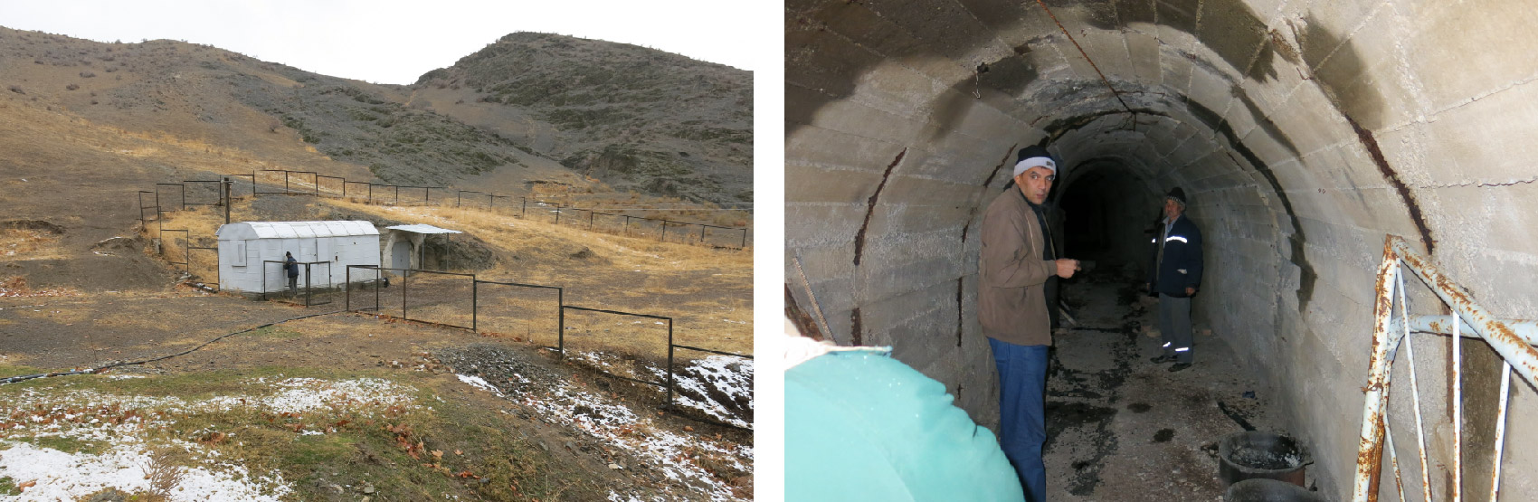
Karasay, Uzbekistan:
”News for You: the department of the international relations of the cabinet of Ministry of the Republic recommended to all departments to undersign about coordination on one copy of the Agreement. Now we run on instances and we sign the Agreement.“
Alisher Ibramagov, Director, Tashkent Region
Sept 22, 2015

Slide 13
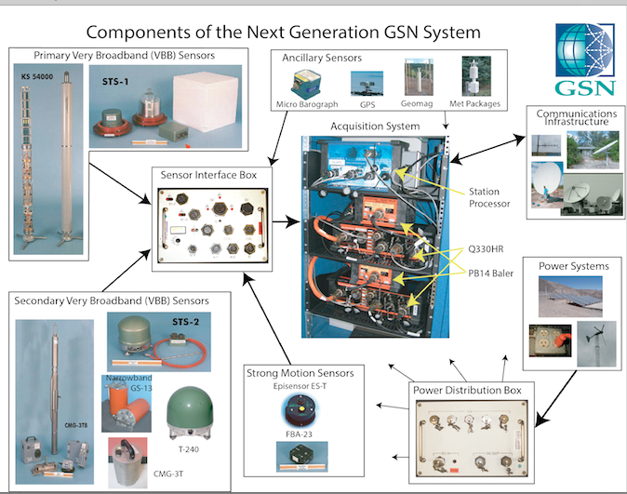
Typical Equipment at GSN Stations

Slide 14
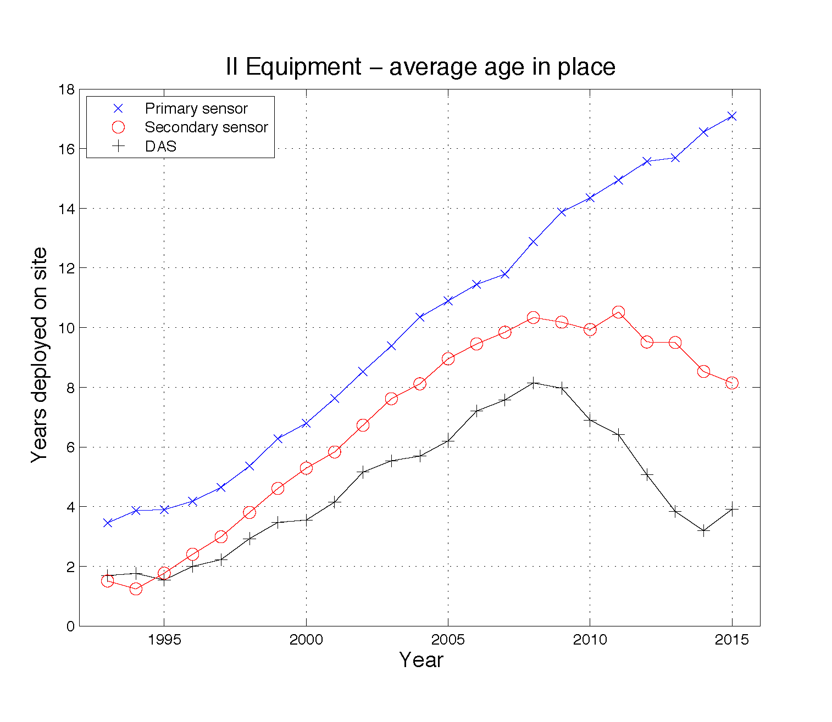
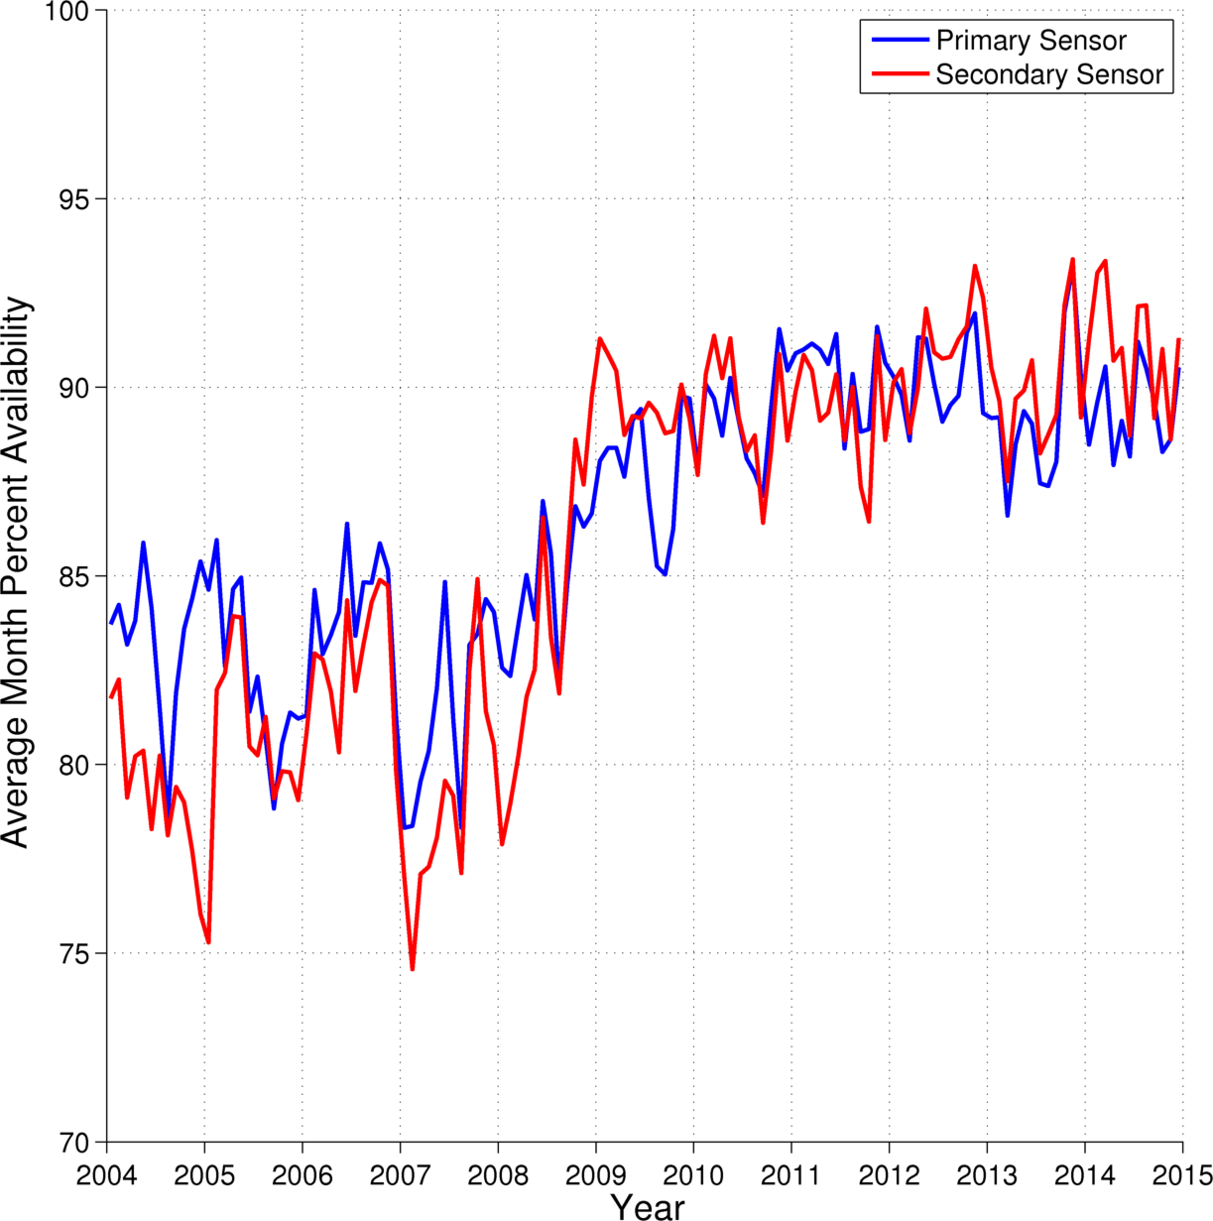
EQUIPMENT AGE & DATA AVAILABILITY
ARRA funding
ARRA funding
An increase in network performance, i.e. data availability, can be correlated with the refurbishment of stations with the next generation data loggers and secondary sensors

Slide 15
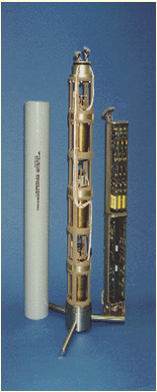
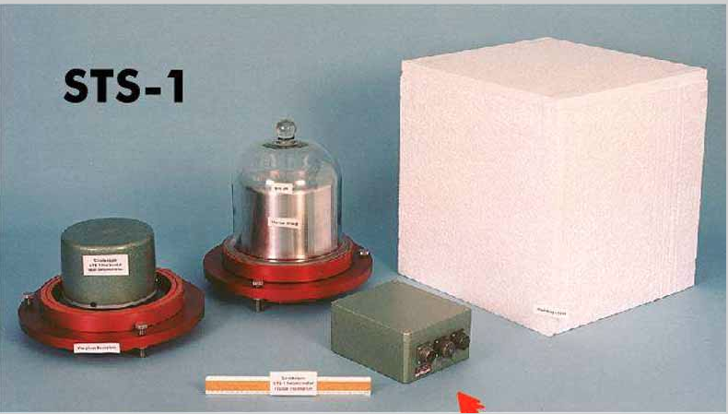
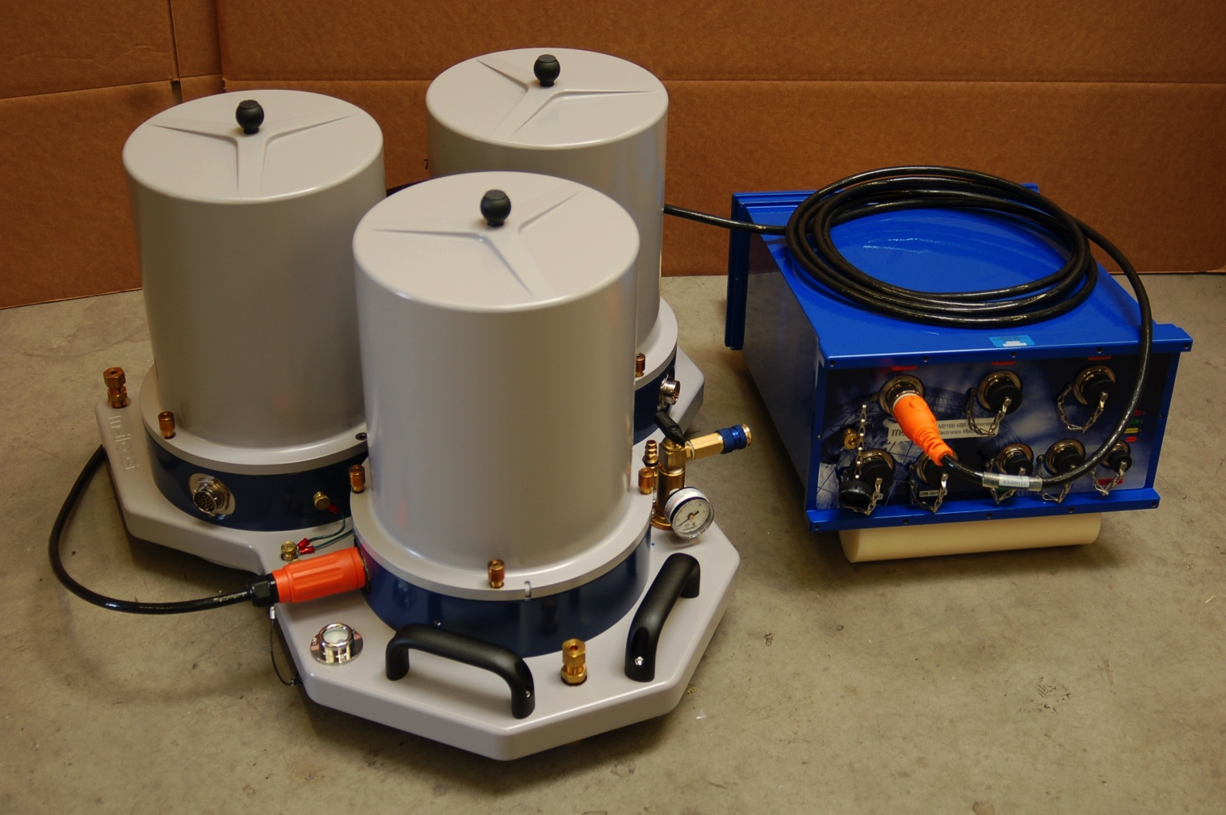
TECHNOLOGY DEVELOPMENTS
GSN design goals require very broadband seismometers Technological advancements to the STS-1 and KS54000 must be driven by science & community
KS54000
VBB
Borehole
Seismometer under development
(STS-6A)
M2166-VBB
Prototype vault sensor being tested
Notes:
DOE funds in 2012 provided 5.7 million dollars to develop and procure next generation
Of primary borehole sensors. The first prototypes should be available for testing this fall.

Slide 16
Key Recommendations
Review Design Goals in light of current research & monitoring requirements
Return GSN to full funding levels, & continued cost-effective operations
Review recent technology developments and quantify costs and benefits
Maintain strong community oversight of GSN
Sustain emphasis on data quality
Strengthen international partnerships
Ensure continued close integration between data collection, archiving and distribution
Continue the dual-operator, academic/government partnership between NSF/IRIS and the USGS

Slide 17
GSN RENEWAL
PRIMARY GOALS:
  Replacement of data acquisition equipment (essentially complete)
  Replacement of the primary borehole sensors (prototype sensor in development)
  Replacement (as needed) of primary vault sensors;
  Repair/replacement of infrastructure
  Strategic relocation or infill of station sites ( e.g. Tajikistan and Uzbekistan stations)

Slide 18
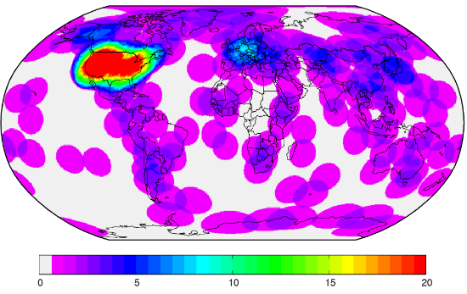
2015 External Review Recommendation
“a global network of uniformly spaced stations (~2000 km spacing”), capable of recording the full range of seismic signals, with data collection in real time”
Convene a community effort to design & propose a pilot/demonstration project addressing important research options in the oceans
Potential OBS-GSN sites
Map showing existing GSN & FDSN station distribution. Contours show # of stations within 10 degrees of each point
Notes:
We routinely miss earthquakes in the southern oceans due to sparsity of permanent network coverage.

Slide 20
Role of the GSN Program Manager
Provide technical advice and leadership in the development and evolution of the GSN Program
  Interface with IRIS governance (GSN Standing Committee, etc.)
  Interface with IRIS management (IRIS President, Instrumentation Services Director, etc.)
  Interact with the leadership of the US Geological Survey
  Guide and encourage instrument development
  Pursue external funding resources, particularly for GSN recapitalization
Manage the GSN Program including
  Program technical, cost, schedule responsibilities
Serve as the primary interface between GSN and the user community

Slide 21



SUSTAINED OPERATIONS on SEA FLOOR
Map showing existing GSN& FDSN station distribution.
Contoured values show the number of GSN stations
within 10 degrees of each point

Slide 22
GSN RESILIENCE
Technical
  Redundancy and robust field systems, power and communications
  Diversity in communications infrastructure
Operational
  Efficiency and optimization of station operations
    Both ASL and IDA continue making improvements to
    efficiencies in network operations, and share techniques
    and procedures
    Standardization of equipment allows us to approach
    cross-training between networks (GSN and beyond).
Funding
  Continue cultivating financial support from non-NSF/USGS GSN users
International Partnerships
Notes:
The ability to keep the system from failing, and mitigating risks and vulnerabilities.

Slide 23
SUMMARY
GSN design goals have largely been met (except for oceans)
Large volumes of data are fully archived and distributed
Management & operational partnership serves both the scientific research and monitoring communities
Improved data quality is an area of significant focus, and tools are being shared
Network is resilient as a result of operational structure, multiple sensors and telemetry paths and multiple DCCs

Slide 24
MODELS FOR FUNDING:
Stable funding is critical to ensure basic network operations result in high-quality observations. The current model: Periodically, core NSF and USGS Funding has been augmented by funds from the DOE, DOD, DOS to enable the recapitalization of the network.
PROS
Easier to get funding for recapitalization than for O&M
Engages the science community; reaffirms GSN needs and objectives
CONS
no “guarantee” of sufficient budget to maintain high level of operations

Slide 25
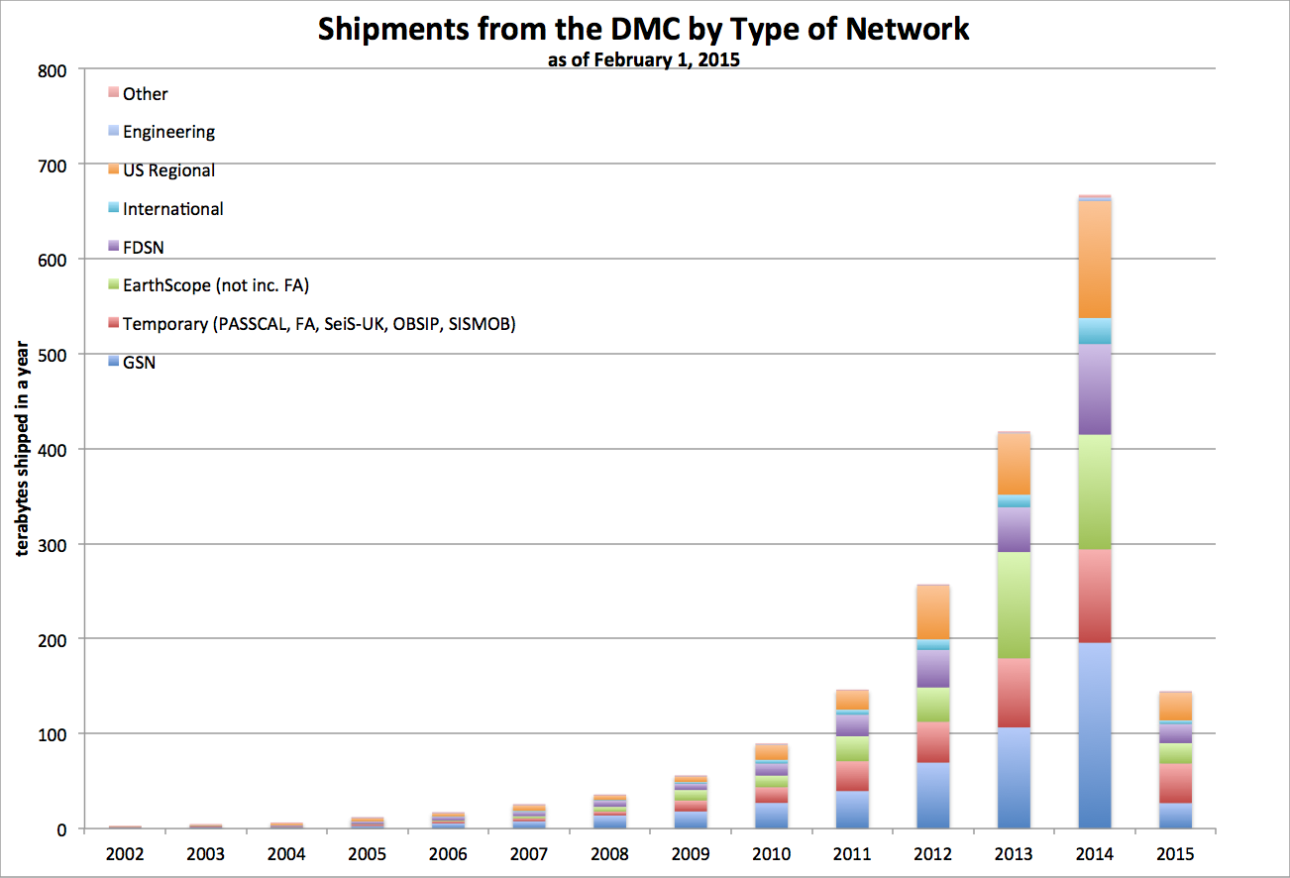
GSN DATA ARCHIVING & DISTRIBUTION
All GSN data are freely and openly available, and provided in near real-time.
All GSN data flow into the DMC
via the GSN DCCs

Slide 26
AVERAGE USGS GSN COSTS
MAJOR CATEGORIES | AVERAGE EXPENDITURES/YEAR over LAST 5 YEARS
GSN station O&M | $ 2,889,732
Data QC | $ 620,997
ASL Facilities | $ 311,418
Instrument Testing | $ 299,778
Total | $ 4,121,925
USGS NET ALLOCATIONS WAS $4.2M, BUT DECREASED TO $3.9M in FY13
AND HAVE REMAINED FLAT SINCE THEN

Slide 27
Working with the European Data Centers to modernize data distribution
CoopEUS Project
  Adoption of FDSN standard web services
    Europe
      ETHZ, RESIF, INGV, GFZ, ORFEUS-DC
    US
      NCEDC, IRIS DMC
  Will allow us to promote FDSN web services to other parts of the globe
  IRIS DS supported the incorporation of FDSN web services into SeisComp3, the Seattle version
Federation (time for a modern NetDC)
  Supports distributed data center concepts advocated by some of the larger FDSN centers
  Still allows smaller networks to rely on larger centers for backup or primary data center functions
Federation in practice
  IRIS has developed an IRIS Federator
  Intend to take the Federator concept to the FDSN

Slide 28
IMPACTS on SCIENTIFIC RESEARCH
Imaging of Basic Earth Structure
GSN station coverage has increased resolving power, e.g. Shear Wave Velocity Models
Studies provide input into
understanding of geodynamics, tectonics
and understanding of large EQs

Slide 29
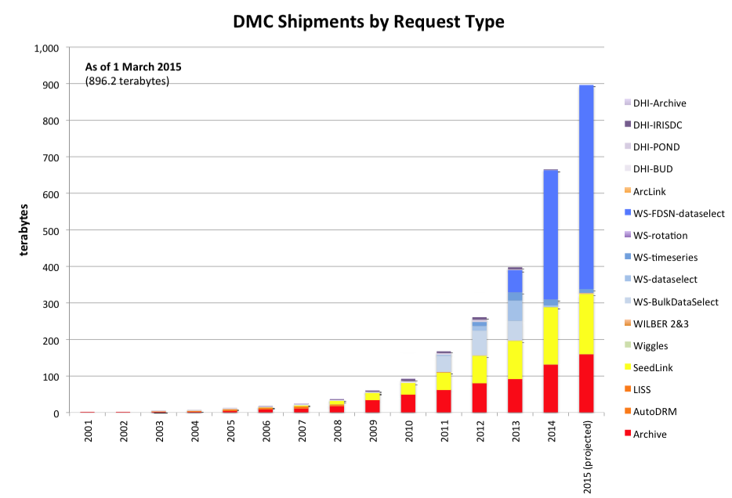
GSN DATA ACCESS METHODS
Data distribution statistics attest to effectiveness

