Slide 1
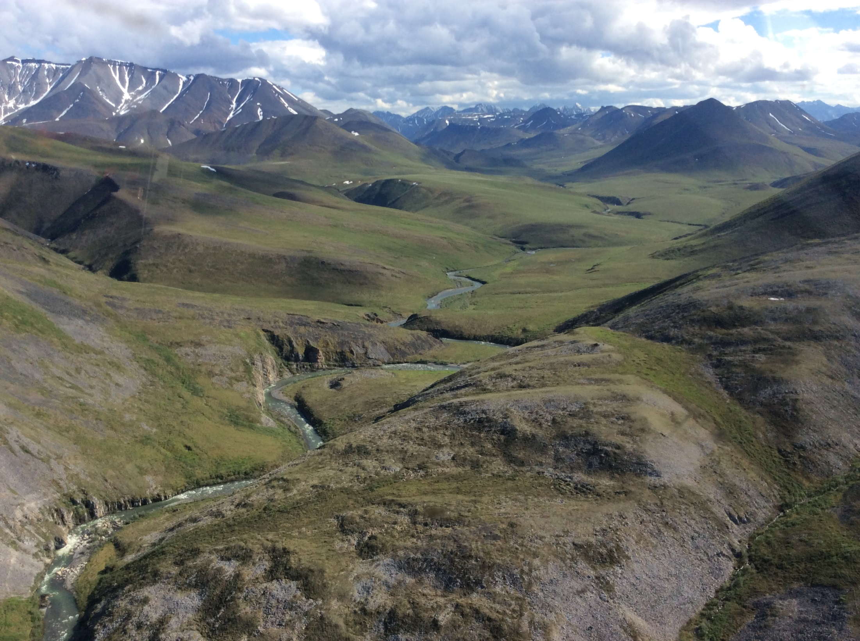
Alaska Transportable Array Site Reconnaissance Process
Steve Rowland, PE
RECON LLC (Palmer, Alaska)
Juniper Crk to Echooka R. Pass

Slide 2
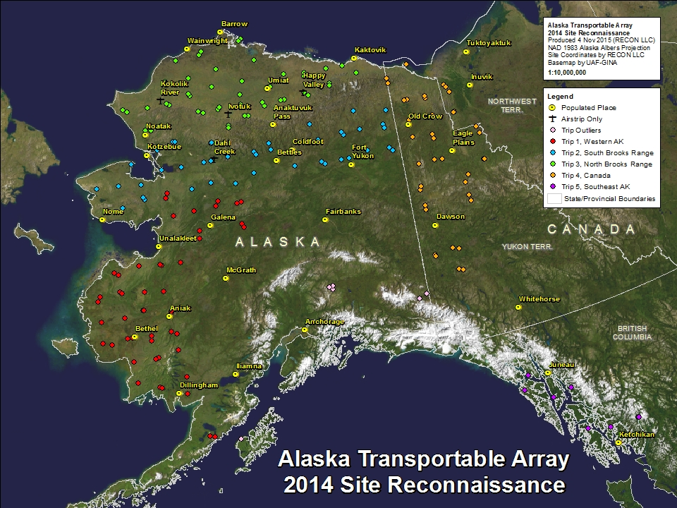

Slide 3
1500 miles
1100 miles

Slide 4
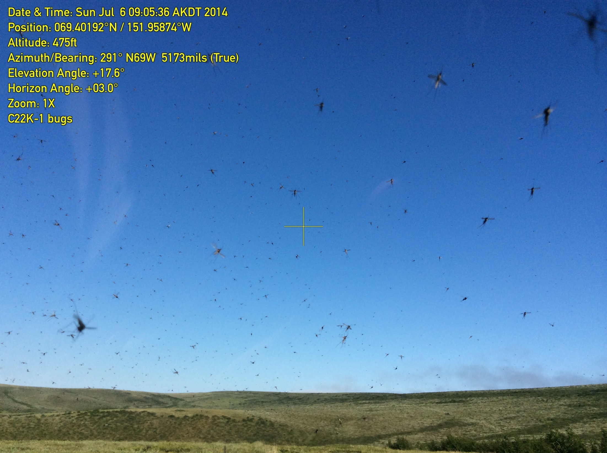
2014 Recon Scope
5 trips of 5 to 8 days each
126 target areas
199 individual sites visited.
Each trip included 2000-3500 flight miles
Averaged 5.5 hours of flight-time per day
Umiat, North Slope

Slide 5
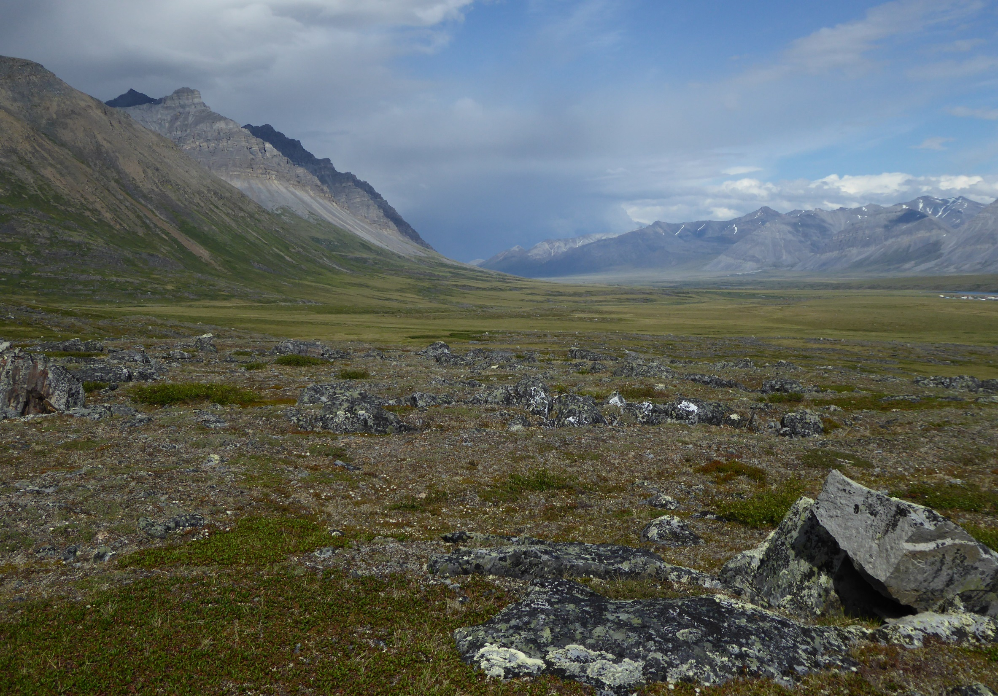
Process starts with “Desktop Recon”
Begin with an area roughly defined by a 50 km circle as provided by IRIS team
Evaluate terrain and land status using maps, imagery and available GIS data
Select 2 or 3 potential sites within a target area
Input site points in field GIS and navigation software
Select operational base locations
Develop flight plans for each day
Plan access to fuel and arrange to spot helicopter fuel at remote locations
Plan for accommodations or camp sites
Arrange for helicopter and fixed wing transport
Print hard copy maps and for each target area and each planned flight path
Compile permits from land managers and appropriate agencies
Prepare a folder for each day with subfolder for each target area
Anaktuvuk Pass, Brooks Range

Slide 6
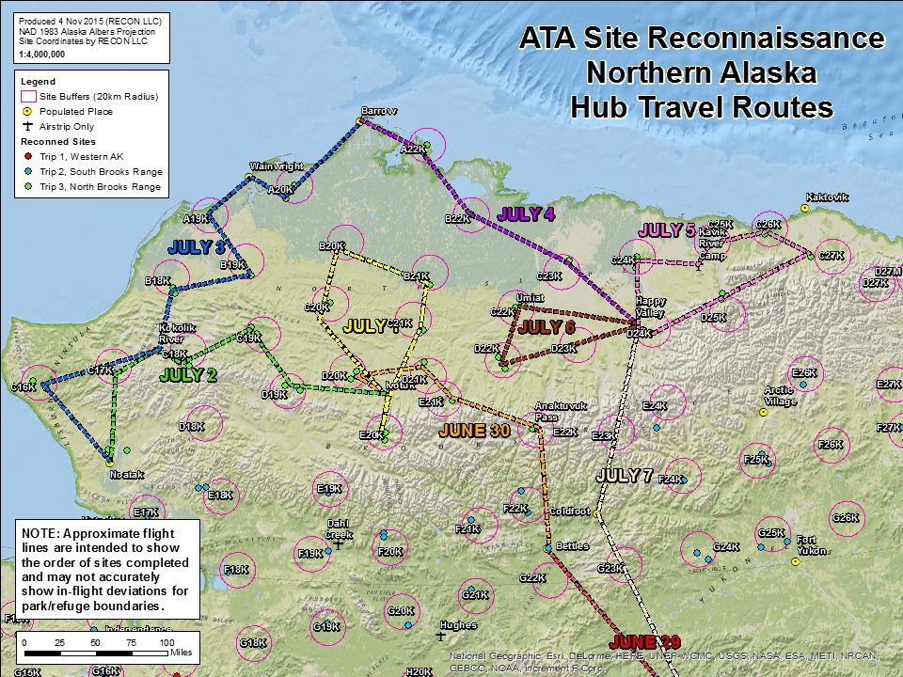

Slide 7
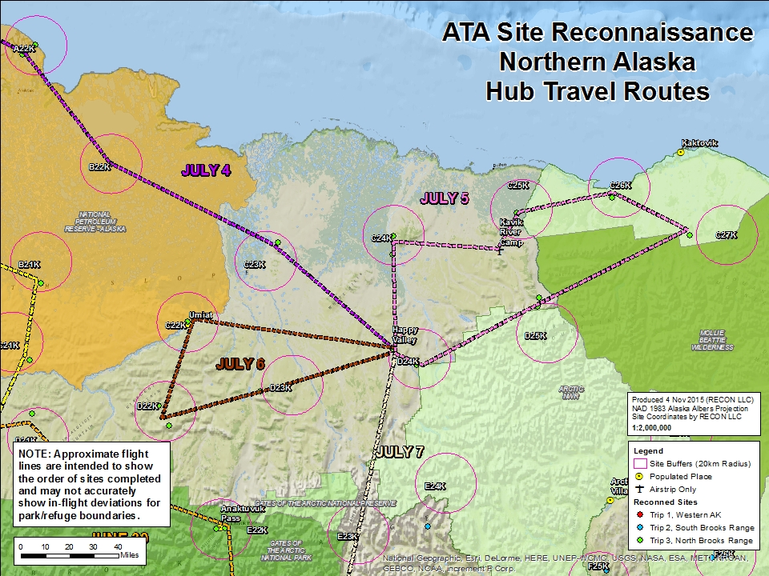

Slide 8
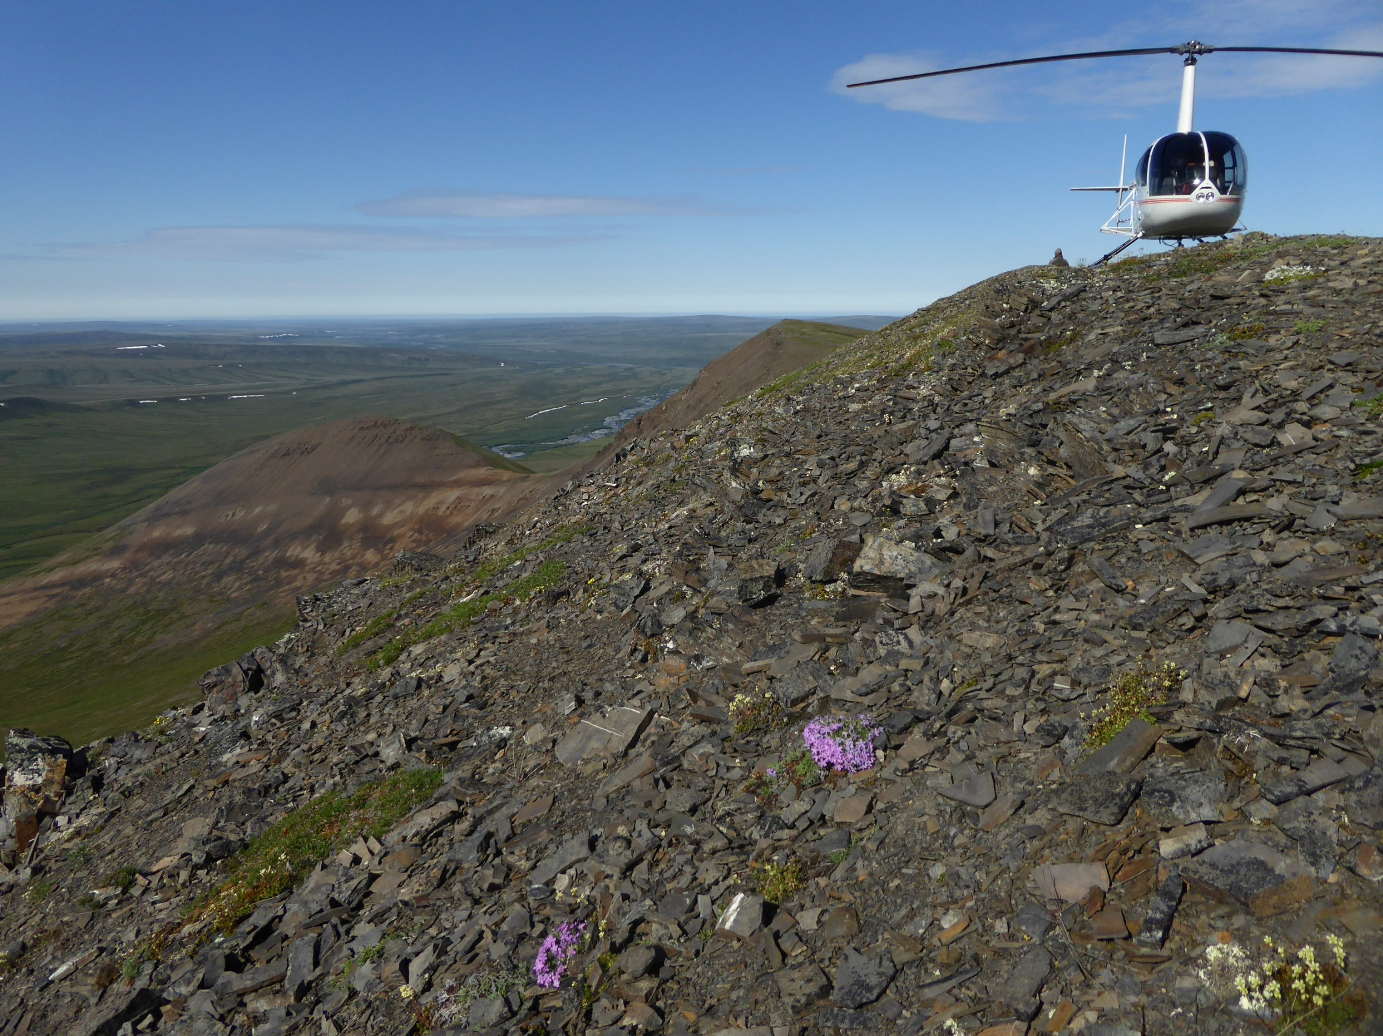
Site Selection Criteria
Slope and Aspect
Soil or rock character
Terrain
Permafrost or seasonal frost influence
Proximity to noise sources such as moving water and ice
Wind exposure
Geohazard risks such as slides, rock-fall or avalanche
Wild fire risk
Communications capability
Helicopter or fixed wing aircraft accessible
Suitable work area
Relative distribution
Juniper Creek, NE Foothills Brooks Range

Slide 9
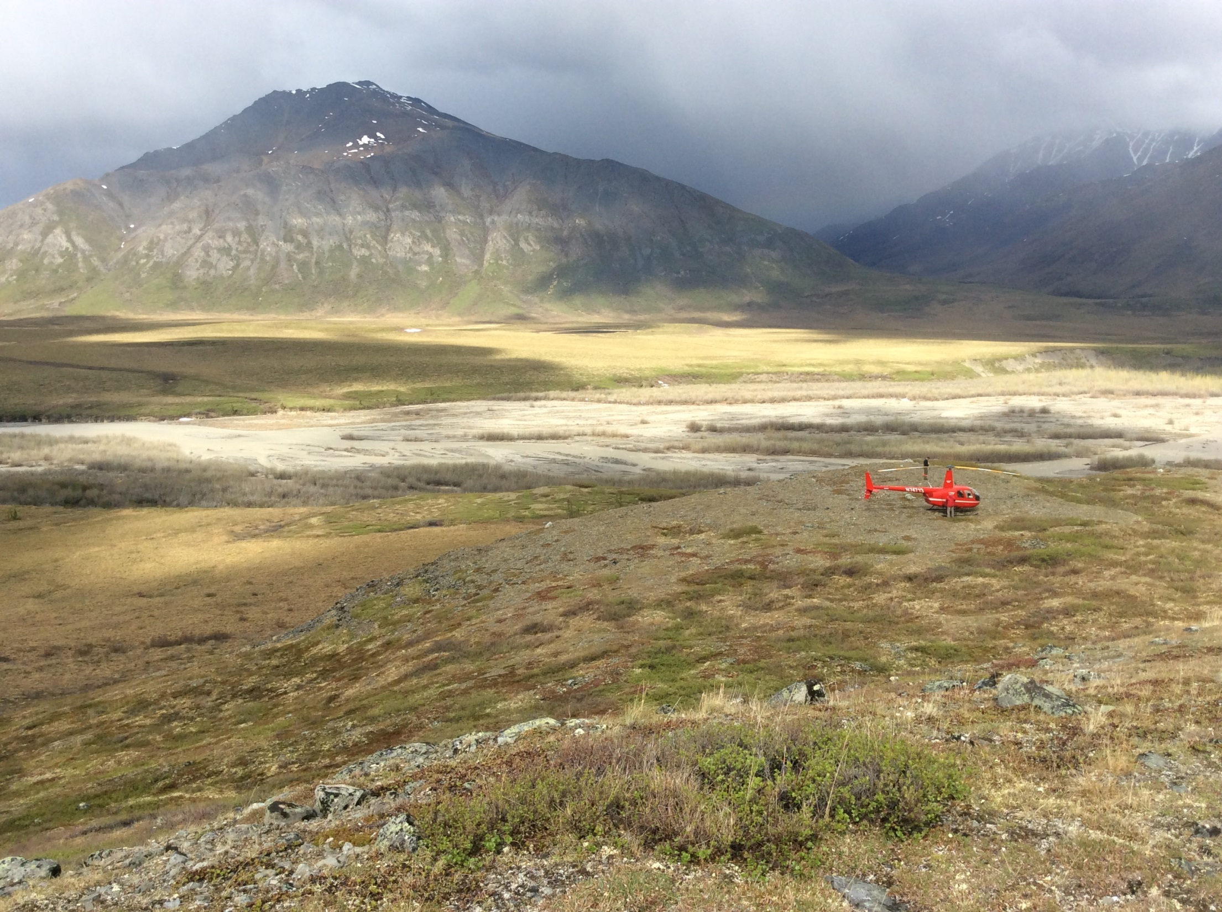
Field Folder
Relevant Permits
Land status maps
Regional maps
Site area maps
GIS Files
Trip Itinerary
Contacts list
Logistics plan
Spare bug dope
Your Creek, Eastern Brooks Range

Slide 10
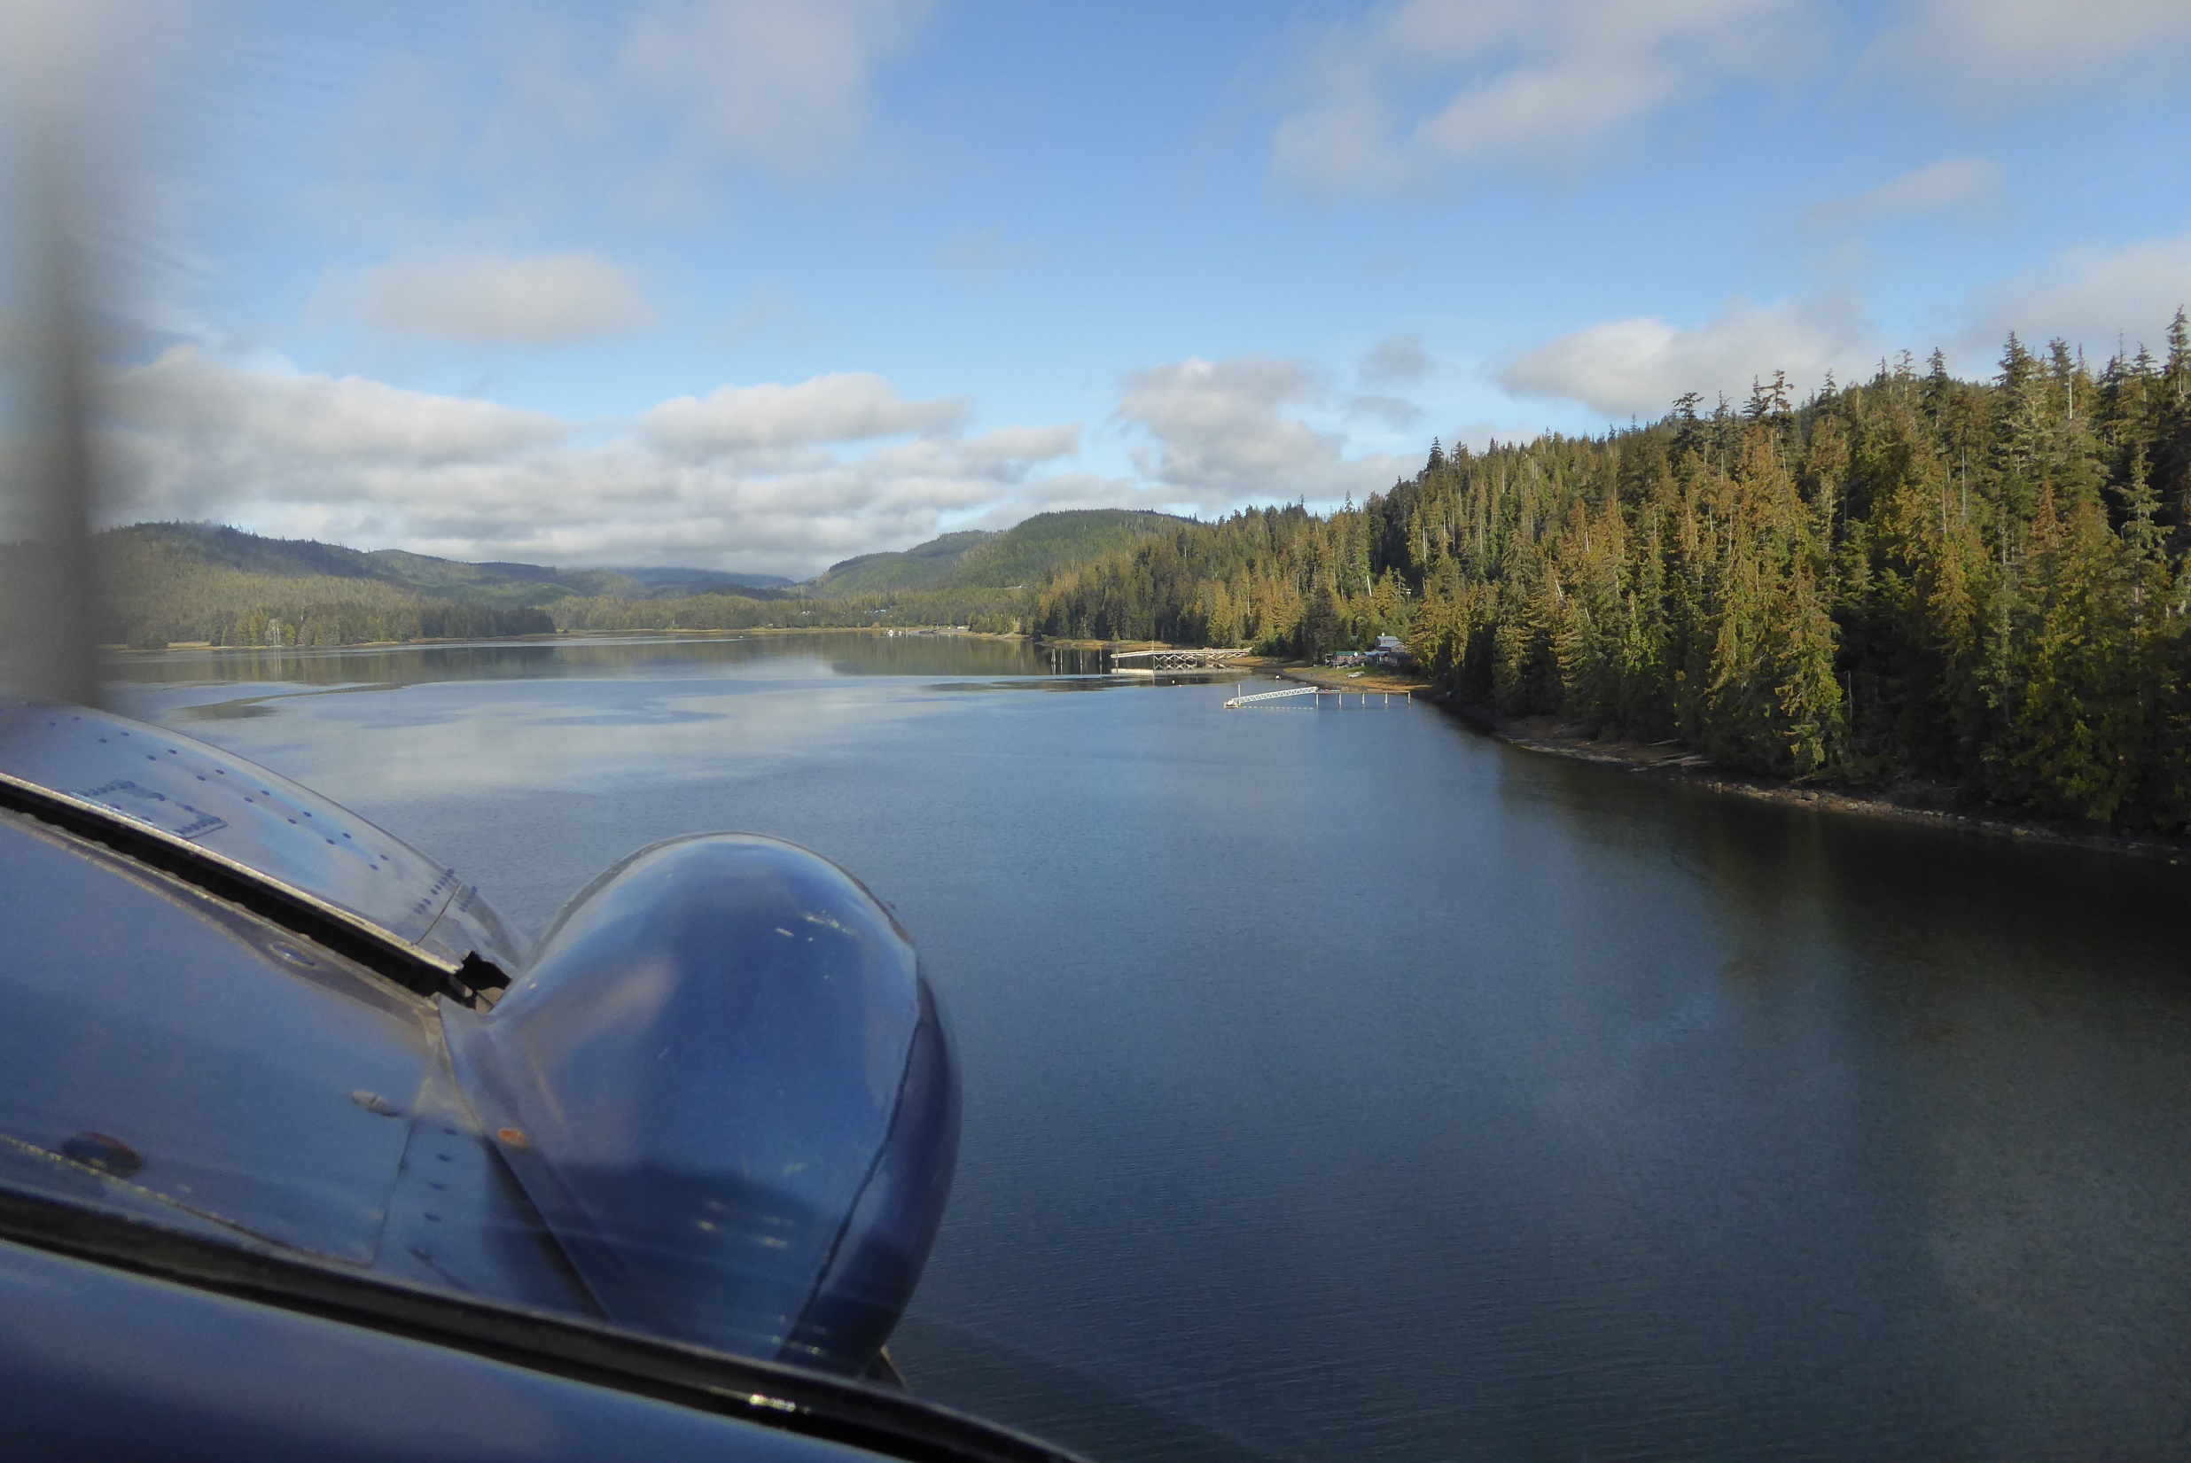
Field Tools
Aircraft tracking system
Maps
Compass and clinometer
Hand held GPS
Aircraft flight planning app (Foreflight) and other navigation tools on IPad
GIS app on IPad with sites, target areas, aerial imagery and maps
Whale Pass, Prince of Wales Island

Slide 11
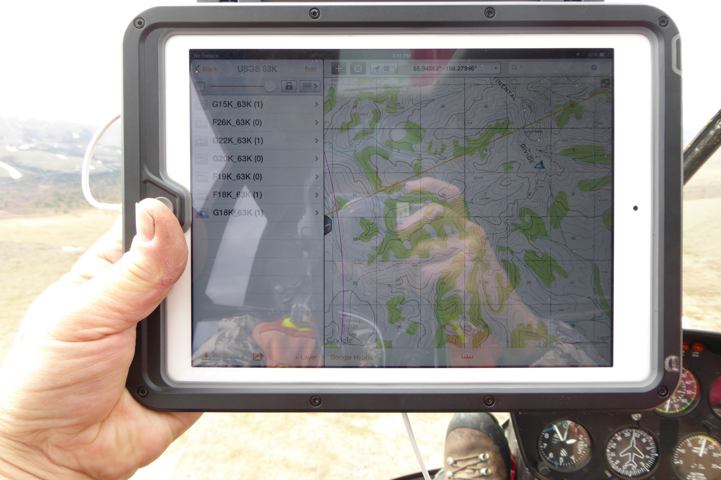

Slide 12
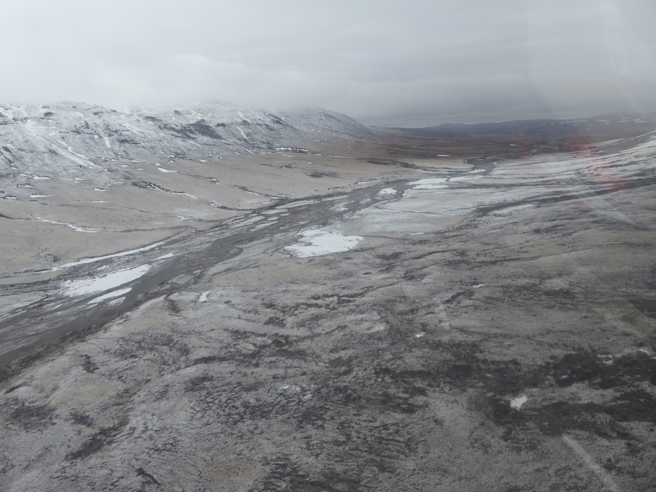
Field Tools
Aircraft tracking system
Maps
Compass and clinometer
Hand held GPS
Aircraft flight planning app (Foreflight) and other navigation tools on IPad
GIS app on IPad with sites, target areas, aerial imagery and maps
Photo logging app on Ipad (Theodolite)
Firearm of choice
Survival gear
Camp gear
Field computer
Sat. phone
Satellite comm. test unit
Camera
Northern Seward Peninsula

Slide 13
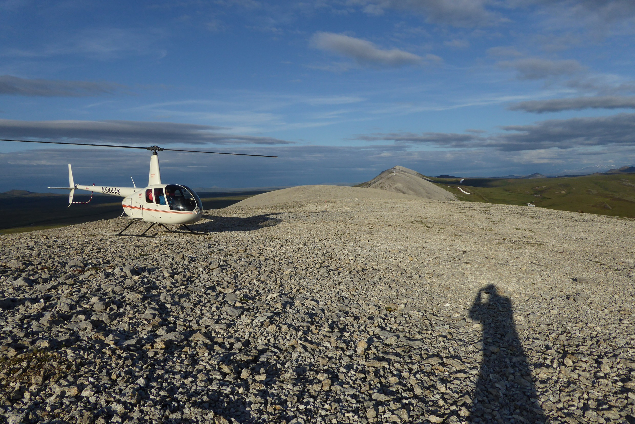
Aircraft of Choice
Avgas more available than JetA
Fuel Economy is good (15 gph)
Low operating cost
Excellent range with auxiliary fuel (400 nm)
Decent speed
Readily available
Reliable and low maintenance
Reasonably comfortable
Lisburne Ridge, Northern Foothills Brooks Range

Slide 14
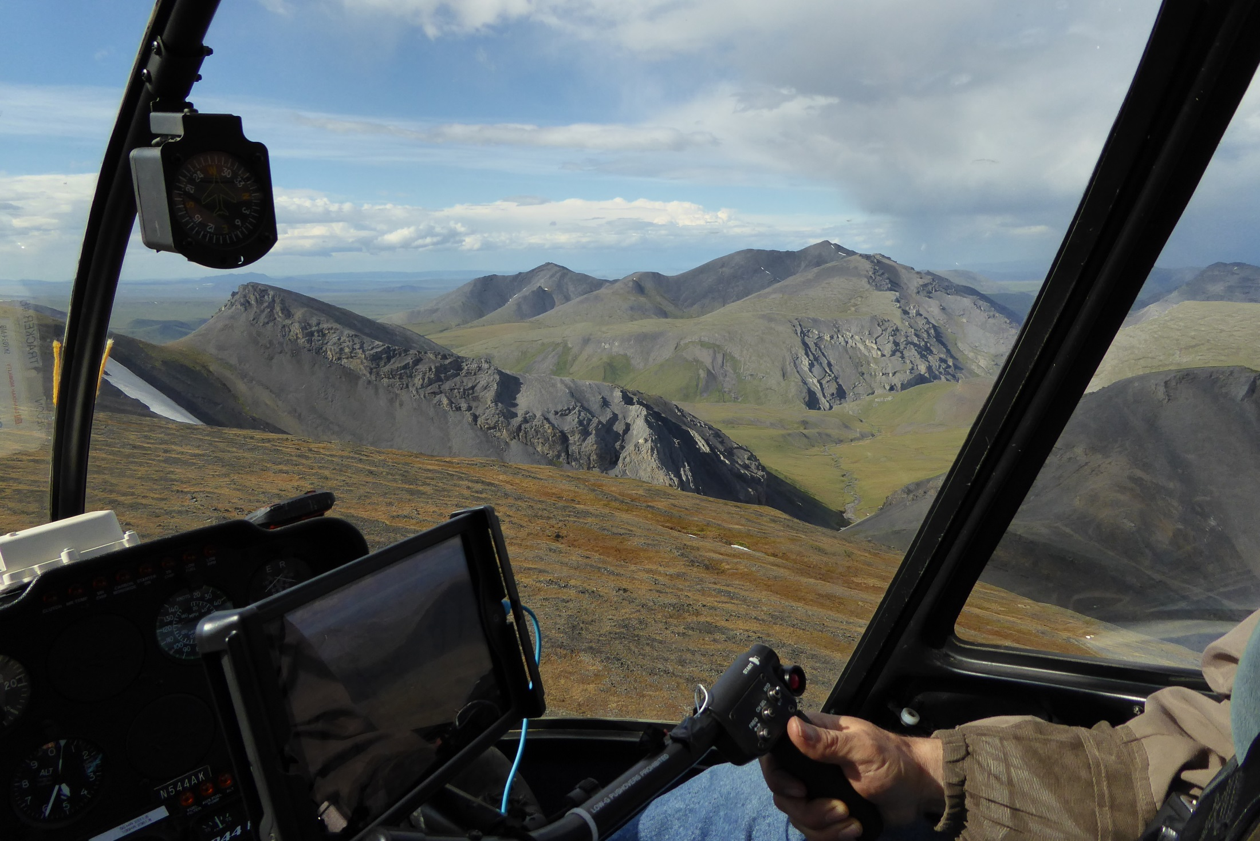
R44 RECON Home Office

Slide 15
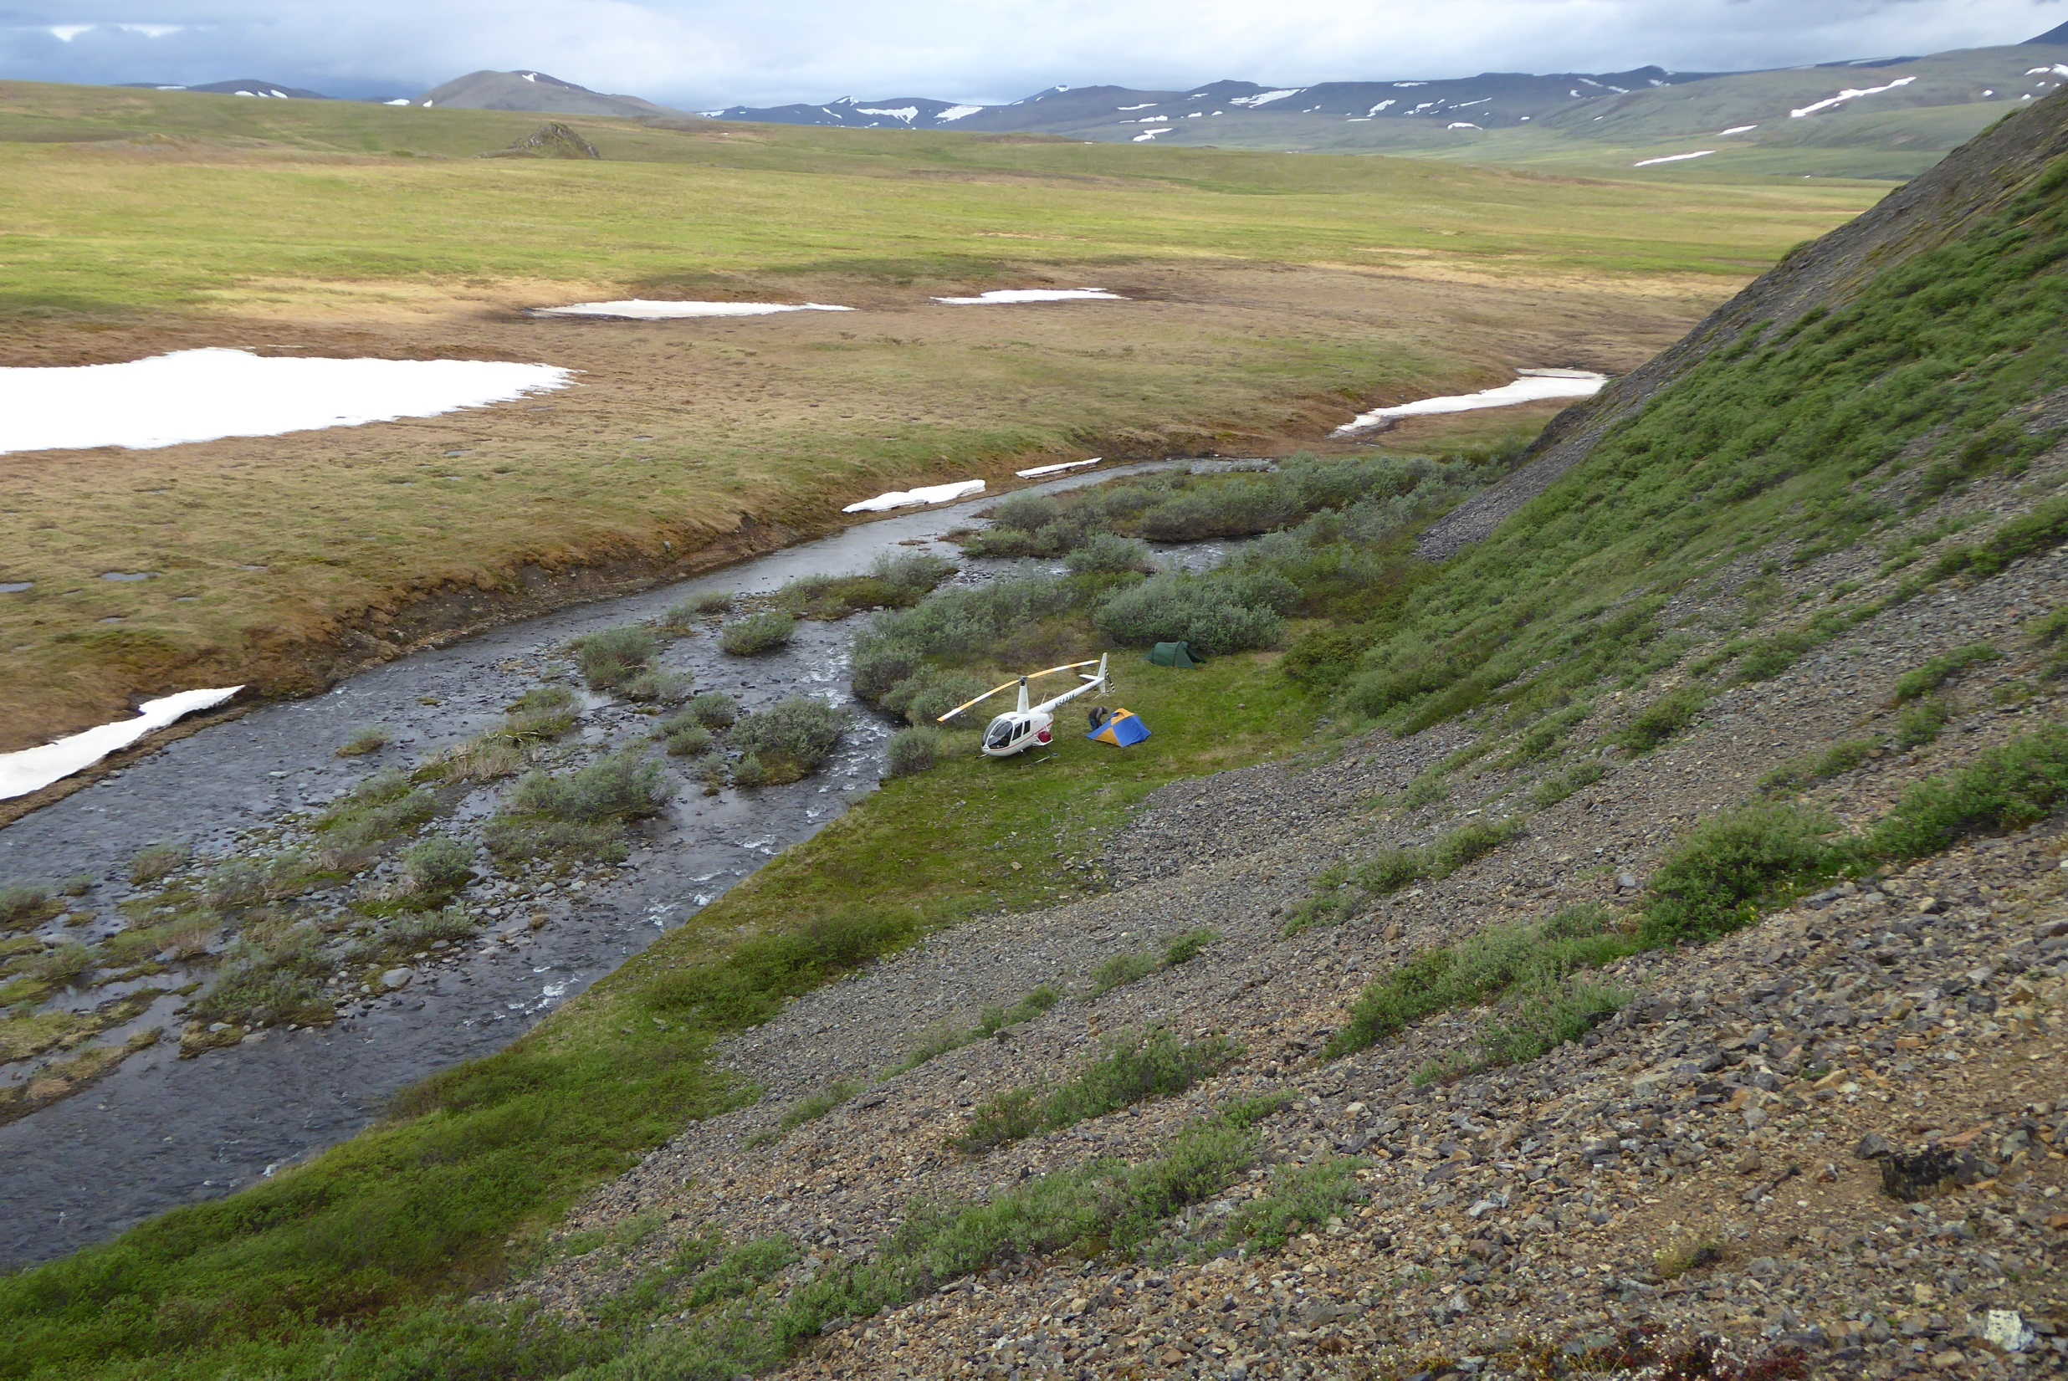
Camp 2, Trip 2 Kuna River headwaters, Brooks Range

Slide 16
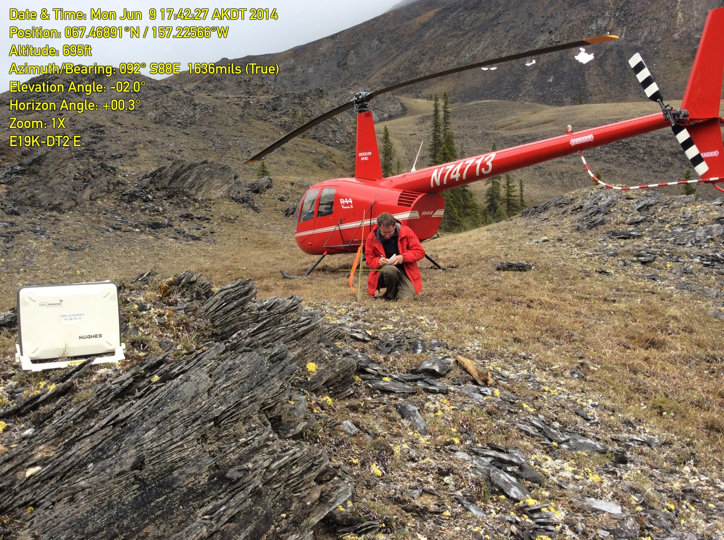
Once on site
Set up comm test unit
Document site characteristics
Collect quadrant photos and aerial photos
Record site coordinates
Complete site form on Ipad
John River, South Central Brooks Range

Slide 17
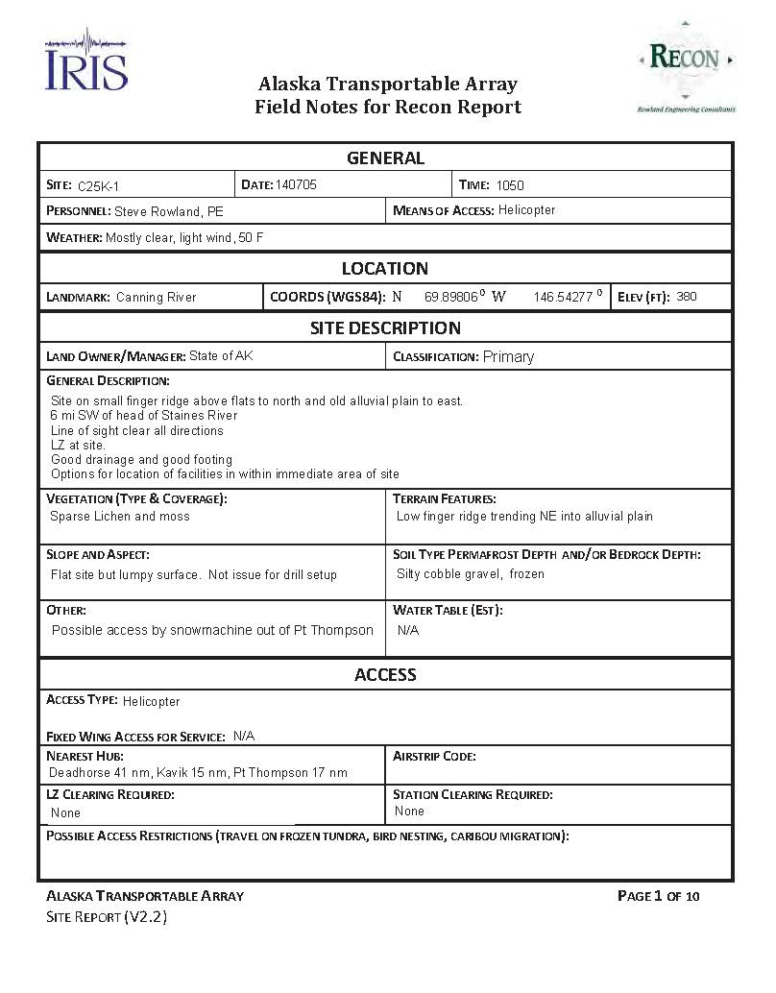
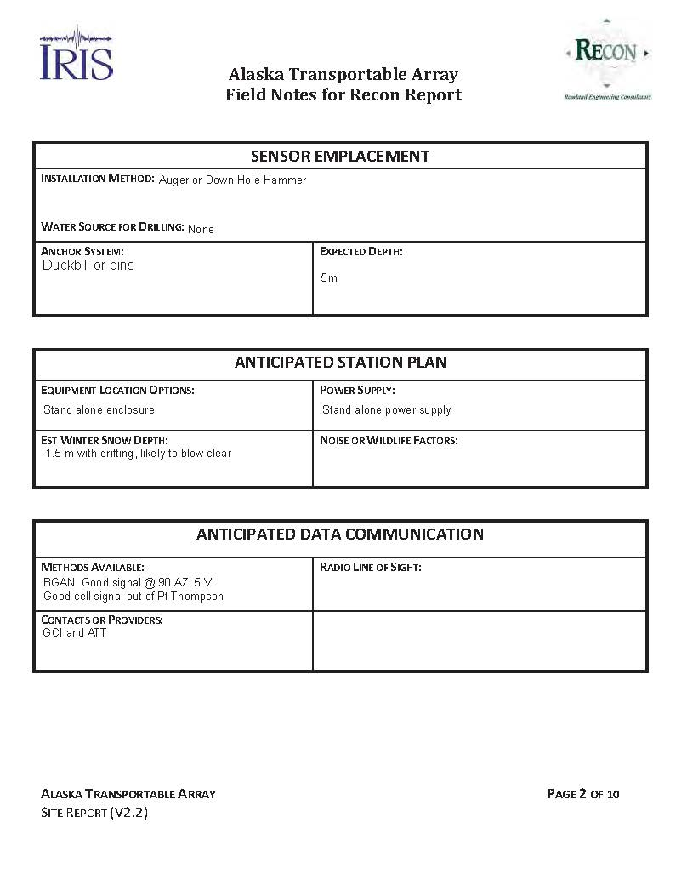
Typical Site Reconnaissance Form

Slide 18
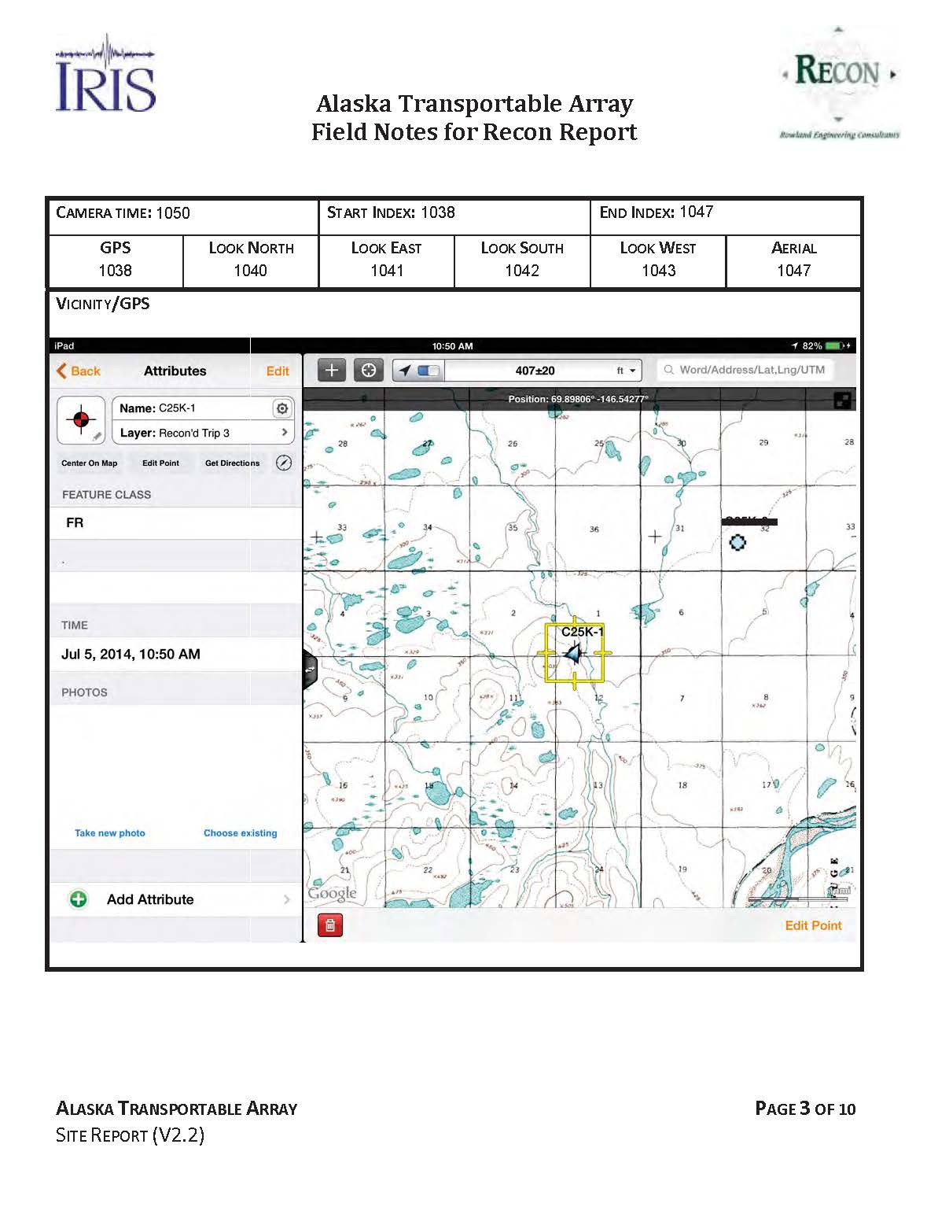
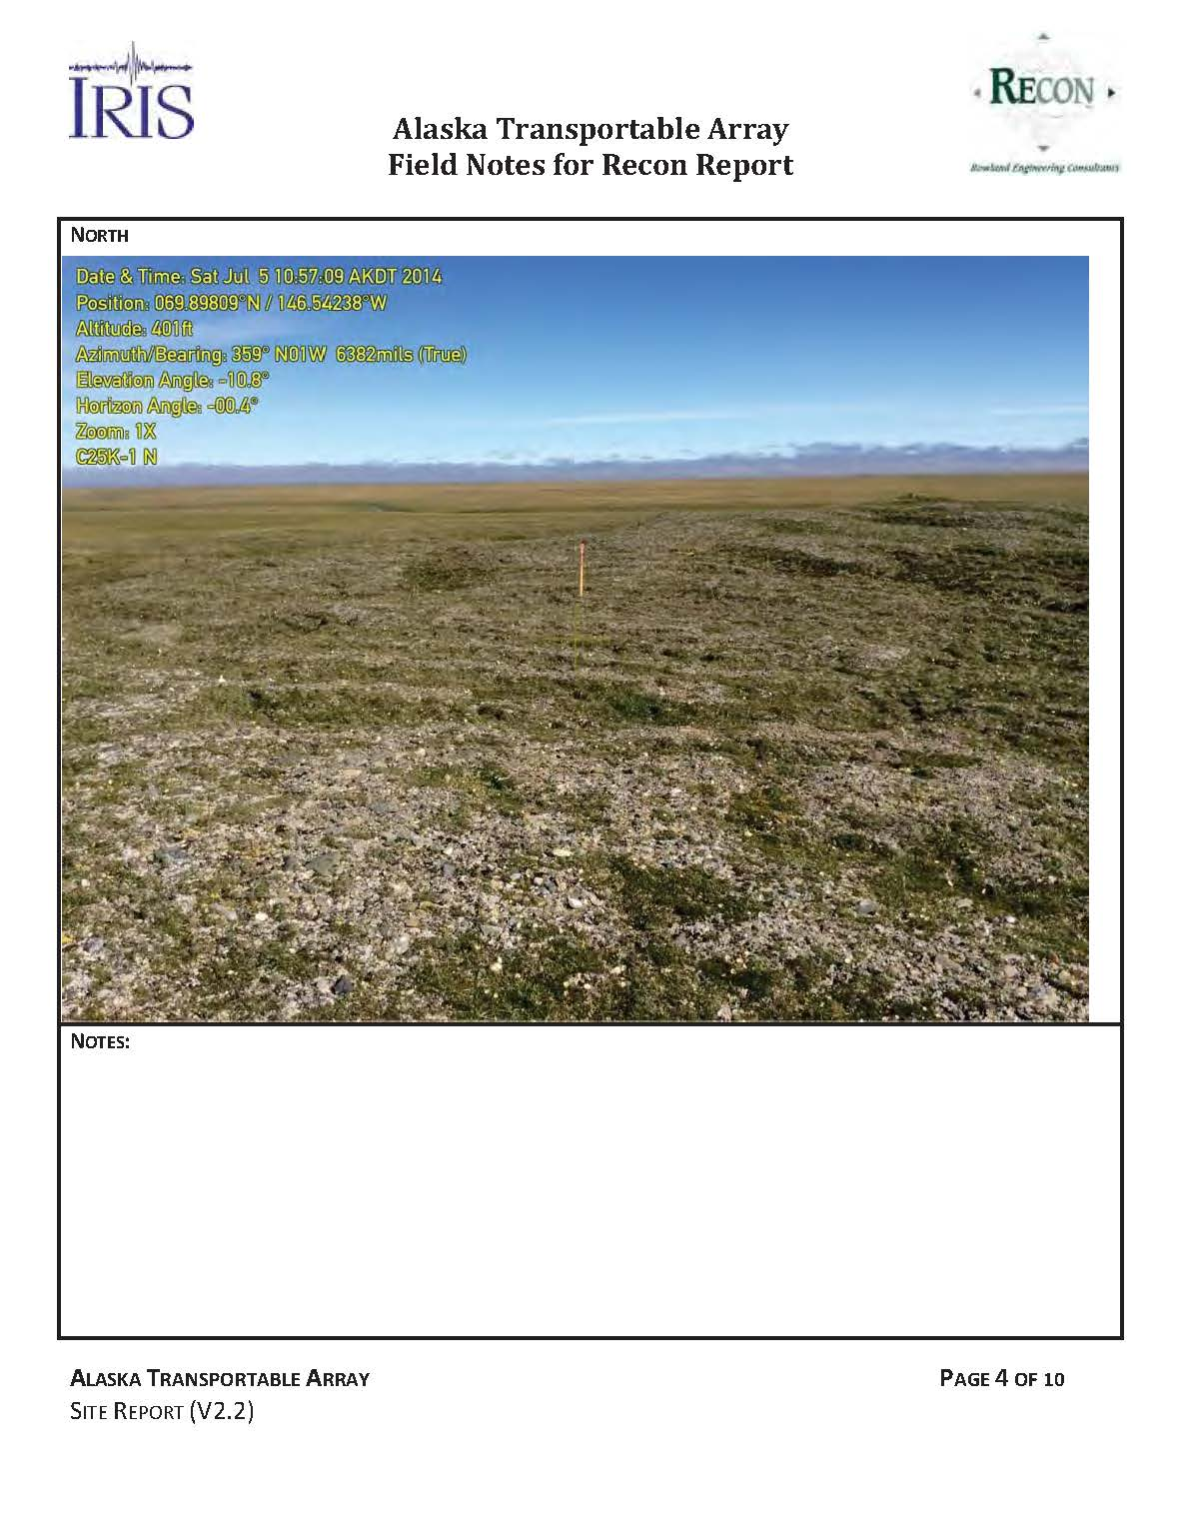
Typical Site Reconnaissance Form

Slide 19
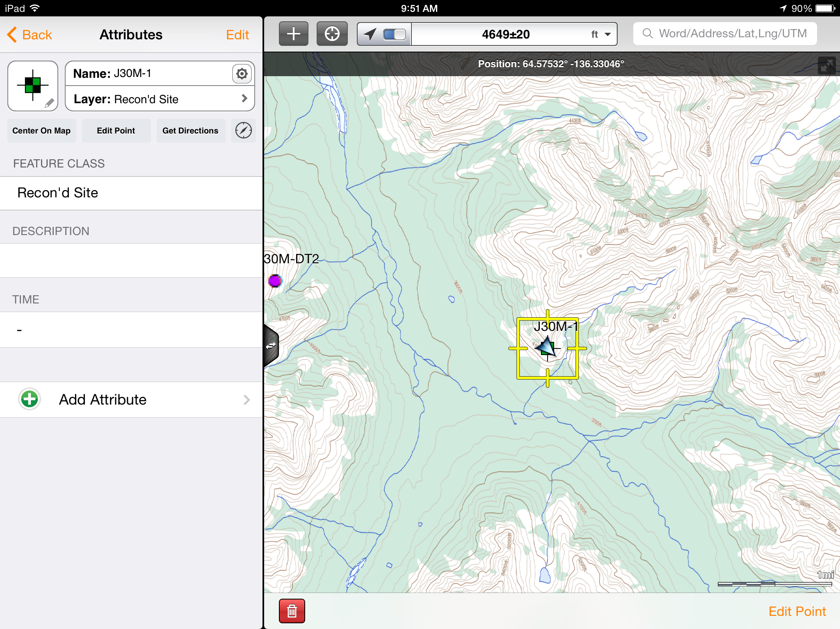

Slide 20
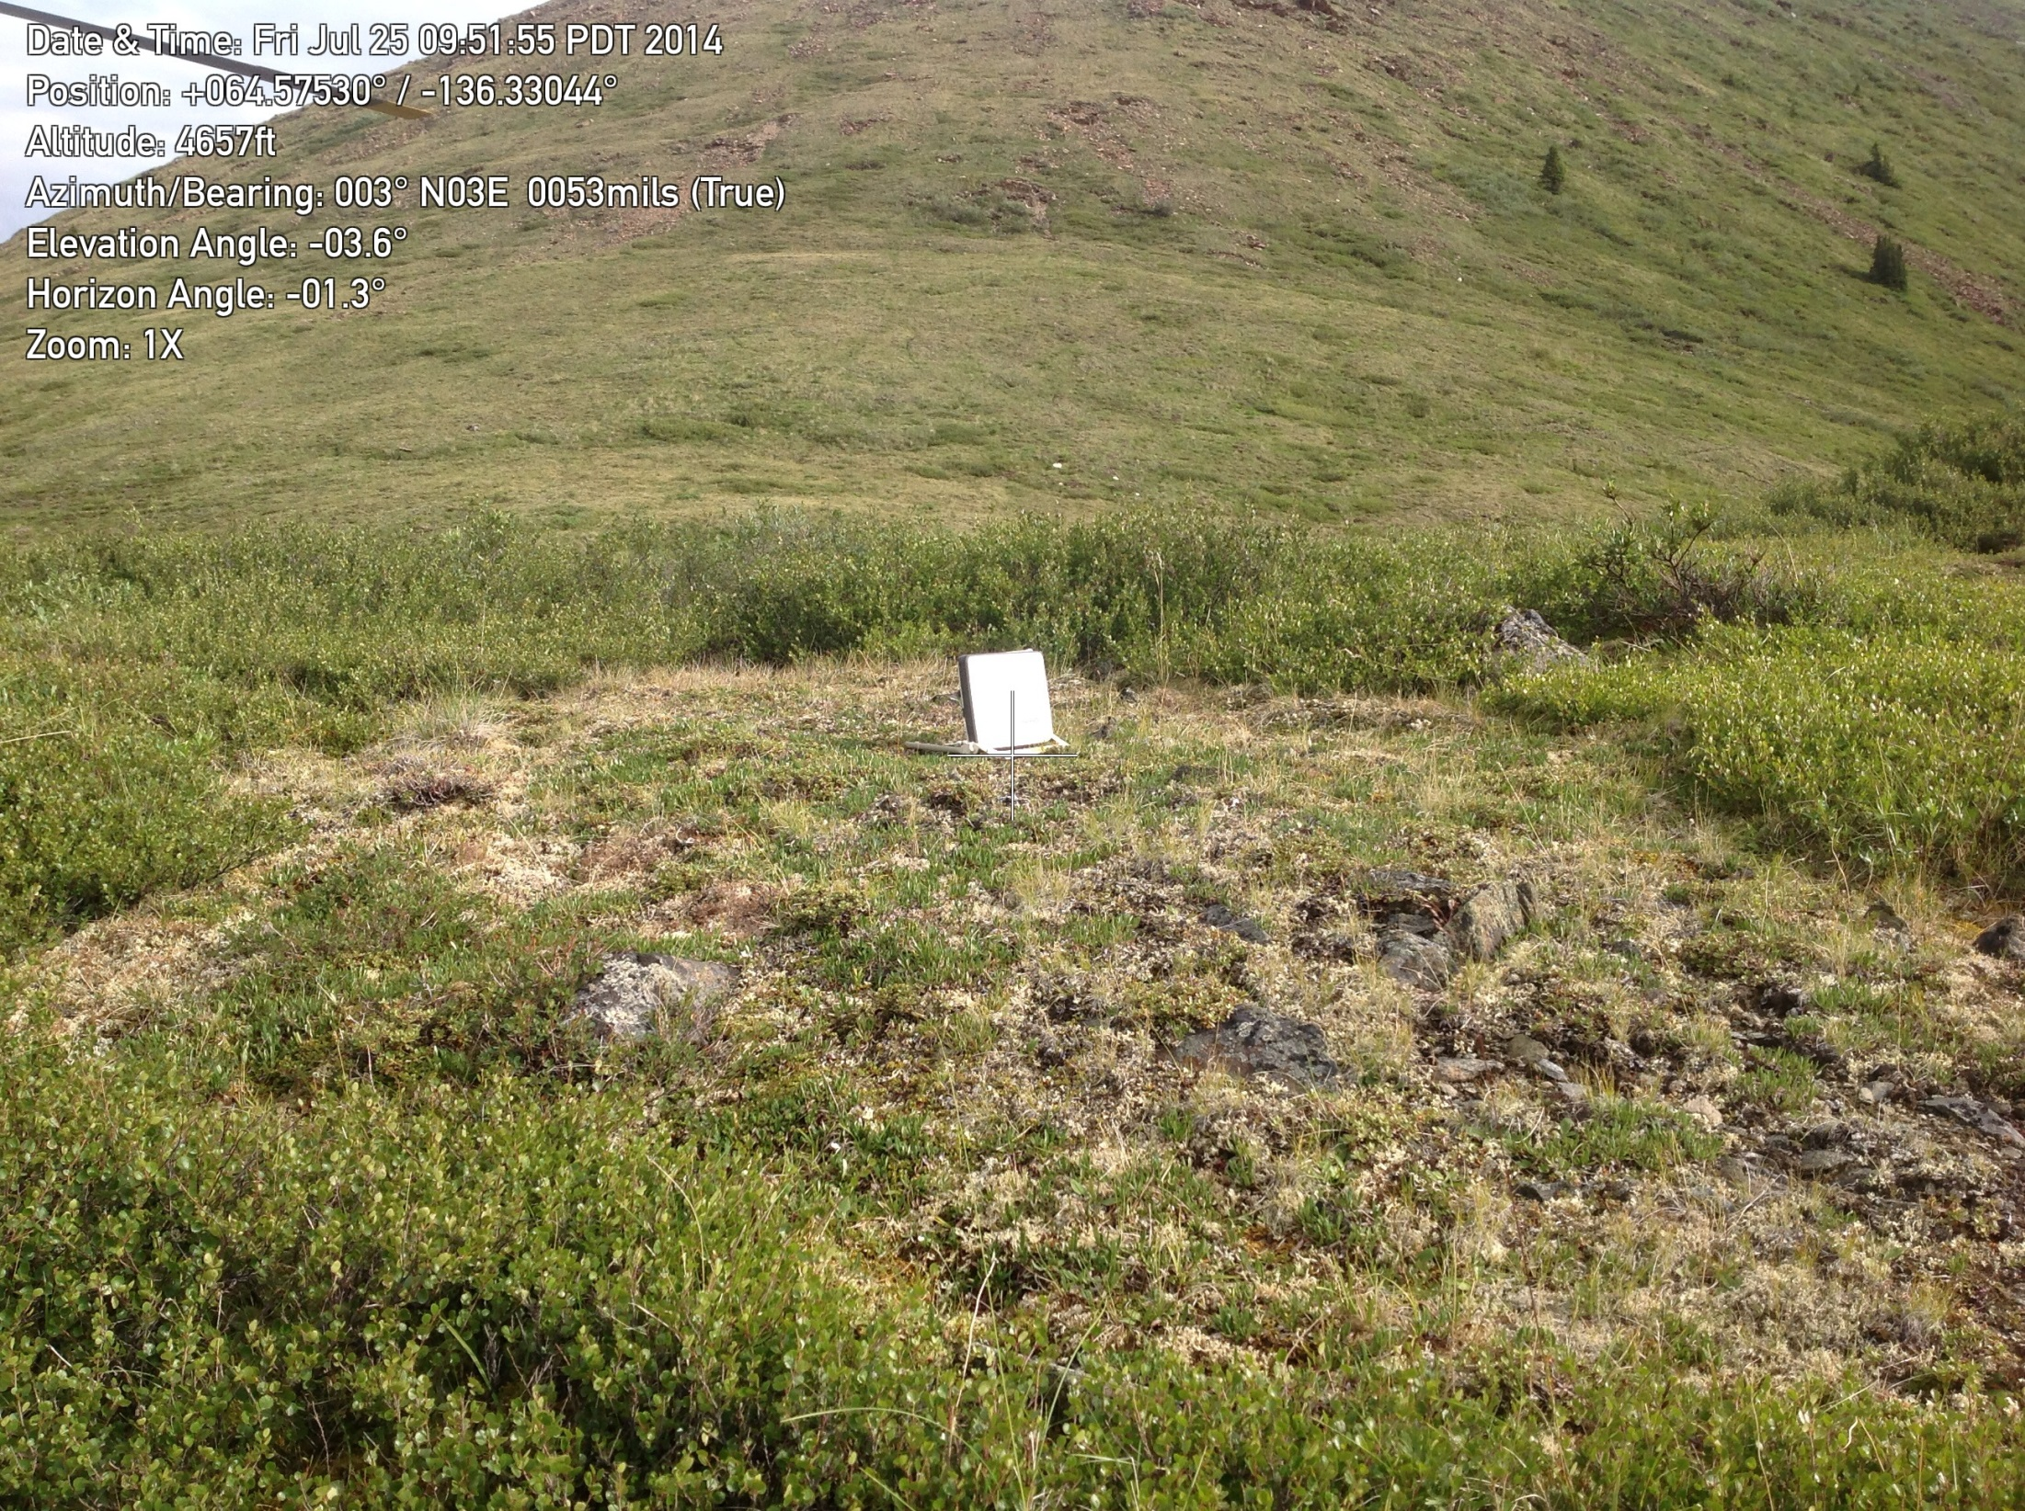

Slide 21
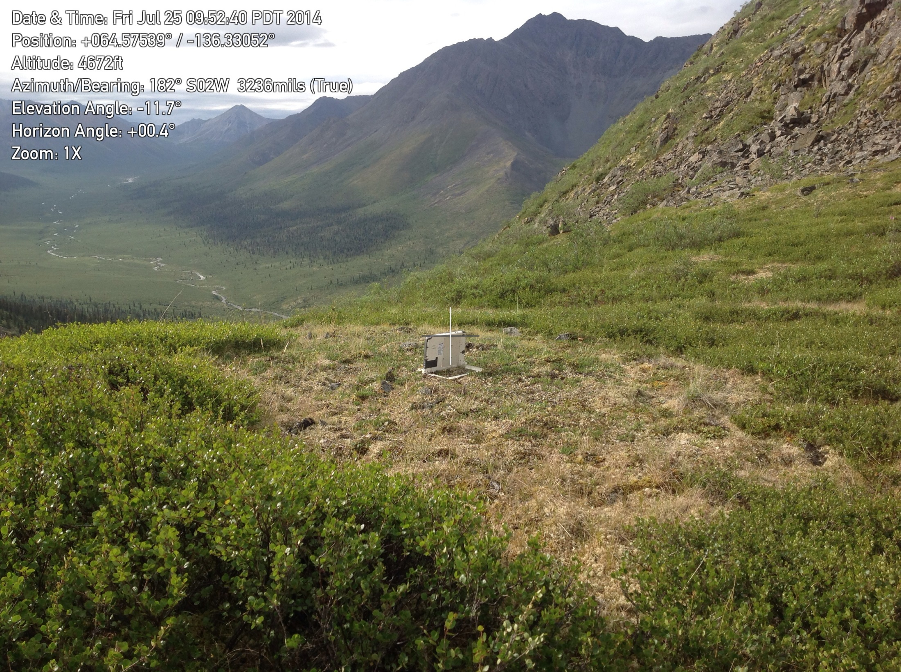
Olgilvie Mountains, Yukon Territory

Slide 22
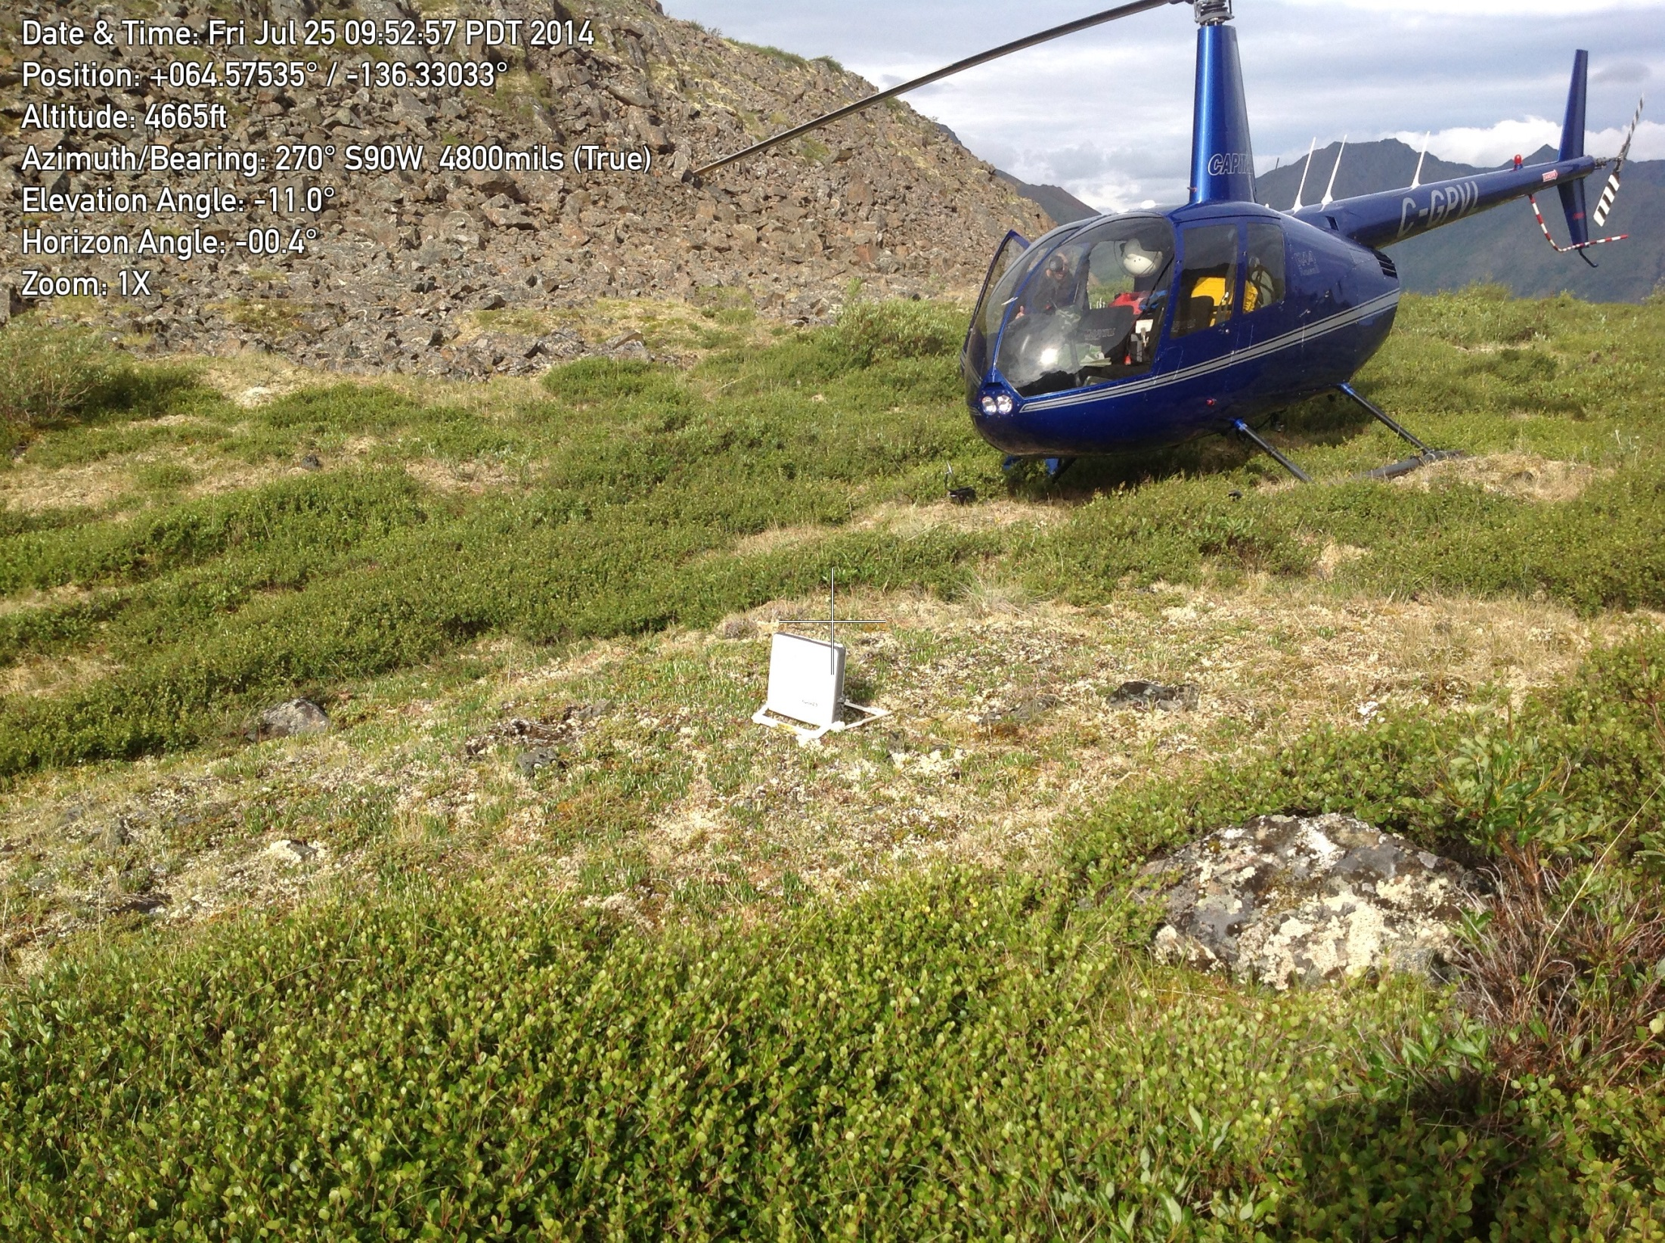

Slide 23
Olgilvie Mountains, Yukon Territory

Slide 24
Rowland Engineering Consultants
DAILY FIELD REPORT
Trip 4 - Yukon
Date | 140725 | Time Start | 0800
Report # | 003 | Time End | 1800
By | Isaac Rowland | Miles | 12
Weather
60F, low overcast, rain
Daily Log
Completed J28M in morning with primary and alternate sites. Found low cloud deck obscuring I28M. Located one possible site on high ridge near south limit of buffer. Diverted to western sites and located one site at H28M and two sites at H29M, but recons were hampered by low clouds obscuring high points. Overnighting at Eagle Plains.
Tomorrow's plan: Weather is currently poor with thick fog. If possible will recon H31 & G31 before transiting to Old Crow. If not possible to recon the eastern sites, will work towards Old Crow and plan on completing skipped sites on return journey.
Photo
Daily Field Report
Page 1 of 1

Slide 25
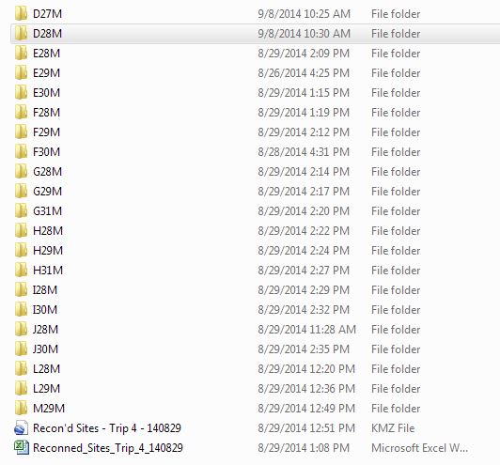
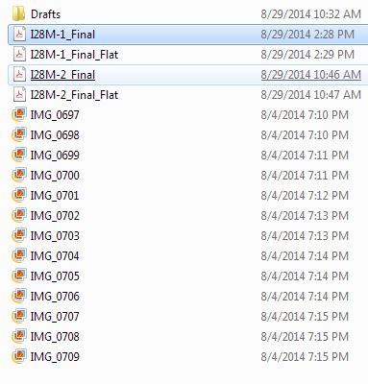
Final deliverable included a trip file with subfolders for each site
Subfolder for site contained final site report and photos

Slide 26
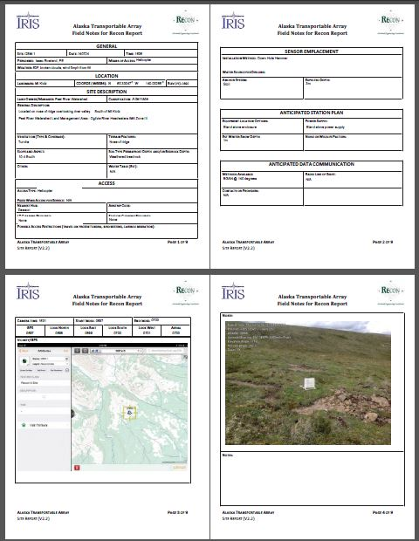
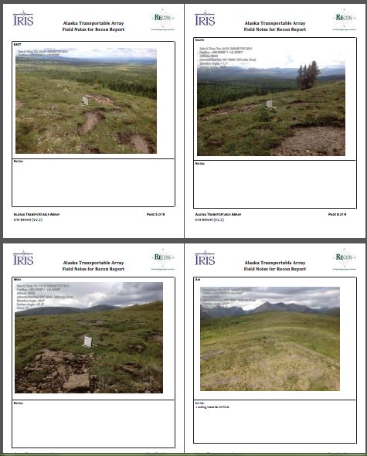
Site I28M-1 Final

Slide 27
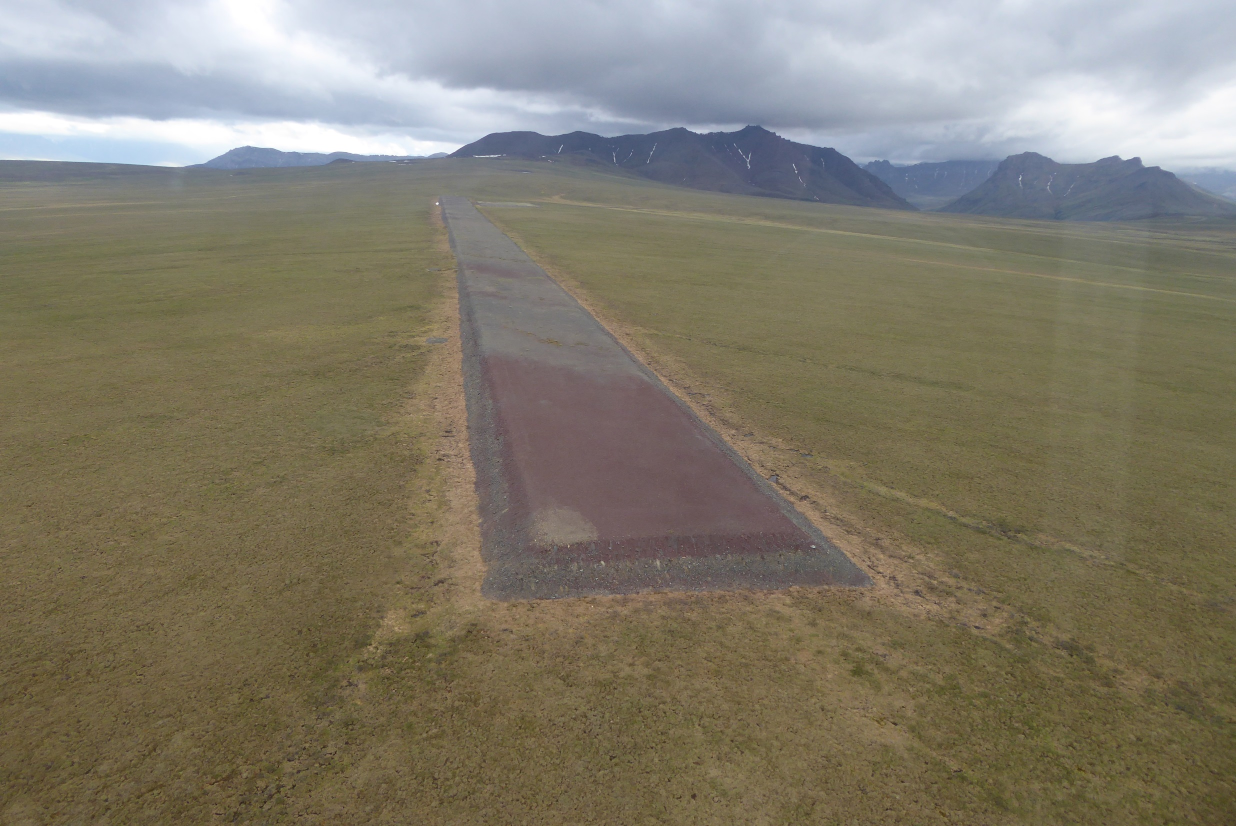
Each region unique with it’s own character and challenges
North Eastern Foothills Brooks Range

Slide 28
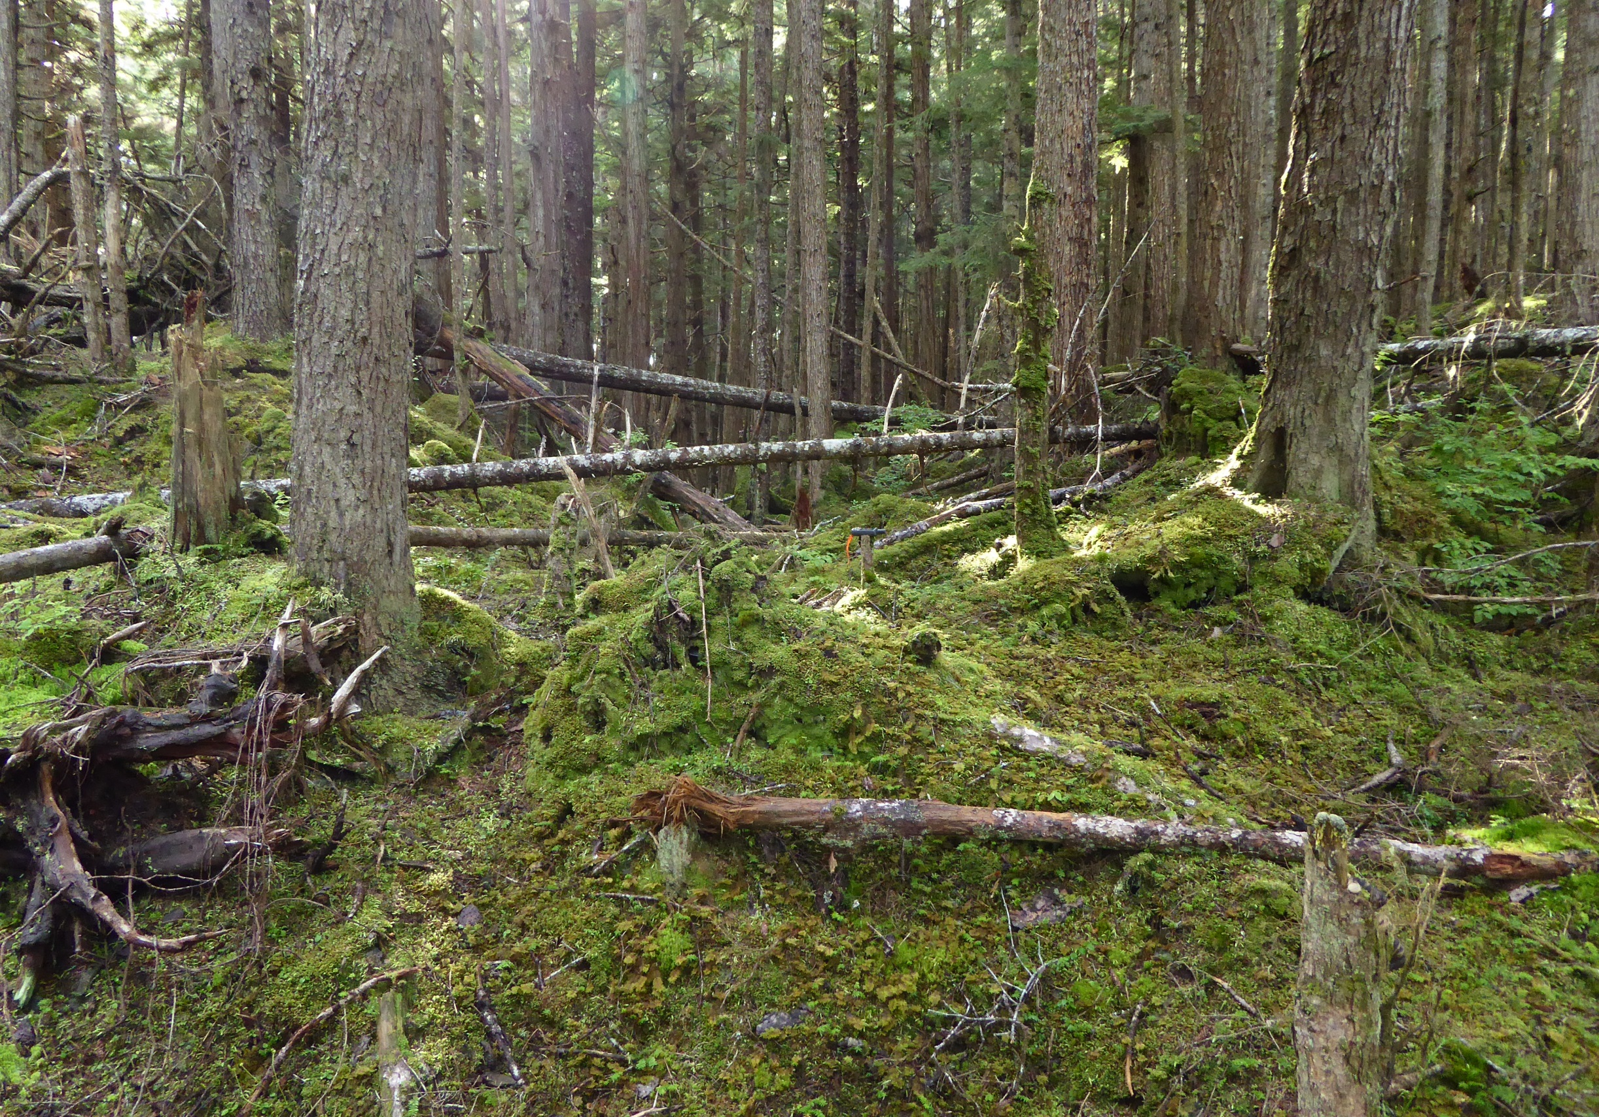
SE Panhandle

Slide 29
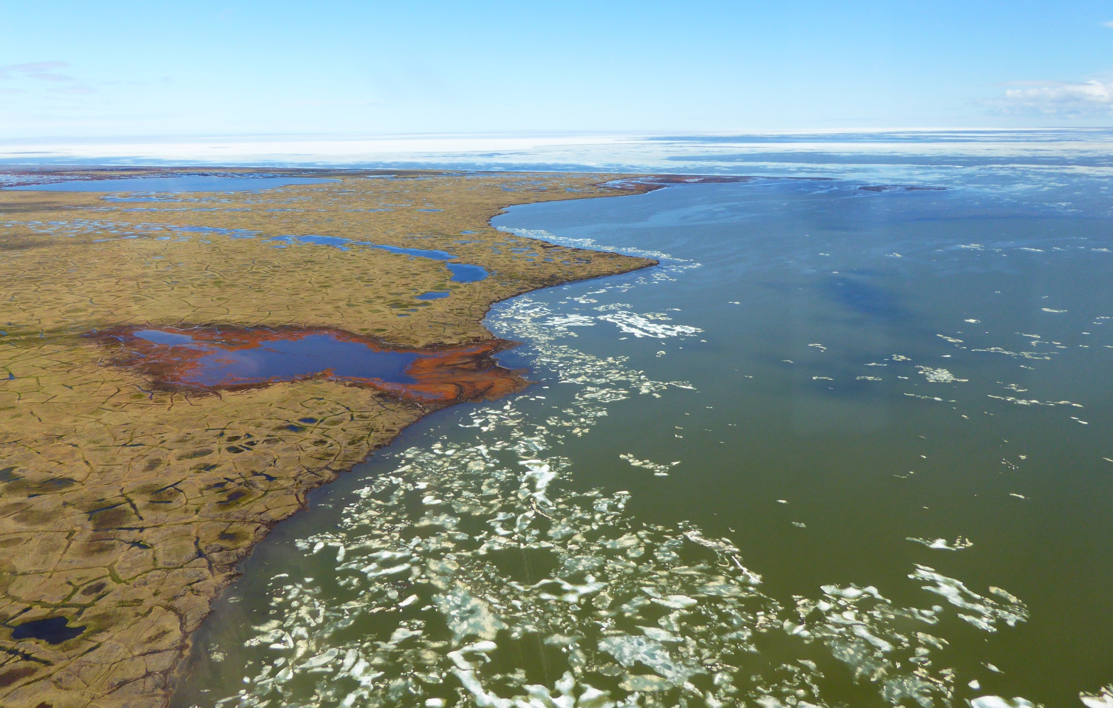
Arctic Coastal

Slide 30
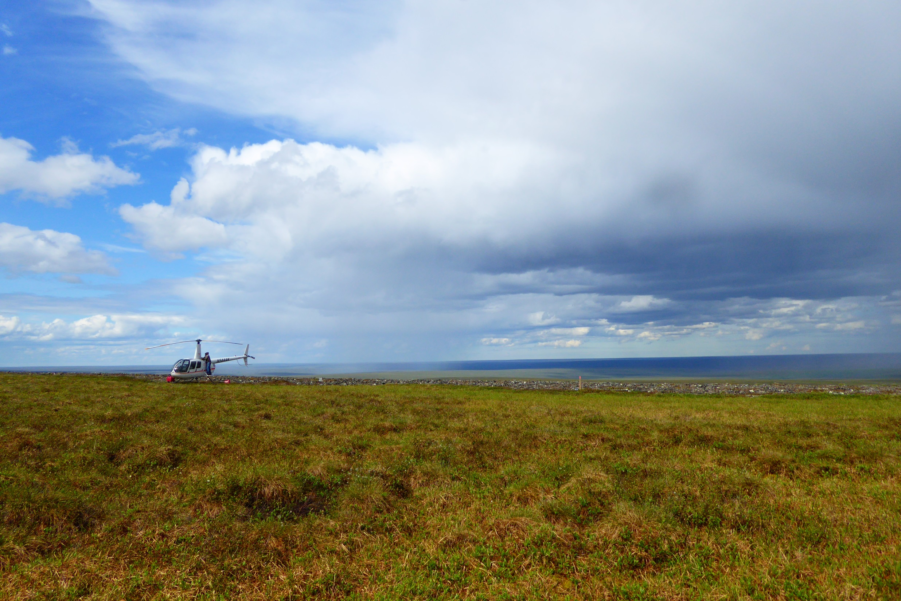
North Slope

Slide 31
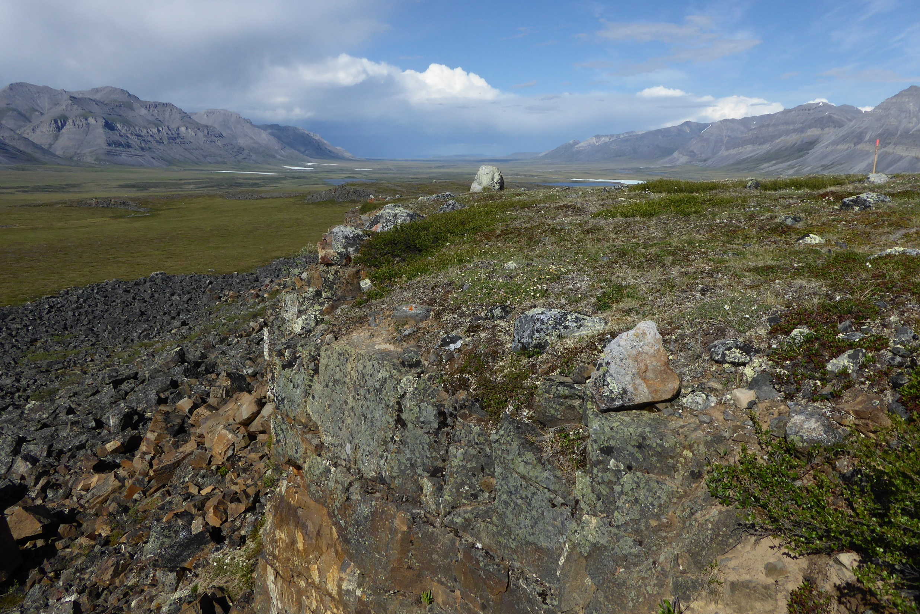
Brooks Range

Slide 32
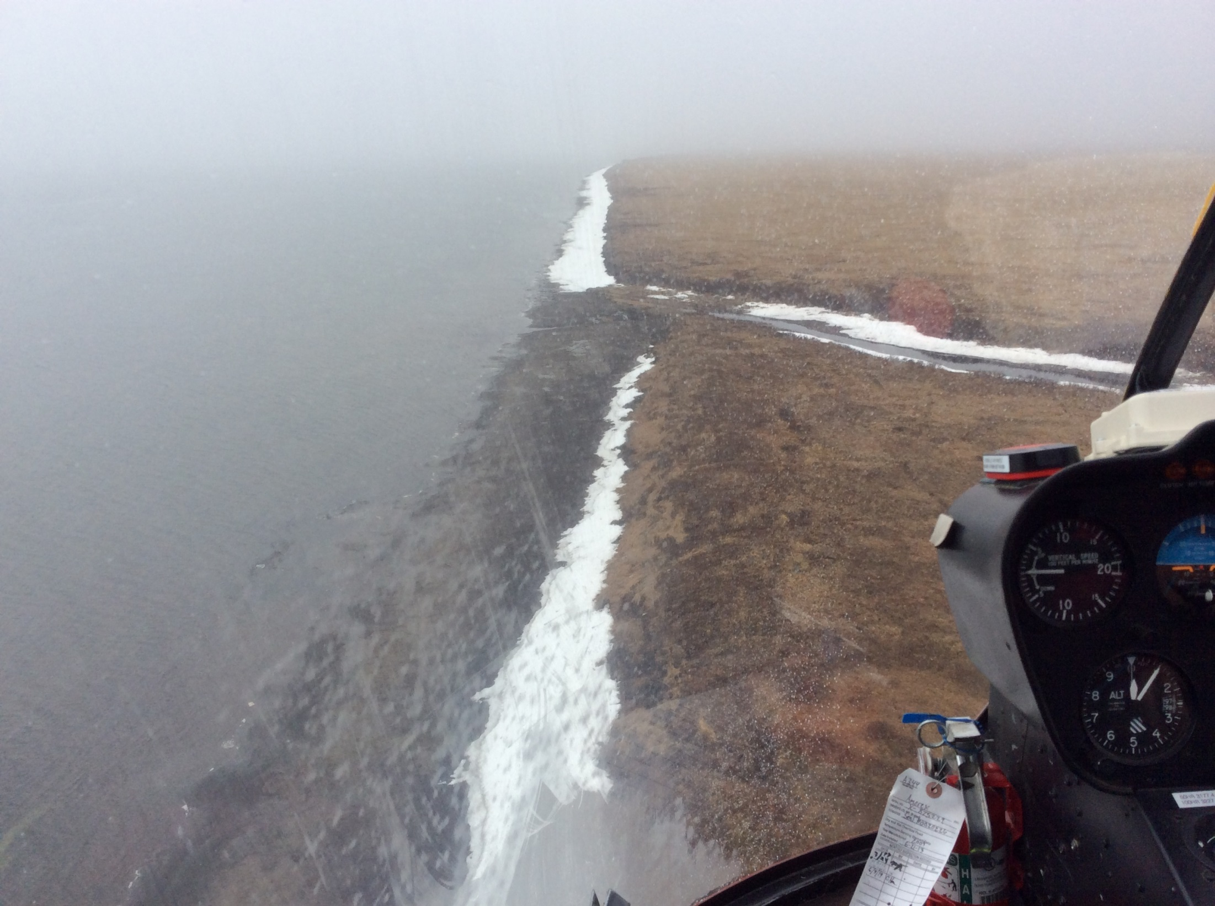
NW Coastal

Slide 33
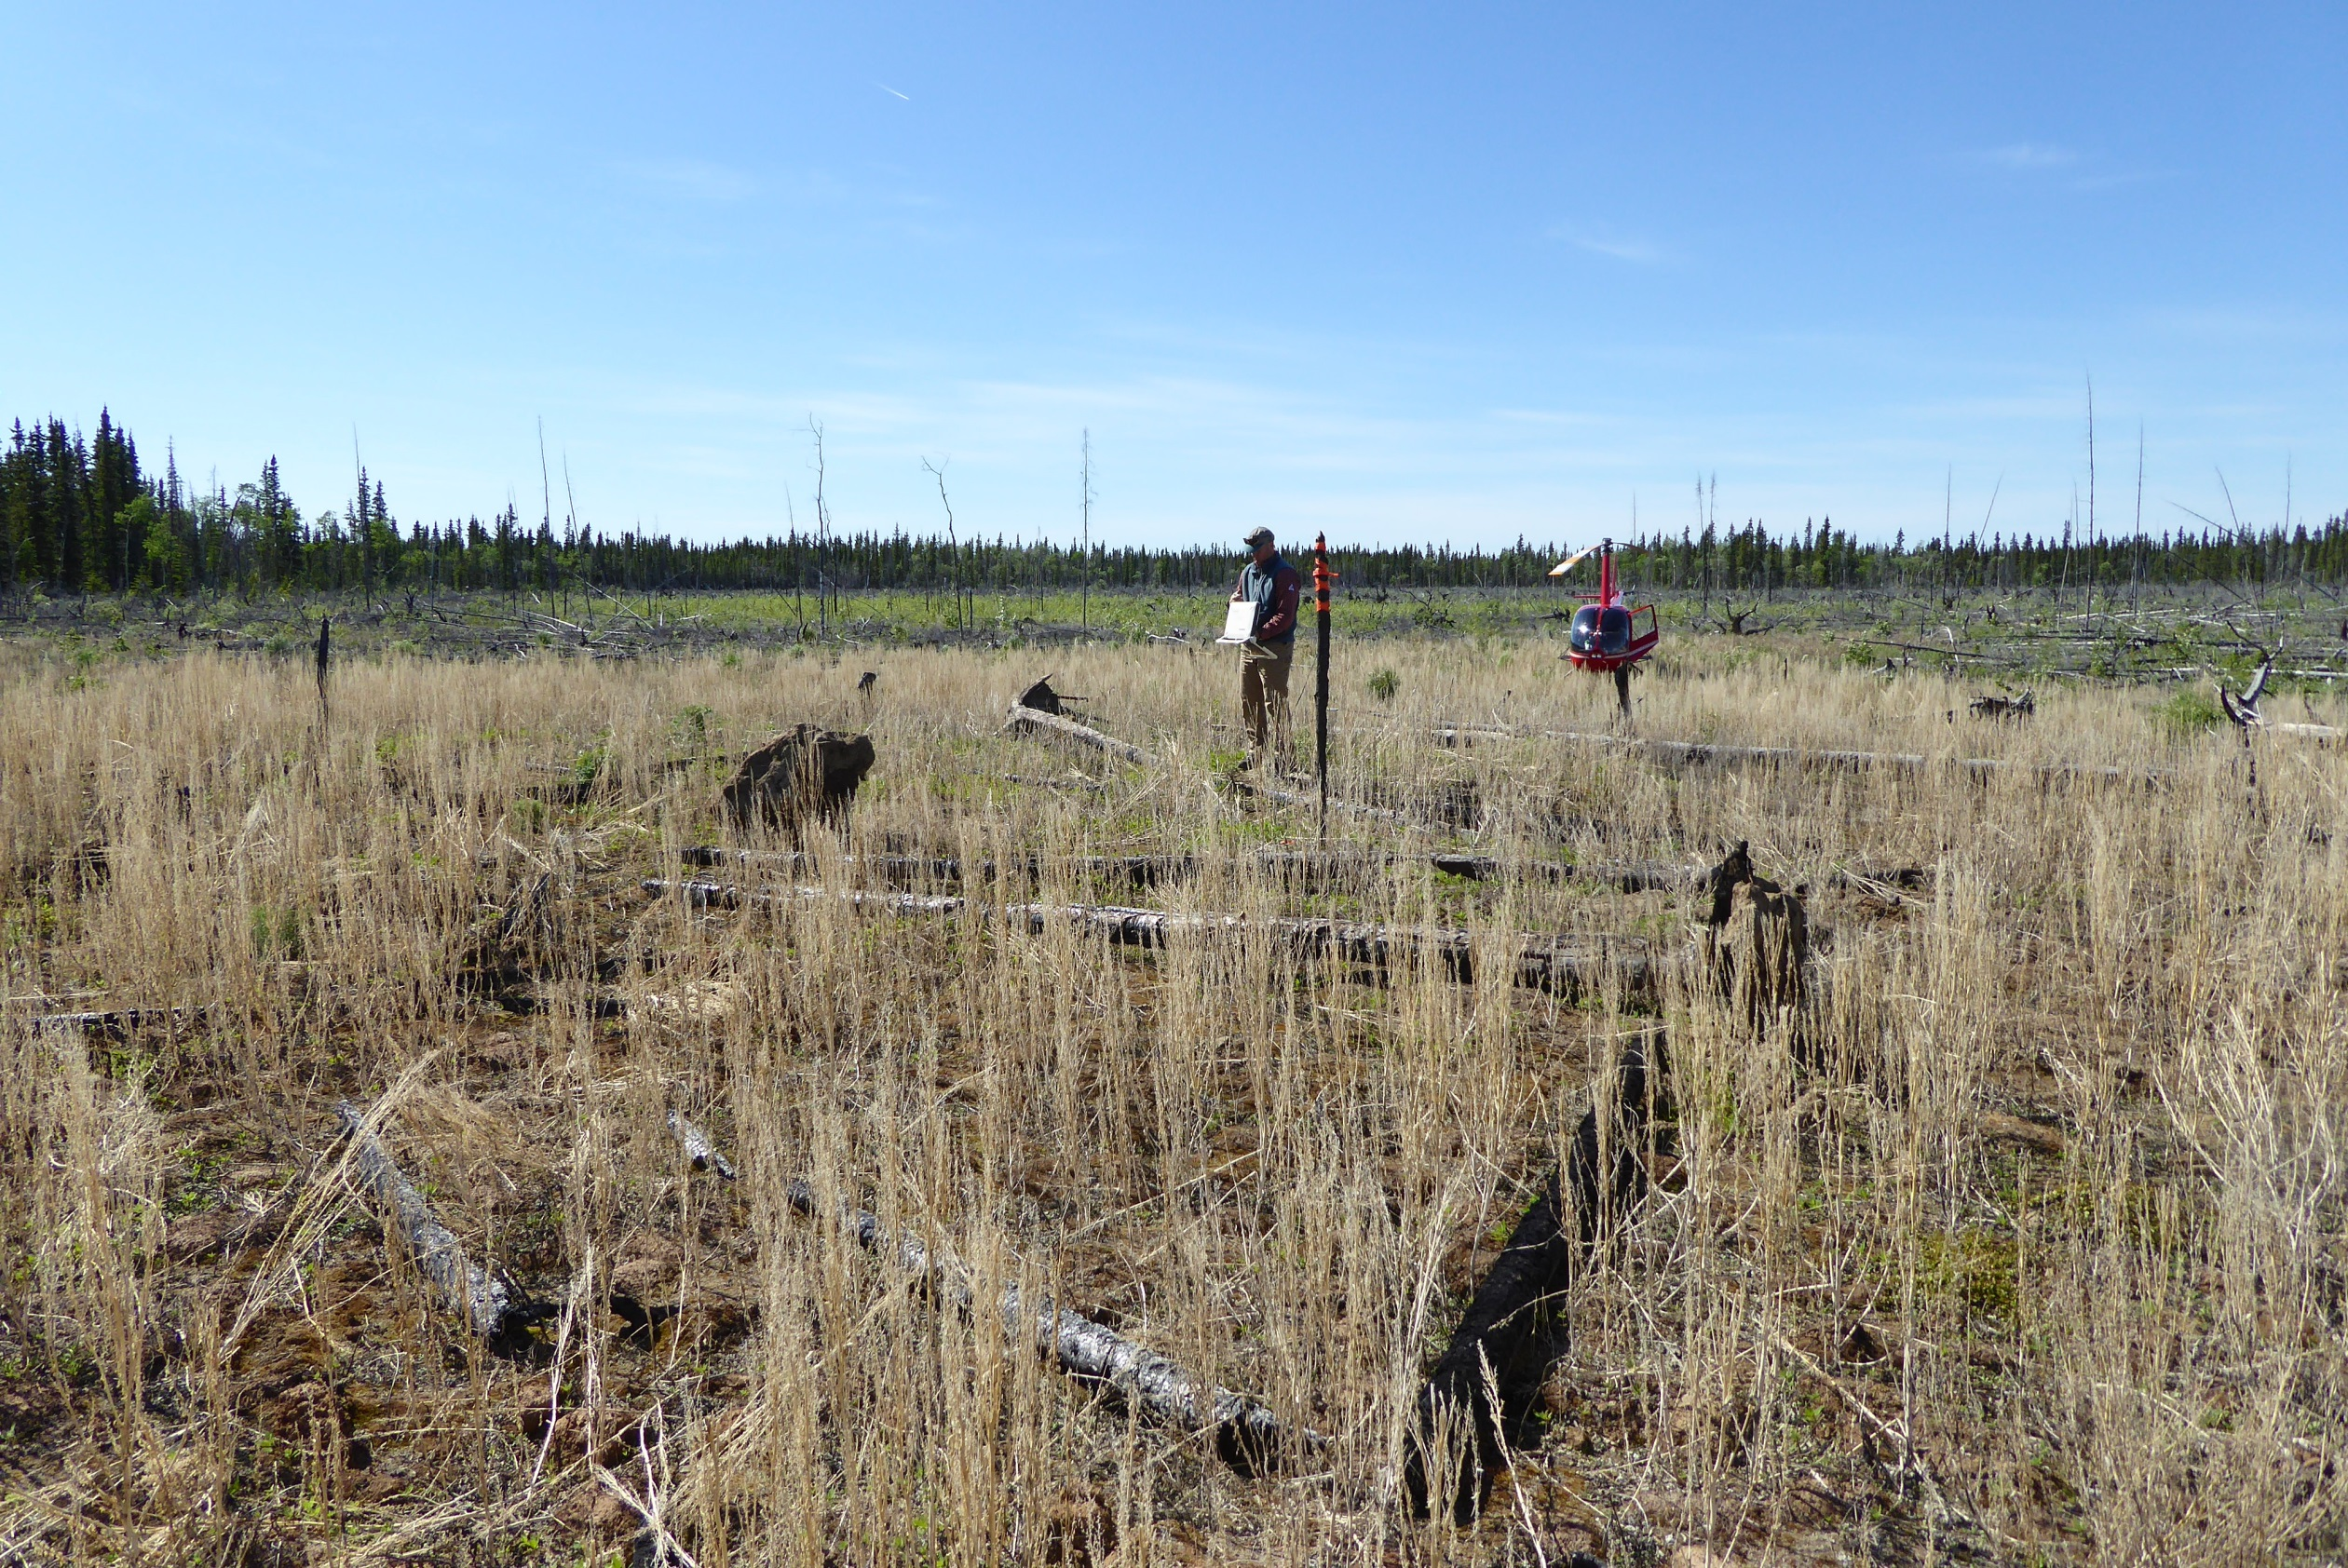
North Central

Slide 34
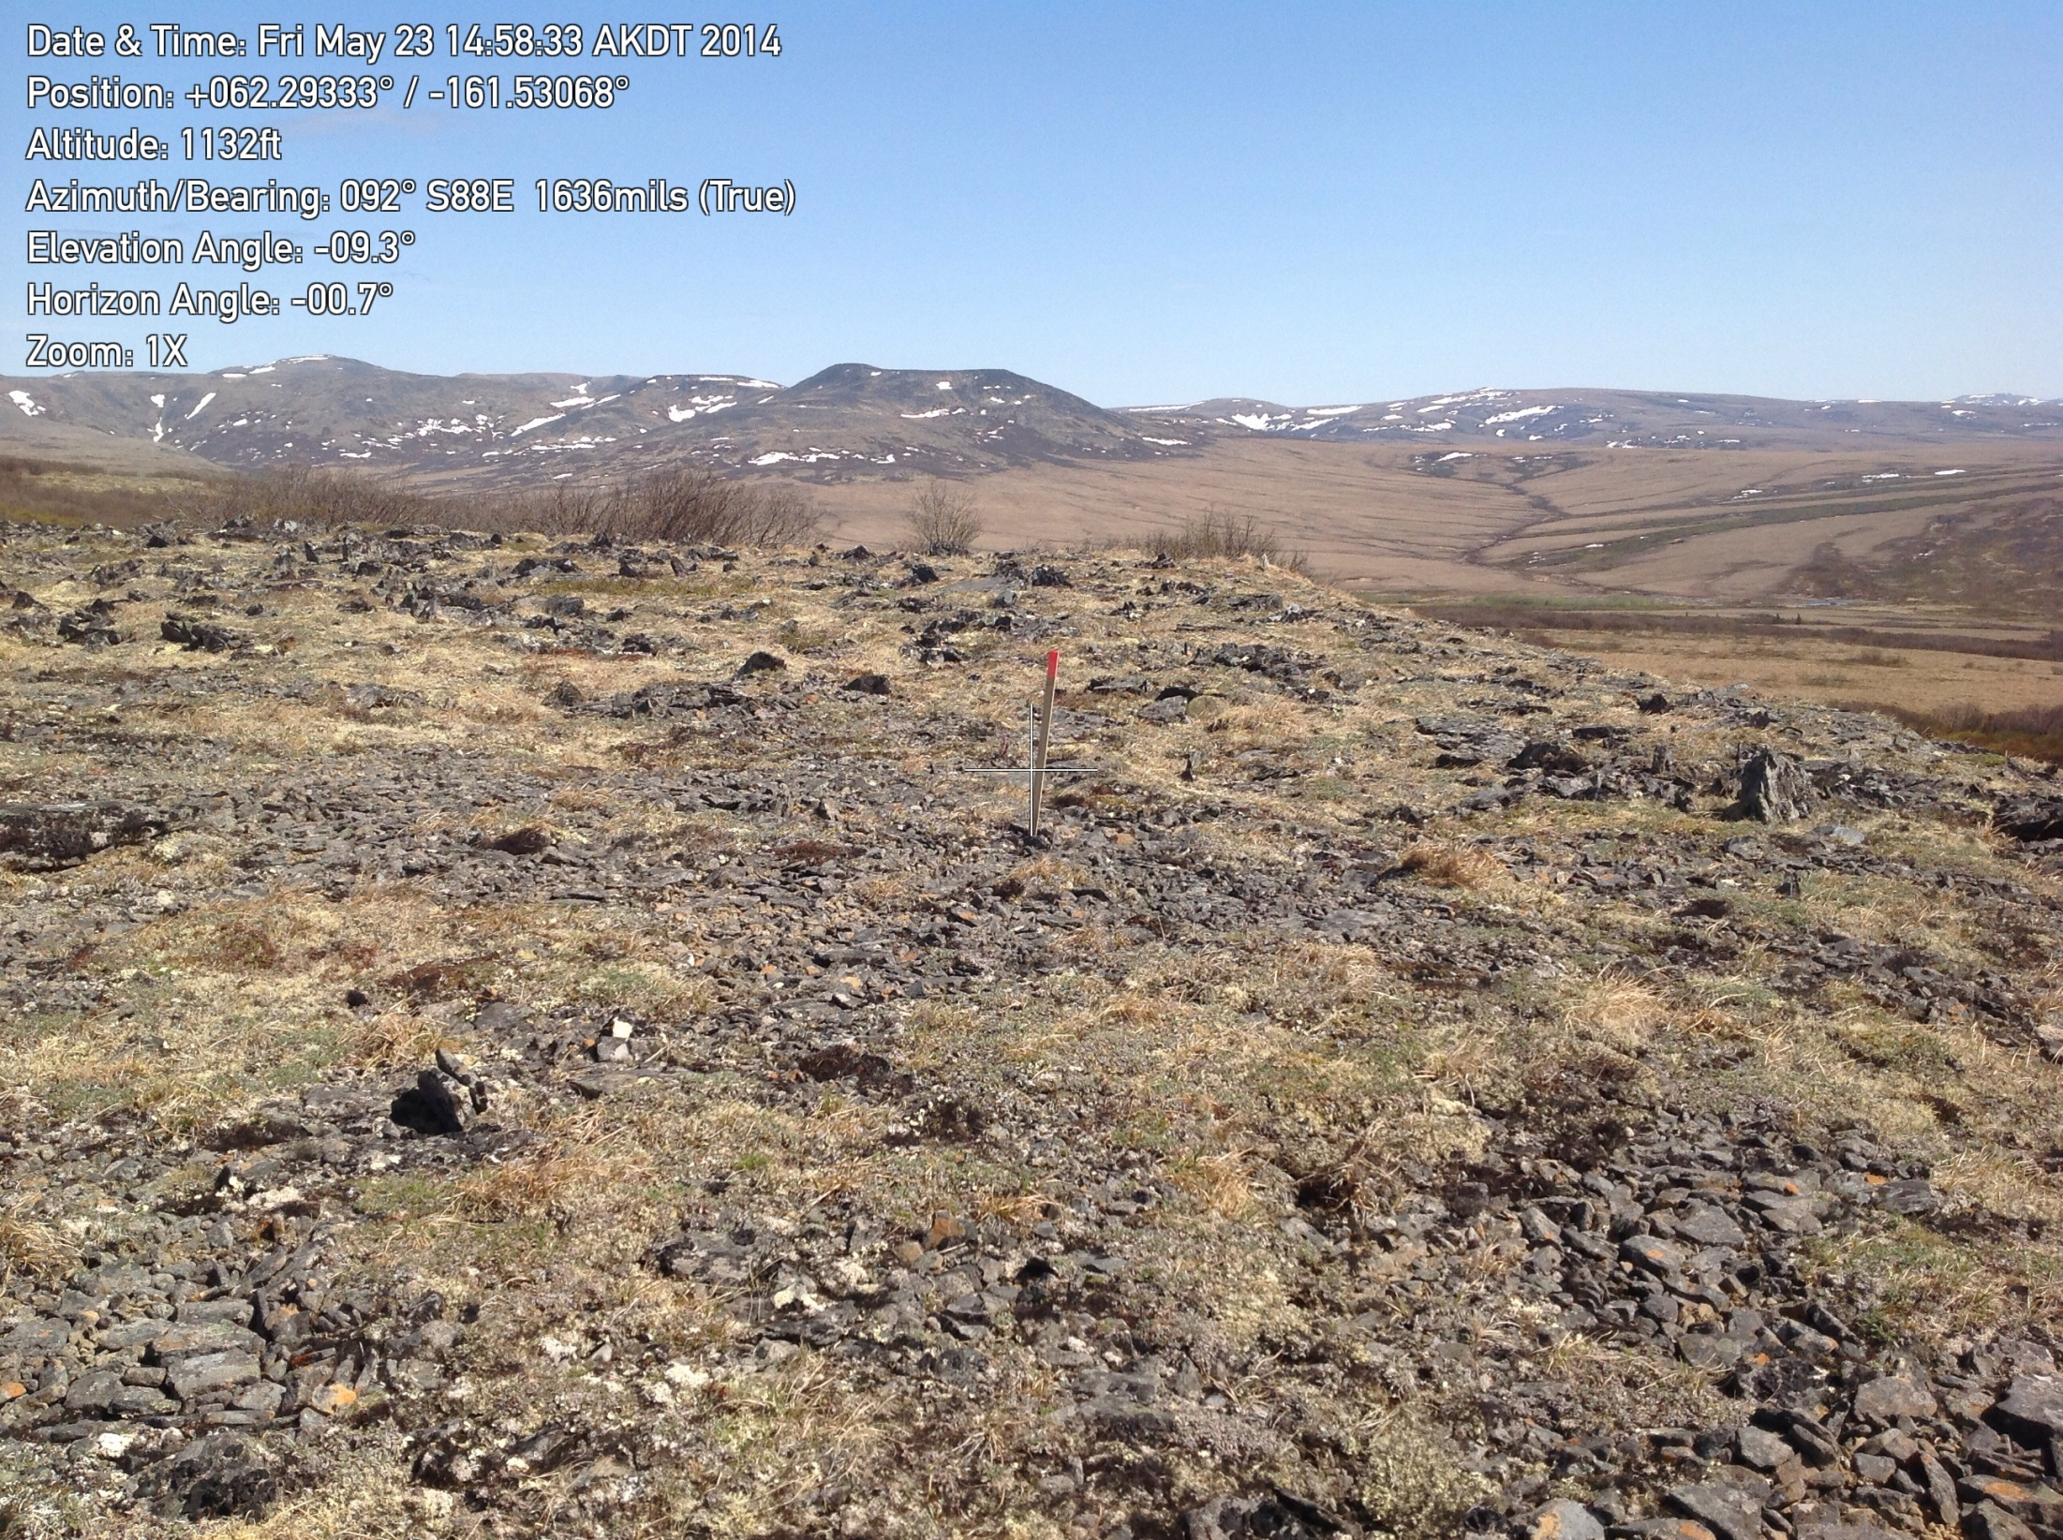
Western

Slide 35
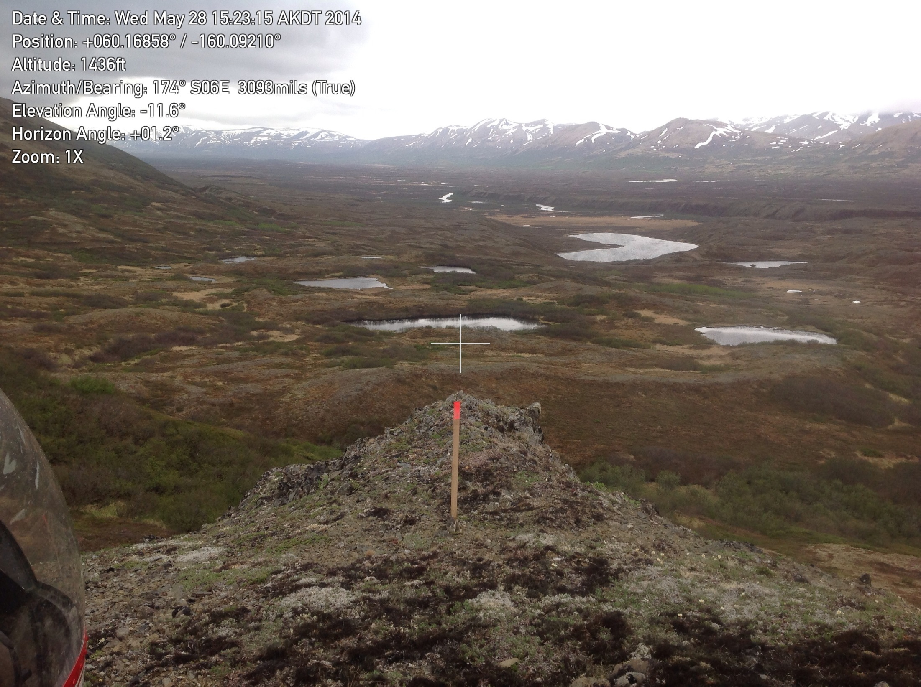
Southwest

Slide 36
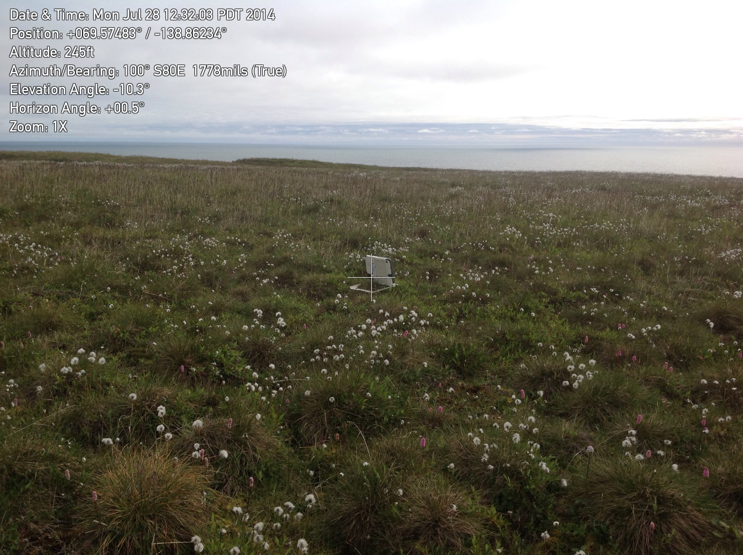
Hershel Island Canada

Slide 37
GOOD LUCK WITH THE INSTALLATIONS

Slide 38
