Slide 1
Twelve Years of the
Transportable Array
The TA All Hands Meeting
November 9-10, 2015
La Jolla, CA

Slide 2
Welcome
12th year of EarthScope – USArray – Transportable Array
9th TA All Hands
Wyoming
South Dakota
Nebraska
Minnesota
Wisconsin
New York
Massachusetts
Oregon
California
A chance to review where we have been, take stock of where we are now, and look ahead to the future

Slide 4
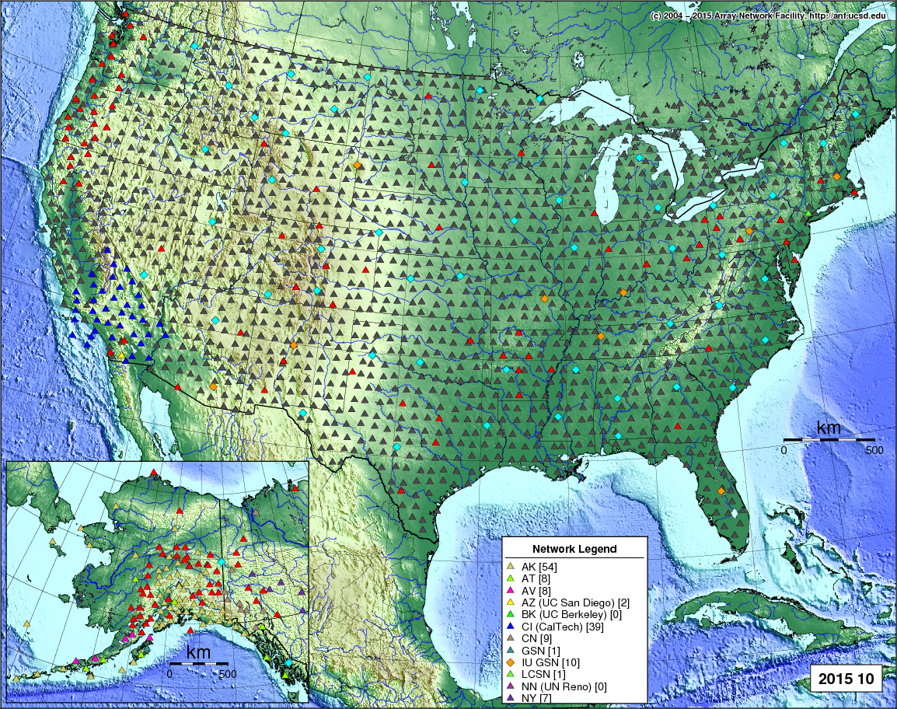
The Lower 48
The TA has left the building . . .
After 12 years and ~1,700 sites . . . The TA has completed its two year deployment at every site in the Lower 48
On time!
Under budget!!
Greg Anderson to Bob Busby:
“CONGRATULATIONS! . . . You and the whole TA team have done a tremendous job, and I hope you'll take a moment to reflect with pride on the hard work you've all done on behalf of the science community.”

Slide 6
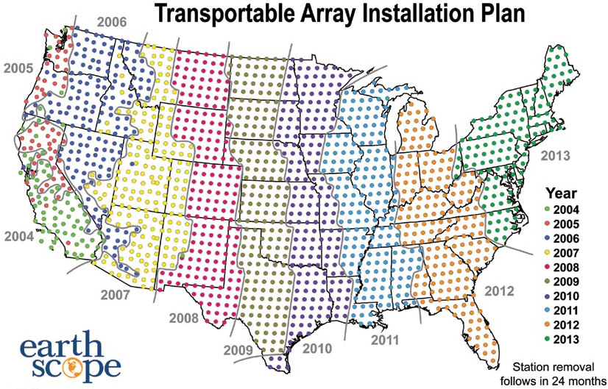
A Ten Year Plan
March 8, 2007

Slide 7
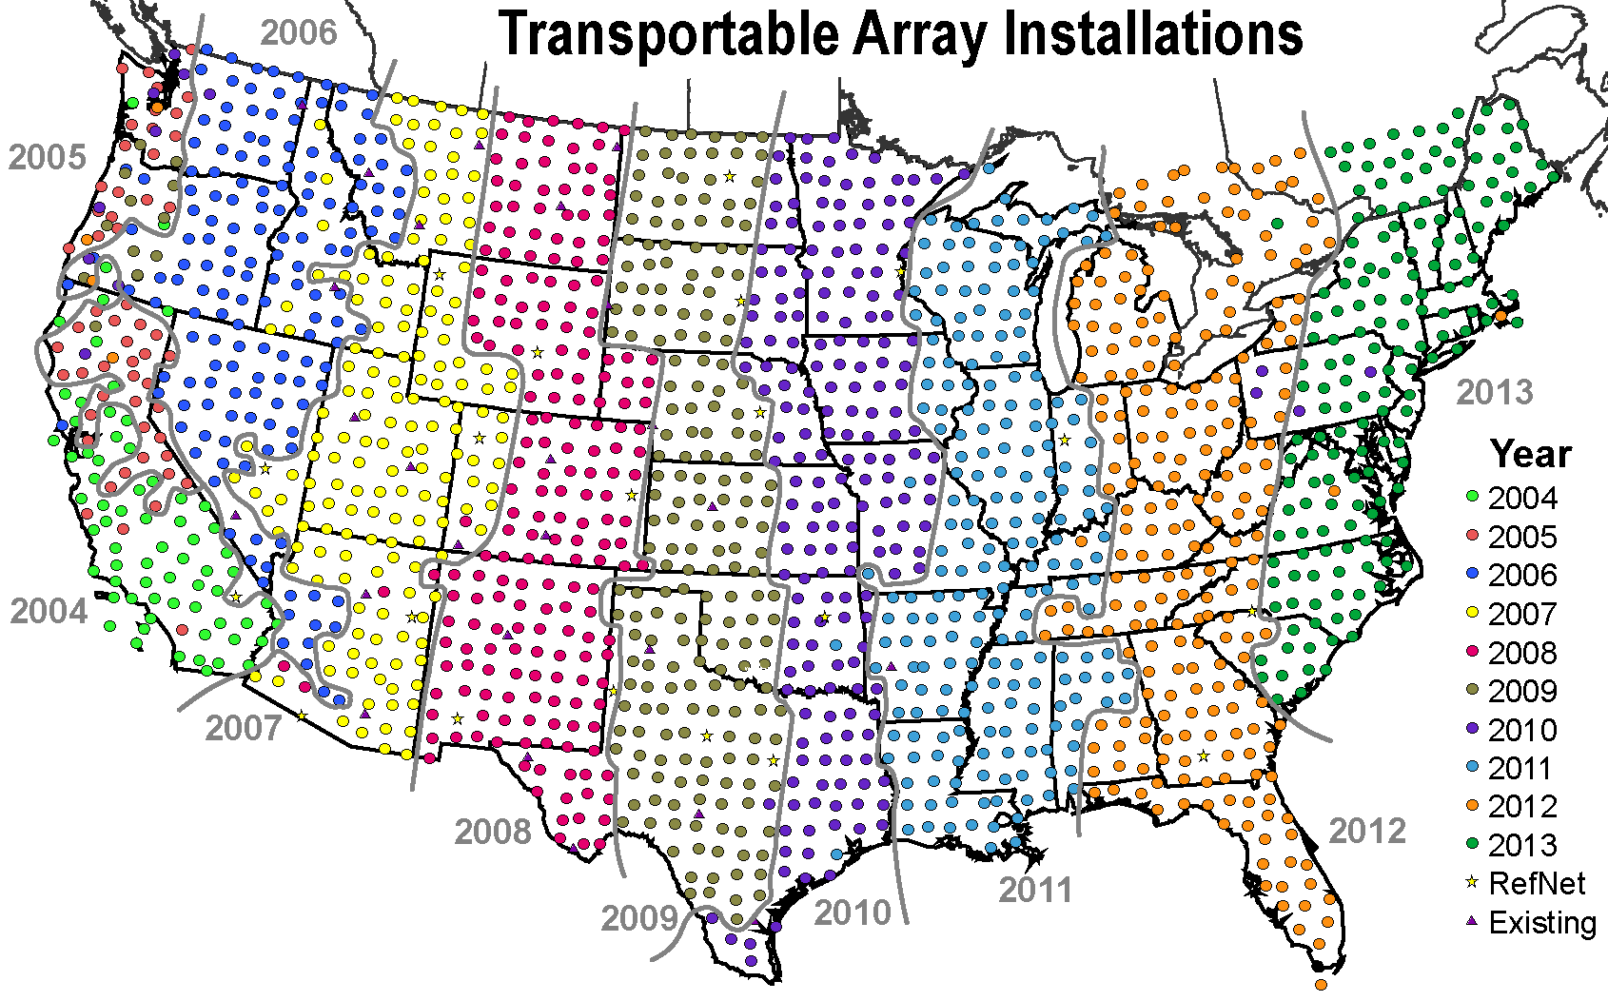
Ten Year “As Built”

Slide 8
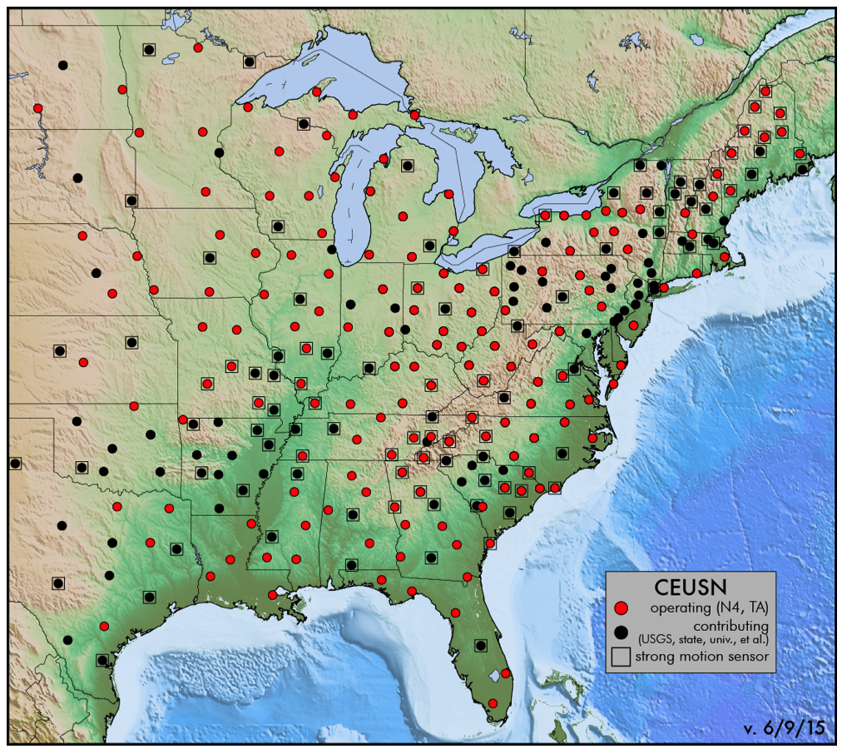
CEUSN
Complete deployment
At full capability – 159 stations
Addresses
Seismic hazard
Monitoring of shaking at critical facilities
Basic science
Multi-agency support
National Science Foundation
US Geological Survey
US Nuclear Regulatory Commission
Department of Energy
A ~$12 M investment by NSF
O&M, a few strong motion installs, maybe replace some leakers, 200 sps capability
The USGS on the CEUSN:
“The CEUSN has become more important to us than we ever imagined when it was created.”

Slide 9
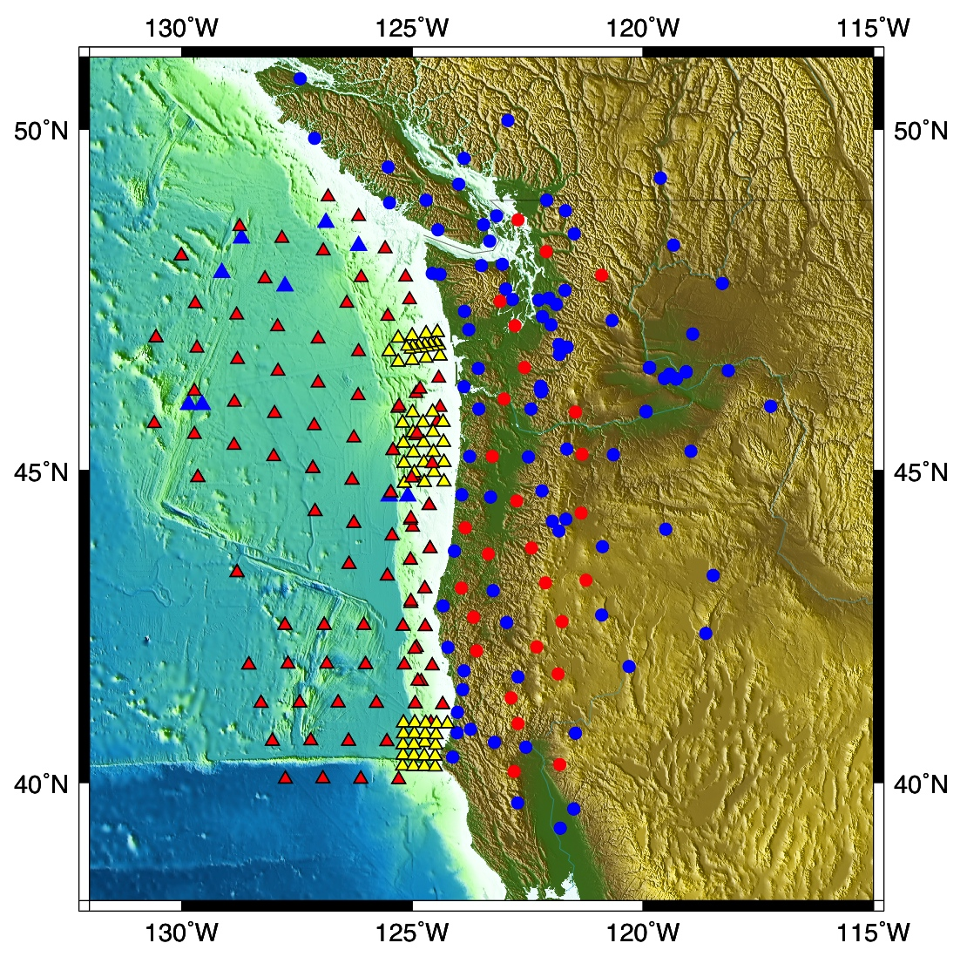
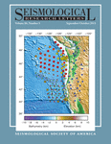
TA in Cascadia
The 27 TA stations anchored the Cascadia Initiative
Experiment complete
Oregon adopting 15 stations
One year of operations for OR, WA, and CA
The Cascadia Initiative was a highly successful experiment . . . It is producing prodigious amounts of high quality data from both land and offshore instruments that are being used to accomplish significant and exciting science.
From the Amphibious Arrays Facilities Workshop Report, 2014

Slide 10
Alaska

Slide 11
A Few Words from our Sponsor
Regarding the TA’s past season in Alaska:
“Despite challenging installation conditions, the team has done well! . . . I am impressed that you could mount this campaign, with all its extremes and unknowns, and come in so close to budget and schedule.”
Dr. Carol Frost, NSF EAR Division Director
“Thanks very much for this report, and to Bob and his team for all their hard work. I'm really excited by the progress to date, especially given the tough environment of work in Alaska.”
Dr. Greg Anderson, NSF EAR EarthScope Program Officer

Slide 12
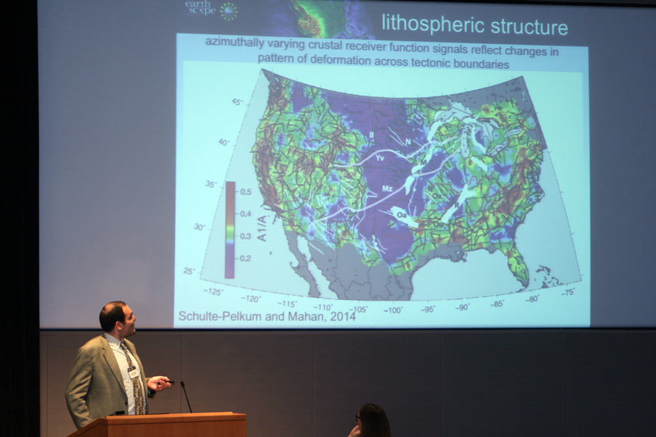
Scientific Impact
Research using TA data continues to pour in

Slide 13
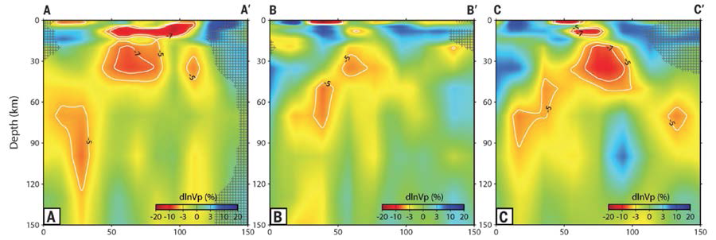
Imaging the Yellowstone Supervolcano
The TA has enabled a whole series of new images of the structure beneath Yellowstone
Huang, H.-H., F.-C. Lin, B. Schmandt, J. Farrell, R. B. Smith, and V. C. Tsai (2015), The Yellowstone magmatic system from the mantle plume to the upper crust, Science, 348, 6236, doi:10.1126/science.aaa5648

Slide 14
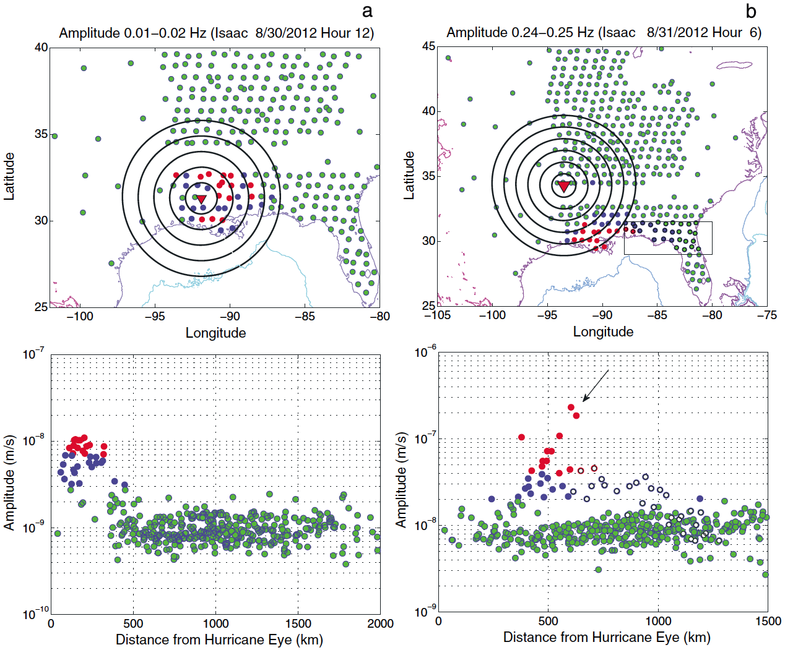
Understanding Major Weather Events
Dense seismic networks can resolve atmospheric behavior
The USArray Transportable Array stations were used to analyze the decay of Hurricane Isaac following its landfall in August 2012
Tanimoto, T., and A. Lamontagne (2014), Temporal and spatial evolution of an on-land hurricane observed by seismic data, Geophys. Res. Lett., 41, 7532–7538, doi: 10.1002/2014GL061934.

Slide 15
Science Impact*
From the TA seismic instruments
107 PhD theses
47 Masters theses
~225 refereed publications! (the gold standard in terms of measuring NSF research
We’ve lost count of the number of conference presentations
From the TA infrasound and meteorological instruments
~ 8 refereed publications using the infrasound and meteorological data
~100 conference presentations
*Special thanks to Frank Vernon and Michael Hedlin for researching and assembling this information.

Slide 16
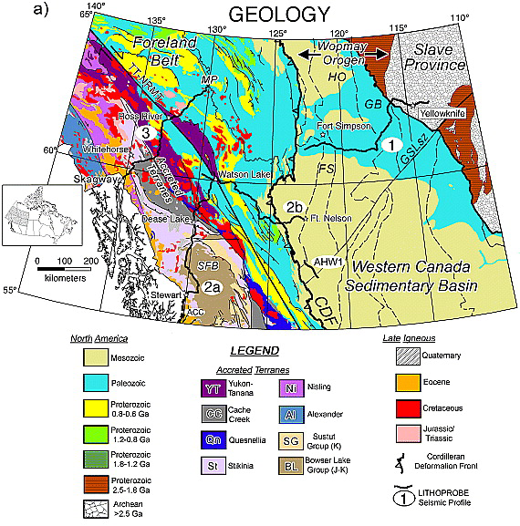
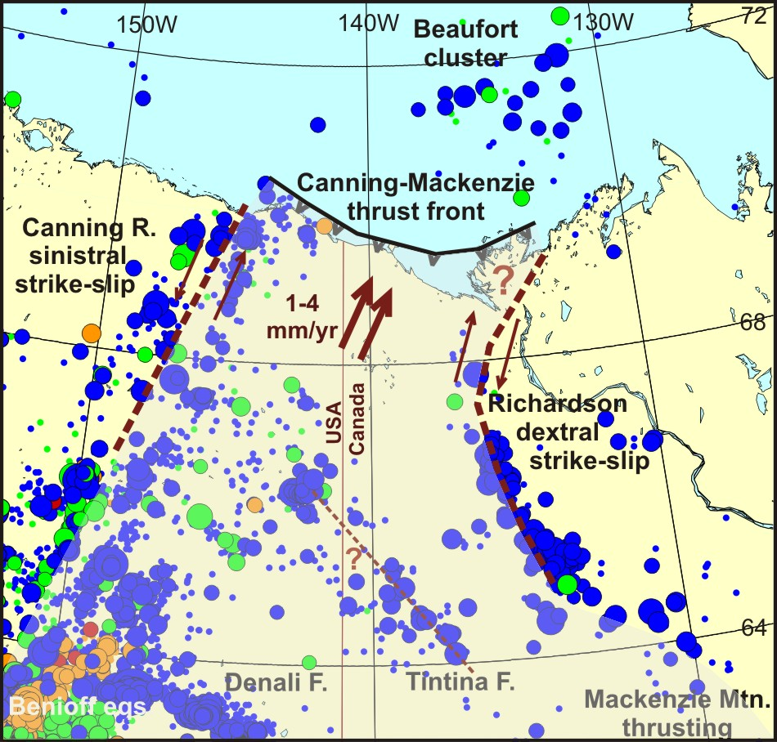
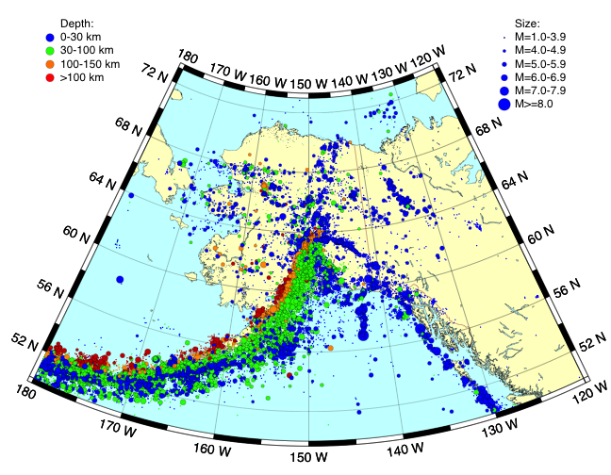
Science Outlook for AK
Alaska deployment will produce transformative results
First order geophysical targets
Extensive seismicity
“Uncharted” terrain

Slide 17
The Flexible Array
The Flexible Array / PASSCAL is focusing in on specific features and continues to concentrate on the Lower 48 and Alaska

Slide 18
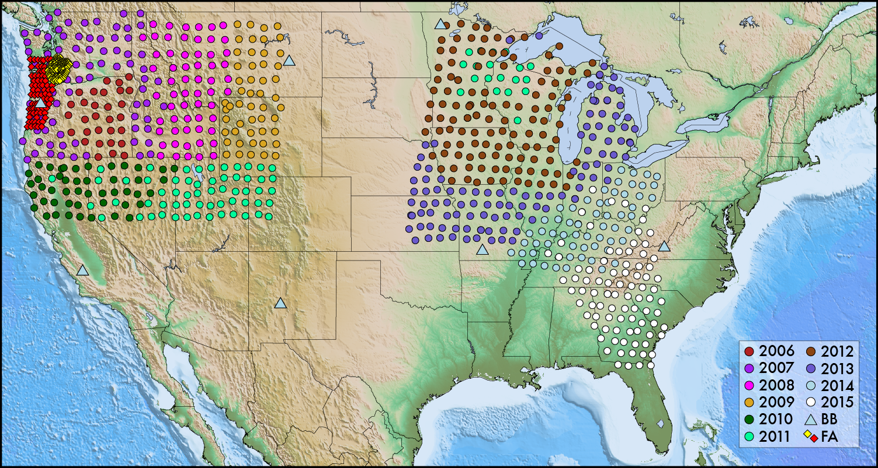
USArray Magnetotelluric Program

Slide 19
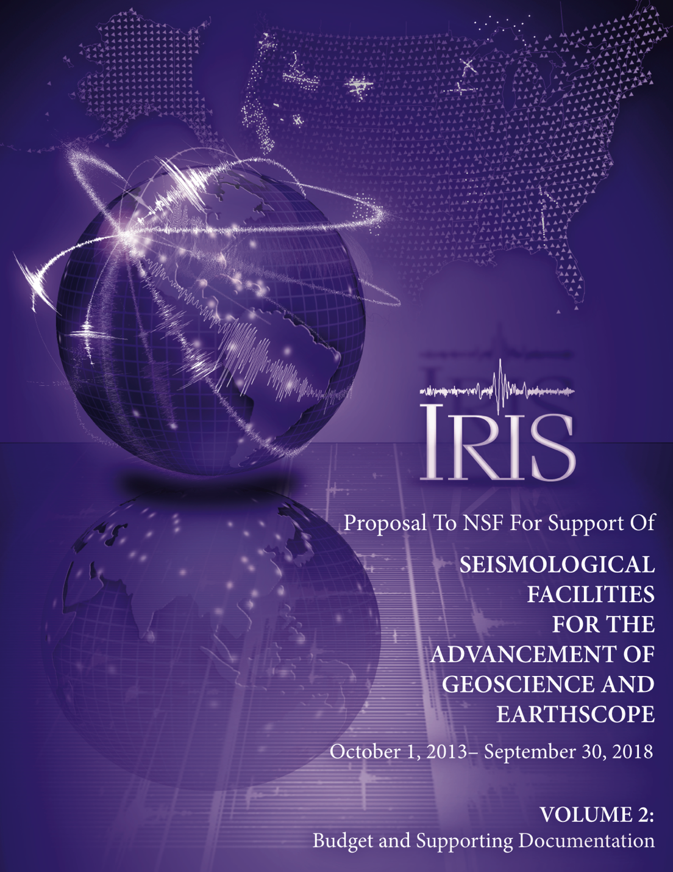
Our Funding and Support
In the third year of a five year cooperative agreement with NSF
Enjoy solid, stable funding from NSF
Budgets are flat – for everyone
“flat is the new normal”
We had to reset our plans a bit
But, we’re still a big project
Clever adjustments means science objectives are not compromised
We (IRIS) are still funded at over $24 million / year of public funding
Solid expectation of stable funding through 2018

Slide 20
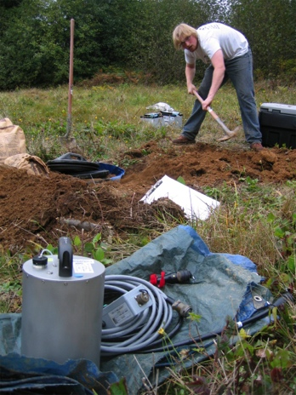
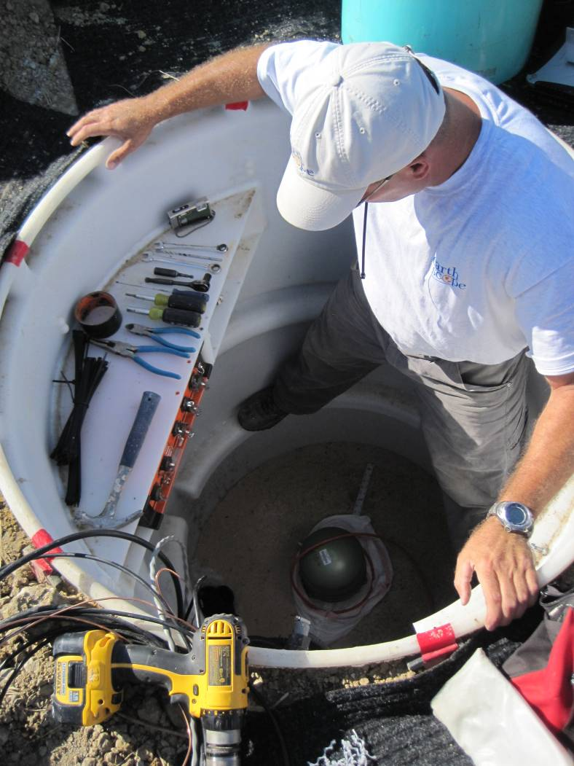
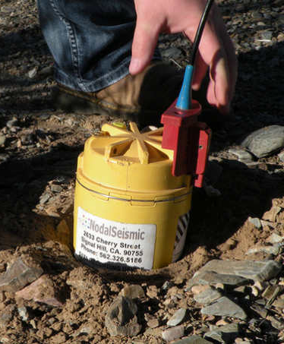
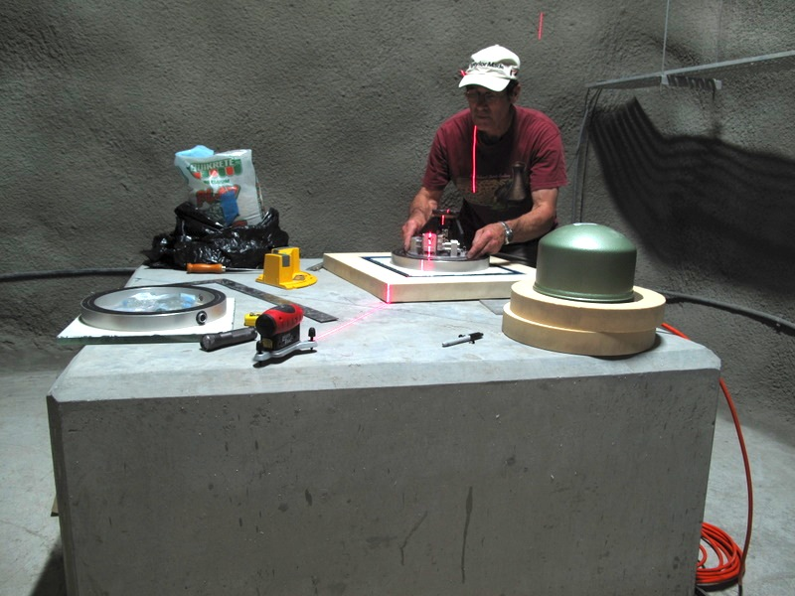
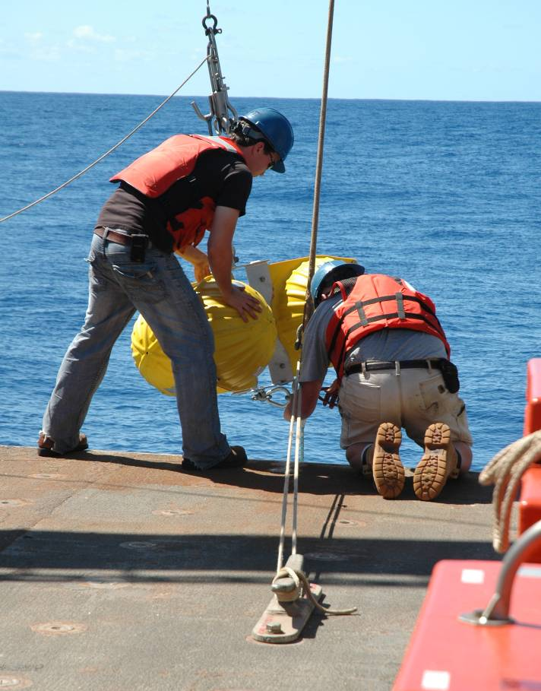
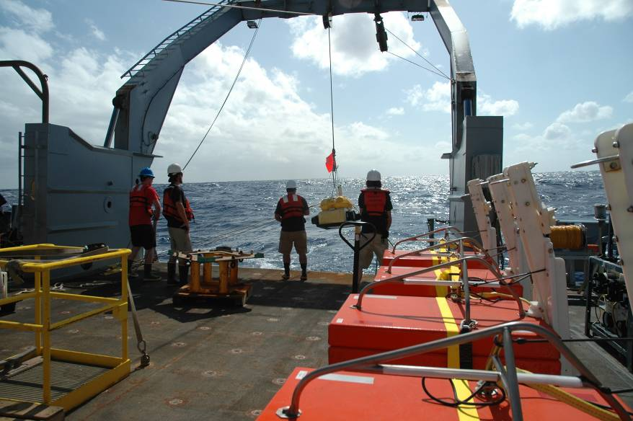
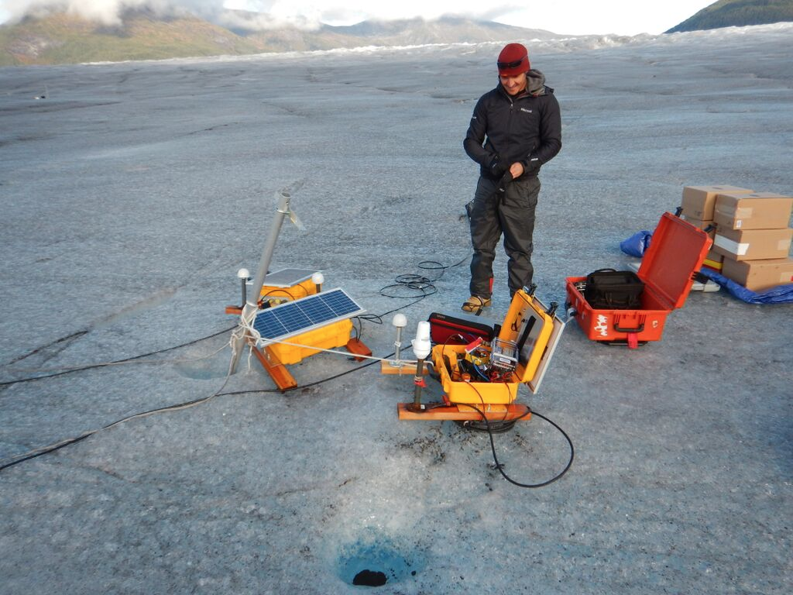
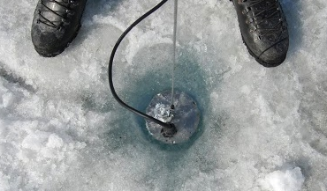
Other IRIS Instrumentation Activities
Temporary to Permanent
Vaults
Temporary
Harsh Environments
Ocean Bottom

Slide 21
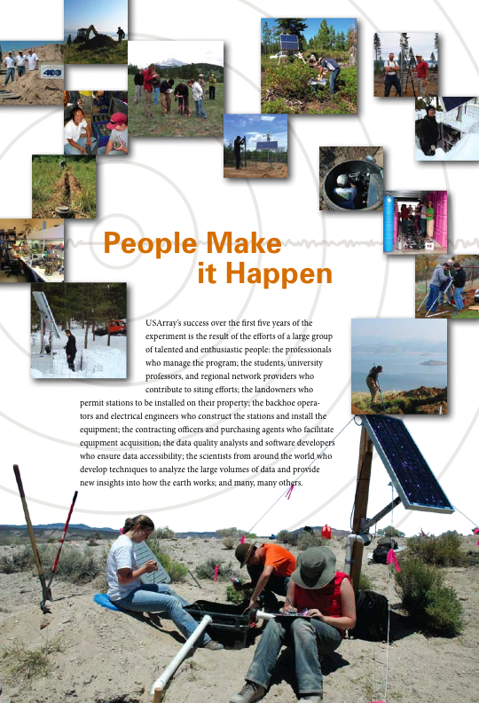
Summary
The TA continues to enable breakthrough science
The Transportable Array has changed the way our field thinks about “big science” projects
The TA has reset the bar for what is possible in large seismic network operations
The TA has been and continues to be a transformative project
The TA team effort has been enormously successful and is widely admired

Slide 22
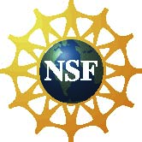
Want More Info?
On the Web
EarthScope
www.earthscope.org
USArray
www.iris.edu/usarray
National Science Foundation
www.nsf.gov
woodward@iris.edu
EarthScope is funded by the National Science Foundation.
EarthScope is being constructed, operated, and maintained as a collaborative effort with UNAVCO, and IRIS, with contributions from the US Geological Survey, NASA and several other national and international organizations.
Notes:
Presentation notes:
1. This slide is required by the National Science Foundation, please include it in all your presentations on EarthScope
2. Please add your institution's logo if it is not already present

Slide 23
L48 Operations
Ongoing O&M of stations
Removals
Re-installs of a few CEUSN stations
Conversions of CEUSN stations

Slide 24
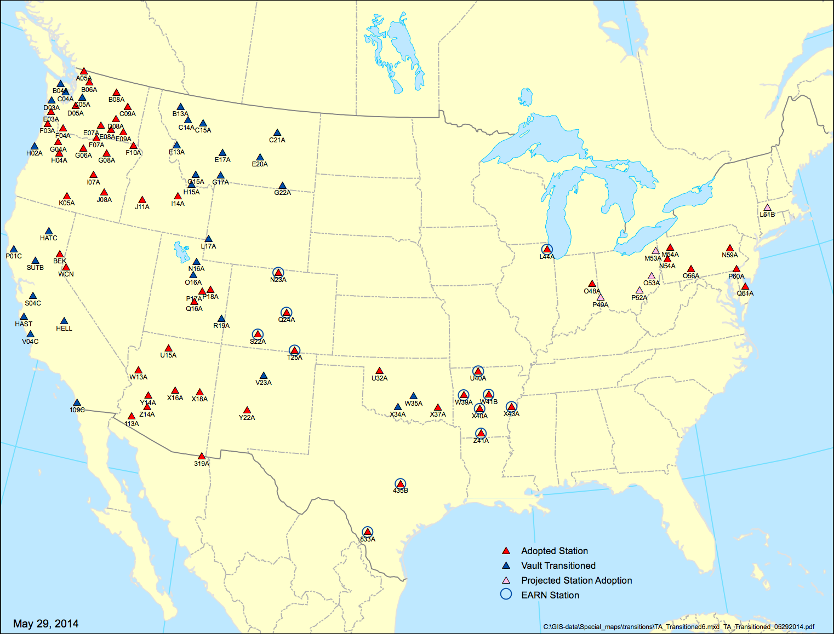
Legacy of Permanent Stations

Slide 25
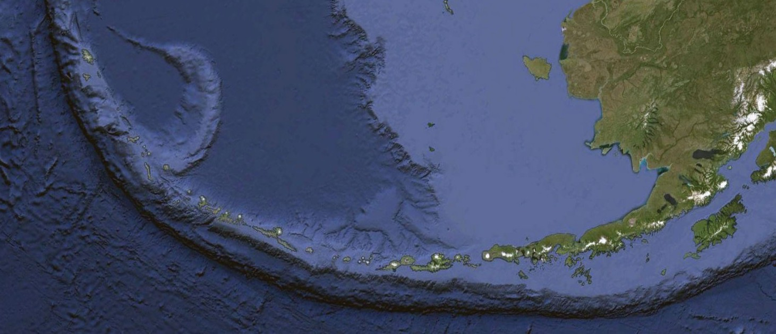
Leveraging the TA . . .
The GeoPRISMS Alaska primary site
The possible redeployment of the Amphibious Array
Into the future . . . A Subduction Zone Observatory?

Slide 26
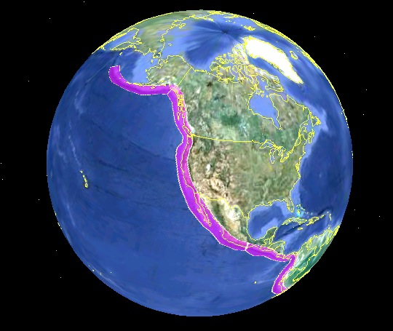
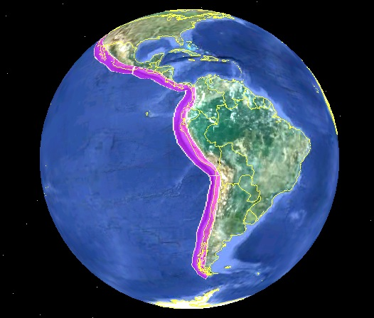
Subduction Zone Observatory
A coherent, structured, multi-disciplinary observatory along the length of the eastern Pacific
From IRIS presentation at EarthScope meeting, 2013

Slide 27
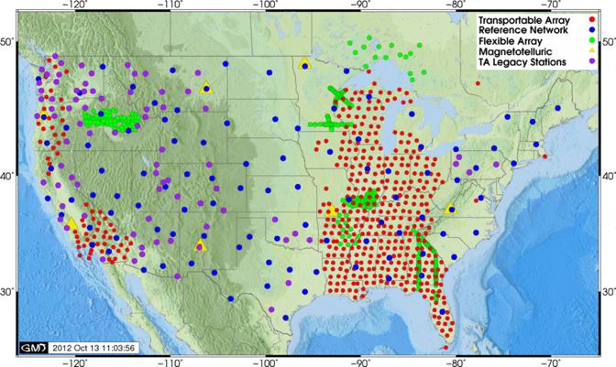
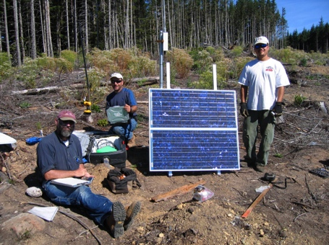
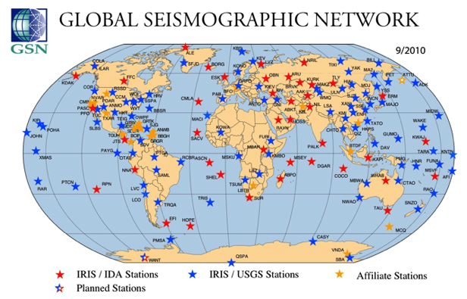
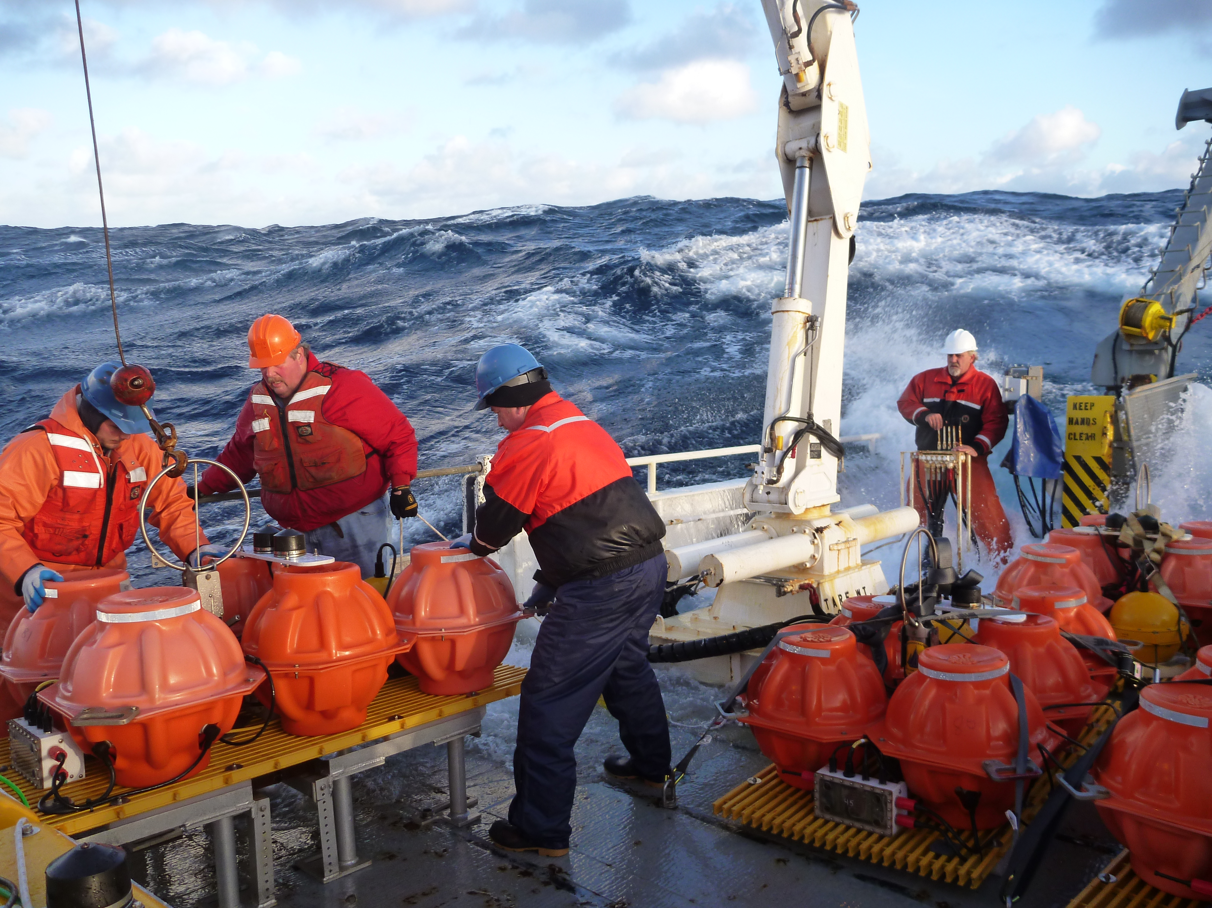
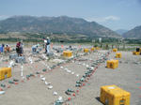
Multiple Observing Programs
Continental Scale
Meters to Basin Scale
Global Scale
Oceans
Science drives approach, scale, frequency band
Notes:
Show TA movie? Show rotating globe with stations or cover image from the last proposal with 3D image of earth.
Images must convey facility to uninformed audience.
3D GMV?
40 year seismogram
Alternative concept something like IS collage in last annual report.

Slide 28
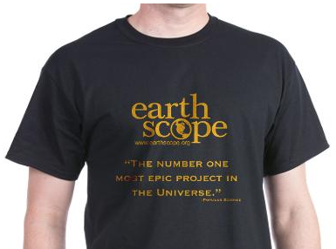
Our Reputation
NSF is funding us – the best compliment
But, we enjoy support and visibility at the highest levels of NSF
The Director of NSF and the Director of GEO both attended the our Decade celebration

Slide 29
Wavefields at Other Scales . . .
Building on the success of the TA
The “Wavefields Initiative”
Inspired by:
The TA’s dense sampling at the continental scale
Oil industry sampling at the super fine scale
Excitement has carried over to other scales and targets
Long Beach, CA
5000 receivers, 100 m spacing
5x7 km area
Nodal Seismic, Inc. and Signal Hill Petroleum

