Slide 1
Tomography Model Comparison
Andrea Gallegos
Maeva Pourpoint
Mostafa Mousavi
Kevin M. Ward
IRIS EarthScope Advanced Short Course 2015

Slide 2
Goal
Compare differing tomography models in order to report a quantitative measure of similarity.

Slide 3
Motivation
We want to be able to report which features in a tomography image are robust across different models and which are not.
Areas of high disagreement may indicate the presence of artifacts in one or both models that are being compared.

Slide 4
Example Tomographic Models
IRIS earth models can be found in NetCDF format at https://ds.iris.edu/ds/products/emc-earthmodels

Slide 5
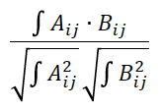
2D Cross Correlation
Cross correlation is a measure of the similarity of two sets of data. In this case we are measuring the similarity of two tomographic models.

Slide 6
Work Flow
Download model from IRIS EMC-Earthmodels.
Format the data to be input in cross-correlation.
Plot the resulting correlation in order to visually inspect pattern similarity.
Conclude which features are statistically robust.
Execute a statistical significance test.

Slide 7
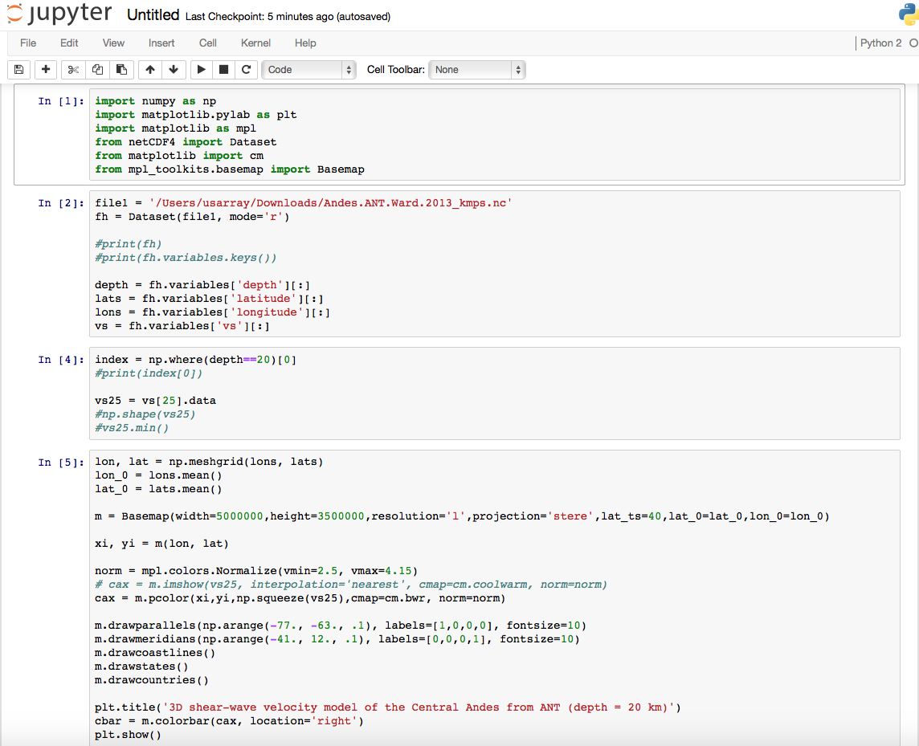
Successes

Slide 8
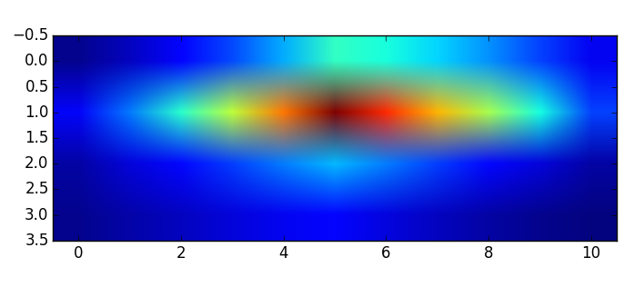
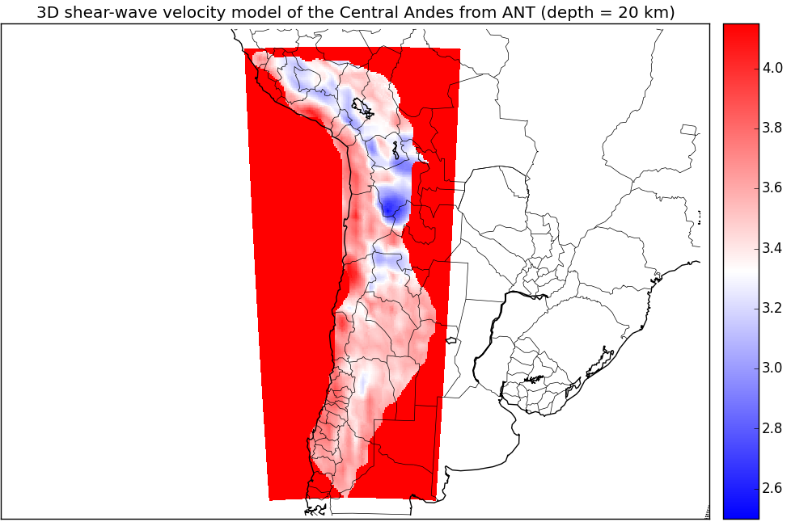
Successes II
[[ 30 89 176 290 430 595 550 482 392 281 150]
[ 156 342 556 796 1060 1346 1160 956 736 502 256]
[ 30 61 92 122 150 175 130 90 56 29 10]]

Slide 9
Suggestions for Implementation
Mathematical techniques?
Computational approaches?
i.e. Languages, GUI or no GUI, etc.
Other applications?
i.e. Gravity models?
Usefulness?

Slide 10
Acknowledgments
Thank you to IRIS DMC, Indiana University, and all the instructors!

