Slide 1
OK Wavefields: Reflection Image from an earthquake record
Diego Quiros¹, Nishath Ranasinghe²
¹Baylor University
²University of new mexico

Slide 2
Why dense arrays rock?
The close station spacing allows identification of more seismic
phases than would be possible with a conventional aftershock network.
Quiros et al. 2017

Slide 3
What are those arrivals?
Using simple travel time modeling of an aftershock we argue that these arrivals most likely correspond to reflections from subsurface interfaces.
Quiros et al. 2017

Slide 4
Reflection imaging with earthquakes: A history
A few studies have attempted to use the tools of common midpoint (CMP) processing to image reflectors illuminated by local seismicity.
However, their strategy to time-shift the events to the surface (i.e. statics) and apply CMP stacking is not appropriate for sources at depth.
Quiros et al. 2017

Slide 5
Difference between CMP and VSP processing
Quiros et al. 2017

Slide 6
Applying the VSP mapping to a synthetic record
Quiros et al. 2017

Slide 7
A more robust VSP transformation
Quiros et al. 2017

Slide 8
VSP transformation for multiple events: Stacking
Quiros et al. 2017

Slide 9
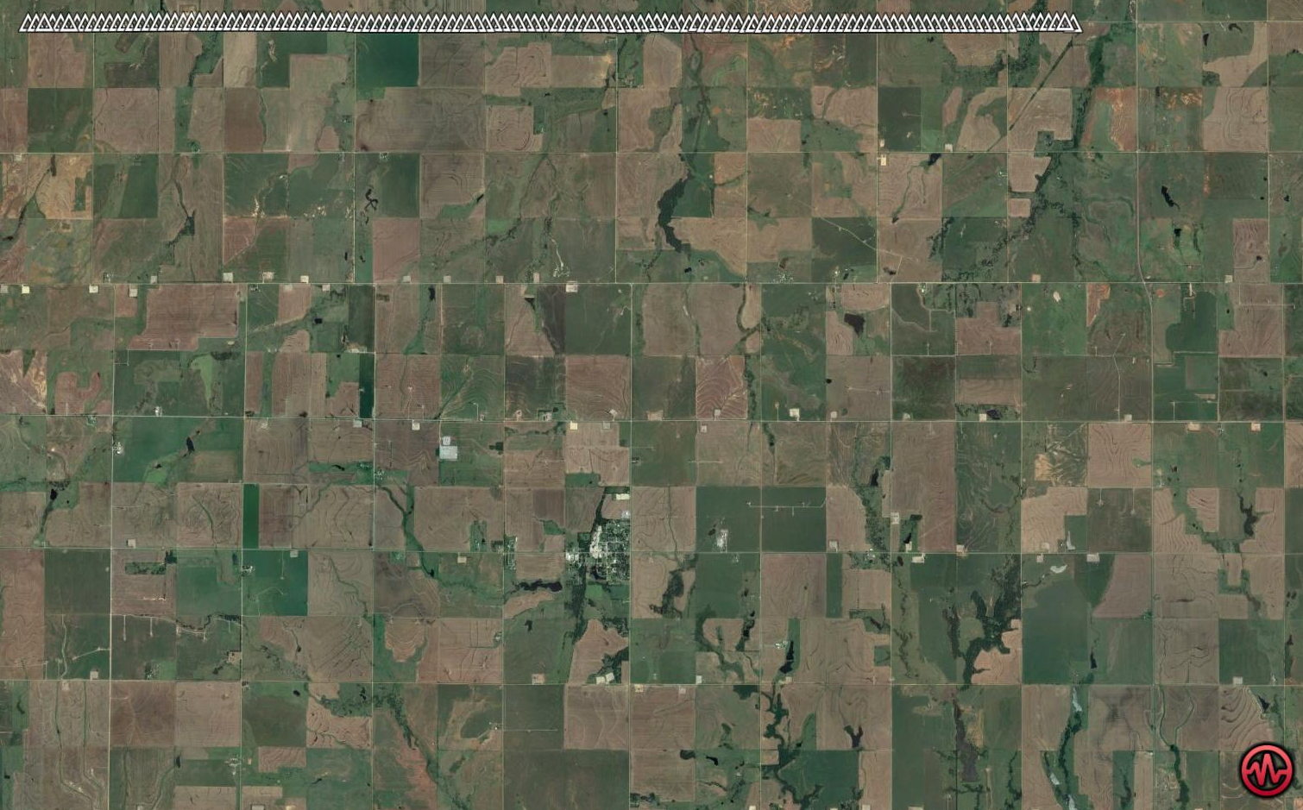
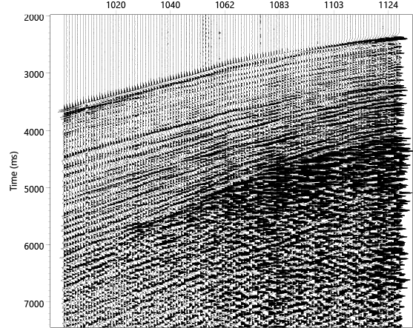
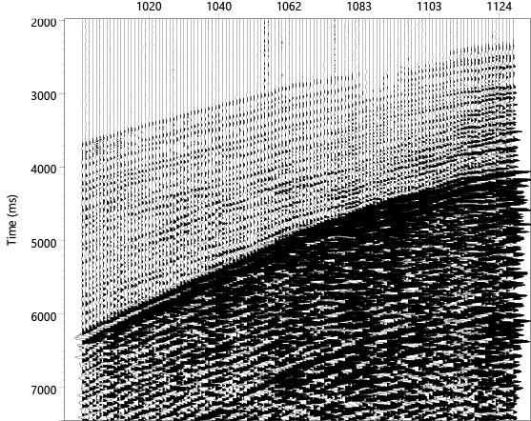
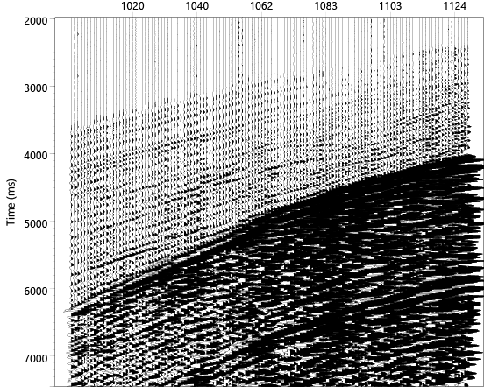
Oklahoma M 2.8 event
Lat Lon uncertainty : ± 1.4 km
Depth : 9.1 ± 7.4 km
Vertical N-S E-W

Slide 10
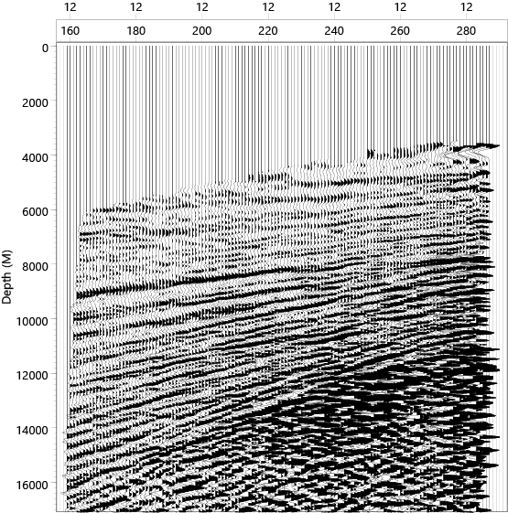
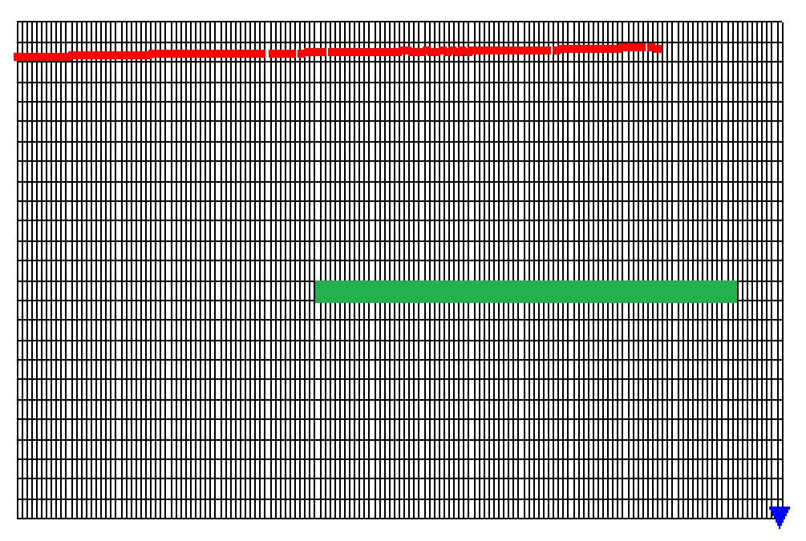
VSP transformation for Oklahoma event

