Slide 1
Broadband Array
Processing of SH-wave
Data using superarrays
Michael S. Thorne
University of Utah
Nicholas C. Schmerr
NASA Goddard
Notes:
What I’m going to talk about today is some experiments that Nick Schmerr and myself have done with array processing of SH-wave
Data using the HLP flexible array experiment as a seismic array.
Many people have worked on array processing of deep mantle seismic phases, such as ScP or PcP, using short period veritcal component seismic arrays such as Yellowknife. But, I haven’t seen much efforts at array processing with broadband arrays – or S-wave data for deep mantle structure. Recently I know Tine Thomas has been working on some of this.
We haven’t done anything really fancy. Just standard beamforming and simple migration of data that we already rotated to the transverse component.
These flexible array type experiments make a good test case for what one can do with array processing techniques to look at small scale discontinuity structure in the deep Earth. I will discuss a couple of the experiments we have done, (1) with respect to D” discontinuity strucutre, and (2) w.r.t. to a laterally variable discontinuity at about 300 km depth.
I will wrap up with some thoughts I have on global arrays of arrays.

Slide 2
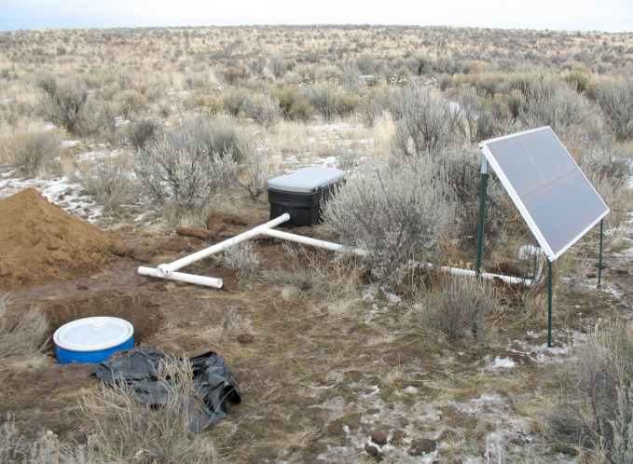
High Lava Plains (HLP) Flexible Array
Final Array: 118 broadband stations
Deployment: ~ 2006-2009
Station spacing: ~ 20 km
Aperature: ~400 km NW-SE line.
http://www.dtm.ciw.edu/research/HLP/
Notes:
In these experiments we have used the HLP flexible array as our array.
The HLP experiment was deployed from ~2006-2009 and consisted of a total of 118 broadband sensors.
The station spacing averaged about 20 km, with a total aperature around 400 km.
The center of the array was located in eastern oregon and stretched over a little into idaho and nevada.
The setup of each station was done as sort of a typical PASSCAL type of experiment – as shown in this picture.
The station deployment was in the form of a X. I shown the Array response function to the right. This array provides
Pretty good slowness resolution for most backazimuths – except we see a line of smearing around 80 or 260 deg. This is
Understandable as in this direction across the array we haven’t a large aperature of sensors.

Slide 3
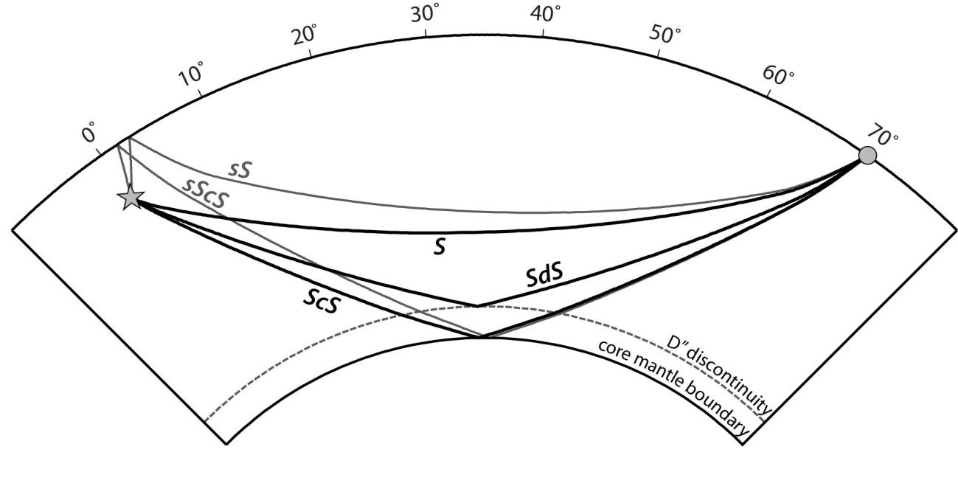
Scd Array Processing - Data
Notes:
OK, first I’m going to talk about searching for the D” discontinuity.
The D” discontinuity is a laterally variable discontinuity characterized as being roughly 150-300 km above the base of the CMB with
An S-wave velocity contrast on the order of 1-3%.
In particular its existence is inferred from the Scd arrival which refracts and turns just below the discontinuity. It is referenced to the the direct S-wave arrival and the core reflected ScS arrival.

Slide 4
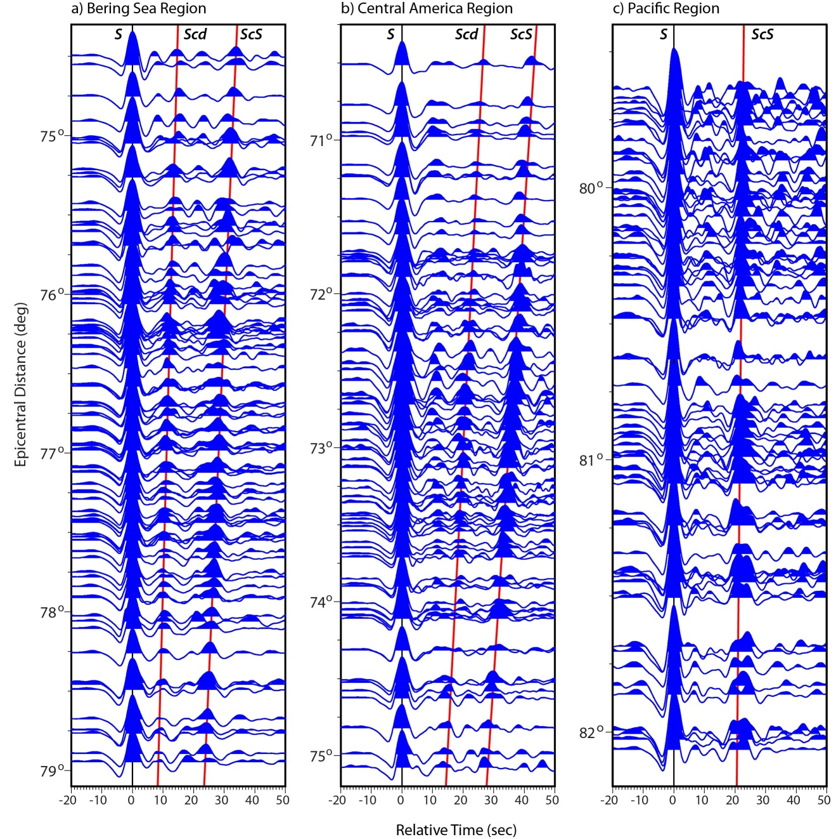
Scd Array Processing - Data
Transverse component
displacement seismograms.
Up to 94 traces used in a
single event.
Other stations also used if
within HLP circumference.
Aligned and normalized to
unity on direct-S.
BP filtered 1-20 s.
Notes:
Here are some examples of data from events in
Japan (ScS bouncepoint beneath the Bering Sea)
S. America (bps in Central America)
Tonga-Fiji (bps in Pacific Ocean)
All data are transverse component displacement seismograms aligned in time on the direct S-wave arrivals.
These data were bp filtered between 1 and 20 sec.
In addition to the HLP stations we also used any data from any station within ~2.0 deg of the array centroid.
For these data we used a maximum of 94 stations for any given trace. Of course, these are some of the finest events
And we can clearly see additional arrivals between S and ScS without any further processing, which speaks to the high
Quality of these HLP data to begin with.

Slide 5
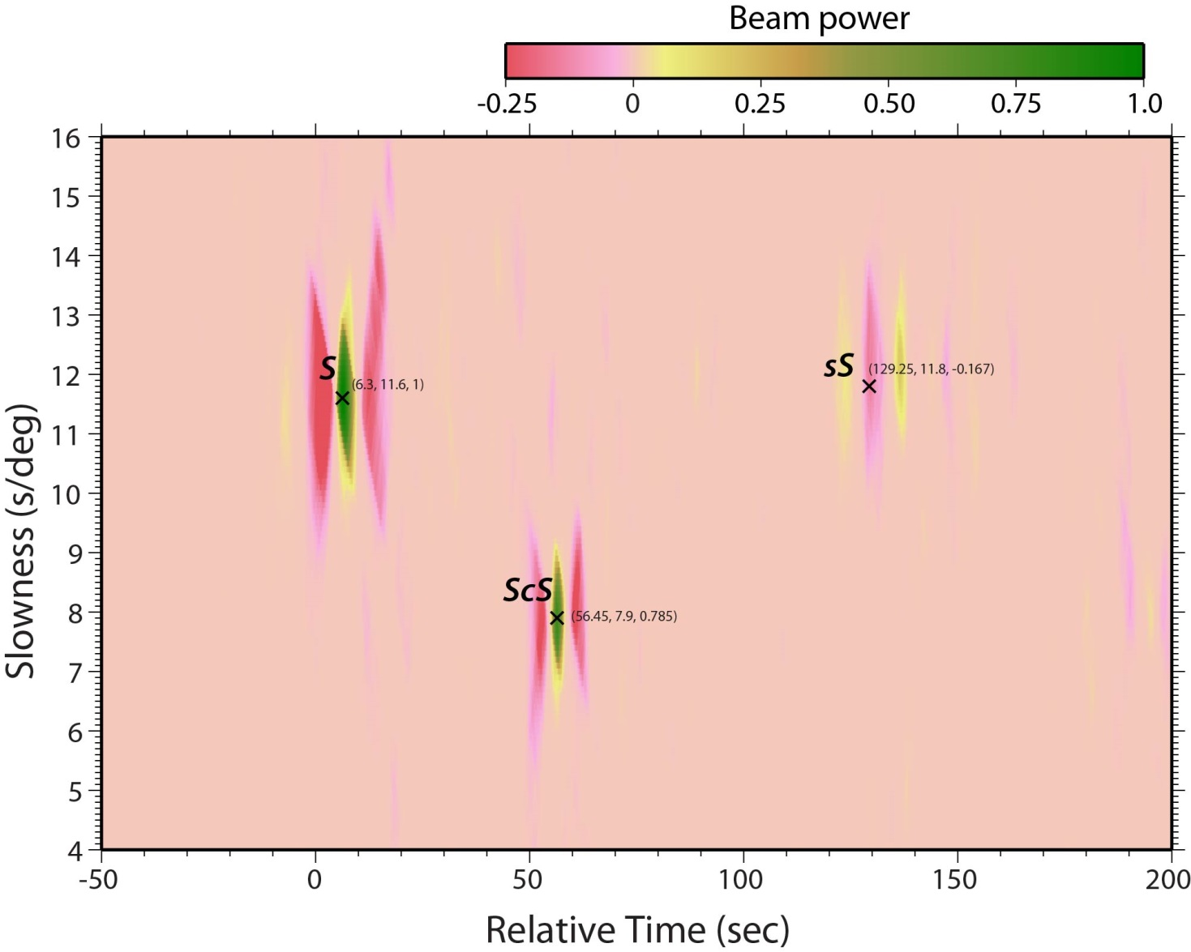
Scd Array Processing - Vespagrams
200806292053
Notes:
Some of these are really simple. Just, S, ScS, sS in this time window.

Slide 6
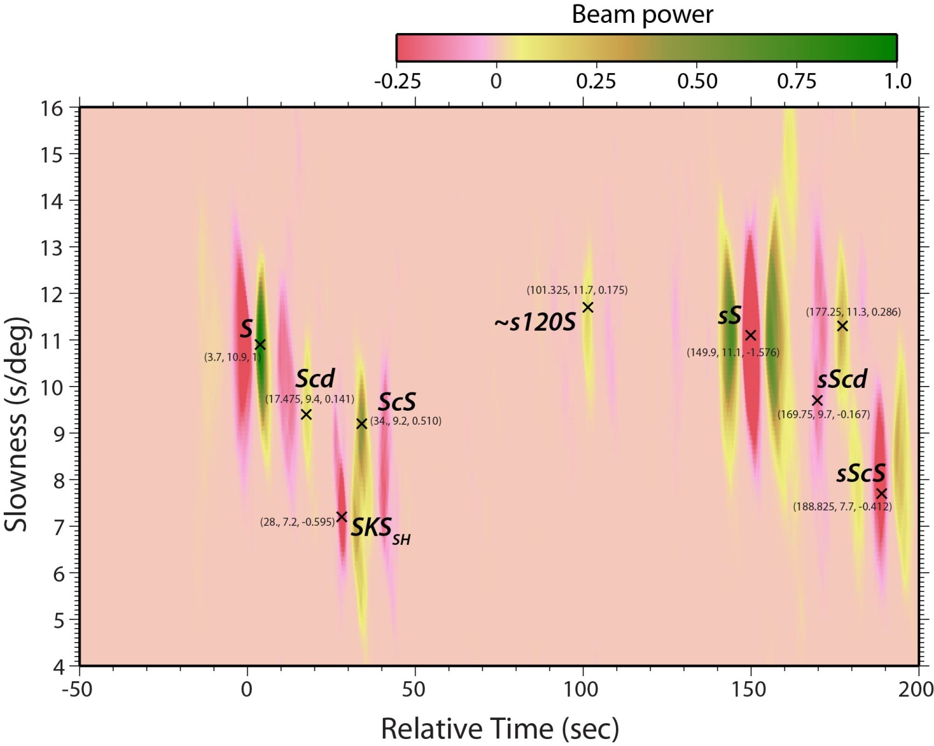
Scd Array Processing - Vespagrams
Notes:
Here is the vespagram of that previous event. I Have highlighted the major phases.
This plot shows beam power (colored) as a fuction of time and slowness. In these plots slowness varies from 4 to 16 s/deg
Or you can think of it as the angle at which the energy is coming up to the array.
For low slownesses the rays are coming up at steeper angles.
For this event we see clearly S and ScS coming in at the appropriate time and slownesses. Also, sS and sScS.
At least for this event there is a strong Scd arrival at intermediate time and slowness between ScS and S.
Here, we also see a sScd arrival.
The arrival I highlighted on the previous image shows up quite clearly on this vespagram and has a slowness similar to sS,
Suggesting that this is a bounce from an underside discontinuity. Just running some travel-times through TauP suggests a
Reflector at a depth of approximately 120 km.
I also note there is strong shear-wave splitting beneath oregon and we often see some SKS energy (in both the vespagrams and raw data on the transverse component). Also, other arrivals – like this one which must be a reverberation after sS.

Slide 7
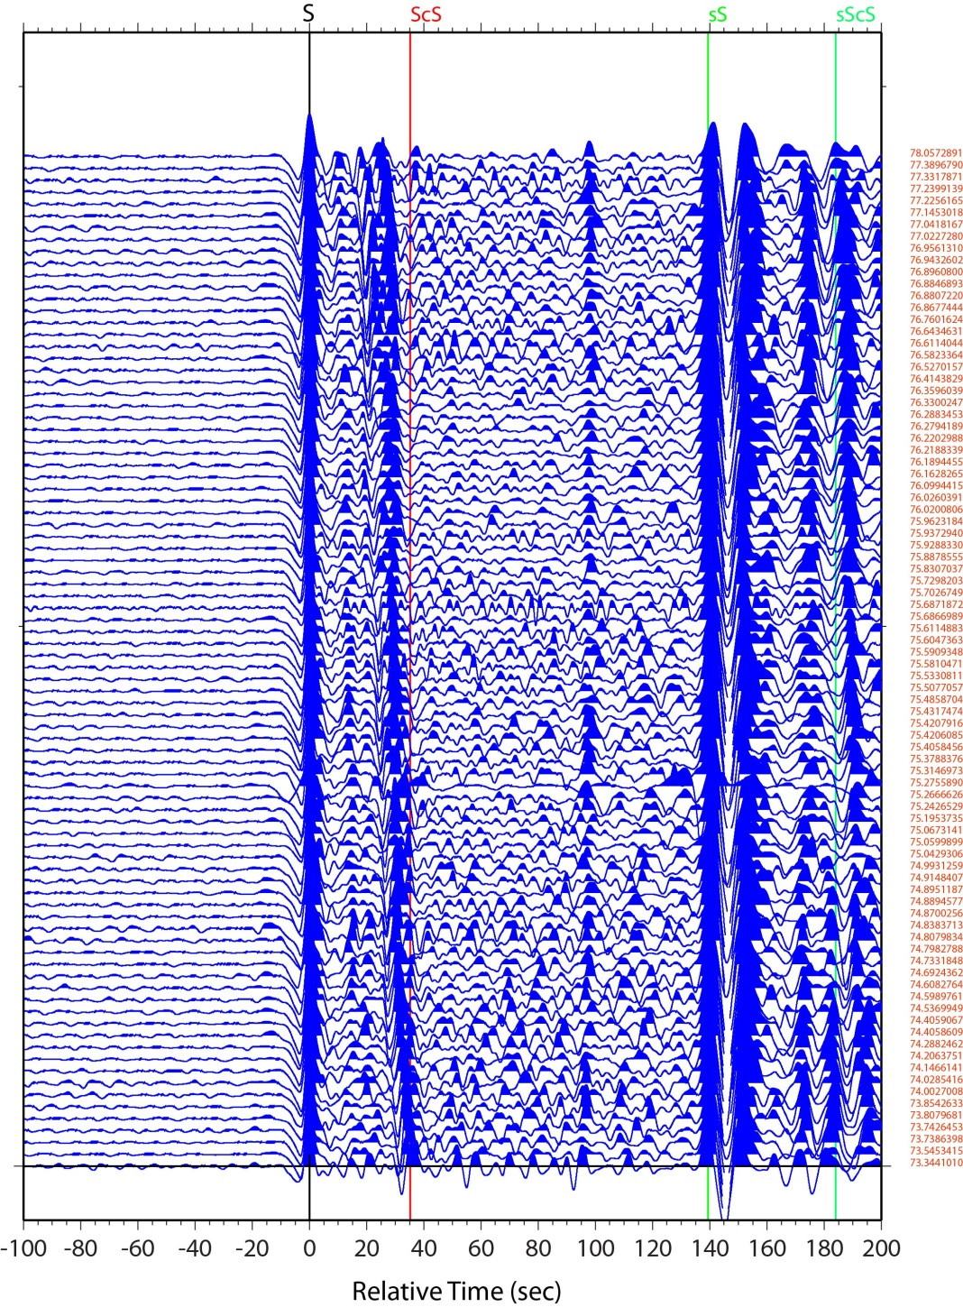
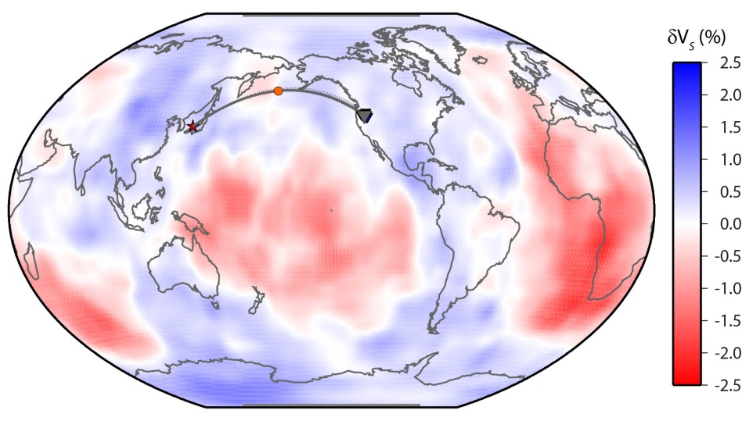
Scd Array Processing - Data
Event: 200707161417
Depth: 350 km
Mw: 6.8
Avg Distance: 75.6 deg
Notes:
Here’s another way of looking at these data. This is just for a single event beneath Japan.
Instead of showing a distance section I just show the individual records, sorted by distance, one of the ways
I look at these data to ensure I don’t have any funny traces that might mess up any later processing.
We can clearly see the S and ScS arrival here. At later times we see sS and sScS, but even looking at just these
Raw traces we can start seeing some interesting stuff…

Slide 8
Scd Array Processing - Data
Event: 200707161417
Depth: 350 km
Mw: 6.8
Avg Distance: 75.6 deg
Notes:
In case you haven’t spotted it.
So, we can beamform these data on different slownesses…

Slide 9
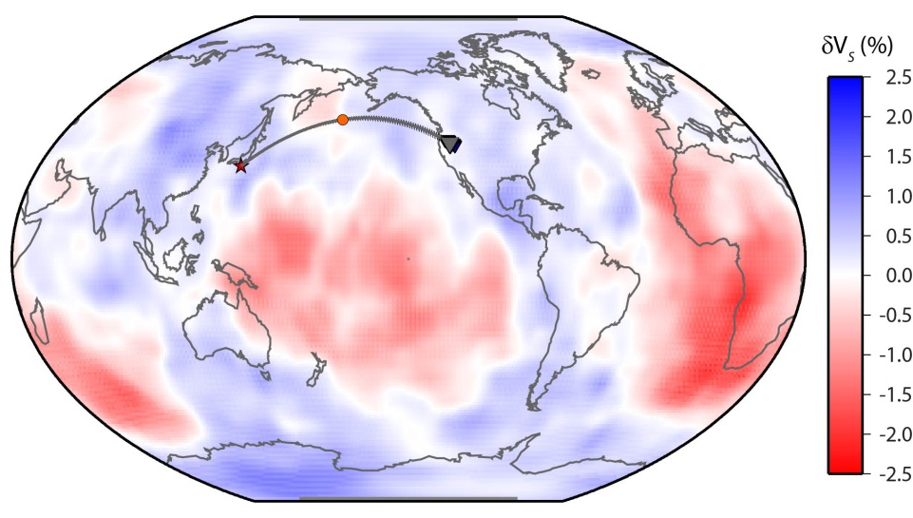
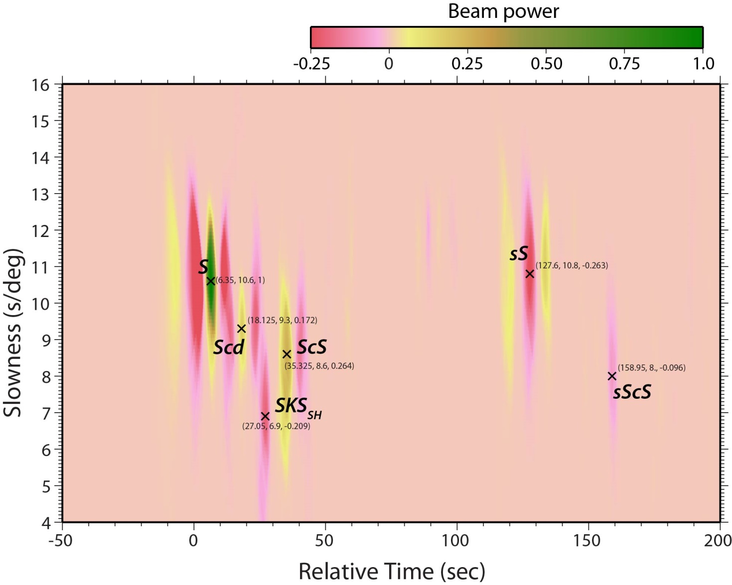
200908091055
Notes:
Here’s another example. Not as nice of an event in the raw data as the previous one, but
Still pick out Scd arrival at about same time and slowness and some hints of energy around 120 km depth.
But shows the consistency of the vespa process of these data.
But, no sign of sScS

Slide 10
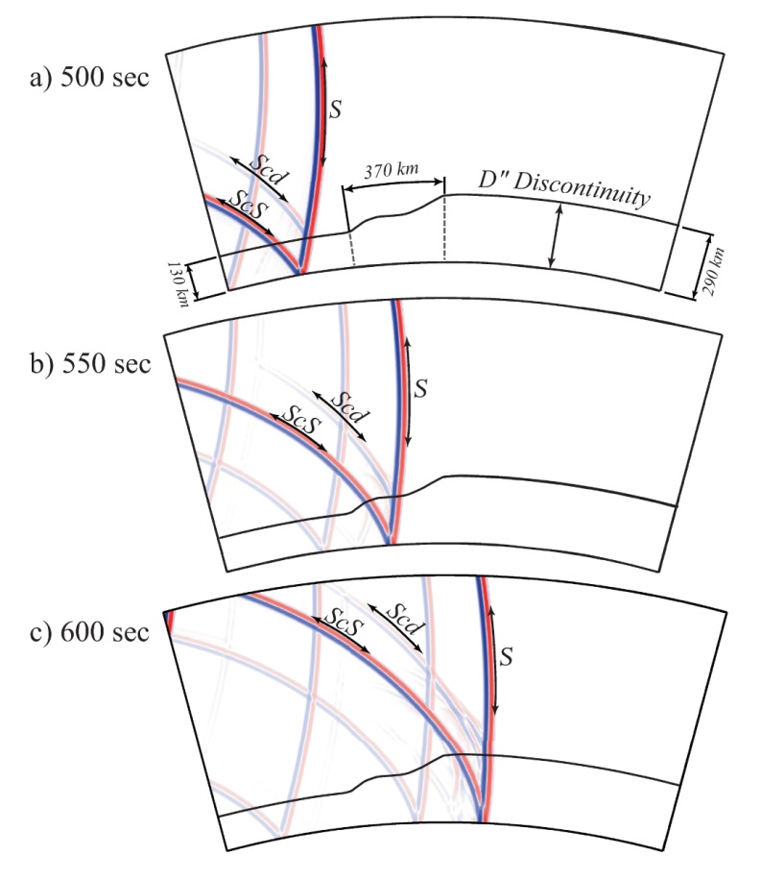
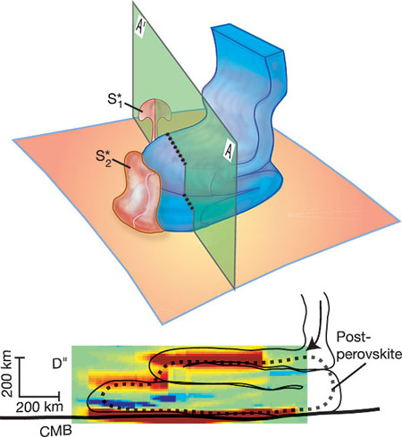
D” discontinuity topography
Hutko et al.

Slide 11
Scd Array Processing - Observations
11 good events
Roughly 2 years data
Central America
D” thickness:
279-290 km
dVs = 1.5-3.0%
Bering Sea
D” thickness:
248-260 km
dVs = 1.5-2.0%
Radial Components:
No Scd visible.
Some observations at shorter distances than Scd normally observed.

Slide 12
SS Precursors

Slide 13
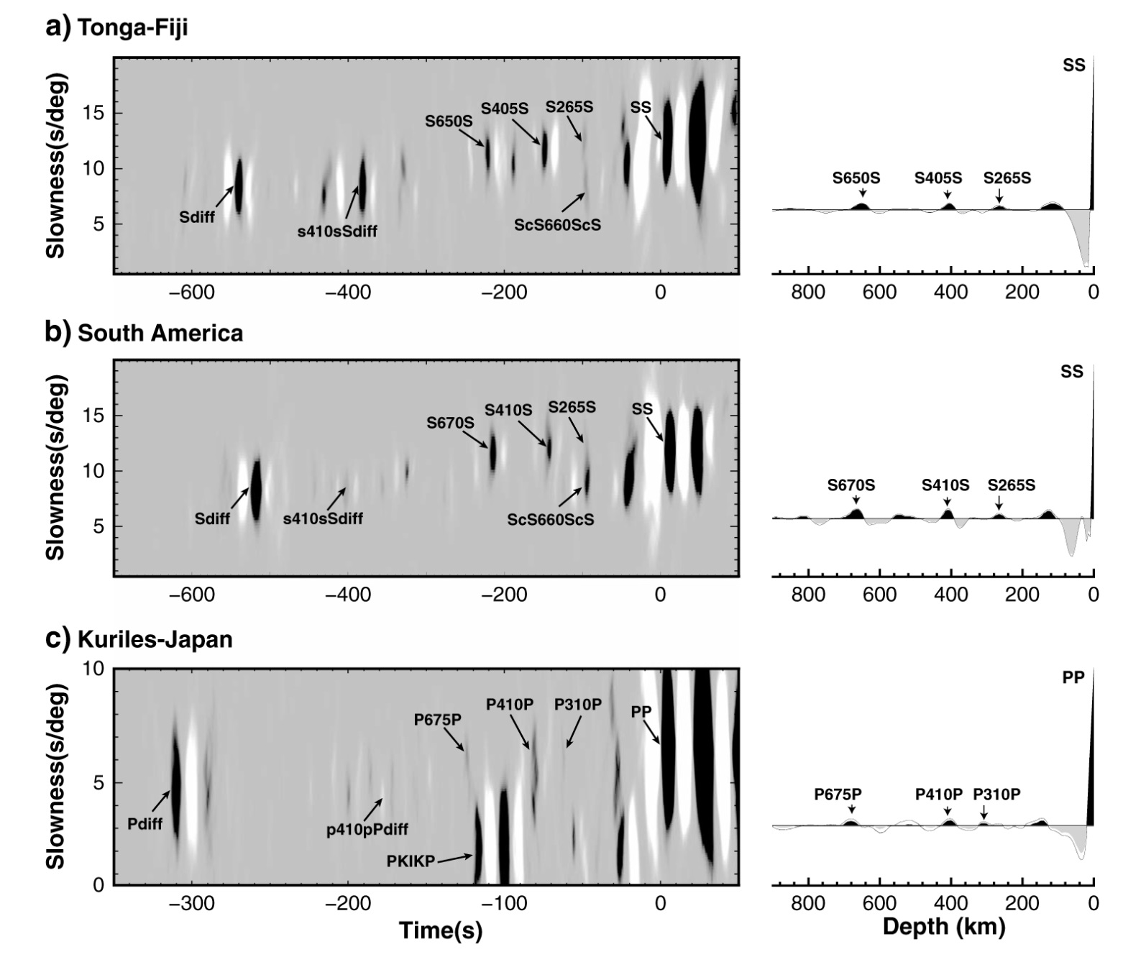
300-km Discontinuity (Schmerr, Kelly, Thorne – GRL, 2013)

Slide 14
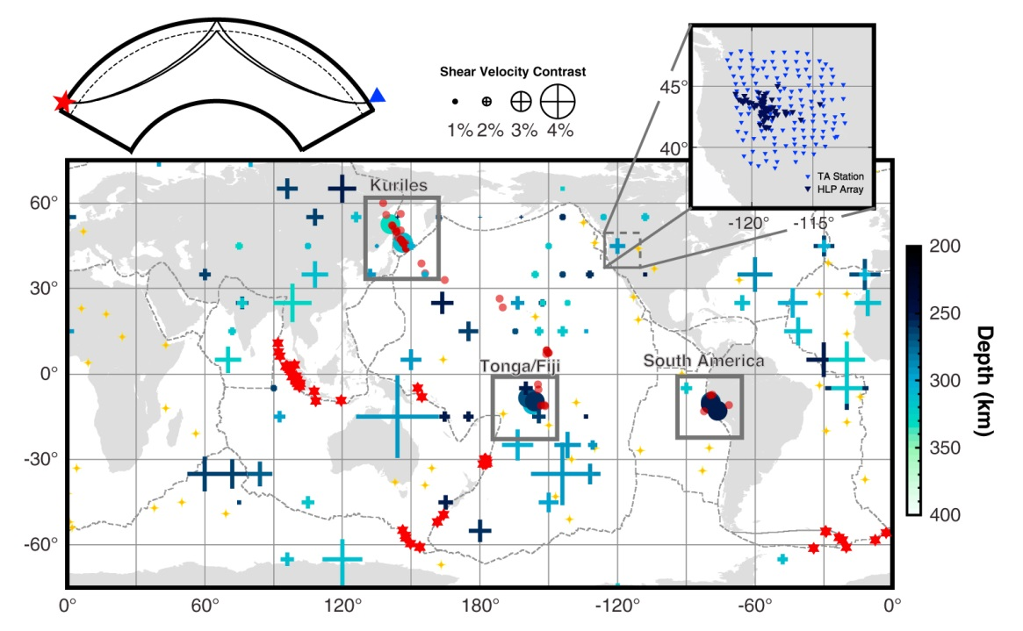
300-km Discontinuity (Schmerr, Kelly, Thorne – GRL, 2013)
Notes:
Non-detections red circles
Detections – blue circles
Crosses – detections from standard SS precursor stacking
Intermittent detections. 300 km discontinuity not always visible. Can’t determine location from single array.

Slide 15
Summary
Standard array processing techniques to SH-wave data;
laterally variable low amplitude discontinuities can be mapped;
but only limited spatial extent with single arrays.
Flexible array type experiments seems sufficient
in layout/design. Cross design not perfect.
Good slowness resolution in most directions, but circular
geometry preferred.
2-3 year PASSCAL type deployment – too short of a
time span. 5+ years would be preferred.
Given 500 stations, I’d opt for multiple 100-sensor arrays.

