Slide 1
Open questions in earthquake physics and the contribution of array seismology
J.-P. Ampuero
Caltech Seismolab
Acknowledgements: Lingsen Meng (now at UC Berkeley)

Slide 2
Overview
Earthquake physics: how earthquakes start, propagate and stop? + broader impact
More specific open questions
Limitations of source inversion
Contribution of array seismology

Slide 3
General goals of earthquake dynamics research
How earthquakes start, propagate and stop?
Relation between rupture patterns and mechanical properties of the fault zone at a variety of scales: friction law, state of stress, off-fault inelastic deformation, geometrical roughness
Fundamental quest: bridge the gap between first principles and observations at laboratory and natural scales
Practical impact: physics-based earthquake hazard assessment, time-dependent hazard, earthquake predictability, situational awareness, earthquake early warning

Slide 4
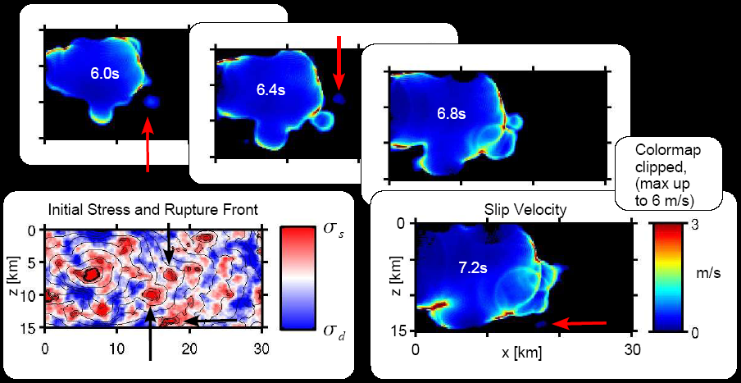
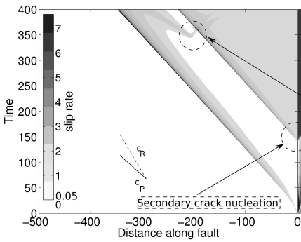
Some open questions in earthquake seismology
What controls rupture speed?
What controls rise time?
What controls the location of high and low frequency slip?
How large is the spatial variability of these source parameters?
How do frictional properties and stress vary along active faults?
How deep can ruptures propagate?
When and how far can rupture jump/branch to other fault segments?
How is rupture affected by the subduction wedge, the fault geometry, the presence of a low velocity fault zone?
Can slip nucleate repeatedly during a single earthquake?
from Rippeger et al (2007)
Gabriel et al (2012)

Slide 5
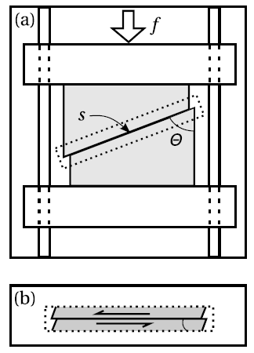
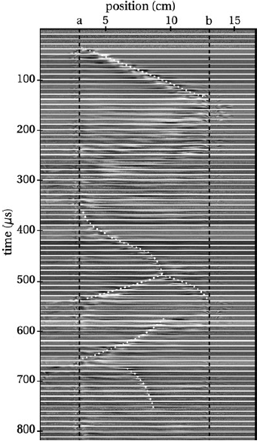
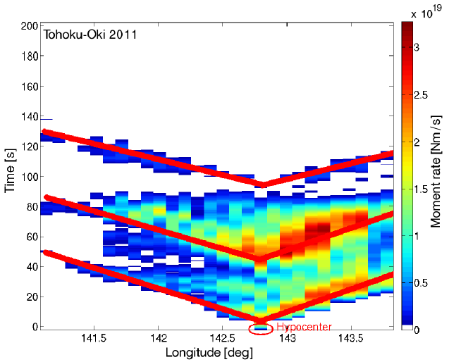
Rupture complexity: multiple rupture fronts
based on source inversion by Lee et al (2011)
Slip rate
Rupture front splitting
Repeated front
Gabriel et al (2011)
Reverse front
Nielsen et al (2010)

Slide 6
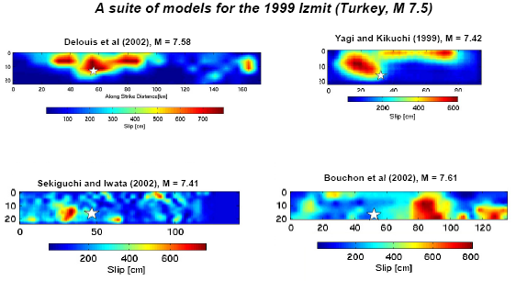
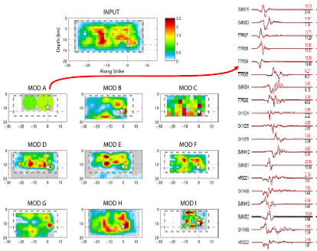
Intrinsic limitations of source inversion
Source inversion = infer the space-time distribution of slip from seismological + geodetic + field + tsunami + remote sensing data
Only seismological data constrains the time-dependency of the source
Poor knowledge of the crust structure at small scales → only low frequencies (<<1Hz) are exploited
Resulting slip models are notoriously heterogeneous (spatial variability)
However, the inverse problem is intrinsically ill-posed → limited spatial resolution (>10km)
Can we distinguish real source complexity from inversion artifacts? What can we trust?
from Martin Mai and SIV project

Slide 7
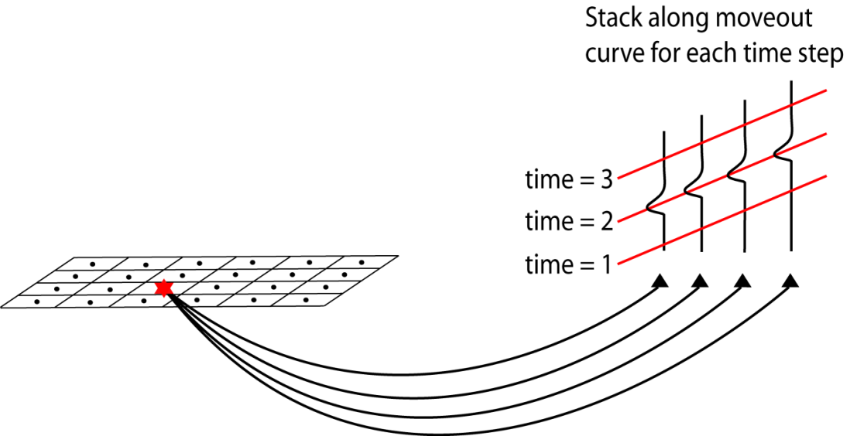
Earthquake source imaging by
back-projection of teleseismic array data
Introduced by Ishii, Shearer et al (2005)
Principle:
Identify coherent wave arrivals across a dense tele-seismic array
Use their differential arrival times to infer source locations
Repeat as the earthquake unfolds, in order to track the rupture
Seismic array
Source region
(Hutko, 2009)
Seismic rays
High-resolution is obtained by exploiting high-frequency waves (~1Hz)
Notes:
back projection in the context of source imaging is an alternative way of study the rupture process. The idea is that if the waves from different source regions comes with different arrival time curve at seismic array, identifying the arrival times can recover the source location. Color dots are the image of the rupture front as a function of time. Agree with the aftershock. Example to show the benefit of apply this in complicated geometry. Model does not change with time. The benefit of this technique is free of prior assumptions of rupture kinematics and geometry. Also because it works on higher frequency, it sees more details. Two arrays from different azimuth, both agrees

Slide 8
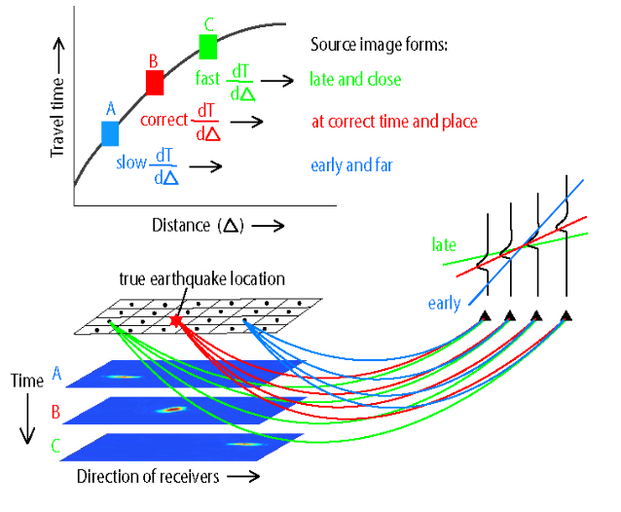
Earthquake source imaging by
back-projection of teleseismic array data
Introduced by Ishii, Shearer et al (2005)
Principle:
Identify coherent wave arrivals across a dense tele-seismic array
Use their differential arrival times to infer source locations
Repeat as the earthquake unfolds, in order to track the rupture
(Hutko, 2009)
High-resolution is obtained by exploiting high-frequency waves (~1Hz)
Notes:
back projection in the context of source imaging is an alternative way of study the rupture process. The idea is that if the waves from different source regions comes with different arrival time curve at seismic array, identifying the arrival times can recover the source location. Color dots are the image of the rupture front as a function of time. Agree with the aftershock. Example to show the benefit of apply this in complicated geometry. Model does not change with time. The benefit of this technique is free of prior assumptions of rupture kinematics and geometry. Also because it works on higher frequency, it sees more details. Two arrays from different azimuth, both agrees

Slide 9
Earthquake source imaging by back-projection of teleseismic array data
Advantages of back-projection compared to source inversion:
High frequency teleseismic data (1 Hz)
Less affected by uncertainties in velocity model
Minimal assumptions about fault geometry
No assumptions on rupture kinematics and size
Challenges and how we addressed them:
Multiple sources → MUSIC method
Non-stationary signals → multitaper method
Swimming artifacts → reference window method
Limited coherency (see later talks by C. Langston and L. Meng)

Slide 10
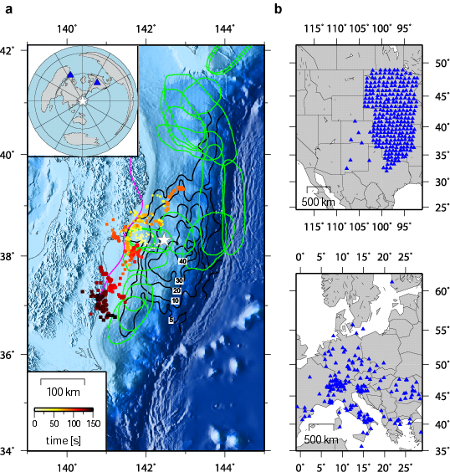
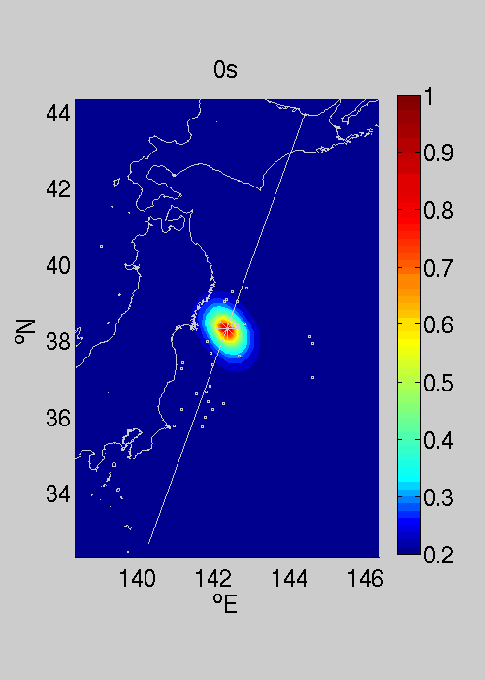
Tohoku earthquake

Slide 11
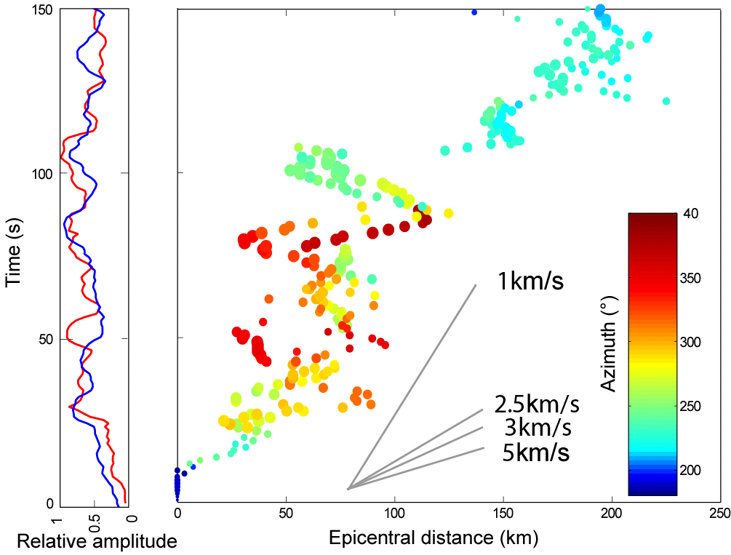
Details of the rupture process
Sketch: position of the rupture front at regular times

Slide 12
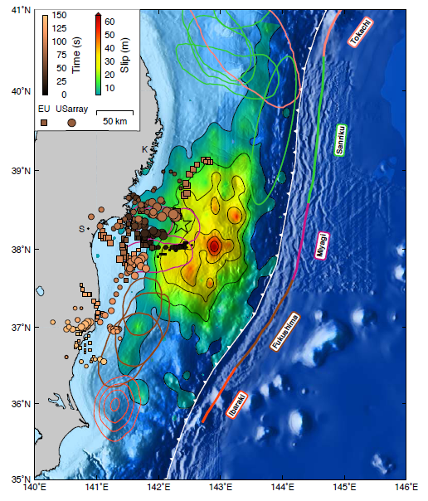
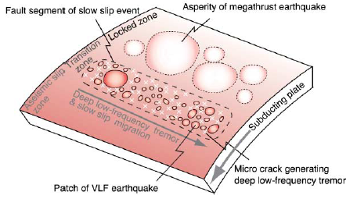
High-frequency radiation is deep
A possible interpretation, :
Deep brittle asperities surrounded by creep
+ Stress concentrations at the edge of past earthquakes
Similar concept emerged from slow slip and tremor observations elsewhere
Ito et al (2007)

Slide 13
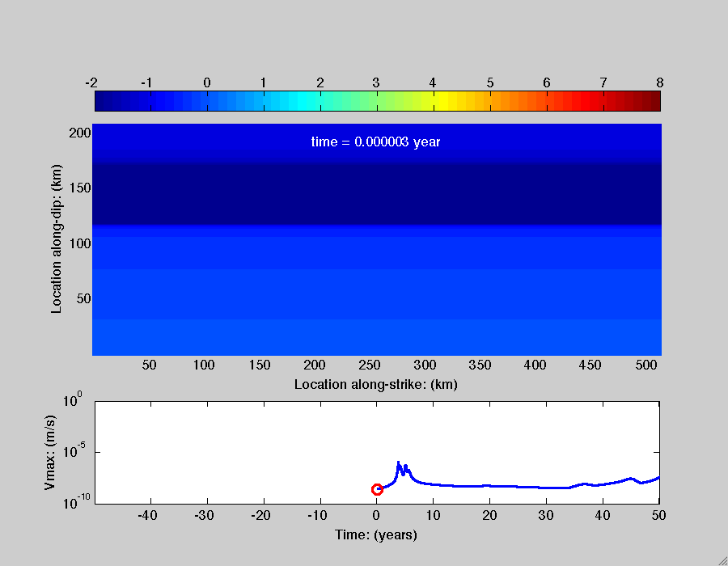
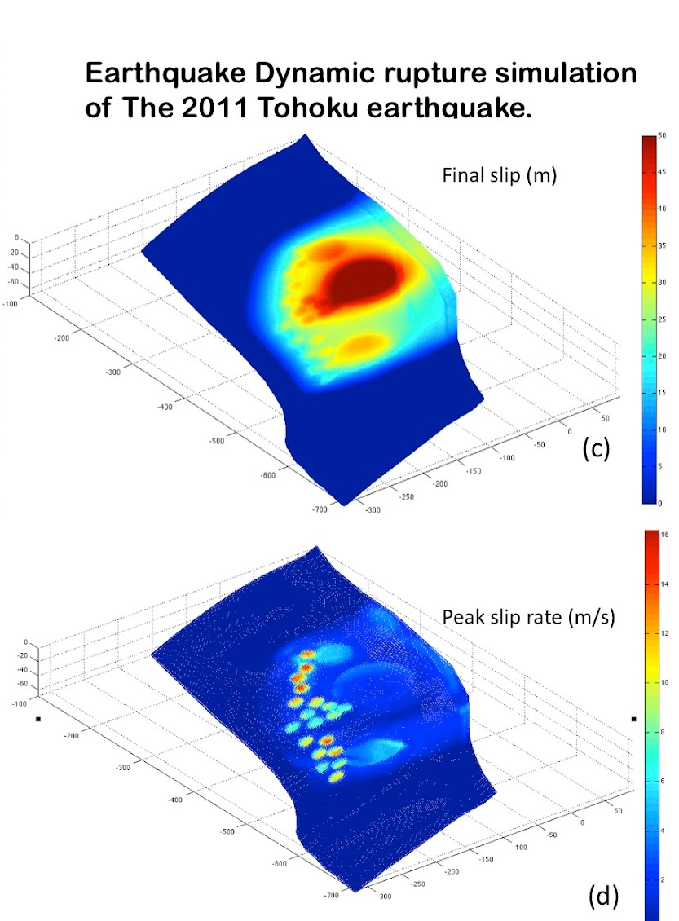
Dynamic modeling
Ito et al (2007)
Yingdi Luo, earthquake cycle simulations
Percy Galvez

Slide 14
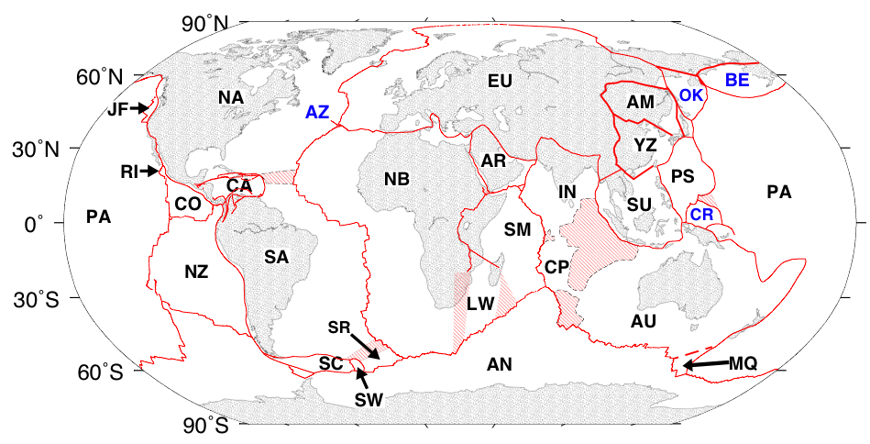
2012 M8.6 Indian Ocean earthquake
India-Australia
diffuse deformation zone,
an emerging plate boundary
DeMets et al, 2010
Largest strike-slip earthquake ever.
Not really an intra-plate event.

Slide 15
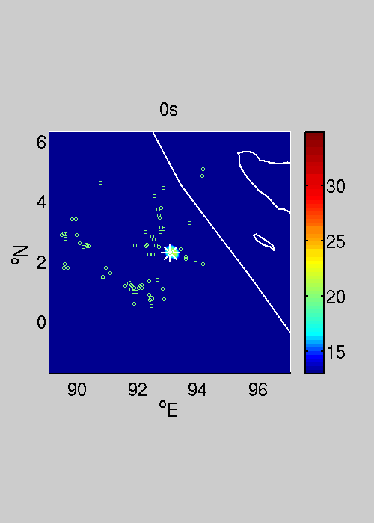
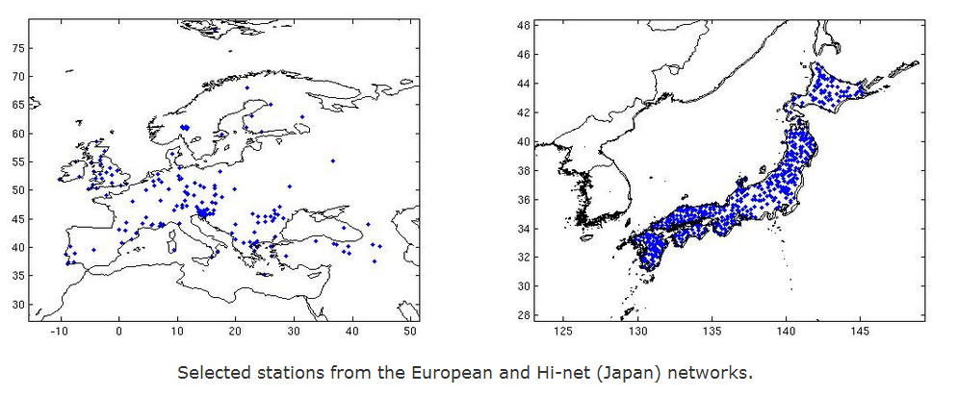
Europe
Japan
Notes:
Now come back the sumatra event, Here’s movie

Slide 16
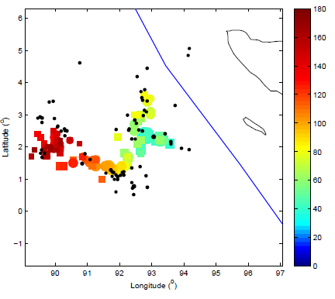
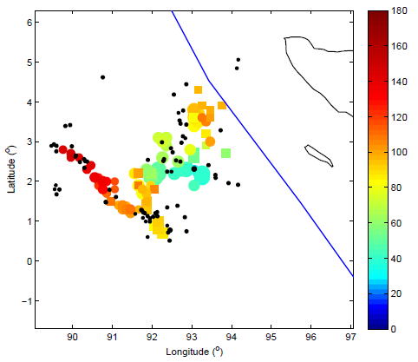
Time (s)
As seen from Europe
As seen from Japan
Rupture branching despite compressive dynamic stresses
→ low pressure-sensitivity of fault strength
②-NE
④
①
②-SW
A
③
B
C
Notes:
Top: Spatio-temporal distribution of high-frequency radiation as seen from Japan (left) and Europe (right). Colored dots indicate the position of peak high-frequency radiation identified from each frame of the movies above. Squares correspond to significant secondary peaks with MUSIC pseudo-spectrum at least 50% as large as the main peak in the same frame. The size of the symbols scales with beamforming amplitude. Their color indiactes their timing relative to hypocentral time (color scale on right). Black dots are the epicenters of the first day of aftershocks from the NEIC catalog. Gray dashed lines indicate possible fault planes consistent with global CMT solutions. Bottom: A possible interpretation of the rupture history. Stage 1: the earthquake started as a bilateral rupture, about 150 km long, on a fault striking NNW (here coined "fault A"). This strike is consistent with one of the planes of the CMT solution (show on the left). This stage generated the strongest radiation. Stage 2: the rupture then branched into a different, almost orthogonal fault ("fault B") consistent with the conjugate plane of the CMT solution. This stage was bilateral and broke about 300 km. Rupture on the NNE segment of fault B reached near the trench. Stage 3: the rupture finally branched into a third orthogonal fault ("fault C"), unilaterally for about 100 km heading WNW, until it reached near the NinetyEast ridge. Stage 4: a weak, late rupture possibly involved a different fault strand parallel to fault C. The location of the M8.2 aftershock, two hours later (not shown here), is consistent with rupture along the SSE segment of fault C

Slide 17
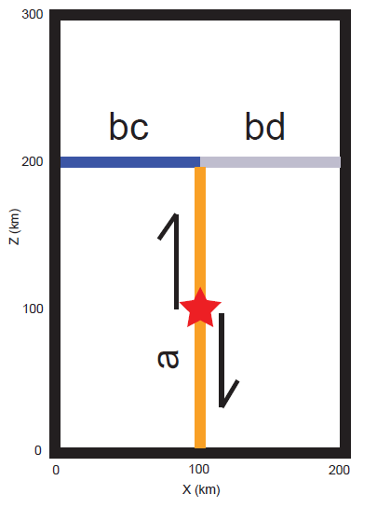
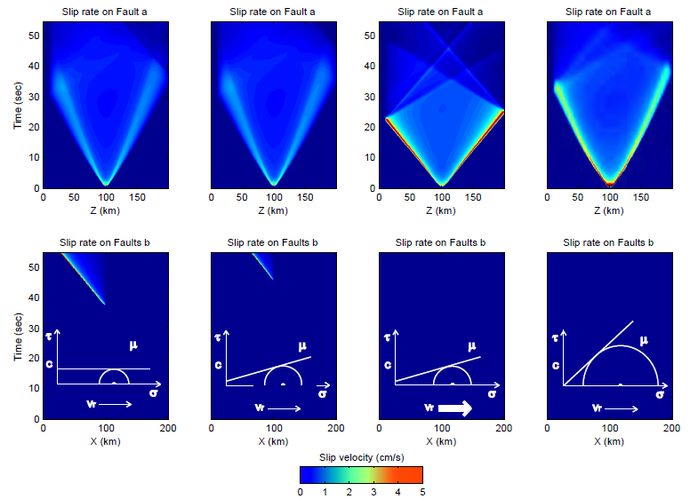
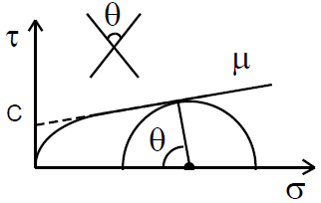
Theoretical expectations confirmed by dynamic rupture simulations
Rupture branching despite compressive dynamic stresses
→ low pressure-sensitivity of fault strength

Slide 18
Perspectives
Contributions of array seismology:
Provides observational constraints on rupture history with minimal assumptions
Breaks the high-frequency (→1Hz) barrier in source imaging
Reveals unexpected rupture patterns
Provides a fast estimate of rupture size and areas of high-frequency radiation for situational awareness (→ShakeMap in poorly instrumented regions, or when local system fails)
Challenges:
Broadband integration of HF array imaging and LF source inversion
Optimal data fusion: how to merge information from multiple arrays?
Quantify and mitigate uncertainties on location, timing and amplitude of high-frequency sub-sources
Can we push to higher frequencies > 1Hz? Can we beat scattering? →smaller magnitude earthquakes

