Slide 1
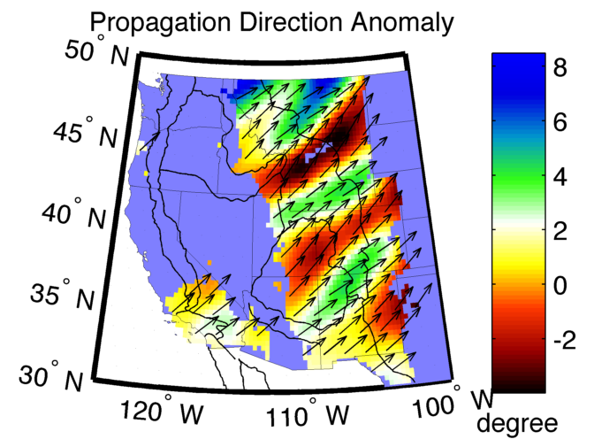

An array analysis of seismic surface waves
James Gaherty and Ge Jin
LDEO Columbia University

Slide 2
Thoughts and Overview
Surface-waves from earthquake sources provide powerful tool for probing upper mantle structure beneath arrays
  Good depth resolution
  Constrain both absolute and relative velocity
  Sensitive to anisotropy and attenuation
Energetic and coherent wavefield amenable to array analysis
  Longest wavelength: outer aperture of array
  Shortest wavelength: ~ interstation spacing
Challenges associated with:
  dispersive character
  propagation complexity (wavefield heterogeneity)
Examples:
  USArray Transportable Array
  Small regional PASSCAL arrays

Slide 3
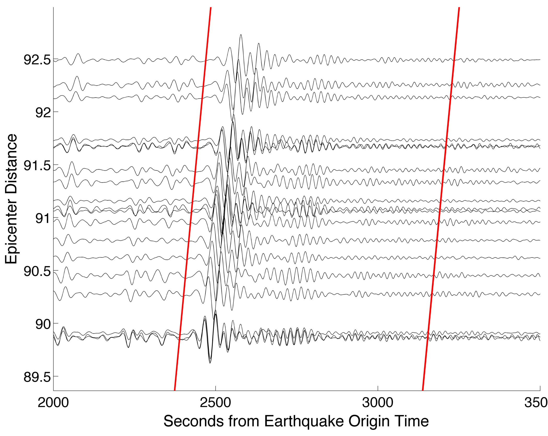
Problem: Near-receiver imaging using surface waves
Traditional approach measures travel time or velocities from source to receiver
Mostly sensitive to source-receiver path
Desired information contained in interstation variability
Nearby waveforms very similar
Exploit using multichannel crosscorrelation

Slide 4
Problem: Near-receiver imaging using surface waves
Approach
Automatic GSDF Method
  Multi-channel cross correlation to extract frequency-dependent relative phase and amplitude variations
Phase gradiometry
  Invert phase variations for 2D variations in dynamic phase velocity -- Eikonal tomography
Amplitude Correction
  Utilize amplitude variations to correct estimate true structural phase velocity from dynamic phase velocity – Helmholtz tomography

Slide 5
Automatic GSDF Method
Real Waveform
Cross
Correlation
Narrow-Band
Filter
Real Waveform
From nearby Stations
Wavelet
Fitting
Amplitude
Similarity – reduce measurement uncertainty
Minimal cycle skipping
Multichannel – measurement redundancy
Phase Delay
Difference
Group Delay
Difference

Slide 6
Processing Example: Original Waveforms

Slide 7
Processing Example: Cross-Correlation Waveforms

Slide 8
Processing Example: Wavelet Fitting
Real Data
Fitting Wavelet

Slide 9
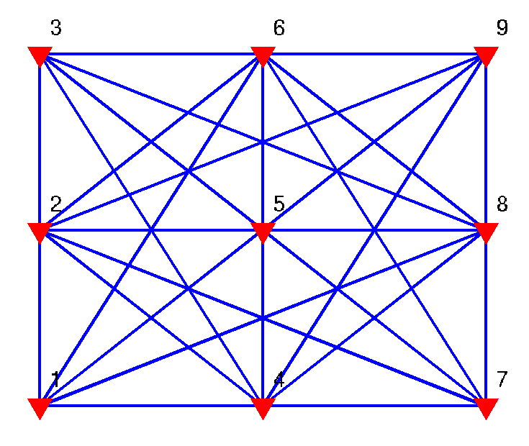
Redundant Time Difference Measurement
Notes:
Get rid of bad measurement

Slide 10
Phase Velocity Inversion
Phase difference Between Stations
Apparent Phase Velocity
Eikonal
Tomography
Averaged Phase Velocity
Amplitude
Correction
Event
Stacking
Structure Phase Velocity
Averaged Apparent Phase Velocity
Event
Stacking

Slide 11
Phase Gradiometry
Apparent Phase Velocity
Travel Time Surface
Eikonal Tomography
Lin et al.,2009

Slide 12
Eikonal Tomography
From Phase Difference to Phase Velocity
Observations:
Modeled as:
Invert for slowness variations S(x,y) with a penalty function

Slide 13
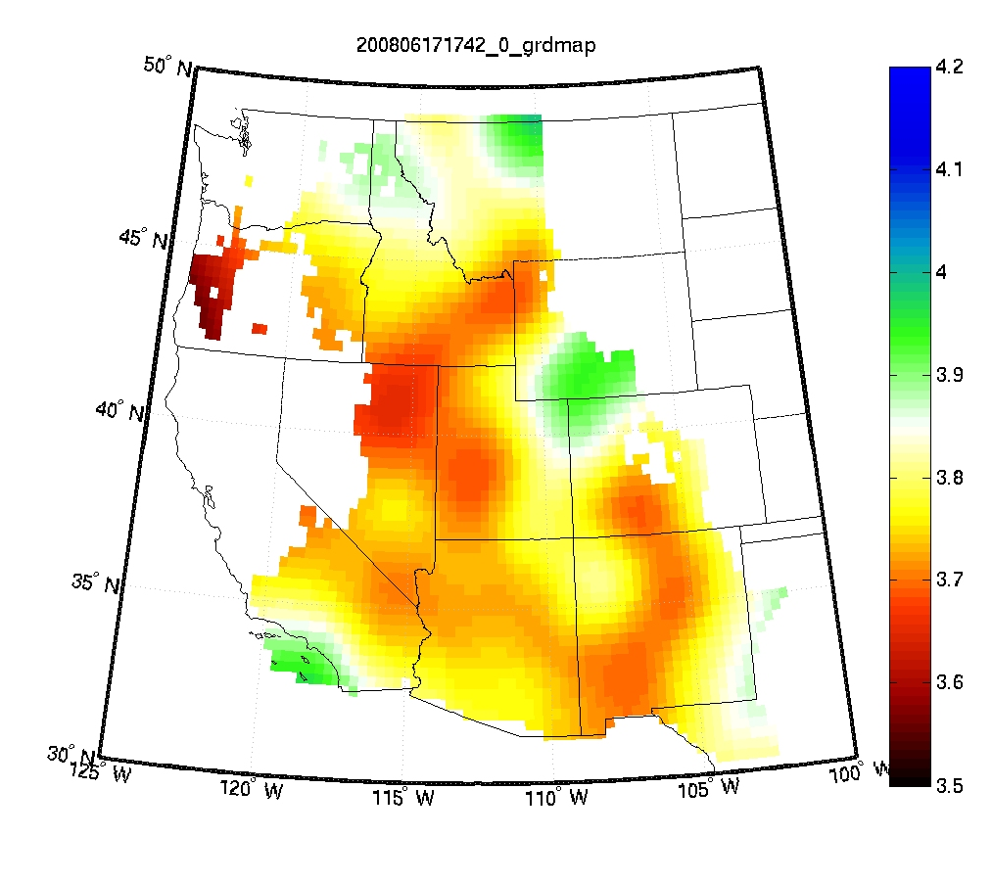
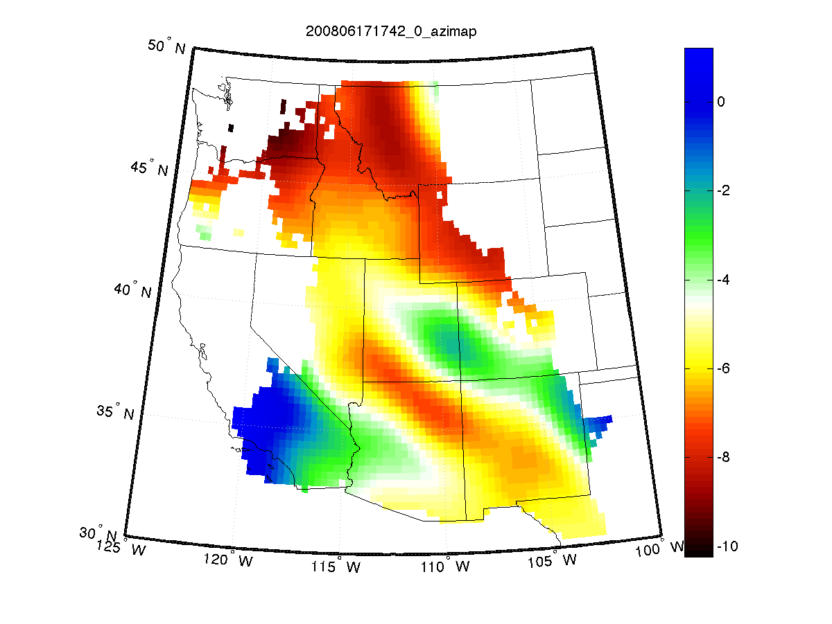
Eikonal Tomography
2
Event: 200806171742
Period: 60s

Slide 14
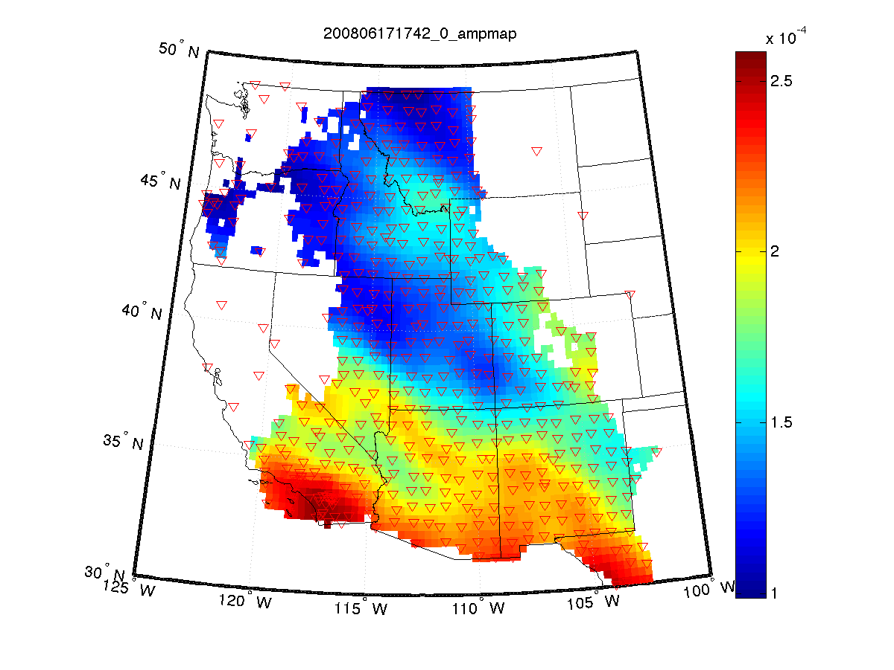
Focusing Effect
Propagation Direction Anomaly
Amplitude
Notes:
Mention the amplitude first

Slide 15
Amplitude Correction of Phase Velocity
Real
Corrected
Uncorrected
Friederich et al. 2000

Slide 16
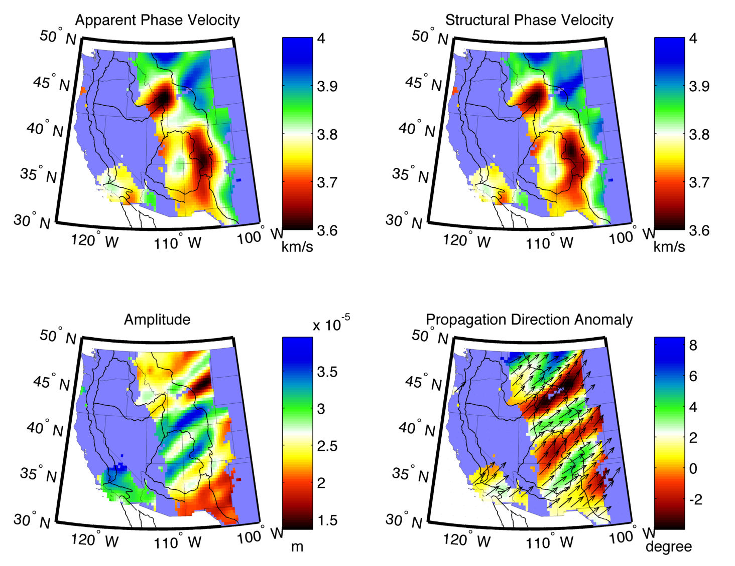
Single Event 1

Slide 17
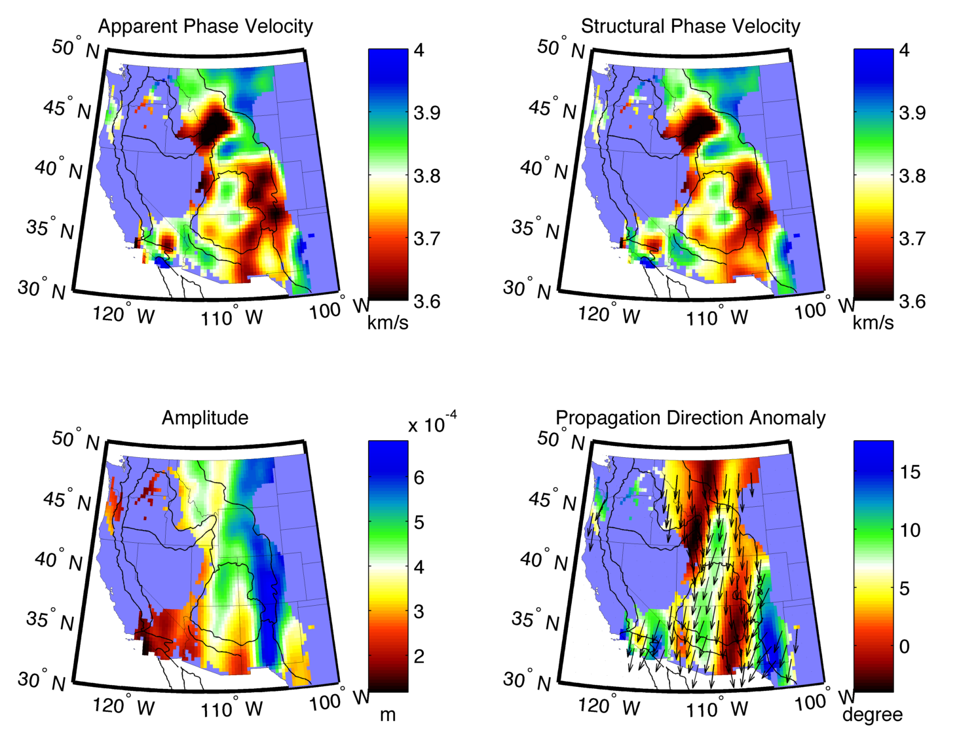
Single Event 2

Slide 18
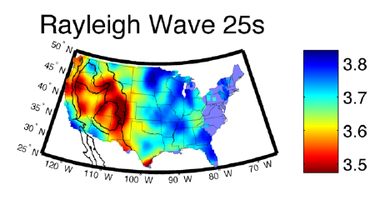
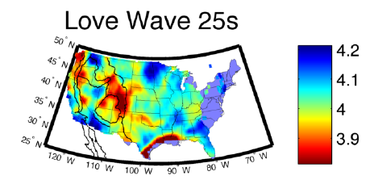
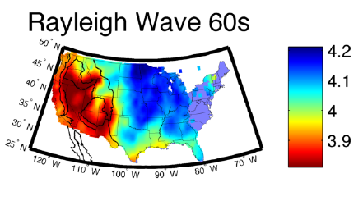
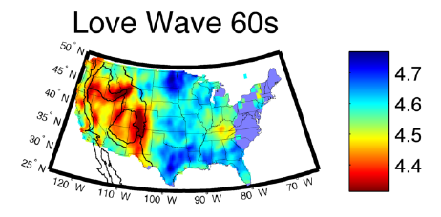
Multi-Event Average
http://www.LDEO.columbia.edu/~ge.jin

Slide 19
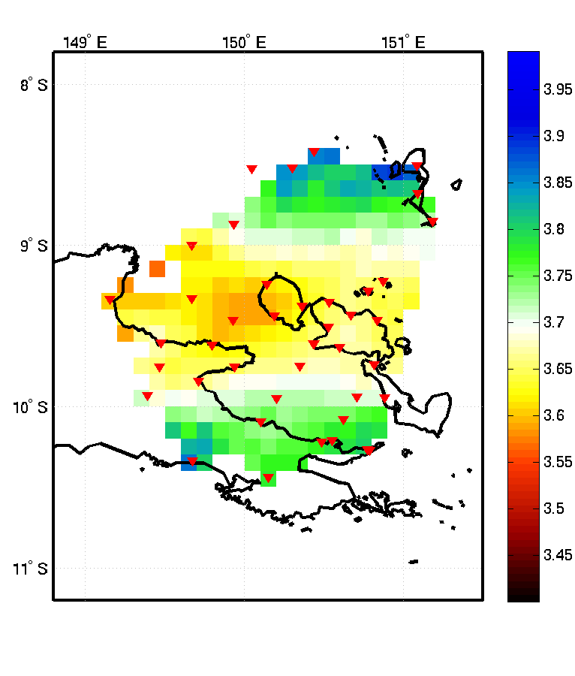
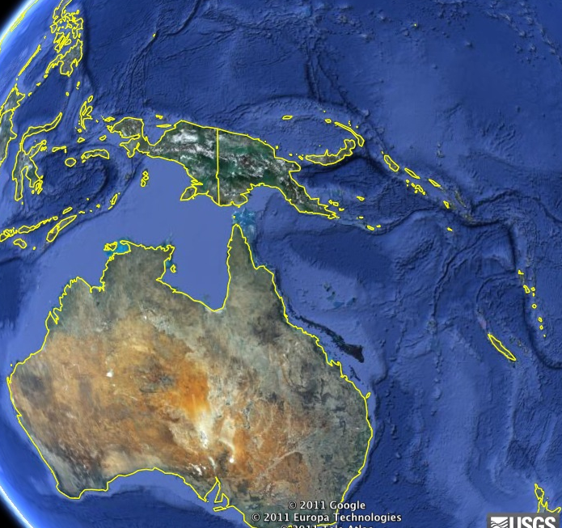
Small PASSCAL Array
Rayleigh
32 Seconds

Slide 20
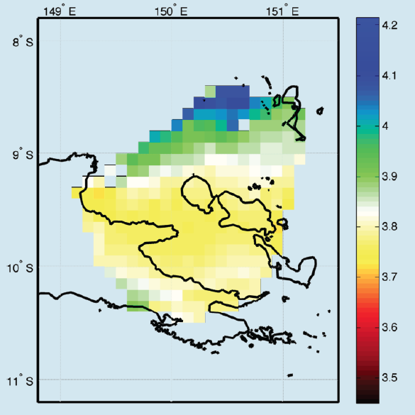
Small PASSCAL Array
Rayleigh
50 Seconds

Slide 21
Thoughts on Array Design for Upper Mantle Imaging
Surface waves provide critical constraints on upper-mantle structure
Period range of interest 20-200 s – wavelengths of 80-800 km – maybe don’t need all of this, but the bigger the better
Even spatial coverage in 2D for wavefield analysis
Interstation spacing likely less critical than other (body-wave) needs? Oversampling is good however.
Broadband is important!
Common instruments (or at least well calibrated) – need accurate instrument response for cross-correlation and amplitude analyses

