Slide 1
Global Seismic Tomography: Why We Need GSN and GABBA (Global Array of Broad–Band Arrays
Adam M. Dziewonski
Harvard University
Raleigh, NC, May 15, 2013

Slide 2
Short Answer
Because there is a dichotomy in the spectrum of mantle heterogeneity and the long wavelength anomalies cannot answer the questions needed to determine the dynamics of the Earth’s interior.
Global models derived by different groups show congruence of major features, including zonation of the spectral characteristics of the mantle. This is not, however, true of shorter wavelength structures. We need a finer tool to identify such structures on a global scale.

Slide 3
Spectral characteristics of three recent models

Slide 4
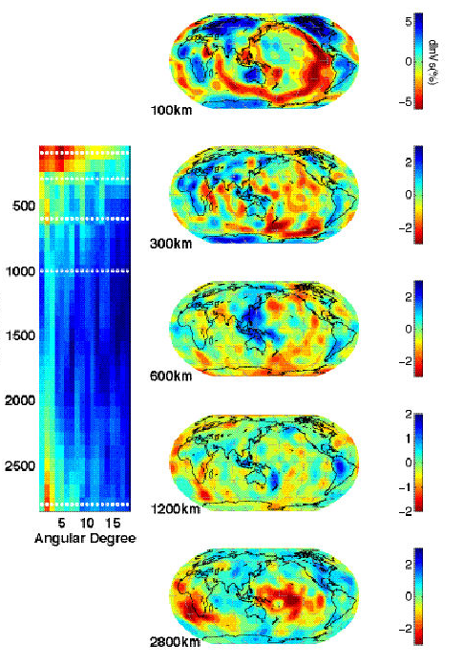
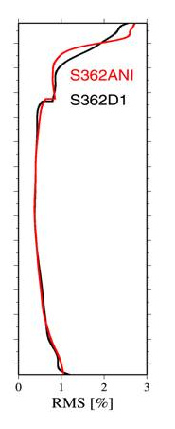
Five zones in the mantle
heterosphere
Moho – 225 km
upper mantle
buffer zone
225-500 km
transition zone
500-650 km
lower mantle
buffer zone
650-2400 km
abyssal zone
2400 km - CMB
(Dziewonski et al., 2010)

Slide 5
Three upper mantle zones
heterosphere
u.m. buffer zone
transition zone
+/- 7% at 100 km depth
After Ritsema et al. 2011)

Slide 6
Rapid change in the level of heterogeneity at 200 – 250 km depth: heterosphere
Romanowicz (2009)

Slide 7
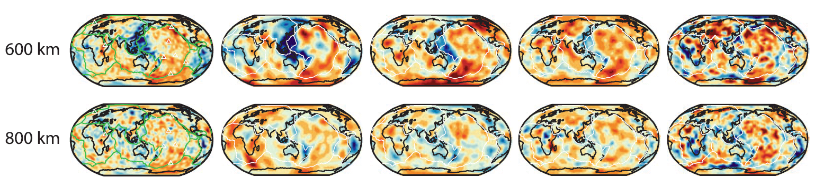
Crossing the 650 km discontinuity
Model TX2008 has weak constrains in transition zone
Model HMSL-S has no constraints in transition zone
After Ritsema et al., 2011

Slide 8
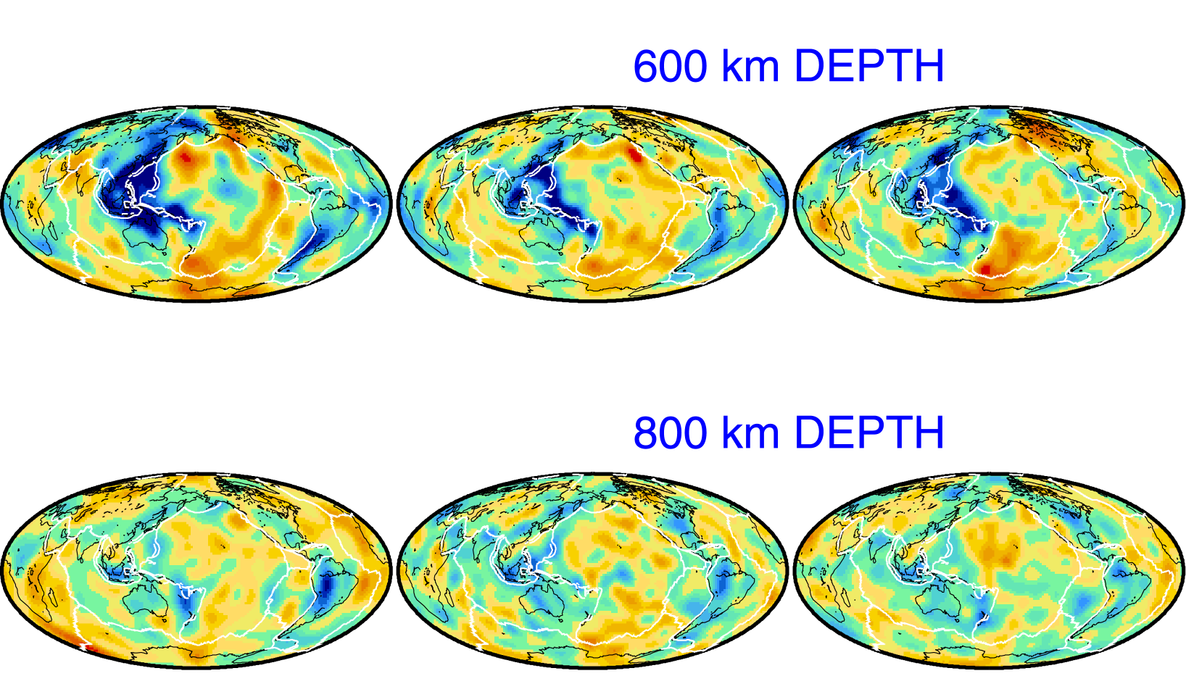
Harvard
Caltech
Berkeley
600 km depth
800 km depth

Slide 9
Lower Mantle
Ritsema et al., 2011

Slide 10
The Abyssal Layer
Velocities
Velocity gradient

Slide 11
How similar are regionalizations based on cluster
analysis of different tomographic models?
Five models voting:
“Slow” or “Fast”
All slow
All fast

Slide 12
Waveform modeling check

Slide 13
Voting vs. harmonic order

Slide 14
What happens to the Superplumes in the middle mantle?
Masters et al., 2000
Ritsema et al., 1999

Slide 15
Principal Component Analysis (PCA)
A multi-dimensional function – a 3-D velocity model, for example – may be represented by a sum of multi-dimensional functions that are orthogonal:
Δv(r,θ,φ) = ∑ λi • fi (r, θ, φ)
Where λi are eigenvalues and
∫ fi • fj dV = δij
The advantage of PCA is to determine the importance of different elements of the model.
Then, the model can be reconstructed using a limited number of the largest PC’s and variance reduction with respect to the origanal model computed.

Slide 16
S362ANI Principal Components
Variance reduction
Radial functions

Slide 17
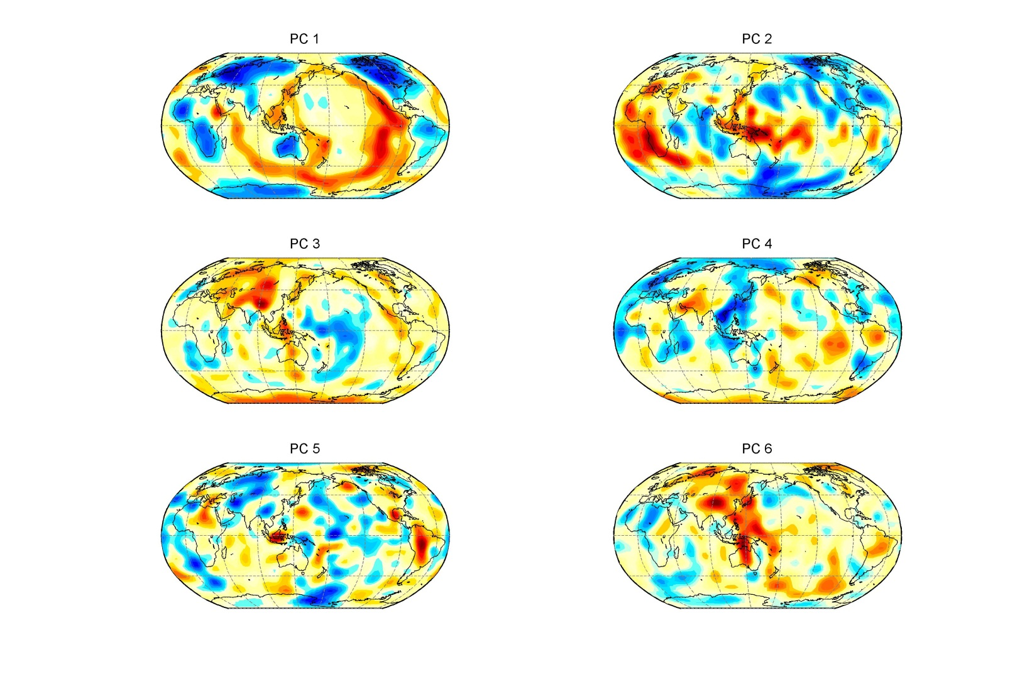
S362ANI horizontal functions
PC 1
PC 2
PC 1
PC 2
PC 3
PC 4
PC 3
PC 4
PC 5
PC 5
PC 6
PC 6

Slide 18
The Two Largest Principal Components
radial
horizontal
100 km
PC 1
300 km
PC 2
600 km
1200 km
2800 km
68% var. red.
362ANI

Slide 19
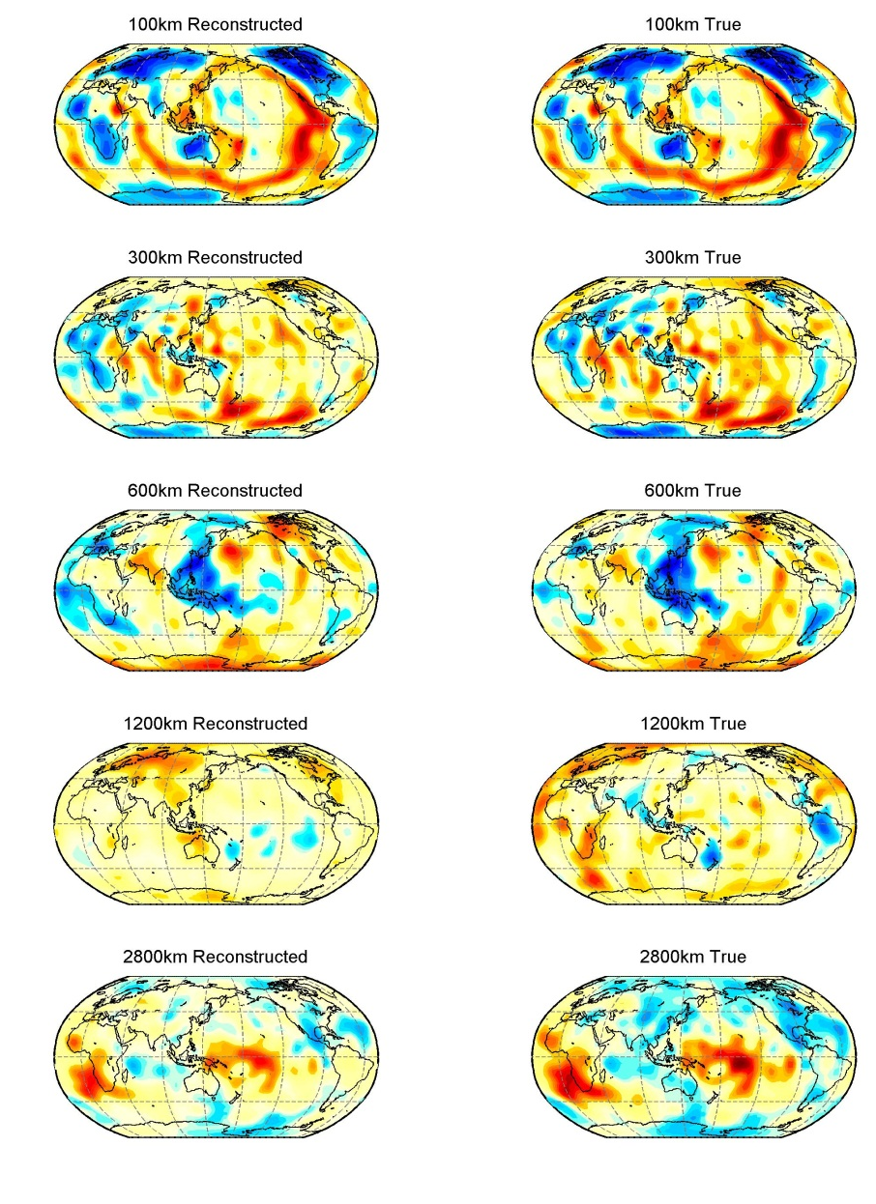
Reconstruction using 6 largest PC’s
100 km
300 km
600 km
1200 km
2800 km
Var. red. 95%
S362ANI

Slide 20
A planet within a planet: three zones in the mantle
The two largest Principal Components describe lateral heterogeneity as if in two different planets.
The first one extends from Moho to about 300 km depth and it is the “Plate Tectonics Planet”.
The second, from 650 km to CMB and this is the “Superplume Planet”,
These two planets are separated by the “Inter-planetary Interaction Zone” ranging from about 300 km to 650 km depth.

Slide 21
The GABBA Concept
These are an order of magnitude numbers:
About 10 globally distributed broad-band arrays equipped with instrumentation as uniform as possible. Real time data collection at each Array, with re-transmission to one or more data gathering centers.
Each array consisting of about 100 three component stations with a band-pass flat to ground velocity from 0.01 Hz to 20 Hz.
If technically and financially feasible consideration should be given to ocean bottom arrays

Slide 22
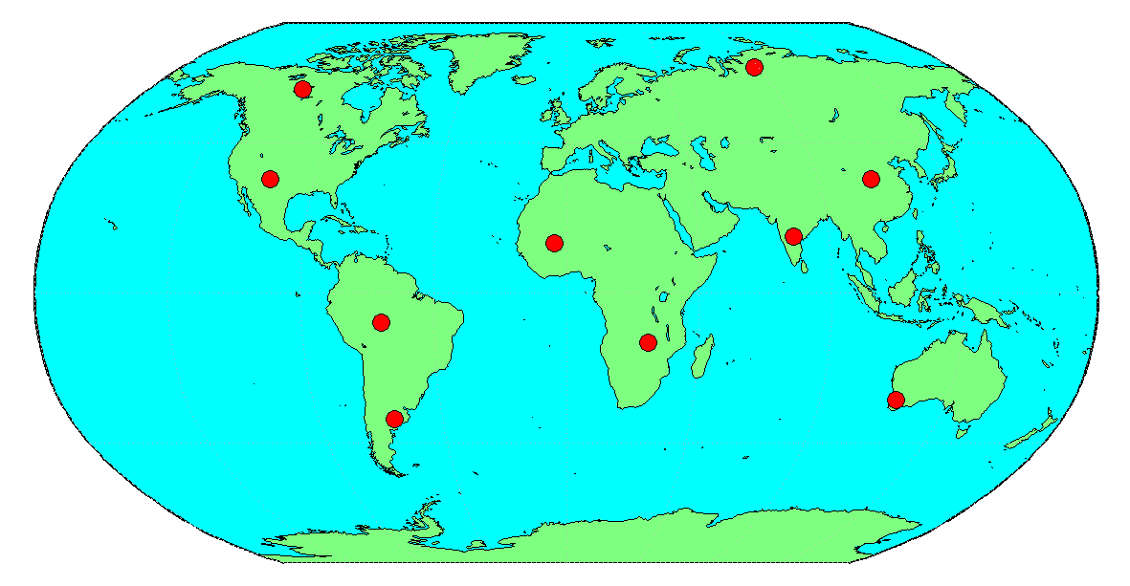
Global Array of Arrays Concept

Slide 23
Why GABBA?
To understand the connection between the connection of the “Plate Tectonic” and “Superplume” Planets through IPIZ we need to resolve finer, smaller scale details than currently possible with the GSN/FDSN stations. The simultaneous use of data from all or selected GABBA stations could resolve location and shape of smaller scatterers by beam forming with the individual arrays aimed at the same point in space.

Slide 24
Other Applications: Source Studies
1) Multi-array analysis of seismic sources would aid both the time and spatial resolution of the radiation process as well as lower the threshold of magnitude of earthquakes for which such analysis can be applied. The higher signal-to noise ratio could also extend the range of routine analysis such as CMT.
2) In a search for velocity anomalies with dimensions on the order of few hundred kilometers the multi-array beam forming may well compensate for the smaller aperture of GABBA arrays compared to Hi-net or TA.

Slide 25
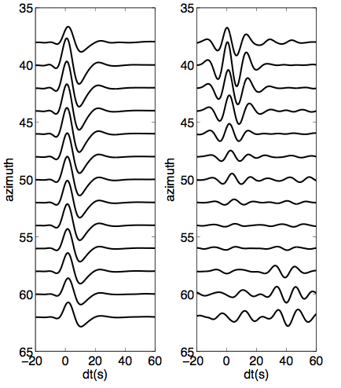
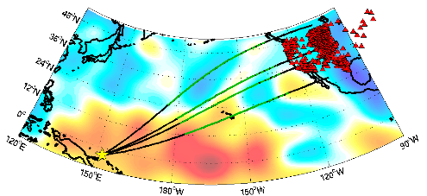
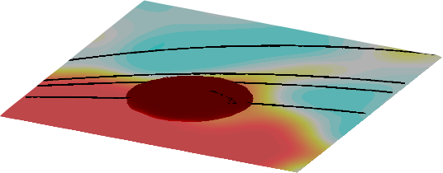
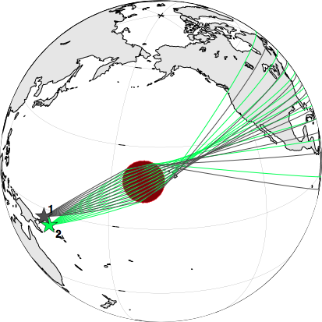
Detection of an “ultra low velocity zone” at the base of the mantle
Observation
Prediction
SH_{diff}, 100-110 degrees
azimuth (dg)
Cottaar and Romanowicz, 2012, EPSL
time around S_{diff} (s)
Height: ~25km
Diameter:~800 km
Velocity reduction:~20%

Slide 26
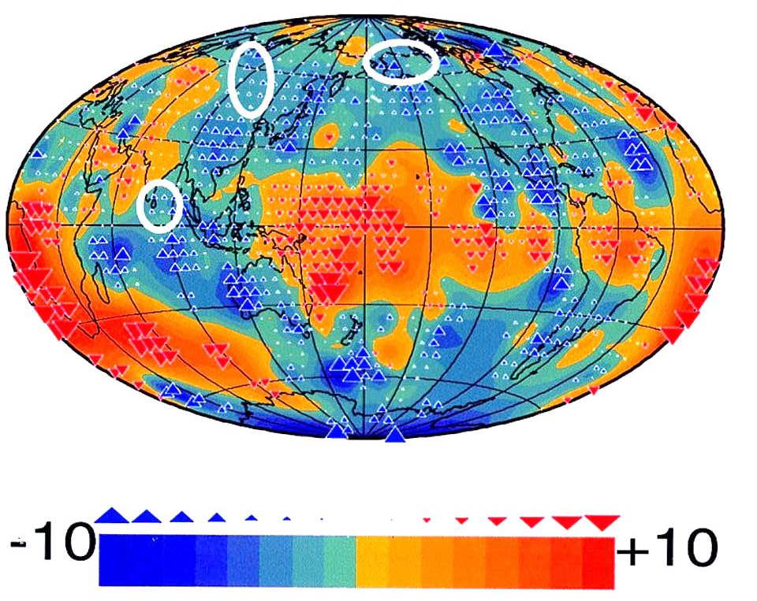
Seismic Elephant: ScS – S; the need for global approach
Conclusions were
drawn about the scale
of mantle heterogeneity
on the basis of data
collected within the
white ovals. It completely
missed the travel time
anomalies caused by
Superplumes
After Woodward and Masters (1991)

