Slide 1
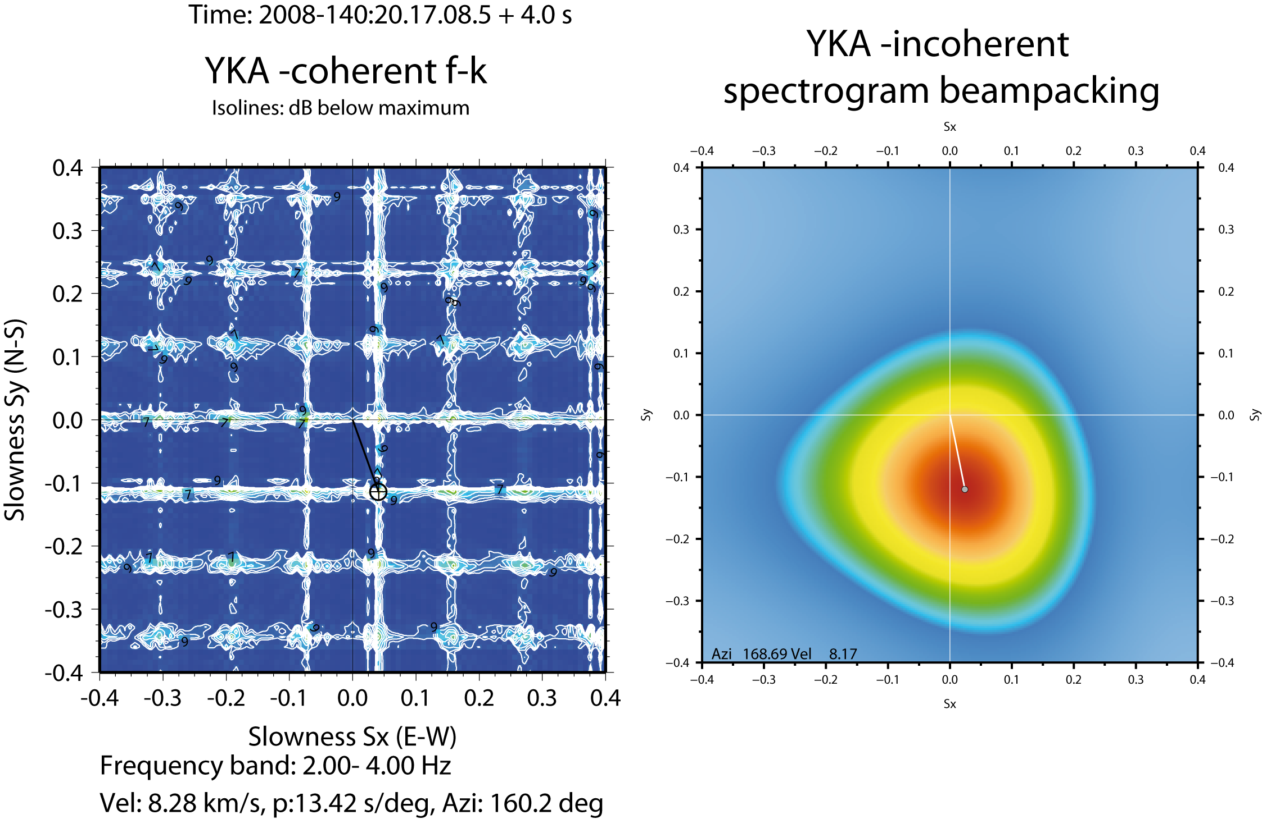
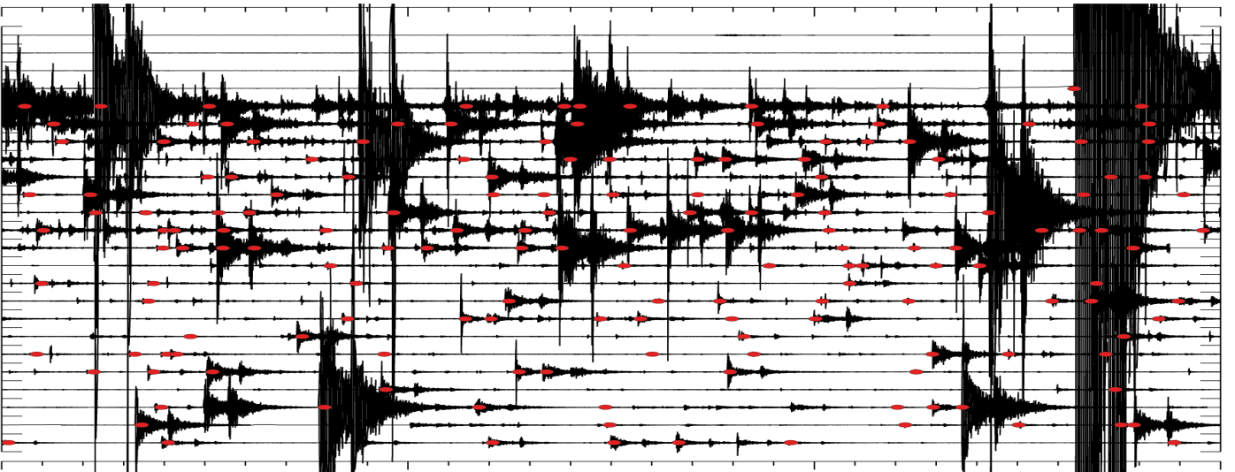
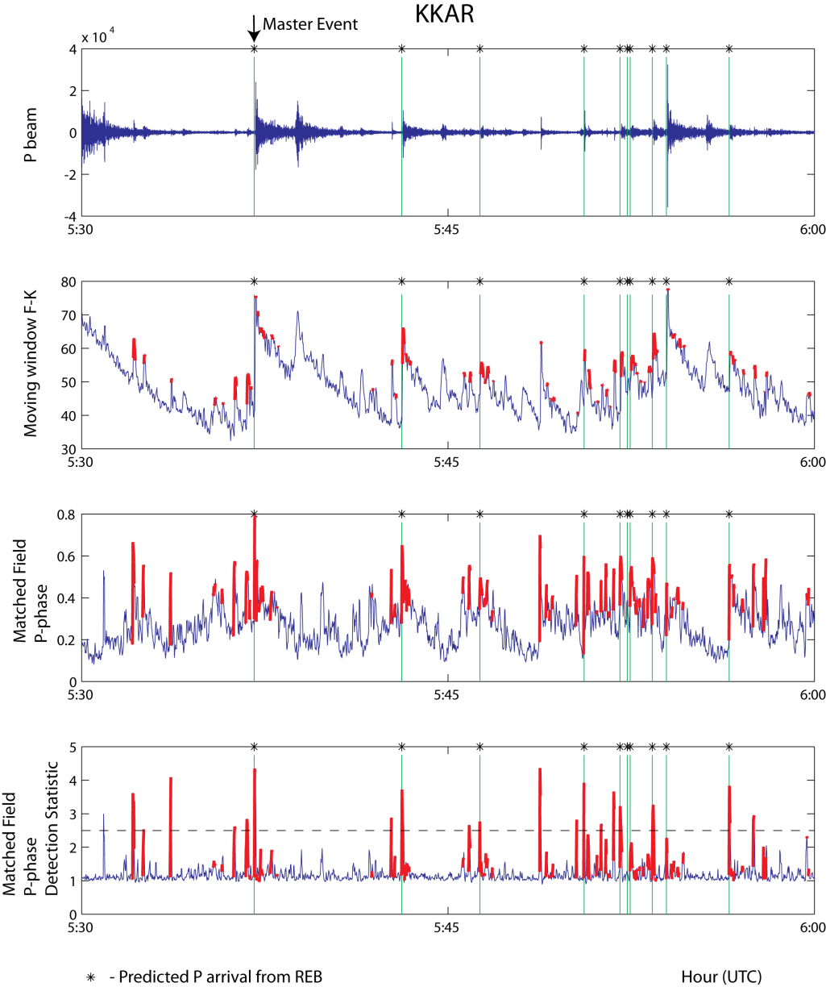
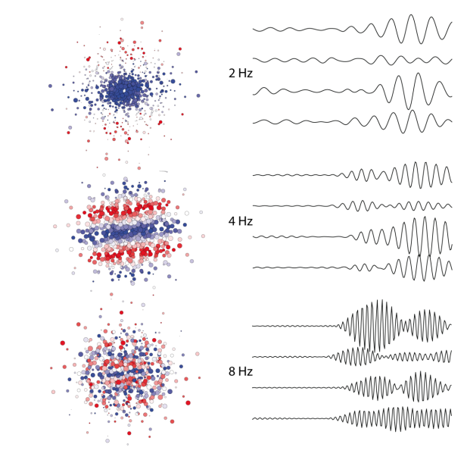
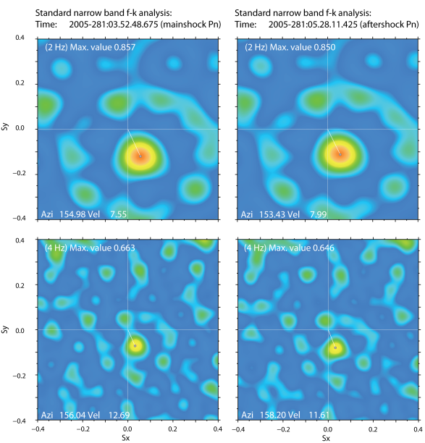
Rethinking Array Seismology in Nuclear-Test-Ban Treaty Monitoring
Steven J. Gibbons
Workshop on Arrays in Global Seismology, Raleigh, North Carolina, May 15-16 2013.
Rethinking Array Seismology in Nuclear-Test-Ban Treaty Monitoring
Steven J Gibbons. Raleigh, North Carolina, 16.05.2013

Slide 2
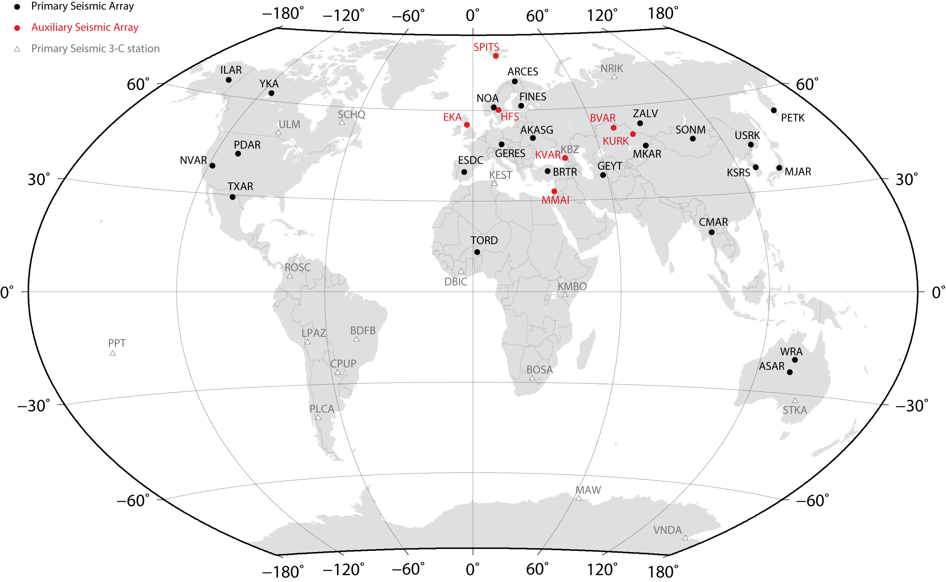
Seismic Arrays of the International Monitoring System (IMS)
Distribution of stations is a problem for monitoring global seismicity.
No seismic arrays in Southern Hemisphere except WRA, ASAR.
Rethinking Array Seismology in Nuclear-Test-Ban Treaty Monitoring
Steven J Gibbons. Raleigh, North Carolina, 16.05.2013

Slide 3
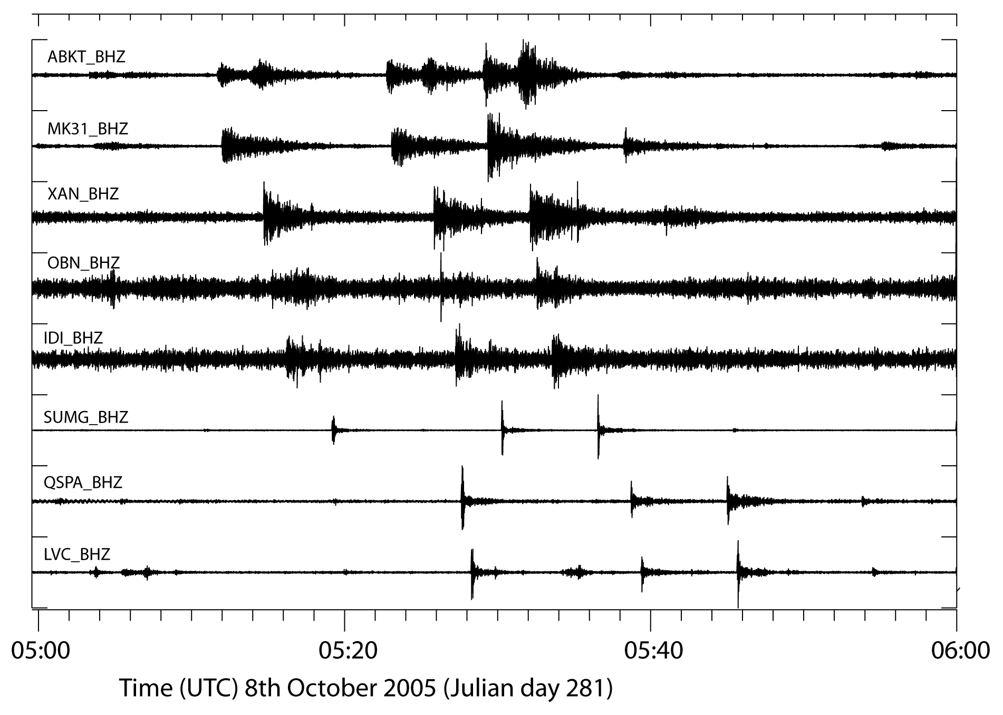
Seismic Arrays of the International Monitoring System (IMS)
The plot below shows an hour of data from global stations for part of the 2005/10/08 Kashmir aftershock sequence. The detectability is not necessarily optimal for Eurasian stations …
Rethinking Array Seismology in Nuclear-Test-Ban Treaty Monitoring
Steven J Gibbons. Raleigh, North Carolina, 16.05.2013
Notes:
We have in a couple of previous projects demonstrated that different types of correlation and matched field detectors can combine the detection and signal identification process into a single operation, and that this can significantly reduce the analyst efforts during aftershock sequences or when analyzing repeating events from well-characterized sources like active mines.
However, the the administrative overhead of creating and running pattern detectors are still relatively high, and we need to good find ways of incorporation a large number of them in parallel in operational pipelines. This is one of the main goals of the current project.

Slide 4
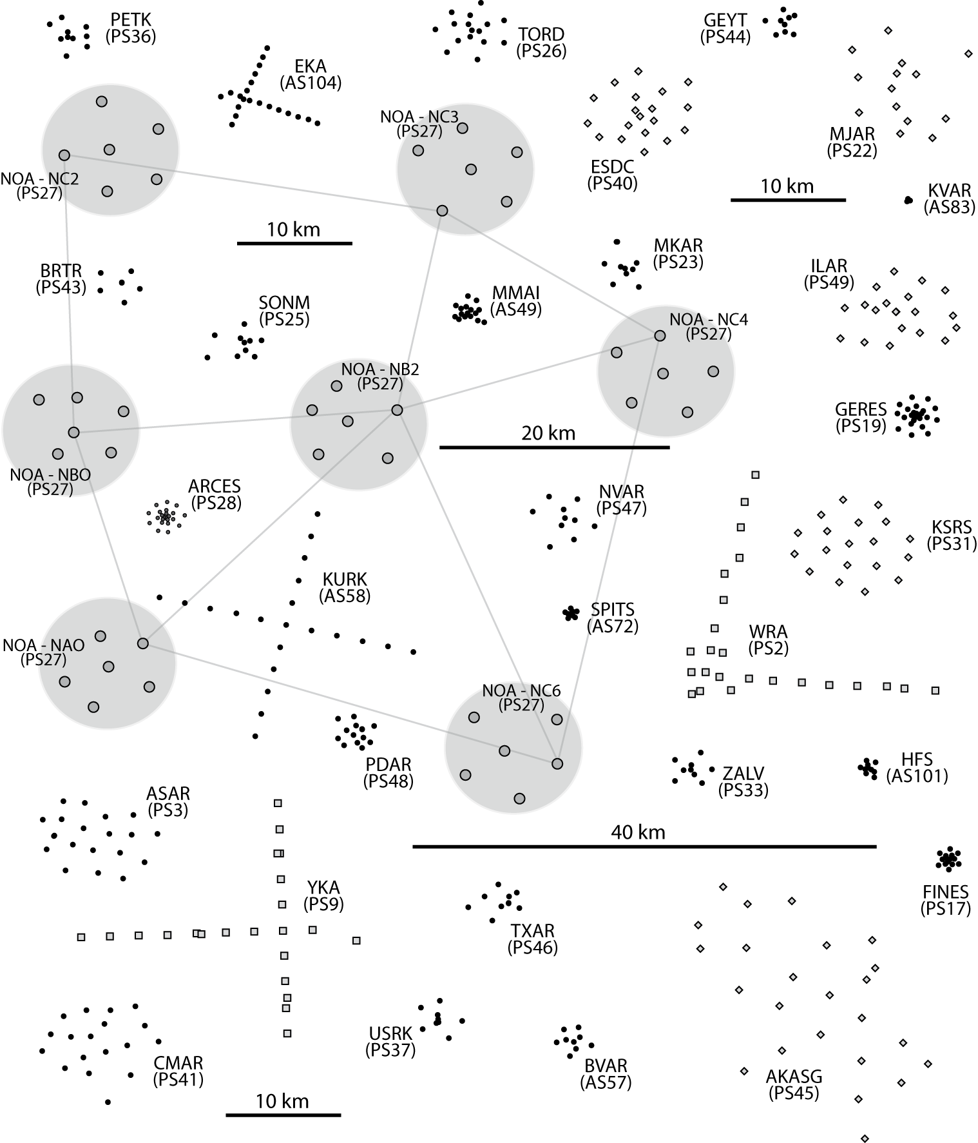
The IMS Seismic Arrays:
a diverse set of stations (!!!)
Over an order of magnitude range of array apertures: ~0.5 km to ~70 km
Resolution and beamforming gain for low-frequency phases poor on very small aperture arrays (Selby, BSSA 2011; GJI 2013)
High frequency signals are incoherent over large aperture arrays.
Both the above situations can result in non-detection or qualitatively incorrect parameter estimates (so not contributing to or even degrading automatic event bulletins)
Rethinking Array Seismology in Nuclear-Test-Ban Treaty Monitoring
Steven J Gibbons. Raleigh, North Carolina, 16.05.2013

Slide 5
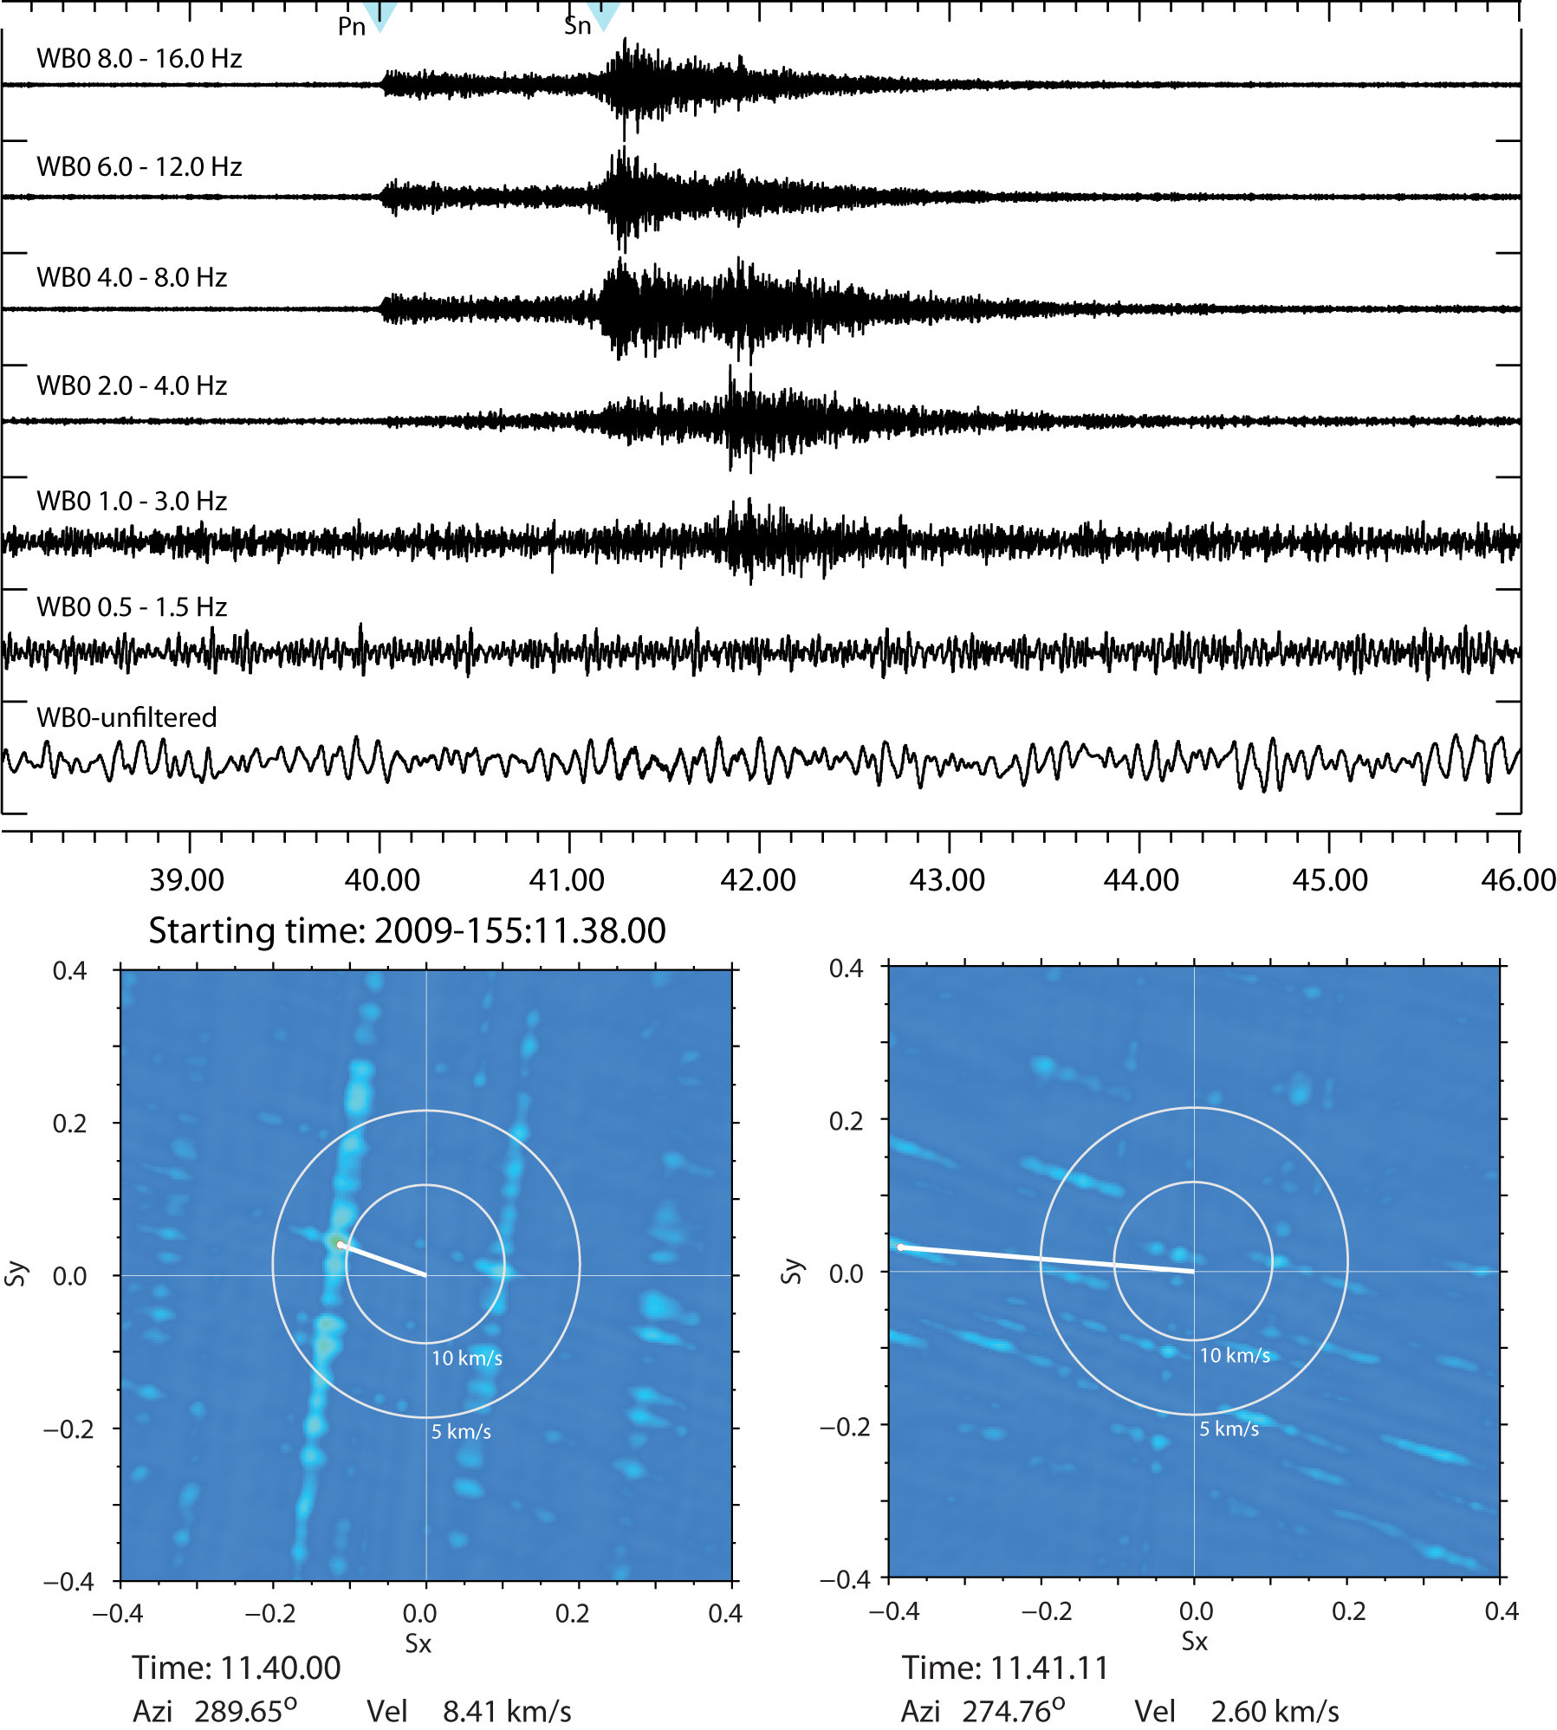
Incoherent Array Processing for regional phases on large arrays?
Example at WRA. Energy is at high frequencies. Coherent Processing only possible at low …
Rethinking Array Seismology in Nuclear-Test-Ban Treaty Monitoring
Steven J Gibbons. Raleigh, North Carolina, 16.05.2013

Slide 6
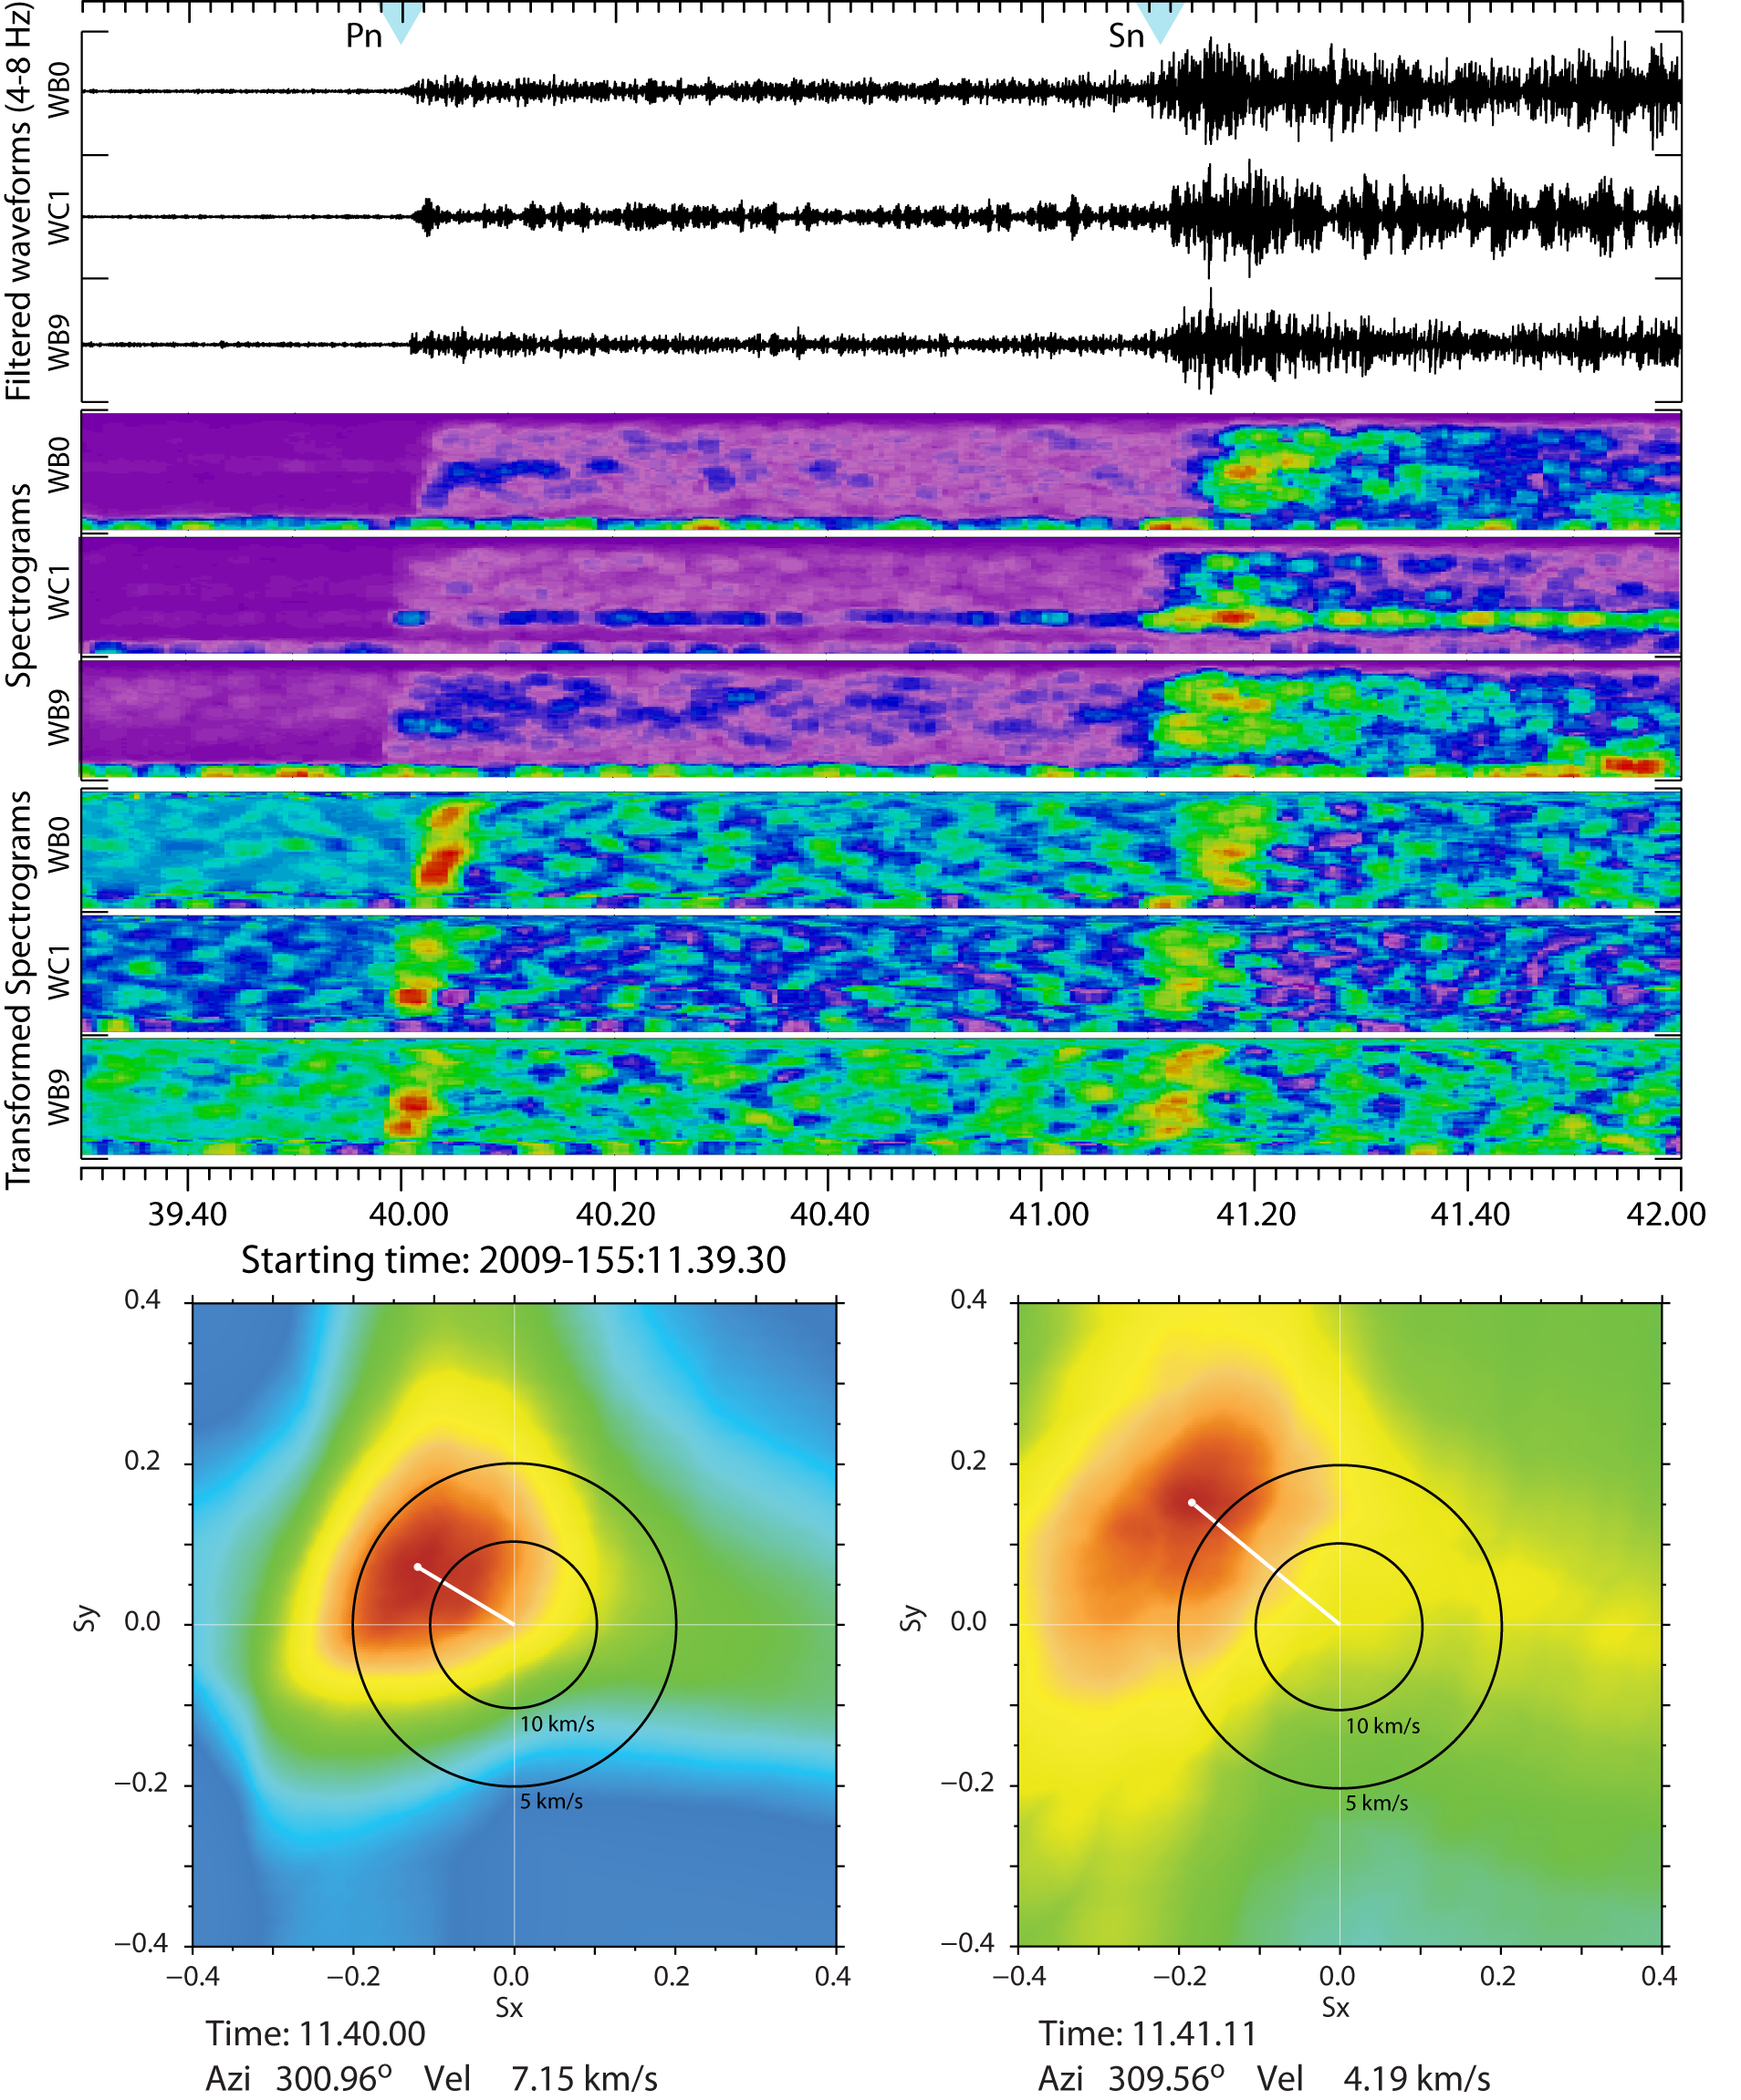
Incoherent Array Processing for regional phases on large arrays?
Generate spectrograms – differentiate – beamform. Lower resolution but more robust estimates …
Example at WRA. Energy is at high frequencies. Coherent Processing only possible at low …
Rethinking Array Seismology in Nuclear-Test-Ban Treaty Monitoring
Steven J Gibbons. Raleigh, North Carolina, 16.05.2013

Slide 7
Seismic Arrays of the International Monitoring System (IMS)
The utilization of some stations is poor due to the definition of Primary and Auxiliary networks. (e.g. KURK, SPITS)
Rethinking Array Seismology in Nuclear-Test-Ban Treaty Monitoring
Steven J Gibbons. Raleigh, North Carolina, 16.05.2013
Notes:
We have in a couple of previous projects demonstrated that different types of correlation and matched field detectors can combine the detection and signal identification process into a single operation, and that this can significantly reduce the analyst efforts during aftershock sequences or when analyzing repeating events from well-characterized sources like active mines.
However, the the administrative overhead of creating and running pattern detectors are still relatively high, and we need to good find ways of incorporation a large number of them in parallel in operational pipelines. This is one of the main goals of the current project.

Slide 8
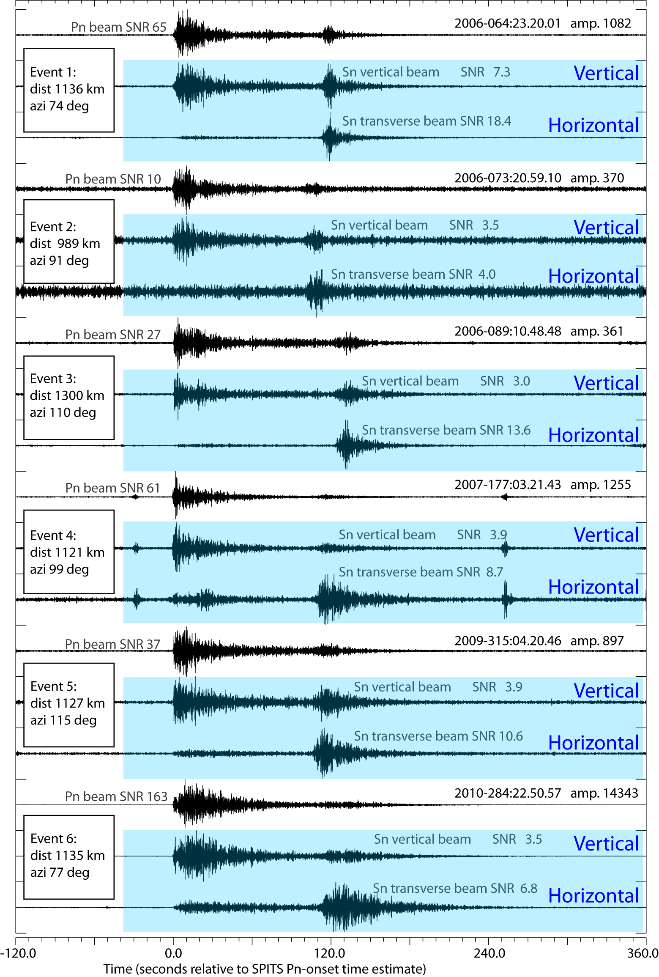
Underuse of 3-C sensors on IMS seismic arrays. Detection of S-phases?
Almost all IMS seismic arrays are vertical-only except for a single 3-C site. Some (e.g. ARCES, GERES, YKA ++) have a small number of 3-C sensors but rarely give an array-processing performance comparable to that of the full-array.
Detection of secondary phases crucial for monitoring of low magnitude events at regional distances with a relatively sparse network.
Beams of rotated horizontal traces are far more effective for the detection of S-phases than the vertical component beams.
Rethinking Array Seismology in Nuclear-Test-Ban Treaty Monitoring
Steven J Gibbons. Raleigh, North Carolina, 16.05.2013

Slide 9
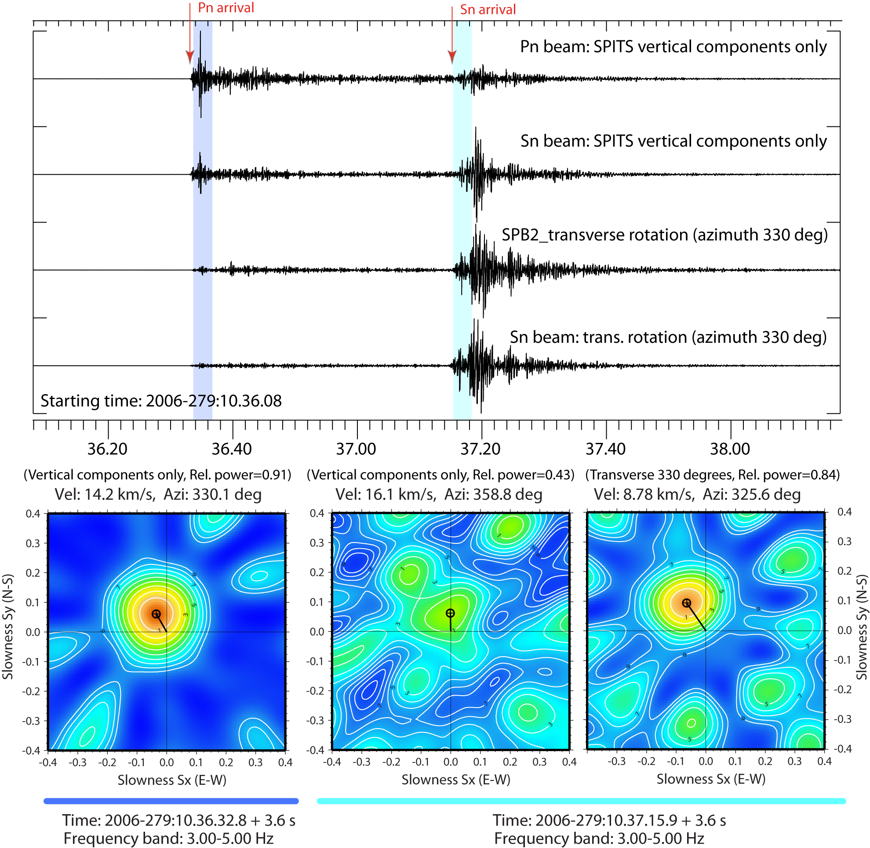
Underuse of 3-C sensors on IMS seismic arrays. Detection of S-phases?
Even when S-phases have a high SNR on the vertical component traces, the vertical f-k analysis often provides qualitatively misleading.
Chances of correct direction estimation and phase classification are greatly improved if f-k analysis is performed on many different components/rotations.
Full 3-C array analysis with particle motion???
Rethinking Array Seismology in Nuclear-Test-Ban Treaty Monitoring
Steven J Gibbons. Raleigh, North Carolina, 16.05.2013

Slide 10
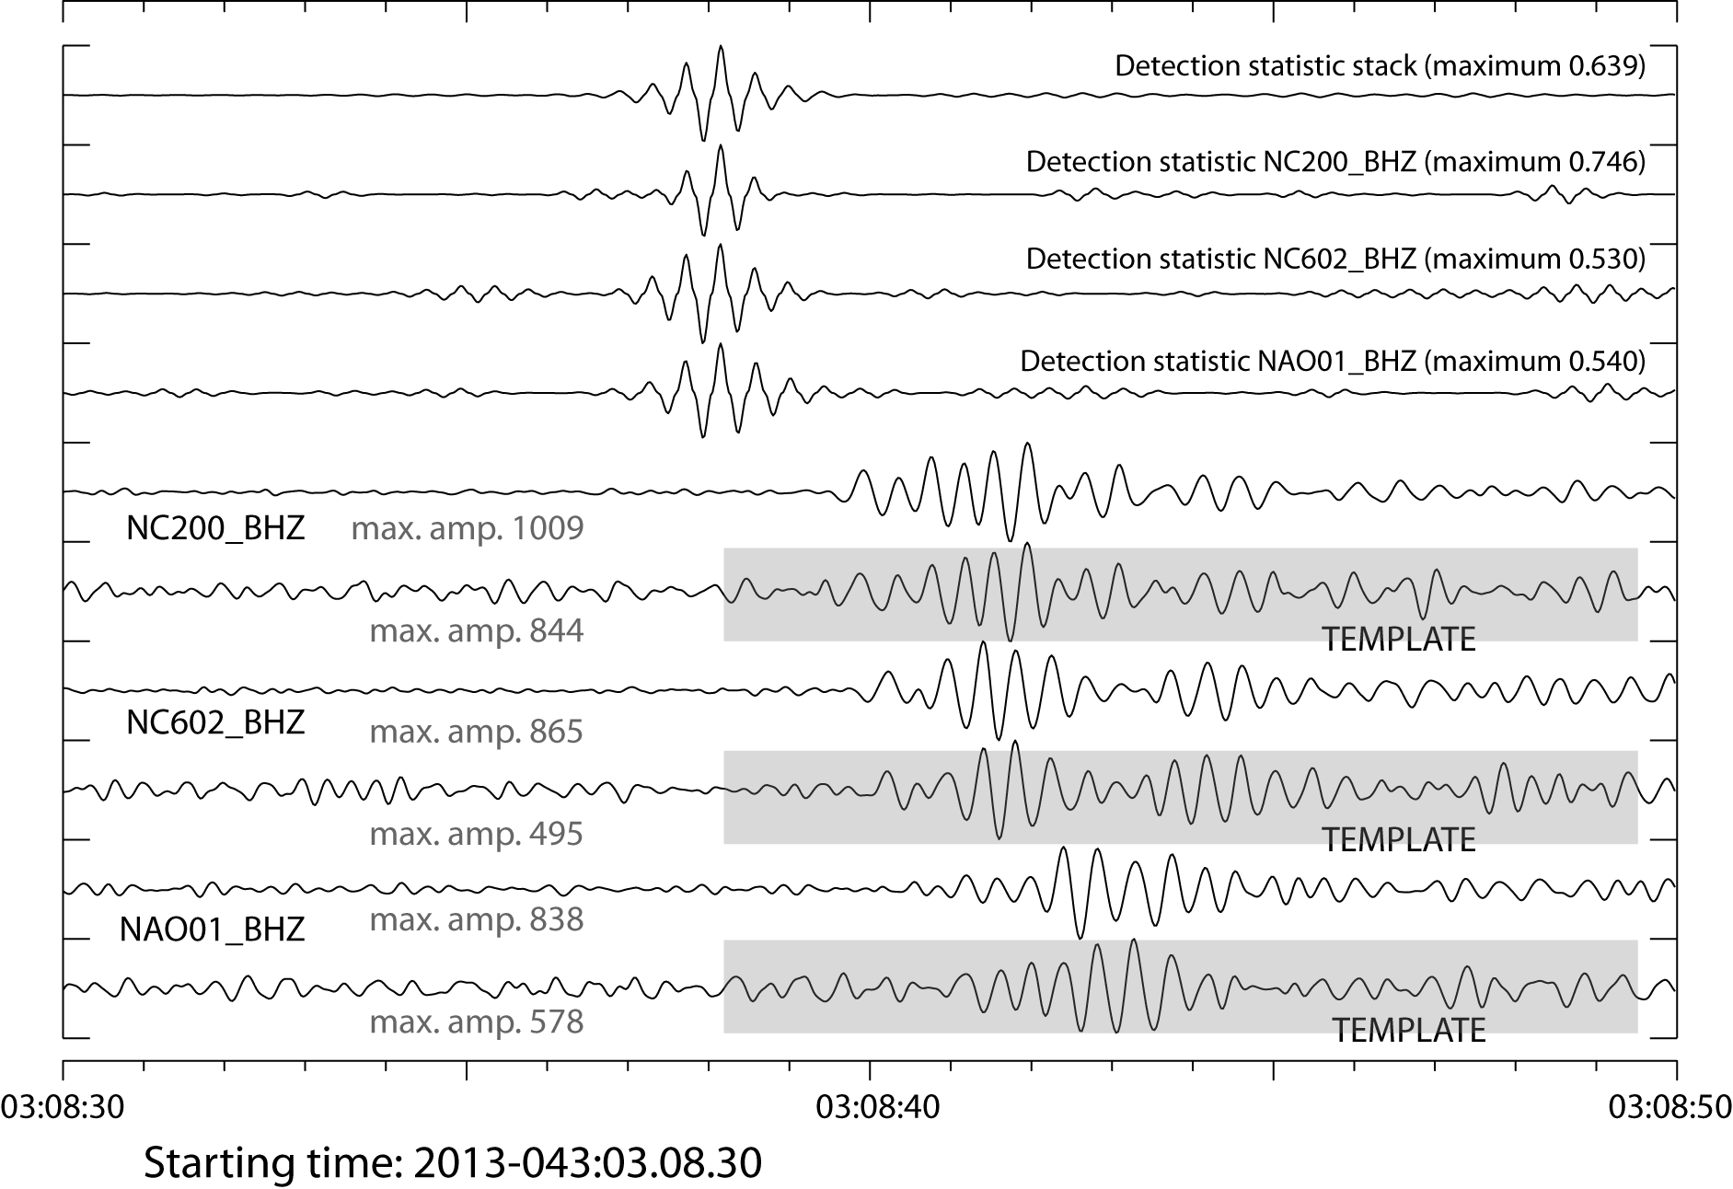
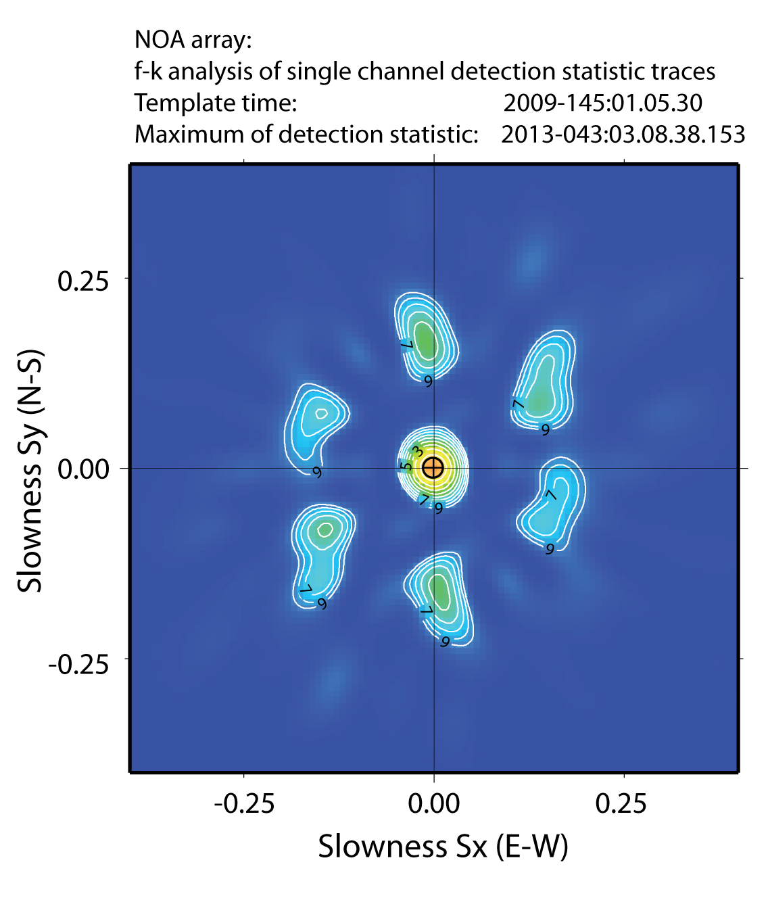
Array processing as a means to enhance correlation detector performance …
Two co-located events will generate CC-traces which stack perfectly over an array or network.
This property can be used to reduce the detection threshold dramatically.
f-k screen on the NOA array for detection of 2013 DPRK nuclear test (using 2009 waveform as template)
Rethinking Array Seismology in Nuclear-Test-Ban Treaty Monitoring
Steven J Gibbons. Raleigh, North Carolina, 16.05.2013
Notes:
We have in a couple of previous projects demonstrated that different types of correlation and matched field detectors can combine the detection and signal identification process into a single operation, and that this can significantly reduce the analyst efforts during aftershock sequences or when analyzing repeating events from well-characterized sources like active mines.
However, the the administrative overhead of creating and running pattern detectors are still relatively high, and we need to good find ways of incorporation a large number of them in parallel in operational pipelines. This is one of the main goals of the current project.

Slide 11
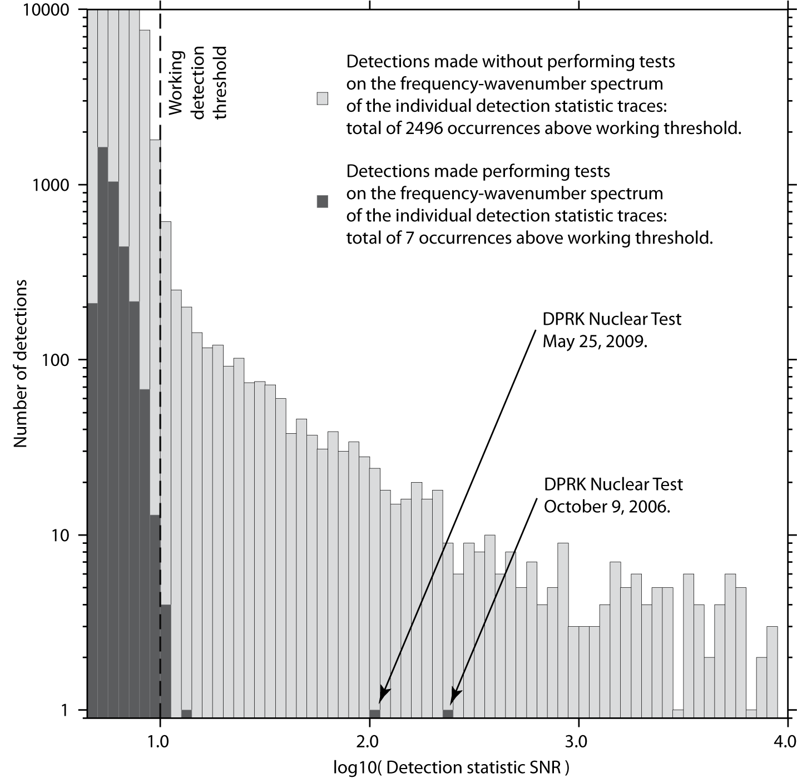
Array processing as a means to enhance correlation detector performance …
How important is f-k screening of correlation detections on an array?
Example from monitoring the North Korea nuclear test site on MJAR (Japan):
Alignment of cross-correlation traces probably constitutes a far more robust detection principle than the actual values of the detection statistics.
Rethinking Array Seismology in Nuclear-Test-Ban Treaty Monitoring
Steven J Gibbons. Raleigh, North Carolina, 16.05.2013
Notes:
We have in a couple of previous projects demonstrated that different types of correlation and matched field detectors can combine the detection and signal identification process into a single operation, and that this can significantly reduce the analyst efforts during aftershock sequences or when analyzing repeating events from well-characterized sources like active mines.
However, the the administrative overhead of creating and running pattern detectors are still relatively high, and we need to good find ways of incorporation a large number of them in parallel in operational pipelines. This is one of the main goals of the current project.

Slide 12
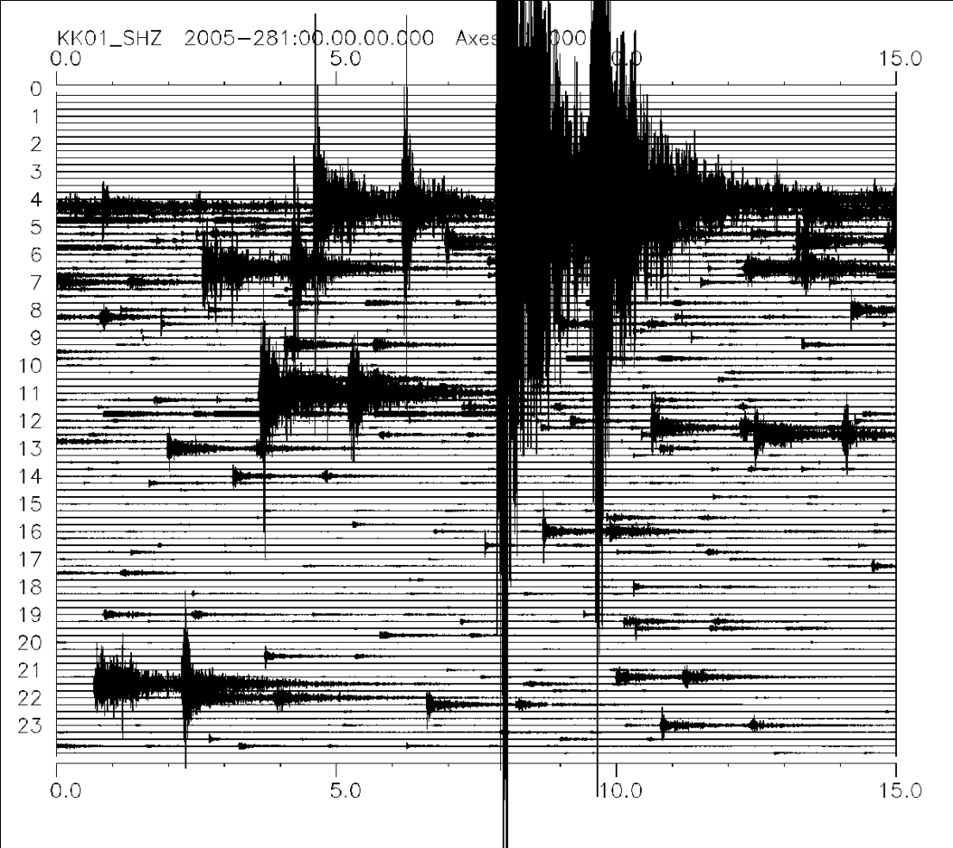
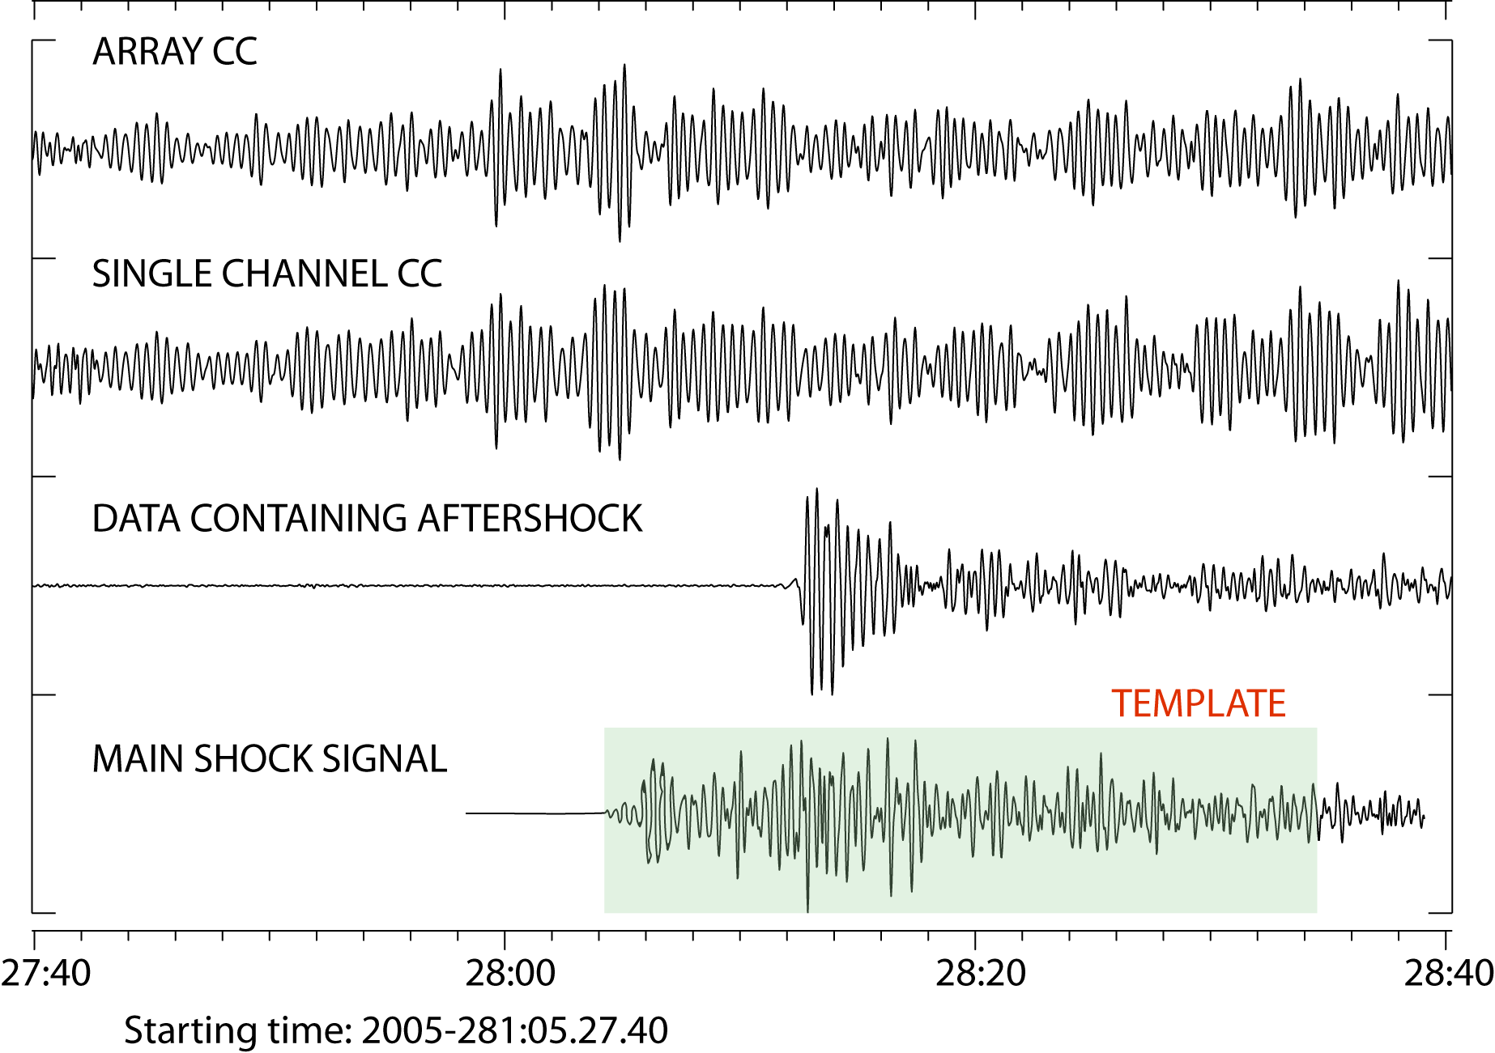
When correlation detectors fail?! Empirical Matched Field Processing (e.g. for aftershock sequences, ripple-fired mining blasts)
Large earthquakes (e.g. M=7+) can create enormous problems for data centers due to the extensive aftershock sequences that follow.
(IDC STILL not processed 20 days in January 2005!)
In a perfect world we would take a waveform template from the master event and just pick off the aftershocks from the CC-traces.
This does not work in any cases I have yet looked at …
Rethinking Array Seismology in Nuclear-Test-Ban Treaty Monitoring
Steven J Gibbons. Raleigh, North Carolina, 16.05.2013
Notes:
We have in a couple of previous projects demonstrated that different types of correlation and matched field detectors can combine the detection and signal identification process into a single operation, and that this can significantly reduce the analyst efforts during aftershock sequences or when analyzing repeating events from well-characterized sources like active mines.
However, the the administrative overhead of creating and running pattern detectors are still relatively high, and we need to good find ways of incorporation a large number of them in parallel in operational pipelines. This is one of the main goals of the current project.

Slide 13
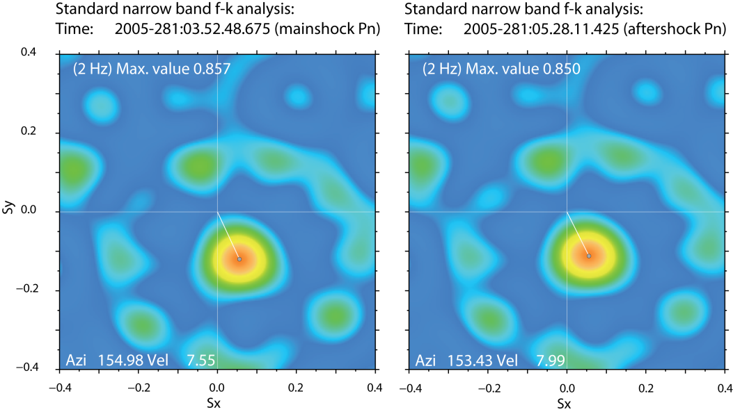
When correlation detectors fail?! Empirical Matched Field Processing (e.g. for aftershock sequences, ripple-fired mining blasts)
The temporal form of the waveform of the master event is typically not similar to that of significantly smaller aftershocks.
However, the pattern of the f-k spectrum when the wavefronts cross over an array are remarkably similar …
A different strategy?
Rethinking Array Seismology in Nuclear-Test-Ban Treaty Monitoring
Steven J Gibbons. Raleigh, North Carolina, 16.05.2013
Notes:
We have in a couple of previous projects demonstrated that different types of correlation and matched field detectors can combine the detection and signal identification process into a single operation, and that this can significantly reduce the analyst efforts during aftershock sequences or when analyzing repeating events from well-characterized sources like active mines.
However, the the administrative overhead of creating and running pattern detectors are still relatively high, and we need to good find ways of incorporation a large number of them in parallel in operational pipelines. This is one of the main goals of the current project.

Slide 14
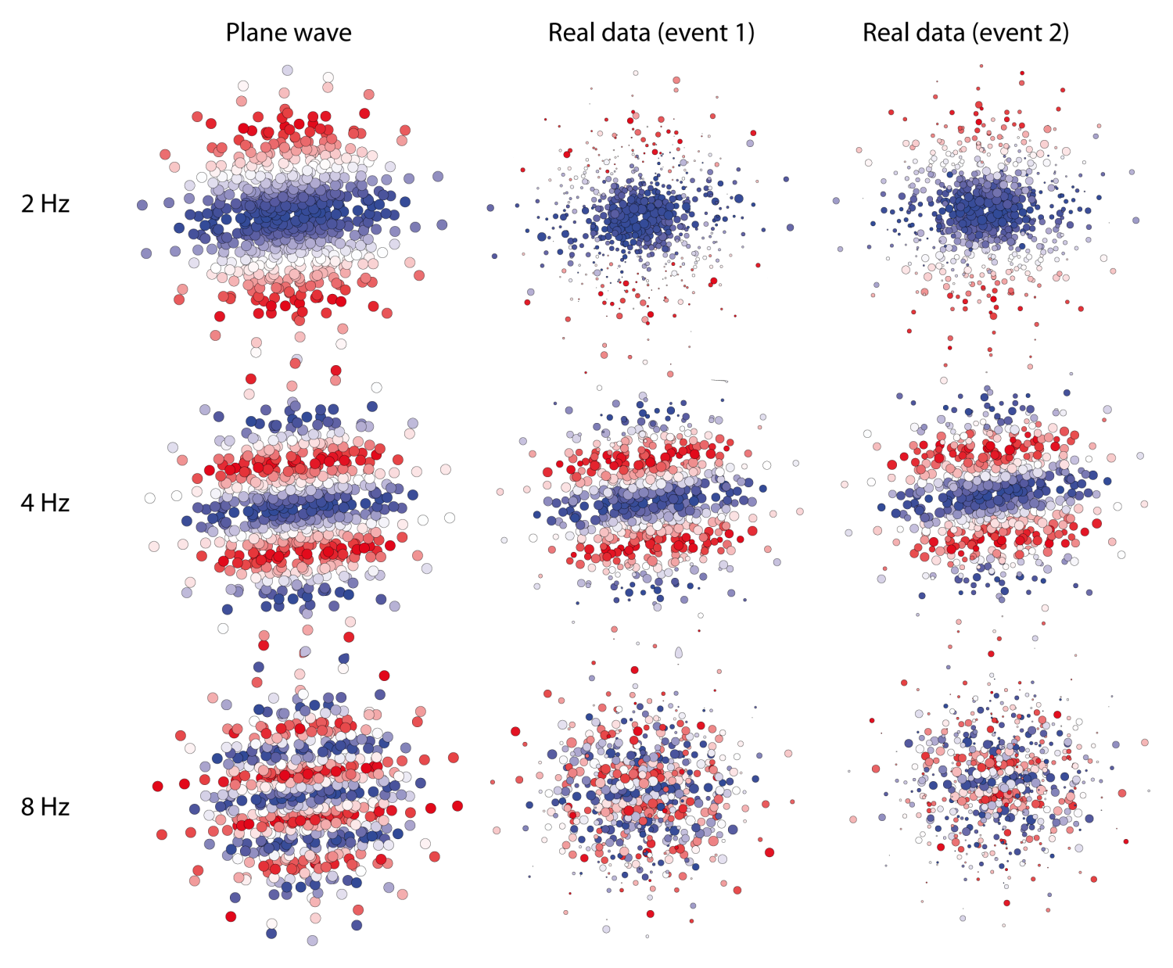
When correlation detectors fail?! Empirical Matched Field Processing (e.g. for aftershock sequences, ripple-fired mining blasts)
This «spatial fingerprint» may be highly characteristic for a given source region.
Far more characteristic than the temporal form of the wavetrain?
Observed phase shifts constitute «empirical steering vectors».
Rethinking Array Seismology in Nuclear-Test-Ban Treaty Monitoring
Steven J Gibbons. Raleigh, North Carolina, 16.05.2013
Notes:
We have in a couple of previous projects demonstrated that different types of correlation and matched field detectors can combine the detection and signal identification process into a single operation, and that this can significantly reduce the analyst efforts during aftershock sequences or when analyzing repeating events from well-characterized sources like active mines.
However, the the administrative overhead of creating and running pattern detectors are still relatively high, and we need to good find ways of incorporation a large number of them in parallel in operational pipelines. This is one of the main goals of the current project.

Slide 15
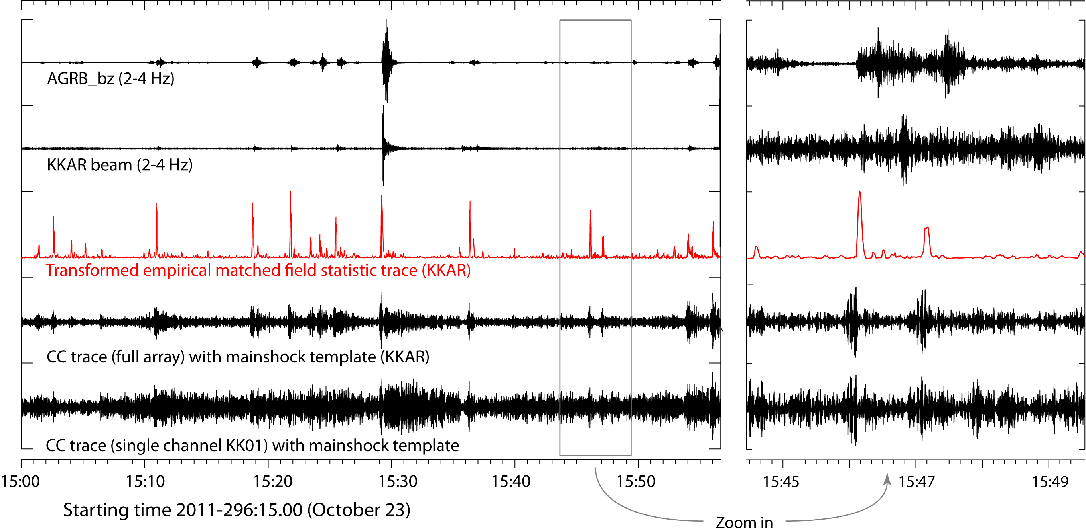
When correlation detectors fail?! Empirical Matched Field Processing (e.g. for aftershock sequences, ripple-fired mining blasts)
Design the matching field from the P-phase of the main shock.
Better performance than correlation and STA/LTA.
Very efficient trigger screen.
Rethinking Array Seismology in Nuclear-Test-Ban Treaty Monitoring
Steven J Gibbons. Raleigh, North Carolina, 16.05.2013
Notes:
We have in a couple of previous projects demonstrated that different types of correlation and matched field detectors can combine the detection and signal identification process into a single operation, and that this can significantly reduce the analyst efforts during aftershock sequences or when analyzing repeating events from well-characterized sources like active mines.
However, the the administrative overhead of creating and running pattern detectors are still relatively high, and we need to good find ways of incorporation a large number of them in parallel in operational pipelines. This is one of the main goals of the current project.

Slide 16
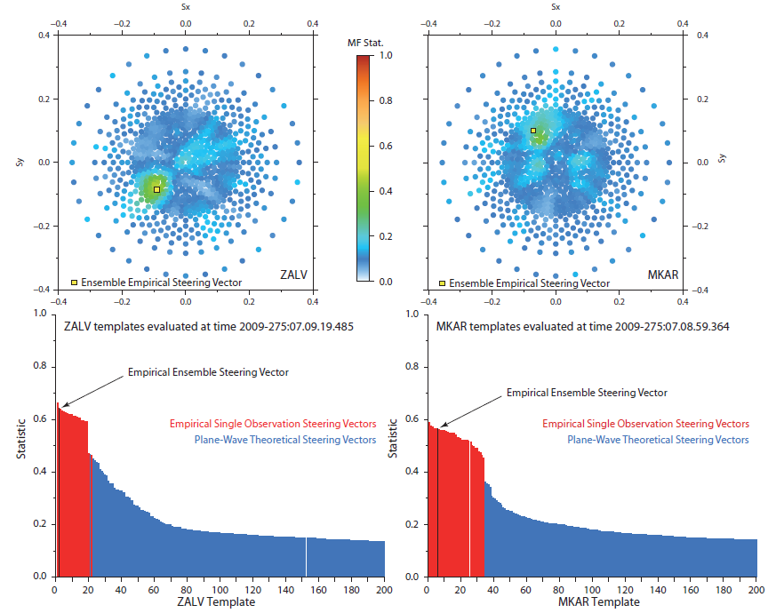
EMFP is a generalization of standard f-k analysis.
We can implement empirical vectors in standard pipelines.
Rethinking Array Seismology in Nuclear-Test-Ban Treaty Monitoring
Steven J Gibbons. Raleigh, North Carolina, 16.05.2013
Notes:
We have in a couple of previous projects demonstrated that different types of correlation and matched field detectors can combine the detection and signal identification process into a single operation, and that this can significantly reduce the analyst efforts during aftershock sequences or when analyzing repeating events from well-characterized sources like active mines.
However, the the administrative overhead of creating and running pattern detectors are still relatively high, and we need to good find ways of incorporation a large number of them in parallel in operational pipelines. This is one of the main goals of the current project.

Slide 17
Conclusions …
Coverage of global seismicity would probably improve vastly if seismic arrays were deployed globally and not just in the Northern Hemisphere! (Arrays providing good gain and good resolution for 1-6 Hz signals would have to have an aperture < 10 km – preferably < 4 km.)
Special considerations need to be applied to process optimally low frequency signals on small arrays and high frequency signals on large arrays. (Not currently done.)
3-C arrays currently not really exploited in Nuclear Explosion Monitoring (IDC). (Partly politics/strategy.) Vital for detection and classification of HF S-phases.
Array processing improves dramatically the performance of pattern detectors: The false alarm rate (and hence detection threshold) is lowered dramatically by array processing the correlation detector output.
Empirical Matched Field Processing is a very promising method for detecting and classifying aftershocks and repeating explosions – and for combining pattern detectors into standard processing pipelines.
Rethinking Array Seismology in Nuclear-Test-Ban Treaty Monitoring
Steven J Gibbons. Raleigh, North Carolina, 16.05.2013
Notes:
We have in a couple of previous projects demonstrated that different types of correlation and matched field detectors can combine the detection and signal identification process into a single operation, and that this can significantly reduce the analyst efforts during aftershock sequences or when analyzing repeating events from well-characterized sources like active mines.
However, the the administrative overhead of creating and running pattern detectors are still relatively high, and we need to good find ways of incorporation a large number of them in parallel in operational pipelines. This is one of the main goals of the current project.

