Slide 1


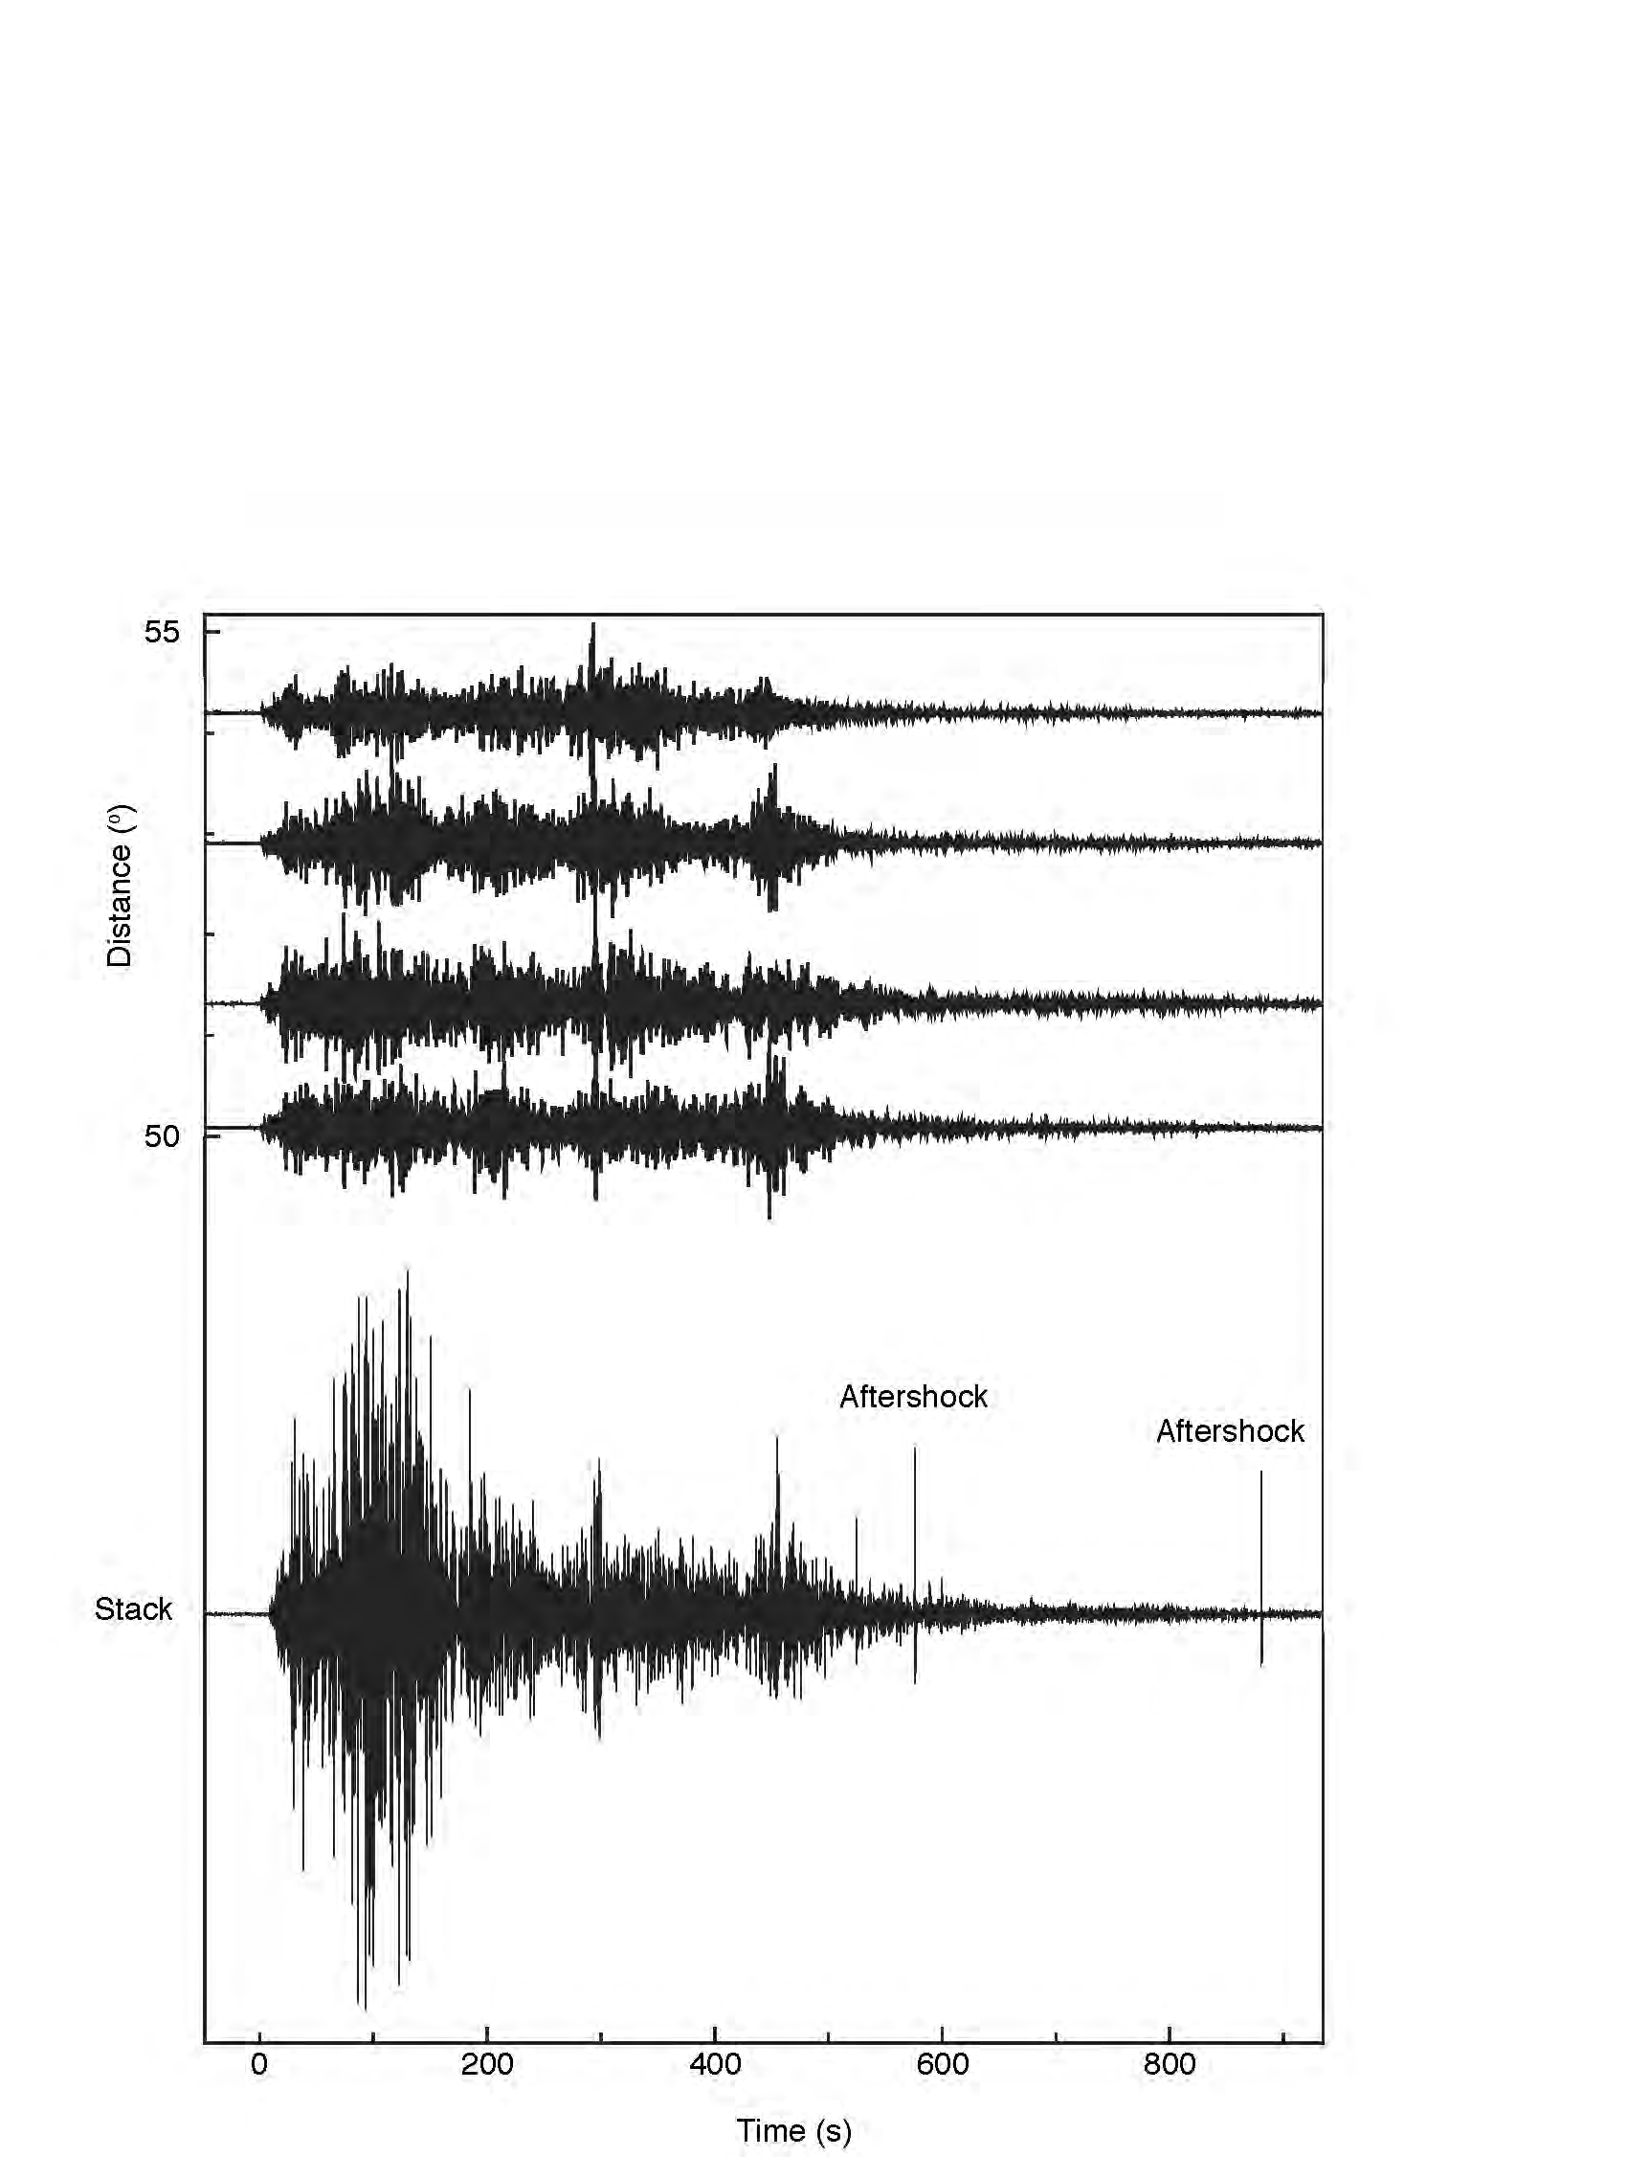
The March 11, 2011 Tohoku, Japan aftershock sequence as imaged by the back-projection method
Eric Kiser^{1,2} and Miaki Ishii¹
1) Harvard University 2) Rice University

Slide 2
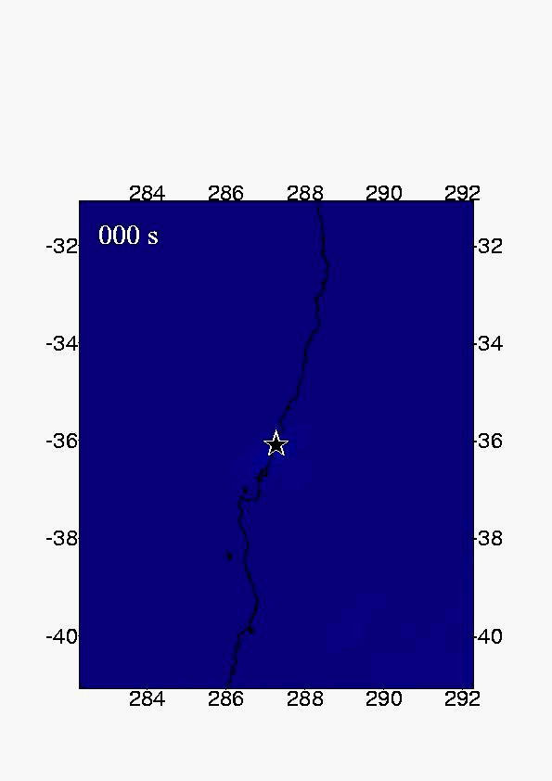
Motivation
February 27, 2010 Mw 8.8
Maule, Chile
Dominant northern rupture
  High rupture speed
Bilateral rupture
Weak southern rupture
  Low rupture speed
Notes:
Chile Earthquake

Slide 3
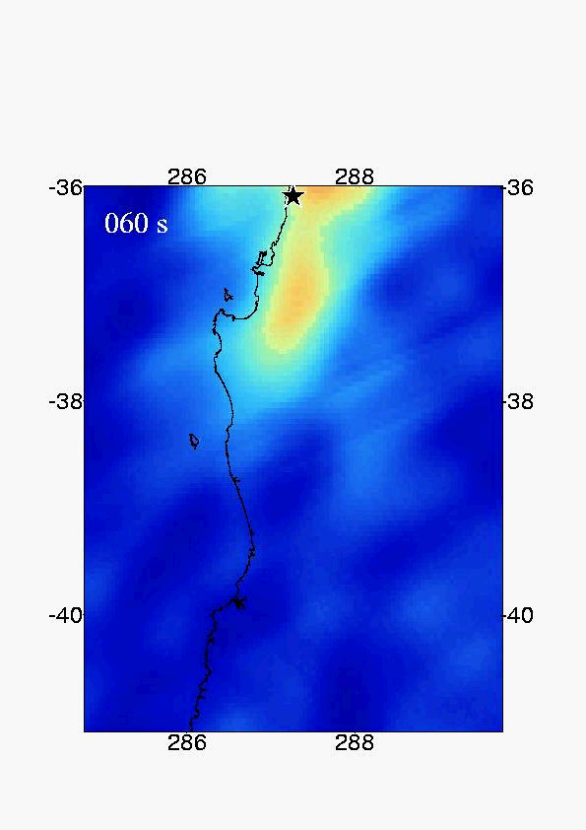
Motivation
February 27, 2010 Mw 8.8
Maule, Chile
Dominant northern rupture
  High rupture speed
Bilateral rupture
Weak southern rupture
  Low rupture speed
Southern rupture imaged in the presence of strong northern rupture
Notes:
Chile Earthquake

Slide 4
Motivation
JMA
March 11, 2011 Mw 9.0
Tohoku, Japan
(Aftershocks)
Image aftershocks during high noise levels
  Seismic waves from the mainshock
  Large aftershocks
JMA Catalogue
First day of aftershocks
  2472 events

Slide 5
Motivation
(Spatial Gaps)
Nanjo et al., 2010

Slide 6
Early Tohoku Aftershocks
~600 North American stations
Band-pass filter data: 0.8-2Hz
Back-project 25 hours of data to the Mw 9.0 mainshock region

Slide 7
Early Tohoku Aftershocks
~600 North American stations
Band-pass filter data: 0.8-2Hz
Back-project 25 hours of data to the Mw 9.0 mainshock region

Slide 8
March 11, 2011 Tohoku Aftershocks
Pick peaks in amplitude/time plots
Event times are chosen at the maximum amplitude times
Plot the spatial distribution of peaks
Event locations are chosen as the center of the energy kernels
Time w.r.t. March 11, 19:45:18

Slide 9
March 11, 2011 Tohoku Aftershocks
2
1
3
1
2
4
3
4

Slide 10
March 11, 2011 Tohoku Aftershocks
(Back-projection catalogue)
BP Results
600 Events detected during the initial 25 hours
Events near the trench and outer rise

Slide 11
March 11, 2011 Tohoku Aftershocks
(JMA Comparison)
Back-projection
JMA

Slide 12
March 11, 2011 Tohoku Aftershocks
(JMA Comparison)
300 in both catalogues
300 only in the back-projection catalogue
Notes:
89 not in JMA with 2.0 degrees and 100.0 seconds

Slide 13
March 11, 2011 Tohoku Aftershocks
(Matched BP Events)
Broad distribution
Few events near the trench and outer rise
Magnitude of matched events

Slide 14
March 11, 2011 Tohoku Aftershocks
(Matched BP Events)

Slide 15
March 11, 2011 Tohoku Aftershocks
(Matched BP Events)

Slide 16
March 11, 2011 Tohoku Aftershocks
(Unmatched BP Events)
Events cluster near the trench and in the outer rise
Use amplitude/magnitude relationship from matched events

Slide 17
March 11, 2011 Tohoku Aftershocks
(Unmatched BP Events)
March 11
06:19:08
M 6.8

Slide 18
March 11, 2011 Tohoku Aftershocks
(Unmatched BP Events)
Time w.r.t. March 11, 05:45:18
Estimated magnitude: 6.8

Slide 19
March 11, 2011 Tohoku Aftershocks
(Unmatched BP Events)
Time w.r.t. March 11, 05:45:18
Estimated magnitude: 6.8
3 JMA events (M 4.7, 4.5, and 5.7)

Slide 20
March 11, 2011 Tohoku Aftershocks
(Unmatched BP Events)
Time w.r.t. March 11, 05:45:18
Estimated magnitude: 6.8
3 JMA events (M 4.7, 4.5, and 5.7)
1 NEIC event (Mw 6.6)

Slide 21
March 11, 2011 Tohoku Aftershocks
Combining unmatched BP events with JMA catalogue reduces spatial gaps
Jump in the magnitude of completeness near the trench

Slide 22
Summary
600 events detected during the first 25 hours of the aftershock sequence
Unmatched events cluster near the trench
Expand back-projection analysis
Characteristics of unmatched events

Slide 23
March 11, 2011 Tohoku Aftershocks
(Back-projection catalogue)
Notes:
P=0.9

Slide 24
March 11, 2011 Tohoku Aftershocks
(Back-projection catalogue)
Strike Directions
Dip Directions
Notes:
P=0.9

Slide 25
March 11, 2011 Tohoku Aftershocks
(JMA Comparison)
300 in both catalogues
300 only in the back-projection catalogue

Slide 26
March 11, 2011 Tohoku Aftershocks
(Unmatched JMA Events)

Slide 27
Depth Distribution
(Unmatched JMA Events)
All JMA Events
(M ≥ 4.5)
Unmatched JMA Events
(M ≥ 4.5)

Slide 28
March 11, 2011 Tohoku Aftershocks
(Unmatched BP Events)
0.5 degrees / 30 seconds
2 degrees / 50 seconds

Slide 29
March 11, 2011 Tohoku Aftershocks
(Combined Catalogue)
Notes:
P=1.1

Slide 30
March 11, 2011 Tohoku Aftershocks
(NEIC Comparison)
Back-projection
NEIC

Slide 31
NEIC Comparison
(Matched BP Events)
409 of 600 BP events are matched
No Spatial Distinction

Slide 32
NEIC Comparison
(Unmatched BP Events)
191 of 600 BP events are unmatched
No Spatial Distinction
Unmatched events decrease with time

Slide 33
March 11, 2011 Tohoku Aftershocks
(Unmatched BP Events)

Slide 34
March 11, 2011 Tohoku Aftershocks
(Waveform Matching Catalogue)
Lengline et al., 2012

Slide 35
March 11, 2011 Tohoku Aftershocks
(JMA catalogue)
Notes:
P=0.9

Slide 36
Characteristics of Undetected Events
Depth=15 Km
Notes:
500 15

Slide 37
Characteristics of Undetected Events
Depth=30 Km
Notes:
Source 500 30

Slide 38
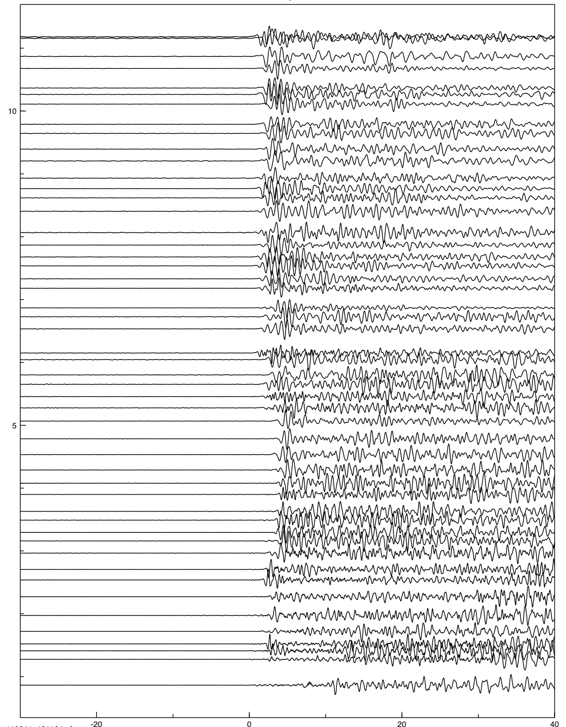
Characteristics of Unmatched Events
10
March 11, 2011
18:11:24
M 6.1
Distance (˚)
5
-20
0
20
40
Time (s)

Slide 39
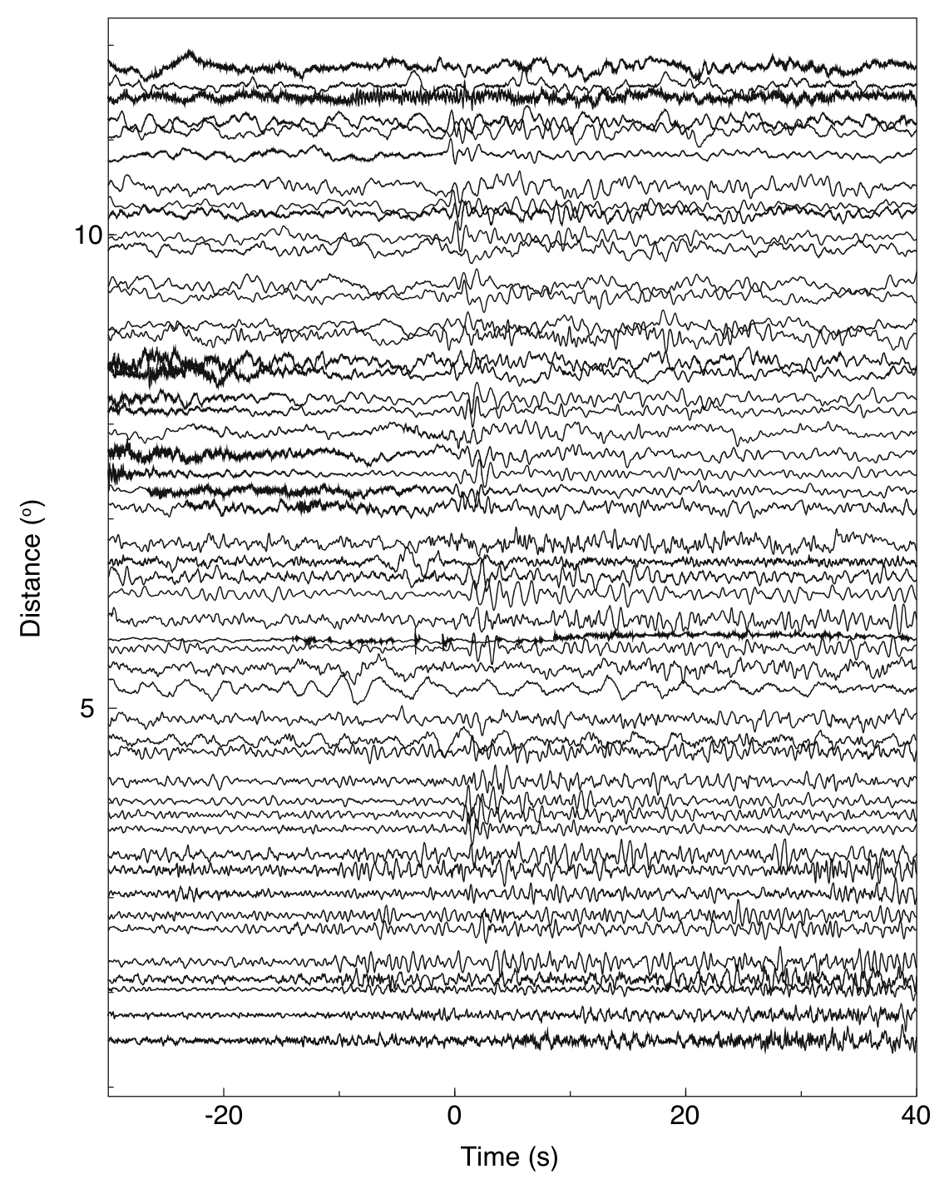
Characteristics of Unmatched Events
March 11, 2011
07:23:30

Slide 40
March 11, 2011 Tohoku Aftershocks
(Unmatched BP Events)
Events cluster near the trench and in the outer rise

Slide 41
Motivation
March 11, 2011 Mw 9.0
Tohoku, Japan
(Aftershocks)
Image aftershocks during high noise levels
  Seismic waves from the mainshock
  Large aftershocks
JMA Catalogue
First day of aftershocks
  2472 events (JMA)

Slide 42
Motivation

Slide 43
Implications
Seismic and Tsunami Hazards
Mainshock Rupture Behavior
Kato and Igarashi, 2012

Slide 44
Plate Interface

Slide 45

Back-Projection
Array of stations
Wavefront
+
+
+
+
+
+
+
+
+
+
+
+
+
+
+
+
+
+
+
+
+
+
+
+
Time-reverse data to a grid of possible source locations

Slide 46
Back-Projection

Slide 47
March 11, 2011 Tohoku Aftershocks

Slide 48
March 11, 2011 Tohoku Aftershocks
(JMA Comparison)

Slide 49
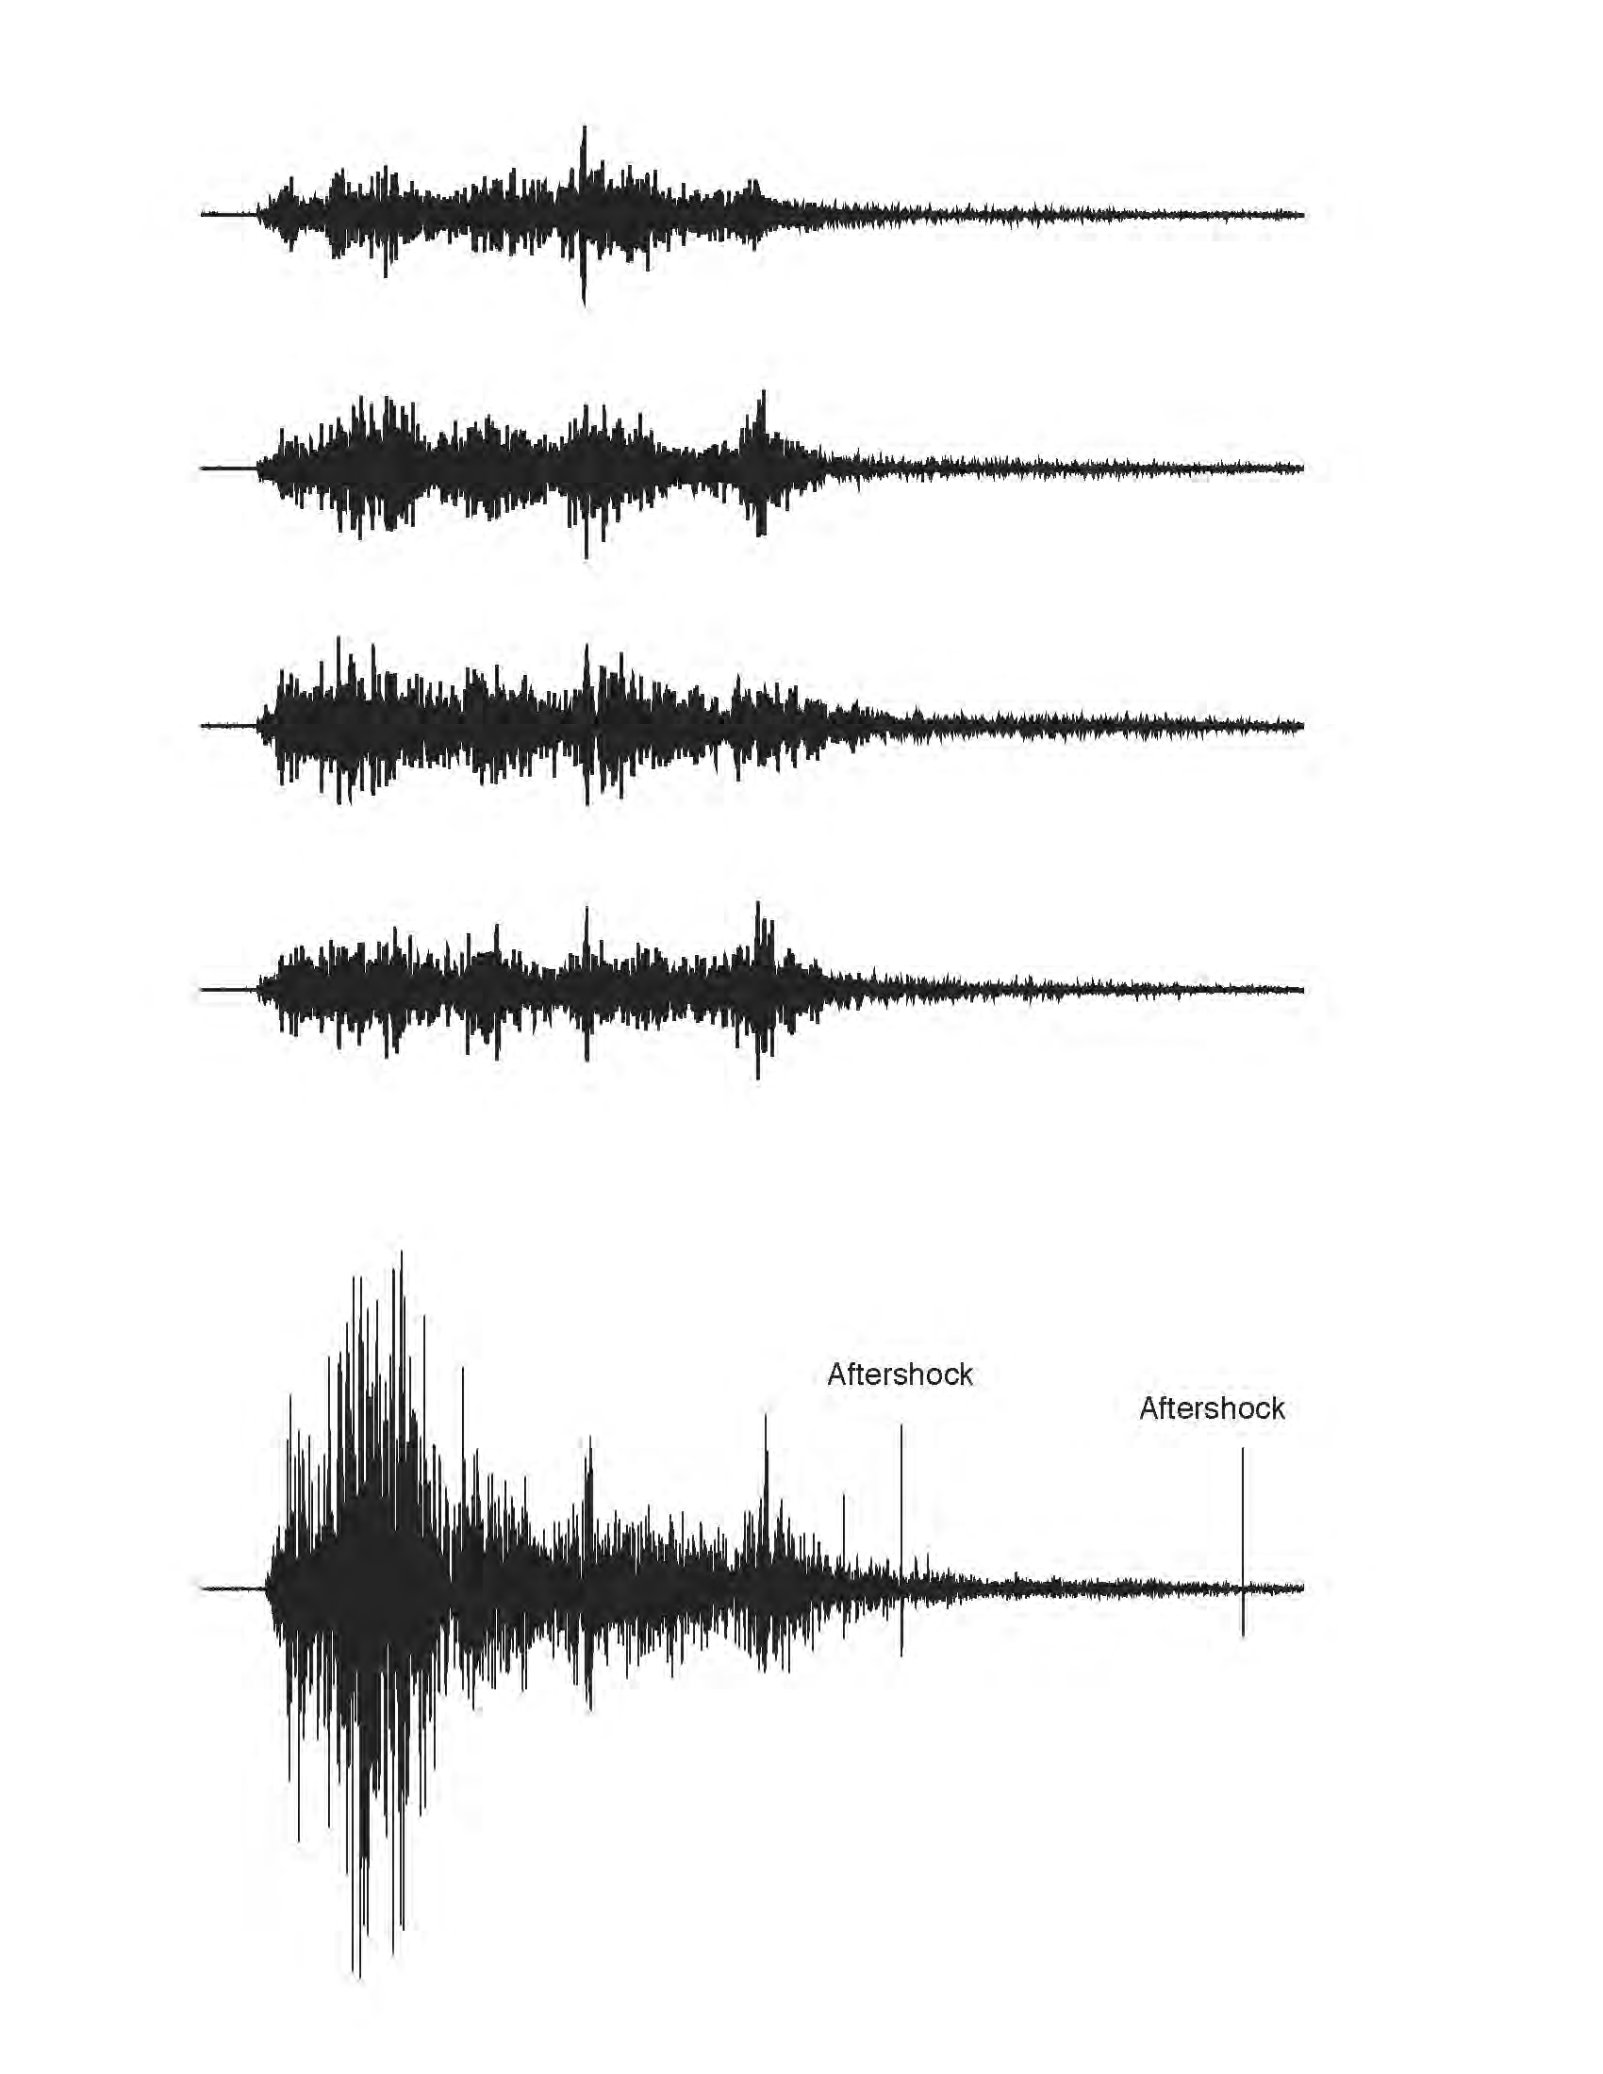
Motivation
+
+
+
+
+
+
+
+
+
+
+
+
+
+
+
+
+
+
+
+
+
+
+
+
Mainshock
Aftershocks

Slide 50
Motivation
NEIC
JMA
First Day of Aftershocks
  663 NEIC
  2472 JMA

Slide 51
Motivation
Image aftershocks during high noise levels
  Seismic waves from the mainshock
  Large aftershocks
First day of aftershocks
  2472 events (JMA)

Slide 52
Motivation
Spatial Gaps
Early Aftershocks
Spatial Completeness of Existing Catalogues
Nanjo et al., 2010

Slide 53
Motivation
Spatial Gaps
Early Aftershocks

Slide 54
Motivation
(Spatiotemporal Gaps)

Slide 55
Motivation
(Spatiotemporal Gaps)

Slide 56
Motivation
JMA
March 11, 2011 Mw 9.0
Tohoku, Japan
(Aftershocks)
Image aftershocks during high noise levels
  Seismic waves from the mainshock
  Large aftershocks

