Slide 1
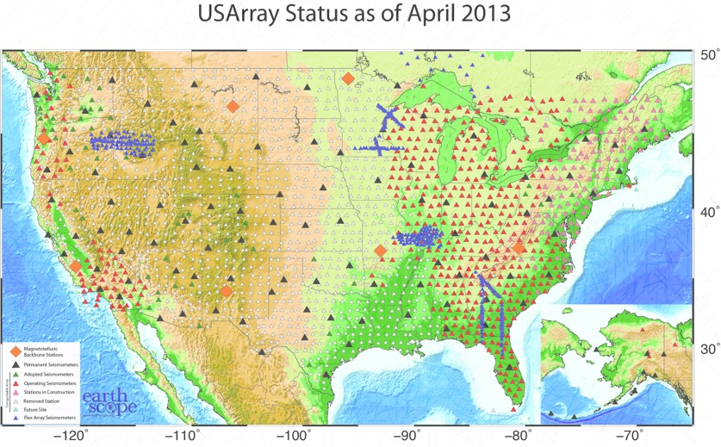






Towards Optimal Design of Seismic Array For Earthquake Source Imaging
Lingsen Meng
UC Berkeley Seismological Laboratory
Pablo Ampuero
Caltech Seismo Lab

Slide 2
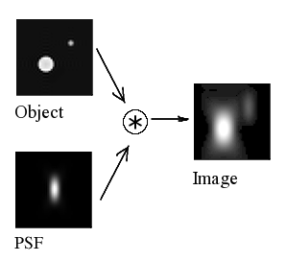
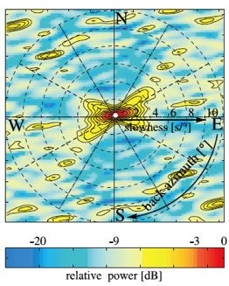
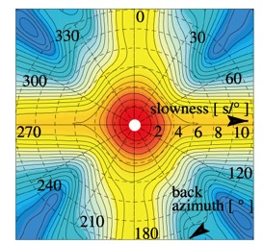
Point Spread Function
GRF array
Yellow Knife Array
Slowness (s/°)
Slowness (s/°)
(Rost & Thomas ,2002)

Slide 3
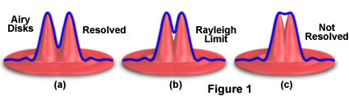
Rayleigh Criteria (resolution limit)
A
L, azimuthal resolution limit on the fault
Δ, distance away from the source
A, aperture of the array
λ, Horizontal wavelength
Array
Δ
Fault
USArray Example :
Δ=70°, λ=18 km/s*1s=18 km,
A=25°, L=50 km
L

Slide 4
Coherency
100Hz
10Hz
1Hz
Luco and Wong (1986)

Slide 5
Coherency of USArray
M6.3
M7.7
Deep earthquakes (most simple sources with enough SNR)
Same processing for BACK-PROJECTION,
( Teleseismic vertical component, Period proportional window, Narrow band, Alignment, First window)
Flat for small earthquake, distance fall-off for large earthquake

Slide 6
Incoherency Caused by Uncorrelated Noise
Signal to Noise Ratio (dB)

Slide 7
Implications
Coherency falls off due to finite source
The first arrival window is coherent up to 5hz across US Array
Coherency is not a problem for source imaging (If the early coda decays fast enough)
Consideration of resolution (size), Aliasing (spacing) and SNR (borehole) for conventional array design
Adapting array processing to finite source effect (alignment with small earthquaks)

Slide 8
Point Spreading Function of USArray
All stations
1/2 stations
1/4 stations
1/8 stations
Notes:
Usarray is too dense for source imaging, criteria is that the strong side lobe does not come in the field of view, our tolerance of the secondary feature
Label the number of stations.

Slide 9
Resampled BP of the Tohoku earthquake
All stations
1/2 stations
1/4 stations
1/8 stations
Notes:
No difference in ¼ stations, over all the same

Slide 10
The Early Coda
Notes:
How fast

Slide 11
A Large Continental Array For Source Imaging
Notes:
Plot the array response of the backbone.

Slide 12
PSF of the TA backbone stations

Slide 13
Discussion
Large scale array is coherent up to high frequency for the first window
Design future arrays according to Resolution, Aliasing and SNR
How much does the early coda matters?
How fast does the coherency decay with time?
How much SNR does we gain by increasing the number of stations ?
How much does the source velocity structure matters?
Notes:
Aperture, logitics, too large, teleseismic range, radiation pattern, does not cross the nodal plane,

