Slide 1
Does Antarctica Provide a Unique Environment for Array Seismology?
Andy Nyblade on behalf of the Polar Networks Science Committee (PNSC)
Array Seismology Workshop
Raleigh, NC
May 16, 2013

Slide 2
YES!
Fills in a big gap in data coverage
Low noise environment
Science
Global
Antarctic
Some possibilities

Slide 3
Seismic Networks/Stations in Antarctica
Permanent Stations
GSN, others (mainly around the periphery of the continent)
Temporary
TAMSEIS, AGAP, POLENET, TAMNNET

Slide 4
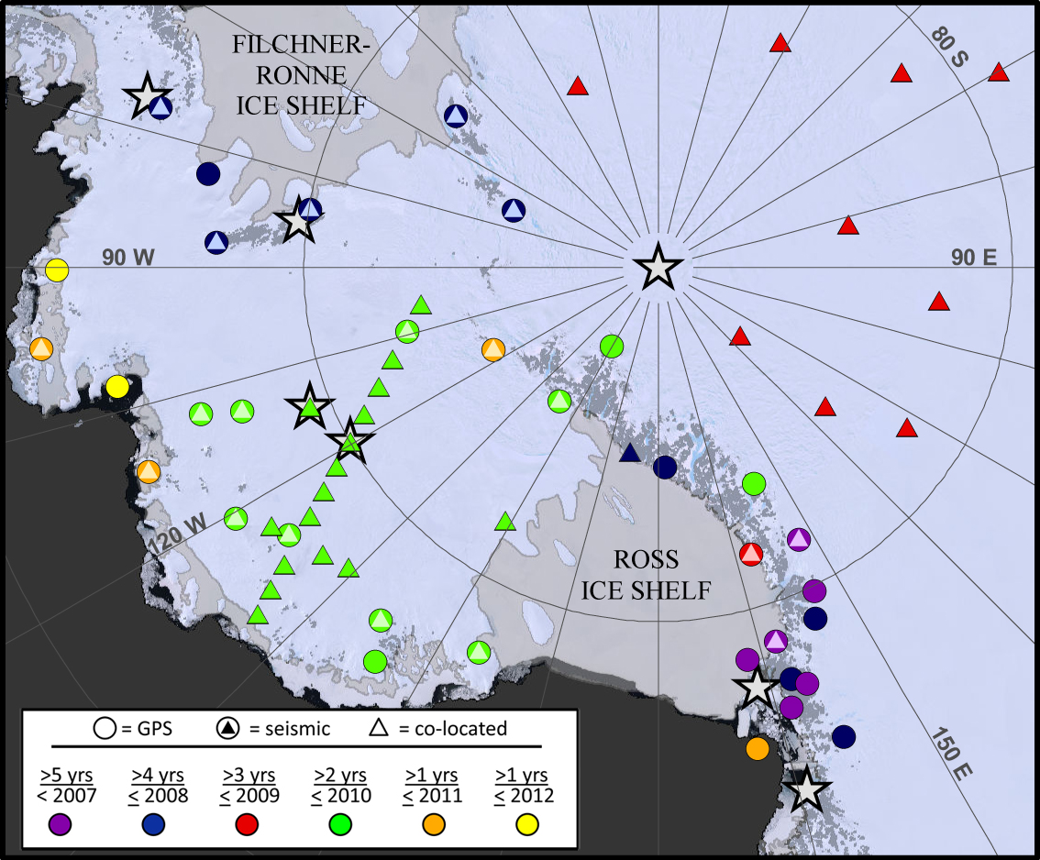
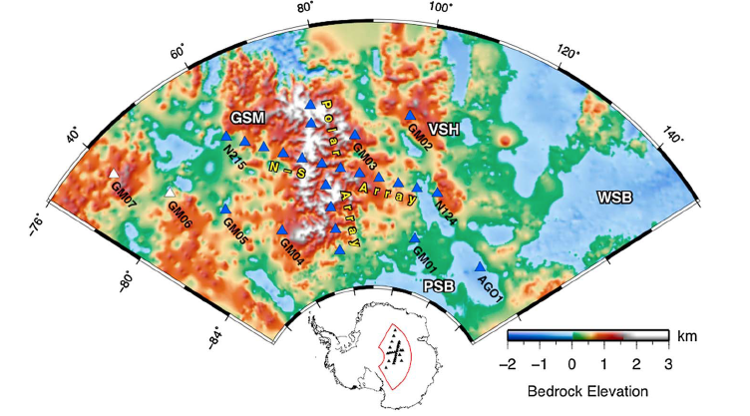
Polenet
Fig. 1. The POLENET-Antarctica Network (ANET).
GAMSEIS/AGAP

Slide 5
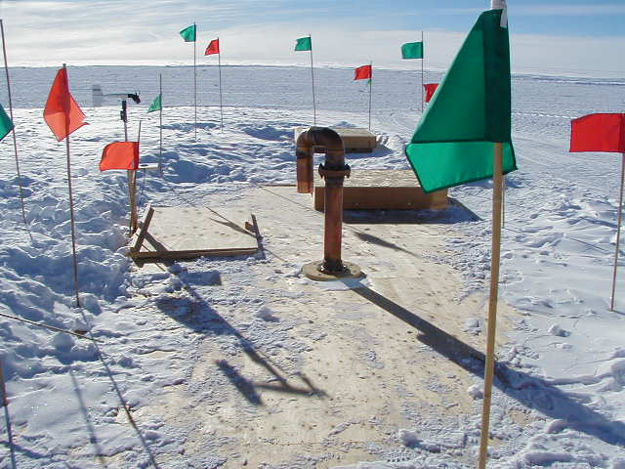
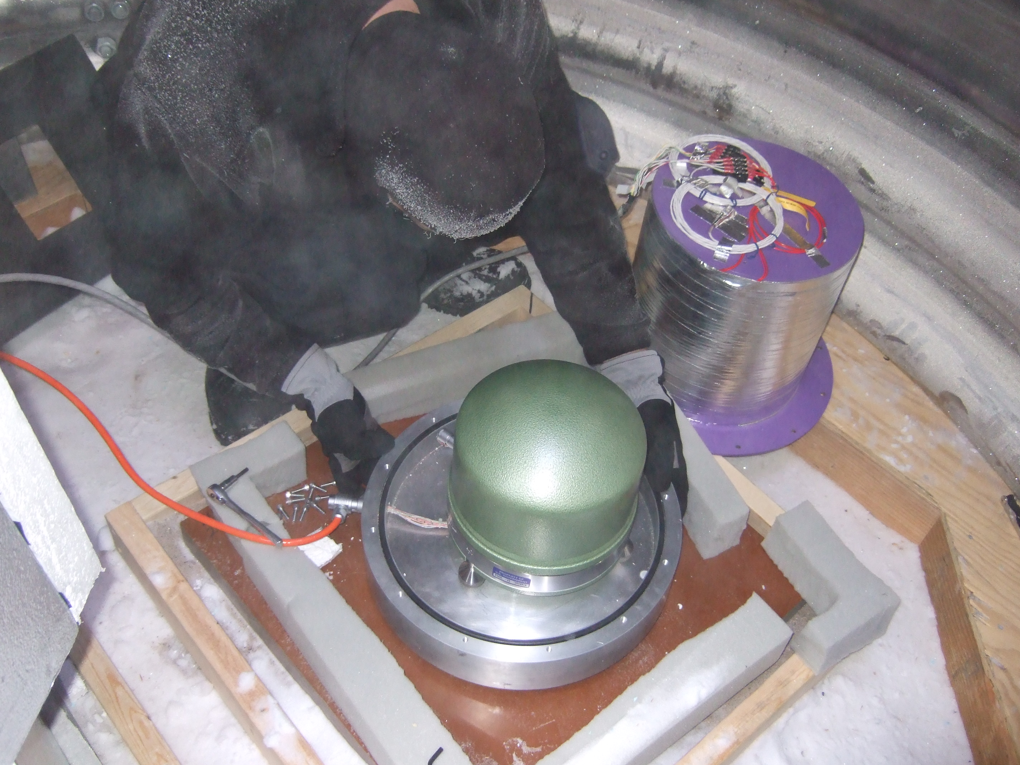
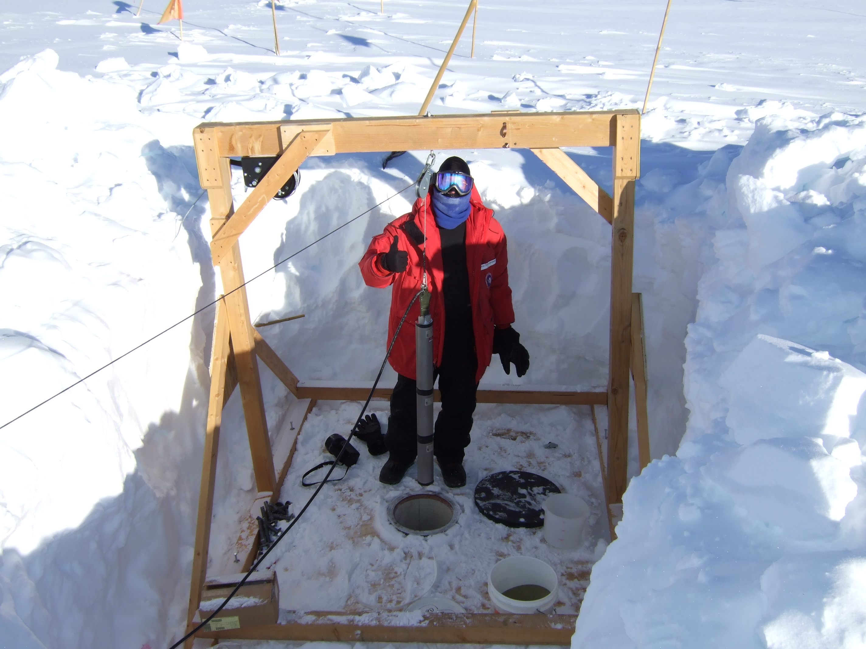
QSPA
located 8km from the geographic south pole and sits on a glacier ~2.5km thick.
Vault Condition:
Surface instruments are in a 8ft diameter cylindrical vault with the floor of the vault ~4 m below the surface of the snow.
Borehole instruments are in ~12 diameter holes at depths of 275m (KS54000) and 255m (Guralp). Boreholes are dry and not cased and are in solid ice.

Slide 6
QSPA (borehole) for December 2007 – December 2011 (Rob Anthony).
The median PSD is plotted (solid black line); 5th and 95th percentile statistics (dashed lines).
The ~20 dB variation observed for the primary and secondary microseisms is a function of both the wave state of the southern ocean as well as the extent of the sea ice surrounding the continent (Seasonal variation of the primary microseism shown in expanded box).
QSPA anthropogenic noise is illustrated by the ~20 dB jump in short period noise during the Antarctic field season.

Slide 7
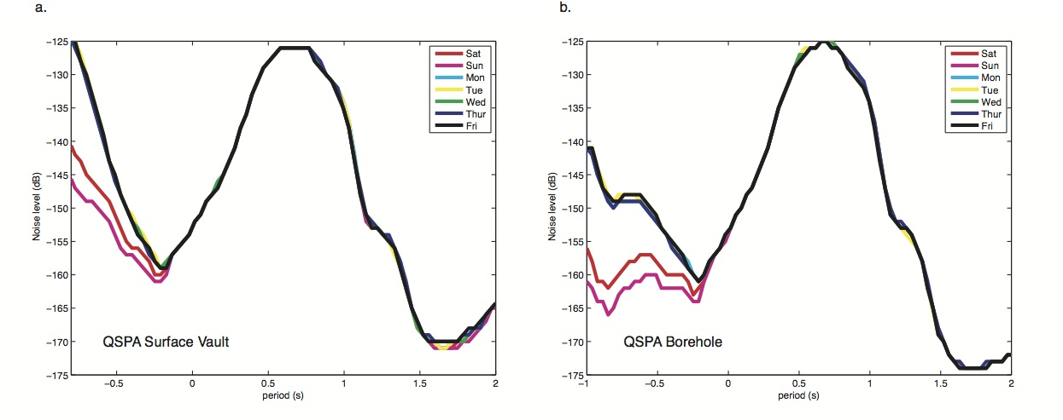
QSPA – surface vs borehole
on the weekends……

Slide 8
Noise levels at temporary stations?
Median vertical-component power for quietest and noisiest permanent global-network stations (gray), POLENET (red), and AGAP (blue) for each of the five period bands with 90% confidence intervals (error bars) (from Rob Anthony)

Slide 12
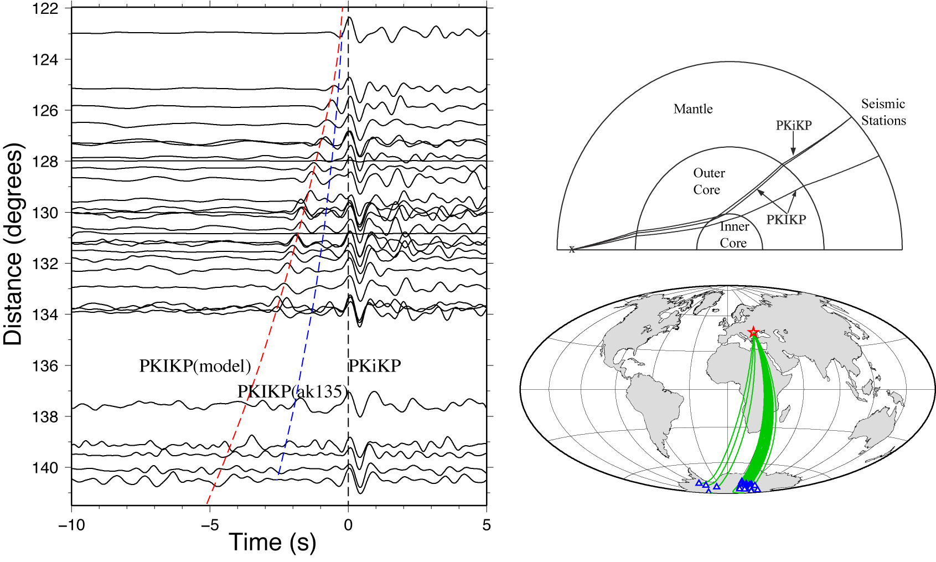
Science
Unique environment for recording core phases - polar recordings are desirable due to the approximate alignment of the fast axis of inner core anisotropy with the Earth’s spin axis
Sun et al., 2010

Slide 13
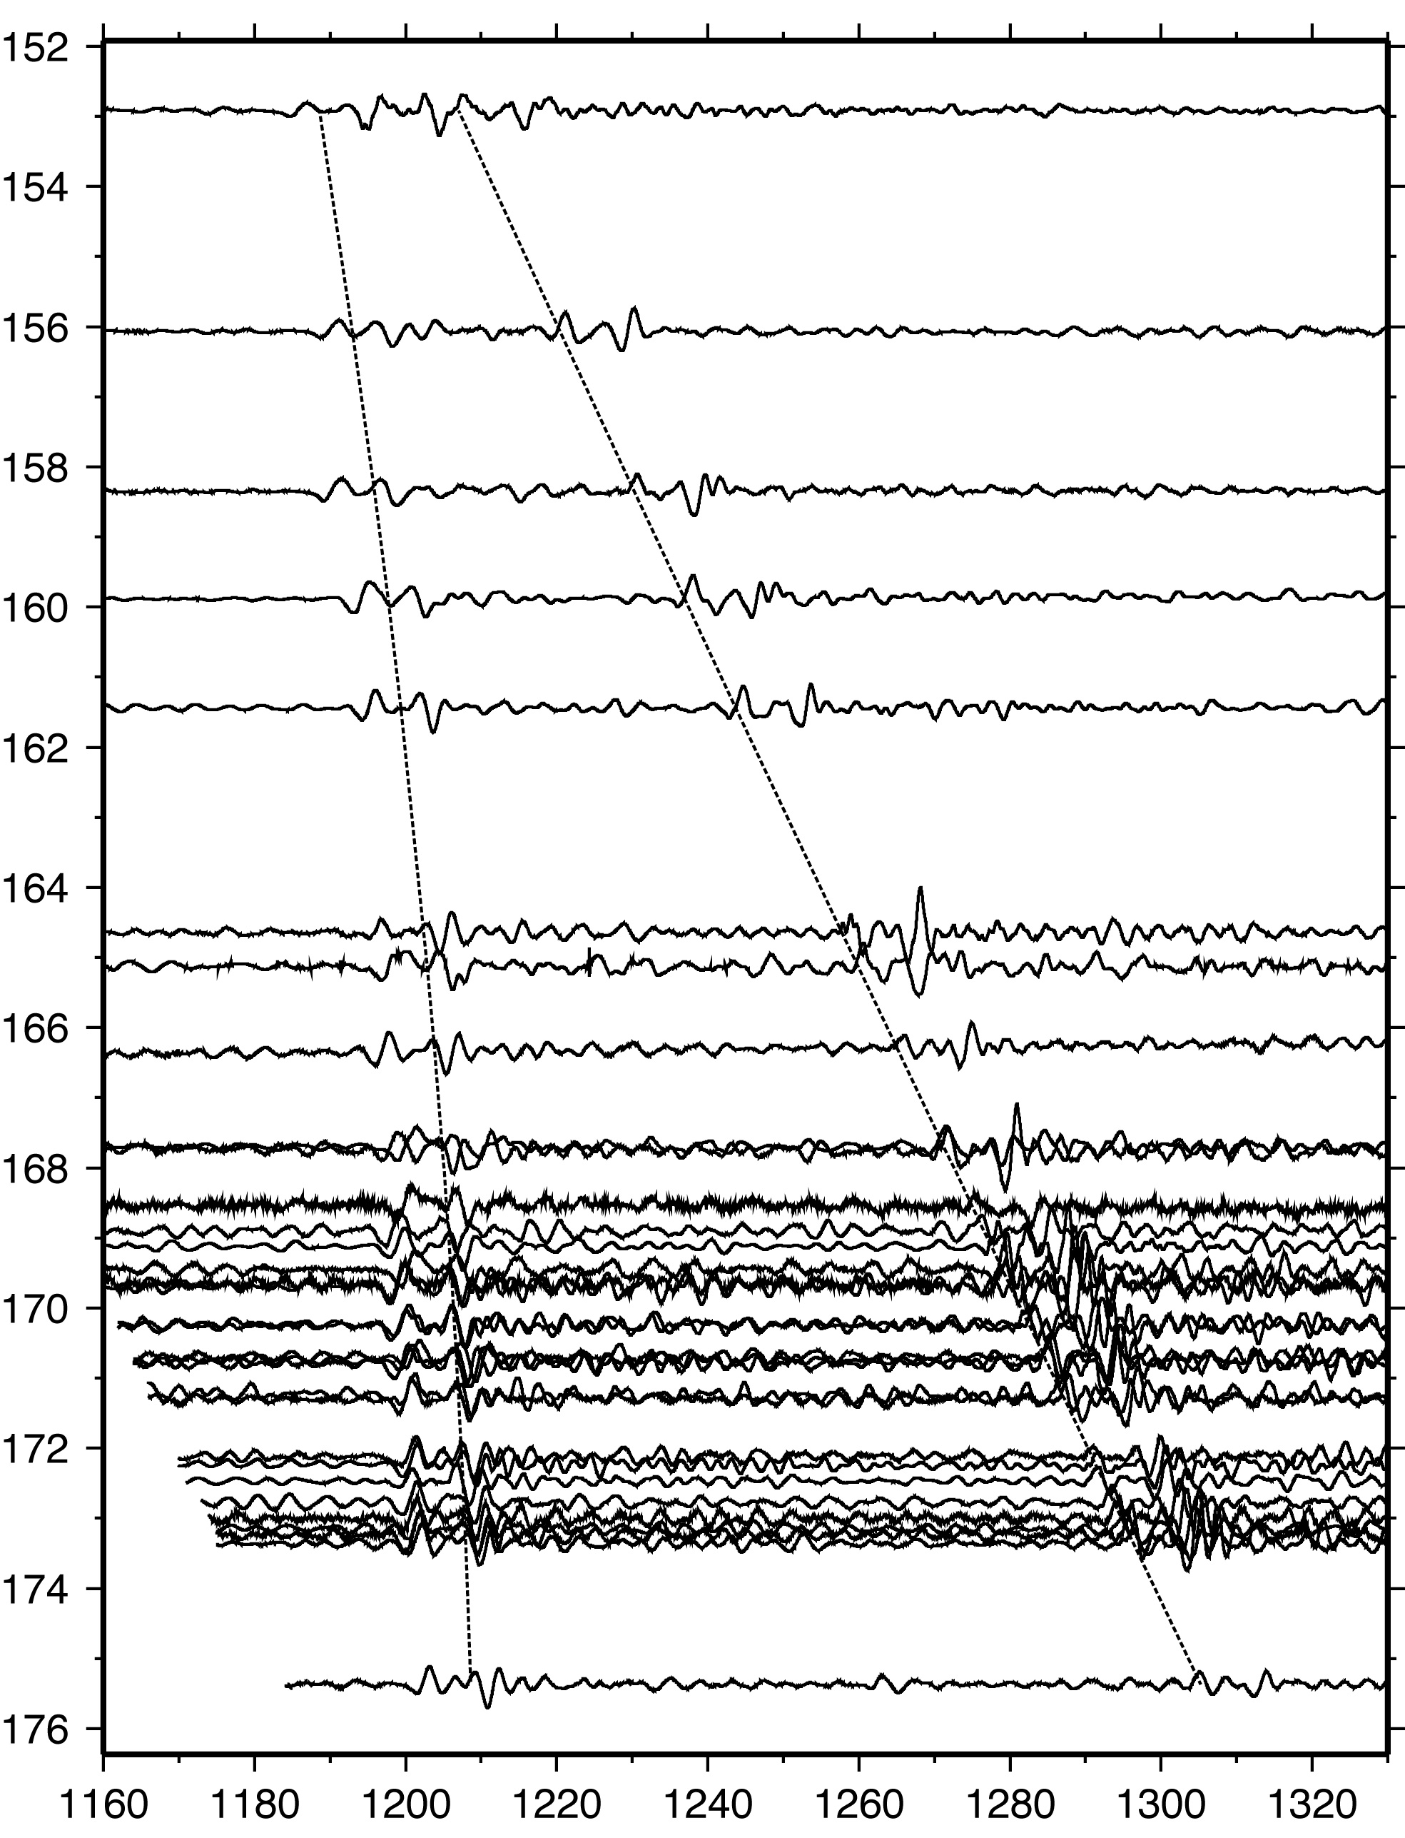
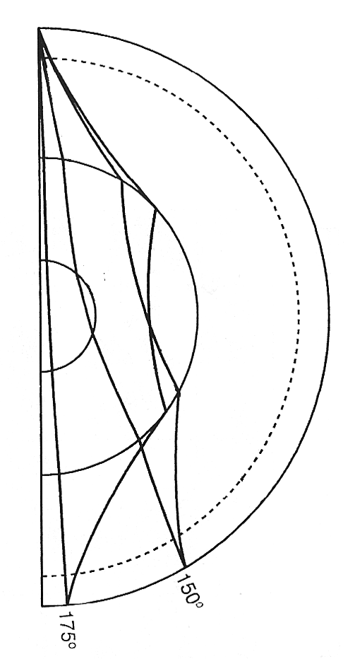
Nearly Antipodal PKPdf arrivals
Rare paths sample core along fast axis
7/7/09 Mw 6.1 Baffin Bay (Doug Wiens)
PKPdf
PKPab
Ray Paths
PKPab
PKPdf

Slide 14
Local/Regional Seismicity
Amanda Lough, Doug Wiens

Slide 15
Glacier Seismicity
Well-located seismic sources from several months of POLENET/ANET and AGAP seismograms in 2009 and 2010. Low frequency sources (stars) are concentrated in the Vanderford and Whillans regions. Blue symbols denote newly identified cryoseismic sources in the uppermost part of the East Antarctic ice sheet.

Slide 16
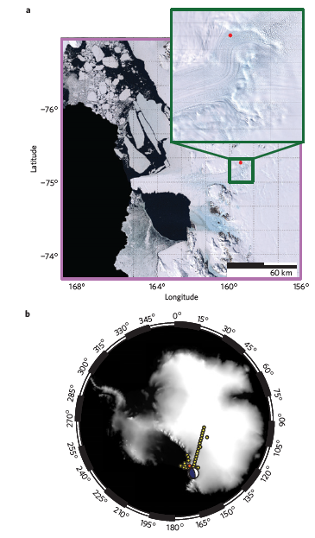
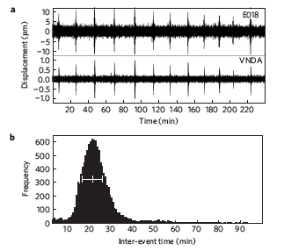
David Glacier – tidally modulated events (Zoet et al., 2012
events are consistent with stick–slip behavior of debris-laden ice moving over a single obstacle of rough bedrock, modulated by relatively small stress changes from the ocean tides

Slide 17
Some possible locations?
Around South Pole
Favorable logistics
QSPA
Low glacier flow rates
Not close to outlet glaciers or ice streams
2) West Antarctica
Closer to outlet glaciers and ice streams
Logistically more difficult
Locations constrained by ice flow rates

Slide 18
Permanent Polenet Stations – 2017-2018
Fig. 1. The POLENET-Antarctica Network (ANET).

Slide 19
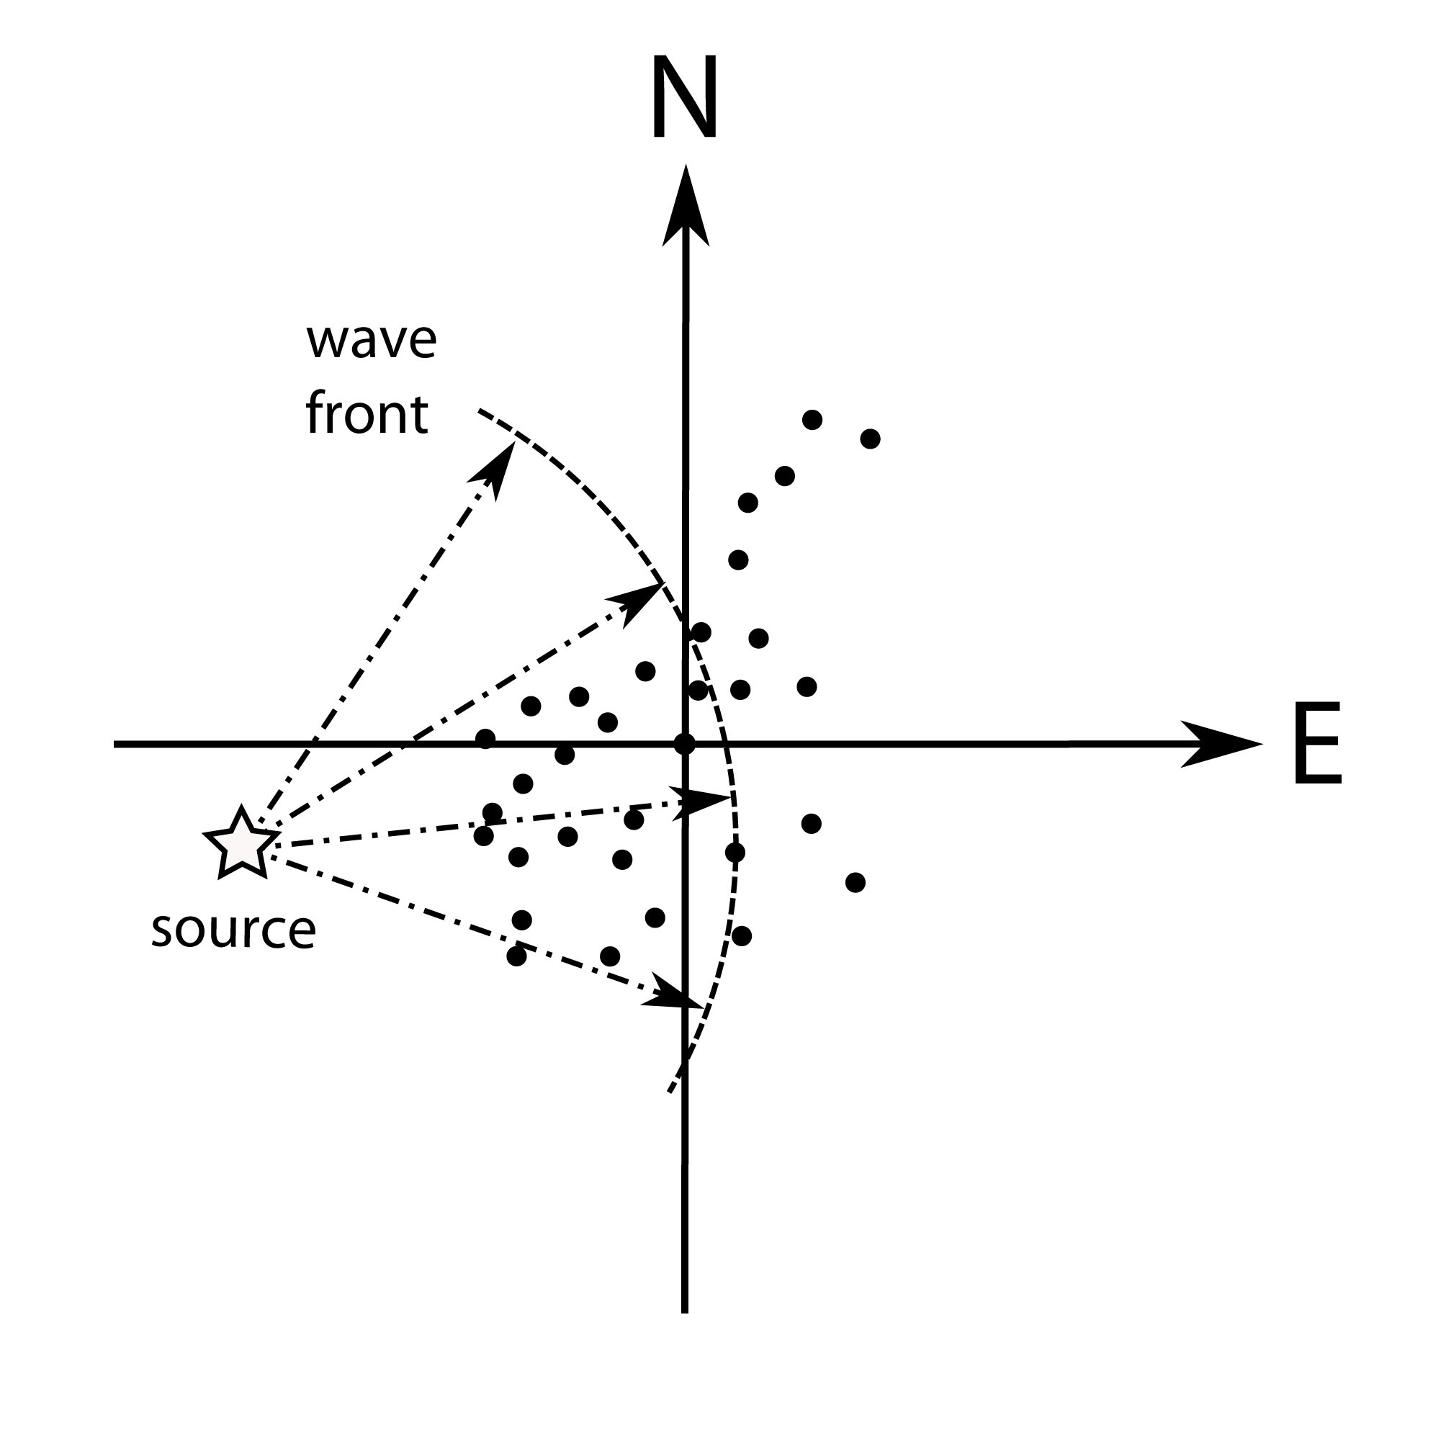
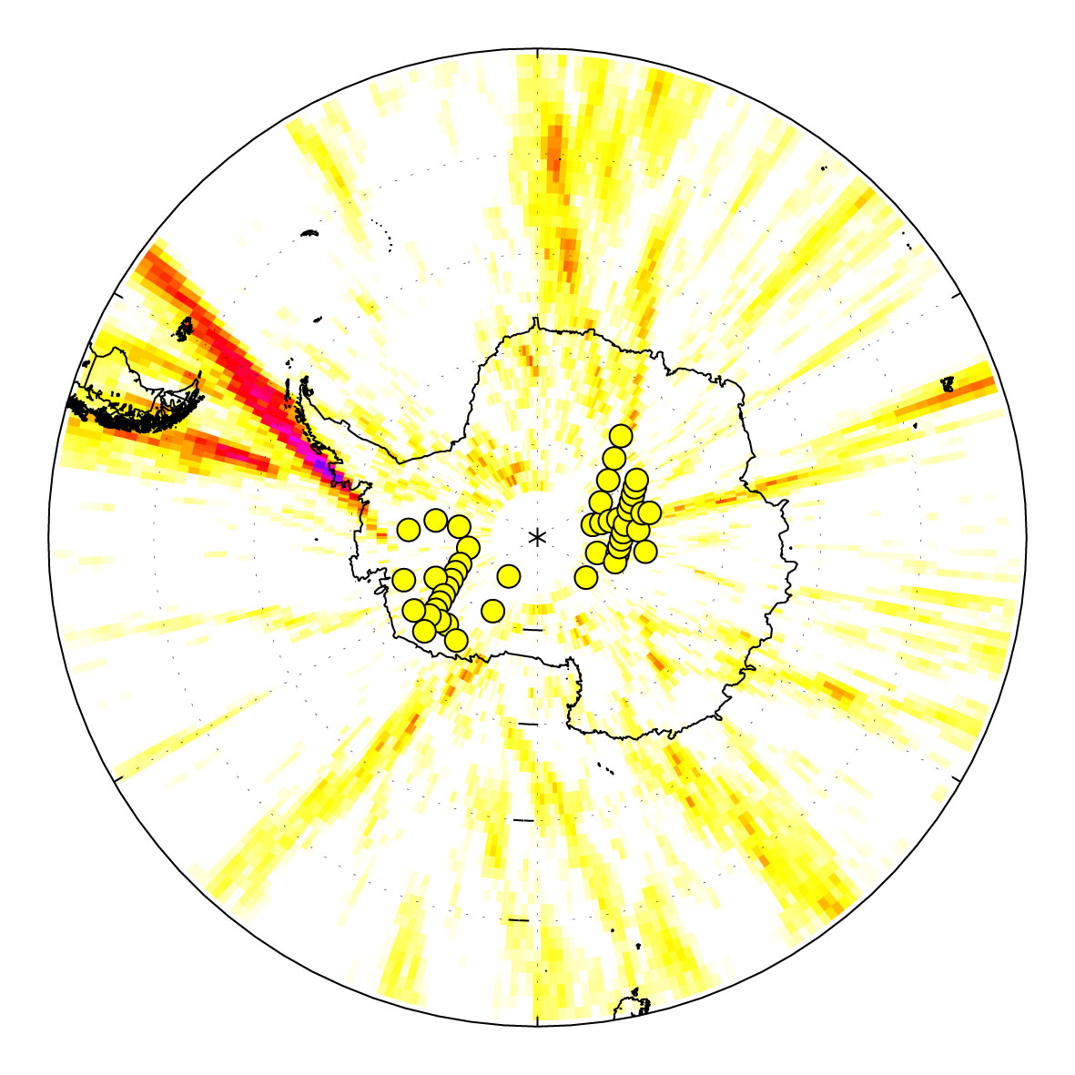
Noise Analysis: Point Source/Spherical wavefront migration Koch et al, in prep

Slide 20
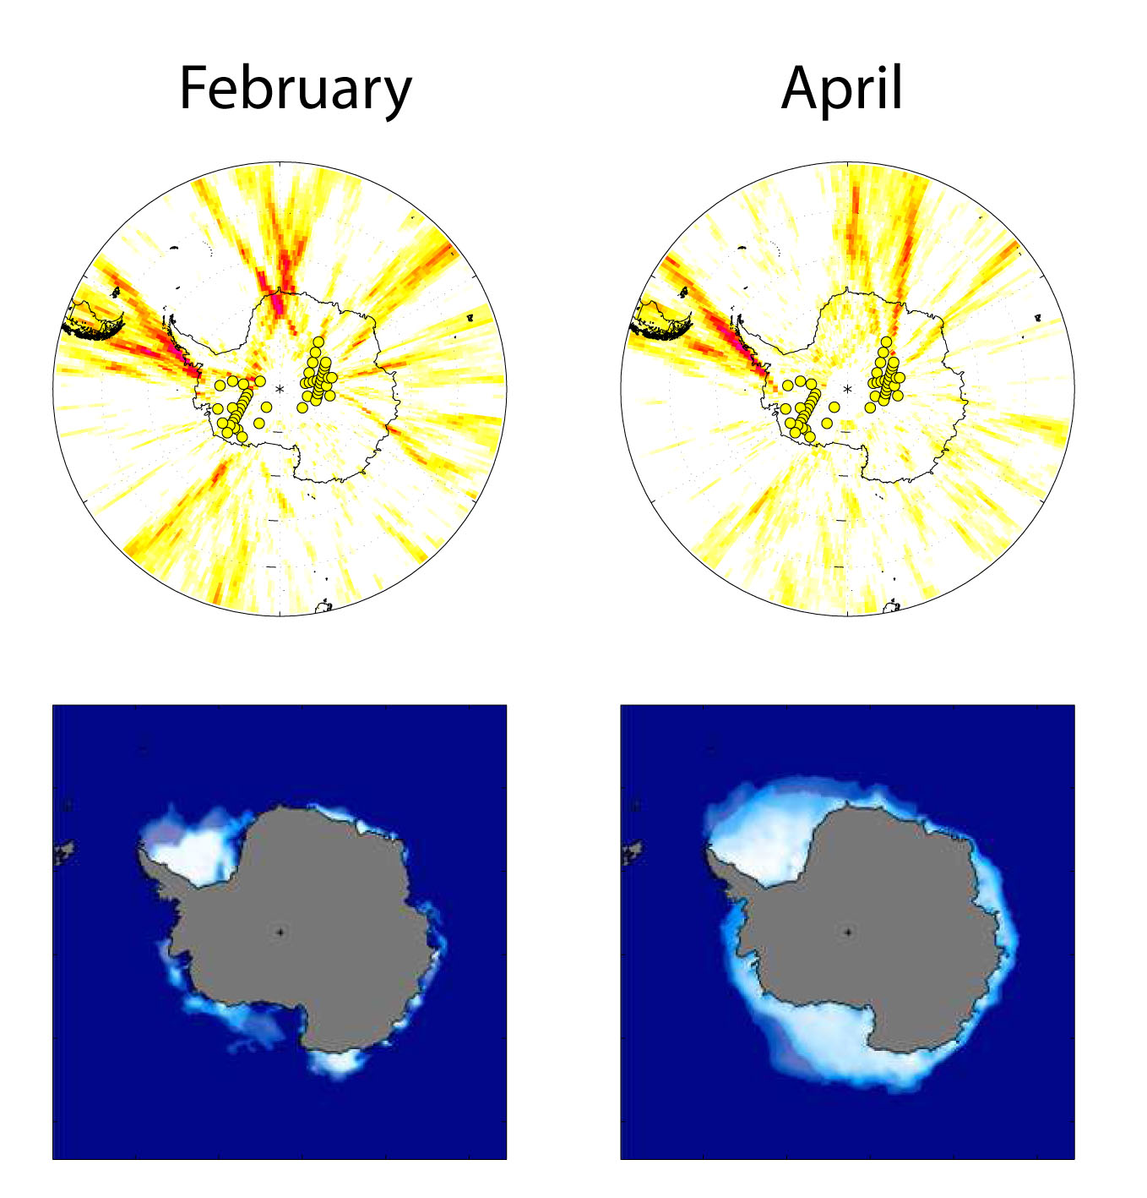
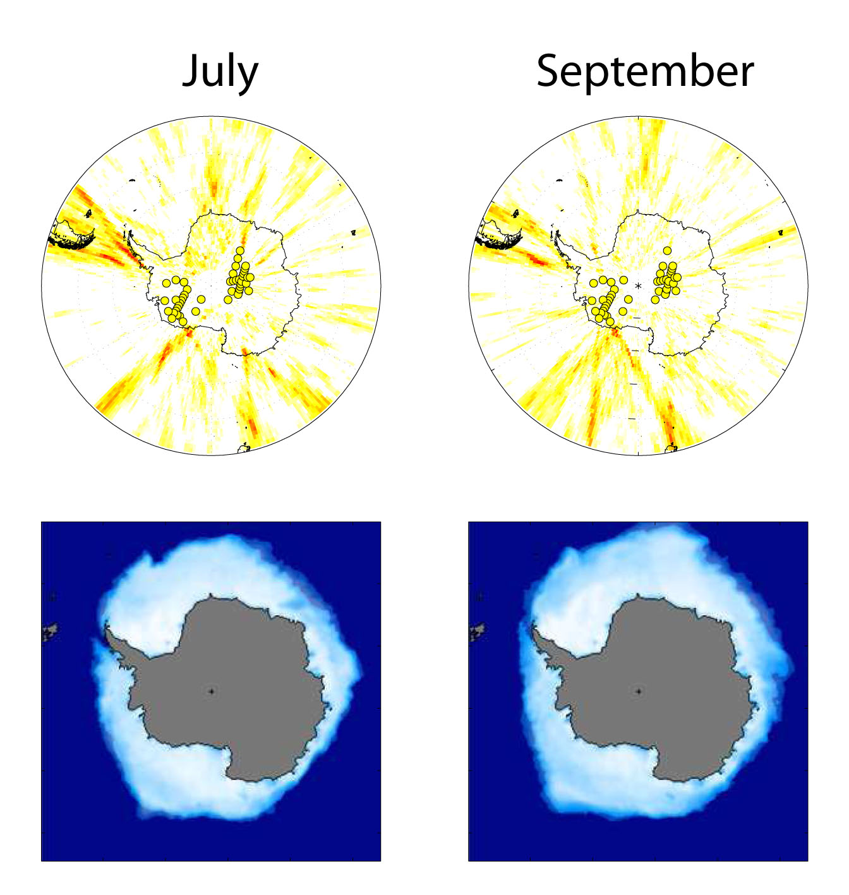
Seasonal Noise Variation – Spherical Wavefront Migration
Noise amplitude decreases as sea ice builds out over the shelf
By September, noise sources are in New Zealand and South America
Koch et al, in prep

