Slide 1
Society-relevant Arrays for Developing Countries: Opportunities and Challenges in South Africa
Andy Nyblade
Penn State University
Workshop on Arrays in Global Seismology
May 15, 2013

Slide 2
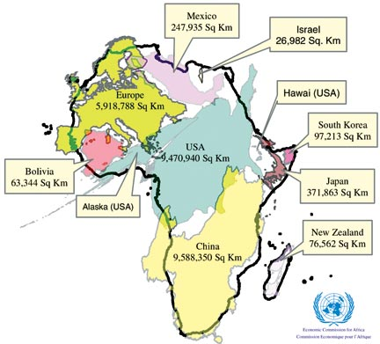

Slide 3
Two models:
Largely externally driven - Niger Array (CTBTO)
Developed in partnership with the local science community – South Africa

Slide 4
Niger Array
Comprehensive Nuclear Test-Ban Treaty Organization (CTBTO)
sixteen element broadband seismic array in southwestern Niger
array has a diameter of 6 km (three rings with a central element), contains twelve vertical and four 3-component broadband sensors (Guralp CMG-3TB)
elements have seismic noise characteristics at or below Peterson's Low Noise Model at greater than 0.5 Hz.
All of the sensors are emplaced
in 50 m boreholes in crystalline rock.
The array is capable of resolving
and detecting events with magnitude
(mb) less than 3.0 from events in Peru
and Indonesia, showing that the array
significantly adds to the IMS detection
capabilities in the Africa region and
world-wide.

Slide 5
South Africa – a possible different model
Engaged seismology and earth science communities
Network infrastructure for leveraging
Government keen on supporting BIG science
Opportunities for building a multi-use science array

Slide 6
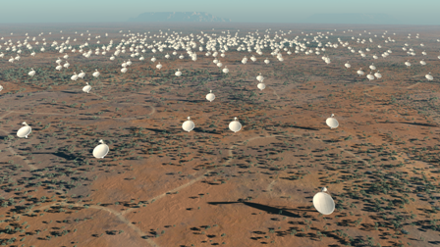
Square Kilometre Array
An array of dish receptors will extend into eight African countries from a central core region in the Karoo desert of South Africa.
A further array of mid frequency aperture arrays will also be built in the Karoo.
A smaller array of dish receptors and an array of low frequency aperture arrays will be located in the Murchison Radio-astronomy Observatory in Western Australia.
The target construction cost is €1,500 million and construction is scheduled to start in 2016.

Slide 7
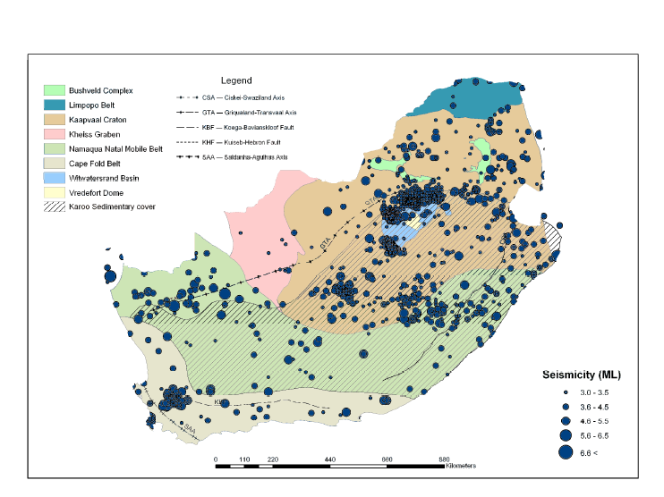
Bejaichund et al. SRL, 2009

Slide 8
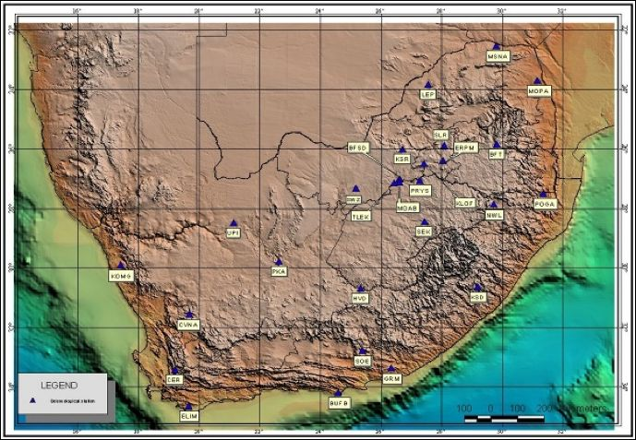
South African National Seismic Network – Council for Geoscience
BB stations
Cell modem telemetry
Contribute data to:
IOTWS
AfricaArray
(IRIS/DMC)

Slide 9
Bejaichund et al. SRL, 2009

Slide 11
Bejaichund et al. SRL, 2009

Slide 12
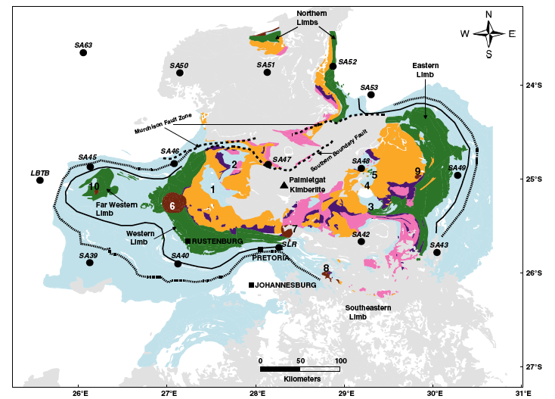
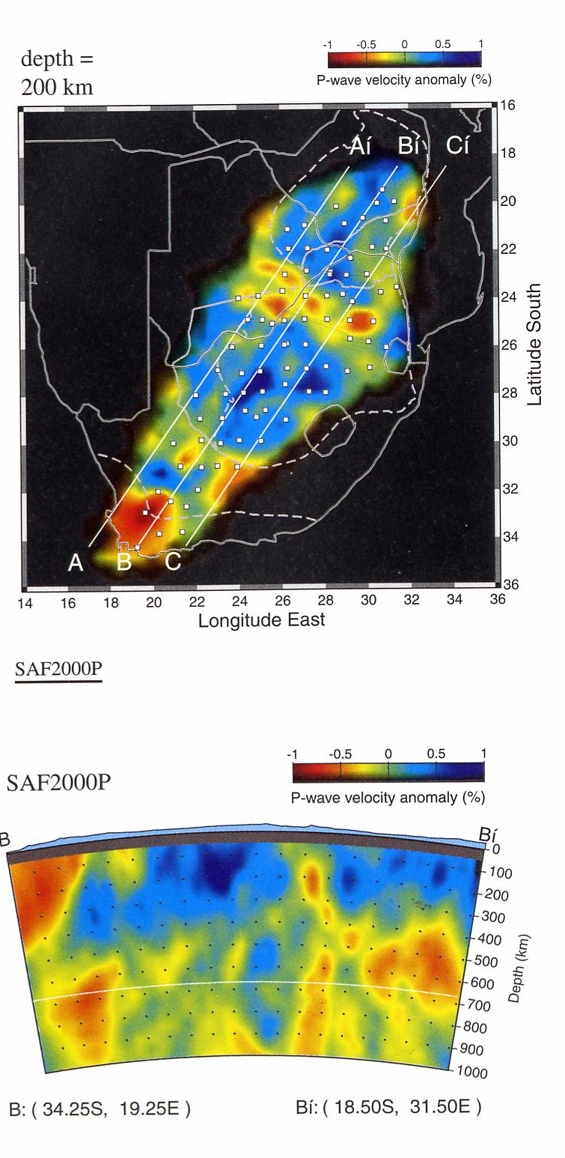
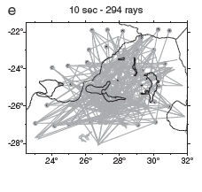
James et al., 2001
Kgaswane et al., 2012

Slide 16
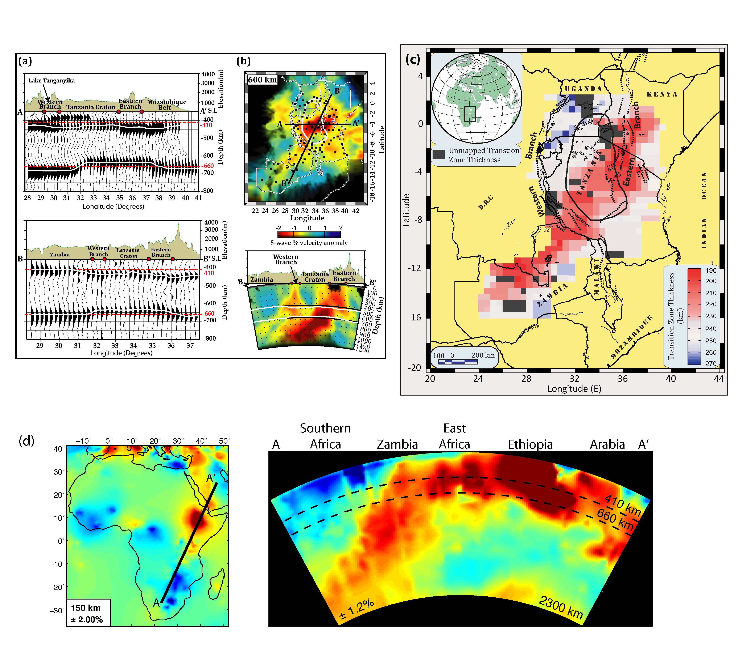
Mulibo and Nyblade, G-Cubed in press; Mulibo and Nyblade, submitted
Hansen et al., EPSL, 2013

Slide 17
South Africa – Large Aperture Array
PROS:
Engaged seismology and earth science communities
Network infrastructure for leveraging
Government keen on supporting BIG science
In kind and real $ support possible
Opportunities for building a multi-use science array
Mine safety – mining related seismicity
Natural resource benefits – imaging shallow crustal structure of the Bushveld
Crust and upper mantle studies linked to the Bushveld
Array seismology for Superplume imaging and other targets
CONS:
Some stations in urban areas. Noise levels may not be optimal at some stations or uniform across the array

Slide 18
If: The Square Kilometre Array: Exploring the Universe with the world's largest radio telescope 1.5B Euro!

Slide 19
Then why not: The 500 Square Kilometre Array: Exploring the planet with the world’s largest terrascope $0.X B ??

