Slide 1
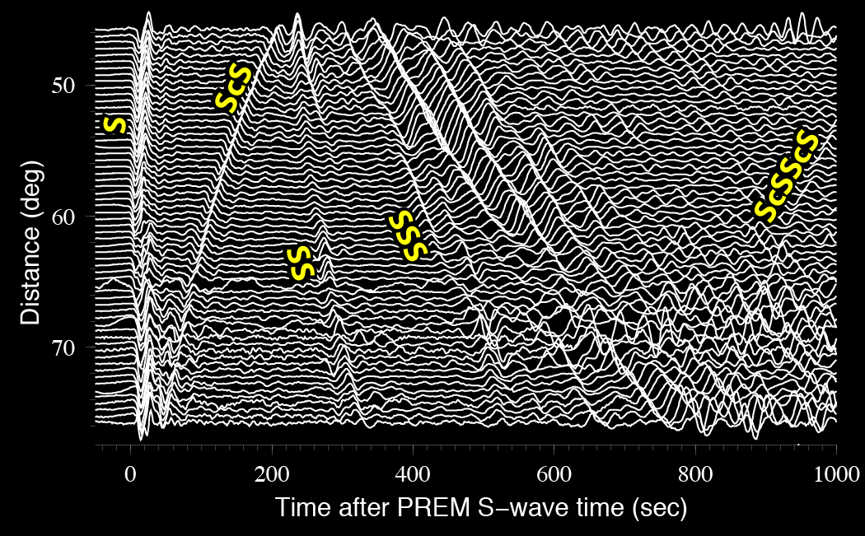
High resolution imaging of deep Earth structure & dynamics using large seismic arrays
Notes:
THANK YOU for invitation to speak. I think GABBA’s are THE NEXT BIG THING, since more and denser data = next generation (unanticipated discovery). I will just quickly review ideas/targets. Body wave perspective. Thk u adam

Slide 2
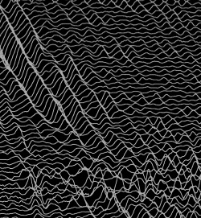
GABBA: “the next big thing”?
More, better, denser data =
next generation of discovery
GABBA’s: “the next big thing”?
More, better, denser data =
next generation of discovery
Notes:
THANK YOU for invitation to speak. I think GABBA’s are THE NEXT BIG THING, since more and denser data = next generation (unanticipated discovery). I will just quickly review ideas/targets.

Slide 3
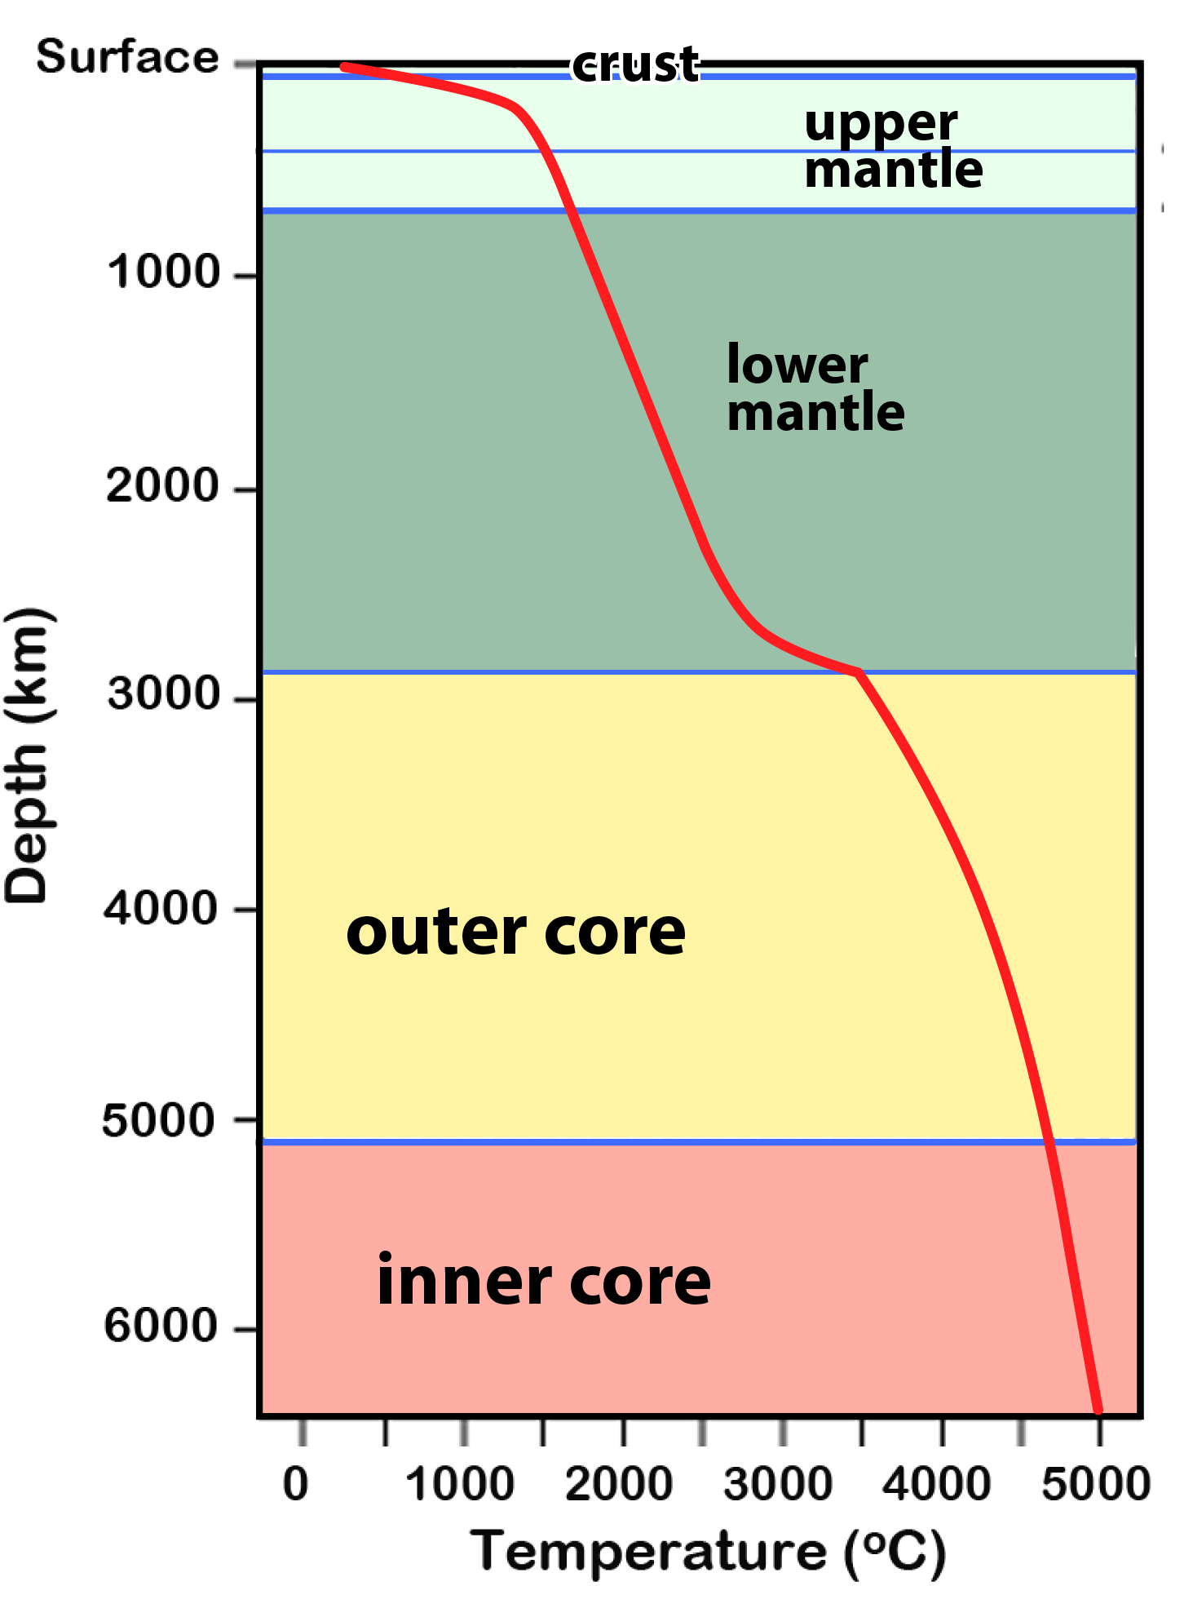
Earth’s internal temperature
Notes:
For sure there is enough heat to mix things…. Radiogenic as well as from formation. T_ Surface of the sun at center

Slide 4
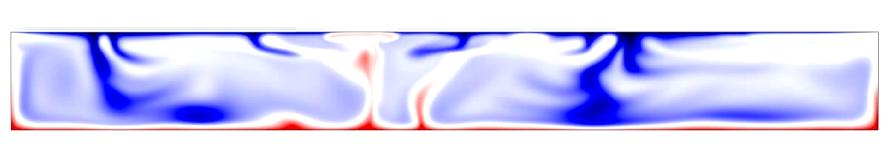
Mantle convection
Over geologic time, Earth’s rocky mantle churns like a convecting fluid
Surface
Core-mantle
boundary
http://mcnamara.asu.edu

Slide 5
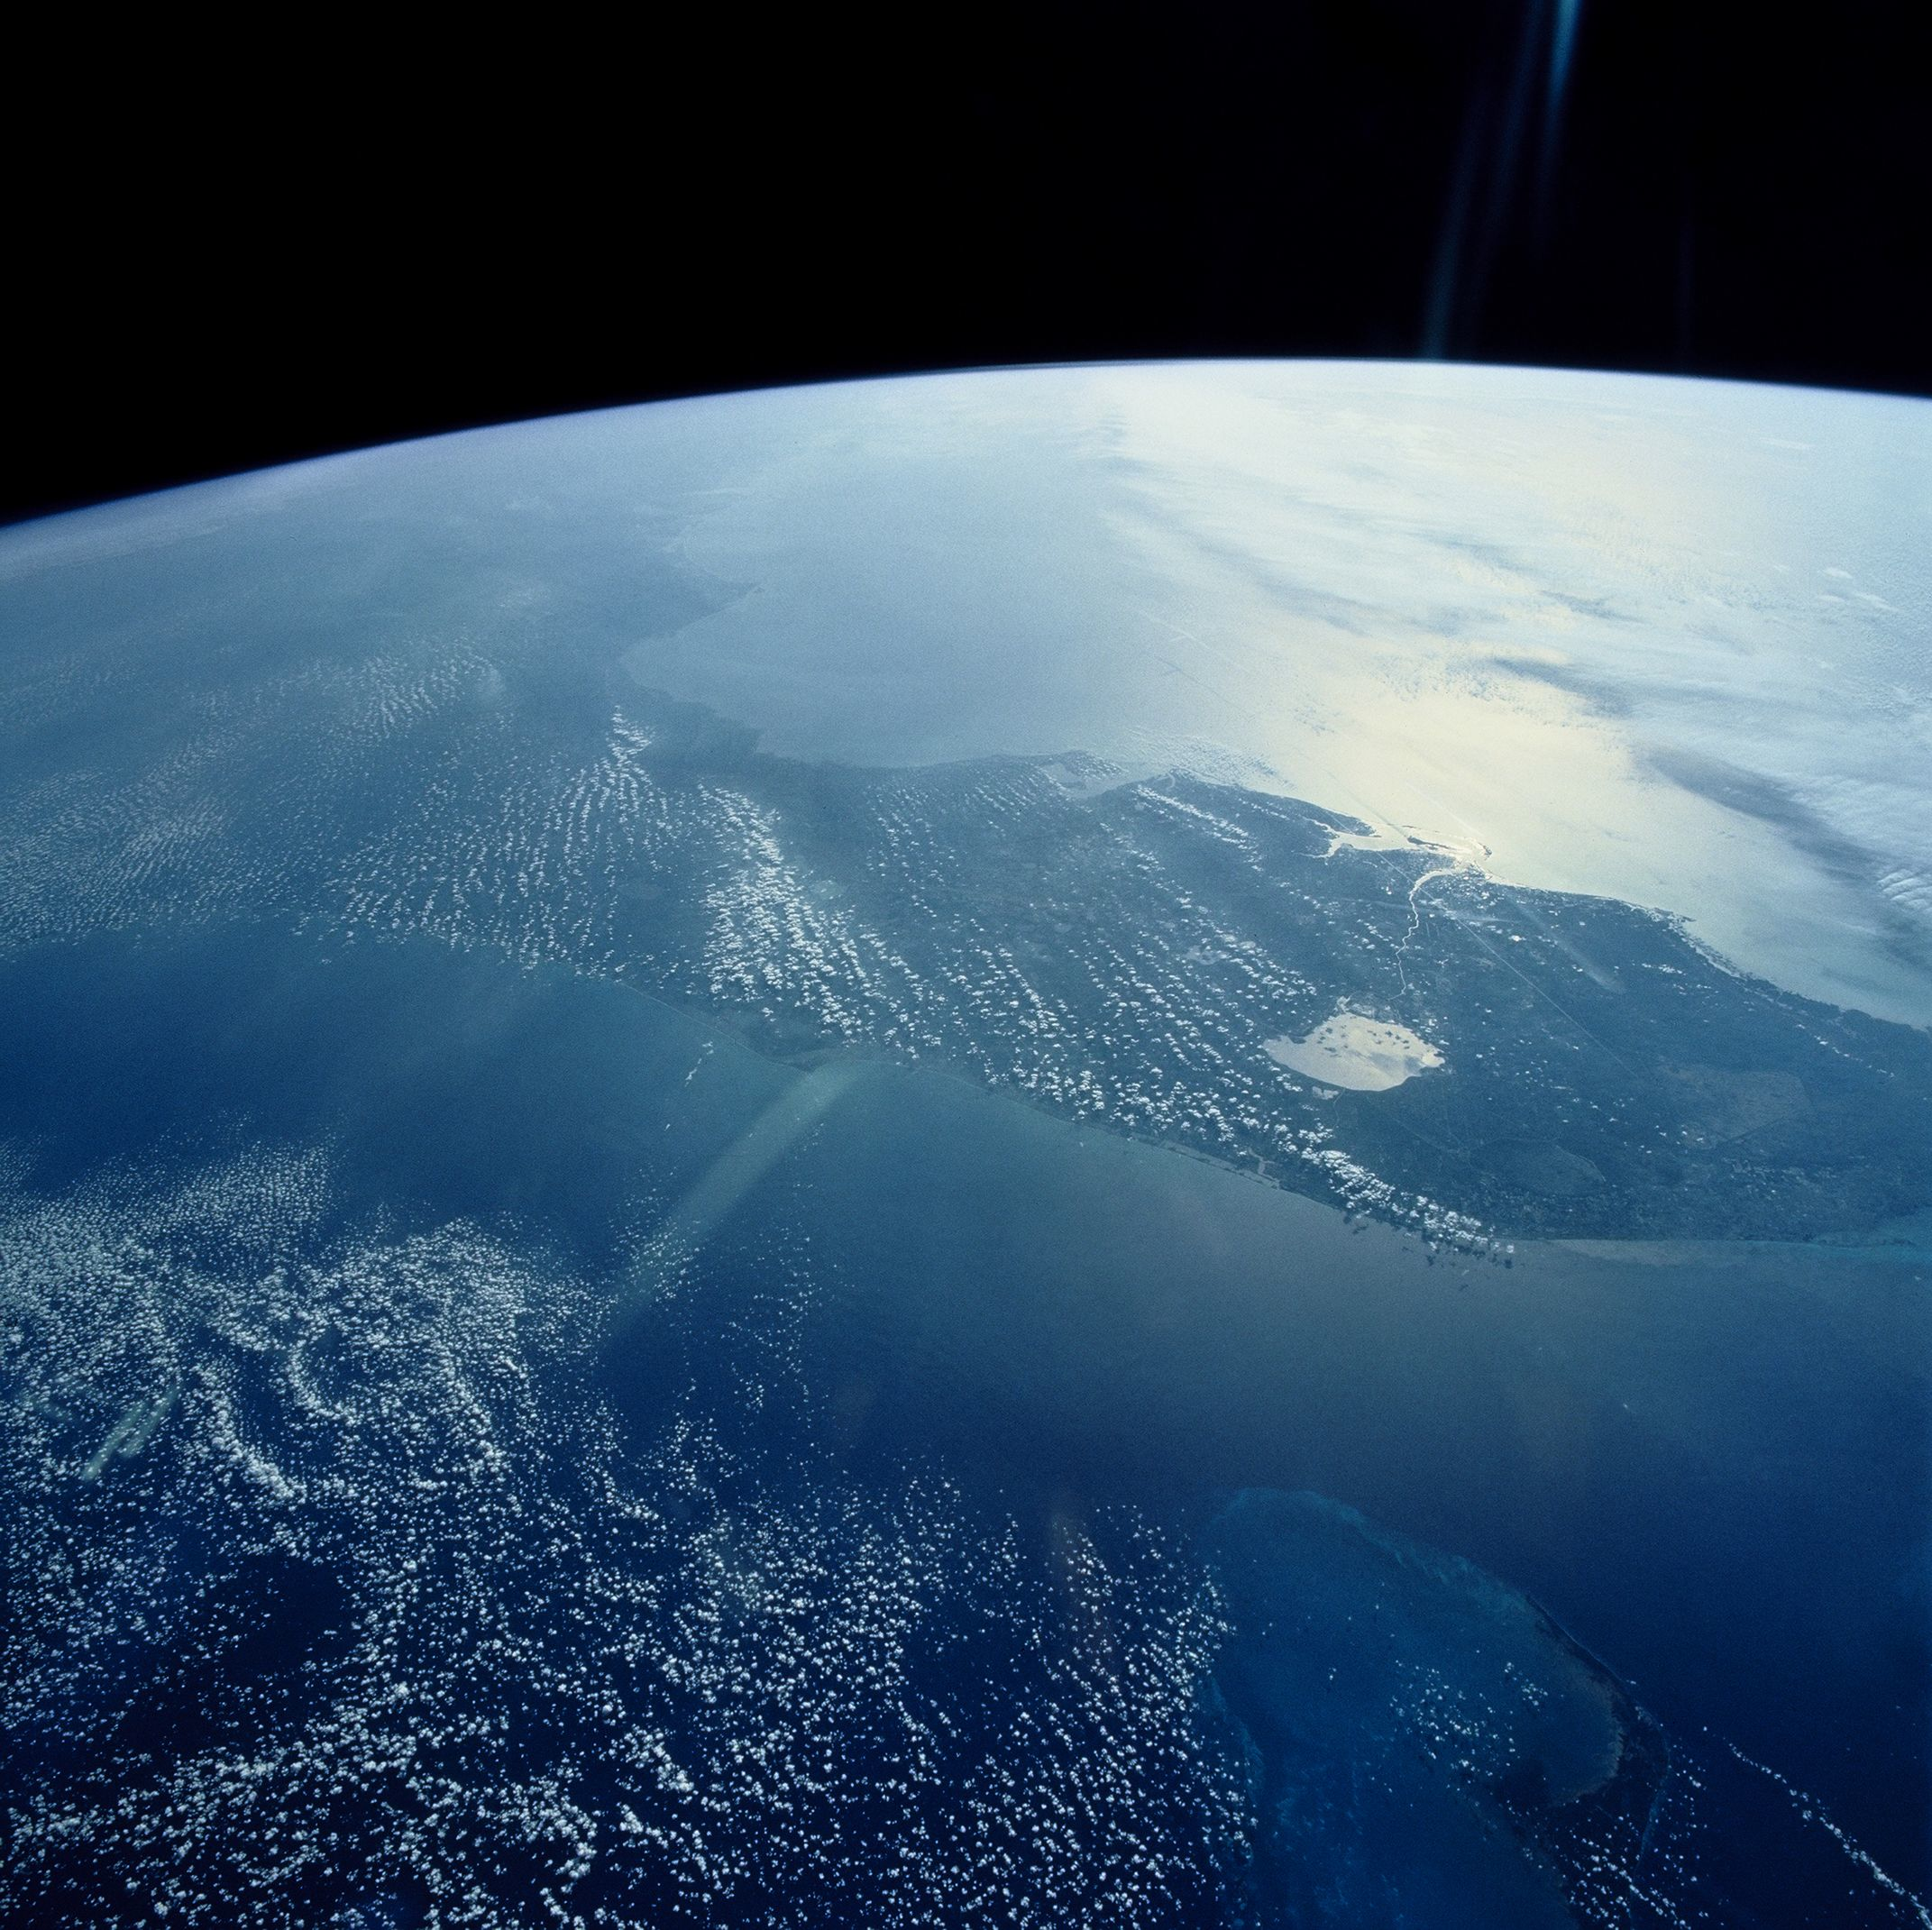
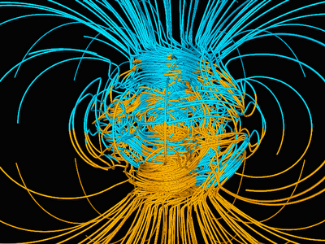
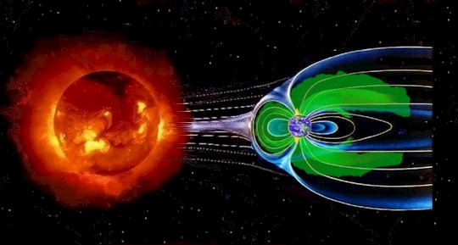
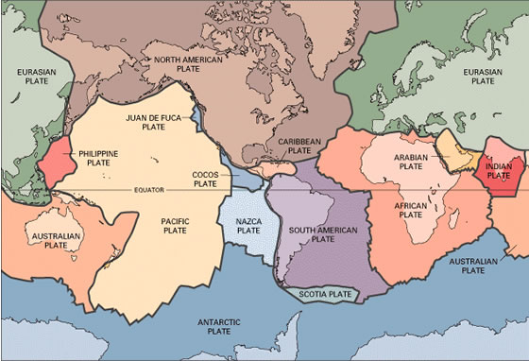
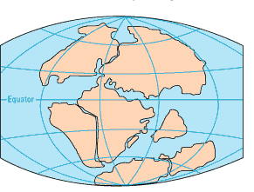
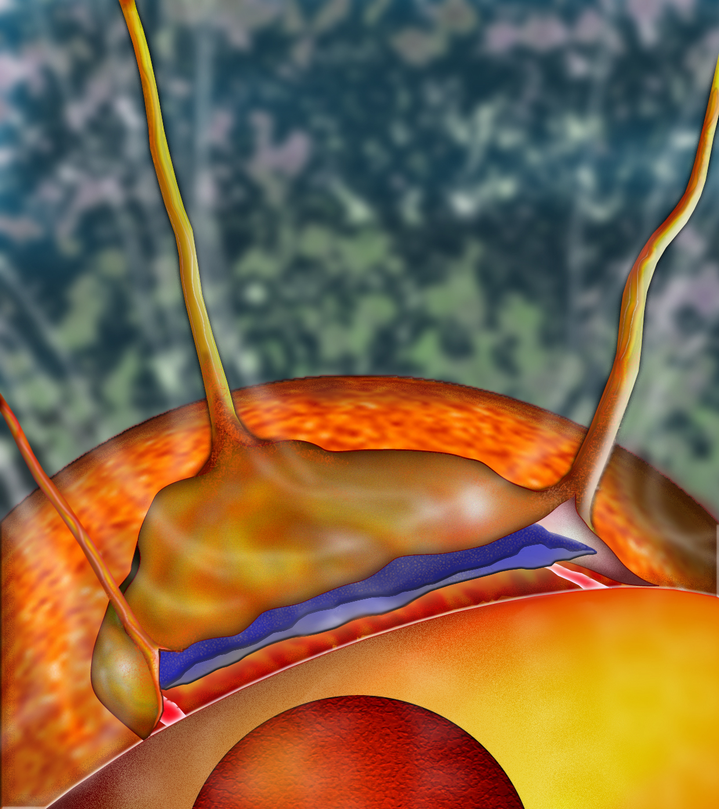
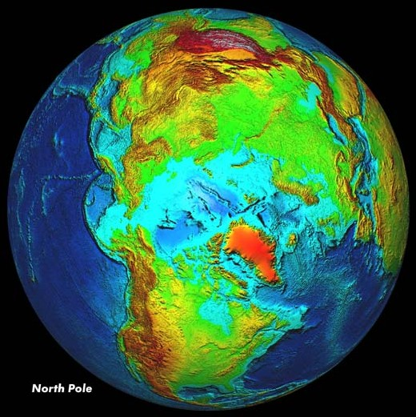
Some big questions
ESA
Glatzmaier
NASA
USGS
UNAVCO
LG’06
Water on Earth: why? planetary cycle/budget? Rel. to mantle chemistry, viscosity?
Plate tectonics: why only Earth? Rel. to mantle convection? Subduction? When initiated? Rel. to & control on mantle thermal/chemical heterogeneity?
Supercontinents: re-org cycles, driving forces? birth/evolution of continents? Rel. to style of & changes in convection mode?
Volcanism: MORBs, OIBs, LIPs: sources, sizes, cycles? rel. to mantle mixing? Plumes? Current/past ocean/atmosphere chem? Earth’s thermal budget?
Magnetic field: when started? reversal details? Rel. to CMB phenomena? Rel to inner & outer core structure/phenom/evol.
Notes:
Subjective list
B FIELD: 1: i.e., convection currents? B-field reversals 2 weeks? How strong are other components? And so on: how big a core for a B-field? Temp? P? Effects on surface bio?
PLATE TECT: What IS a plate? rigid shell on convecting mantle, in 15ish pieces. Did it “start” or have we always convected and a shell grew?
VOLCANISM: next LIP? Level of extinctions?

Slide 6
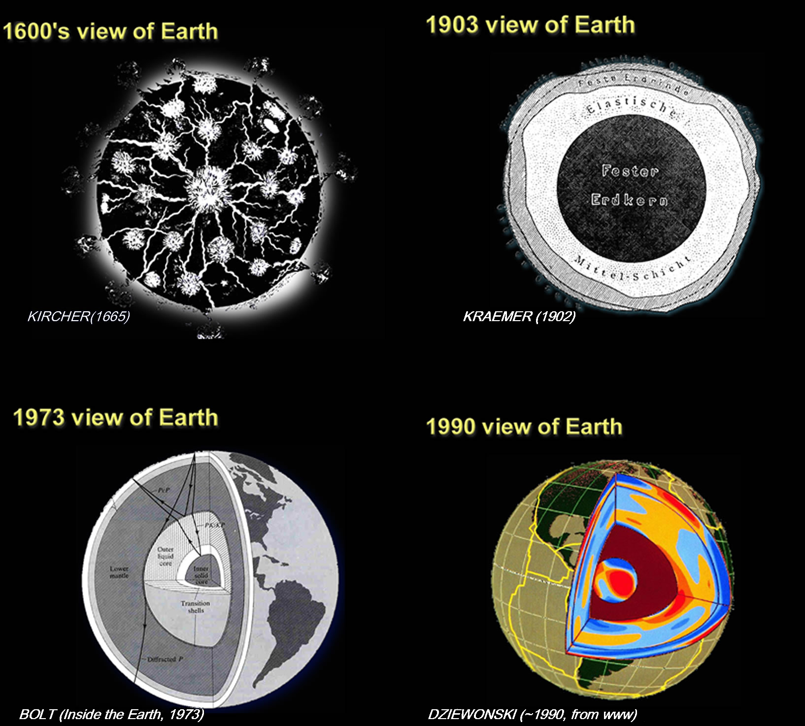
Notes:
One thing we can agree on; U NEED UPS/DOWNS, THEREFORE 3D

Slide 7
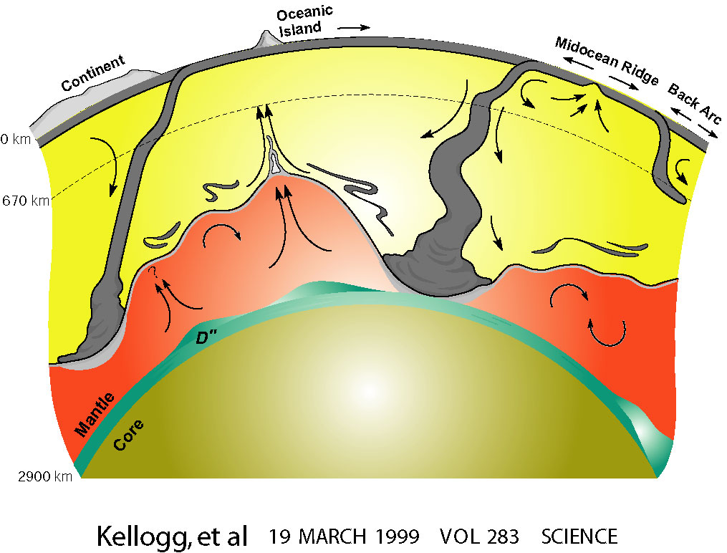
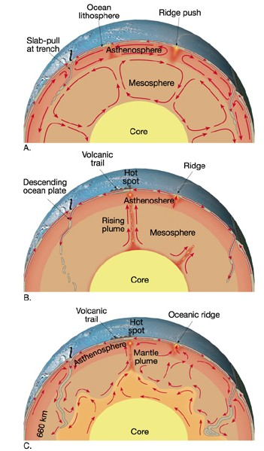
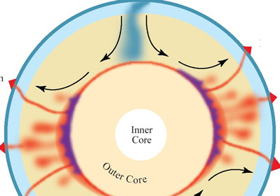
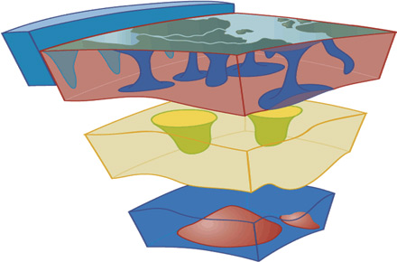
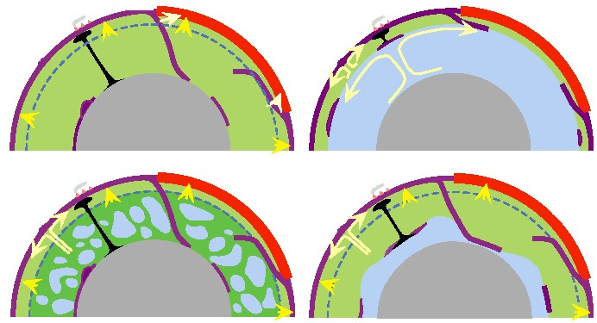
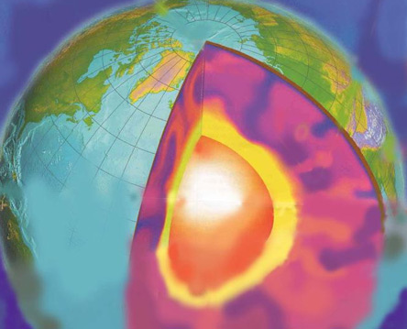
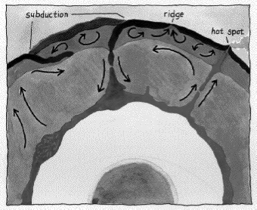
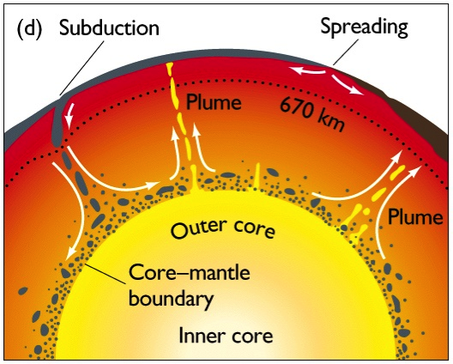
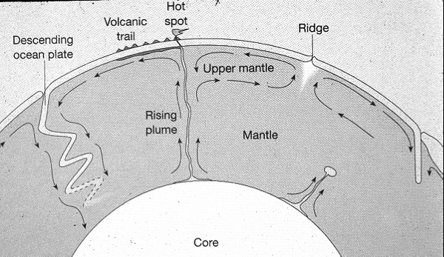
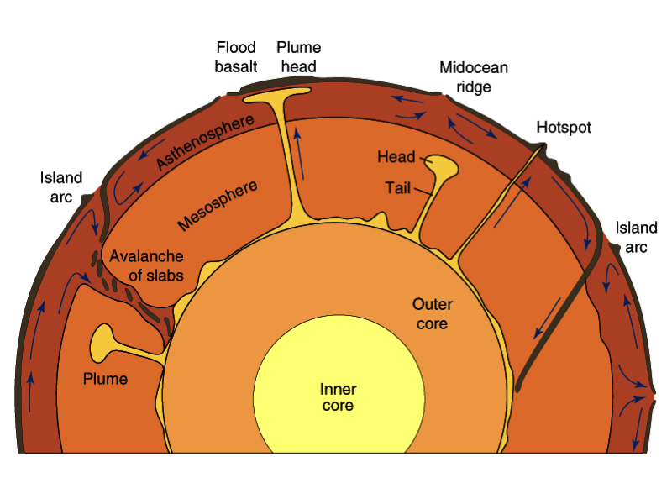
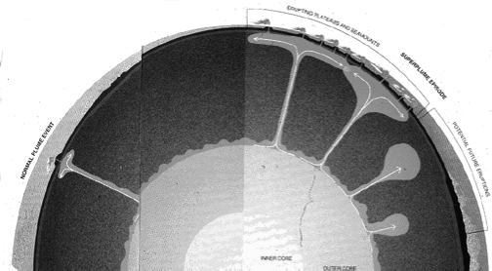
The dynamic interior of Earth: many possibilities
[Alberede, Anderson, Davies, Hager, Jellinek, Kellogg, Manga, Tackley, van der Hilst, Wysession, Geo101 books…]

Slide 8




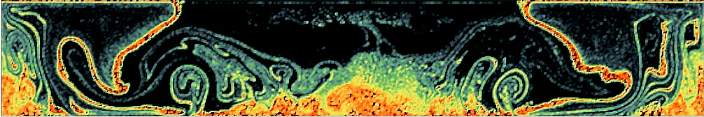
How clearly do we want to see?

Slide 9
Imaging Targets
Depth shells of interest
→ imaging relates to seismic phase types
Notes:
Regional, but also global

Slide 10
Body wave data: we can study details of all of Earth’s shells
Lay and Garnero 2011 AREPS

Slide 11
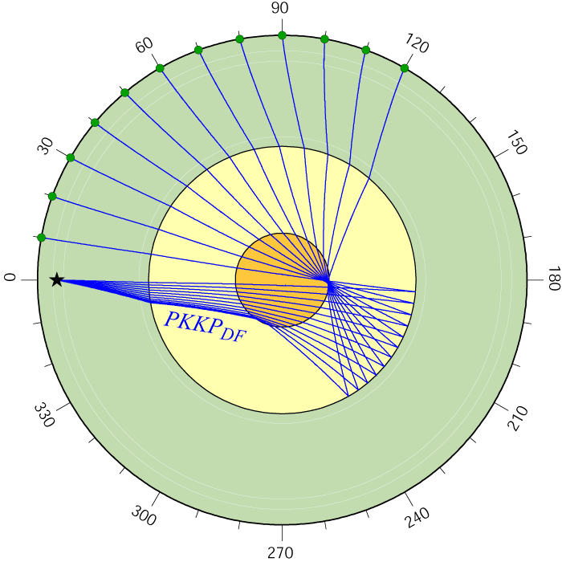
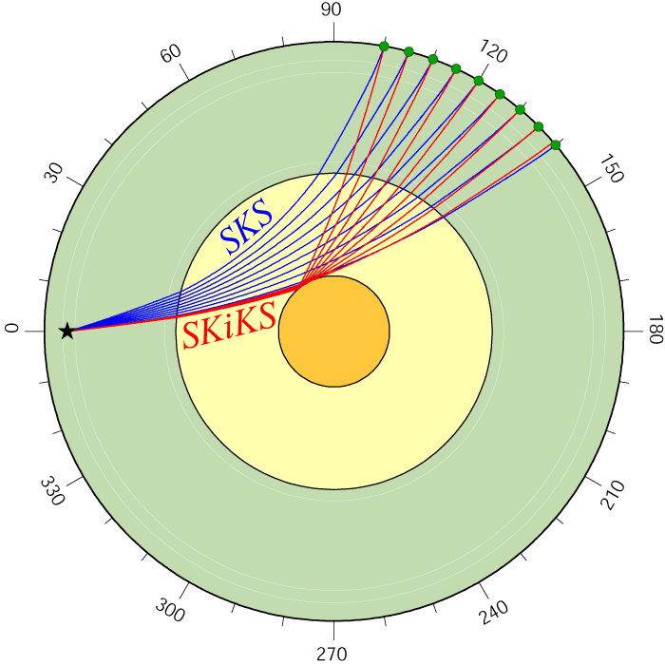
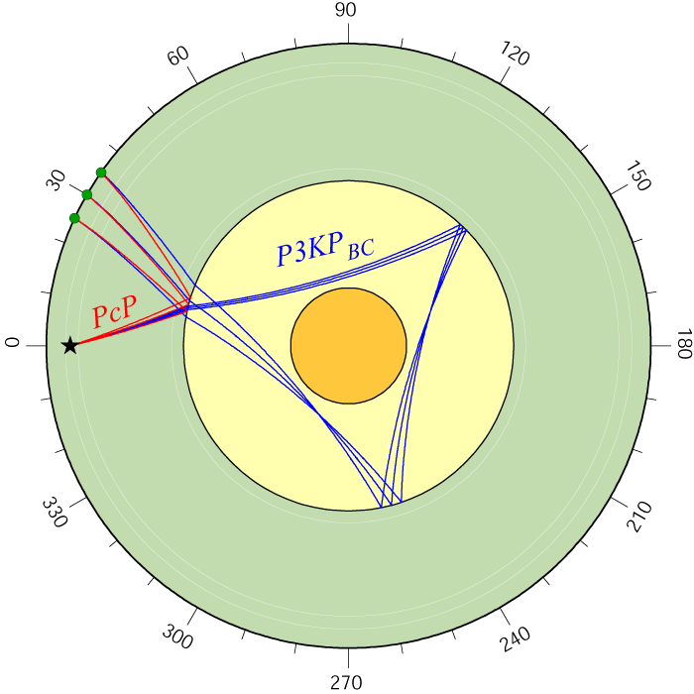
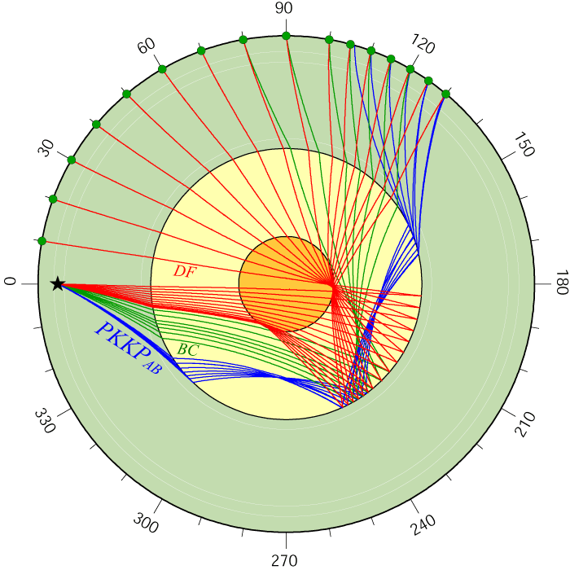
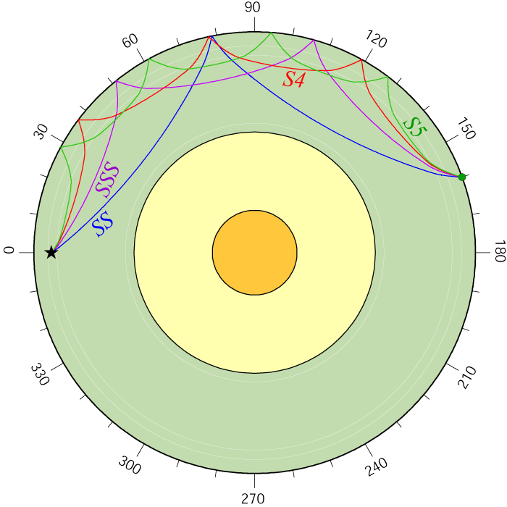
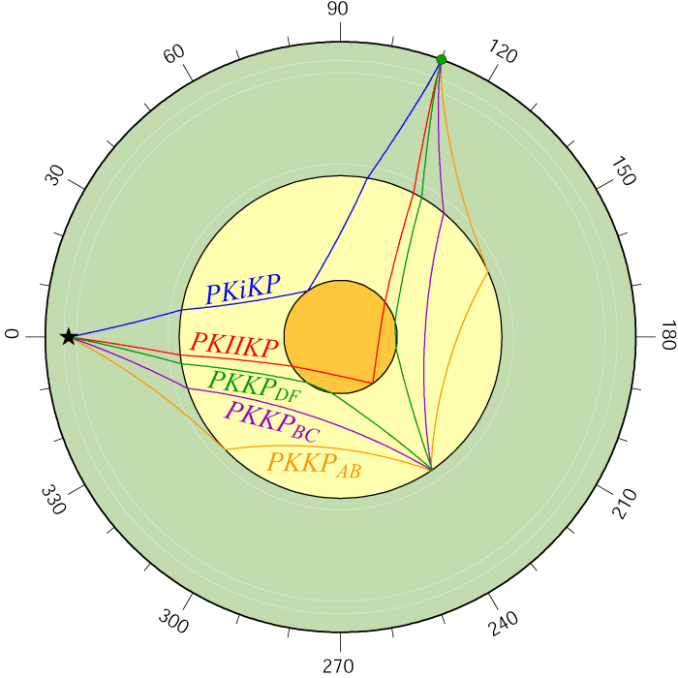
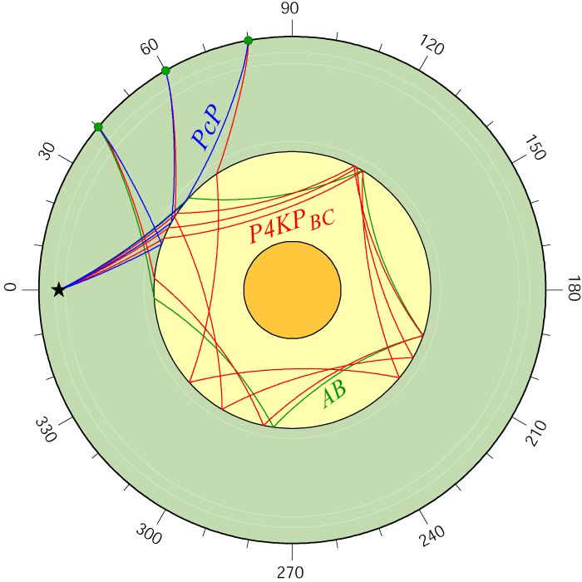
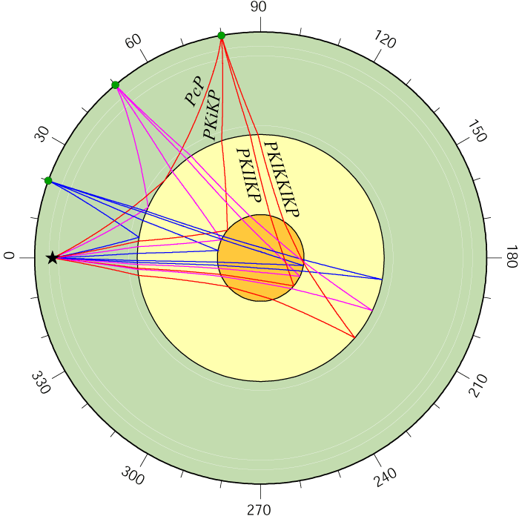
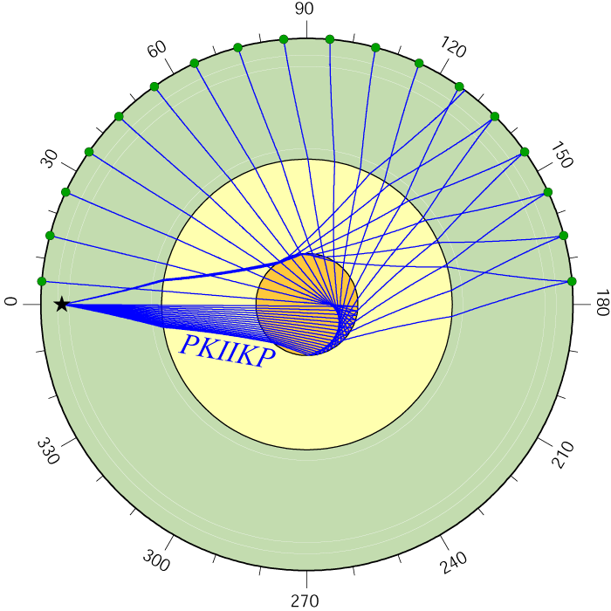
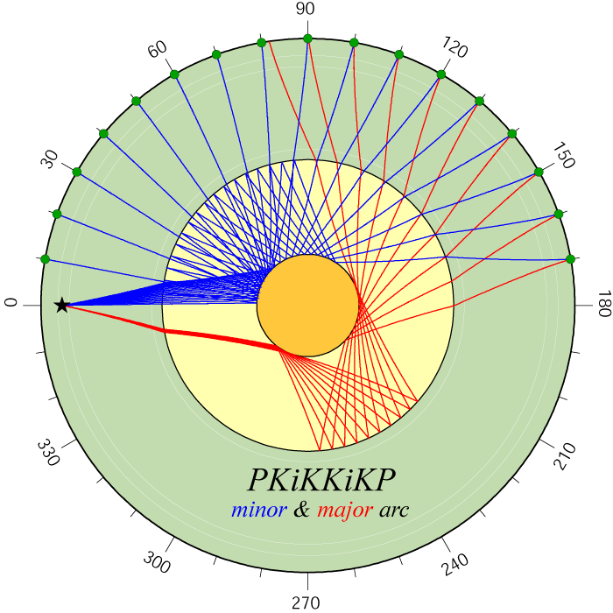
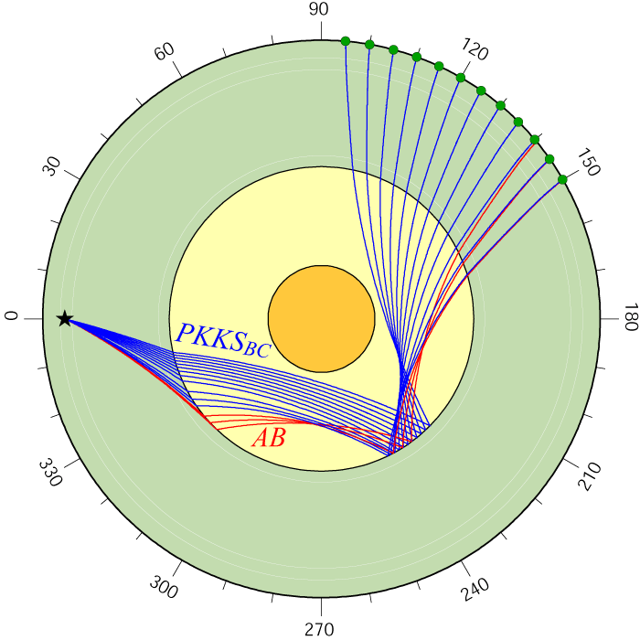
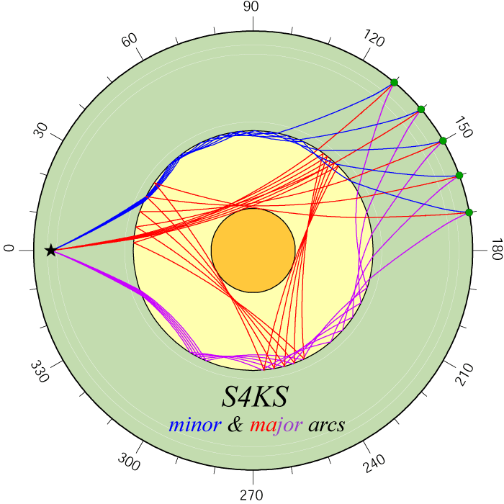
Notes:
So… depending on how far away is your EQ, you can study different depth shells of Earth

Slide 12
Imaging Targets
Depth shells of interest
→ imaging relates to seismic phase types
Geographic region of interest
    → depends upon having earthquakes and seismic network locations where you need them
Notes:
Regional, but also global

Slide 13
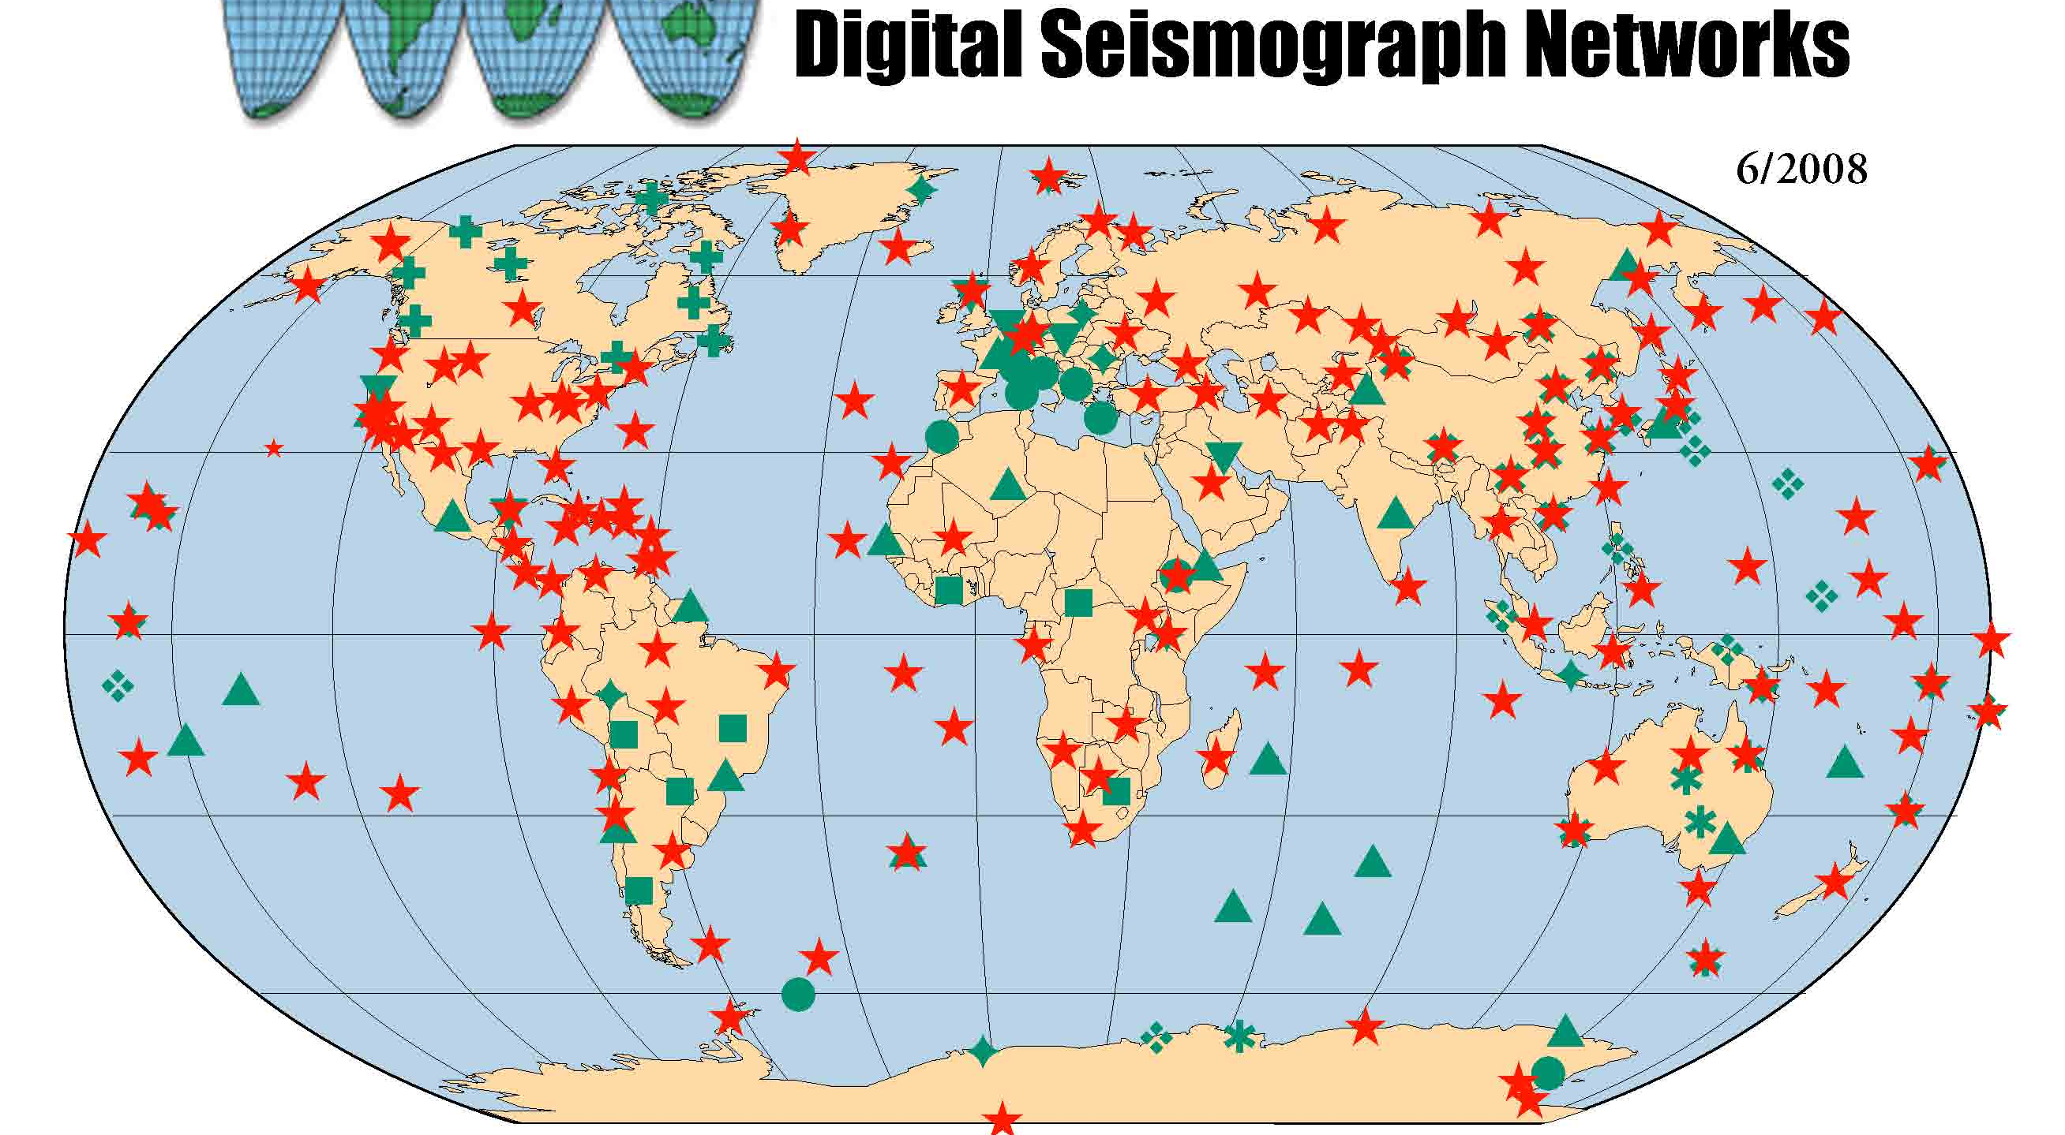
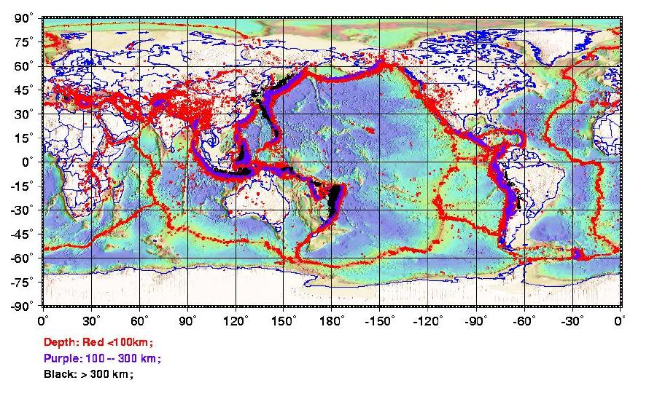
Distribution of EQs & sensors → corridors of energy
http://www.iris.edu
http://web.mst.edu/~sgao/g51/plots/0916_global_seismicity.jpg

Slide 14
Imaging Targets
Depth shells of interest
→ imaging relates to seismic phase types
Geographic region of interest
    → depends upon having earthquakes and seismic network locations where you need them
Earth interior sampling density
    → Directly a function of sensor network density and aperture
Notes:
Regional, but also global

Slide 15
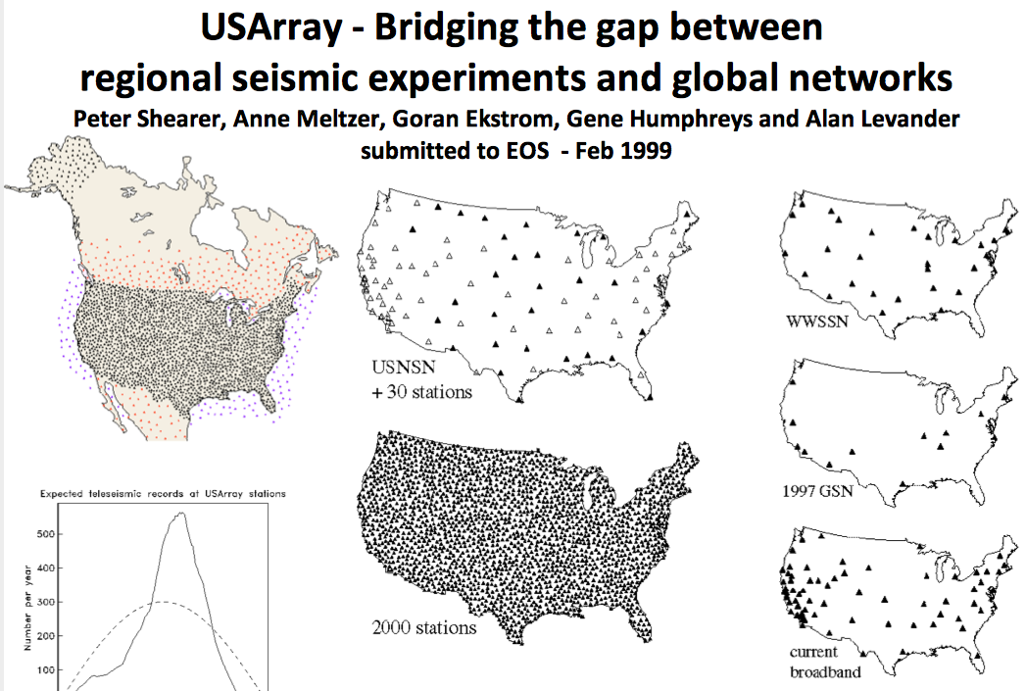
Array densification in the US
Shearer et al. (1999) (slide courtesy of M. Fouch)

Slide 16
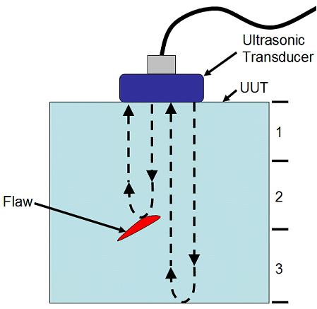
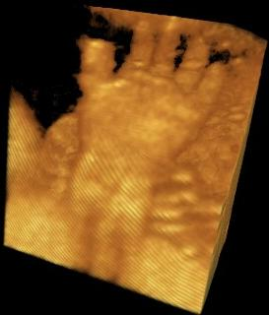
Imaging at smallest scales
Refractions
→ travel time studies, regional tomography, etc
Reflections
→ array analyses, scattering studies, etc.
Diffractions, multipathing
→ forward analyses of wave multipathing, etc.
Notes:
Regional, but also global

Slide 17

ScS
M. Thorne (Utah)

Slide 18
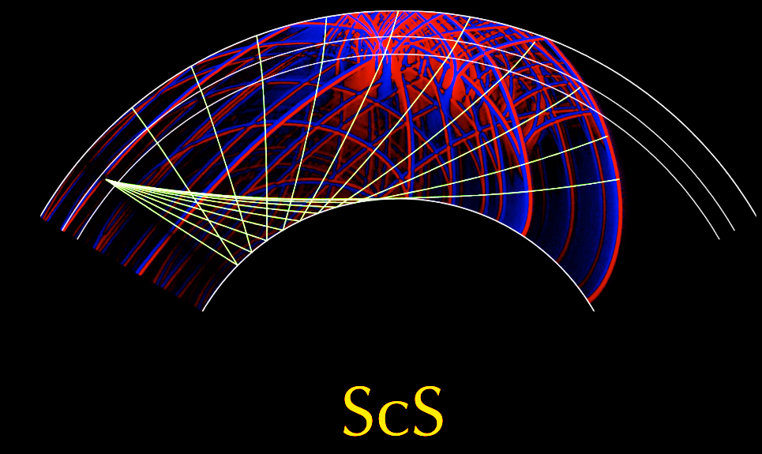

Slide 19

SS
M. Thorne (Utah)

Slide 20
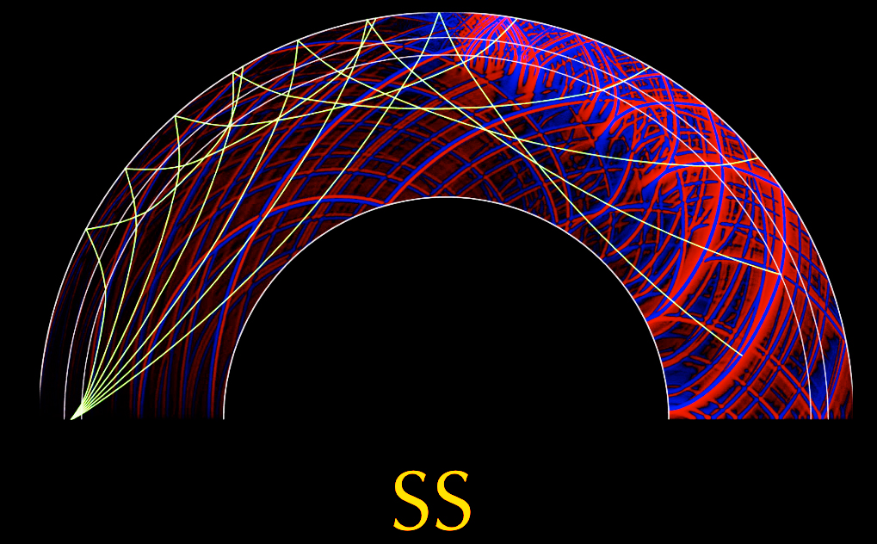

Slide 21
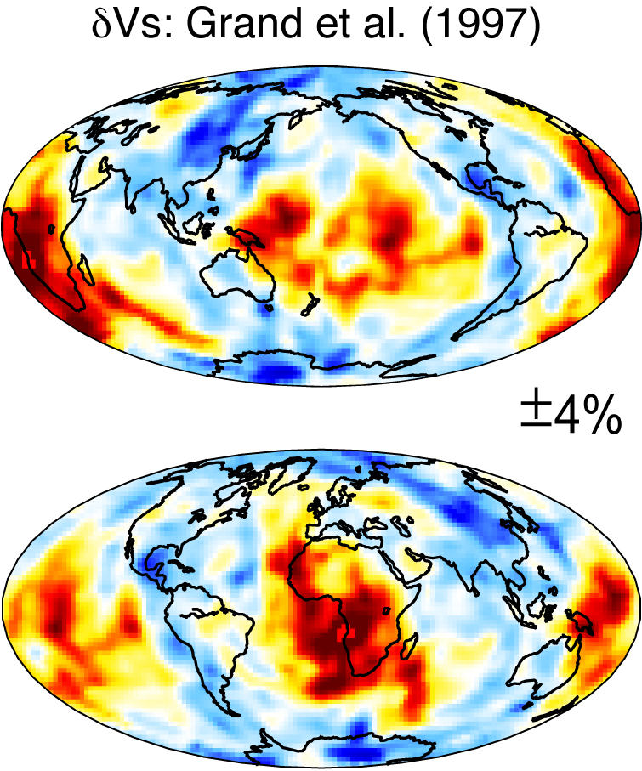
Notes:
D”

Slide 22
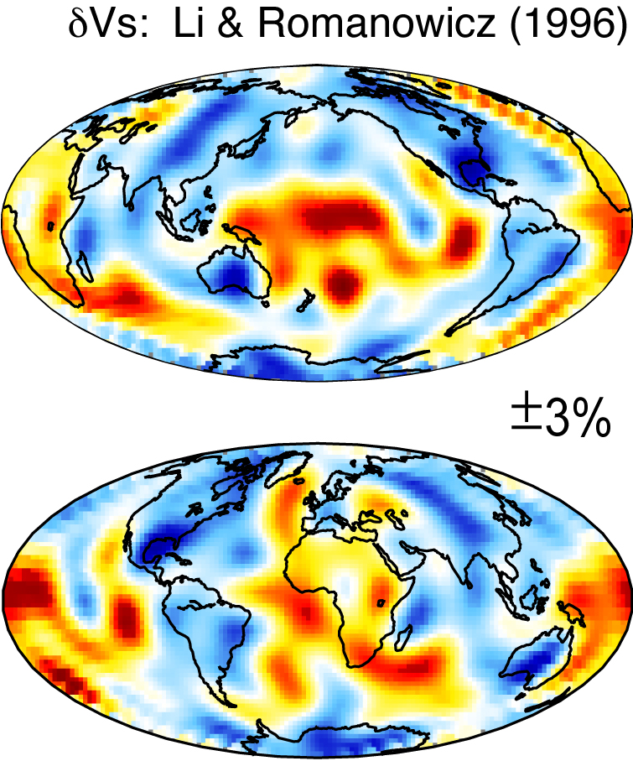

Slide 23
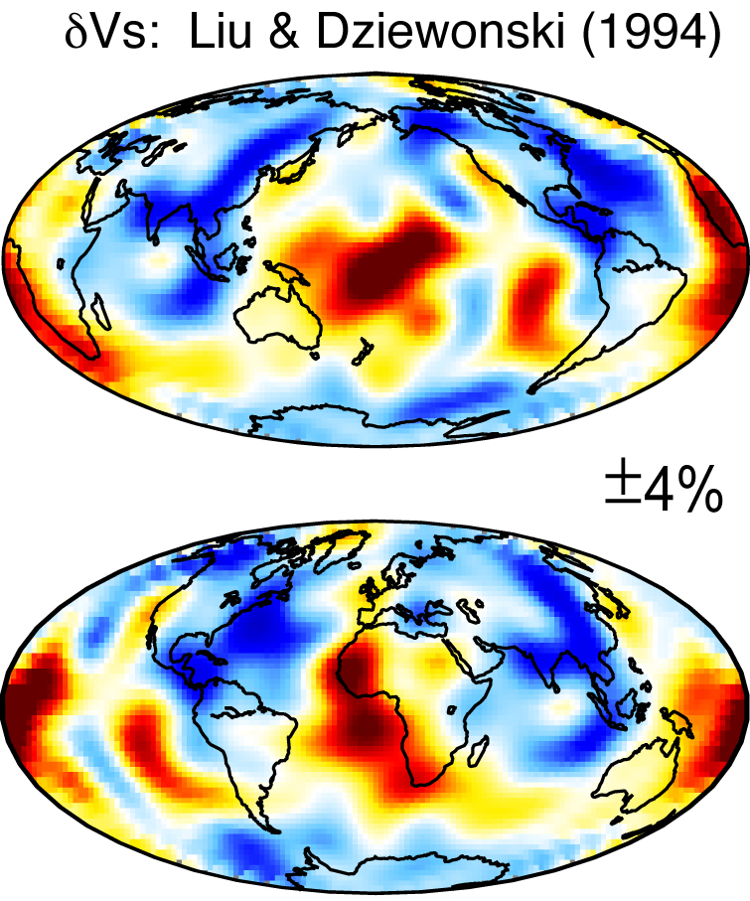

Slide 24
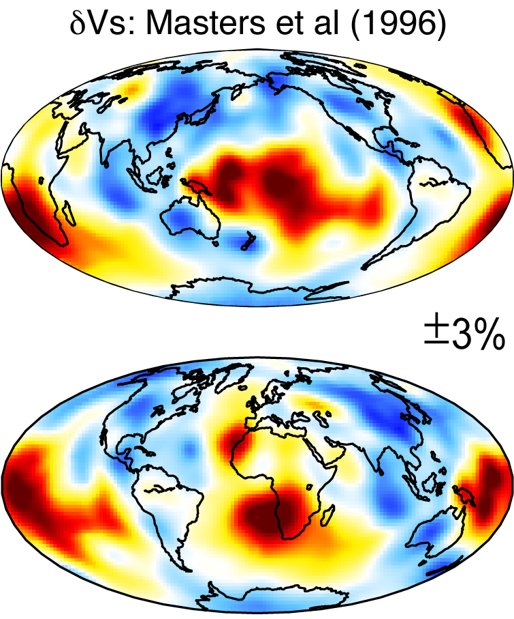

Slide 29
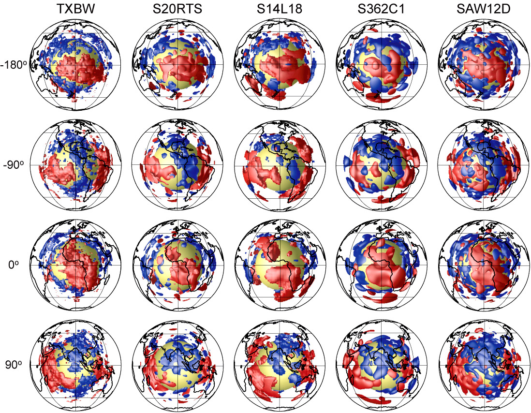
Shear wave tomography: large low shear velocity provinces
Pacific
Americas
Africa
Eurasia
Grand 2002
Ristema &
van Heijst 2000
Masters et al 2000
Gu et al 2002
Megnin &
Romanowicz 2000
Iso-velocity contours: +/- 0.7%
Notes:
Quickly: similarities in many recent tomography models. Low dVs extending up. Large features. Details are different. And this is important.

Slide 30
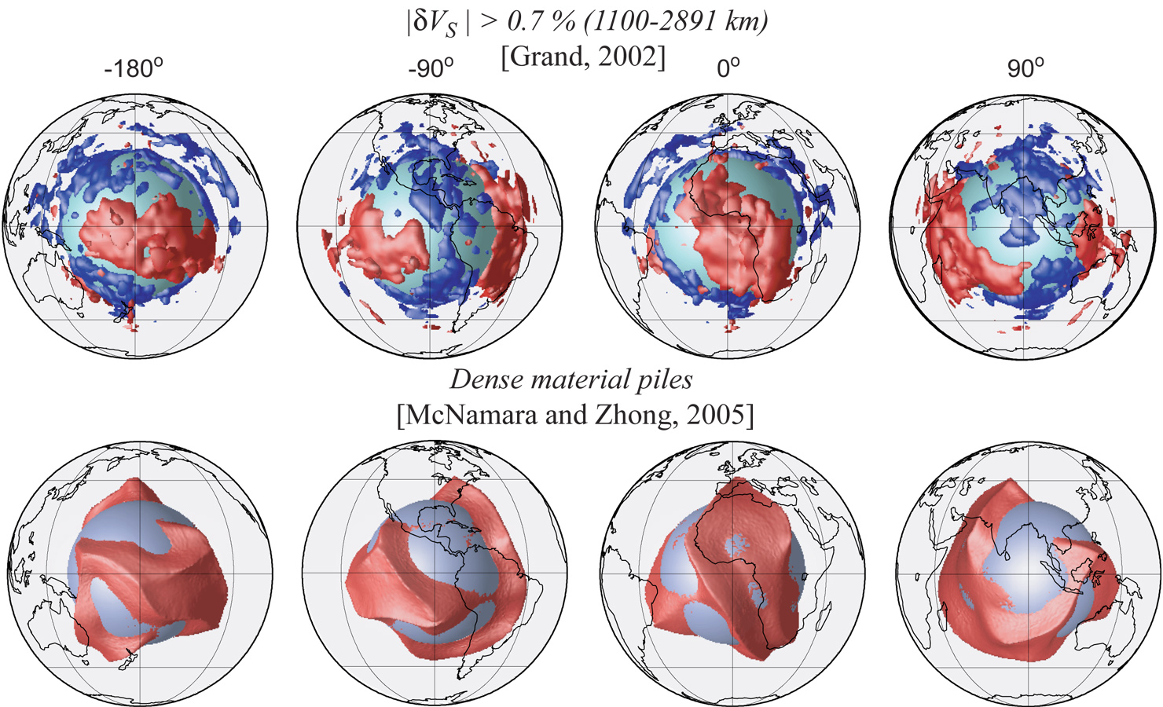
3D Numerical geodynamics
McNamara & Zhong (2005, Nature)
Grand (2002, Phil. Trans. R. Soc. Lond.)
Striking agreement with tomography

Slide 31
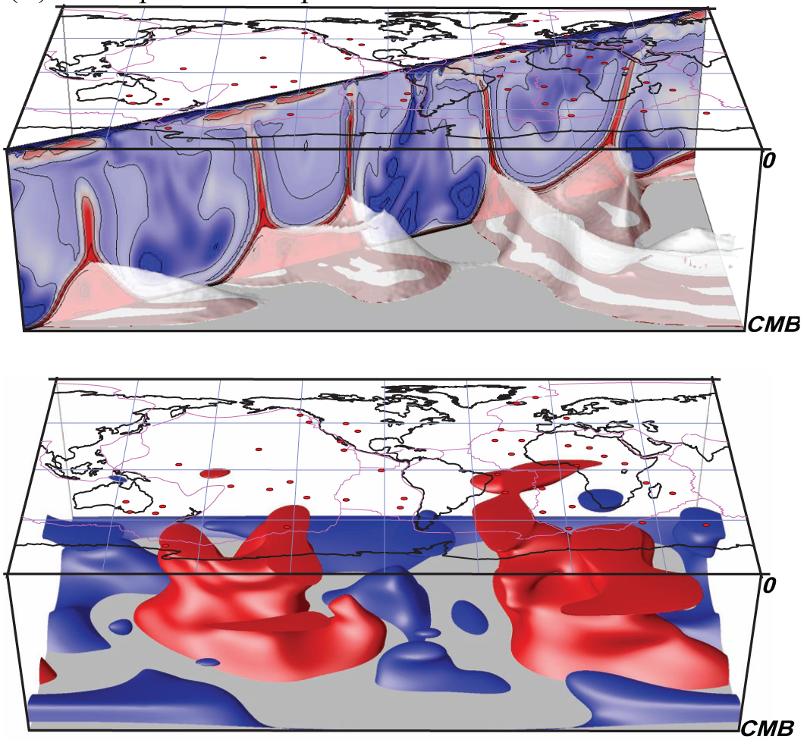
Plumes from piles
Numerical
geodynamics
Seismic
tomography

Slide 32

LLSVPs and hotspots
Iso-velocity contour: - 0.7%
Hotspots:
Thorne, Garnero, Grand [2004, PEPI]
δVs: Grand [Phil. Trans. R. Soc., 2002]
Hotspots: Sleep [JGR, 1981]
Notes:
This supports the geodynamic calculation: hot spots appear to overly edges of low velocities.

Slide 33

Chemically distinct LLSVPs and LIPS
Burke, Steinbergerb, Torsvikb, Smethurst [EPSL, 2007]

Slide 34



D”: perovskite-to-post-perovskite & D” discontinuity
Mineral physics:
Seismology:
200-300 km
above CMB
0.5-3%
velocity
increase
consistent
with onset
of post-
perovskite
phase
e.g., Murakami et al. [Science, 2004]
Oganov and Ono [Nature 2005]
Lay et al. [EOS, 2005]
Lay et al [PEPI, 2004]

Slide 35

Base of the mantle: ultra-low velocity zones
Large P and S wave
velocity reductions
δV_{P}: up to -10%
δV_{S}: up to -30%
Large density increase:
δρ ~ +10%
Values consistent
with partial melt of
deepest mantle rock
Thorne and Garnero [JGR, 2004]
Notes:
Earth’s biggest magma chambers?

Slide 36

Base of the mantle: ultra-low velocity zones
Plotted here on top of dVs tomography
McNamara et al. (2010, EPSL)
Notes:
I won’t interpret thiese today. I will explore this topic more in the Seismology IV lecture

Slide 37

Merging piles and ULVZs
Thorne et al. [2013 EPSL]

Slide 38



Results in context
Vs Tomography:
Plume?
Numerical
geodynamics
Discontinuity
Topography
}
Wolfe et al
(Science 2009)
Schmerr et al
(EPSL 2010)
This study:
Waveform broadening
Montelli et al
(Science 2004)
temperature
Grand
(Phil. Trans 2002)
composition
Garnero & McNamara
(Science 2008)

Slide 39

Topmost outer core
Helffrich & Kanashima 2010 Nature
Notes:
Using SmKS waves

Slide 40

Lowermost outer core
Yu, Wen, Niu 2005 JGR

Slide 41

Inner core
Anisotropy
Heterogeneity
Hemispherical patterns
Depth dependence of properties,
etc
Lauren Waszek, Jessica Irving and Arwen Deuss
(Nature Geosci, 2011)

Slide 42
Parting comments
Body wave seismology cannot study everywhere (limited path coverage), but offer highest resolution where you can sample, if you have enough sensors recording the wavefield, such as GABBA
More data is key: dense and large networks, new region deployments.
Resolving Earth at highest resolution is key in deciphering nearly all “big” questions, from plate tectonics to evolution of the planet.

