Slide 1
Subspace Based Three-Component Array Processing
Gregory Wagner
Nuclear Treaty Monitoring
Geophysics Division
15 May 2013

Slide 2
Introduction
Arrays play a crucial role in AFTAC’s nuclear treaty monitoring mission. The benefits of array data include:
The ability to increase signal-to-noise ratios helps lower detection thresholds.
The ability to characterize the wavefield in terms of frequency, azimuth, slowness, and polarization characteristics helps improve phase identification and, in turn, network processing (the Global Association algorithm uses time, azimuth, slowness, and polarization information in network processing).
The ability to use multi-channel matched filters helps improve identification and classification.
Three-component arrays play an important role in local/regional monitoring because of the relatively shallow incidence angles of local/regional phases.

Slide 3
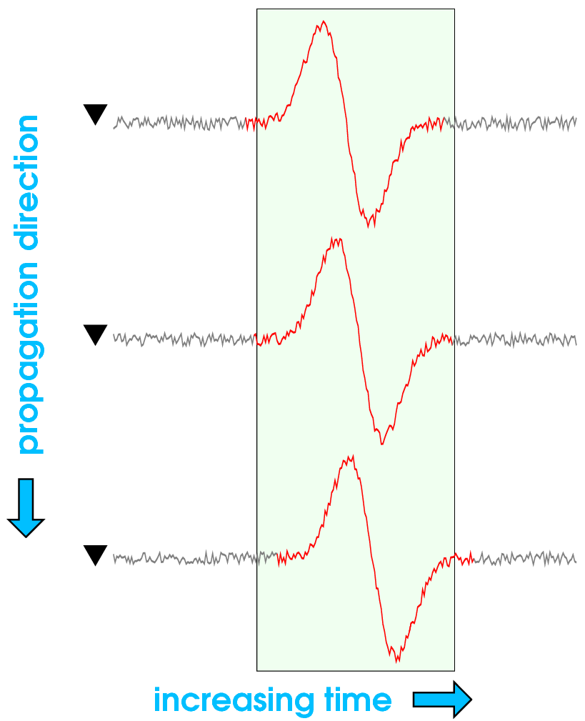
Time Domain Beam Forming: Delay and Sum

Slide 4
Frequency Domain Beam Forming: Shift Theorem

Slide 5
Single-Component Array Frequency Domain Data Vector
In frequency domain fk analysis, “steering vectors” are used to search for maxima in x,y slowness space and in so doing identify the azimuth and slowness of coherent signals (~Factor Analysis (FA)). Steering vectors ( e(w) ) have the same form as the a(w); they parameterize the pair-wise propagation-induced phase delays for a signal with an assumed azimuth and slowness (or sx,sy).

Slide 6
Beam and Beam Power
Using the steering vectors, the beam is given by:
The beam power is given by:
Where R, the covariance matrix, is:

Slide 7
Sample Covariance Matrix
For the single signal, no noise case, the correlation/ covariance matrix is a rank-one matrix:
The propagation induced phase delays are embedded in the covariance matrix. The columns of R are simply the pair-wise propagation induced phase delays with respect to a different reference sensor.

Slide 8
Principal Component Analysis (PCA)
For the single signal case, the vector containing the propagation induced phase shifts can be obtained by performing a principal component decomposition of R:
The eigenvector associated with the largest eigenvalue is essentially an empirical steering vector for the observed signal.
For the single signal case, the principal component eigenvector spans a one dimensional “signal subspace”.

Slide 9
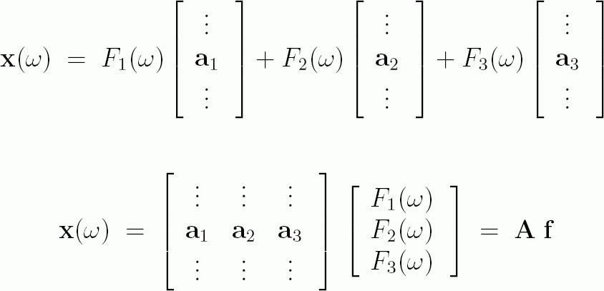
Multiple Signals Plus Noise

Slide 10
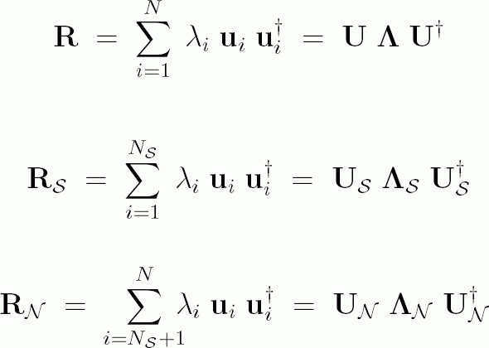
Signal (+Noise) and Noise Subspaces

Slide 11
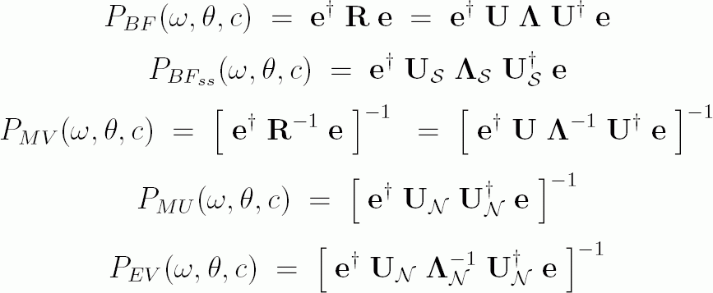
Subspace Based Single- Component Array Processing
For the single-component array case, several estimates can be easily computed using the basis provided by the principal component decomposition:

Slide 12
Three-Component Array Processing
For a single-component array, the steering vectors are used to search for spectral peaks in two-dimensional slowness space (sx,sy, or azimuth and slowness).
For a three-component array, the elements of R (which is now a 3N x 3N matrix) provide information about both the sensor-wise propagation-induced phase delays, and the component-wise amplitude and phase relations for signals that have rectilinear, transverse, or elliptical particle motion.
Using a factor analysis type approach to identify the steering/mode vectors in three-component array data is not practical due to the computational burden it implies (a multi-dimensional search over slowness and polarization space), and/or does not make full use of the three-component array data (e.g., computing independent fk’s using vertical, transverse, and radial components).

Slide 13
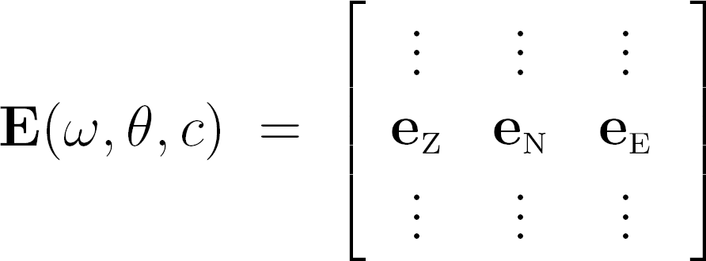
Three-Component Array Processing
For three-component array data we instead perform a second principal component analysis on the Z,NS,EW components from the subspace projections.
For the three-component array case, the 3x3 polarization covariance matrix for the MUSIC (Multiple Signal Classification) estimate is:
3N x 3

Slide 14
Three-Component Array Processing
The magnitude of the multidimensional MUSIC null-spectrum is the inverse of the minimum eigenvalue of C_{MU} ( lamda_3 ).
The associated eigenvector ( p3(x,x,x) ) is, in general, complex and parameterizes the component-wise amplitude and phase relations (i.e., the signal’s polarization characteristics).
The signal’s wave type can be inferred based on c and the particle motion polarization parameterized by p3(x,x,x) .

Slide 15
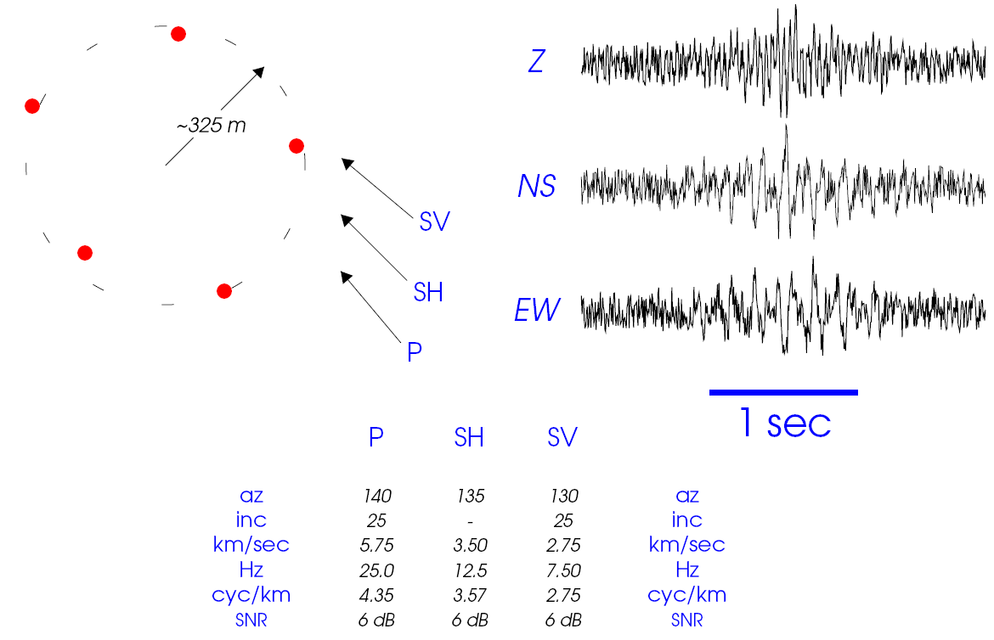
Three Signal Test Case

Slide 16
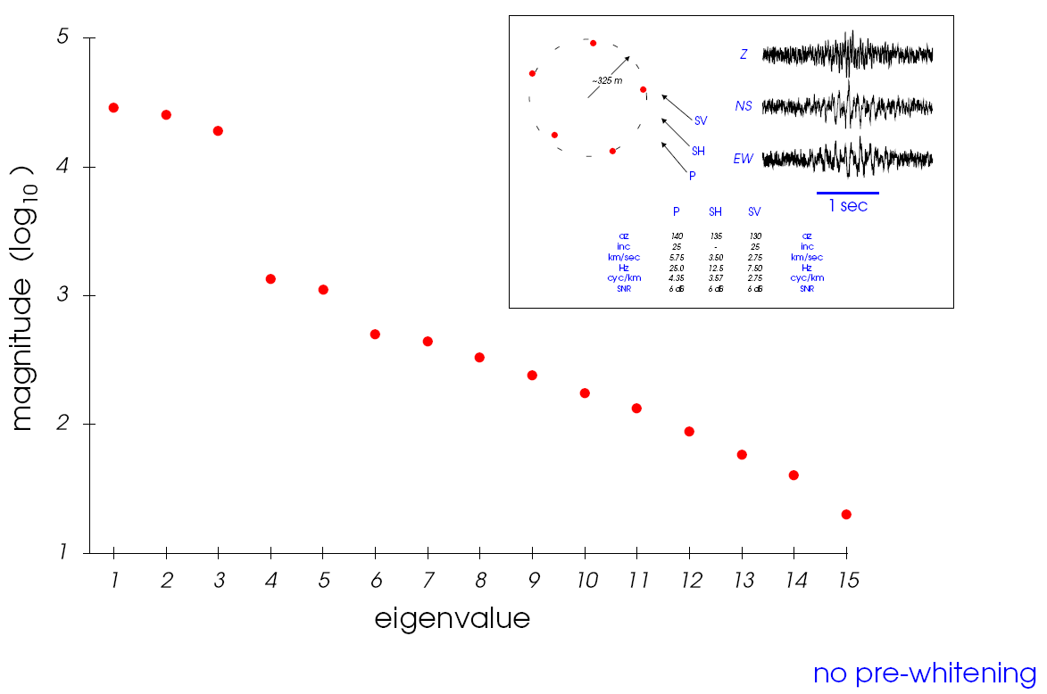
Eigenvalues for Three Signal Test
“Diagonal loading” (~spatial pre-whitening) of the covariance matrix is typically mentioned in discussions about robust adaptive processing.

Slide 17
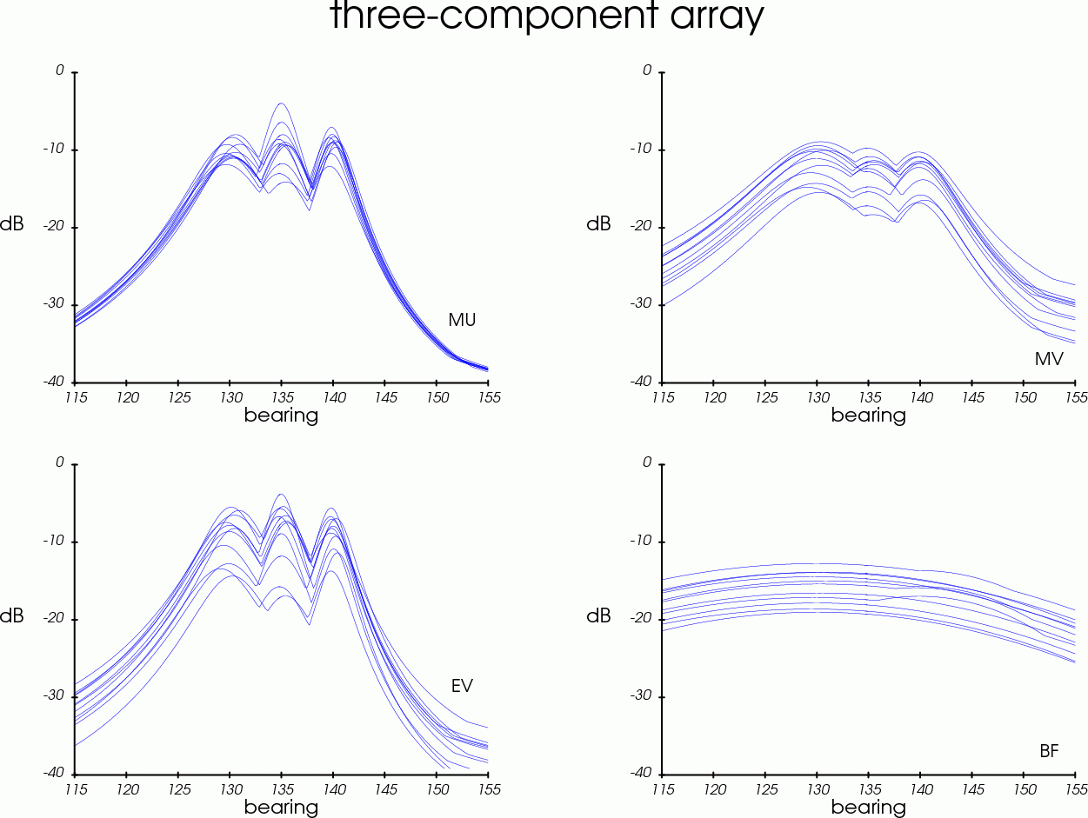
Three-Component Array Processing

Slide 18
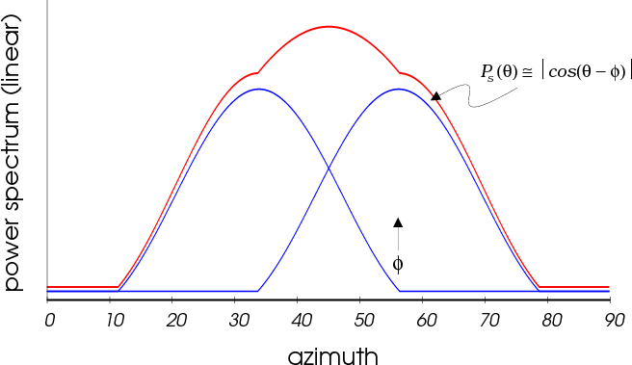
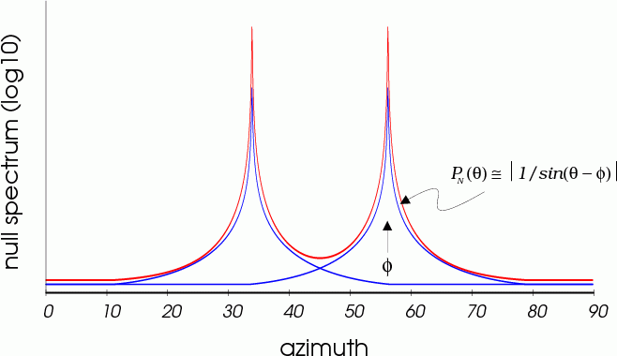
Orthogonal Complement Null Steering

Slide 19
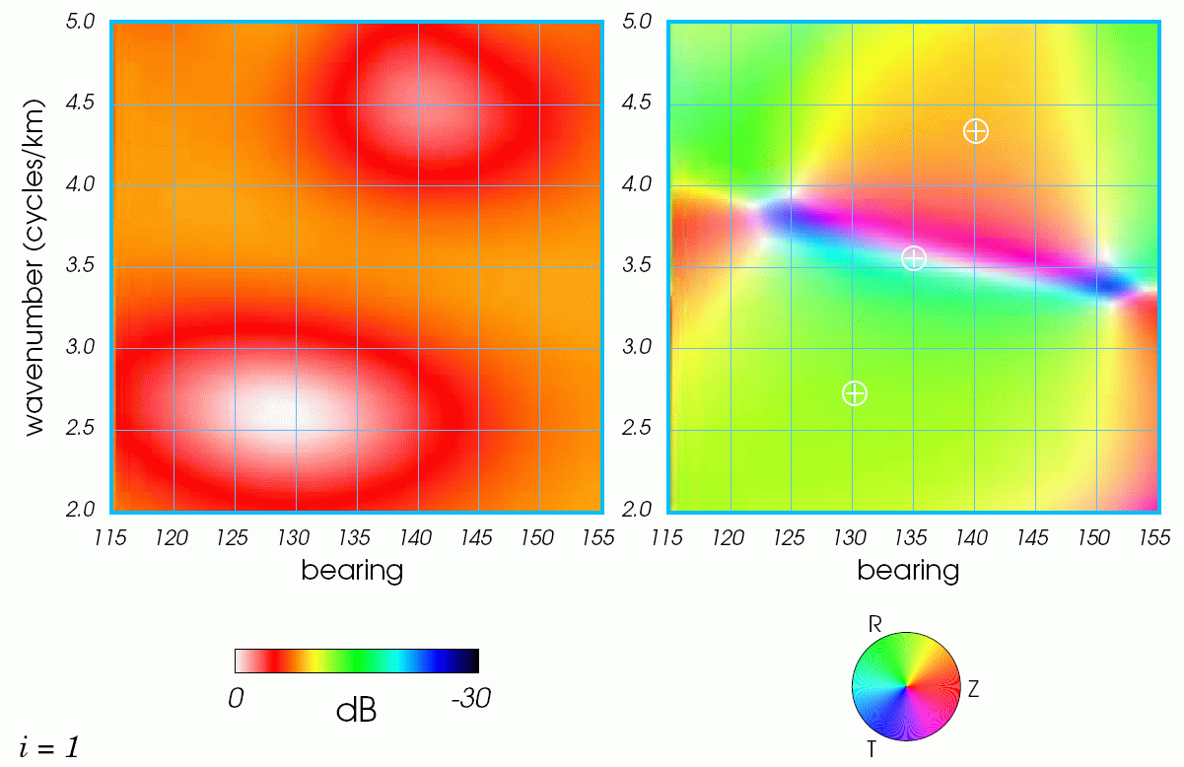
First Eigenvector

Slide 20
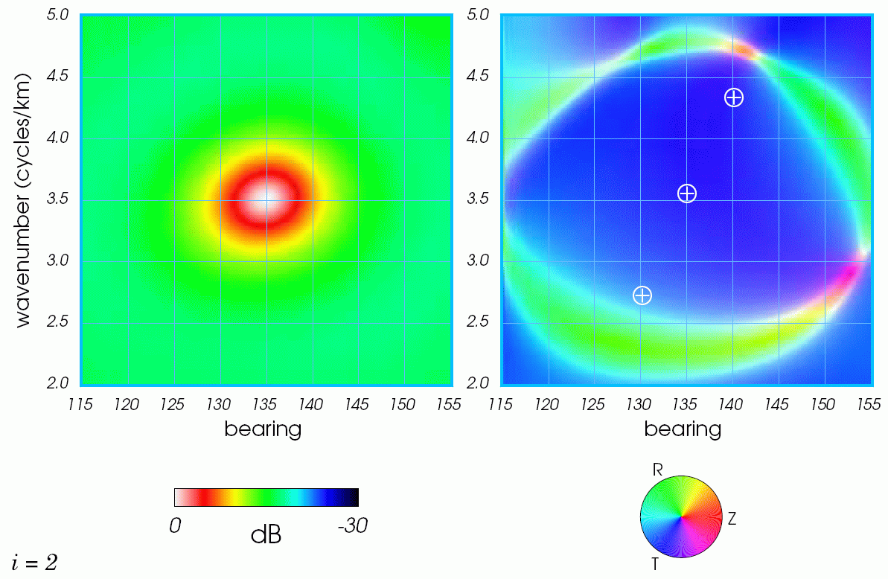
Second Eigenvector

Slide 21
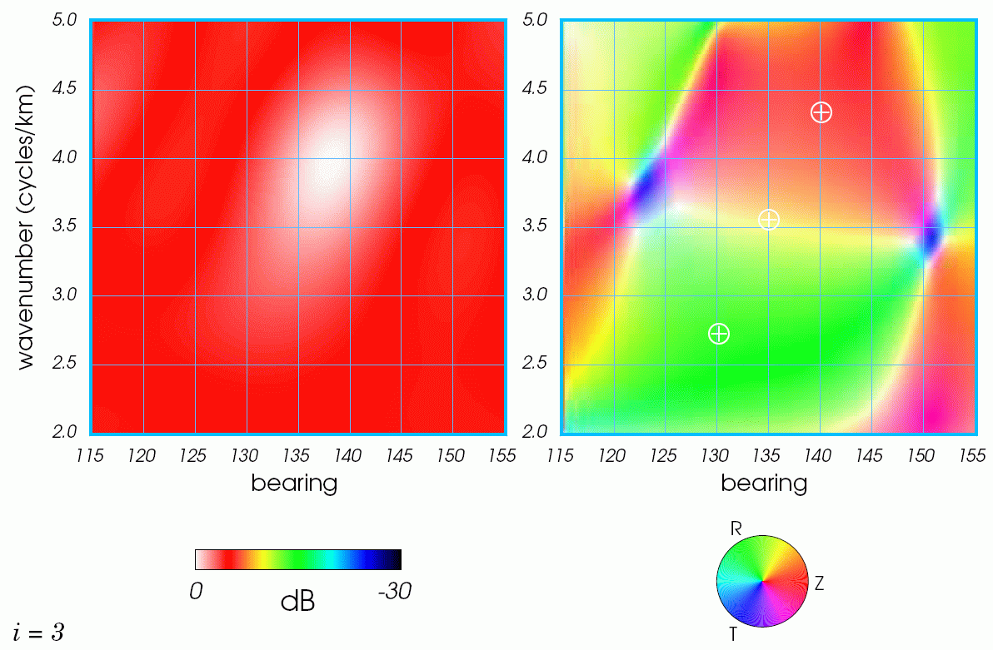
Third Eigenvector

Slide 22
First Eigenvector (again)

Slide 23
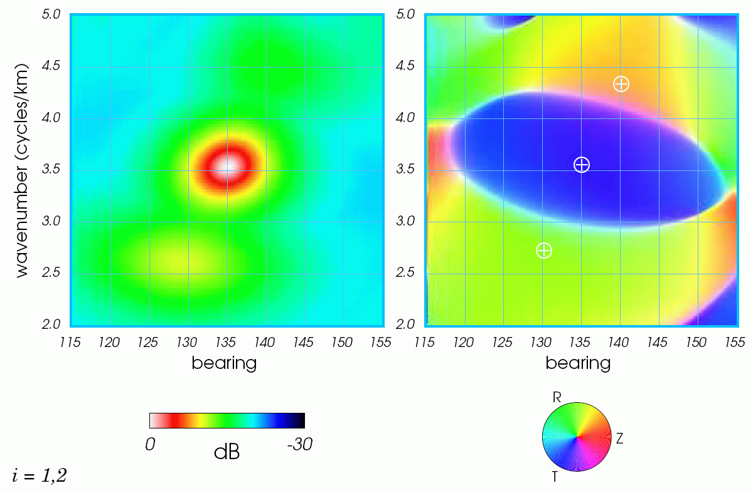
Eigenvectors 1+2

Slide 24
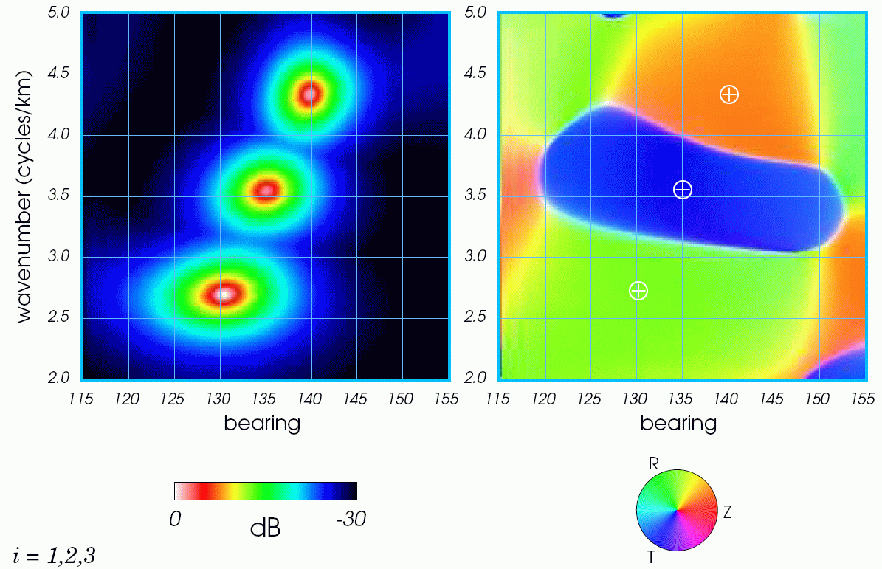
Eigenvectors 1+2+3

Slide 25
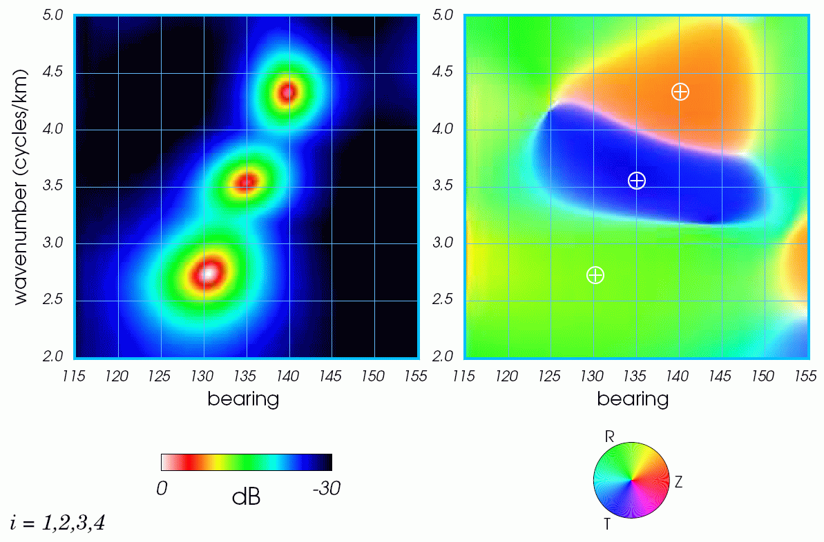
Eigenvectors 1+2+3+4

Slide 26
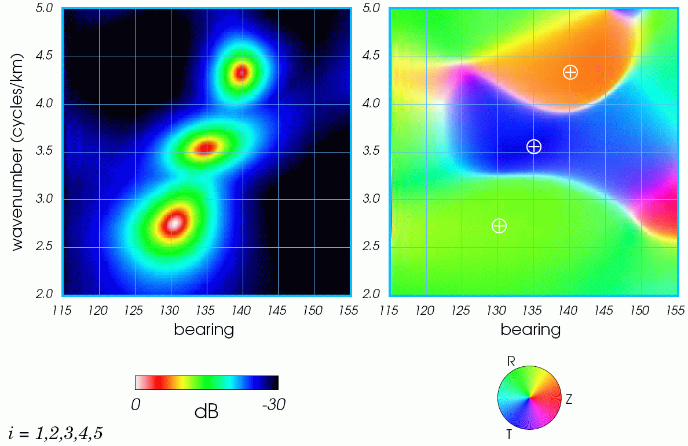
Eigenvectors 1,2,3,4,5

Slide 27
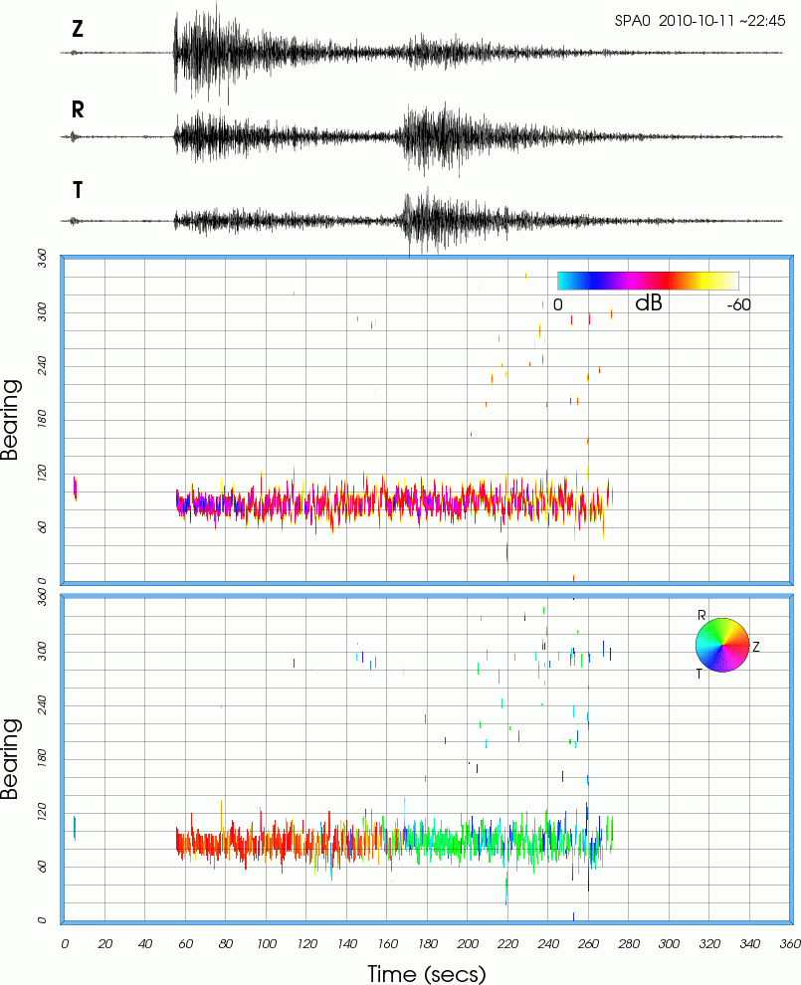
SPITS 2010-10-11 ~22:45 BTR
MU
seaz ~ 76.1
delta ~ 10.5

Slide 28
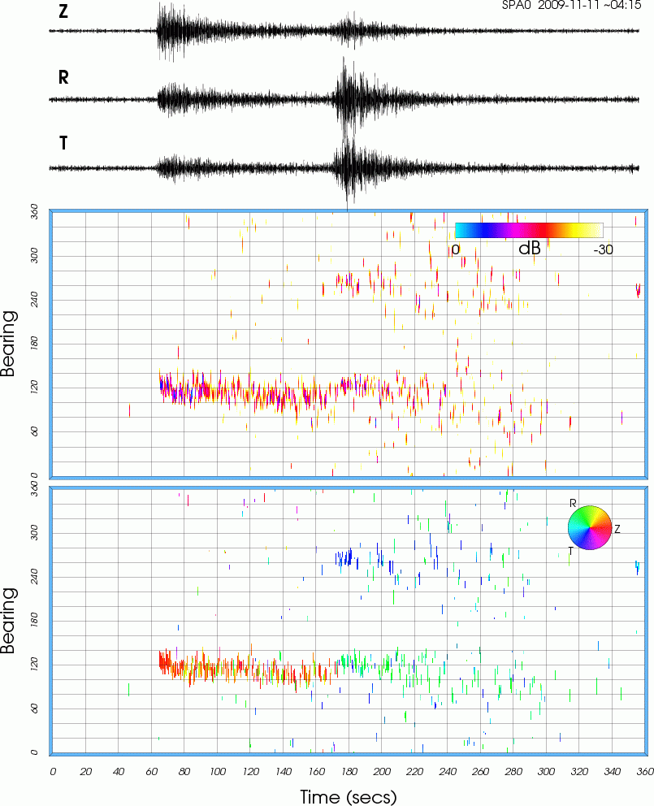
SPITS 2009-11-11 ~04:15 BTR
MU
seaz ~ 113
delta ~ 10.6

Slide 29
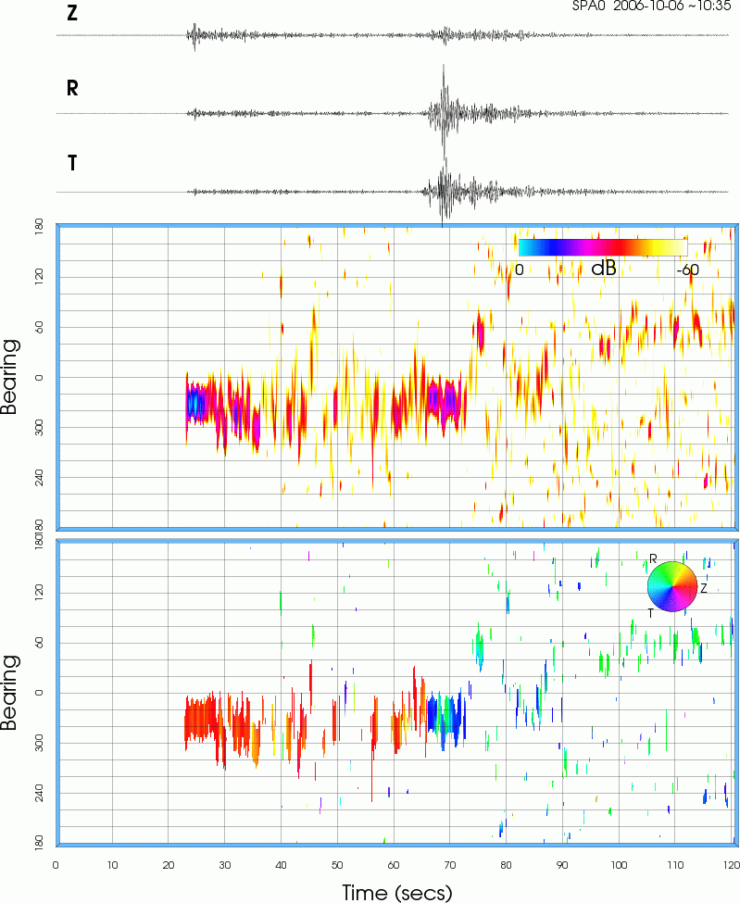
SPITS 2006-10-06 ~10:35 BTR
MU
seaz ~ 310
delta ~ 3.8

Slide 30
Subspace Processing Procedure
Window data and FFT (fftw.org).
Compute covariance matrix (or correlation matrix for 1C case).
Compute eigenvalues and eigenvectors.
For the detection only case, compute just the principal component eigenvalue for use as a detection statistic (netlib.org/lapack zhpevx() option).
Estimate the dimension of the signal subspace.
Project steering/mode vectors onto subspace(s) defined by the eigenvectors.
For the 1C case, several different estimates can be easily computed using the basis defined by the eigenvectors (BF, BFss, MV, MU, EMV).
For the three-component case, use the orthogonal Z, NS, EW subspaces to compute a 3x3 polarization covariance matrix (no diagonal loading!).
Compute the eigenvalues and eigenvectors for the 3x3 polarization matrix.
For null-steering options like MU and EV, use 1/(minimum eigenvalue) and its associated eigenvector.
For standard BF, use the maximum eigenvalue and its associated eigenvector.
For the three-component case, this analysis procedures entails a succession of PCA followed by FA followed by PCA.

Slide 31
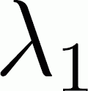
Summary
Subspace based processing provides a convenient approach for processing single-component and three-component array data.
Subspace based processing provides a framework that makes it easy to compute both conventional (BF), and several different adaptive and high-resolution estimates (MV, EMV, MUSIC).
The three-component array processing approach presented in this briefing uses all 3N channels simultaneously. This approach is preferable to approaches that treat three-component array data as three separate single-component arrays (vertical, radial, and transverse components).
The largest/principal eigenvalue of the sample covariance matrix provides a simple and easily computed detection statistic for any type of multi-channel data; 3C stations, 1C arrays (seismic or infrasonic, covariance or correlation matrix), 3C arrays. L1 can also be used to compute multi-channel spectrograms.

Slide 32
Questions?
END

Slide 33
3D Rotation of a P Wave

Slide 34
3D Rotation of a P Wave

Slide 35
3D Rotation of a P Wave

