Slide 1
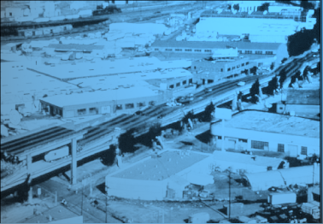

ShakeMap
Examples
David Wald, Kuo-Wan Lin, Bruce Worden
U. S. Geological Survey, Golden, CO

Slide 2
ShakeMap
Atlas
David Wald, Kuo-Wan Lin, Bruce Worden
U. S. Geological Survey, Golden, CO

Slide 3
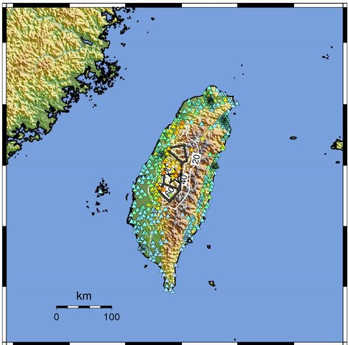
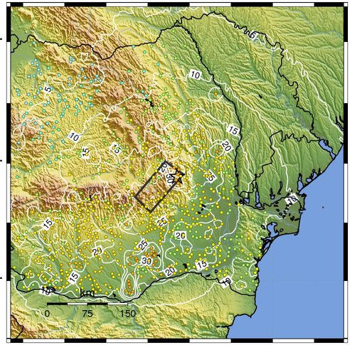
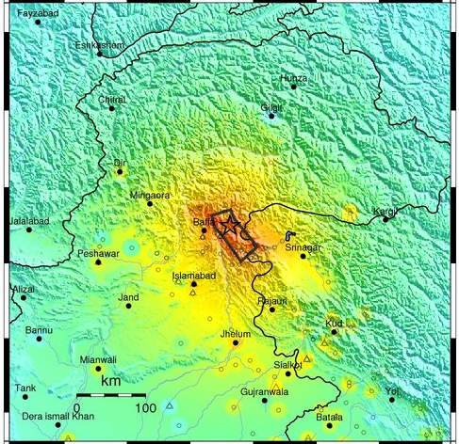
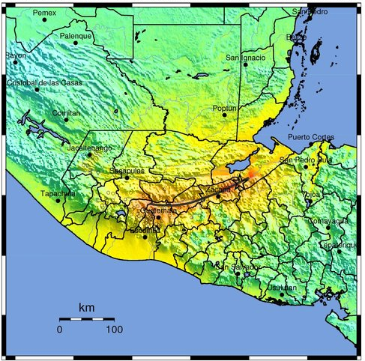
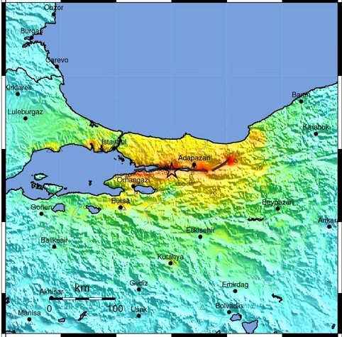
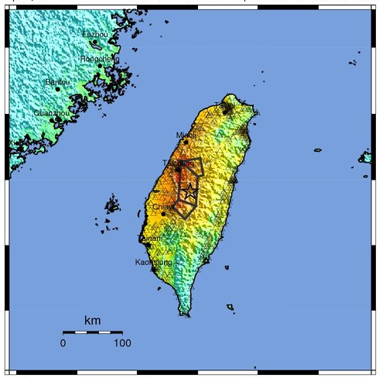
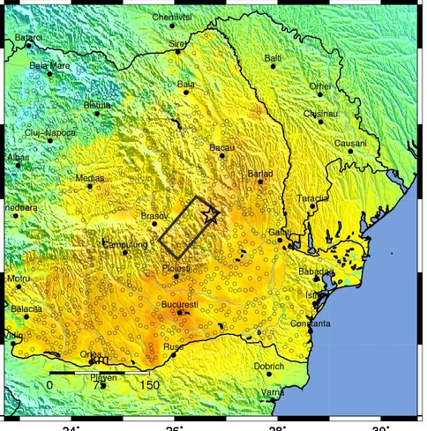
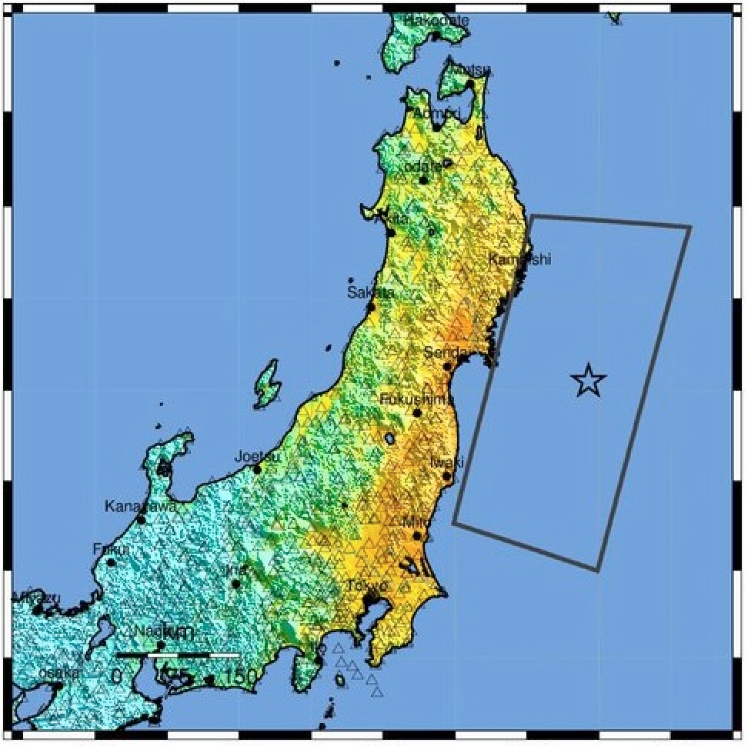
ShakeMap Atlas: ShakeMaps for >6,000 Earthquakes (1973-2012)
Kashmir, 2005
Guatemala, 1976
Izmit, 1999
Chi-Chi, 2005
Romania, 1977
Tohoku, 2011

Slide 4
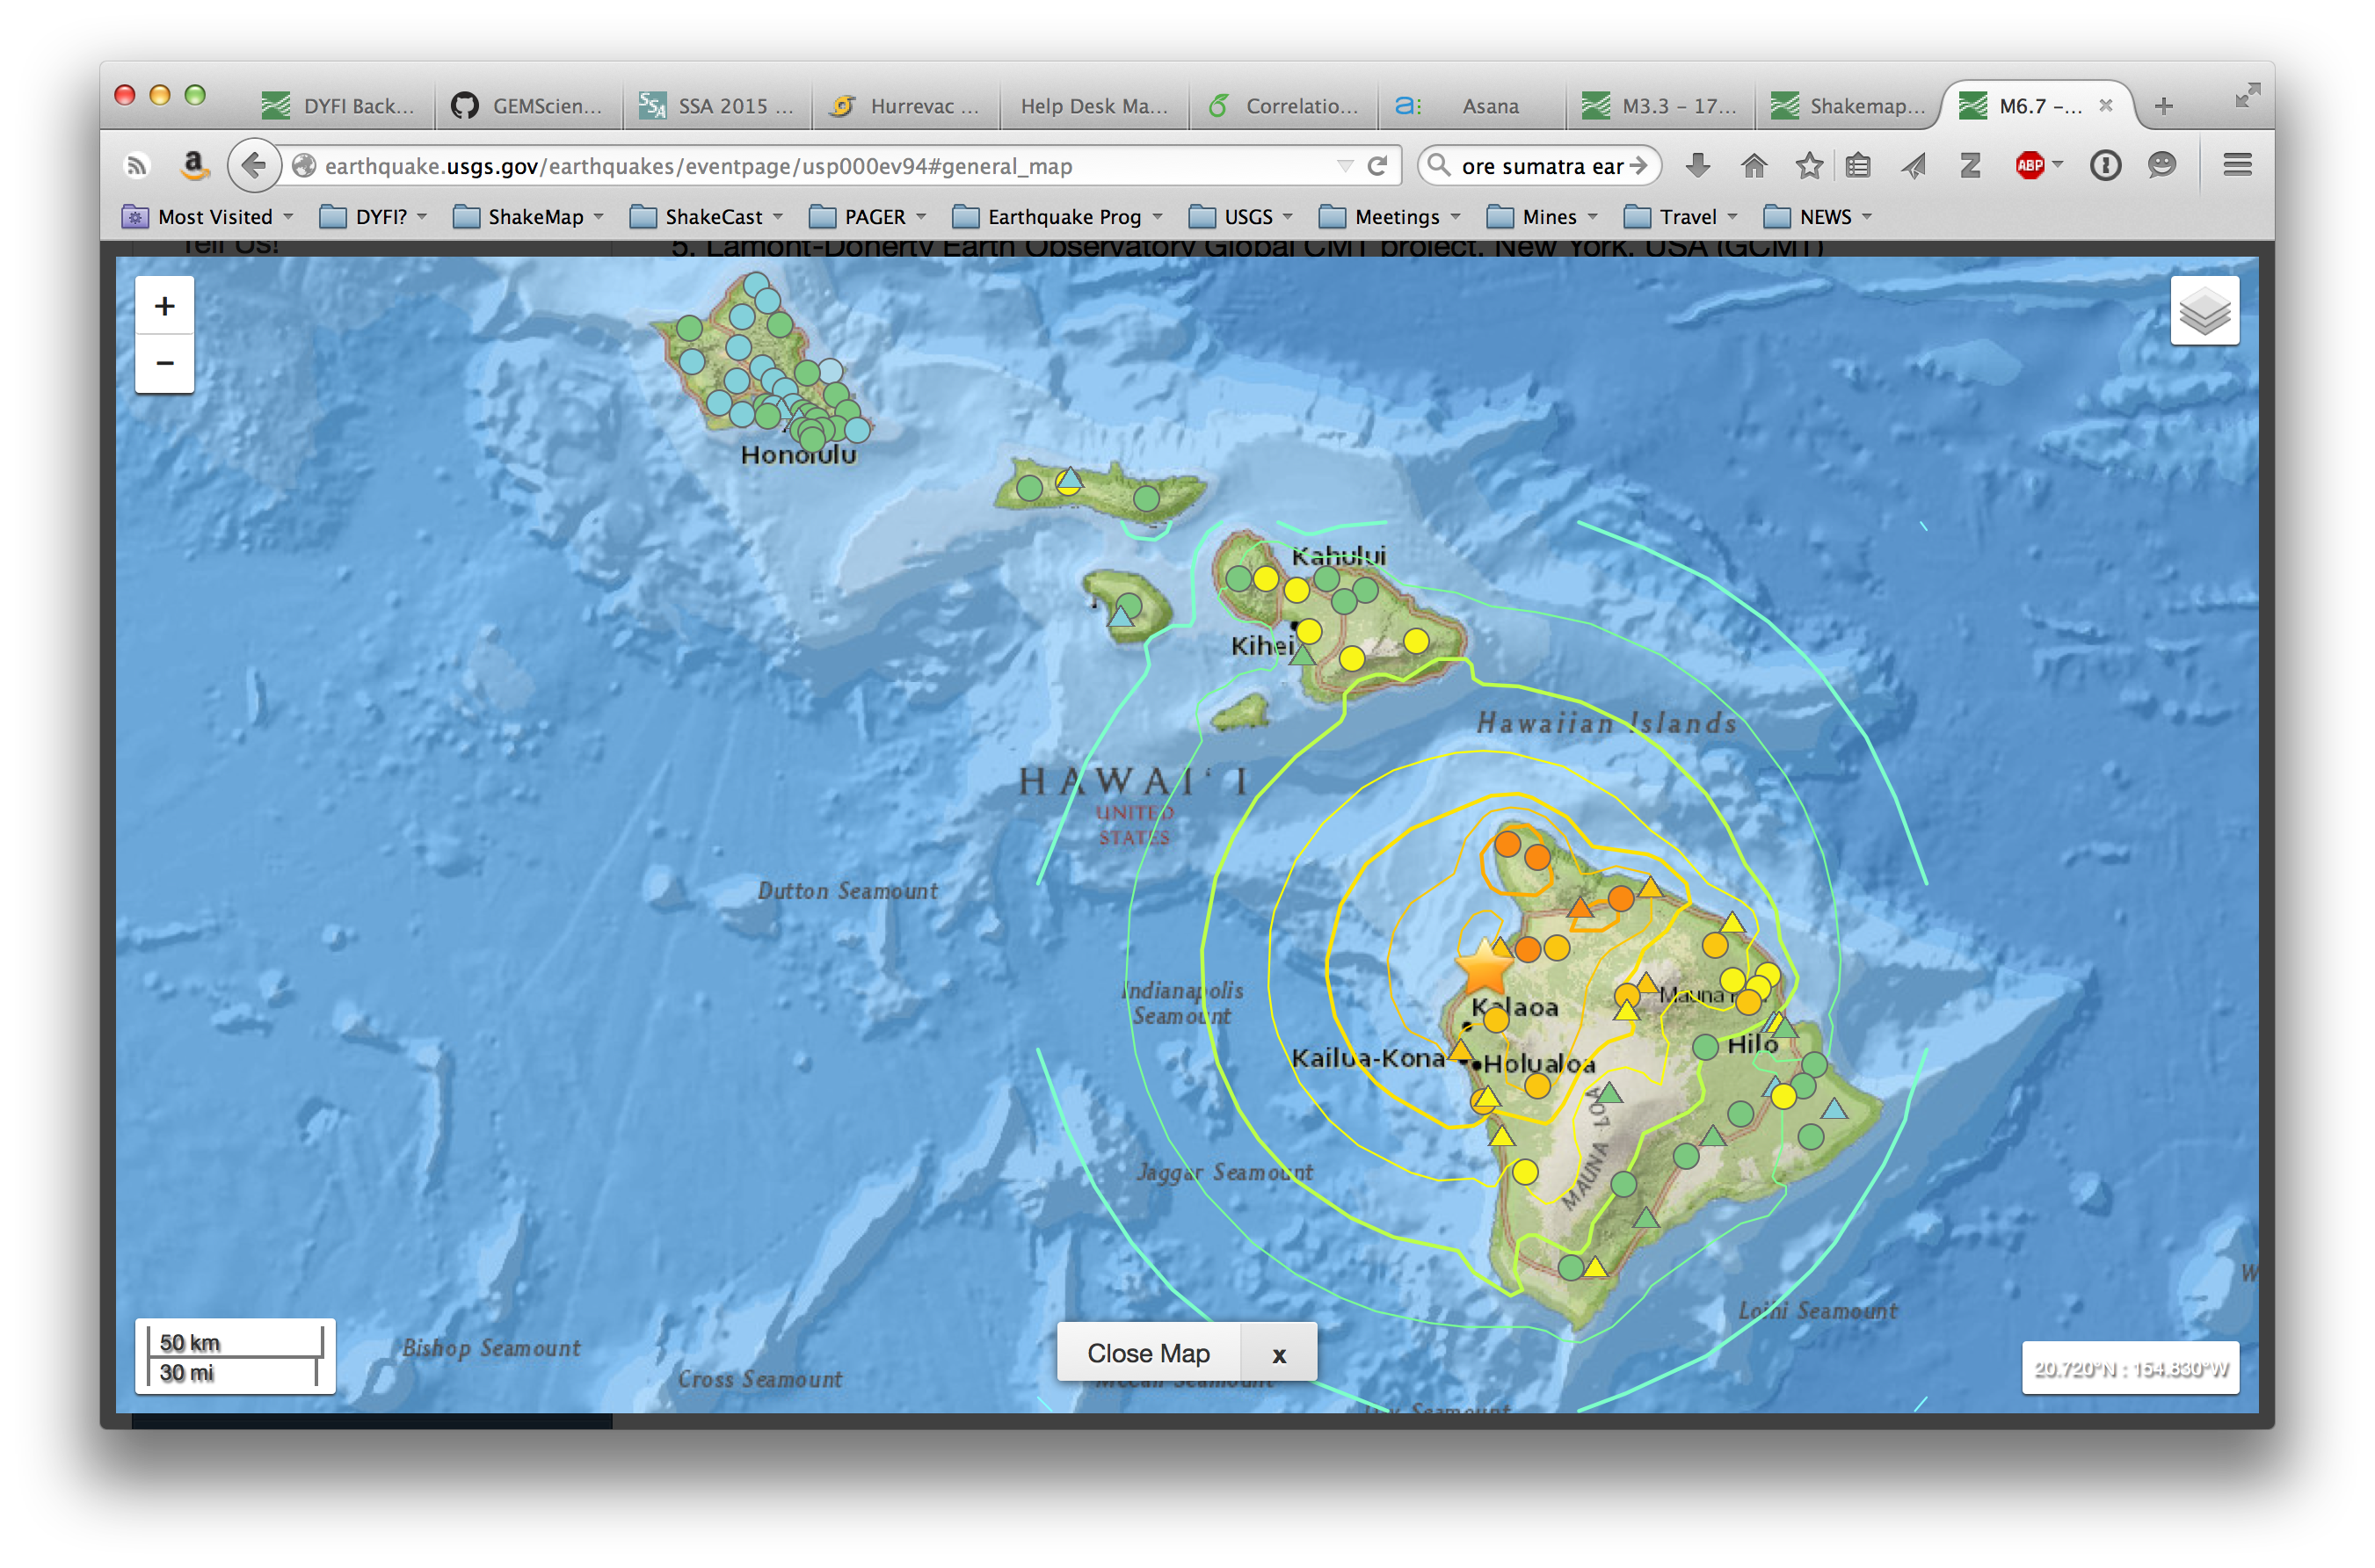

Slide 5
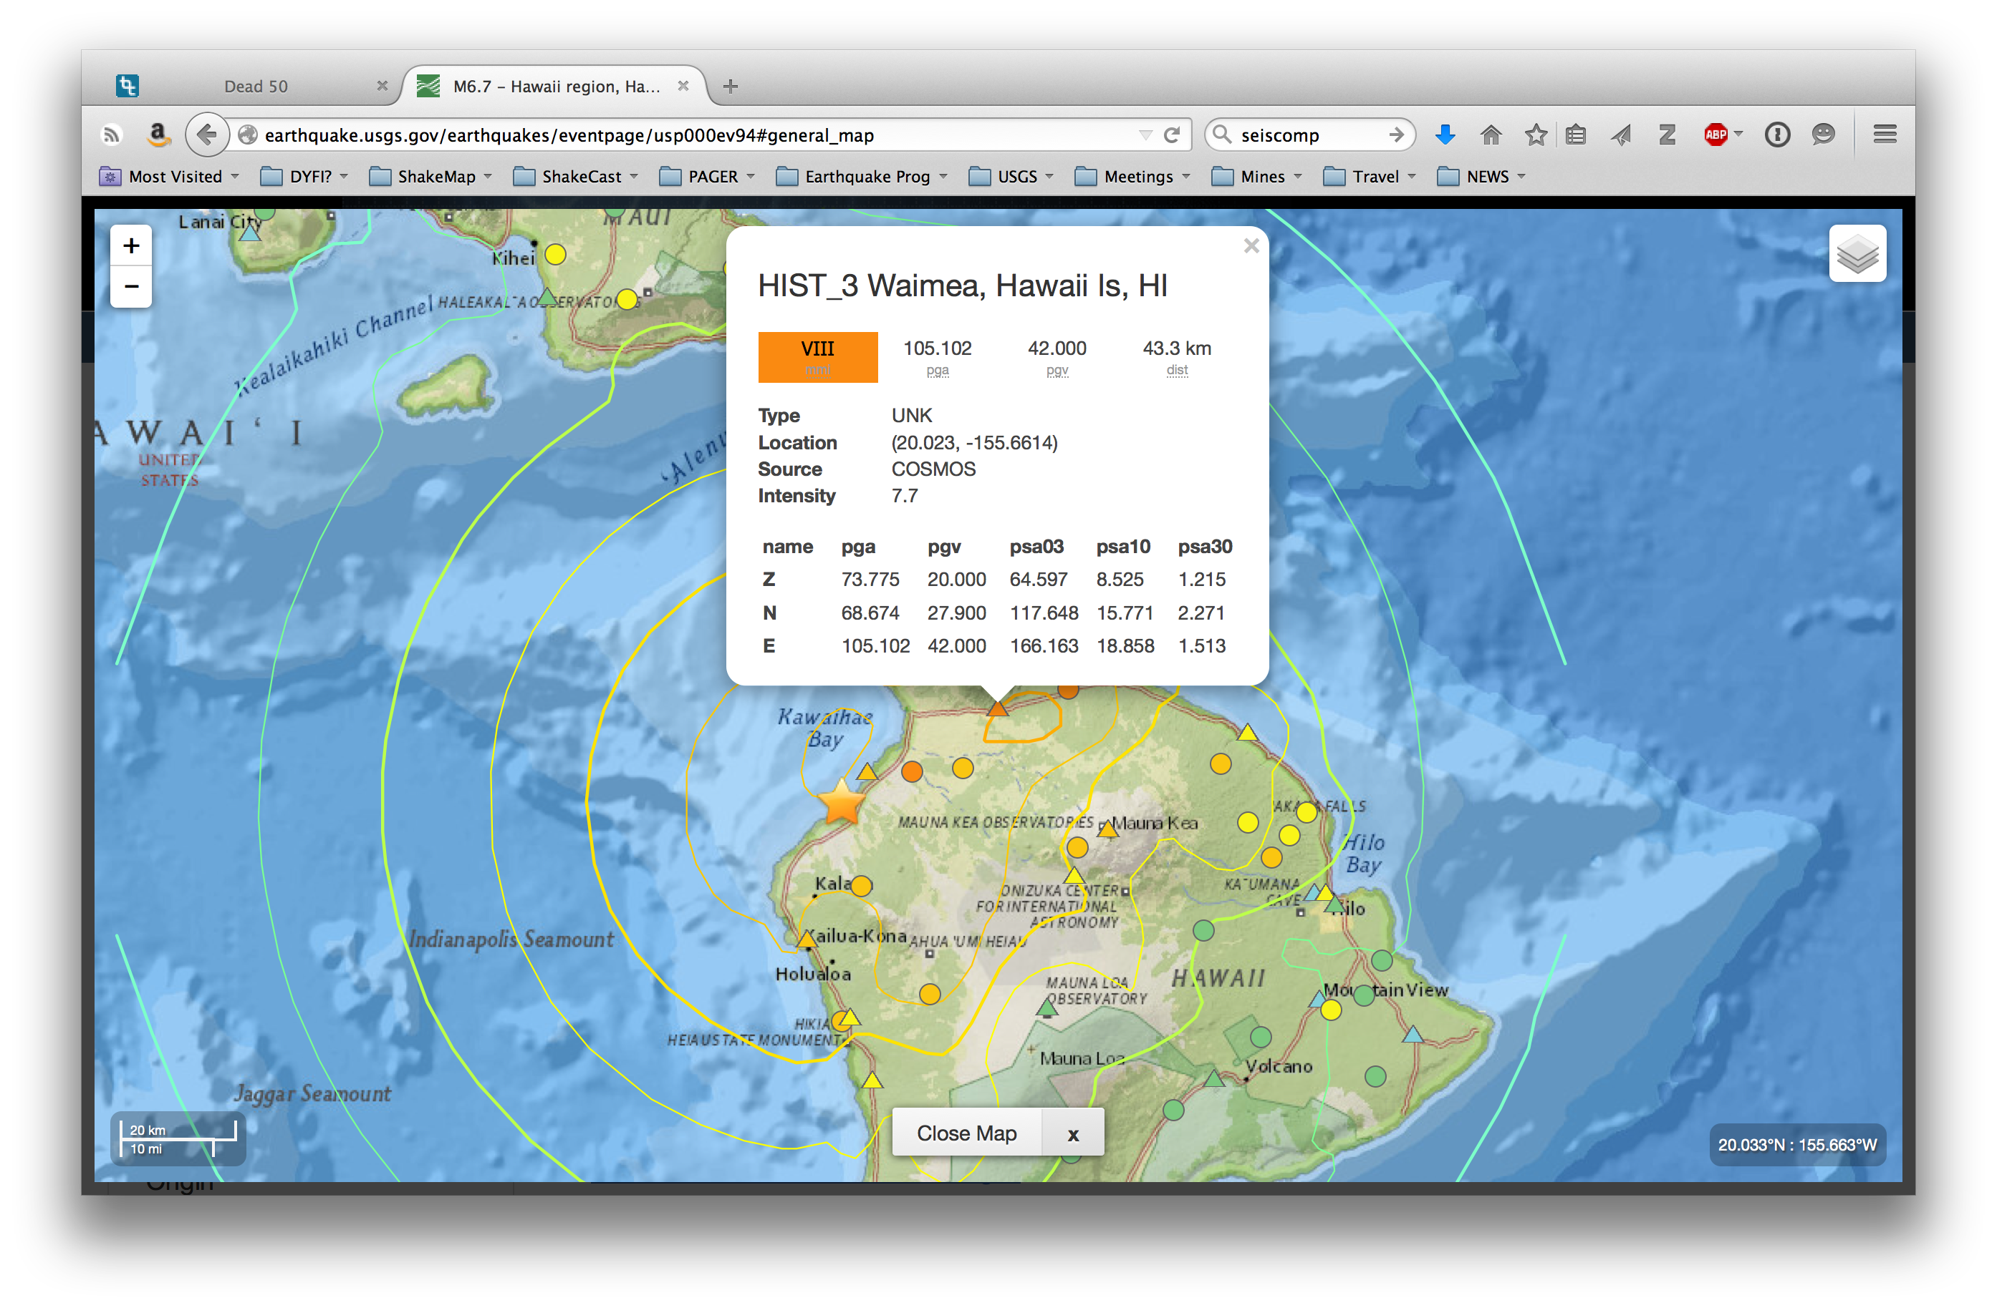

Slide 6
ShakeMap
Recent events & Examples
David Wald, Kuo-Wan Lin, Bruce Worden
U. S. Geological Survey, Golden, CO

Slide 7
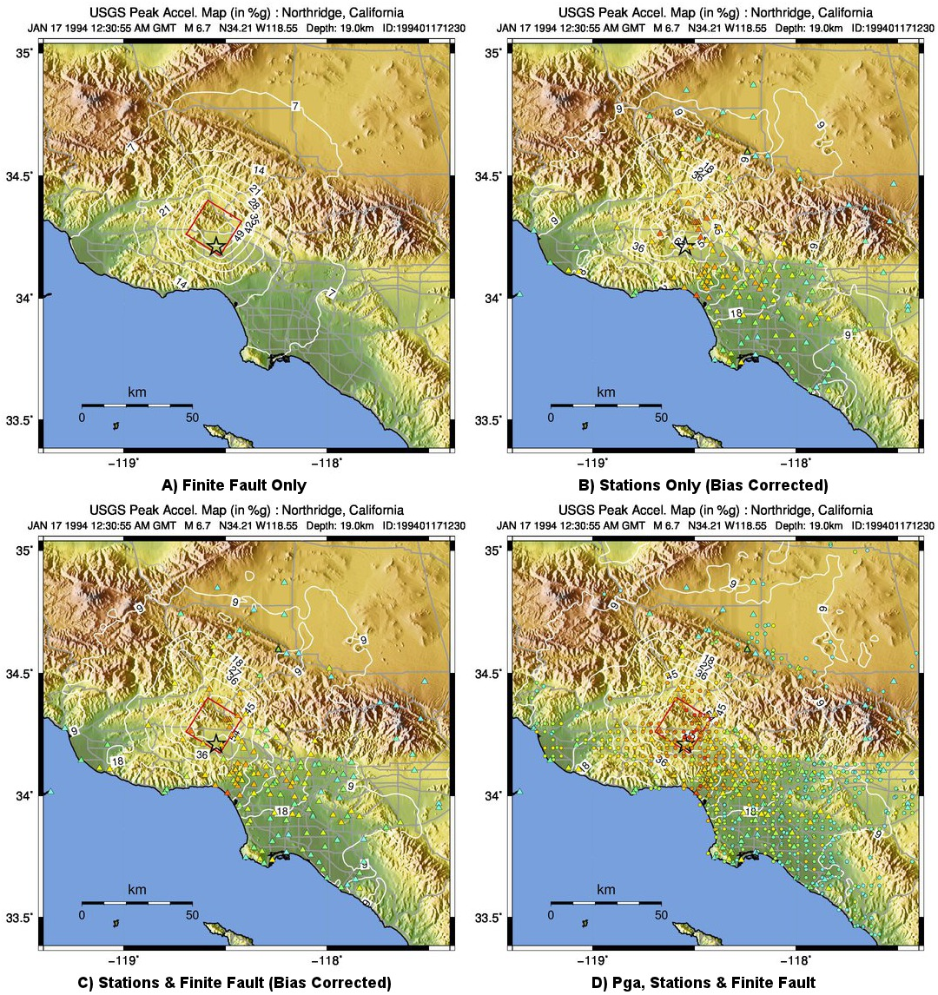

Slide 8
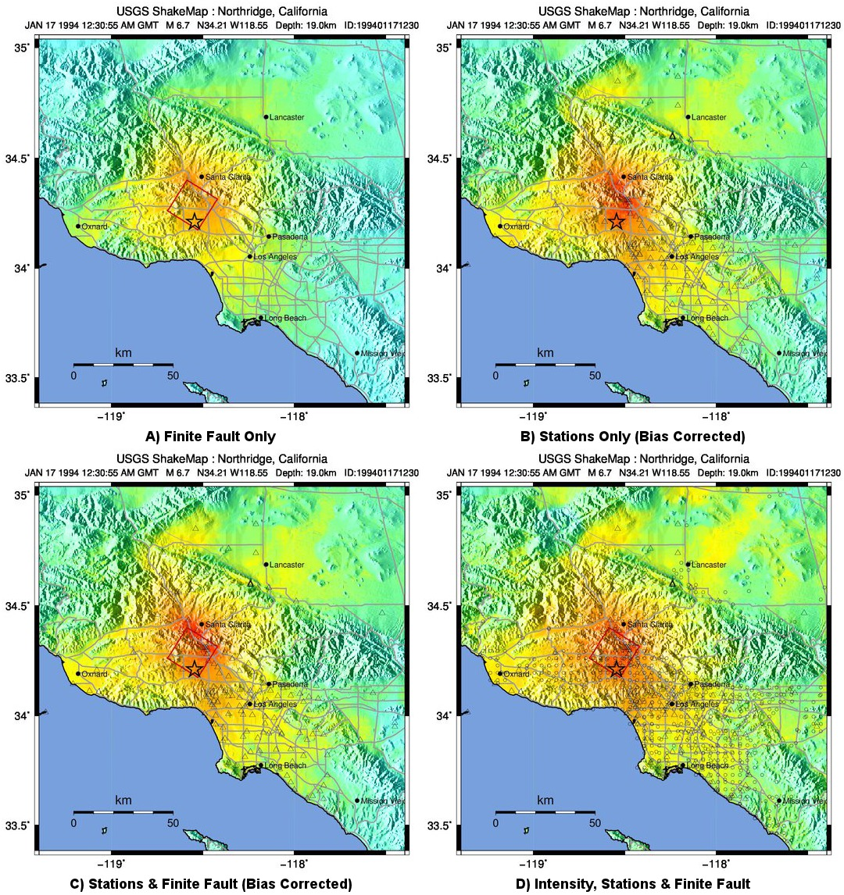

Slide 9
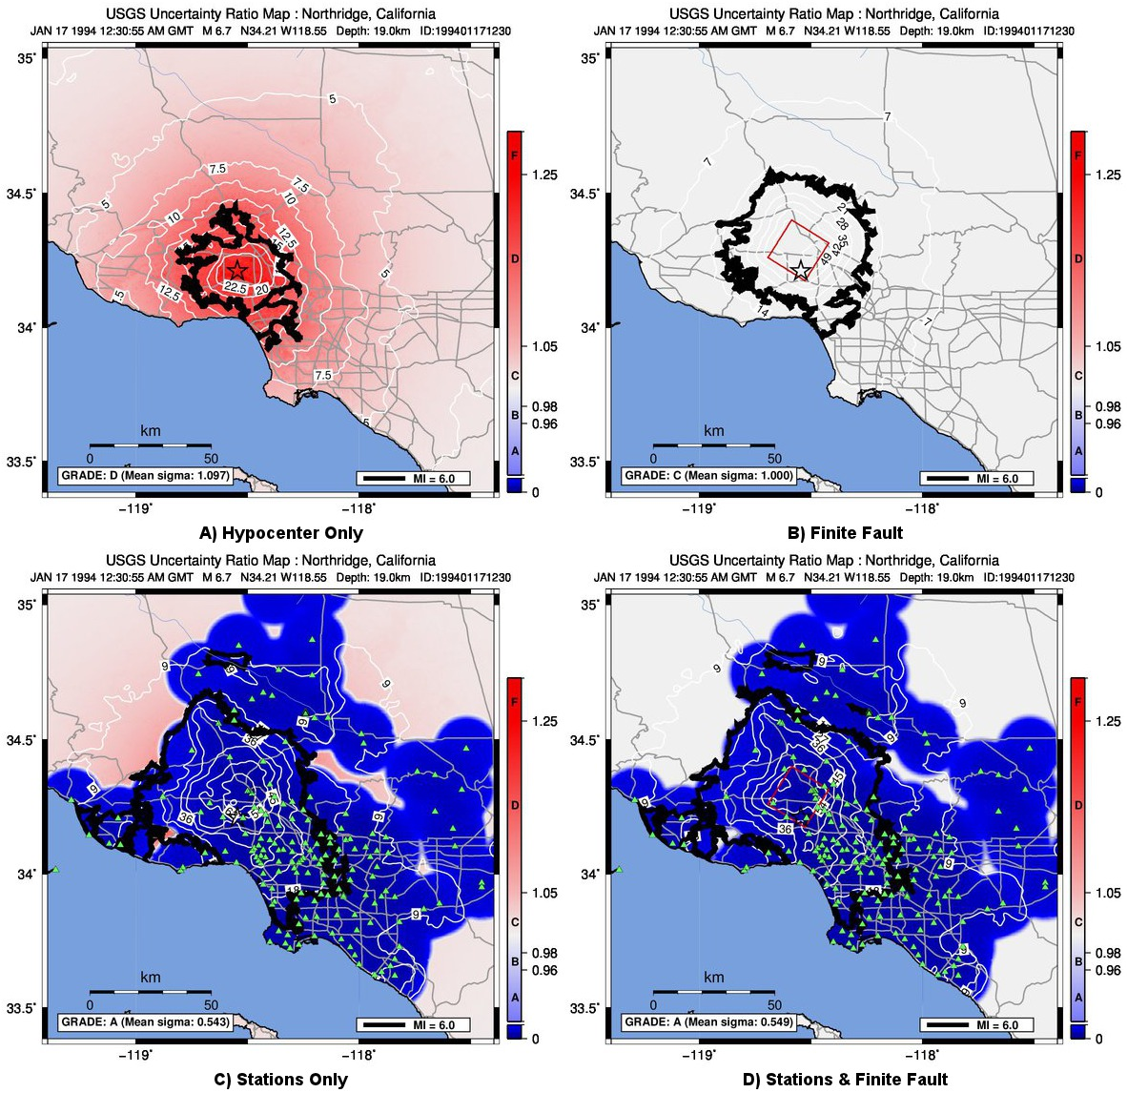

Slide 12
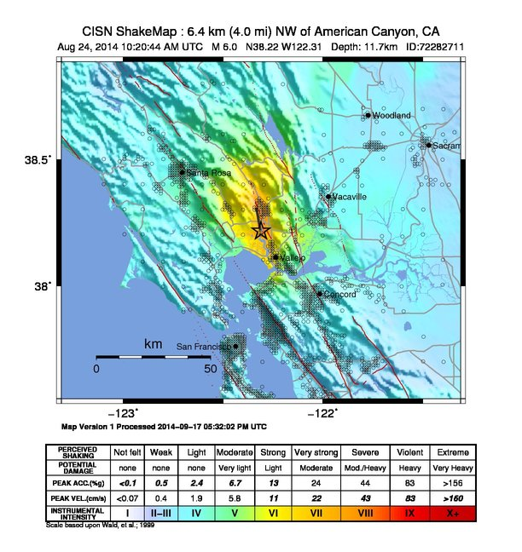
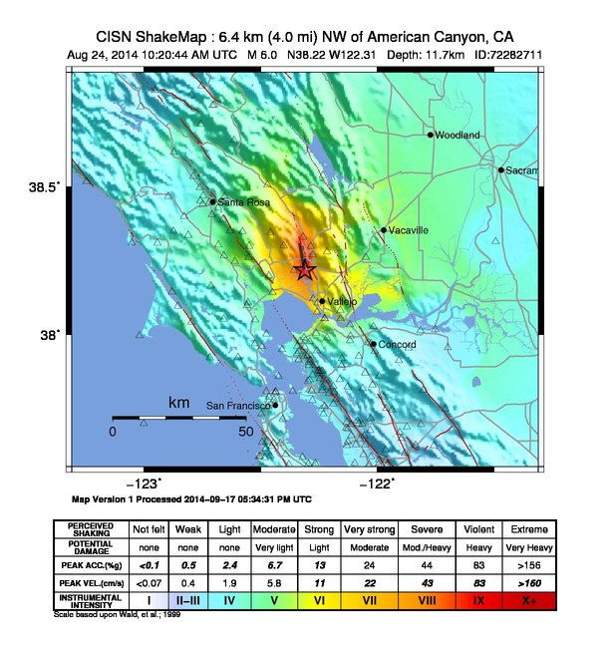
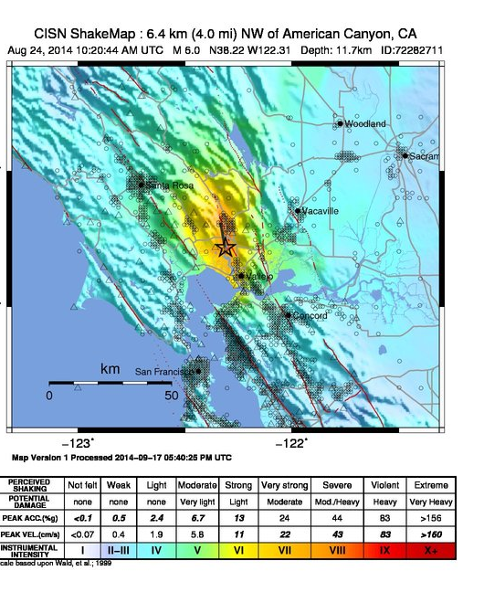
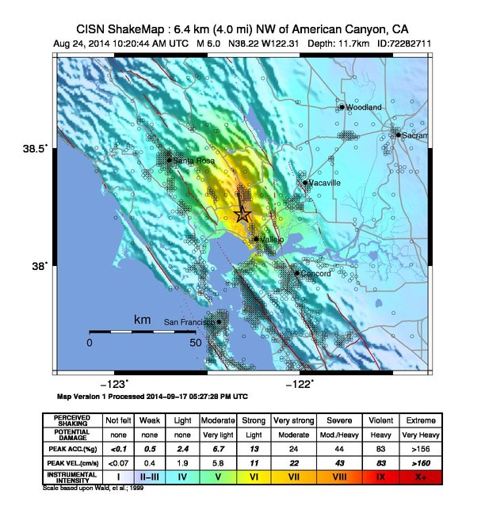
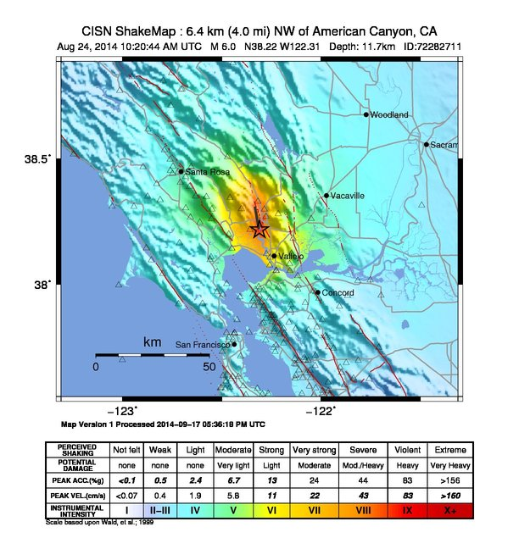
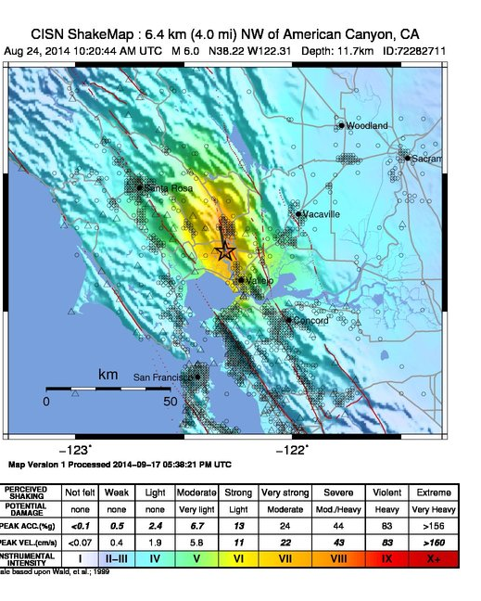
DYFI
SGM
SGM+DYFI
SGM+Bias
DYFI+Bias
SGM+Bias
SGM+DYFI+Bias

Slide 13
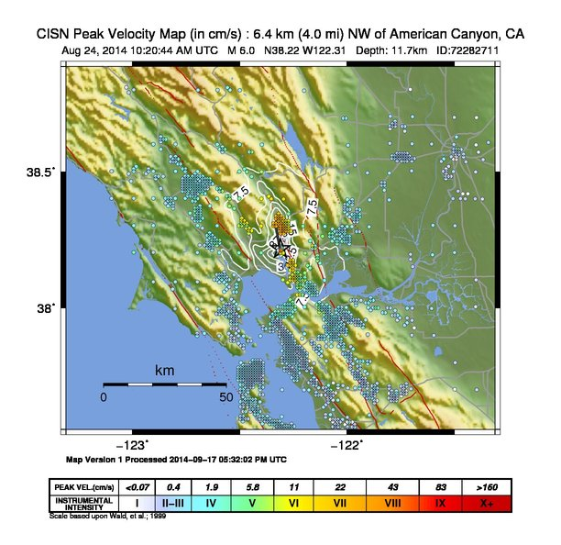
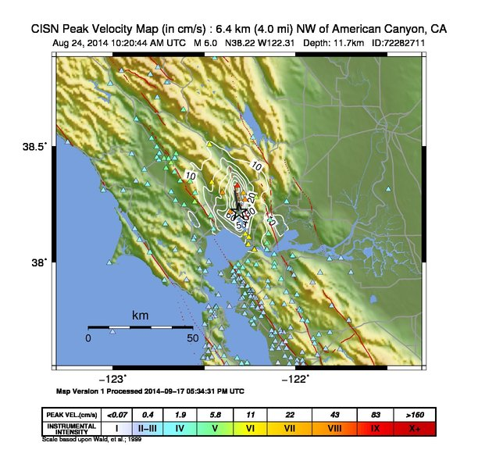




DYFI
SGM
SGM+DYFI
DYFI+Bias
SGM+Bias
SGM+DYFI+Bias

Slide 14
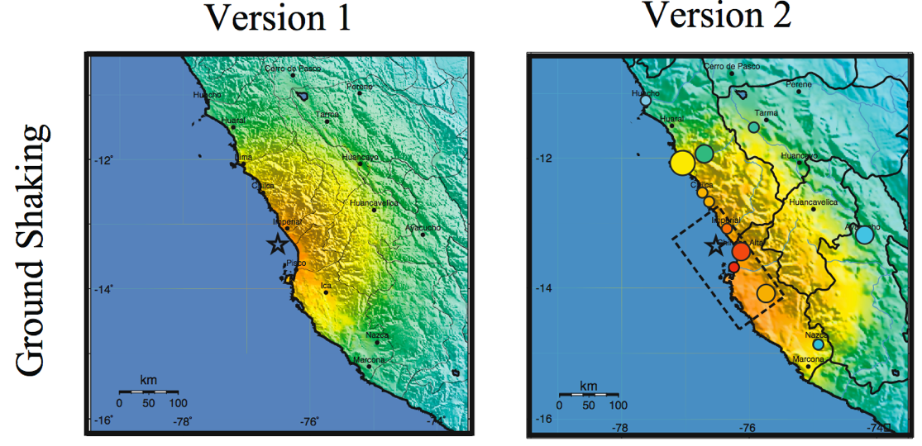
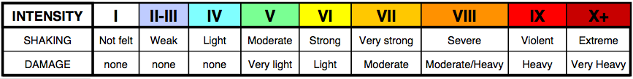
Magnitude 8.0 Pisco, Peru, 2007
Lima

Slide 15
M6.9 Southern Greece, Earthquake, Feb. 14, 2006
Notes:
A second fundamental value for using DYFI MMI data quantitatively is for constraining ShakeMap, used for PAGER.

Slide 16
(log bias=-0.4)
Notes:
Two benefits: 1) Observations come most from cities---intensity constraints—at CITIES which are by definition population centers…exposure is so high it is important to get the
shaking and thus estimate correct, and 2) BIAS correction for GMPE-based motions that are simply off for some reason (depth, M, GMPE, etc.)
Converting MMI to GM and computing Bias, we correct entire map. In some instances this can be important. I’ll come back to the conversion from MMI-PGM

Slide 17
Bias corrected

Slide 18
(log bias=-0.4)
Notes:
Two benefits: 1) Observations come most from cities---intensity constraints—at CITIES which are by definition population centers…exposure is so high it is important to get the
shaking and thus estimate correct, and 2) BIAS correction for GMPE-based motions that are simply off for some reason (depth, M, GMPE, etc.)
Converting MMI to GM and computing Bias, we correct entire map. In some instances this can be important. I’ll come back to the conversion from MMI-PGM

Slide 19
ShakeMap
Scenarios
David Wald, Kuo-Wan Lin, Bruce Worden
U. S. Geological Survey, Golden, CO

Slide 20
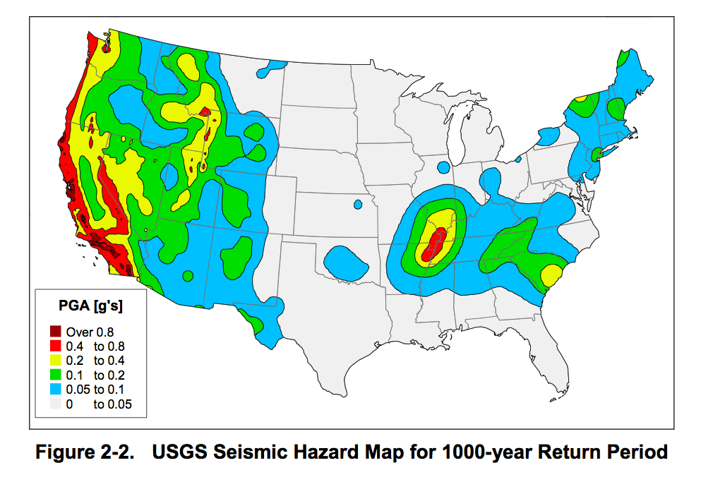
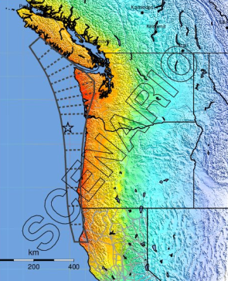
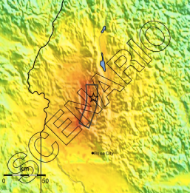
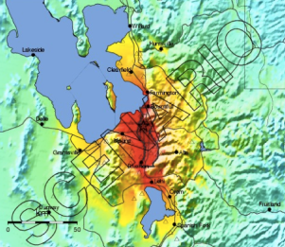
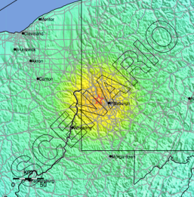

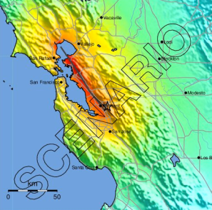
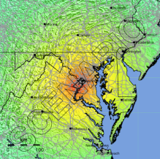
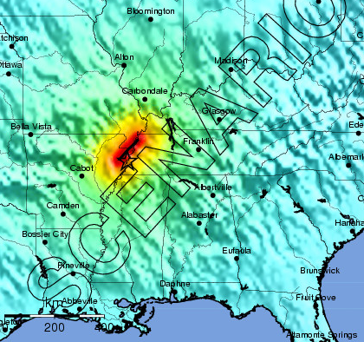
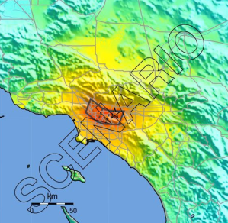
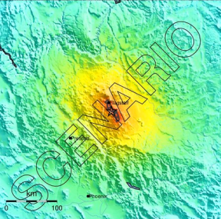
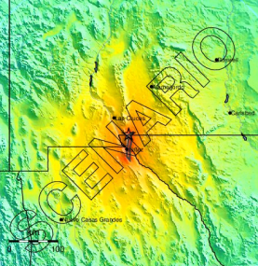
EXAMPLES OF EARTHQUAKE SCENARIOS
[USGS; FEMA 366, 2000]

Slide 22
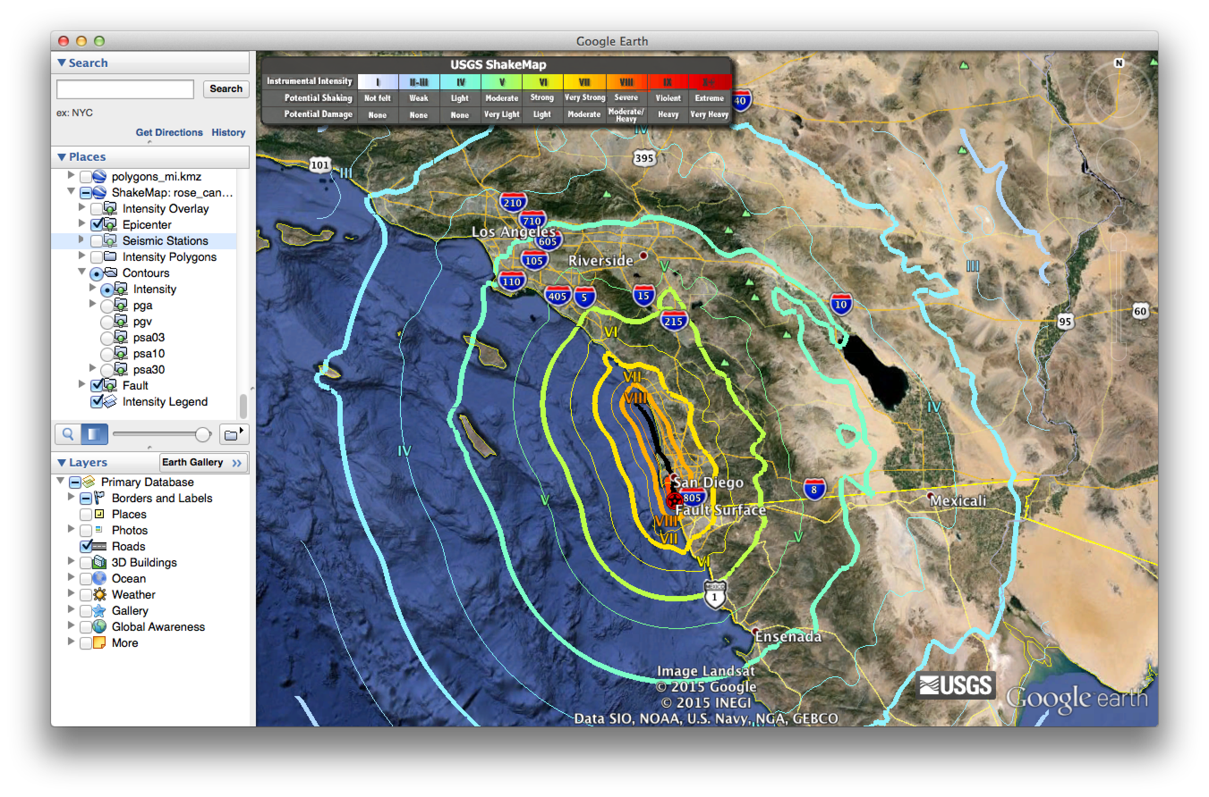
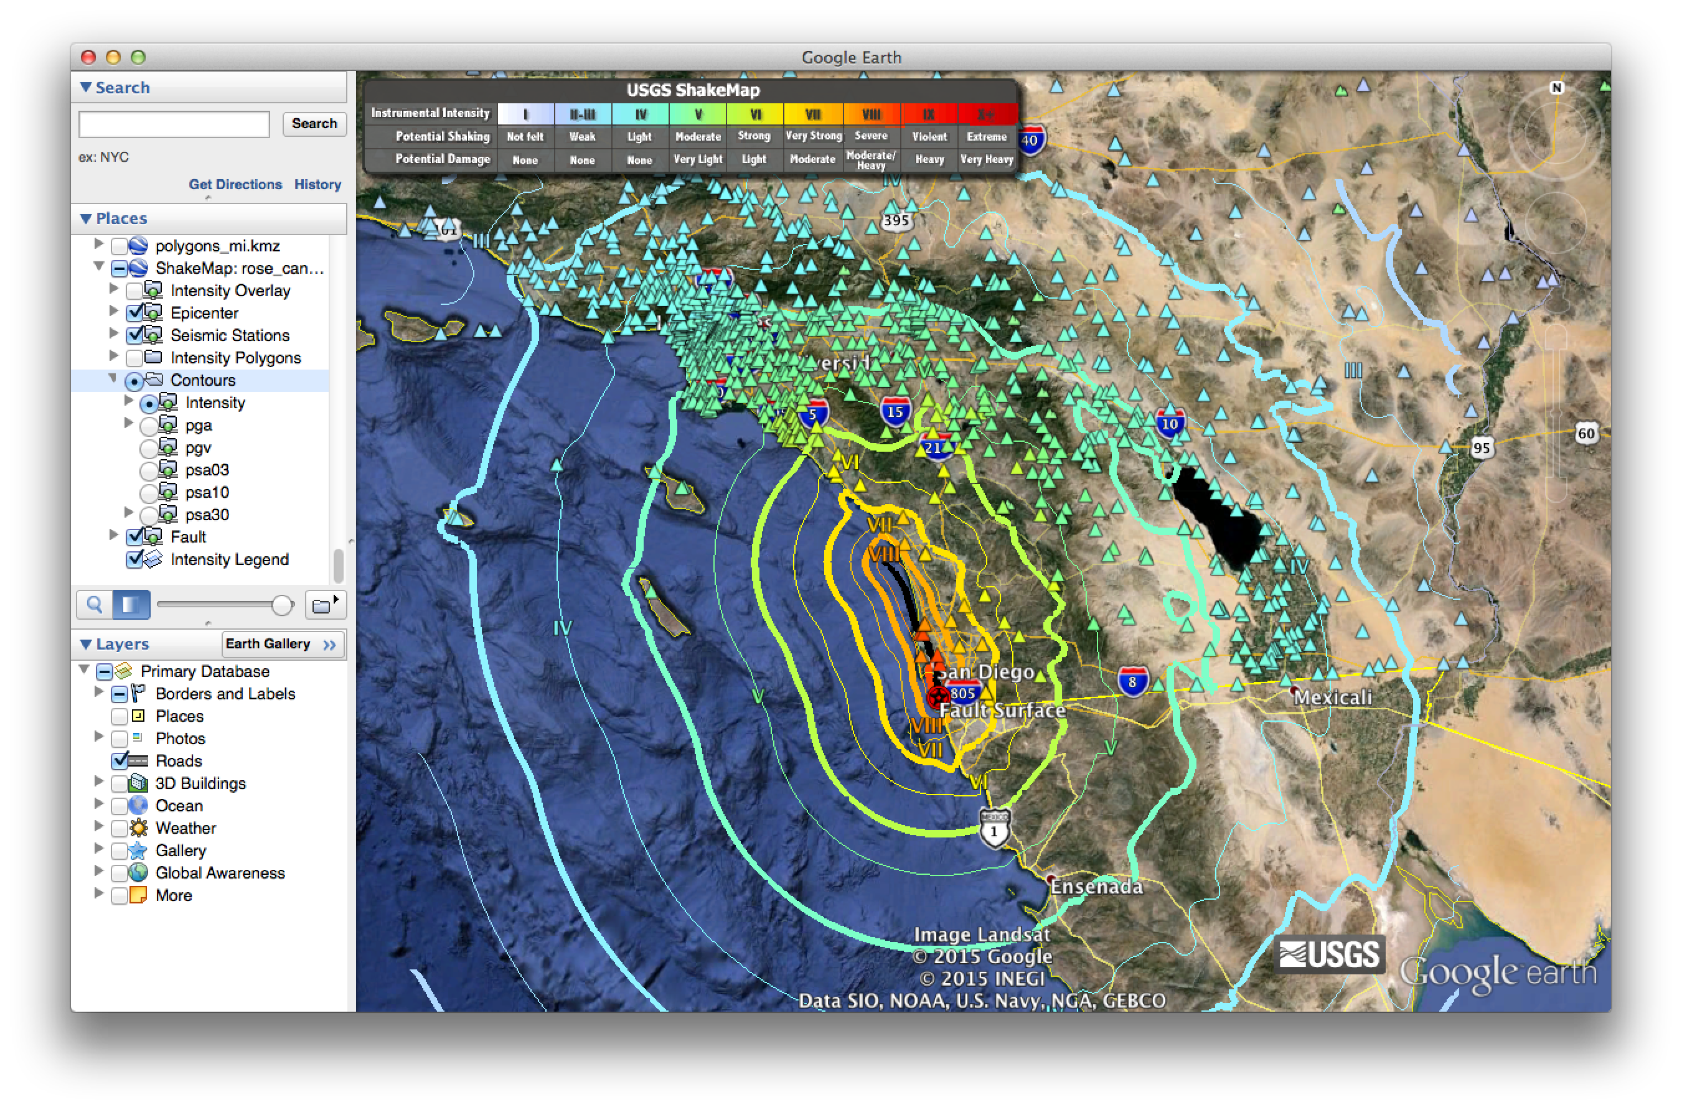

Slide 23
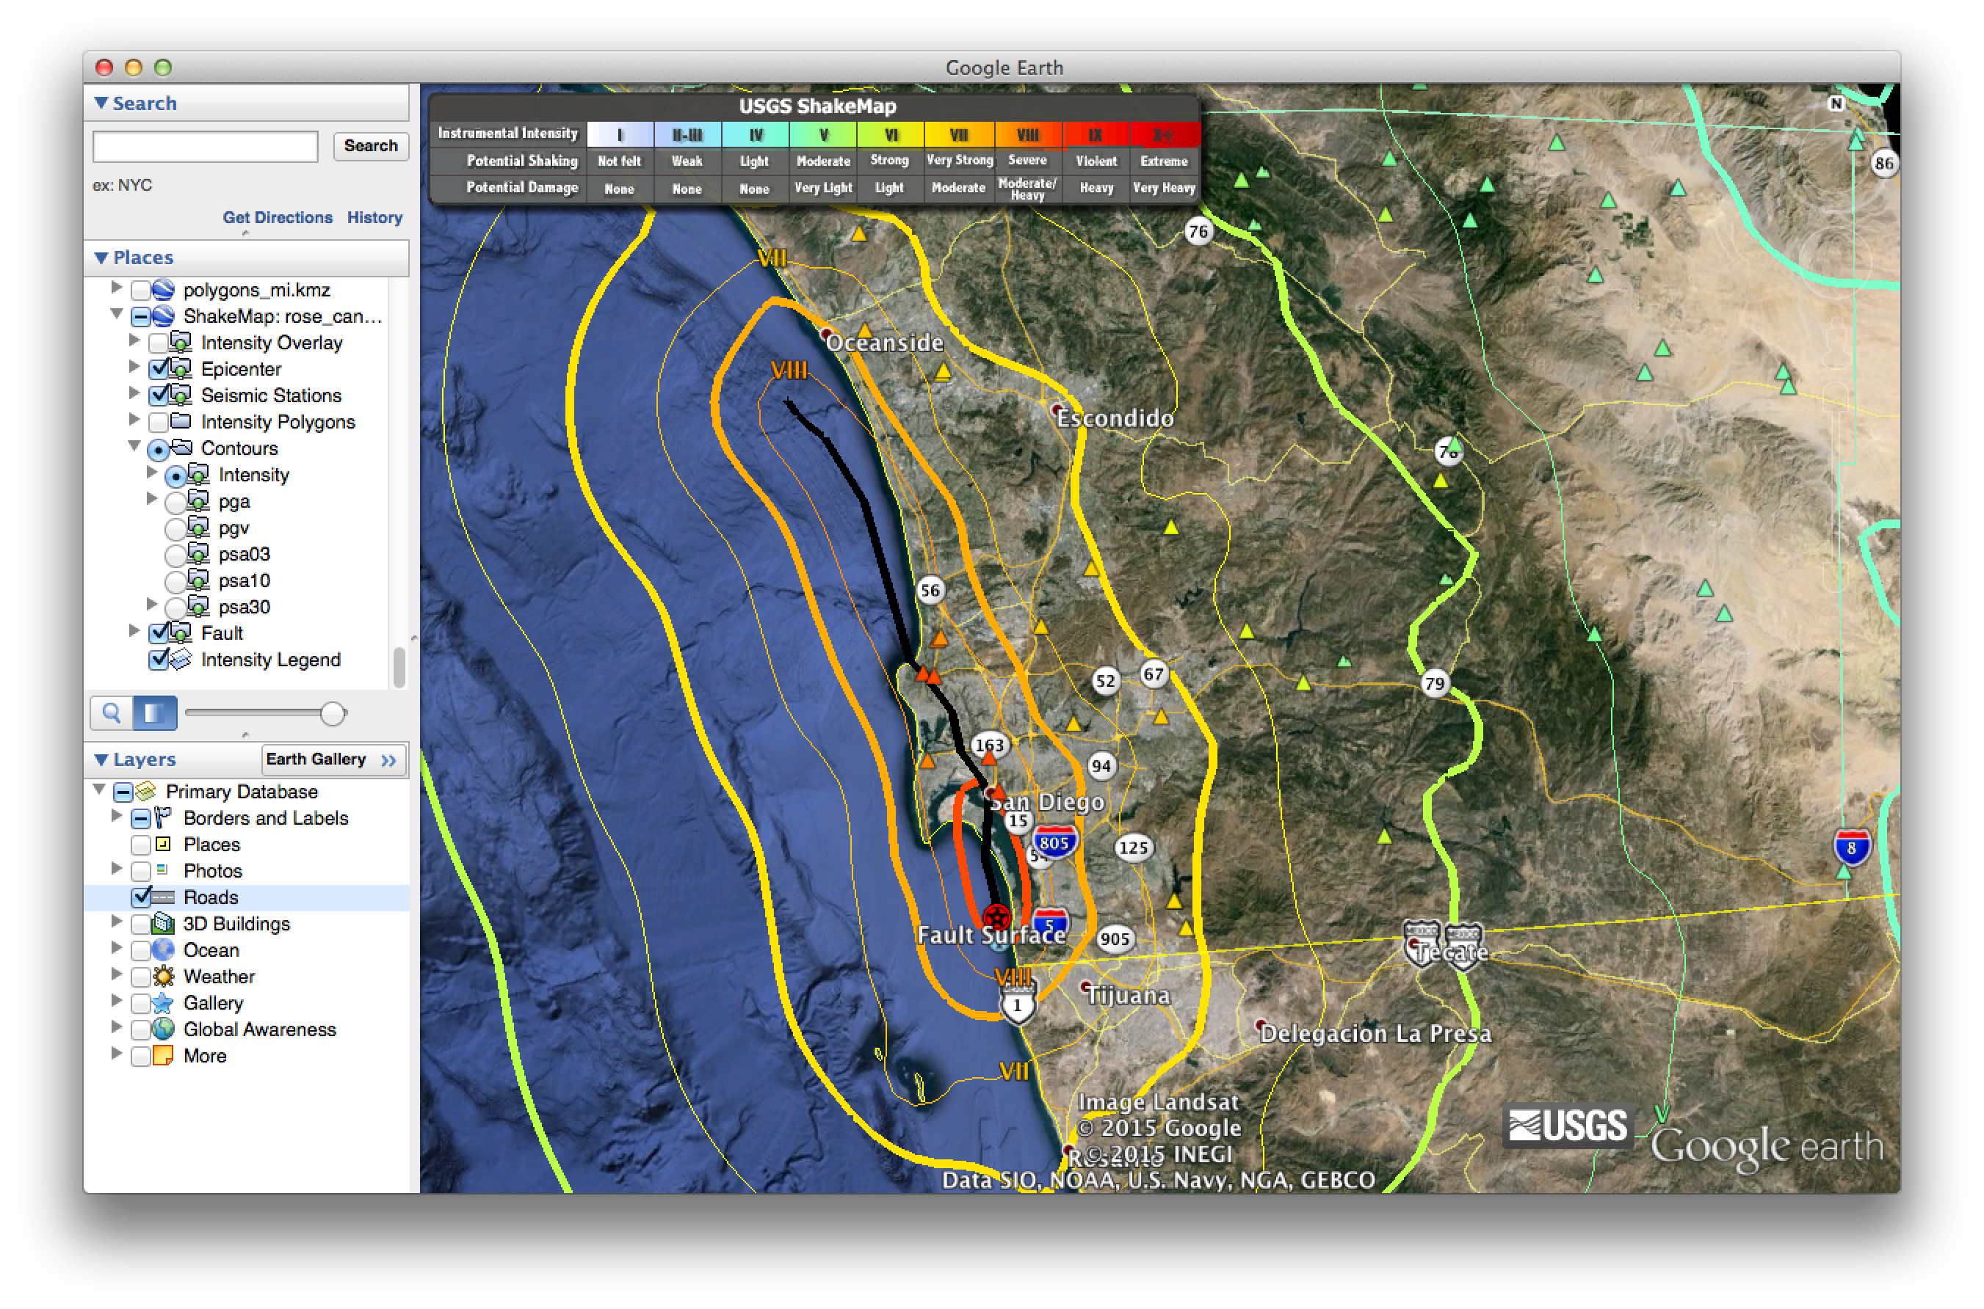

Slide 24
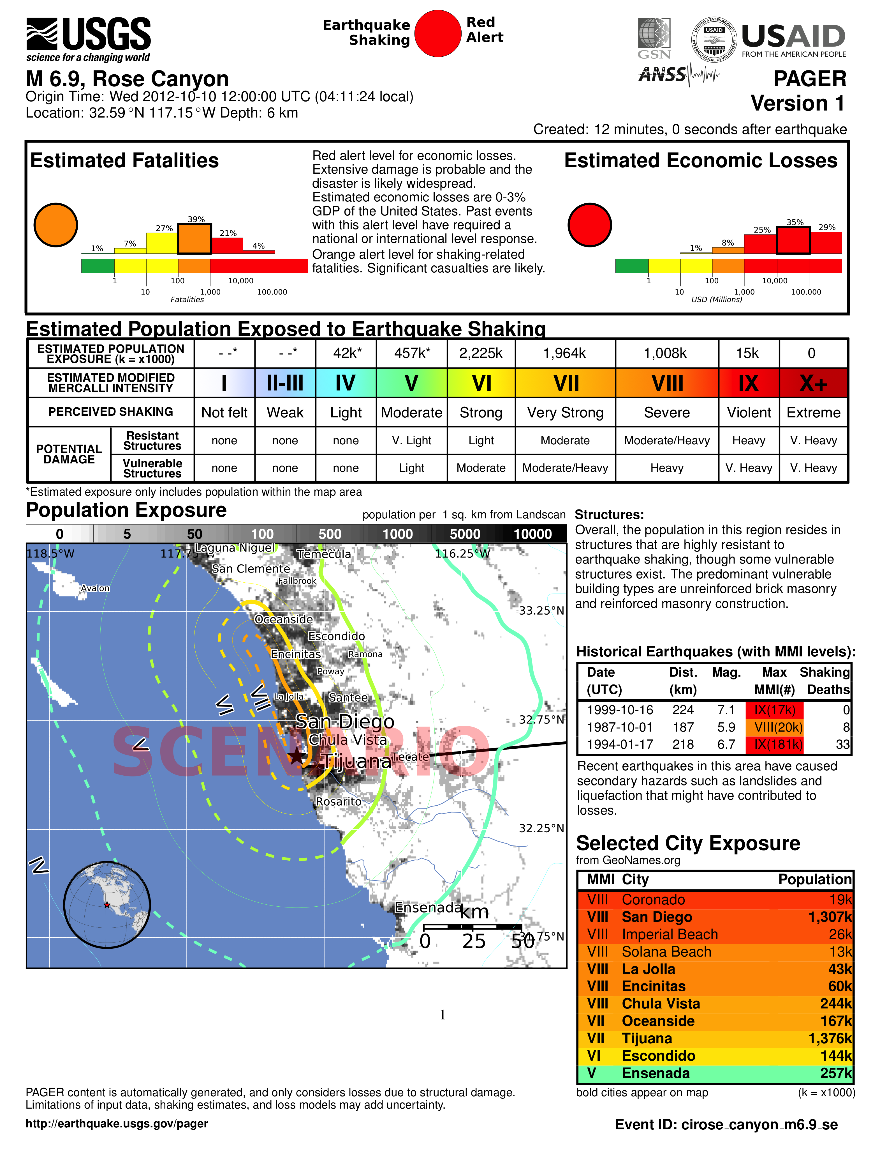
95% in Mexico; 5% in US
10% in Mexico; 90% in US

Slide 25
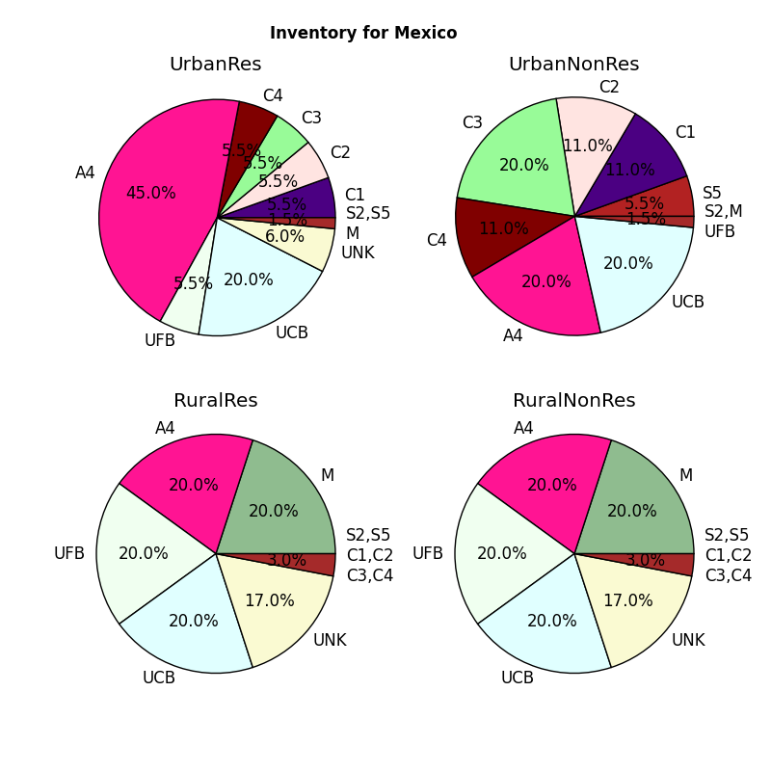
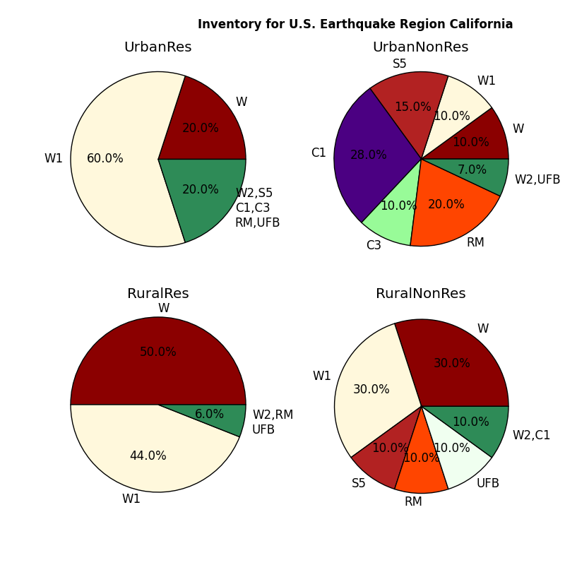
Estimated Exposure by structure type (Urban/Rural/Residential/Nonresidential)
Mexico
USA
Label | Description | Detailed Classification (Based on ATC-13, HAZUS 1999, WHE 2003, EMS 1998 and newly added for PAGER Inventory database 2008)
W | Wood | W1 (Wood with stucco, veneer), W2 (Heavy wood frame, >=5000 sf), W3 (Wood with metal strong wall) and W4 (log building)
S | Steel | S1 (Steel moment frame of low, mid and high rise), S2 (Steel braced frame of low, mid and high rise), S3 (Steel light frame), S4 (Steel frame with concrete shear wall of low, mid and high rise), S5 (Steel frame with URM wall of low mid and high rise)
C | Reinforced Concrete | C1 (Ductile RC moment frame of low, mid and high rise), C2 (RC shear-wall of low, mid and high rise), C3 (Nonductile RC frame with infill of low, mid and high rise), C4 (Nonductile RC frame without infill of low, mid and high rise), C5 (Steel reinforced concrete frame of low mid and high rise)
RM | Reinforced Masonry | R1 (Reinforced masonry bearing wall with flexible diaphragm of low and mid rise), R2 (Reinforced masonry bearing wall with rigid diaphragm of low, mid and high rise)
MH | Mobile Homes | Mobile homes
M | Mud | M1 (Mud wall without wood), M2 (Mud wall with wood)
A | Adobe | A1 (Adobe mud mortar with wood roof), A2 (Adobe mud mortar with thatch roof), A3 (Adobe wall with cement mortar), A4 (Adobe wall with concrete bond beam ), A5 (Adobe with reinforcement)
RE | Rammed Earth | Rammed earth construction
RS | Rubble (Field) Stone | RS1 (Rubble stone without mortar), RS2 (Rubble stone with mud mortar), RS3 (Rubble stone with lime mortar), RS4 (Rubble stone with cement mortar), RS5 (Rubble stone with concrete bond beam)
DS | Dressed Stone, blocks | DS1 (Stone block with mud mortar), DS2 (Stone block with lime mortar), DS3 (Stone block with cement mortar), DS4 (Stone block with concrete bond beam)
UFB | Unreinforced Fire Brick | UFB1 (Unreinforced brick with mud mortar without timber ), UFB2 (Unreinforced brick with mud mortar and timber), UFB3 (Unreinforced brick with cement mortar and wood diaphragm), UFB4 (Unreinforced brick with cement mortar and concrete diaphragm)
UCB | Unreinforced Concrete Block | Unreinforced concrete block construction
MS | Massive Stone | Massive stone masonry construction
PC | Precast | PC1 (Precast concrete tilt up walls), PC2 (Precast concrete frame of low, mid and high rise), TU (Tiltup)
INF | Informal | Informal constructions (Plastic, polythene, miscellaneous)
UNK | Unknown | Unknown (Missing / Default category)
A=Adobe, C=Reinforced Concrete, W=Wood, UFB=Unreinforced Fired Brick, UCB=Unreinforced Concrete Block, S=Steel

Slide 26
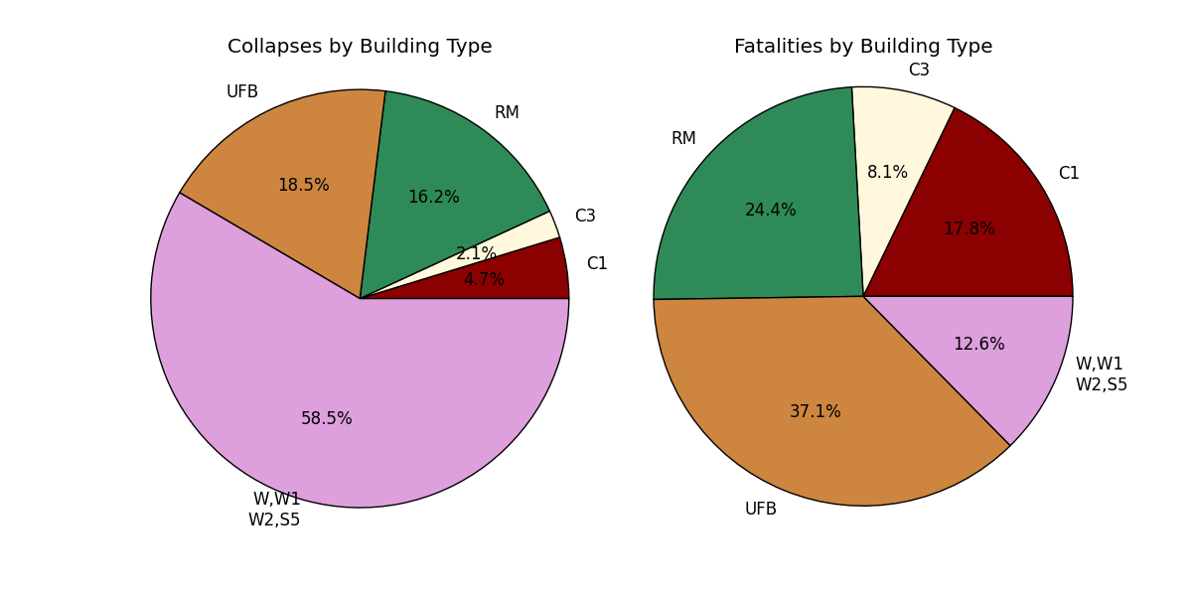
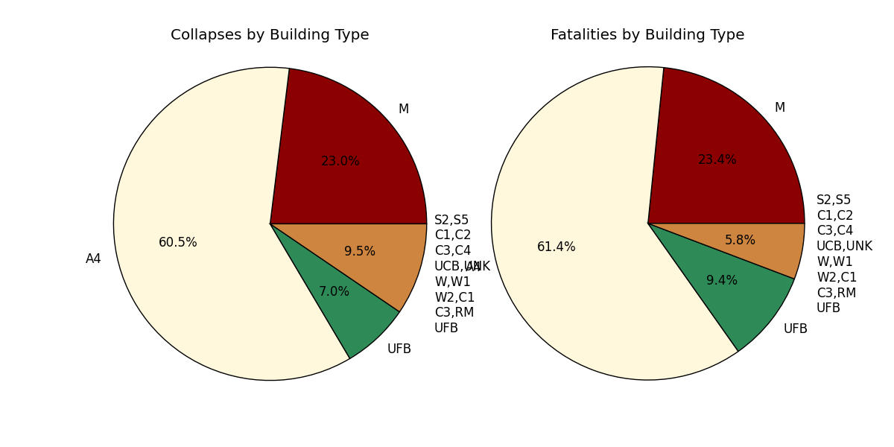
Estimated collapse & fatalities by structure type
USA
Mexico
A=Adobe
C=Reinforced Concrete
W=Wood UFB=Unreinforced Fired Brick
UCB=Unreinforced concrete block
S=Steel

