Slide 1
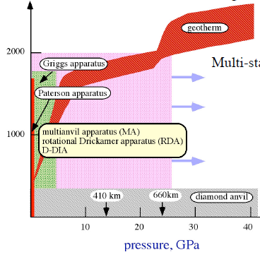
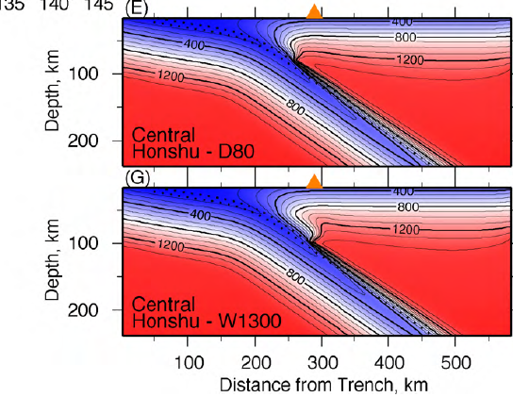
New prospects for investigating subduction zone deformation processes in the lab
Greg Hirth (Brown University)
Brooks Proctor (USGS)
Keishi Okazaki (JAMSTEC)
Temperature (K)
Pressure (GPa))
Syracuse et al., 2010

Slide 2
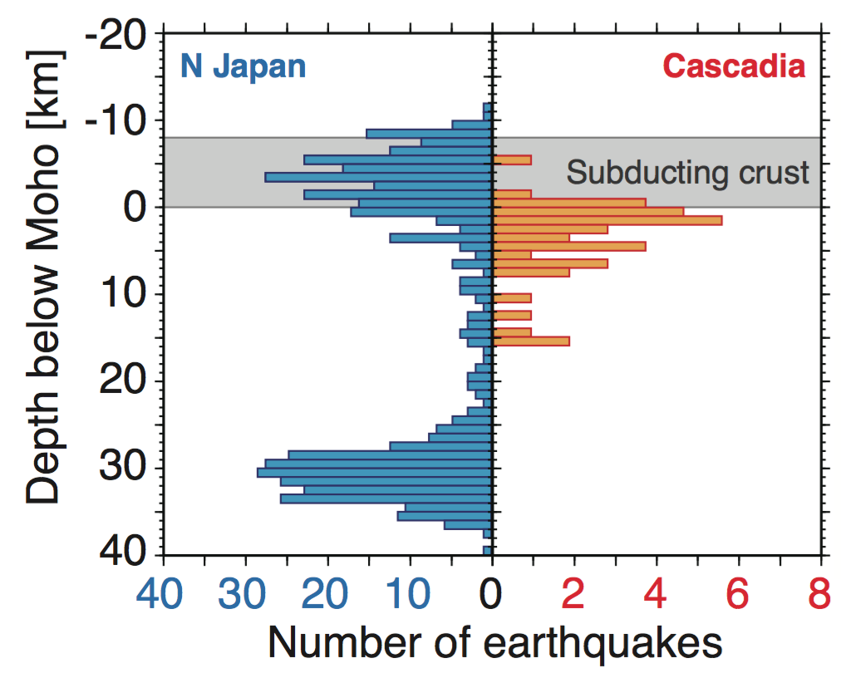
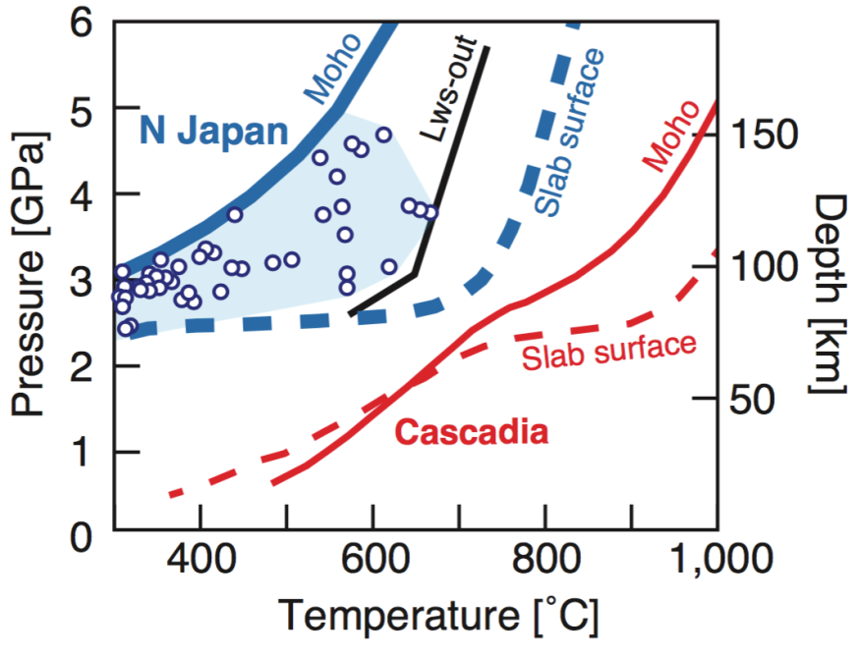
Intra-slab seismicity: Dehydration embrittlement
Cold subduction zones:
Lawsonite blueschist
Cold subduction zone
Hot subduction zone
(N Japan)
(Cascadia)
Lawsonite
dehydration?
Modified from
Abers et al., 2013
Hot subduction zones:
Epidote blueschist
Okazaki & Hirth, Nature, 2016
Notes:
Make sure to note lawsonite dehydration occurs throughout blue zone

Slide 3
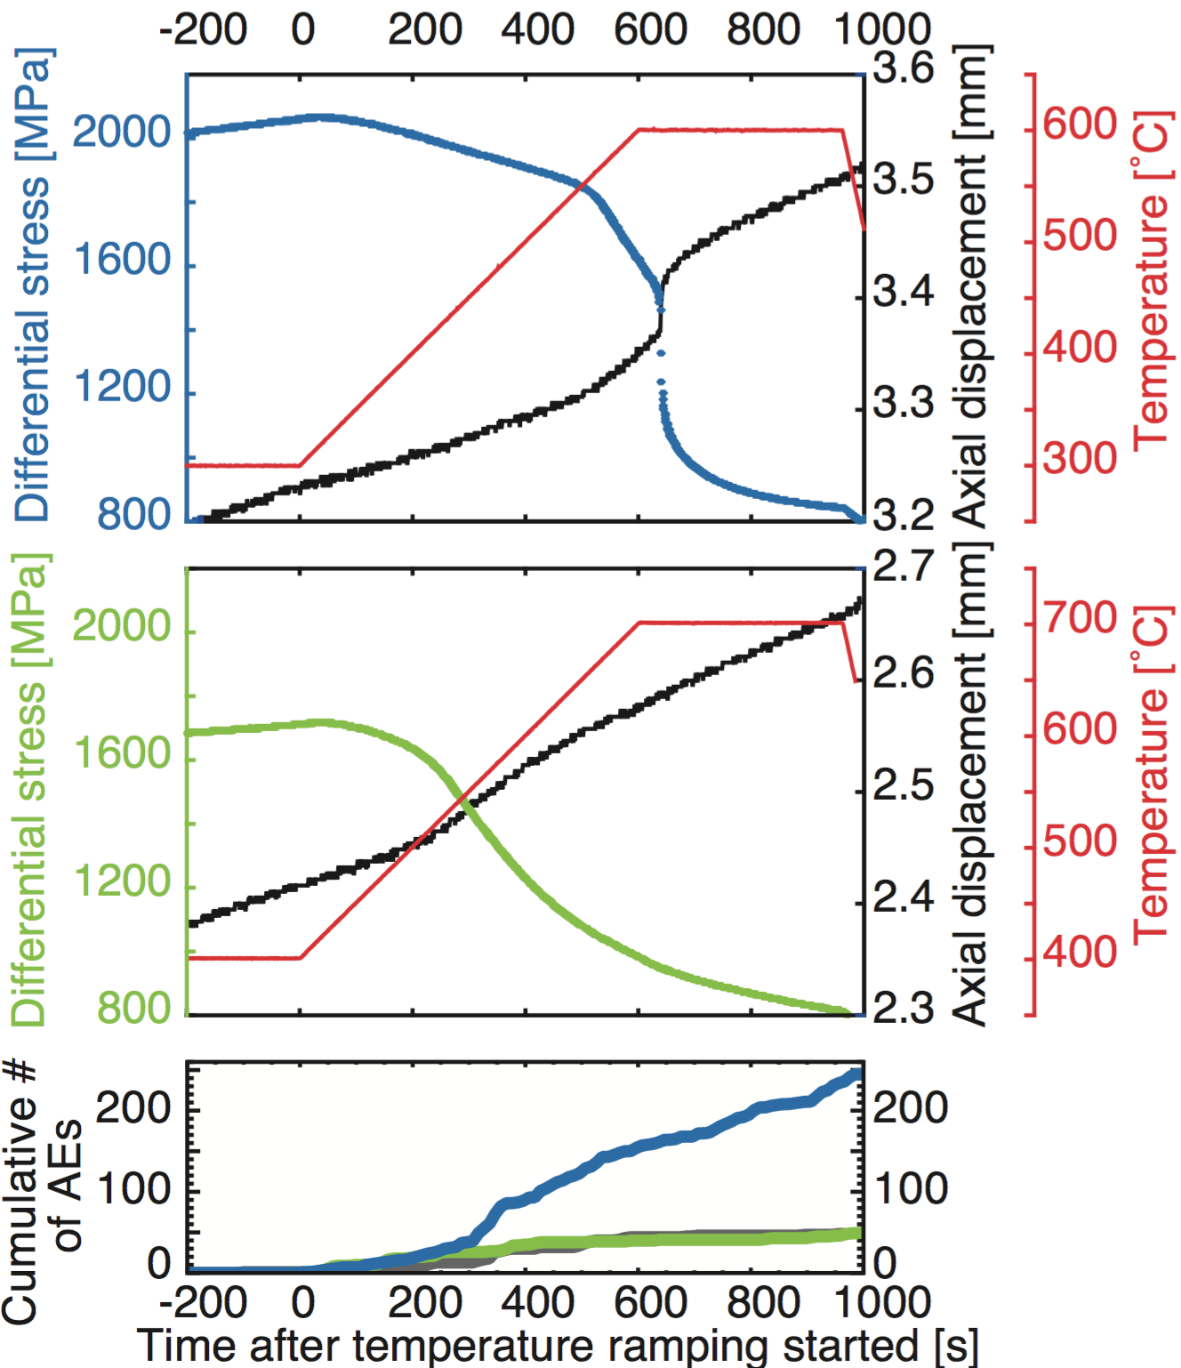
Lawsonite
Lawsonite:
Unstable fault slip
Antigorite serpentine:
Stable (slow) slip
(Chernak & Hirth, 2011, Proctor & Hirth, 2015)
Unstable slip
Antigorite
AE
Lws
Atg, Al
Okazaki & Hirth, Nature, 2016
Notes:
You can note that AE’s are observed for Lawsonite prior to dehydration because it is brittle, unlike antigorite.
Consistent with unstable nature of the brittle deformatio

Slide 4
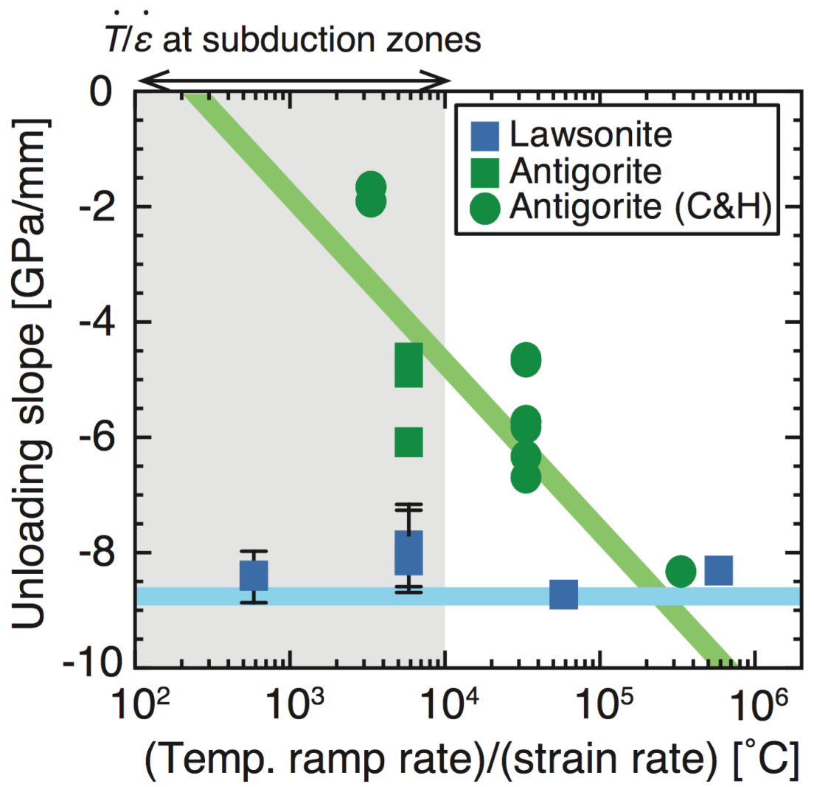
Scaling to Natural Conditions
accounting for reaction rate and dilatancy rate
T ramp rate/strain rate in lab
= 10³–10⁶ ˚C
T ramp rate: 0.5–0.05˚C/s
strain rate: 10⁻⁵–10⁻⁷ 1/s
“T ramp rate”/strain rate
in subduction zones
〜10² – 10⁴ ˚C
Thermal gradient: 15˚C/km
Plate speed: 10 cm/yr
Subducting angle: 30˚
Shear zone width: 1-100km
Okazaki & Hirth, Nature, 2016

Slide 5
Scaling in Scale
Apparatus stiffness = 8.8 GPa/mm
Fault zones: K_{f} 〜6 MPa/mm
K_{f} = G/2/(1–ν)/L (Scholz, 2002)
G, shear modulus: 30 GPa,
ν , Poisson’s ratio: 0.25
L, length of the slipping region:
≈ 30 m for a M1 earthquake
Okazaki & Hirth, Nature, 2016

Slide 6
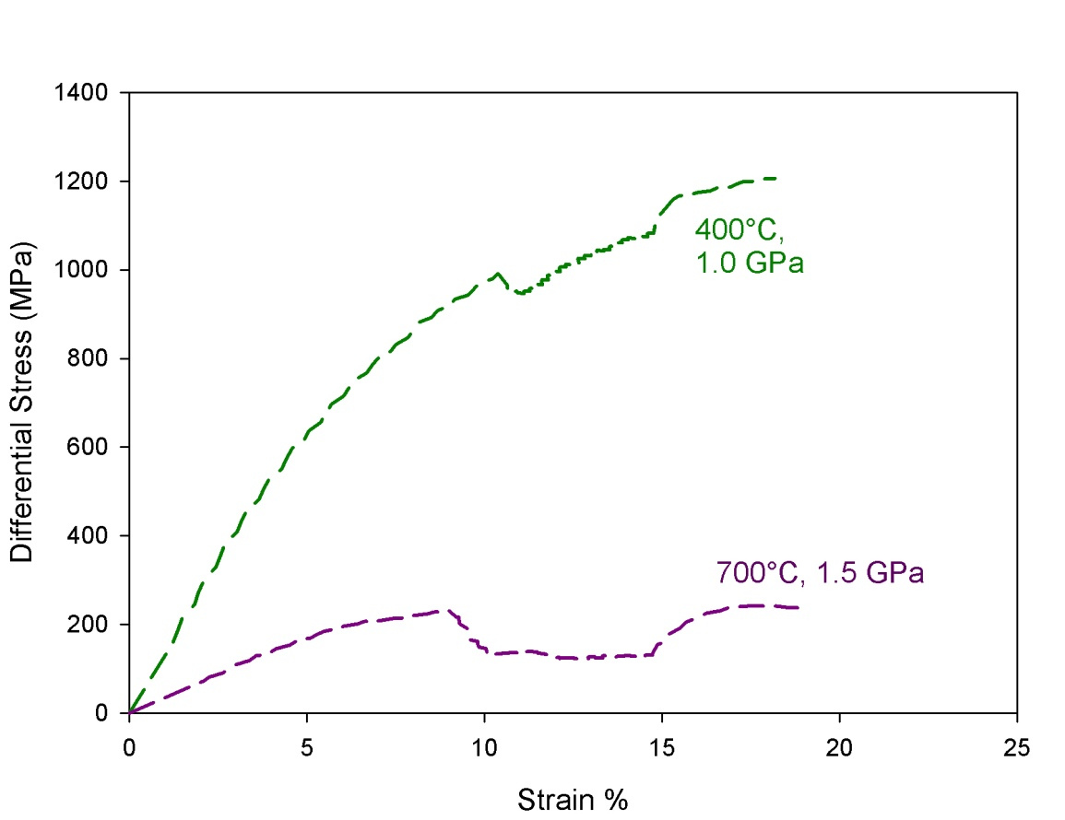
Velocity strengthening prior to and during dehydration
Antigorite
10⁻⁵ s⁻¹
10⁻⁶ s⁻¹
10⁻⁵ s⁻¹
much weaker than olivine
Chernak & Hirth, Geology, 2011
Notes:
In addition to the lack of catastrophic failure that we observe in the temperature ramping experiments, we also observe velocity strengthening behavior both for samples deformed both within the antigorite stability field and where dehydration is observed. This behavior does not promote the nucleation of earthquakes.
6

Slide 7
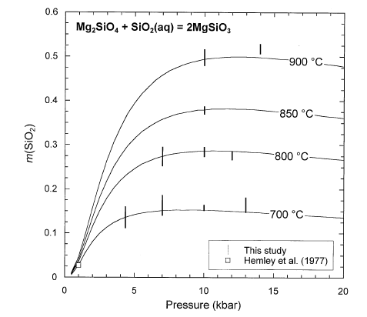
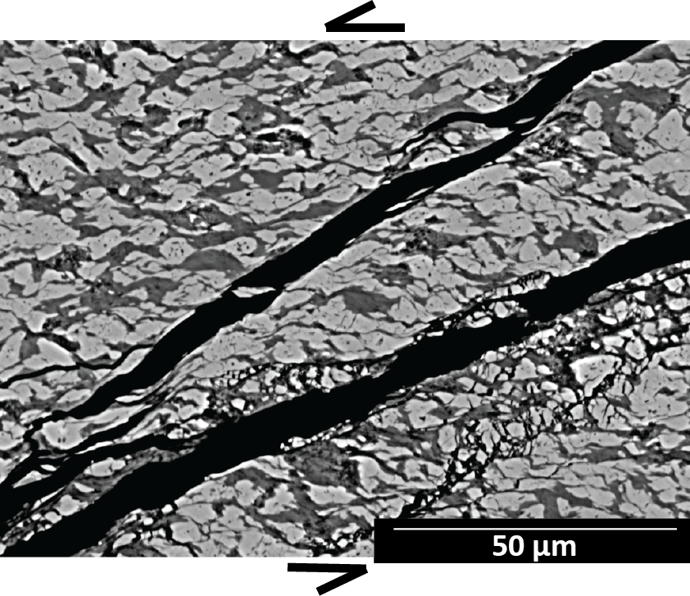
Newton & Manning, 2002
Relatively high solubility
promotes pressure solution
Proctor & Hirth, in prep

Slide 8
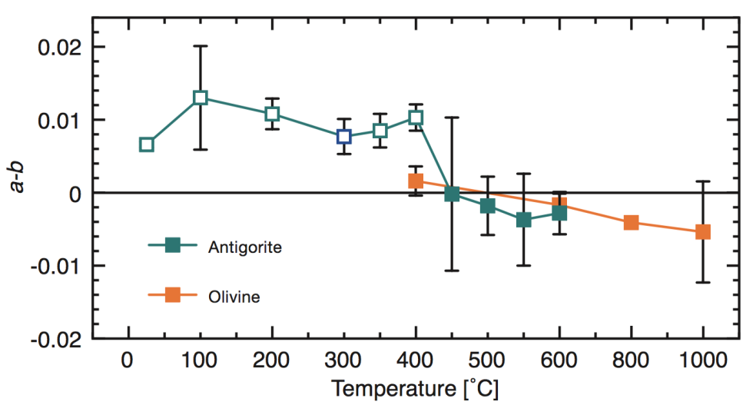
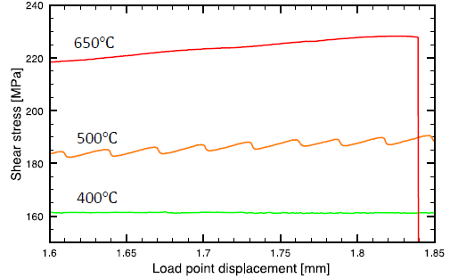
P_{c} = 200 MPa
P_{H2O} = 20 MPa
Okazaki & Katayama, 2015

Slide 9
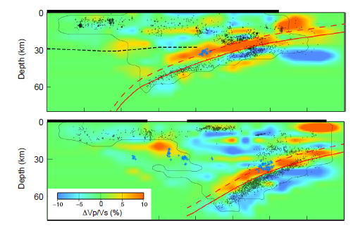
Experiments conducted at P&T
where LFEs occur
at wedge nose
Southeast Japan
Abers et al., 2013 (after Hirose et al., 2008)

Slide 10
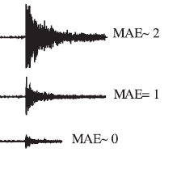
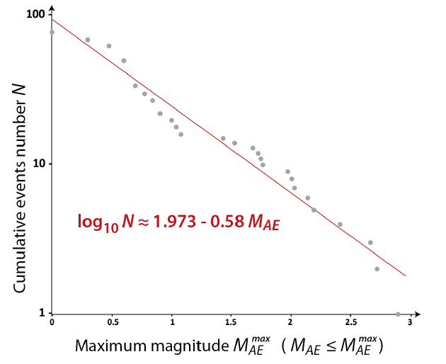
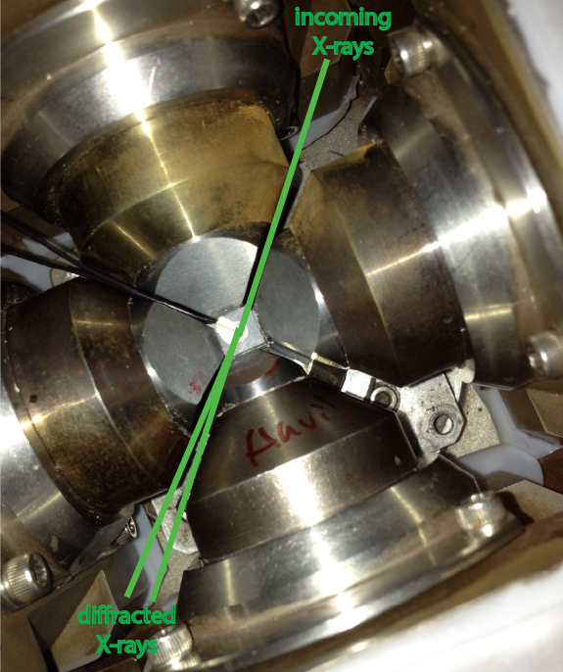
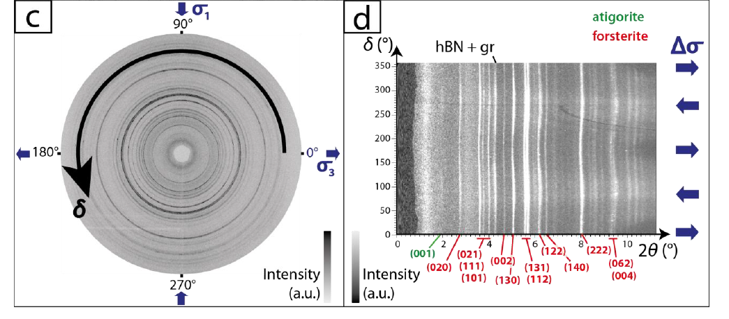
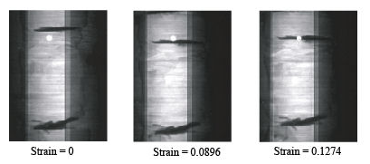
D-DIA
Schubnel et al., 2013; Thomas et al., in prep

Slide 11
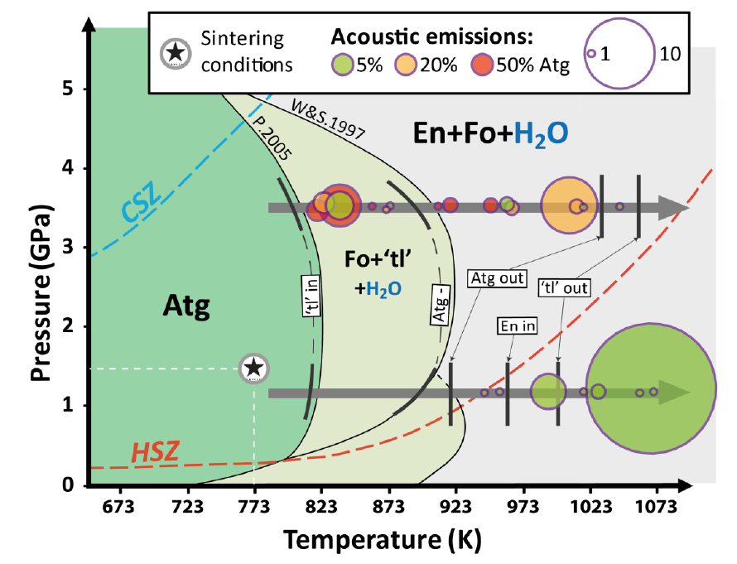
Thomas et al., in prep

Slide 12
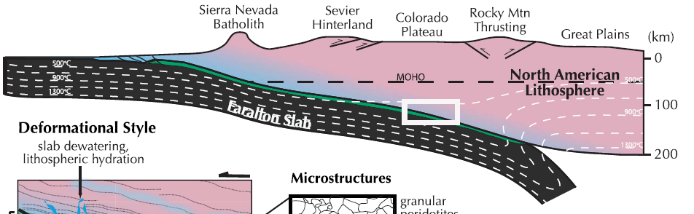
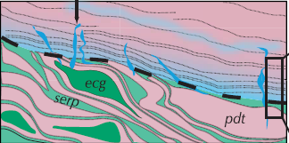
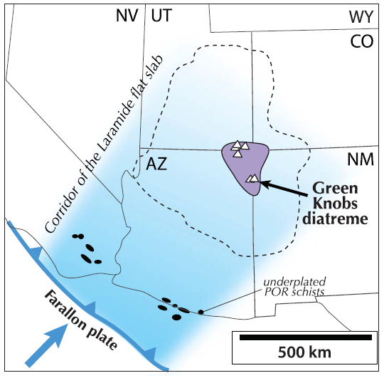
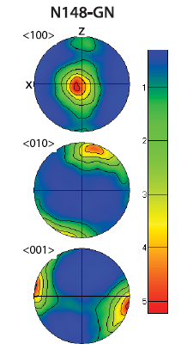
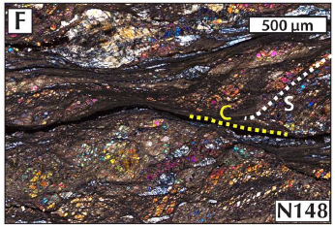
Behr & Smith, 2016

Slide 13
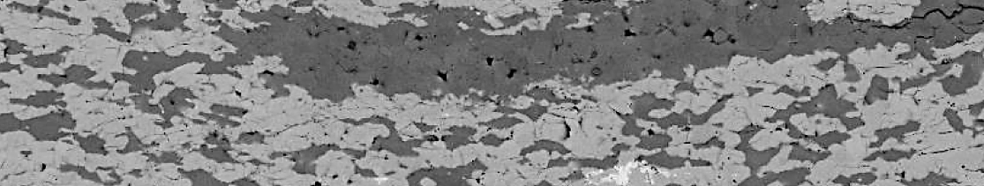
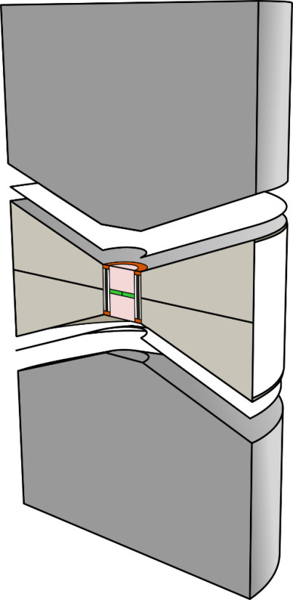
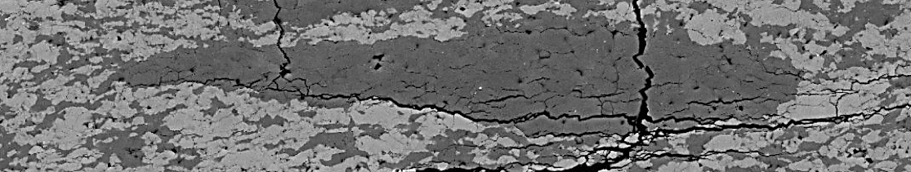
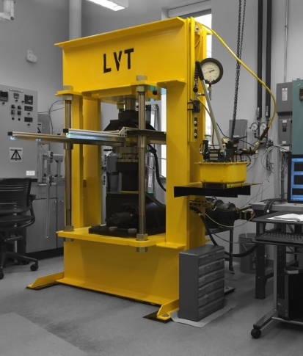
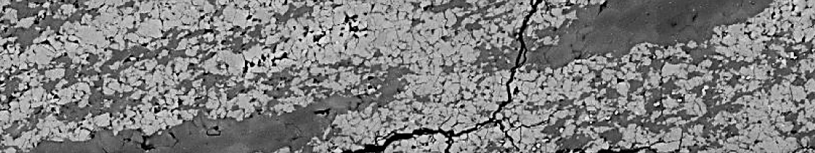
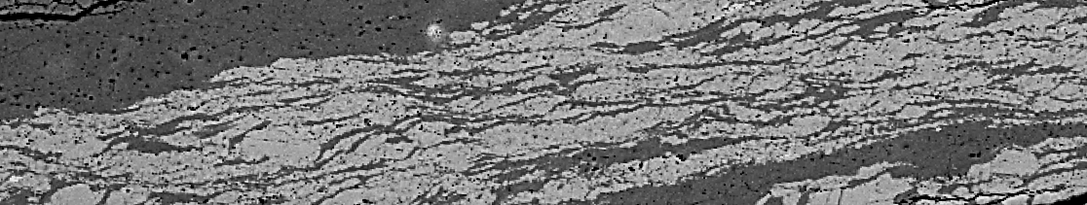
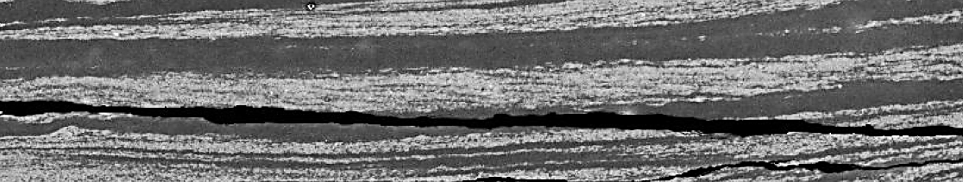
Large Volume Torsion (LVT) apparatus
Washington Univ. in St Louis
(really far from any active subduction)
Deformation of two-phase composite (calcite and anhydrite) at high pressure and temperature, in simple shear
γ = 0
tungsten
carbide
anvil
γ = 1
γ = 3
sample
γ = 6
γ = 17
40 mm
50 µm
Cross and Skemer (in prep)

Slide 14
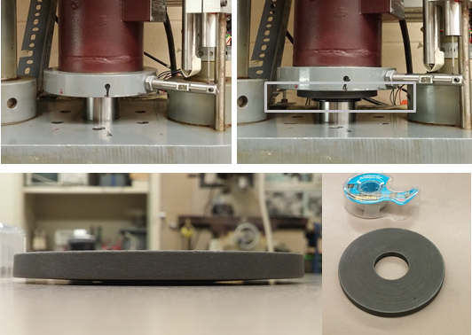
Belleville Washer
Okazaki & Hirth, Nature, 2016

Slide 15
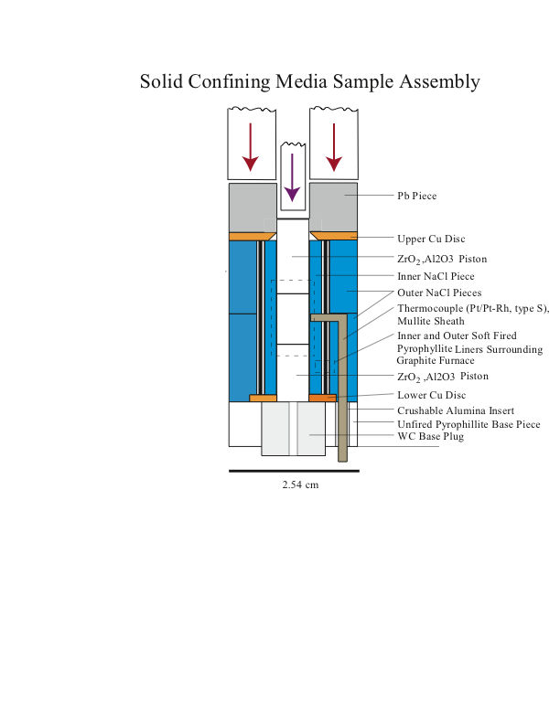
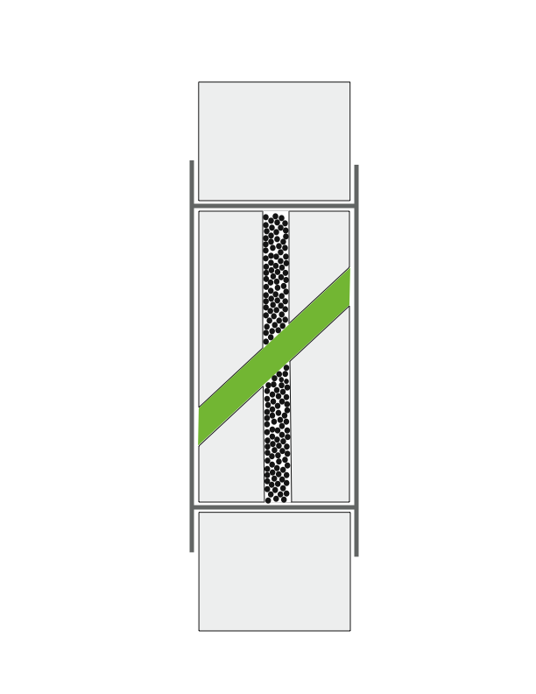
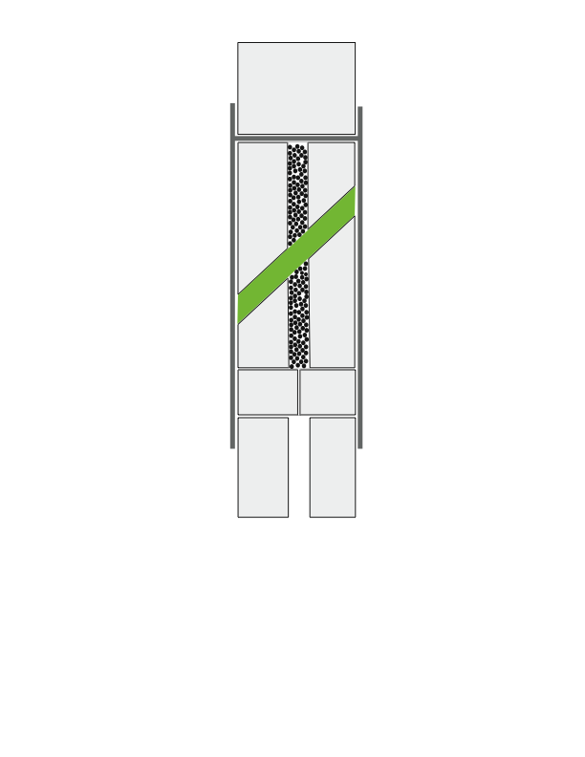
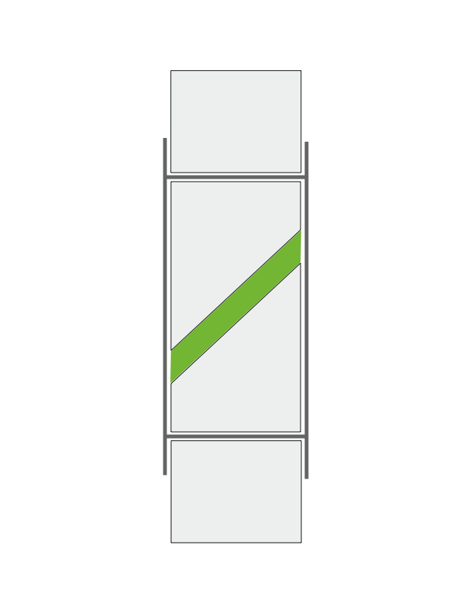
Modified Sample Assembly to Control Pore Fluid Pressure
Undrained
Partially Drained
Drained
Proctor & Hirth, 2015

Slide 16
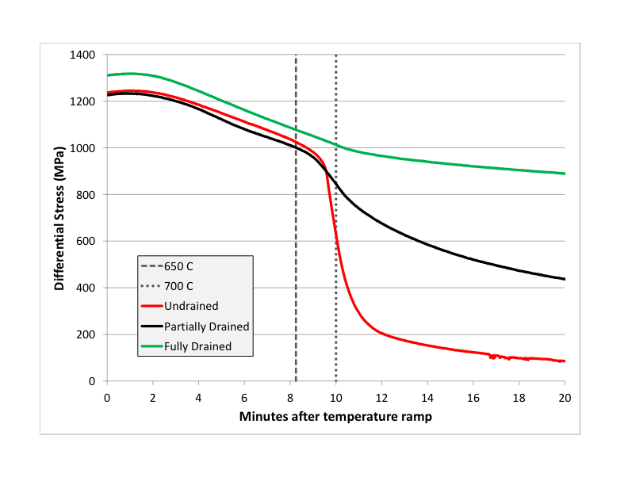
Results - Temperature Ramp
400 C, 1GPa Confining Pressure, ~10⁻⁵/s strain rate
400 C to 700 C
700 C
Proctor & Hirth, 2015

Slide 17
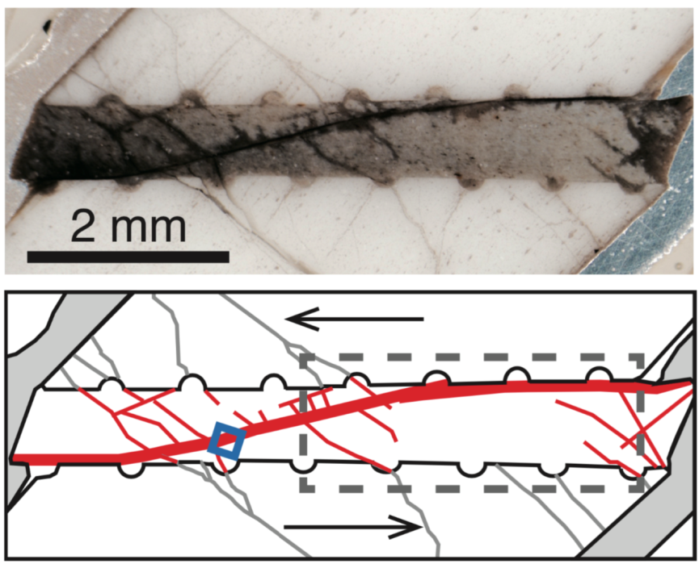
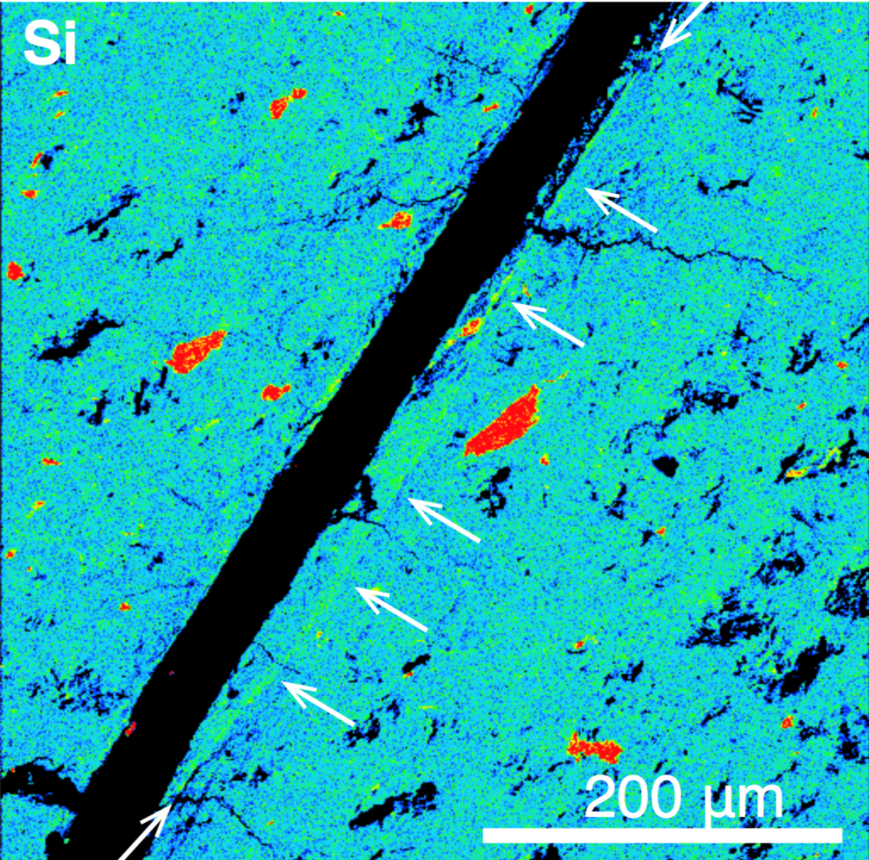
Glaucophane
XRD
Okazaki & Hirth, Nature, 2016

Slide 18
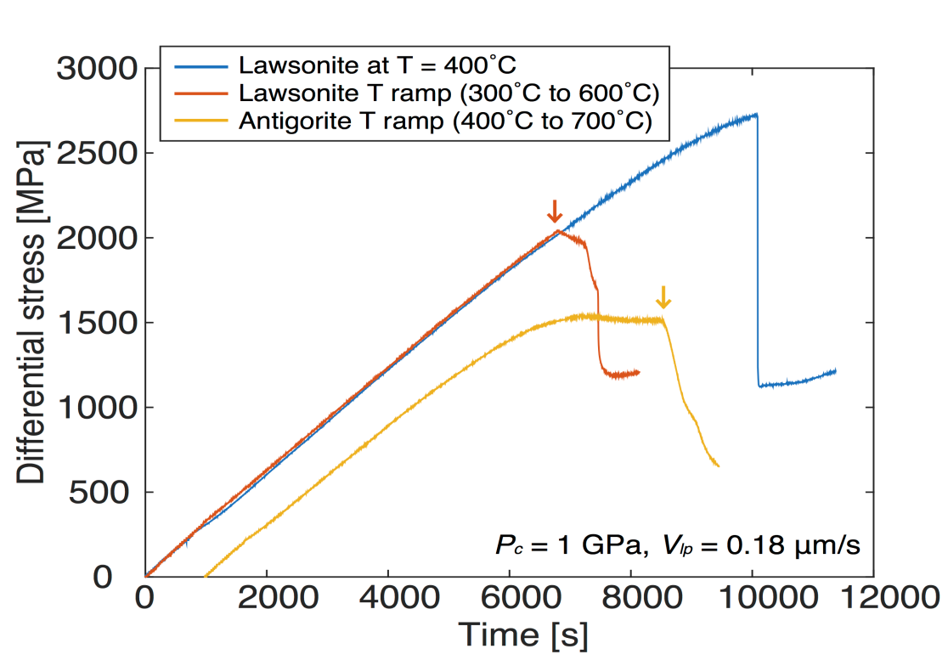
Lawsonite: hydrated Ca, Al Silicate.
OH inside “rings”, rather than layers (like micas and clays)
Okazaki & Hirth, Nature, 2016

Slide 19
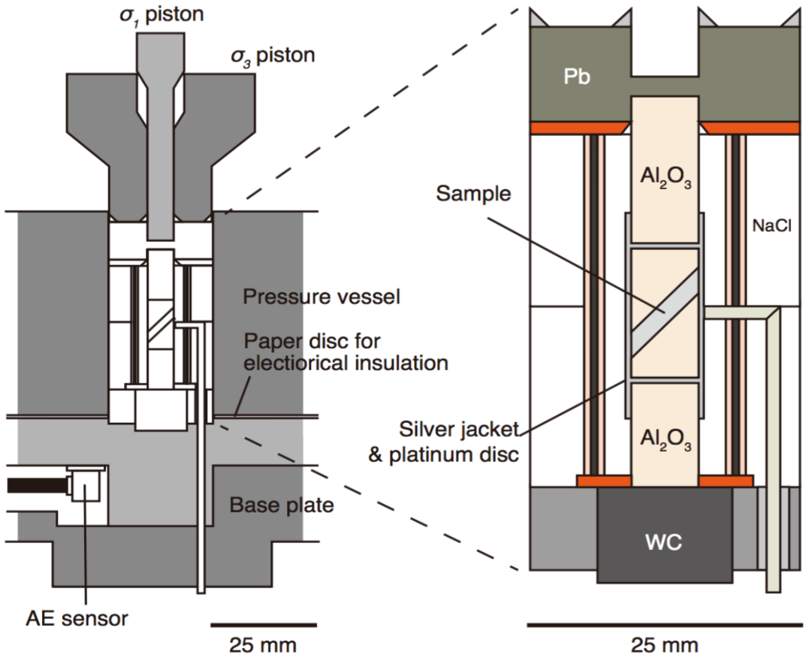
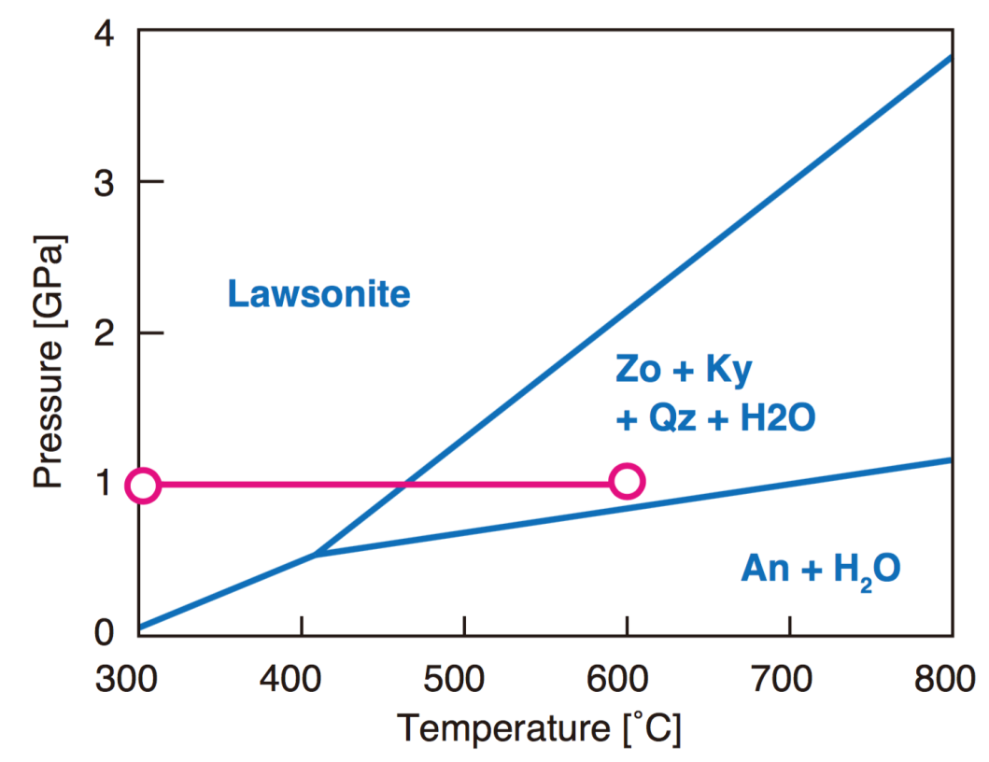
AEs were recorded with f = 2.5 MHz, and then high pass filtered f > 100 kHz.
Okazaki & Hirth, Nature, 2016

Slide 20
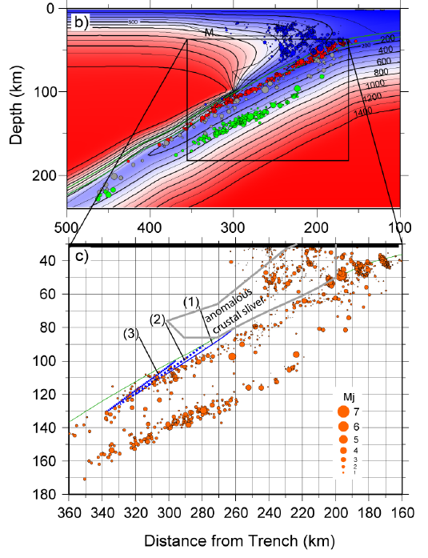
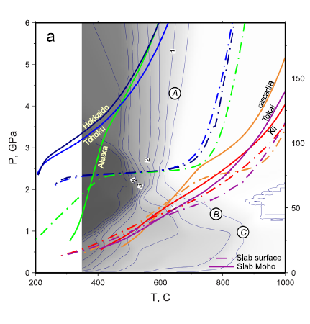
Hokkaido Thermal Model
Abers et al., 2013
van Keken et al., 2012

Slide 21
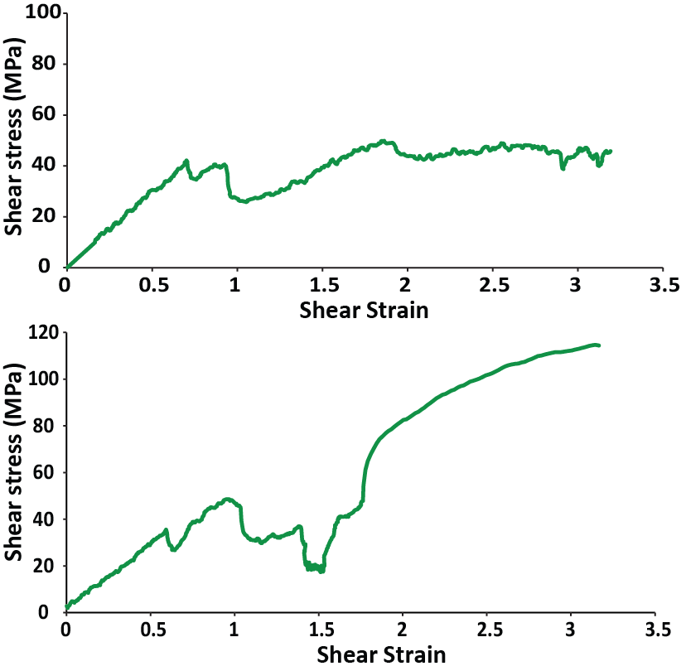
“Slow stick slip” along fluid-rich shear bands, synchronous with ductile flow (pressure solution creep) of matrix. Overall friction is strongly velocity strengthening – PT conditions same as base of the crust at Parkfield
700 °C, 1 GPa, 10⁻⁵/s
700 °C, 1 GPa
10⁻⁶/s
10⁻⁴/s
10⁻⁵/s

Slide 22
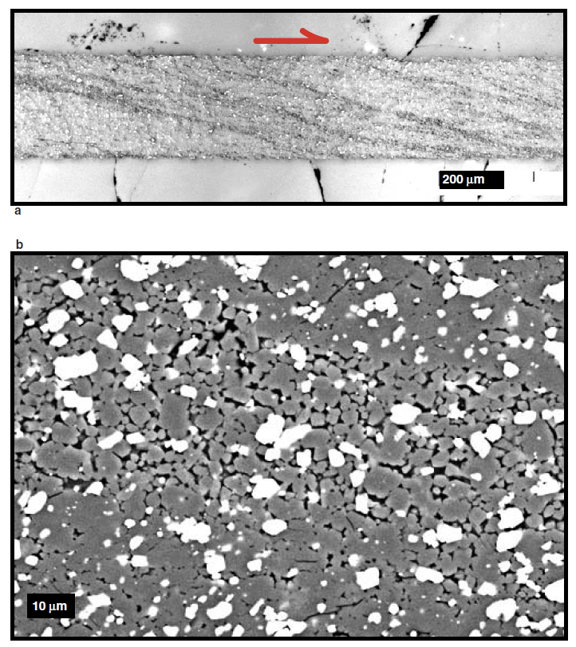
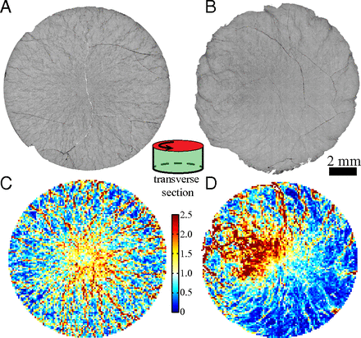
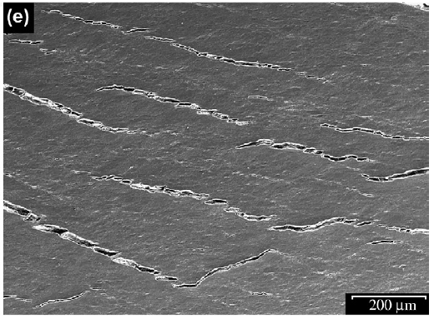
Fluid/porosity redistribution during viscous creep
Olivine+Melt, Holtzman et al. (2003)
Plagioclase+Pyroxene, Dimanov et a. (2007)

Slide 24
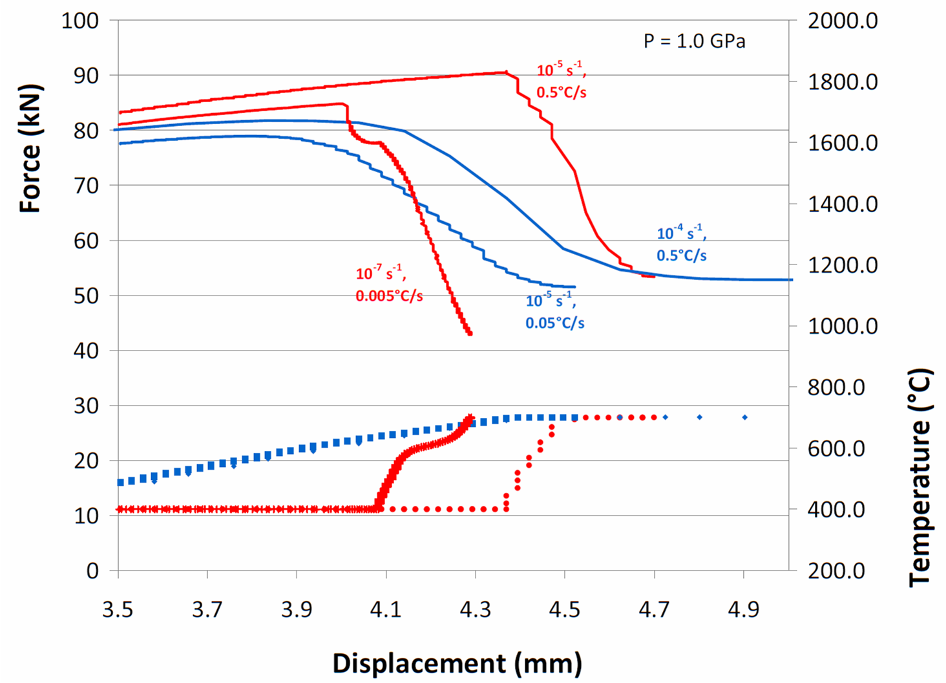


$$\frac{\dot{T}}{\dot{ε}}=5×{10}^{4}℃$$
$$\frac{\dot{T}}{\dot{ε}}=5×{10}^{3}℃$$
Chernak & Hirth, Geology, 2011

