Slide 1
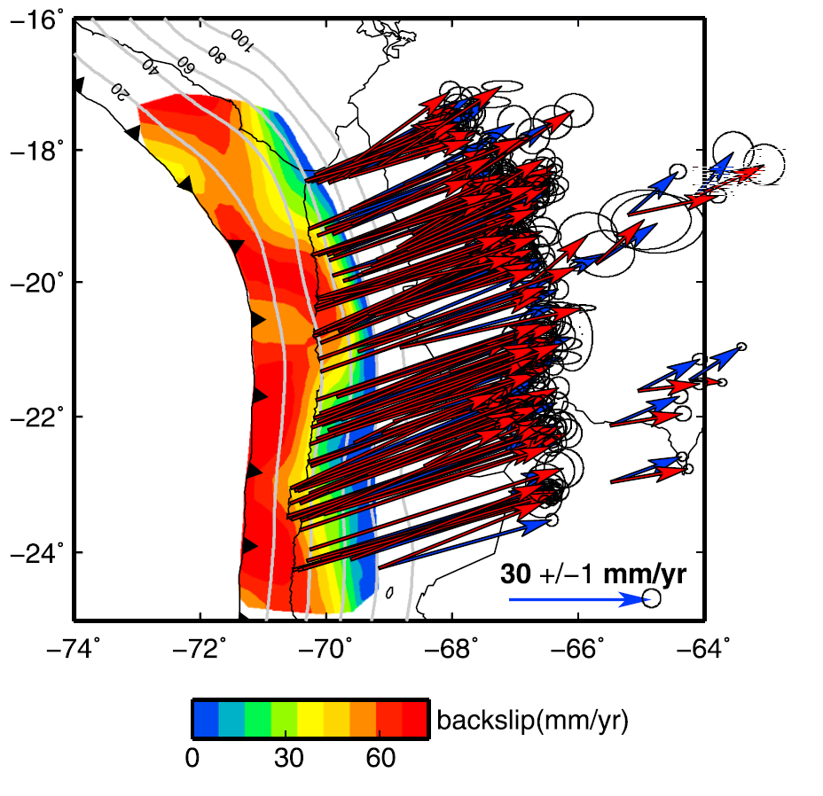
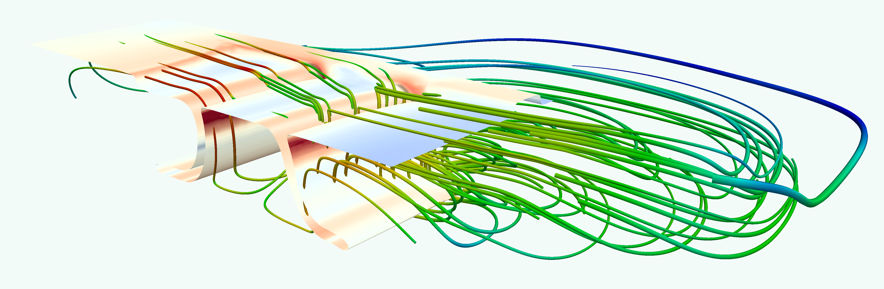
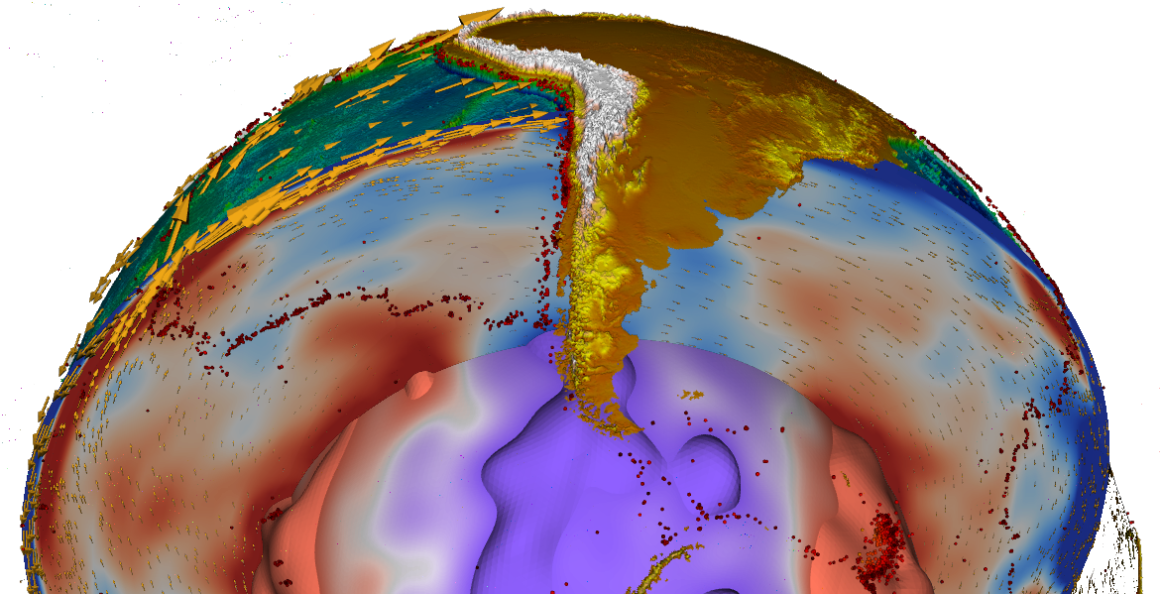
Dynamic models of subduction: Tectonics to tremor
Li et al. (2015)
Thorsten W. Becker
Jackson School of Geosciences
The University of Texas at Austin
Subduction Zone Observatory Workshop
September 30, 2016

Slide 2
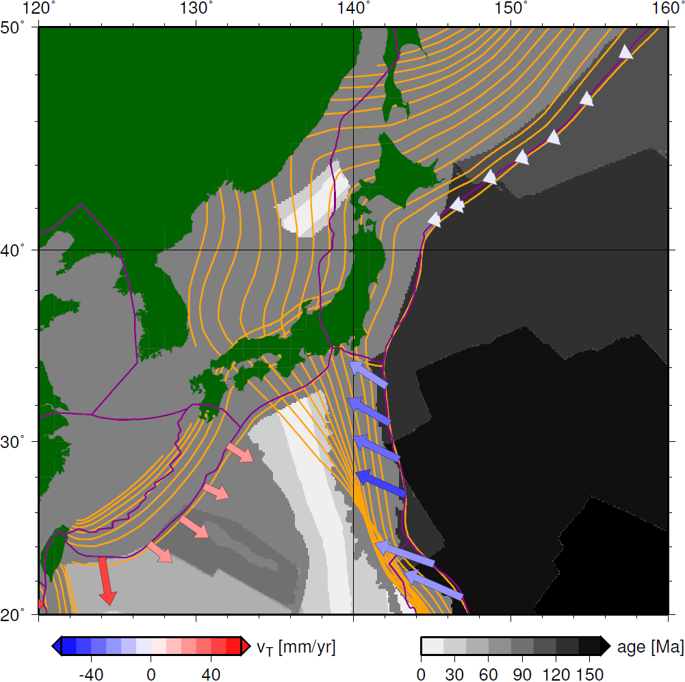
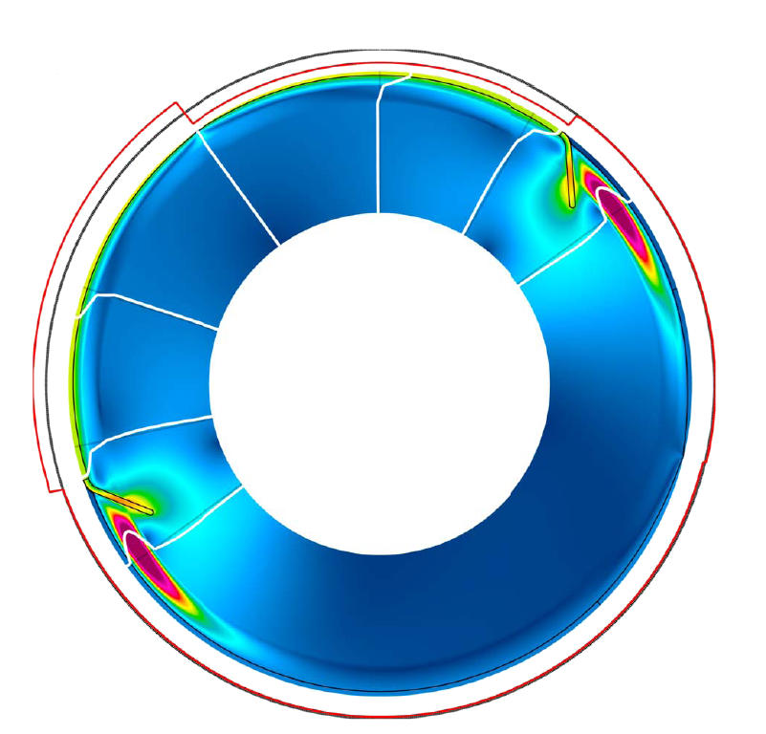
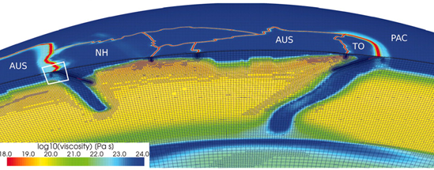
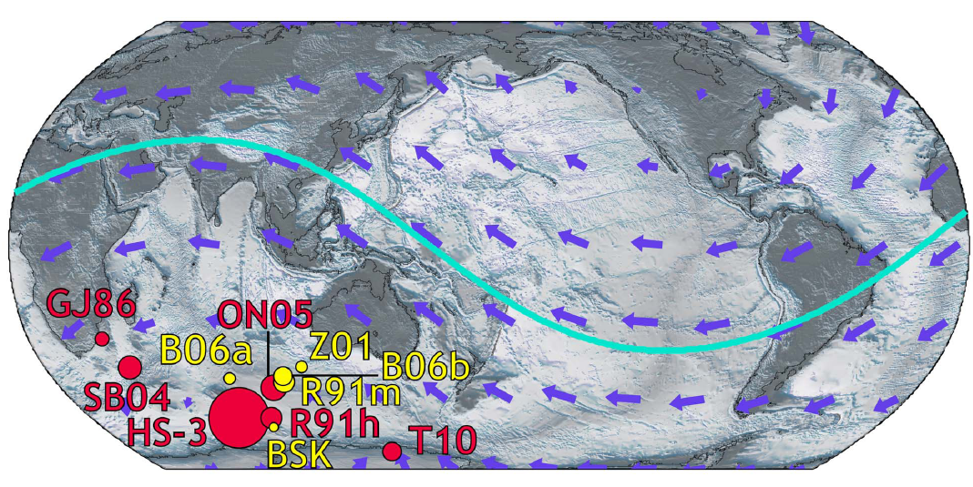
Challenge of spatio-temporal scales:
Regional subduction dynamics can have global effects
rollback
advance
Stadler et al. (2010)
Alisic et al. (2014)
net rotation component
of plate motions
Gerault et al. (2011)
pressure difference in mantle
due to interacting subduction zones,
introduces net rotation, depends on slab strength

Slide 3
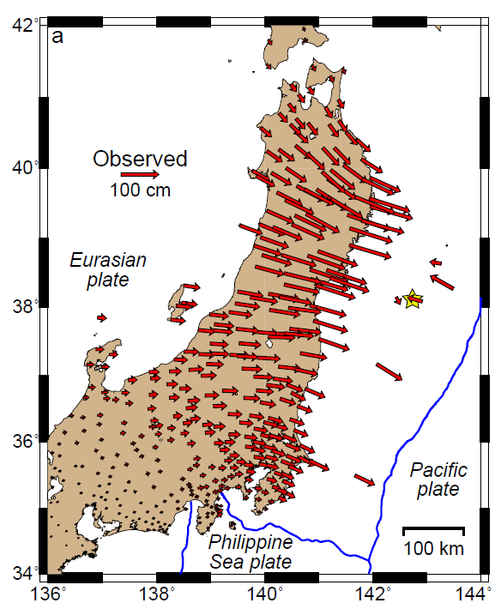
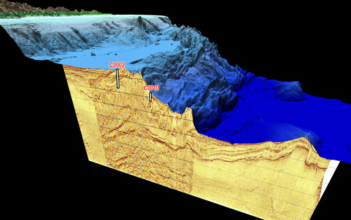
New insights thanks to data-rich observatories
NaTroSEIZE
NA

Slide 4
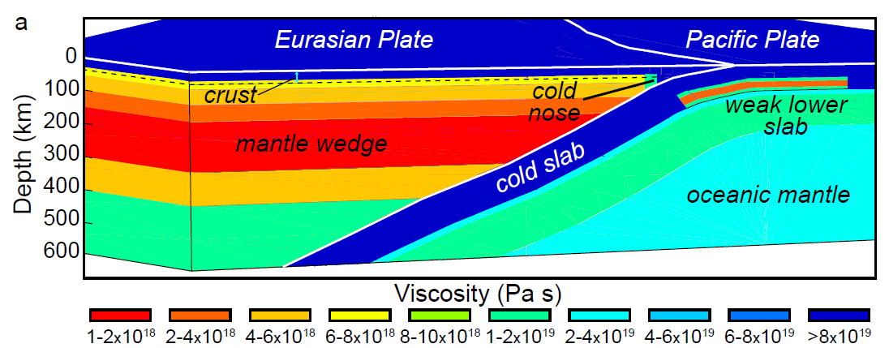
Post-seismic inversion for viscosity on upper mantle scale
post-seismic,
cumulative
displacements
3 years after
2011
Tohoku-oki M9
Freed et al. (submitted)

Slide 5
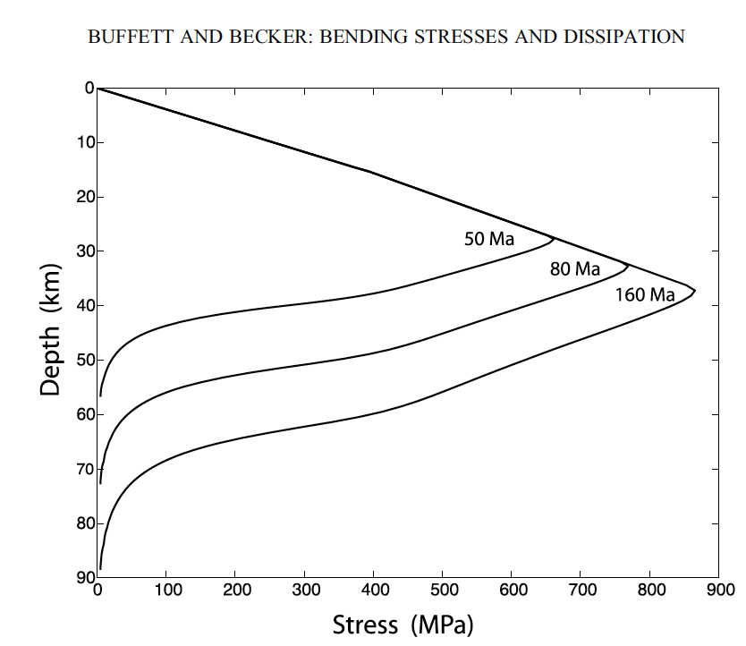
One explanation: Plastic weakening of lithosphere by Peierl’s creep
wet olivine (Hirth and Kohlstedt, 2003)
low T plasticity: Mei et al. (2010)
Buffett and Becker (2012)
Freed et al. (submitted)

Slide 6
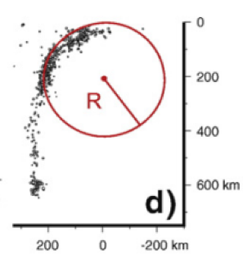
Effectively plastic slab: Bending radius affected by overriding plate thickness
Plastic slab more strongly affected by lifting force (F_{ΔP}) associated with overriding
plate, weak bending stresses
bending radius, R [km]
Overriding plate thickness
F_{ΔP}
thin OP
thick OP
Holt et al. (2015)
Notes:
Double subduction systems represetn
As mentioned earlier, a couple of locations where we think double subduction is important in producing enigmatic plate kinematic, past or present, are India-Eurasia and the Arcs just to the south of Japan.
We have shown that double subduction, with equivalent slab polarities, may be able to cause the anomalously high rates of pre-collision plate convergence between india and eurasia of ~15 cm/yr.

Slide 7
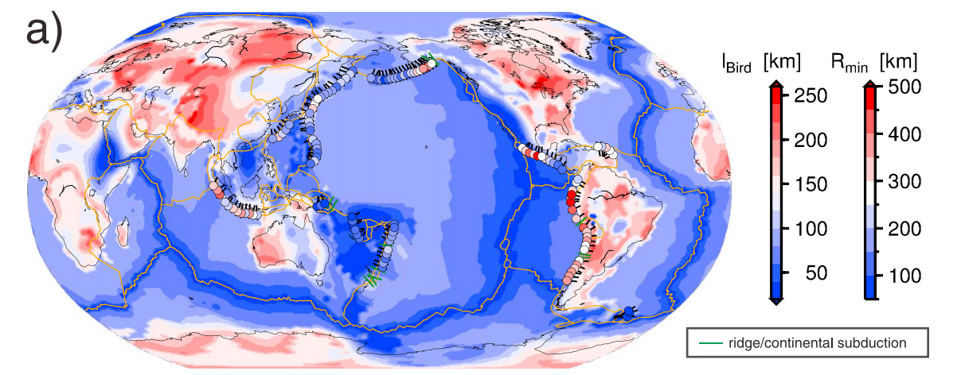
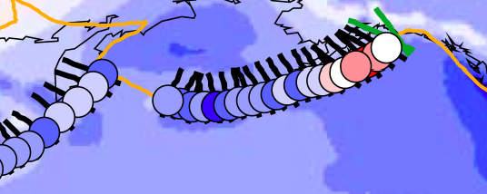
Bending radius and plate thickness in nature
h_{OP}
h_{SP}
Aleutian Trench
Radii of curvature from Benioff zone spline fits (Buffett & Heuret, 2011)
Lithospheric thickness estimated from seismic tomography and
  seafloor age (Bird et al., 2008)
Holt et al. (2015)
Notes:
Double subduction systems represetn
As mentioned earlier, a couple of locations where we think double subduction is important in producing enigmatic plate kinematic, past or present, are India-Eurasia and the Arcs just to the south of Japan.
We have shown that double subduction, with equivalent slab polarities, may be able to cause the anomalously high rates of pre-collision plate convergence between india and eurasia of ~15 cm/yr.

Slide 8
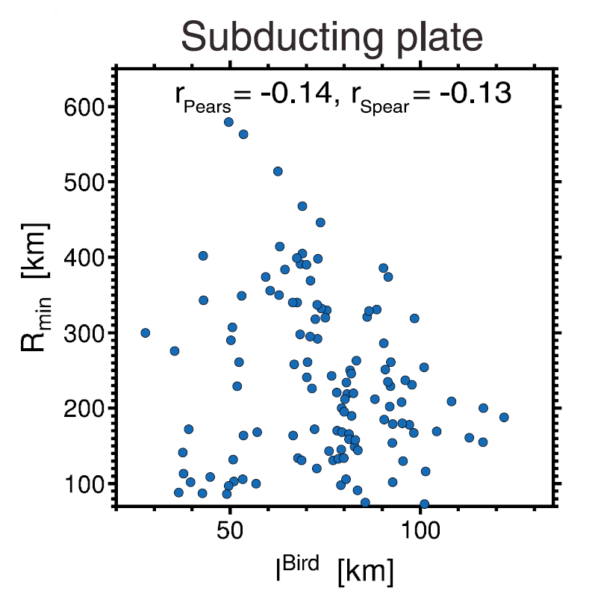
No subducting plate control on slab curvature
radius, R [km]
Lack of correlation between subducting plate thickness, h_{SP} and bending radius, R
(cf. Buffett & Heuret, 2011; Cruciani et al., 2005;
Fourel et al., 2014).
R [km]
subducting plate thickness, h_{SP} [km]
Holt et al. (2015)
Notes:
h ~ sqrt(kt)
Double subduction systems represetn
As mentioned earlier, a couple of locations where we think double subduction is important in producing enigmatic plate kinematic, past or present, are India-Eurasia and the Arcs just to the south of Japan.
We have shown that double subduction, with equivalent slab polarities, may be able to cause the anomalously high rates of pre-collision plate convergence between india and eurasia of ~15 cm/yr.

Slide 9
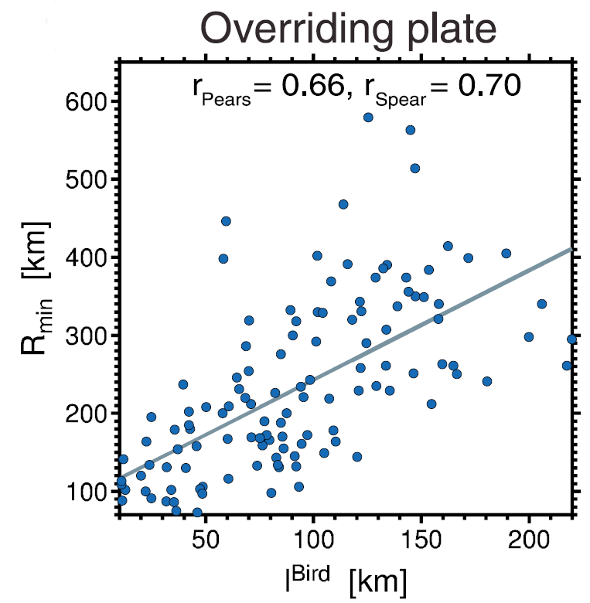
Overriding plate control indicates plates behave plastically
radius, R [km]
Lack of correlation between h_{SP} and R
Strong positive correlation between overriding plate thickness h_{OP} and radius R
overriding plate thickness, h_{OP} [km]
Holt et al. (2015)
Notes:
h ~ sqrt(kt)
Double subduction systems represetn
As mentioned earlier, a couple of locations where we think double subduction is important in producing enigmatic plate kinematic, past or present, are India-Eurasia and the Arcs just to the south of Japan.
We have shown that double subduction, with equivalent slab polarities, may be able to cause the anomalously high rates of pre-collision plate convergence between india and eurasia of ~15 cm/yr.

Slide 10
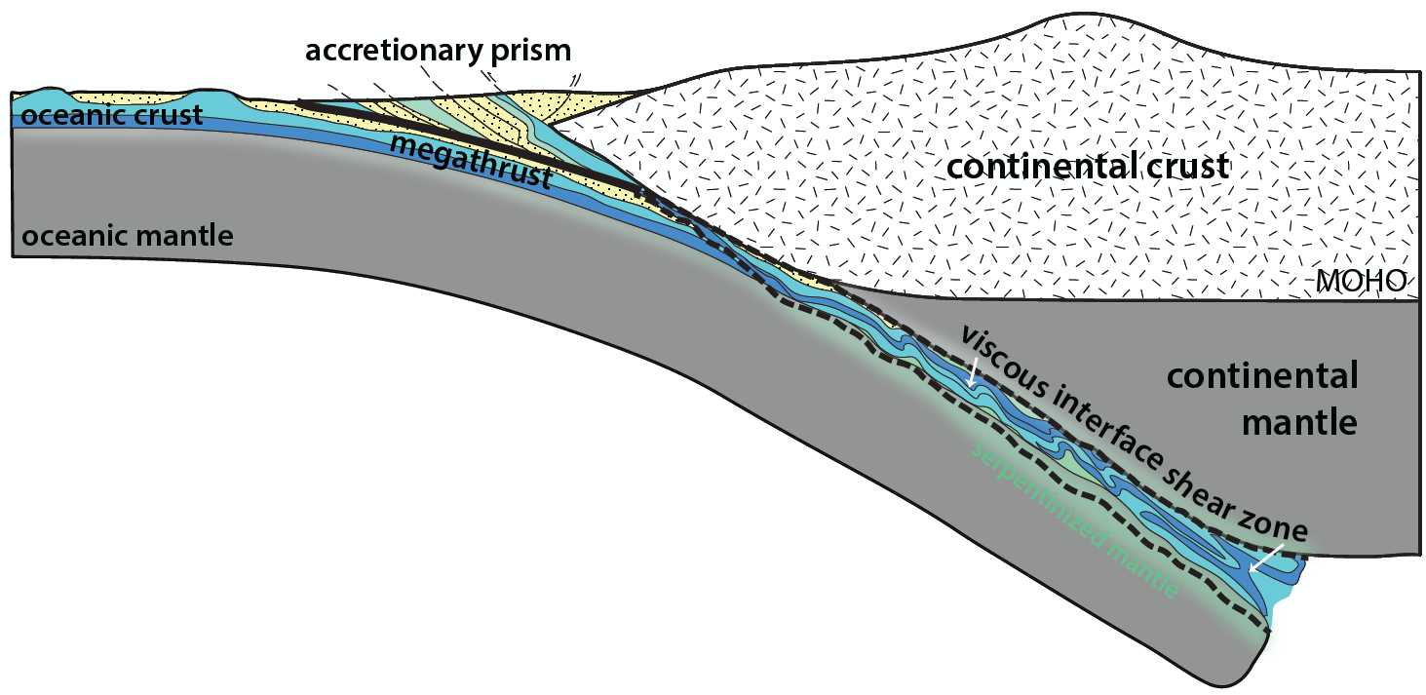
Strange new world:
Interface and overriding plate may matter for long term plate dynamics
modified from Whitney Behr

Slide 11
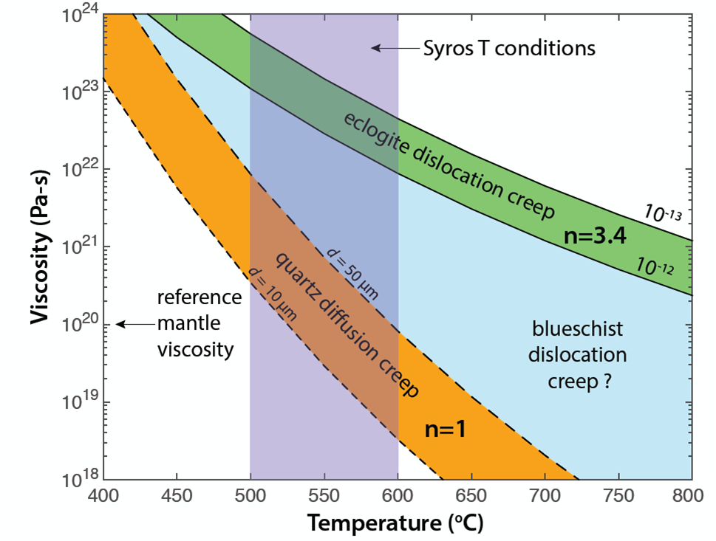
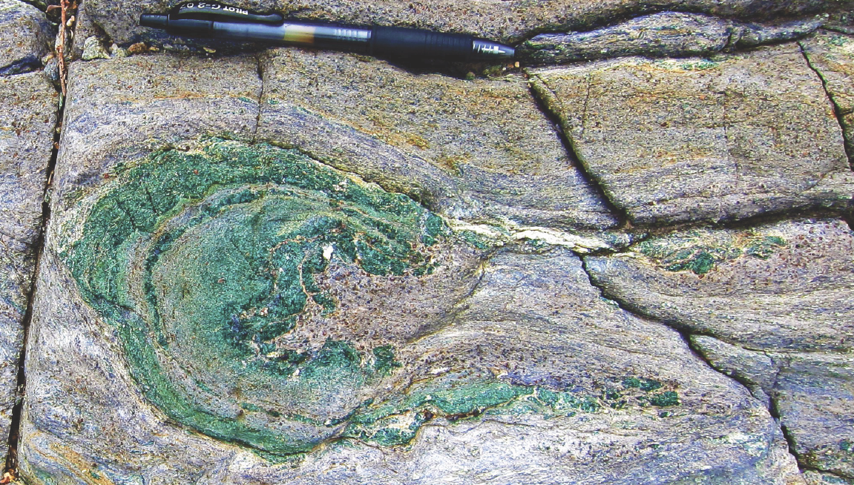

Incoming material may matter, too!
Behr et al. (in prep)

Slide 12
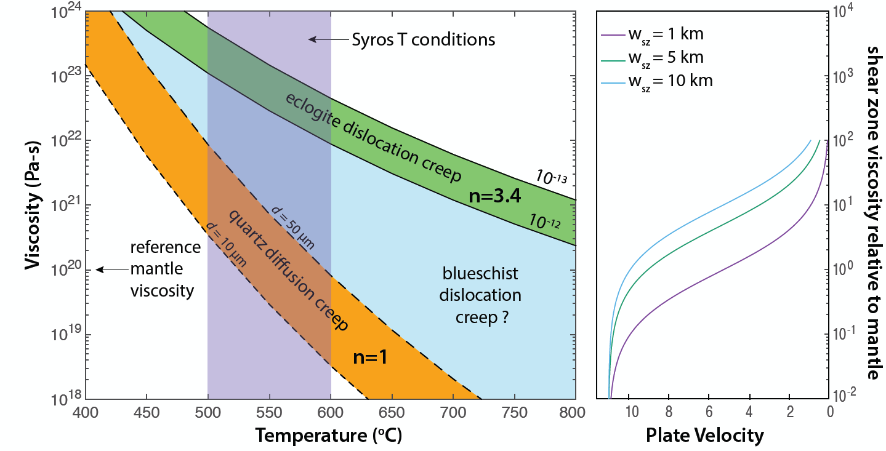
Interface control on plate velocities?
(continental erosion, long term cycles)
basalt interface
sediment interface
plate velocity =
slab buoyancy release – interface shear dissipation
convection cell + bending viscous dissipation

Slide 13
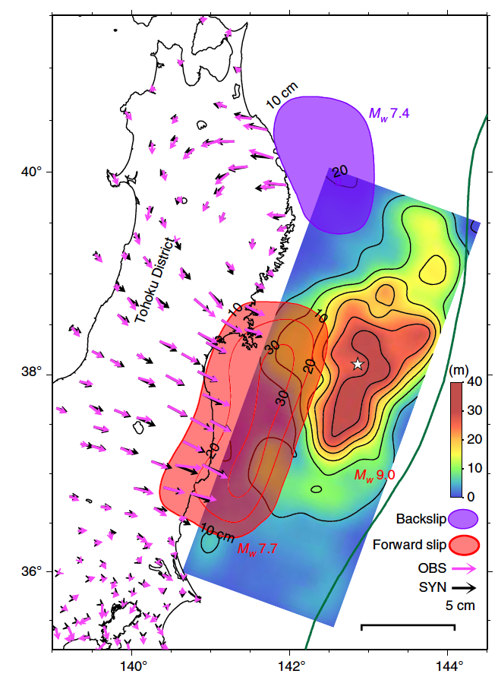
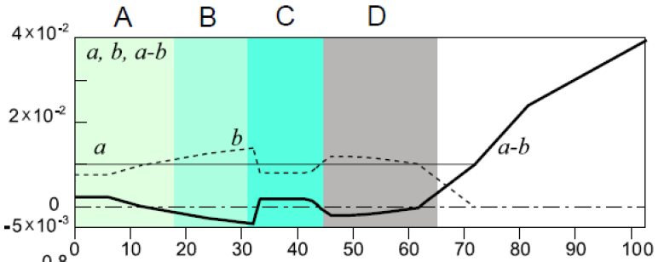

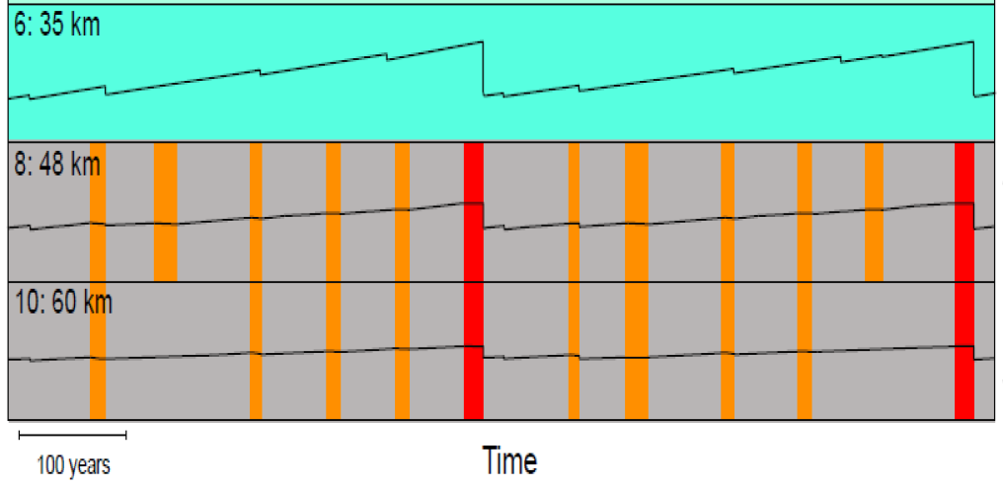
We knew that the interface matters…
Temporal complexity: Transients and supercyles
pre-seismic transient
rate-and-state fault constitutive law f(depth)
supercycles
Yokota & Koketsu (2015)
cf. Mavrommatis et al. (2015)

Slide 14
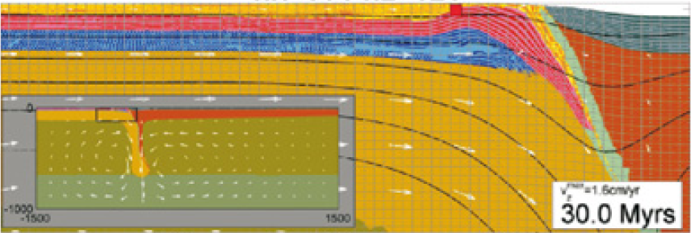
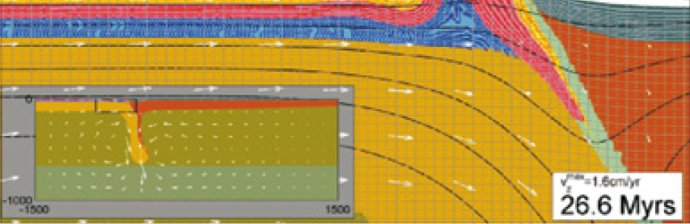
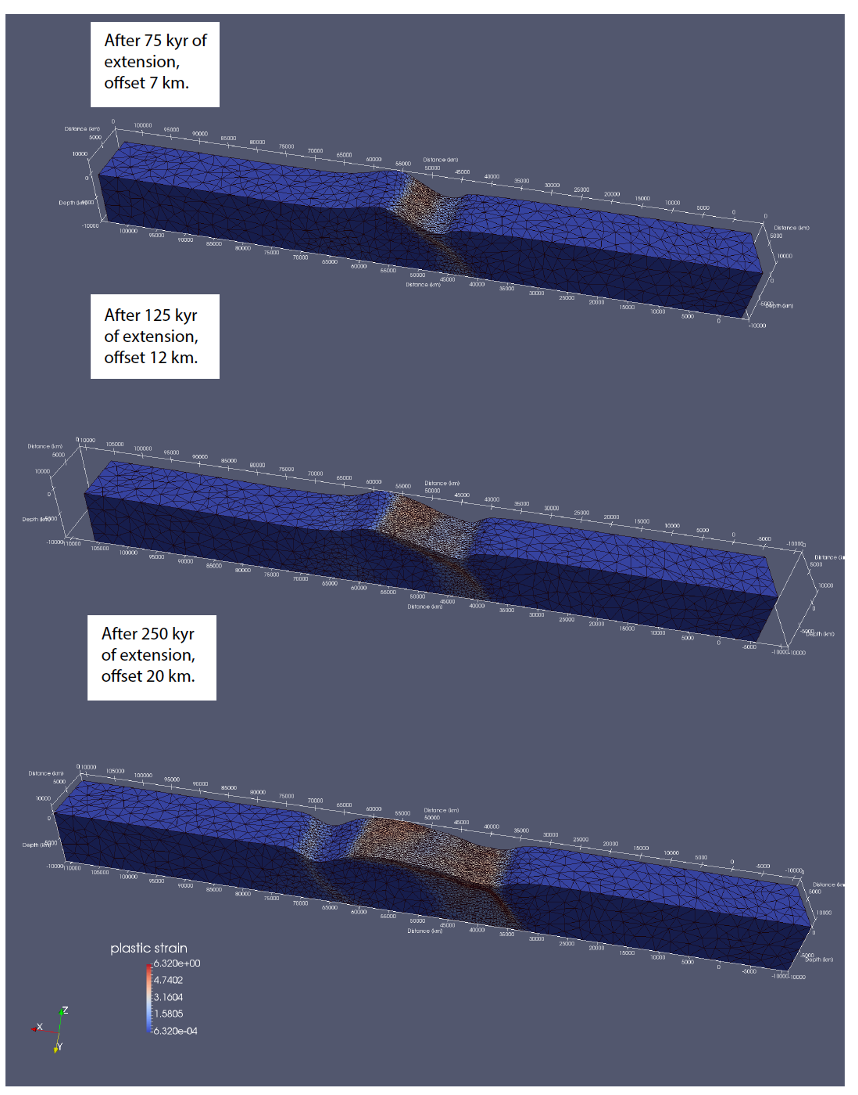
Multi-scale geodynamic modeling:
Numerical approaches to get closer to the complete physics (no fluids yet…)
no erosion
fast erosion
Kaus et al. (2008)
Normal fault evolution with rate-and-state friction
Lavier et al. (in prep)

Slide 15
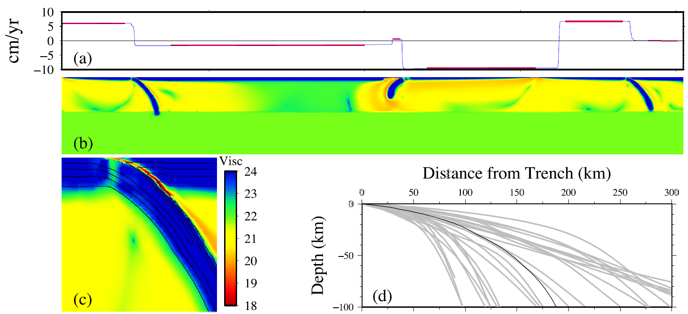
Geodynamic inversions are increasingly powerful:
Solve for rheology given kinematic constraints
observed (blue) and fit (red) plate velocities
viscosity inference
Ratnaswamy et al. (2015)

Slide 16
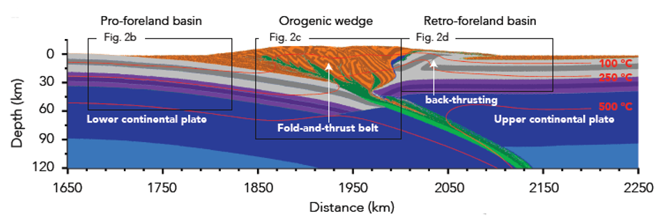
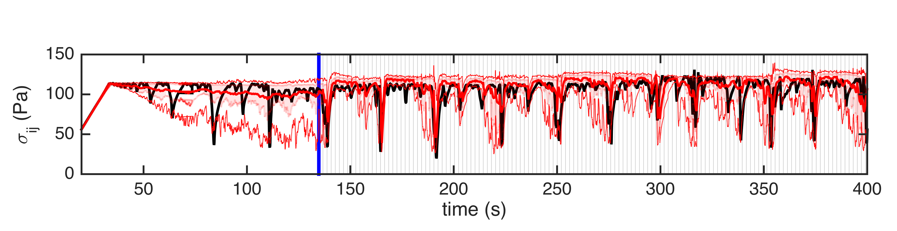
Seismo-thermo- mechanical modeling
For a laboratory thrust fault model, compare stress for
numerical model predictions (black)
observed behavior (red, with ranges)
Doesn’t work, but what if we have borehole stress monitoring?
time (s)
van Dinther et al. (in prep), cf. Colli et al. (2014)

Slide 17
Combine multi-scale modeling and data assimilation
Assimilate observations into physical models to probabilistically estimate state and parameters, while accounting for errors in both sources of information
Sequential Data Assimilation (Ensemble Kalman Filter) recovers evolving fault stress and strength, and thus improves forecasting of analogue event
Assimilation start
van Dinther et al. (in prep)

Slide 18
SZO should build GSZMs:
General Subduction Zone Models
At the verge of seeing 3D, multi-scale geodynamic models spanning mantle convection, tectonics, shear zone (fault) behavior, (and rupture)
Can use these models to
  Optimal experimental design
    e.g., networks designed for geodynamic hypothesis testing
  Explore coarse-graining (homogenization/fudging)
  Evaluate fault constitutive laws
    e.g., parameter sensitivity
  Test system level importance of feedback processes
    e.g., static vs. dynamic heterogeneity on thrust interface
  Improve earthquake forecasting (build earthquake machines!)
    e.g. Lyapunov exponents
  Understand long-term Earth evolution

Slide 19
Additional material

Slide 20
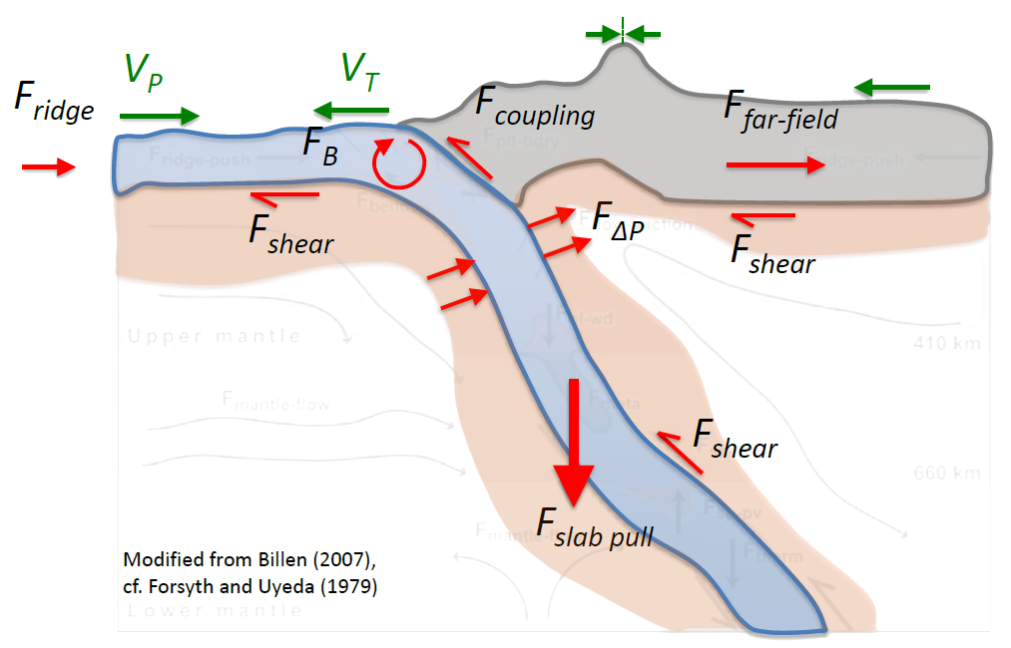
Spatial scales:
Local kinematics depend on global plate system
Trench motions
(advance and retreat)
advance
rollback
Net rotation of the lithosphere
wrt. to mantle (present-day)

Slide 21
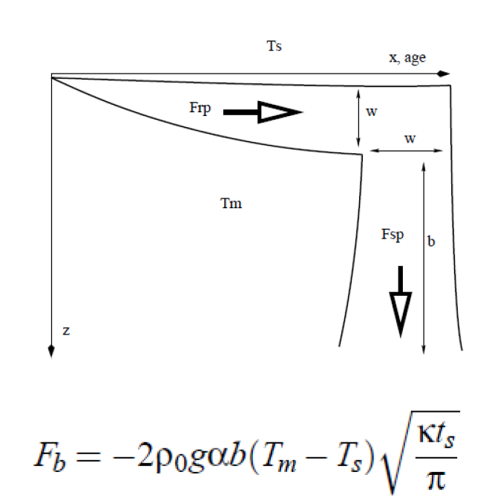
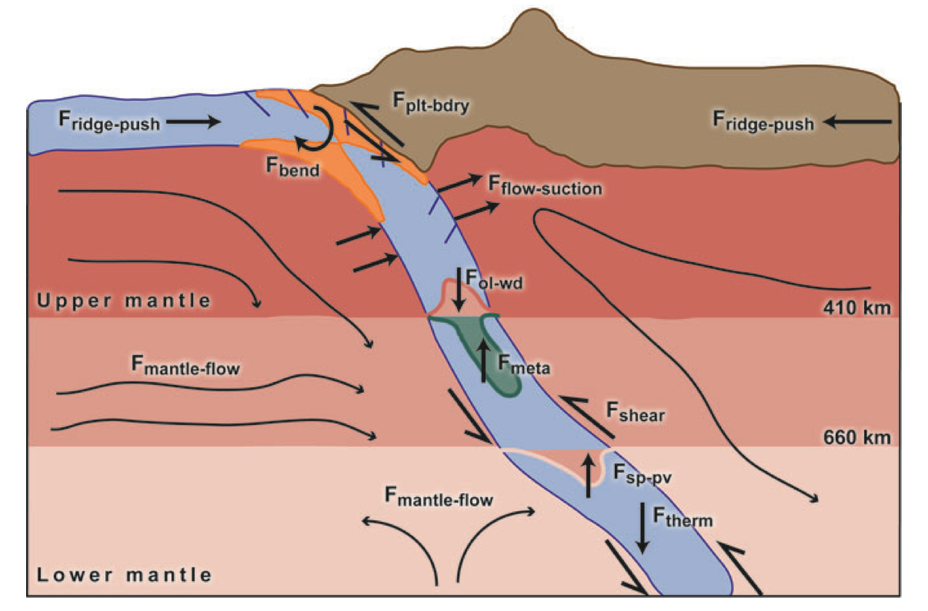
Strategy: Study natural subduction settings to extract driving forces
Dynamics vs. kinematics
Slab pull force
V_{B}
V_{OP}
V_{P}
V_{T}
F_{ridge}
F_{coupling}
F_{far-field}
F_{B}
F_{shear}
F_{ΔP}
F_{shear}
F_{shear}
F_{slab pull}
Potential energy change due to the thermal buoyancy of
a subducting half-space
cooling layer
Modified from Billen (2007),
cf. Forsyth and Uyeda (1979)

Slide 22
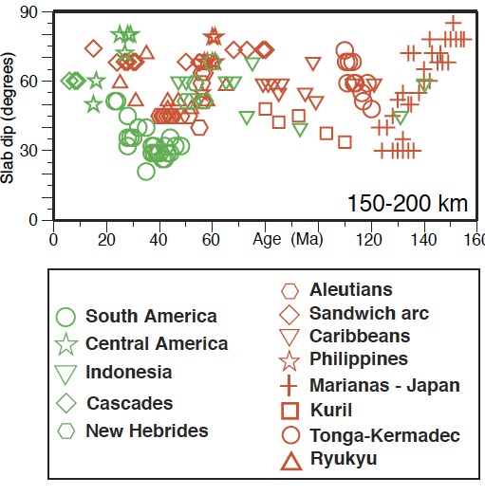
Subduction zone diversity presents a challenge for isolating mechanisms
Slab dip
F_{slab pull}
Cruciani et al. (2005)

Slide 23
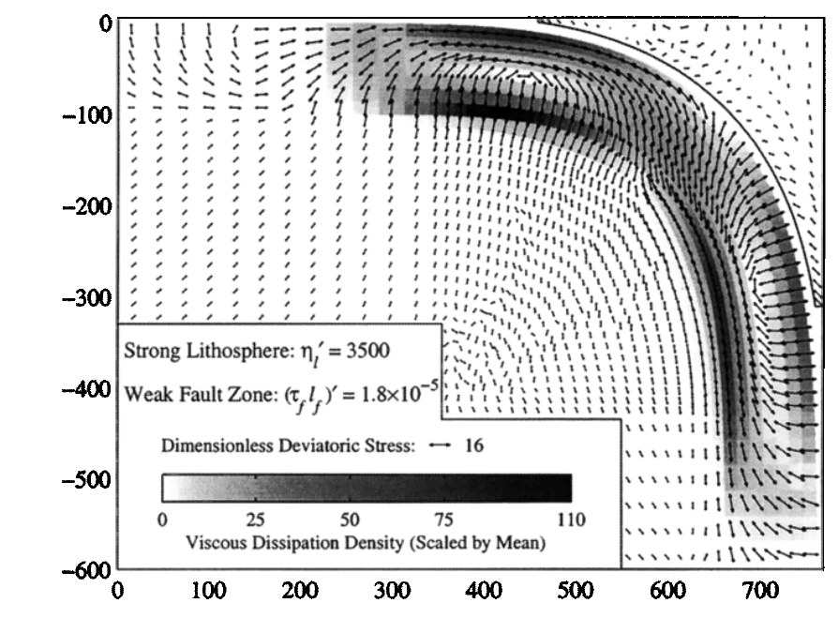
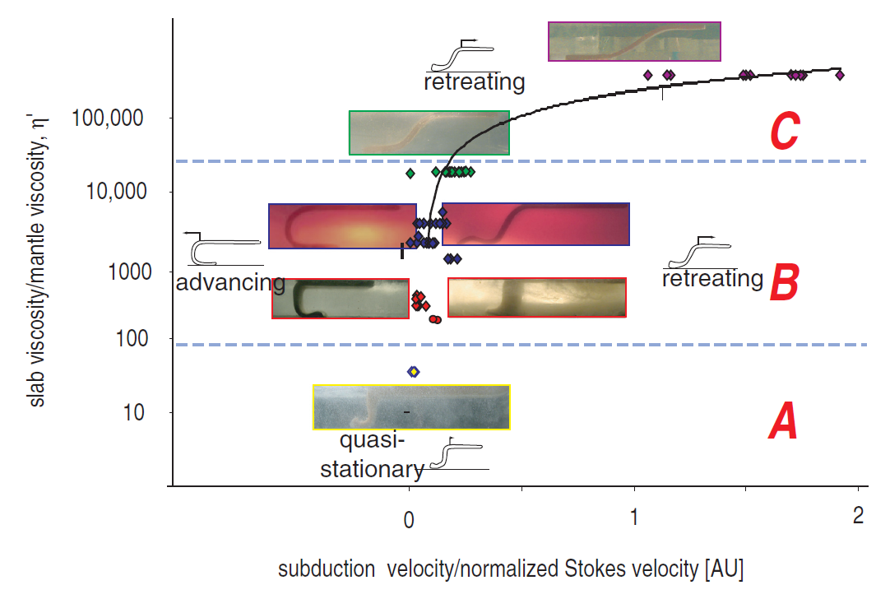
Lithospheric bending: bye bye?
Conrad and Hager (1999)
Funiciello et al. (2008)
slab buoyancy release – interface shear dissipation
plate velocity =
convection cell + bending viscous dissipation

Slide 24
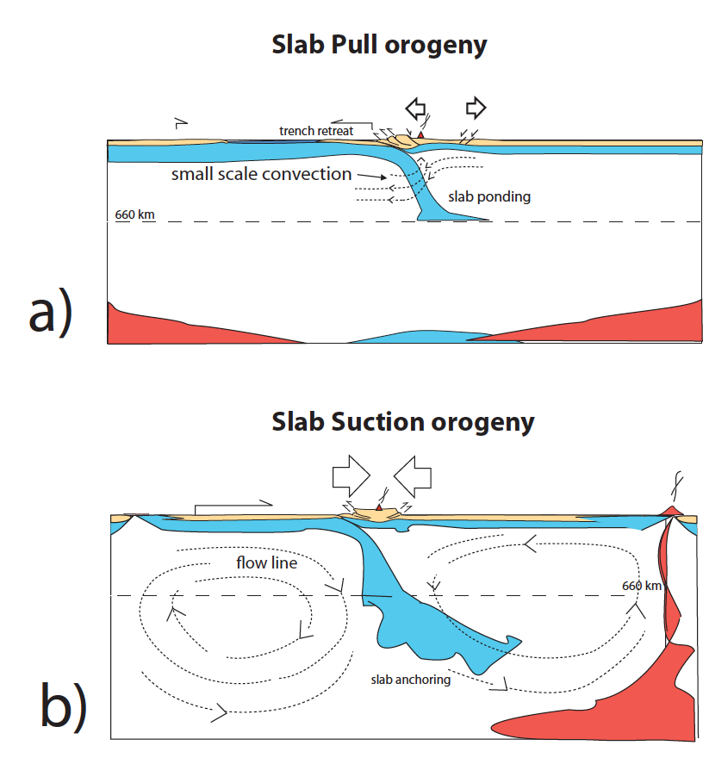
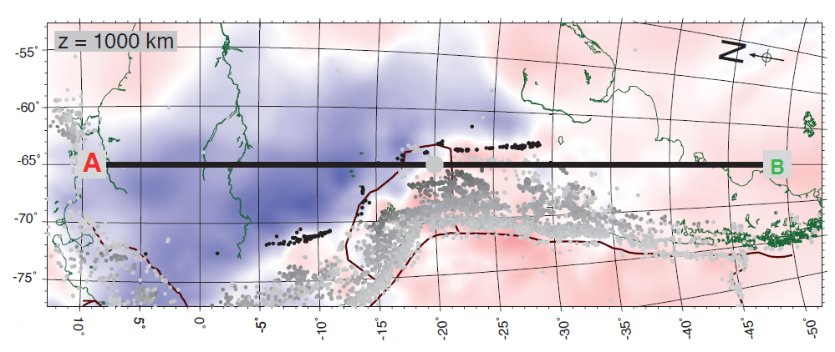
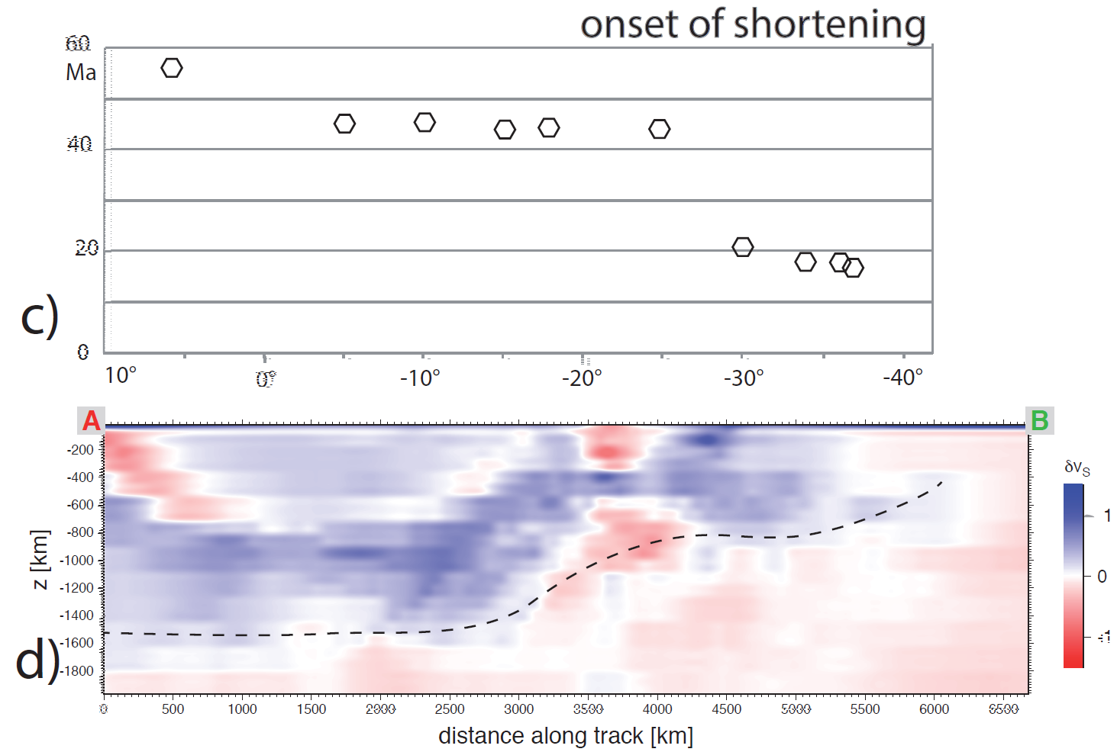
Subduction and orogeny: links between convection and continental geology
Faccenna et al. (2013)
660 km
Faccenna et al. (submitted)

Slide 25
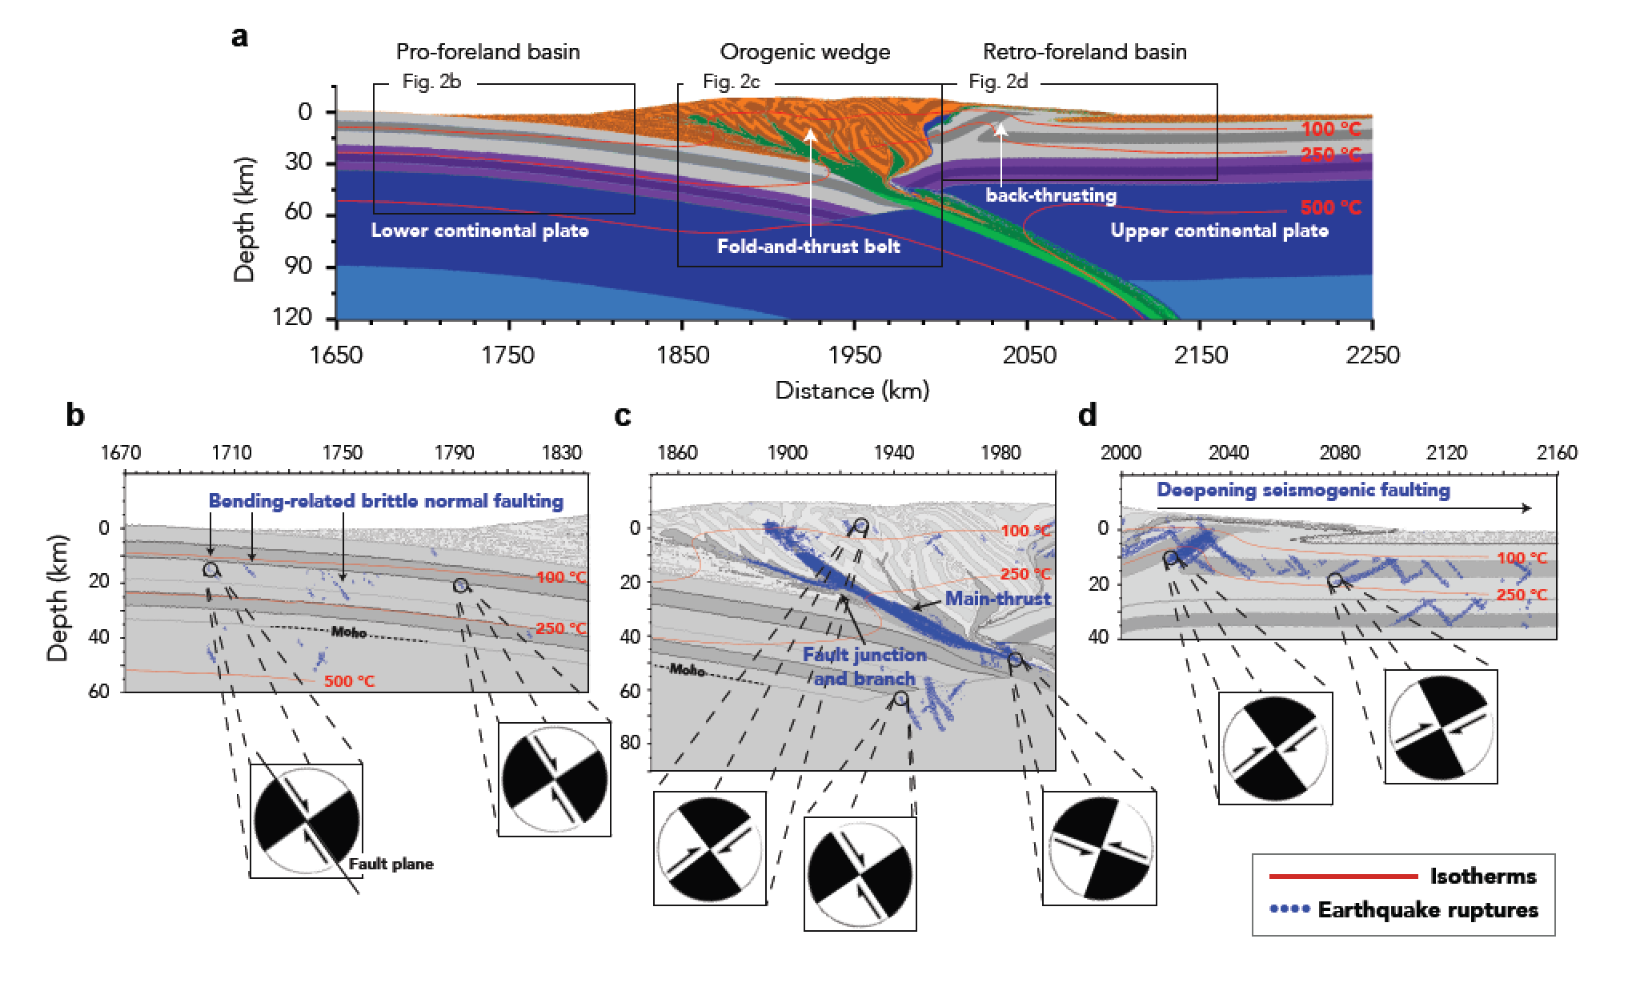
Seismo-thermo-mechanical models
Physically-consistent long-term dynamics of subduction and faulting
Extended with short-term ‘dynamics’ through rate-dep. friction and inertia
Visco-elasticity allows for secondary zone of coseismic uplift
van Dinther et al. (2014, 2015)

Slide 26
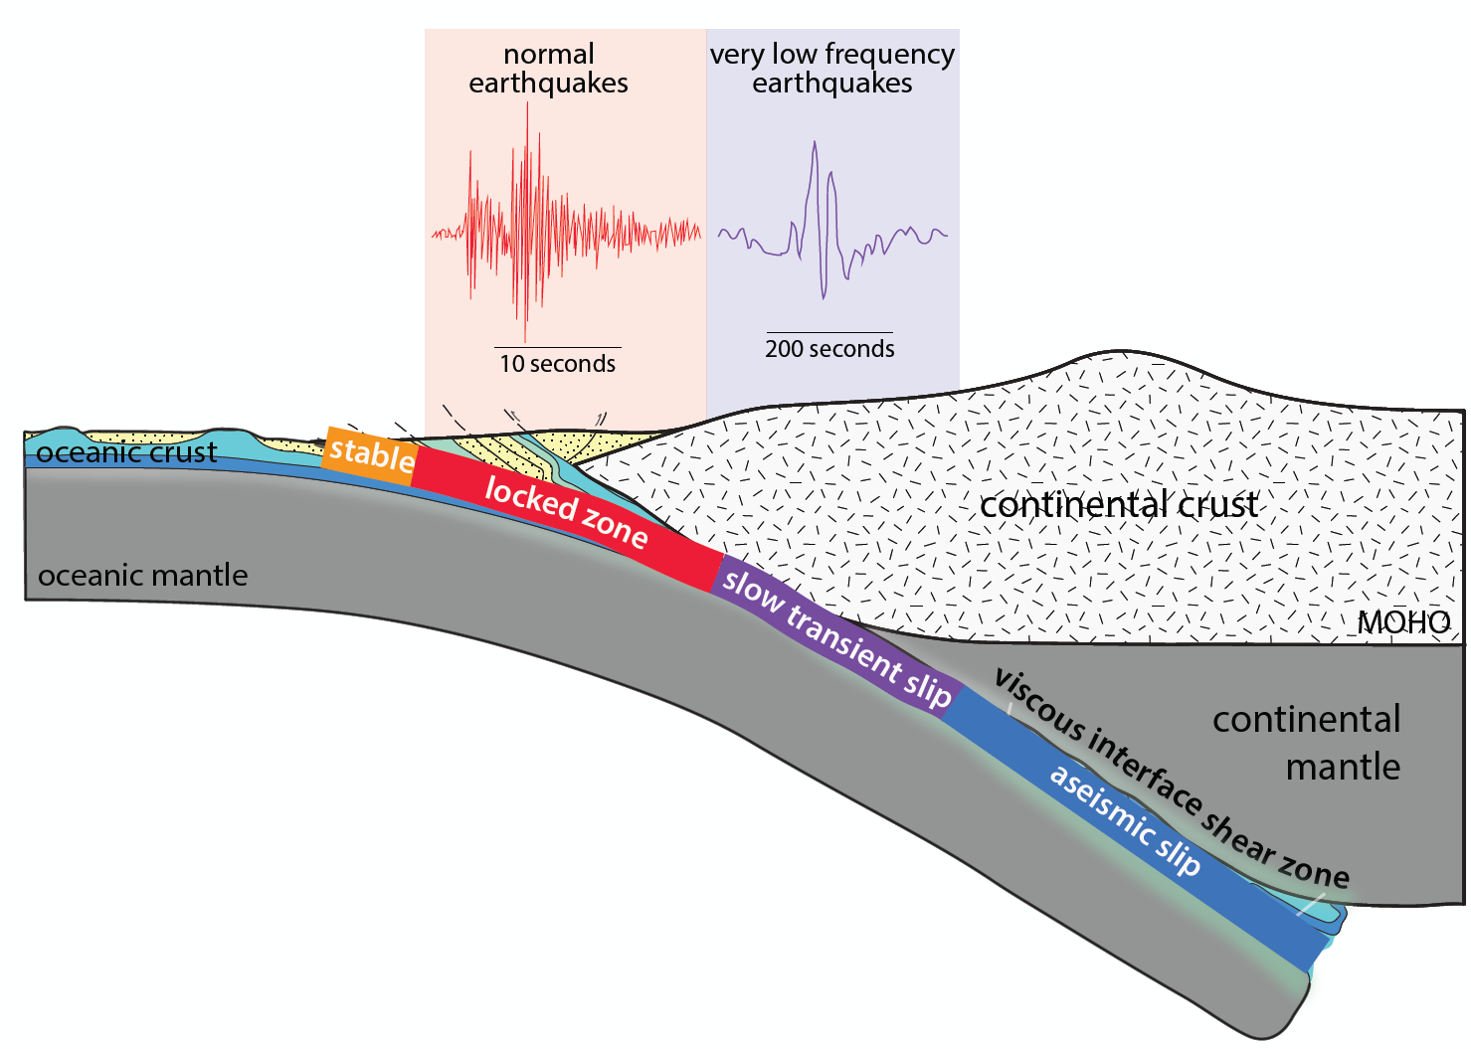

Slide 27
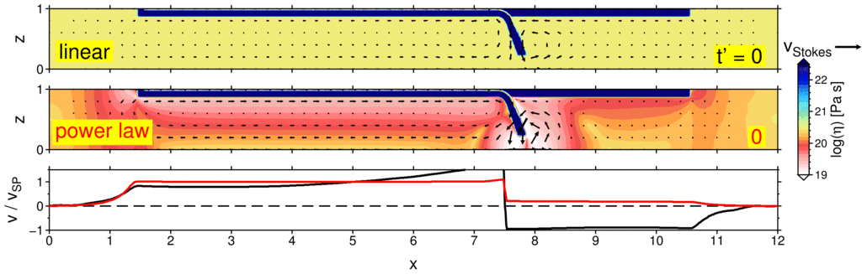
Complications: Rollback affected by mantle rheology (uncertain)
horizontal plate velocity
Holt and Becker (submitted) cf. Billen and Hirth (2003), Jadamec and Billen (2012)

Slide 28
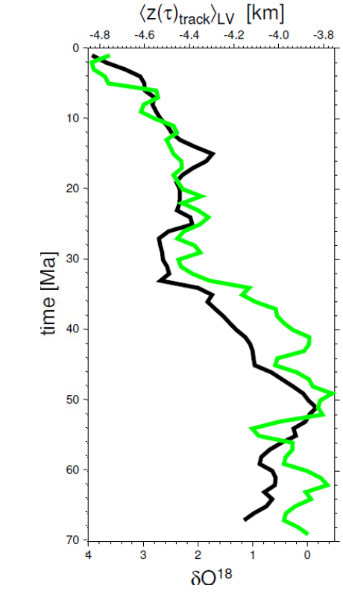
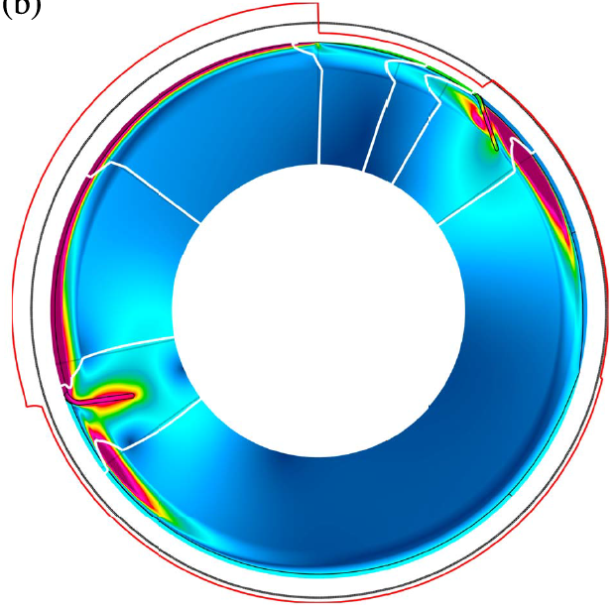
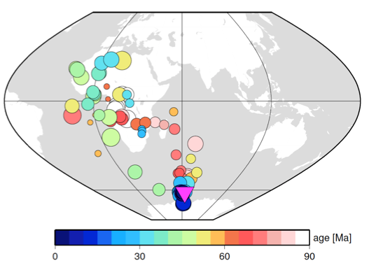
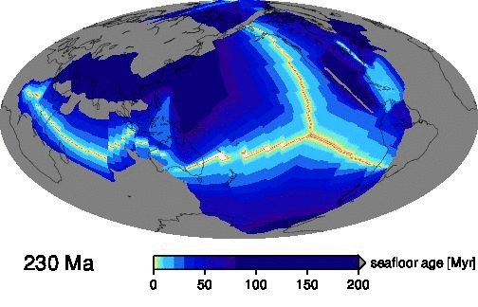

Slide 29

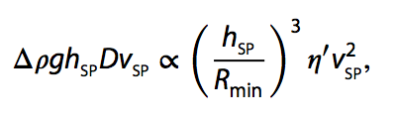


1. Slab curvature
Curvature, R_{min}
Plate velocity, v_{SP}
R dependence on SP thickness:
viscous: slope = 0.81
viscous: slope = 0.38
For viscous SP:
buoyancy flux bending dissipation
But, no positive correlation on Earth: Plasticity reduces this!
Notes:
Viscous:
Rmin = hsp ^ 0.81
Vsp = hsp ^ 0.38
Double subduction systems represetn
As mentioned earlier, a couple of locations where we think double subduction is important in producing enigmatic plate kinematic, past or present, are India-Eurasia and the Arcs just to the south of Japan.
We have shown that double subduction, with equivalent slab polarities, may be able to cause the anomalously high rates of pre-collision plate convergence between india and eurasia of ~15 cm/yr.

Slide 30
2. Trench migration and mantle rheology
Two-dimensional models (Wide trench!)
initial conditions
η_{Newt}
η_{power-law}
Dip increases
V_{T} decreases
V_{T}
Notes:
Double subduction systems represetn
As mentioned earlier, a couple of locations where we think double subduction is important in producing enigmatic plate kinematic, past or present, are India-Eurasia and the Arcs just to the south of Japan.
We have shown that double subduction, with equivalent slab polarities, may be able to cause the anomalously high rates of pre-collision plate convergence between india and eurasia of ~15 cm/yr.

Slide 31
2. Trench migration and mantle rheology
3-D
Notes:
Double subduction systems represetn
As mentioned earlier, a couple of locations where we think double subduction is important in producing enigmatic plate kinematic, past or present, are India-Eurasia and the Arcs just to the south of Japan.
We have shown that double subduction, with equivalent slab polarities, may be able to cause the anomalously high rates of pre-collision plate convergence between india and eurasia of ~15 cm/yr.

Slide 32
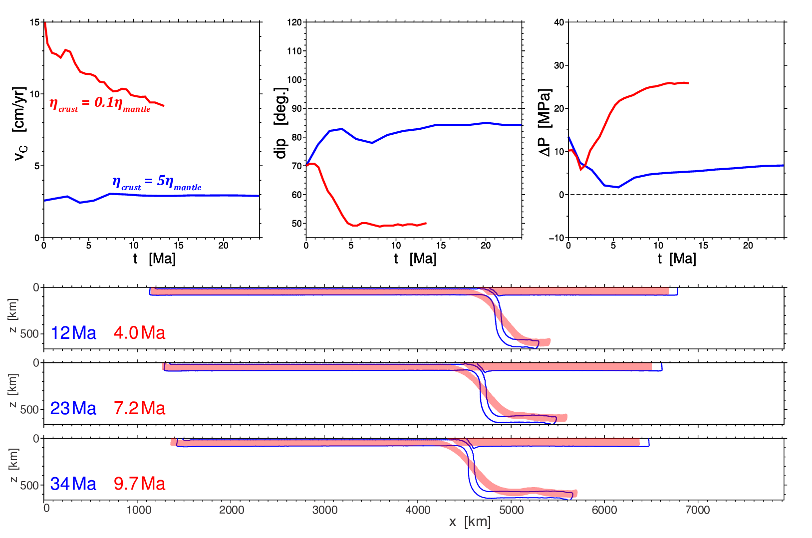
Slab dynamics as f(crust viscosity)
A weaker crust increases convergence rate, promotes rollback, resulting in reduced slab dip.

Slide 33
Double subduction systems
Outward dipping, e.g. Molucca Sea
η_{crust} = 0.1η_{mant}
Increasing
η_{crust}
η_{crust} = η_{mant}
η_{crust} = 5η_{mant}
Same dip polarity, e.g. Japan
η_{crust} = 0.1η_{mant}
Increasing
η_{crust}
η_{crust} = η_{mant}
η_{crust} = 5η_{mant}
Similarly, in more complex subduction configurations, coupling viscosity exerts strong control
Notes:
TIMES UPDATED ON PANEL PLOT

Slide 34

Instantaneous: Coupling as f(crust viscosity)
η`_{crust} = 0.1 η`_{mant}
η`_{crust} = 10 η`_{mant}
vertical horizontal
shear stress in rear channel
pressure in rear channel
horizontal force on rear slab
frontal
rear
η`_{crust} = crust viscosity / mantle viscosity
As crustal strength increases:
Rear slab shear stress increases (dominated by η_{crust}).
Slab pull transmitted through crustal interface increases (dominated by P)
Strength of plate interface exerts strong control on intra-slab force (F_{X} ) propagation
F_{x} increases
Notes:
Now looking at the two subduction zones in the same polarity double slab model. The frontal subduction zone shown in lighter colors exhibit the same systematics at the single slab case, owing to having a free OP: strongly time dependence horizontal force and subducting resisting, upwards vertical force. Interestingly, the rear slab behaves differently. The coupling interface has a more negative dynamic pressure due to the slab pull from the frontal slab, which results in an elevated vertical resisting force and, more importantly, a horizontal force which is now directed to the right.
This, difference in the direction of the horizontal force, in conjunction with the opposite sense asthenospheric pressure gradients, induces opposite sense torques on the two slabs.

