Slide 1
Fishing for answers:
Offshore opportunities
in volcano science
Matt Haney
AVO/USGS

Slide 2
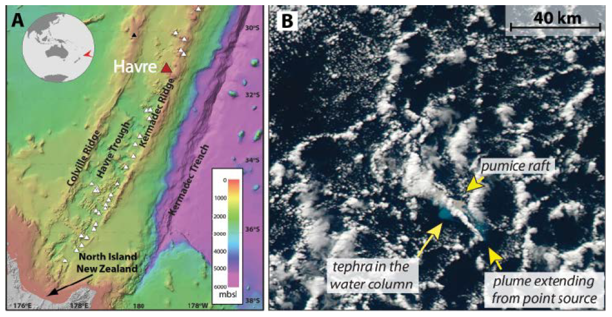
Havre eruption
Carey et al. EOS (2014)
Jutzeler et al. Nature
Comm. (2014)
Initially detected by a passenger on transoceanic flight
Eruption occurred at great depth, > 700 mbsl
Produced 100’s km² of pumice rafts within 1 day
No international organization warns of dispersal from submarine erupted products
Submarine arc volcanism not as well understood as its mid-ocean ridge counterpart

Slide 3
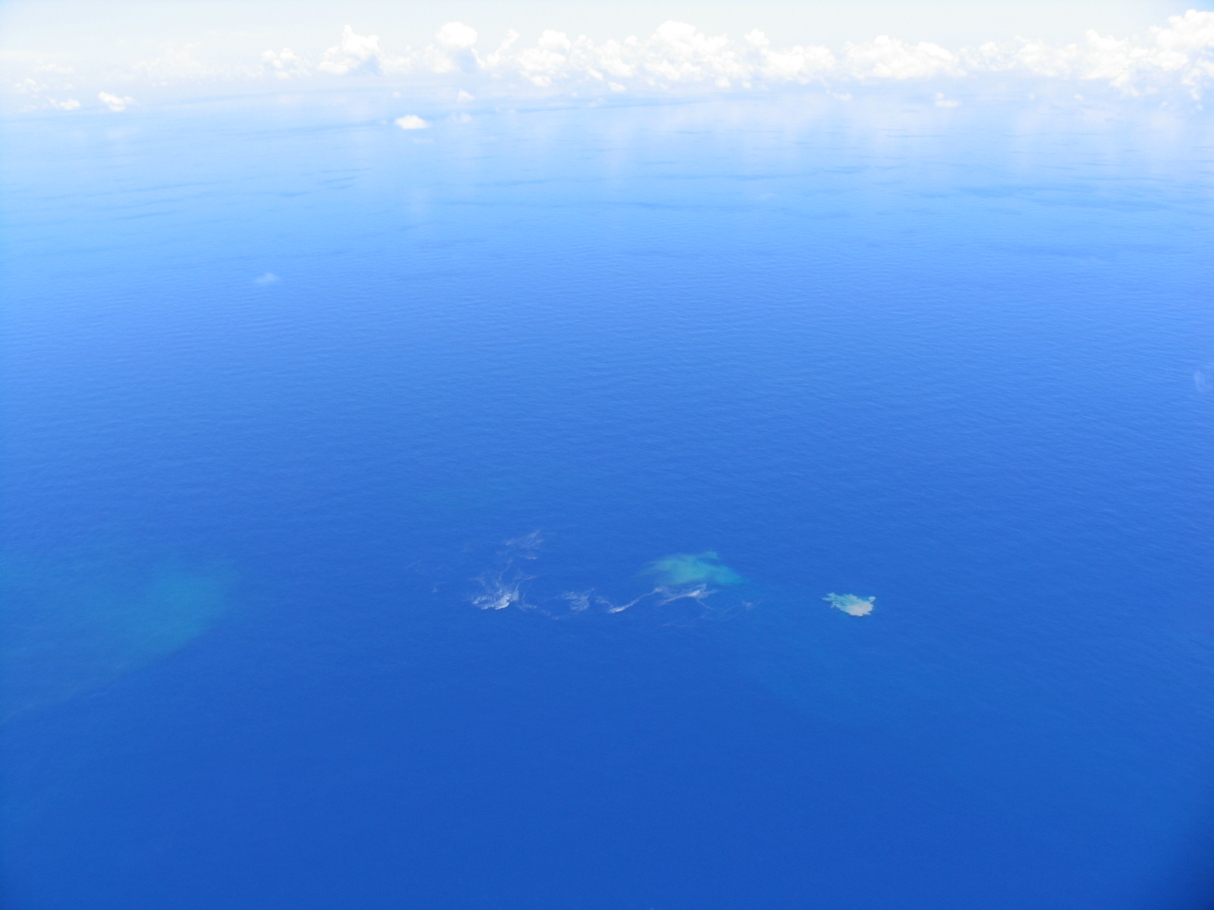
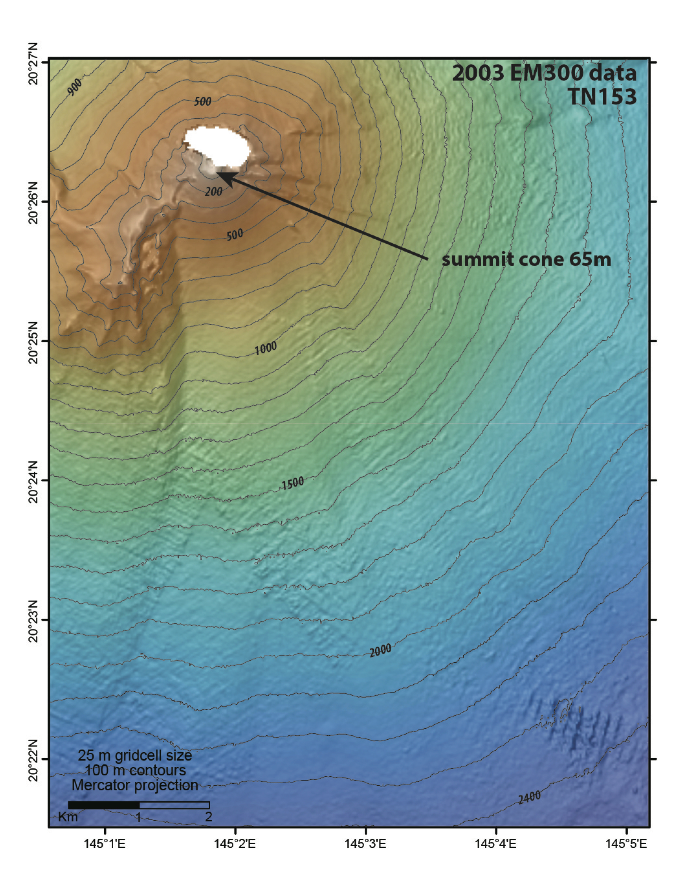
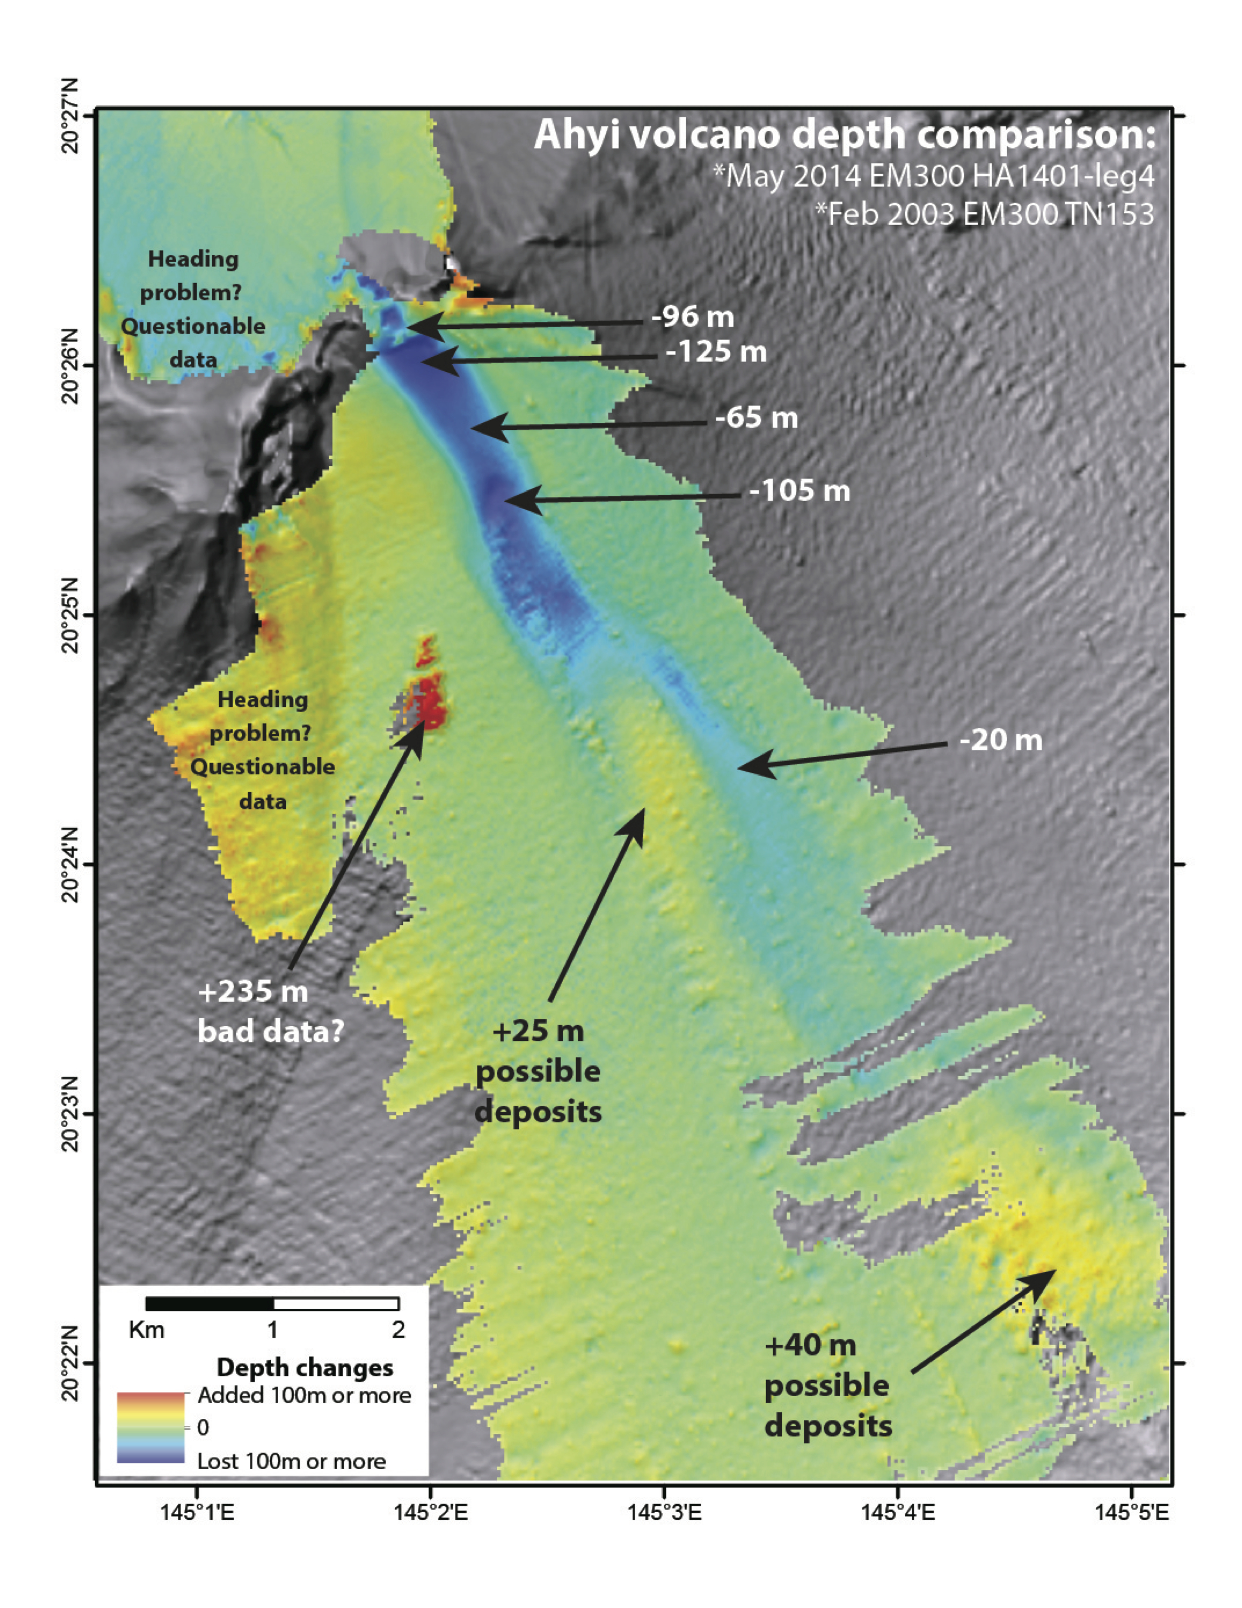
Submarine arc volcanism in the Pacific
South Sarigan Volcano
Ahyi Volcano
Only 2
submarine arc eruptions extensively observed:
- NW Rota
- West Mata

Slide 4
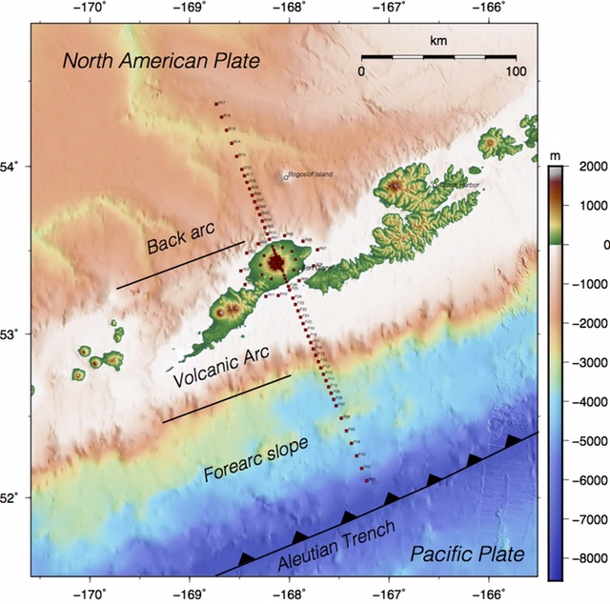
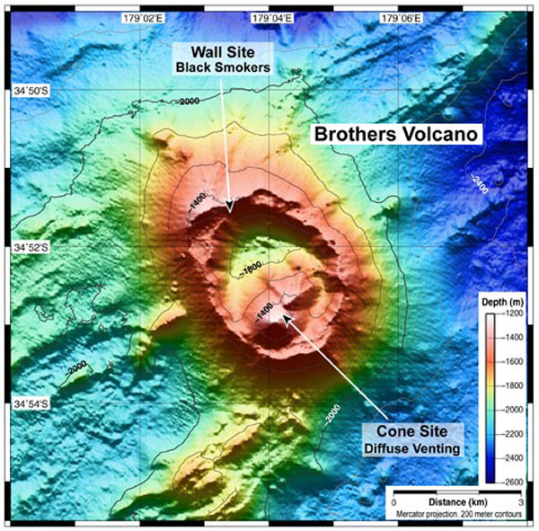
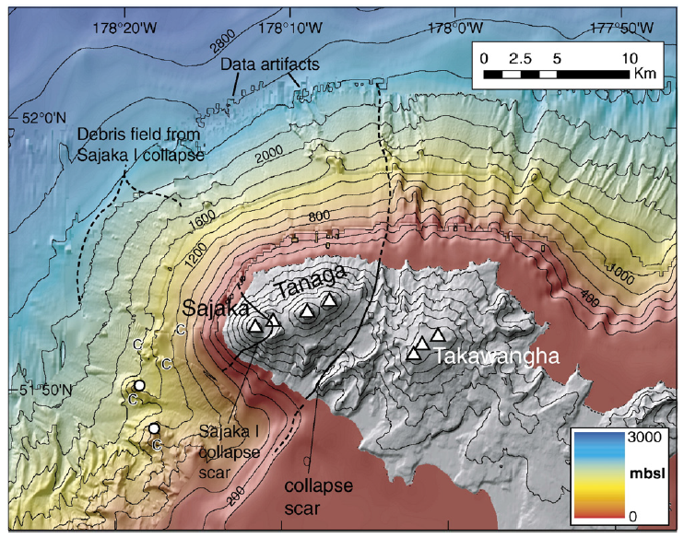
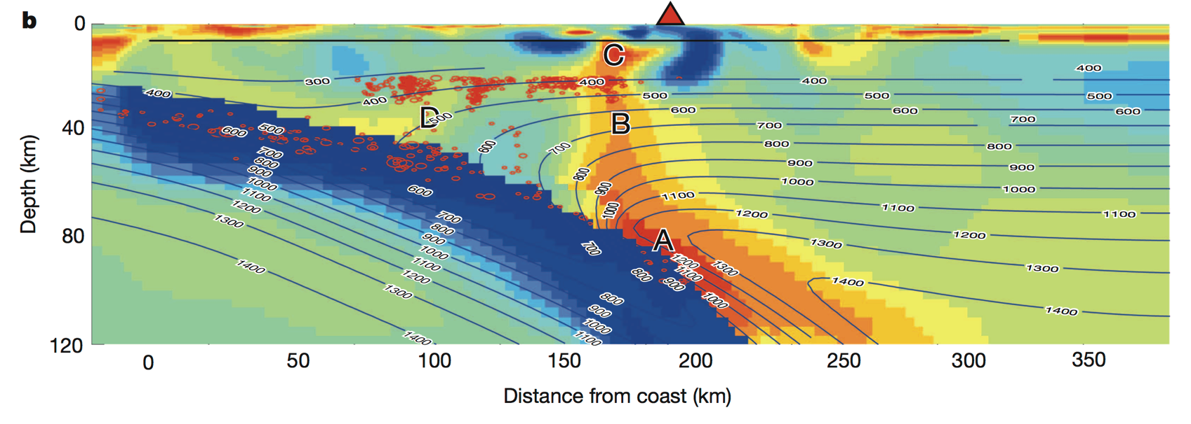
Ocean drilling and dredging
at volcanoes
Marine Magnetotellurics (MT)
IODP 376
de Ronde et al.
Kerry Key (Scripps)
Ninfa Bennington
(Univ. Wisc.)
McGary et al.
Nature (2014)
Coombs et al.
EPSL (2007)

Slide 5
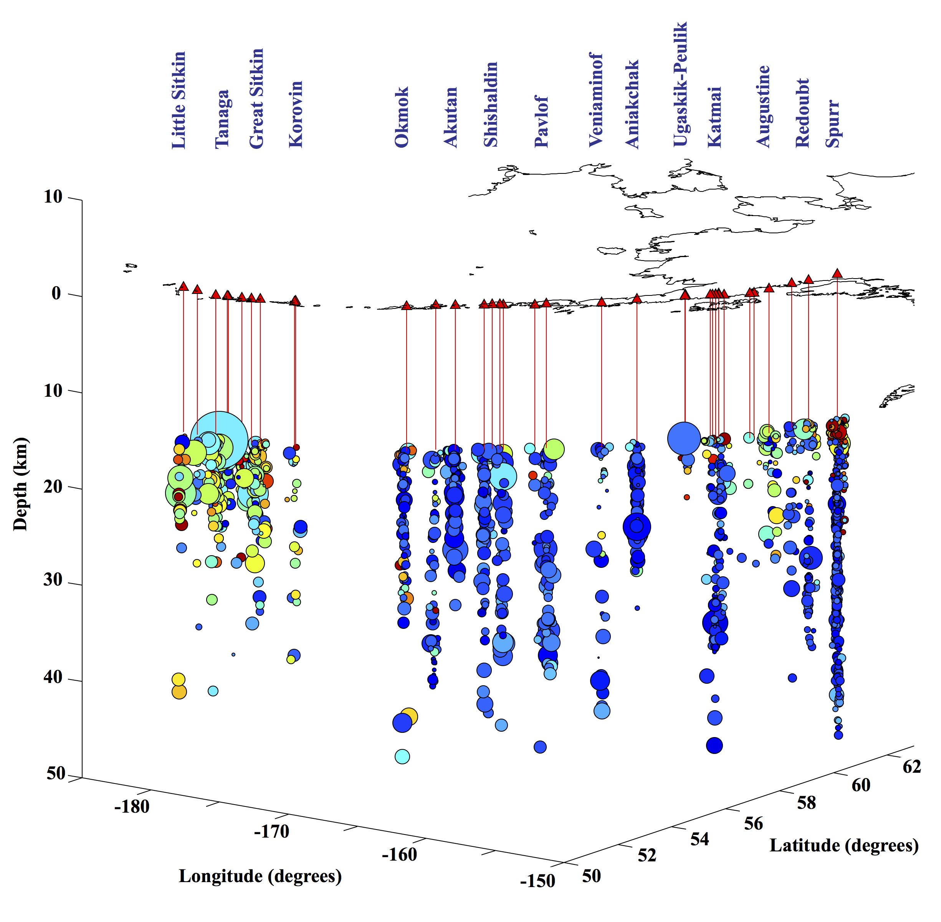
Volcano
seismicity in the mid-to-lower crust
Wider aperture needed
to constrain and image
the deep roots
of volcanoes
Ketner et al.
AGU (2013)

Slide 6
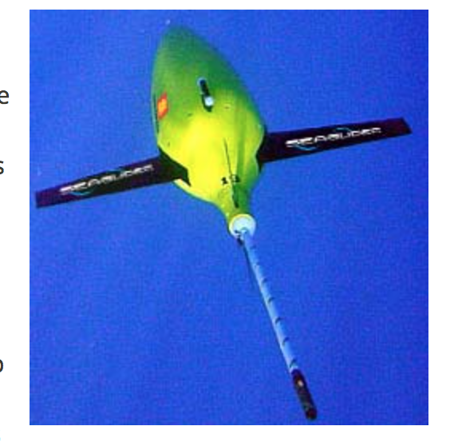
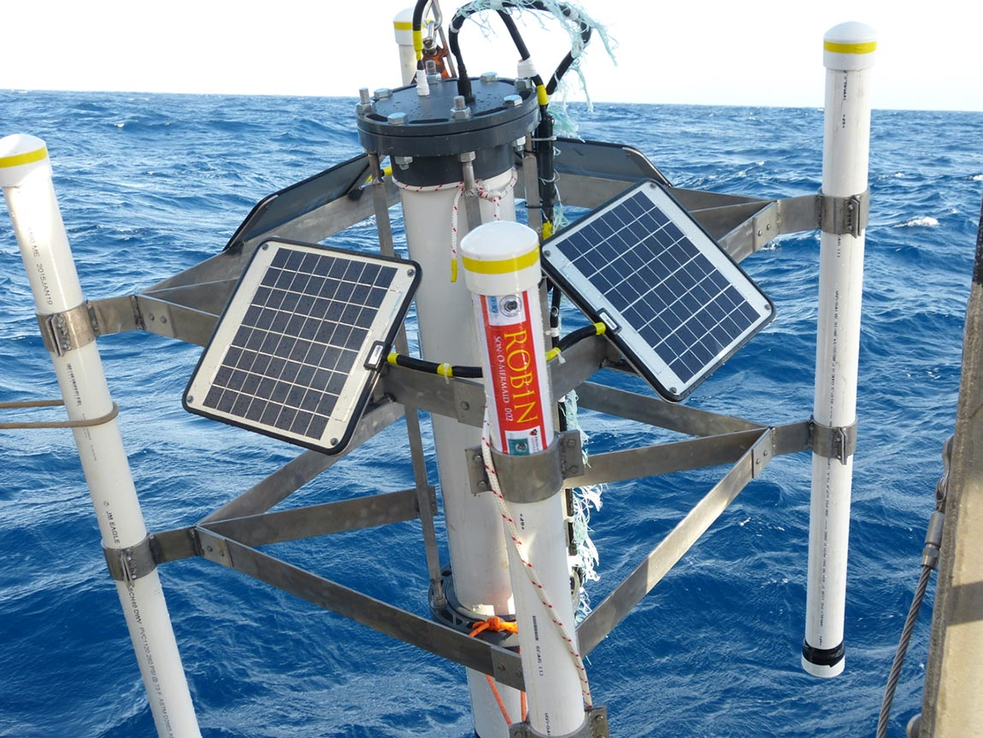
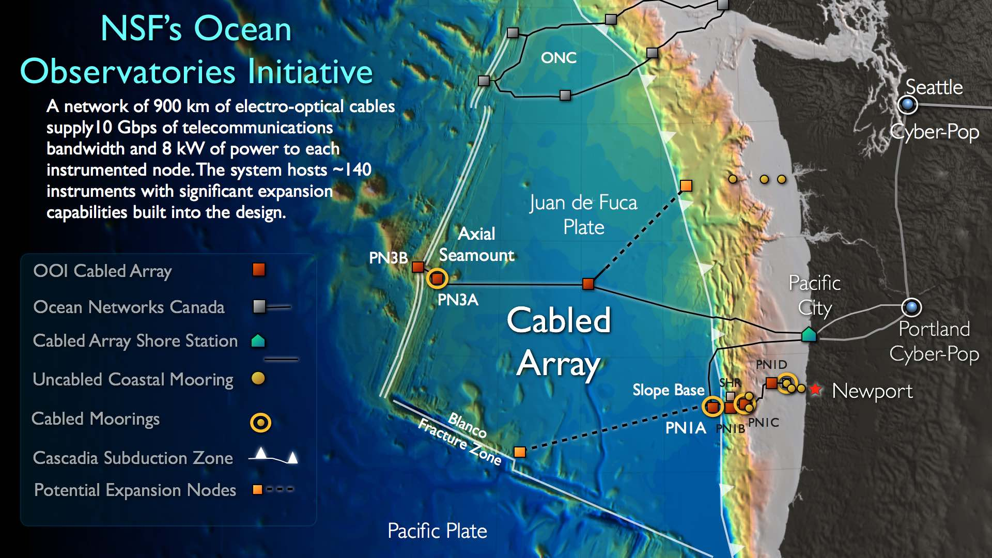
Acoustic seagliders remotely piloted from shore for months-long deployments
Real time processors onboard for detection
Other options: hydrophones w/acoustic modems, Mermaids, and cabled systems
Into the abyss …
Notes:
• Axial Seamount is now part of a cabled observatory providing real-time monitoring data to shore.

