Slide 1
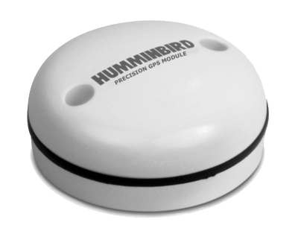
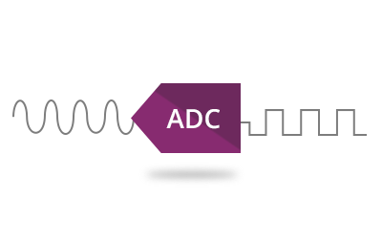
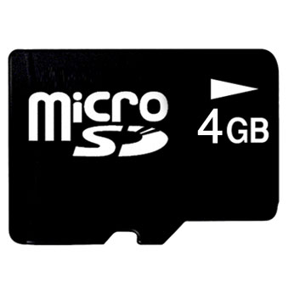

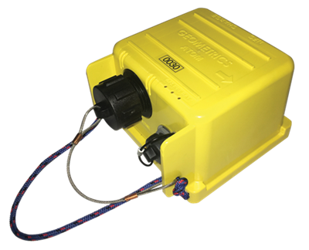
Cableless seismograph Atom
Battery
GPS
A/D
SD card
Specification
Preamp gain | 0db, 12db, 24db, 36db
Distortion | < 0.0001 %
Data storage | 4GB
Frequency response | 0.2 – 200Hz
Dynamic range | 124 dB (measured)
A/D converter | 24 bits
Sampling time | 0.25, 0.5, 1, 2, 4 msec
Dimension | 142×140×102 mm
Weight | Approx. 1.6 kg
Channel number | 1 or 3
Notes:
We developed a single- or three-channel cableless seismograph (Atom). Each Atom unit includes a CPU, 24-bit A/D converter, GPS controlled clock, battery, and 4 GB of internal data storage, all in a small, lightweight, easy-to-use box. The GPS clock allows units to be synchronized over any distance without cables. Operation in the field is easy. Shaking the unit turns it on, and after the unit achieves GPS lock, it will automatically begin recording. The Atom units are equipped with Wi-Fi for data download. Users can download data from multiple units simultaneously by Wi-Fi and directly into data processing software, either in the field or office.

Slide 2
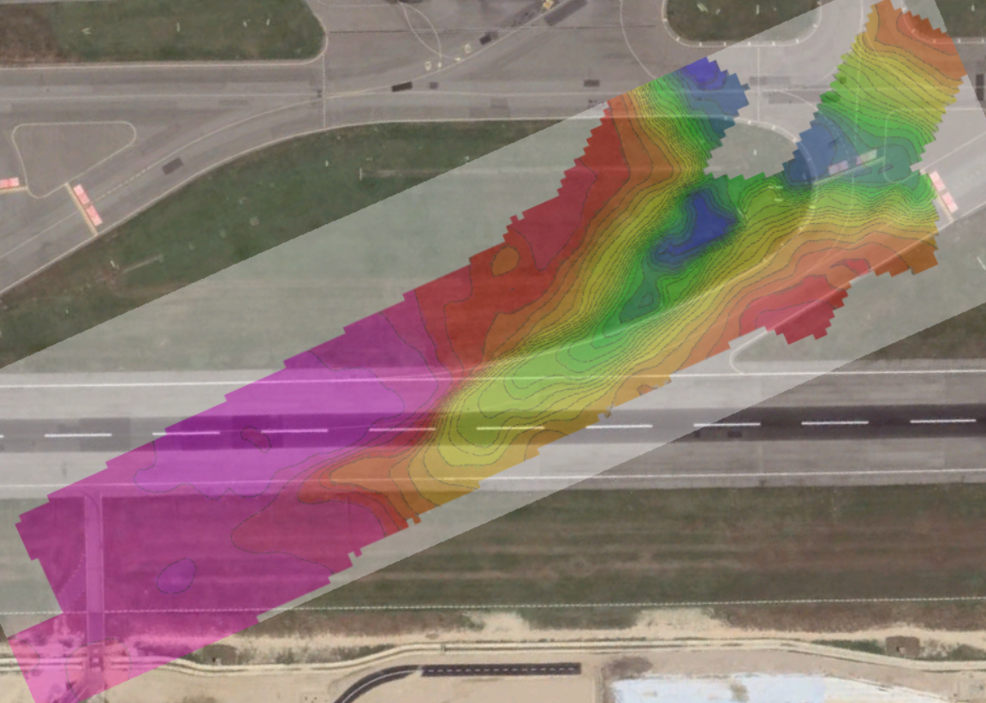
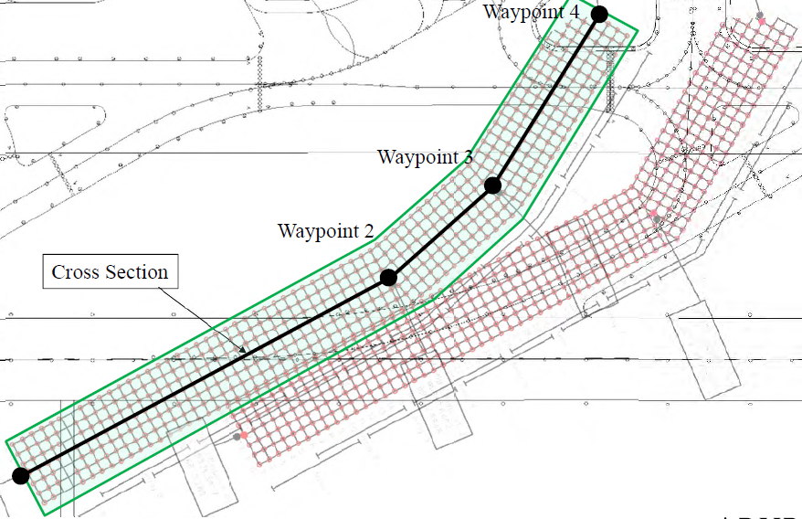
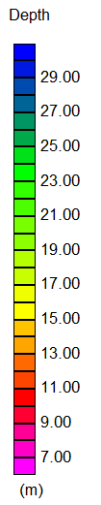
Example of 3D ambient noise tomography
Sensor distribution
Bedrock depth
100 m
Notes:
In order to delineate depth to a bedrock, ambient noise tomography (passive surface wave method) was carried out.
Investigation area is 500 X 200 m.
70 sensors were deployed with 8 m spacing.
Thirty arrays with overlap were measured and total sensor location is approximately 1000.

Slide 3
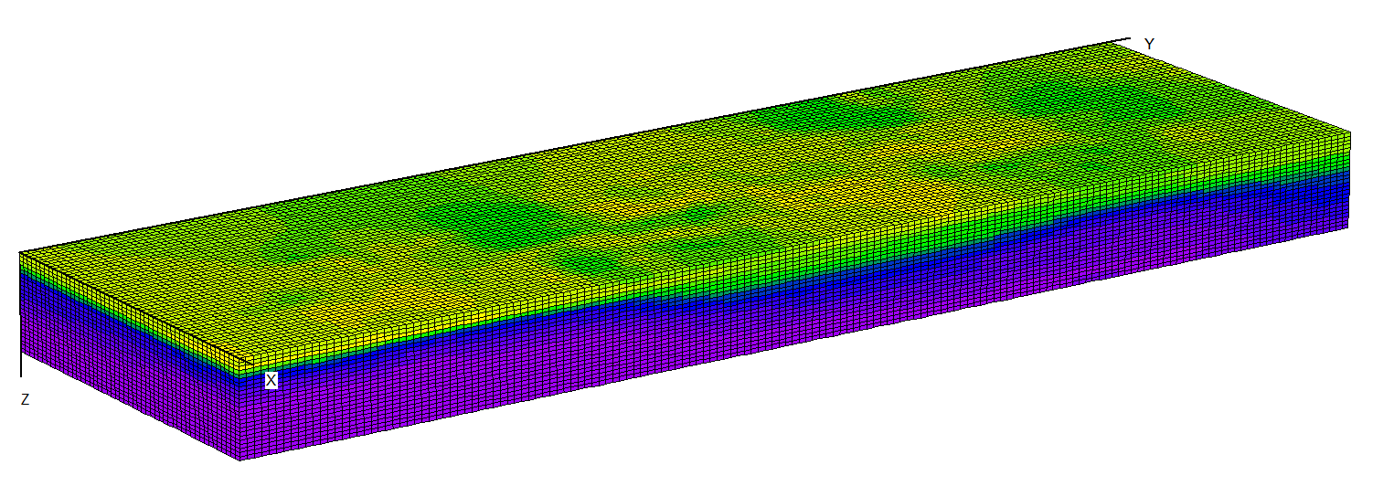
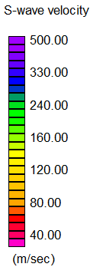
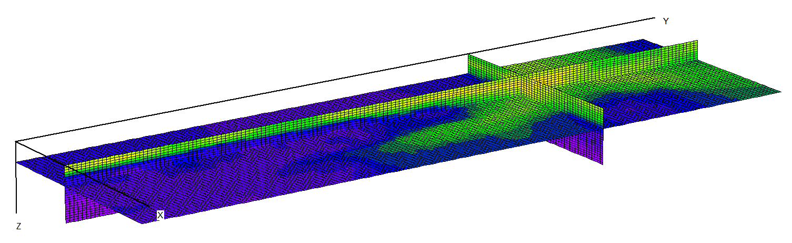
Example of 3D ambient noise tomography
Notes:
Here is the result of the investigation.
SD S-wave velocity structure down to a depth of 50 m are clearly imaged.
Right hand side shows a depth to a top of bedrock with a S-wave velocity of 250 m/sec.
We can clearly recognize a buried channel at the site.

