Slide 1
THE SMALLEST THINGS MAKE BIG THINGS HAPPEN
Your ally in research

Slide 2
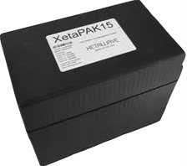
As a drop-in replacement for 12 AH, 24 AH, and 100 AH lead acid batteries
Insulated package
Your ally in research

Slide 3
XetaWave, a Colorado-based wireless technology provider, released XetaPAK™, an advanced, long lasting smart battery that represents an entirely new approach for batteries used in remote, solar powered telemetry sites.
Insulated package
Your ally in research

Slide 4
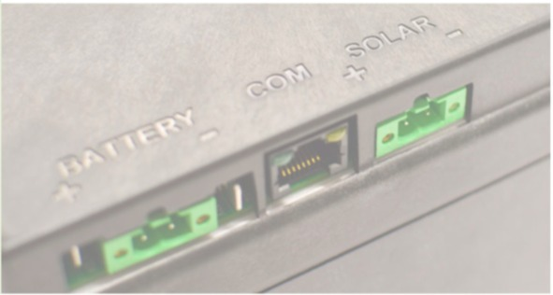
Instead of being just a simple battery, the XetaPAK is the only battery that combines solar charging, thermal management and fault protection
MPPT (maximum power point tracking) solar panel controller
Load current limiter
Low voltage shutdown
Battery temperature management
Modbus logging
Your ally in research

Slide 5
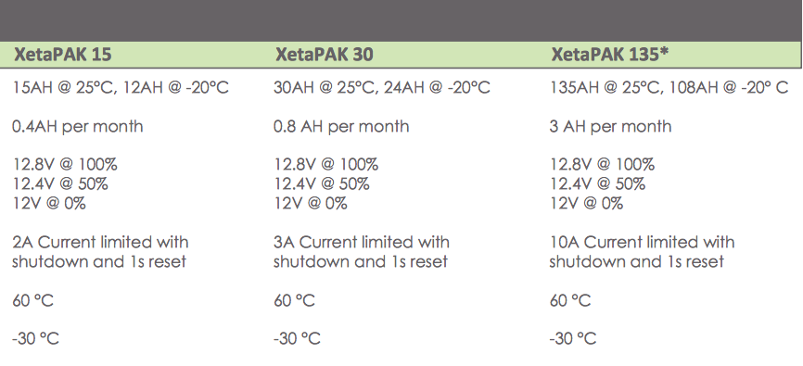
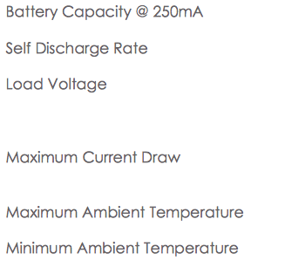
XetaPAK™ is available in three versions

Slide 6
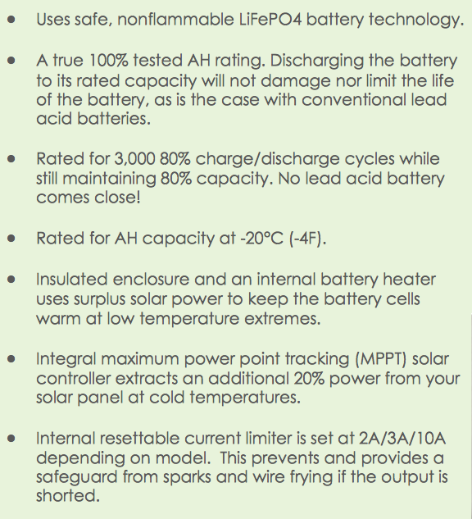
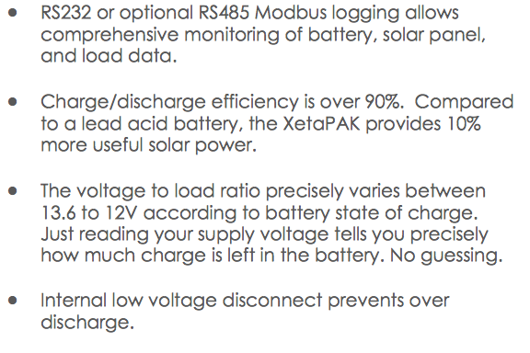
XetaPAK™ Technology differentiators
Genius to get precision data

Slide 7
XetaPAK™ a whole new concept in light baggage
Your ally in research

Slide 8
The XetaPAK is so reliable, invulnerable to abuse, and has such a long life you will never need to replace it at your remote site
UNCONDITIONAL

Slide 9
Your ally in research
Thank you!

