Slide 1



Anti-Harassment/Discrimination Curriculum for REUs and Field Camps
*This webinar will be recorded
Michael Hubenthal, IRIS Consortium
Daphne LaDue, University of Oklahoma
Martin Snow - University of Colorado Boulder
Acknowledgments: This material is based upon work supported by NSF under Grant Nos. EAR-1852339, AGS-1560419, & AGS-1659878, and SAGE, which is a major facility operated by the IRIS Consortium and funded by NSF under award EAR-1851048 and earlier NSF awards.
Notes:
By the end of this webinar we would like participants to…
Be able to explain why the inclusion of a curriculum like this is important
Have an increased interest in running the curriculum in this or future summers…
Have increased confidence in being able to implement the curriculum for this summer as a virtual training.

Slide 2
Summer 2019 Pilot – Expert Review
 | Reviewer
 | 1 | 2 | 3
Do you feel there is a need for this type of resource for REU sites? Why/why not? | Yes | Yes | Yes
Would you use this curriculum with your REU participants? Why or why not? | Yes | Yes | Yes
Would you recommend this curriculum to other REU PIs? Why or why not? | Yes | Yes | Yes
Summarized comments:
Appreciated interactivity of the curriculum
Provides a great baseline to begin discussions with students
Opportunities to expand or adapt
Increase the emphasis on microaggressions as these affect the retention of underrepresented groups.
It would be helpful to have a “best practices” for writing a policy manual

Slide 3
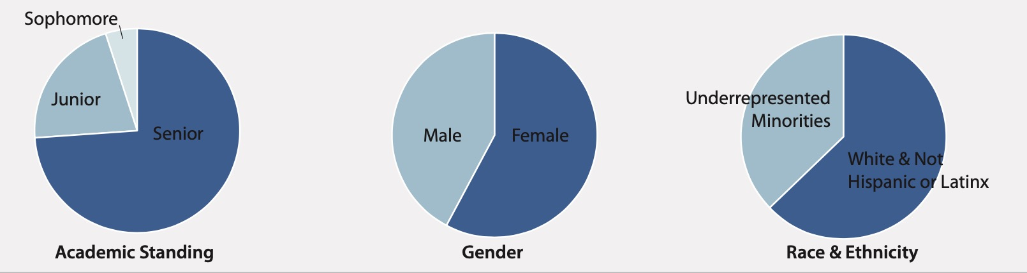
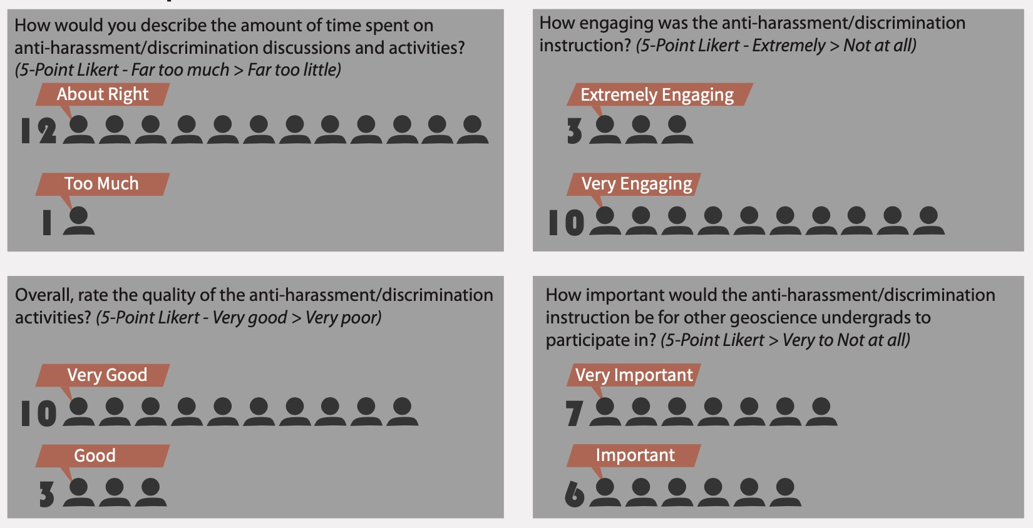
Summer 2019 Pilot – Student Responses
Demographics
“The curriculum regarding this subject was eye-opening to the number of forms it can appear in.” “I enjoyed the fact it was not just here is harassment, it made us draw from our experiences.”
“The 'what to do,' was very helpful. Explaining how to report and how to help someone else was helpful.”
“I think the interactiveness was the most positive part of seminar that we did. The focus on personal issues helps to hit home with people more than just sitting in a space and being lectured for an hour about a topic.”
Perceptions
https://www.iris.edu/hq/internship/images/uploads/Files/AntiHarass_2019_AGU_Poster.pdf

Slide 4
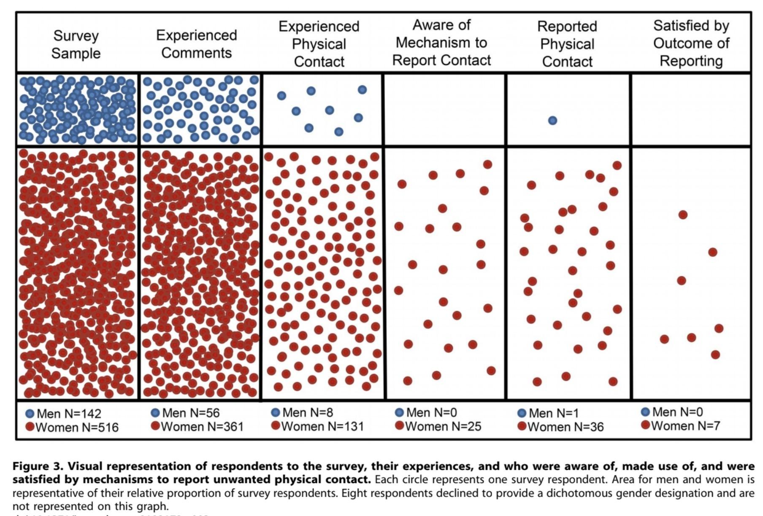
Motivations
Alarming rates of discriminatory and harassing behavior (of all kinds!) in the scientific workplace
Few individuals are aware of the mechanisms to report misconduct should they witness it or experience it
Participants in REU programs may be uniquely vulnerable
A desire to educate students in how to recognize, respond to, and report situations they may experience or witness, and a lack of existing resources to do it.
The need to demonstrate the organizational importance of these issues and policies
REU PIs need practical resources to enable them to work to address many of the aforementioned issues and contribute to a culture of change.
(Clancy et al., 2014)
Notes:
They are commonly away from their home campus where they are removed from usual support systems, and are unlikely to know institutional policies and procedures should incidents of harassment and discrimination occur.

Slide 5
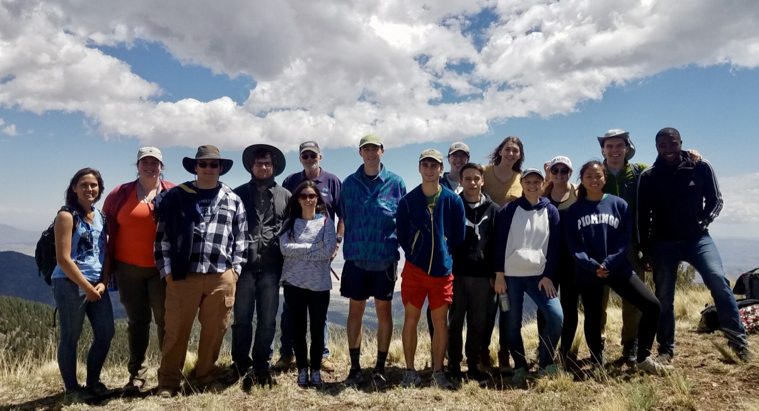
Curriculum Overview
Audience: Undergraduate students participating in science, technology, engineering, or math summer research opportunities, or participating in short duration field campaigns such as geoscience field camps, etc.
Total Time = ~120 minutes (in person)
  Session 1 - ~75 minutes
  Session 2 - 30 to 60 minutes
Instructors = 2 are strongly recommended

Slide 6
Curriculum Overview
Item | Description
Prior to starting… | Safe space, resources, etc.
Open (15–20 min) | Discussion of literature-based data and anonymous survey
Prior Knowledge (20–22 min) | Keyword Pictionary and consensus definition construction
Explore / Explain (35 min) | Whole group discussion of terms and small group work to discuss the scenario in light of key info in program handbook policies
Reflect (35 min) | Whole group discussion of how do “I” fit in? Bystander intervention
Apply (15–18 min) | Putting it all together. Video clip and discussion.

Slide 7
Following instruction, participants will be able to:
Describe a work environment that consists of mutual respect, promotes respectful and congenial relationships, and is free from all forms of harassment and discrimination
Summarize who is responsible for creating the work environment described above
Distinguish between behavior that is or is not harassing or discriminating.
Describe how to report harassment or discrimination to the program, the program’s investigation procedures, and possible disciplinary outcomes
Plan how they would use the bystander interventions to respond to incidents of discrimination or harassment
Apply the program’s anti-harassment, anti-discrimination, and non-fraternization policy to a series of case studies

Slide 8
Prior to Instruction
Develop a program handbook that addresses issues of harassment and discrimination. Your program may fall under your campus guidelines.
Explore what what sorts of mental health resources are available on your campus or location for students. To whom can you refer them in order to receive help of they are struggling? How do you/they make those connections?
Consider attending a Mental Health First Aid Training

Slide 9
Safe Space*
Respect confidentiality. The discussion (comments, stories, and perspectives) shared at meetings should remain private.
Lean into the work. Some topics may be challenging. Be willing to experience some discomfort in discussions, and learn from it as a cohort.
Use “I” statements. Speak from your own experience rather than generalizing.
Listen. Listen actively by respecting others when they are talking, and respectfully by listening even if you disagree
Step Up, Step Back. Encourage participants who don’t talk much to “step up” (speak up, participate), and those who participate a lot to “step back” (say less) to make room for everyone to contribute
Criticize the ideas, not the person. Aristotle said "It is the mark of an educated mind to be able to entertain a thought without accepting it." We can agree to disagree.

Slide 10
What to do if a participant is struggling?
Participants should feel free to step out of the discussion at any time should they feel uncomfortable.
Have a plan in place to allow you or a member of your team to step out and check on the participant.
  Listen non-judgementally and give reassurance
  Who are their regular supports and how can you connect them to those supports?
  If necessary connect to other resources on campus or in the community

Slide 11
Open - (15 - 20 Minutes) – Discussion of literature-based data and anonymous survey
Which of the following most closely to applies to you?
  Never witnessed discrimination or harassment and never heard of someone who experienced it
  Heard of someone who experienced discrimination or harassment but never witnessed it
  Witnessed discrimination or harassment
  Experience discrimination or harassment
(Clancy et al., 2014)
Illustrate that discrimination/harassment is not a theoretical construct represented only in articles or a handbook.
Reflect on and discuss within their group.

Slide 12
Prior Knowledge - (20 - 22 Minutes) Keyword Pictionary and consensus definition construction
Harassment
Illegal
Flirting
Mutual respect
Unwanted
Investigation
Joke
Discrimination
Wanted
Power
Etc.
Small group Pictionary games
Develop consensus definitions in small groups

Slide 13
Consensus definition for:
Joke

Slide 14

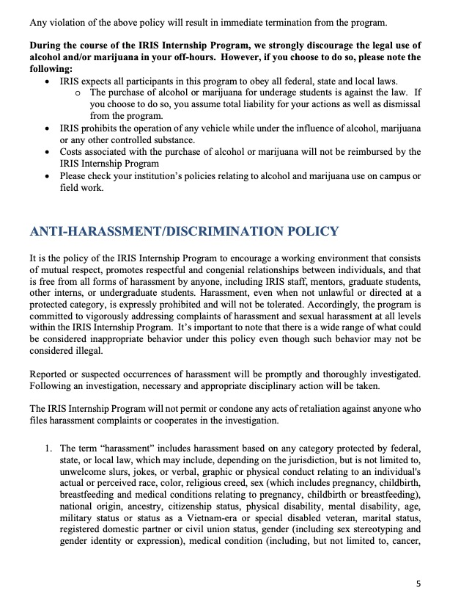
Explore/Explain - (35 Minutes) Whole group discussion of terms and small group work to discuss the scenario in light of key info in program handbook policies
Facilitate a whole group discussion to clarify and refine terminology… steering final revisions towards accepted definitions
Assign participants to read where harassment is covered in the internship handbook.
Sample policies available
Clarify terminology and programmatic policies as a whole group.

Slide 15
Explore/Explain - (35 Minutes) Whole group discussion of terms and small group work to discuss the scenario in light of key info in program handbook policies
Jordan, has decided to go back to graduate school after having worked in industry for 15 years. Several of the other students in the labs have taken to calling Jordan “Boomer”. Jordan laughed at first, but several weeks in is now looking uncomfortable. Is this harassment?
  Yes
  No
Why do you think so?
Small groups review scenario and discuss in light of handbook. Review complaint procedure and outline program’s investigation procedures and possible disciplinary outcomes .

Slide 16

Reflect - (35 Minutes) Whole group discussion of how do “I” fit in? Bystander Intervention
5 Ds Interventions
What sorts of benefits might be derived from a work environment that consists of mutual respect, promotes respectful and congenial relationships and is free from all forms of harassment and discrimination vs one that is not?
Direct: Confront the situation. Be firm, clear, and concise
Distract: Take an indirect approach to de-escalate
Delegate: Seek help from a third party
Delay: Check in with the person being harassed.
Document: If it is safe to do so, document the situation.
Brainstorm as whole group and reflect on who is responsible for this. Revisit scenarios asking what could be done.
Introduce 5Ds as whole group and discuss what is meant by each and barriers to action

Slide 17
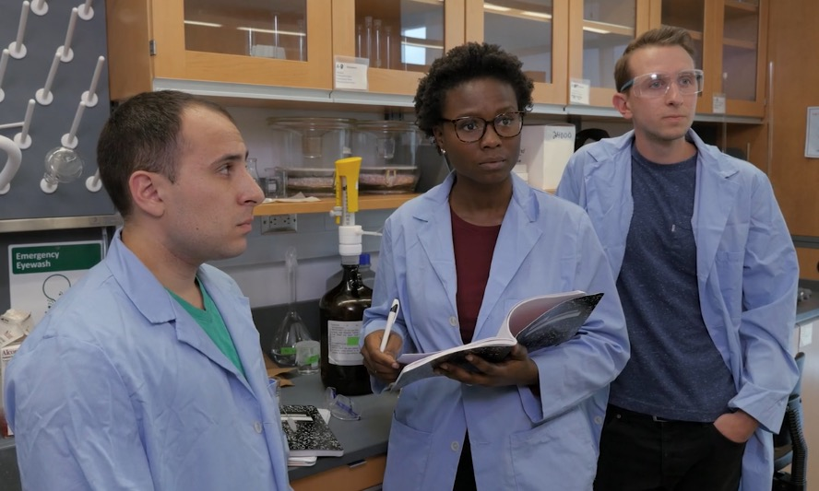
Apply - Putting it all together. Video clip and discussion (15 to 18 Minutes)
Whole group facilitated discussion of scenario in clip, what is happing in light of program policies, and what 5D interventions make sense

Slide 18
Take away ideas…
Alarming rates of discriminatory and harassing behavior (of all kinds!) continue to be found in the scientific workplace… and participants in REU programs may be uniquely vulnerable
This curriculum
  both educates and empowers students around civil behaviors in the workplace
  IS something that REU PIs can implement! It has supports in place for novice trainers (e.g. discussion points, answer keys, references to policies in an example handbook, etc.).
The evaluation of the 2019 pilot finds that
  Participants find the curriculum engaging and about the right length, of high quality and important for their peers to participate in.
  Post instruction, participants demonstrated
    more aware that they don’t have to directly experience harassment and discrimination for it to affect them
    gains in understanding of behaviors that are discriminatory and harassing vs. those that are not
    knowledge of strategies to respond should they witness harassment or discrimination including how to report harassment or discrimination
By running this you assert your stand on these issues and make your expectations for behaviors explicit

Slide 19
Thanks! Questions?
Michael Hubenthal, IRIS Consortium (hubenth@iris.edu)
Daphne LaDue, University of Oklahoma (dzaras@ou.edu)
Martin Snow - University of Colorado Boulder (Marty.Snow@lasp.colorado.edu)

Slide 21
Extra Stuff

Slide 22
Curriculum Design Process
Following instruction, participants will be able to:
Describe a work environment that consists of mutual respect, promotes respectful and congenial relationships, and is free from all forms of harassment and discrimination
Summarize who is responsible for creating the work environment described above
Distinguish between behavior that is or is not harassing or discriminating.
Describe how to report harassment or discrimination to the program, the program’s investigation procedures, and possible disciplinary outcomes
Plan how they would use the bystander interventions to respond to incidents of discrimination or harassment
Apply the program’s anti-harassment, anti-discrimination, and non-fraternization policy to a series of case studies

Slide 23
Summer 2019 Pilot – Student Responses
Demographics
Many respondents arrived aware that a workplace with mutual respect is important to them, and that everyone is responsible for creating this. The data suggests participants leave slightly more aware that they don’t have to directly experience harassment and discrimination for it to affect them.
Most respondents arrived with a reasonable understanding of behaviors that are discriminatory and harassing vs. those that are not. However there were some post-instruction gains.
Post instruction, participants agree that they know how to report harassment or discrimination.
Post instruction, participants agree that they know how ways they could respond should they witness harassment or discrimination.
Perceptions
https://www.iris.edu/hq/internship/images/uploads/Files/AntiHarass_2019_AGU_Poster.pdf

Slide 24
Summer 2019 Pilot – Student Comments
“The curriculum regarding this subject was eye-opening to the number of forms it can appear in.” “I enjoyed the fact it was not just here is harassment, it made us draw from our experiences.”
“The 'what to do,' was very helpful. Explaining how to report and how to help someone else was helpful.”
“I think the interactiveness was the most positive part of seminar that we did. The focus on personal issues helps to hit home with people more than just sitting in a space and being lectured for an hour about a topic.”
“I liked establishing (that) it was a safe space before we began talking. Defining terms in our own words was a good activity.”
“Showing students the data from archaeology was a good way to start as there may be students who are unaware that this is as widespread of an issue that it is. I think the quantity of time spent on it was really important and makes be glad to be a part of the program.”
Notes:
Take of these and push up to slide three and only have two slides for Pilot

Slide 25
What we expect from sites
Encourage and enable REU students to complete our pre surveys (if they choose to participate)
Implement the curriculum with all REU students
Remind REU students to complete our post surveys (if they choose to participate)
Complete the instructor post-use survey and provide supporting documents
“It was good to learn the process of reporting harassment. I have never had a policy likes this explained to me in a place of work and there have been a few instances where I wish I had known about a policy.”

Slide 26
Steps to participate as a pilot site
Step 1 - Provide a letter of agreement/permission indicating that your campus can be a site for piloting this curriculum (Draft Letter)
Step 2 - Whomever will run the instruction and complete the faculty survey must complete a consent form.
Step 3 - Provide REU participants’ email addresses and we will send the pre-survey, which contains the consent form.
Step 4 - Notify us instruction is complete and post survey will be disseminated to participants.

Slide 27
Curriculum Pilot
This project seeks to answer the following questions
  After participation, do participants achieve the desired learning outcomes (and to what degree)?
  How and to what degree does the curriculum affects participants’ behaviors, attitudes, skills, and interests?
  What are participants perceptions’ of the curriculum and its implementation?
  What is the fidelity of implementation of the curriculum?
  What are instructors perceptions’ of the curriculum and its implementation?

Slide 28
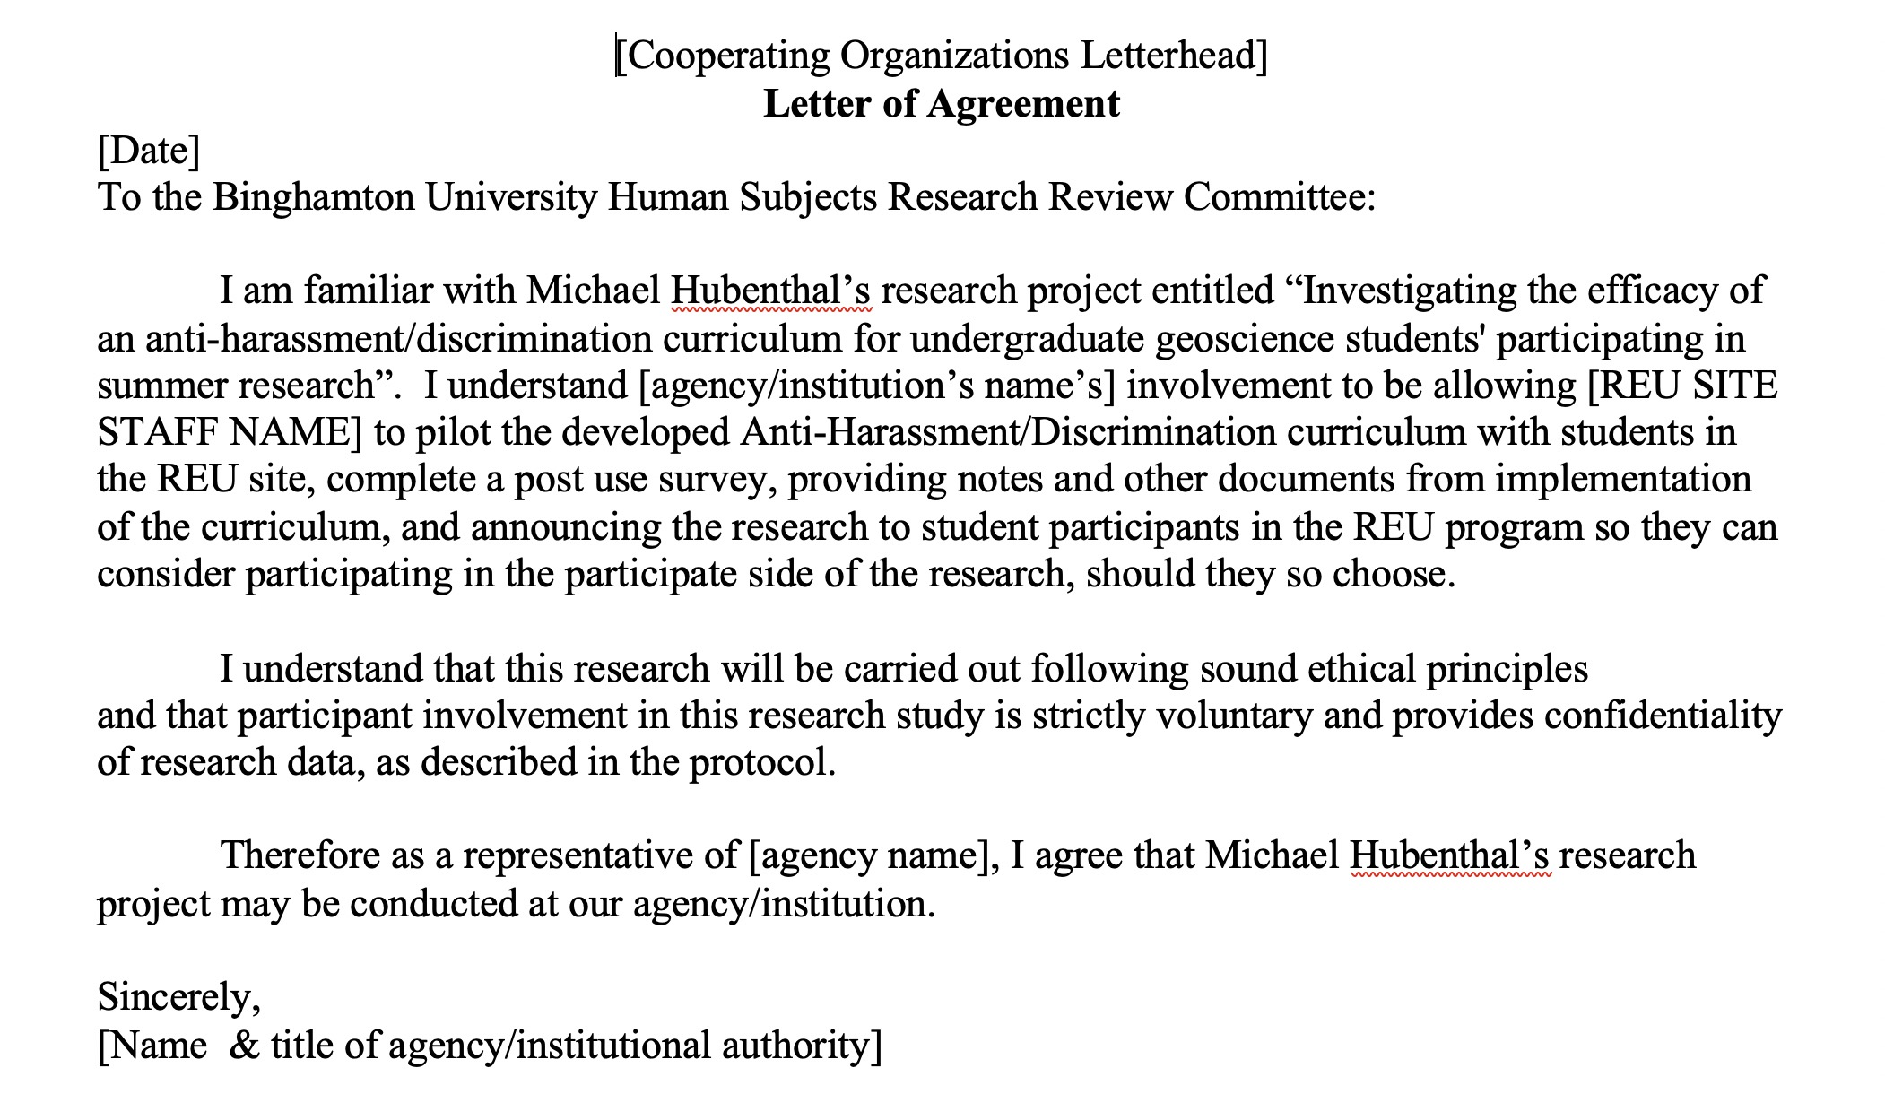

Slide 29
Curriculum Overview
Mike has decided to go back to graduate school after having worked as a field geologist for 15 years. Several other students have taken to calling Mike “Pops.” Mike laughed at first, but now it makes him uncomfortable. Is this harassment? Why do you think so? How would you respond in this situation?
Prior to starting… (Safe space, resources, etc.)
Open - (15 - 20 Minutes) – Discussion of literature-based data and anonymous survey
Prior Knowledge - (20 - 22 Minutes) Keyword Pictionary and consensus definition construction
Explore/Explain - (35 Minutes) Whole group discussion of terms and small group work to discuss the scenario in light of key info in program handbook policies
Reflect - (35 Minutes) Whole group discussion of how do “I” fit in? Bystander Intervention
Apply - Putting it all together. Video clip and discussion (15 to 18 Minutes)

