Slide 2
If so, consider applying to the IRIS Undergraduate Internship Program!
Are you a physics, math, or geoscience major interested in using your quantitative skills to explore Earth?
Notes:
If so, the IRIS Summer Undergraduate Internship program is a great way for you to gain research experience, explore graduate school possibilities, and expand your horizons.

Slide 3
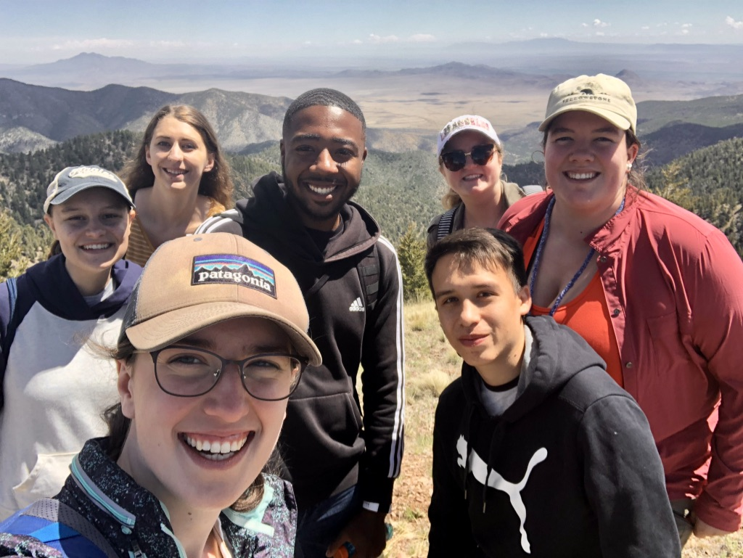
We seek applications from students representing the full spectrum of society, as well as students with lived experiences, such as students with disabilities, veterans, and non-traditional students!
Will you be with us?

Slide 4
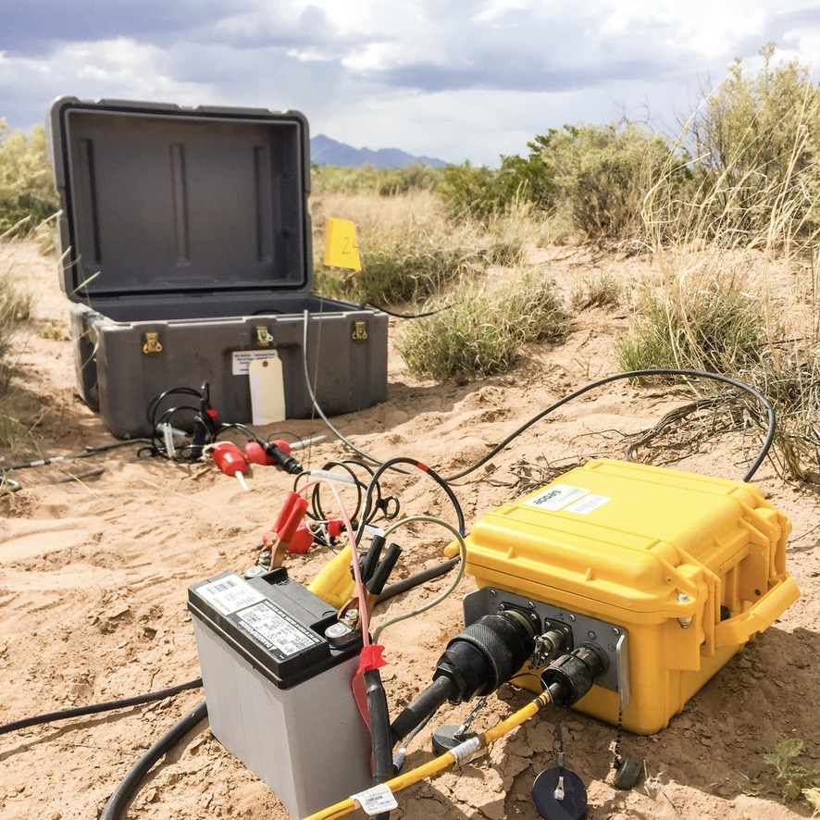
As an intern you will…
Conduct research with state of the art geophysical data and leading researchers
Develop an understanding of scientific inquiry, defending scientific arguments, and preparing publications
Gather, manage, and convey information, using various skills, strategies, resources, and
Learn, use, and evaluate technologies for the collection and study of geophysical data
Notes:
If accepted to the program, you will have the opportunity to
Conduct geophysical research at one of the many IRIS institutions distributed across the country.
Gain experience with state-of-the-art geophysical equipment, data and data analysis techniques and
Engage in the process of science. From the design and implementation of a scientific investigation to the presentation of the results.

Slide 5
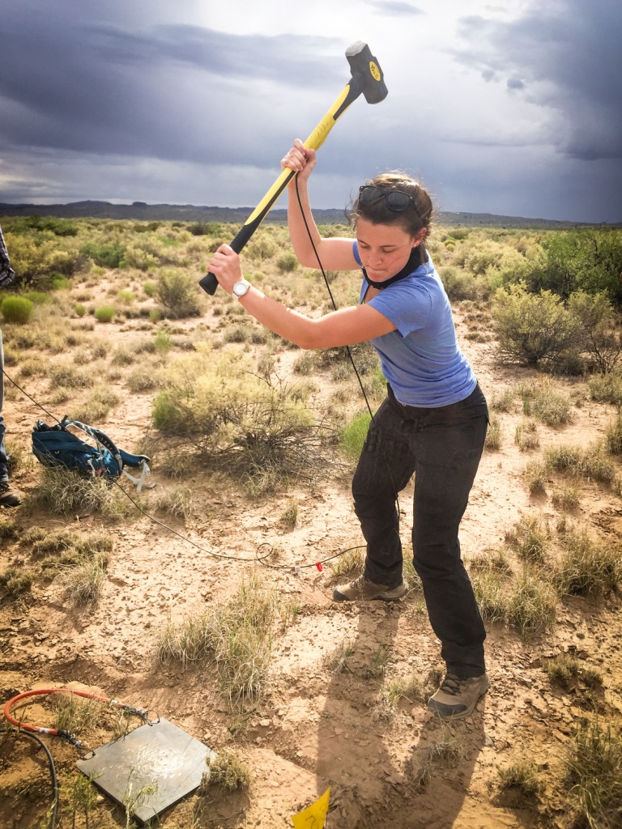
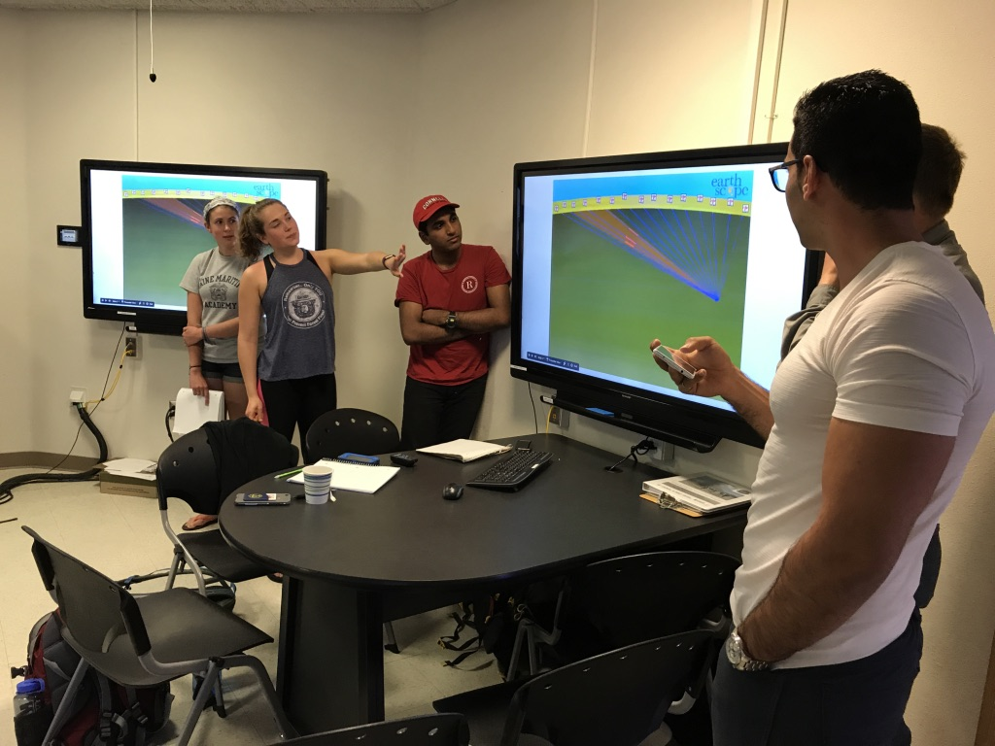
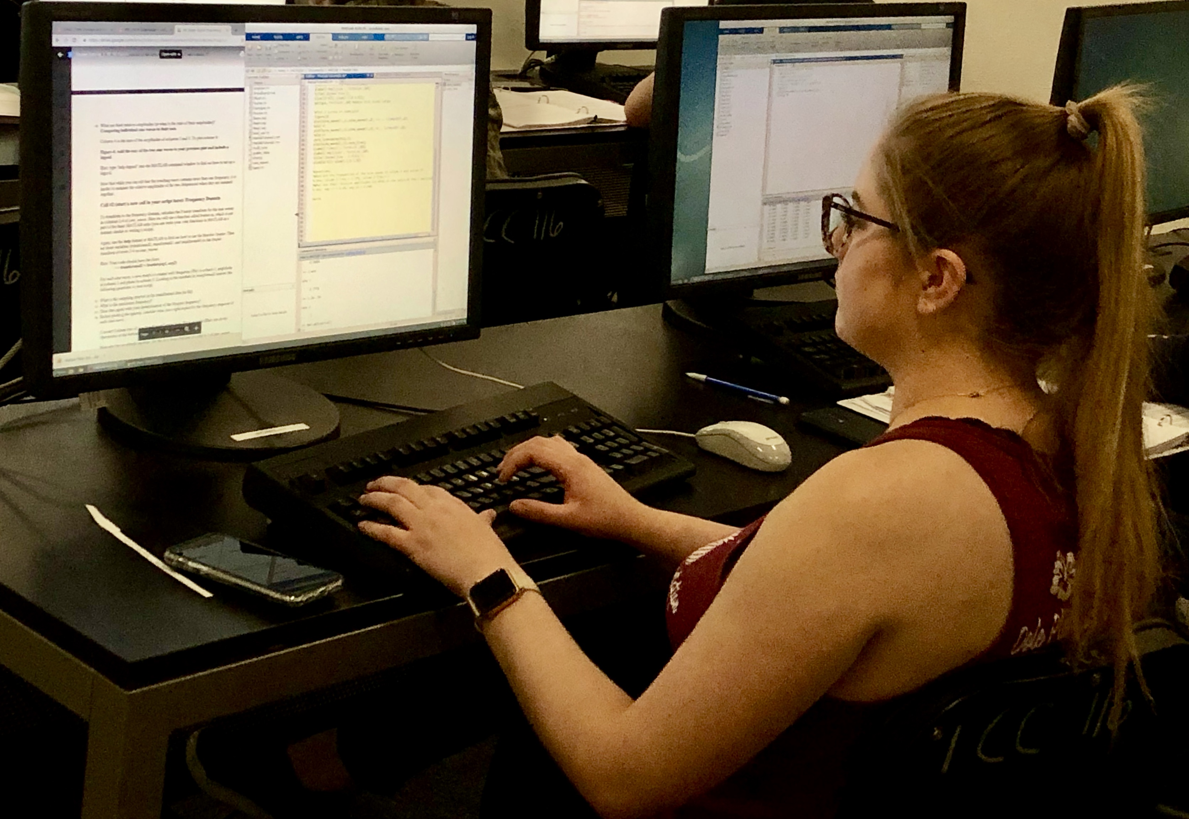
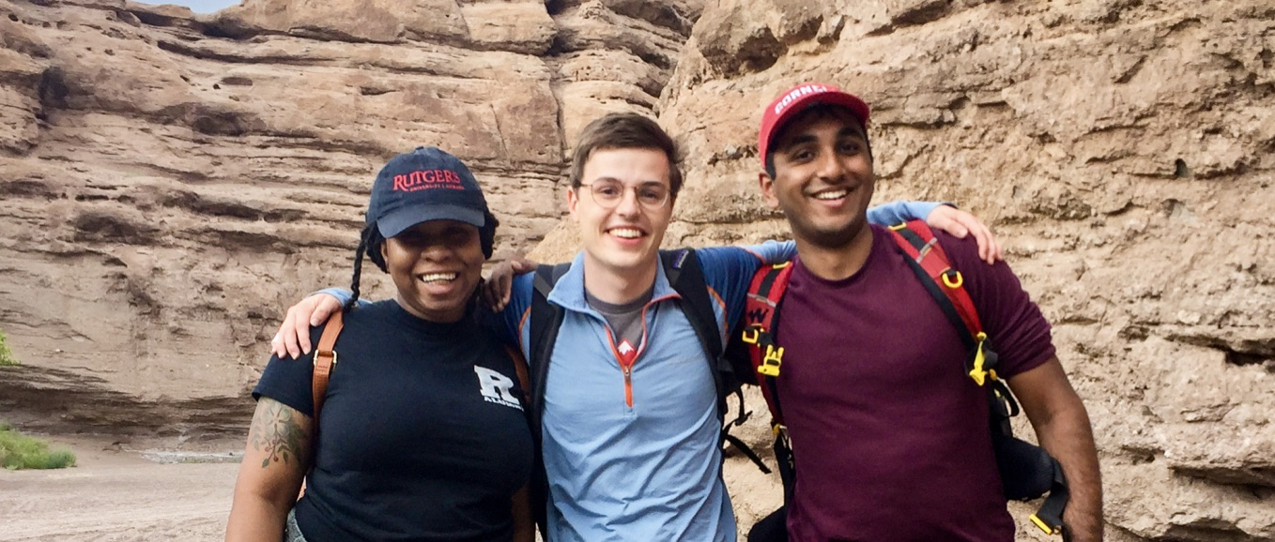
Your experience begins with a week-long orientation and then transitions to your mentor’s institution for research!
Notes:
Your summer experience will begin with a week-long orientation held on the campus of New Mexico Tech during Labor Day week.
The goal of this orientation week is to mix fun and learning together! Specifically, the week is designed to provide interns with an introduction to some of the most exciting aspects of modern seismology and to foster a strong sense of community among the interns. Volunteers from within the IRIS and the broader Earth science community donate their time and expertise to lead a variety of interactive sessions, labs, and field trips to enhance student understanding of geophysics content and to improve student collaboration.
Following the orientation, you would then proceed to your science mentor’s institution to conduct your research. These include federal facilities (e.g. USGS) , academic institutions and even National Labs (e.g. Sandia NL, Berkeley NL, etc.). Research projects may involve the deployment of seismic instruments in the field (within the US or internationally), and/or analyses of seismic data in a lab setting with the ultimate goal of producing results to be presented at a national scientific meeting.

Slide 6
Your summer culminates as you present at the Fall AGU meeting!
Notes:
Your summer research project will culminate with the opportunity to experience the exciting atmosphere of a professional meeting, while presenting your results. In the past, most interns and their hosts have chosen to present at the Fall American Geophysical Union (AGU) meeting held in San Francisco in early December.
The program’s longevity allows us to hold the program’s alumni reception annually at AGU. Here you can meet former interns, explore options for your future and make lasting connections. Frequently these connections extend for year to come!

Slide 7
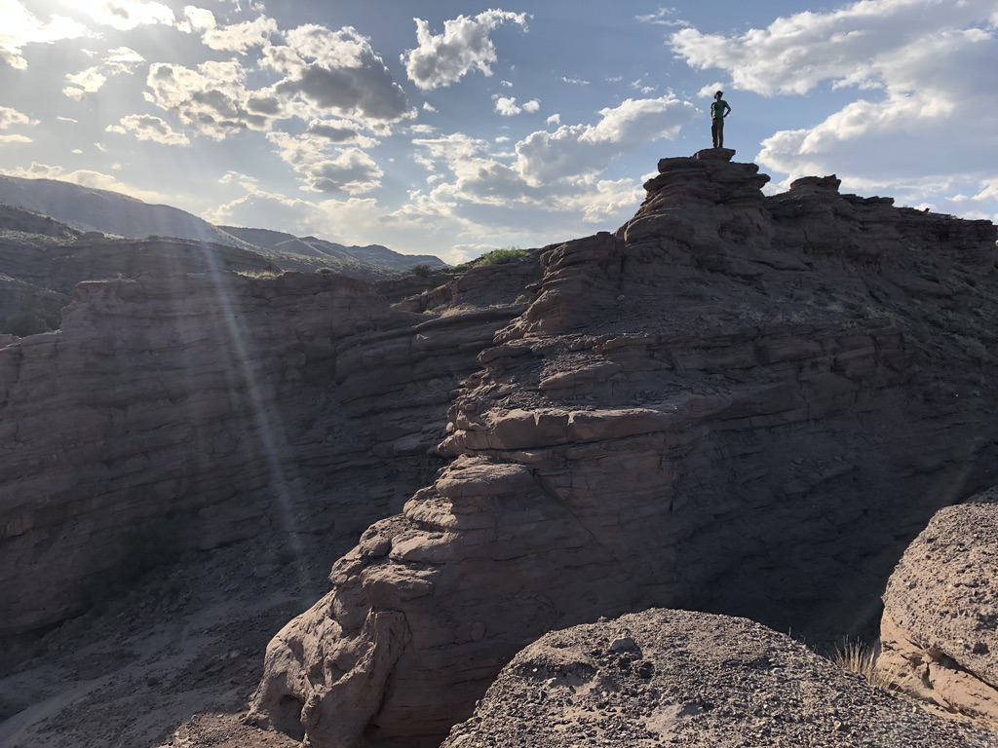
As an IRIS intern you will receive…
A stipend ($600/week for 9 - 11 weeks + $200 for subsistence)
Funding for travel and room and board at the orientation week
Funding for travel to and from your mentor’s institution
Assistance securing housing at the mentor’s institution
Funding for any additional expenses related to fieldwork
Funding for travel to a professional meeting to present your results along with the associated meeting costs (travel, registration, abstract submission fee and per diem)
Notes:
The IRIS Internship is designed to be fully supported and cost you nothing!

Slide 8
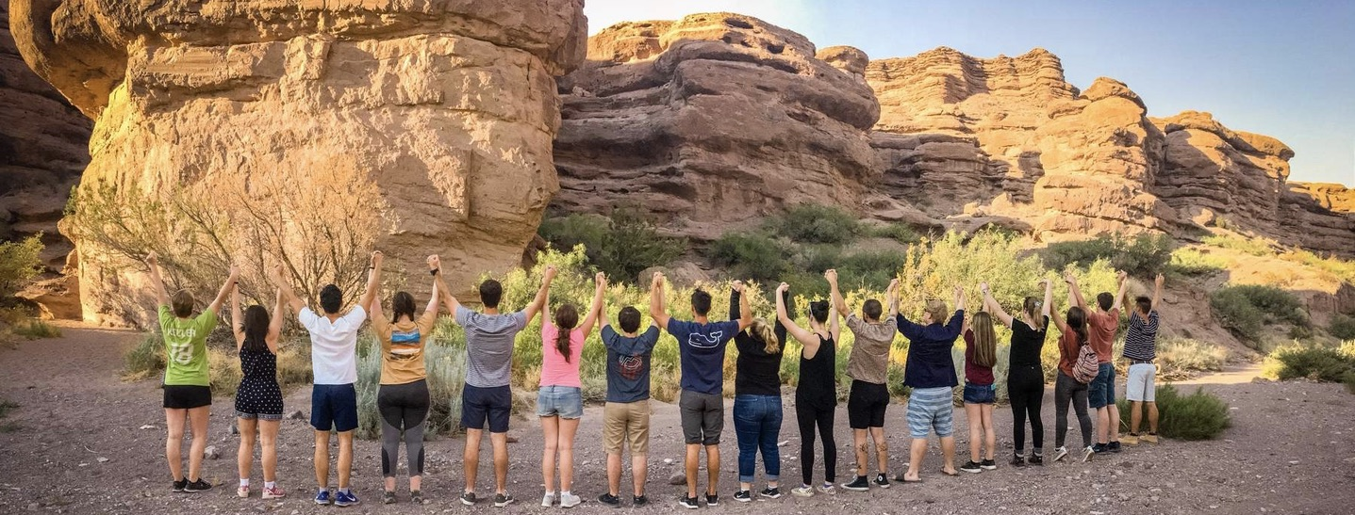
Minimum Qualifications
Interest in using quantitative approaches to investigate Earth!
Completed freshman year but not graduating spring semester
US citizenship or permanent resident status
3.0 GPA
Two semesters of each Math & Physics
Computer programming (Matlab, Mathmatica, Python, etc) is a plus
Experience or coursework in seismology or geophysics is not a requirement for successful candidates.
Notes:
While we have created a list of minimum qualifications for the program, there is no single path to geophysics. Thus, the selection committee is interested in getting to know you, the training you have had in physics, math, geoscience and computers, and the life experiences you have had that are important to you! This allows us to take a holistic approach to the selection process to find students with strong research potential.
Please note that experience or prior coursework in seismology or geophysics is not a requirement for successful candidates

Slide 9
The annual deadline to apply is February 1

